Slide 1
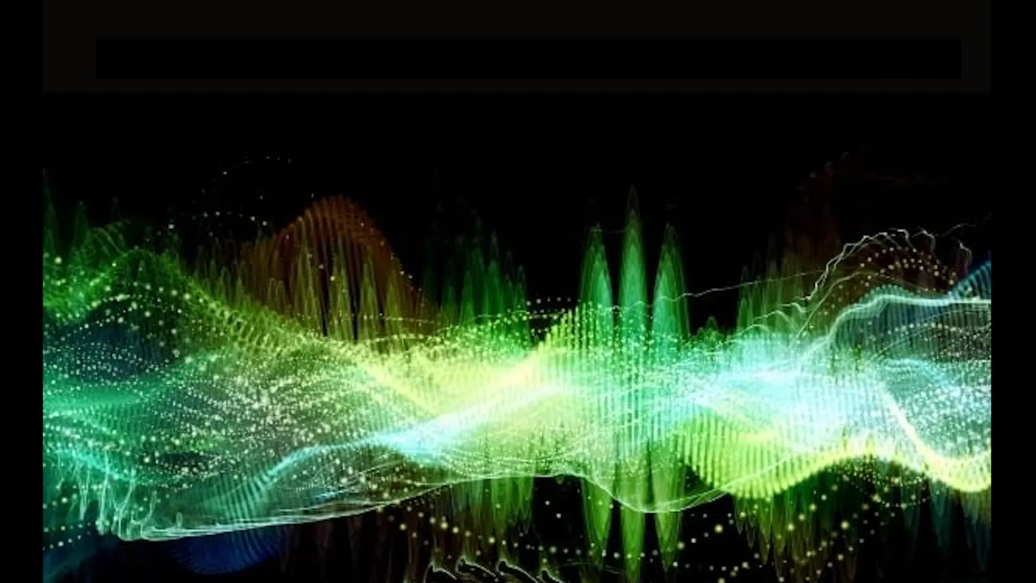
ECEN 4/5632 Theory and Application of Digital Filters
Lecture 1, 8-20-26, 8-25-26
Peter Mathys*
* With generous help from Gemini Pro and ChatGPT

Slide 2
DSP + ML
Signals, LTI Systems,
and Convolution
Week 1 • Lecture 1 • 75 minutes
Classical DSP foundations → modern signal representations → machine learning
Samples
LTI system
Convolution
Features
ML model
x[n]
h[n]
x*h
spectra / maps
CNN / classifier
Notes:
Timing: 2 min. Set the course promise: rigorous DSP, but always connect the math to algorithms students will implement. Ask: “What does a CNN layer actually do to an audio signal?” Return to this on slide 22.

Slide 3
Today’s learning objectives
00–15 MIN
By the end, students should be able to reason—not just compute.
Represent discrete-time signals using impulses, steps, and complex exponentials.
Test systems for linearity, time invariance, causality, and BIBO stability.
Explain why the impulse response completely characterizes an LTI system.
Compute finite-length convolutions graphically and numerically.
Connect convolution to filtering and to the operation used by neural networks.
Course habit
For each new equation, ask: What does this let us predict about a real signal?
Notes:
Timing: 3 min. Emphasize combined senior/graduate expectations: seniors master core calculations; graduate students should also be able to justify conditions and generalize.

Slide 4

Why start with LTI systems?
00–15 MIN
Because many useful DSP operations become simple, interpretable building blocks.
Physical world
Sampling
DSP
Features
ML
speech / vibration / RF
sequence x[n]
filter / transform
spectrogram / embeddings
decision / regression
Classical DSP gives us…
ML later needs…
Structure: linearity and invariance
Closed-form analysis
Stability and causality tests
Frequency-selective filtering
Well-conditioned inputs
Meaningful local structure
Efficient operators
Interpretability and diagnostics
Notes:
Timing: 5 min. Ask students for examples of “systems” applied to audio: gain, echo, equalizer, compressor, noise gate. Point out that not everything important is LTI—LTI is a tractable baseline.

Slide 5

Discrete time: index n is not “time in seconds”
15–35 MIN
n labels samples; physical time appears only after a sampling rate is specified.
Example sequence x[n]
x[n] is defined only at integer n.
A shift x[n−n₀] changes the sample index, not the amplitude.
Normalized angular frequency ω has units rad/sample.
0
1
2
3
4
5
6
Audio connection
At 48 kHz, one sample is 20.83 μs. A 2400-sample delay is 50 ms.
Notes:
Timing: 4 min. Use this to prevent later confusion between ω (rad/sample) and f (Hz). The 50 ms example is a short audible echo / slapback delay.

Slide 6


The unit sample δ[n] is a coordinate basis
15–35 MIN
It isolates one sample at one index.
δ[n]
δ[n−1]
-2
-1
0
1
2
-2
-1
0
1
2
Interpretation
A sequence is a weighted sum of shifted impulses—the discrete-time analog of expanding a vector in basis vectors.
Notes:
Timing: 6 min. This identity is the foundation of the convolution derivation. Make the vector-space analogy explicit; graduate students may recognize basis expansions.

Slide 7



Slide 8

The unit step u[n] and useful identities
15–35 MIN
Steps describe turn-on behavior; impulses describe changes.
u[n]
-2
-1
0
1
2
3
Quick check
What is u[n+2]? Where does it turn on?
Notes:
Timing: 4 min. Do a 30-second think-pair-share on the shift direction. Common misconception: sign inside bracket feels backwards.

Slide 9


The unit step u[n] and useful identities
15–35 MIN
Steps describe turn-on behavior; impulses describe changes.
u[n]
-2
-1
0
1
2
3
Quick check
Answer
What is u[n+2]? Where does it turn on?
At n = −2. A “+2” inside the brackets shifts the sequence left by 2.
Notes:
Timing: 4 min. Do a 30-second think-pair-share on the shift direction. Common misconception: sign inside bracket feels backwards.

Slide 10




Complex exponentials are the “natural modes” of LTI systems
15–35 MIN
Today: recognize them. Lecture 2: prove the eigenfunction property.
What each factor does
Why DSP cares
A sets scale / phase
αⁿ gives growth or decay
e^{jω₀n} gives rotation / oscillation
Sinusoids probe frequency response
Exponentials diagonalize convolution
Spectra decompose signals into modes
Notes:
Timing: 5 min. Use α=0.9 as a decaying envelope and α=1 as a pure sinusoid. Avoid diving deeply into convergence yet; that belongs naturally with DTFT/z-transform.

Slide 11

What is a discrete-time system?
35–55 MIN
A rule that maps an input sequence to an output sequence.
Examples
Nonlinear / time-varying examples
Gain: y[n]=2x[n]
Delay: y[n]=x[n−3]
Moving average: y[n]=(x[n]+x[n−1])/2
Squaring: y[n]=x²[n]
Compressor / limiter
Gain that changes with n
Question to ask
Which properties let us predict behavior without simulating every possible input?
Notes:
Timing: 3 min. Frame system properties as shortcuts for reasoning.

Slide 12
Linearity = superposition
35–55 MIN
Scale inputs → scale outputs. Add inputs → add outputs.
Linear
Not linear
y[n]=3x[n]
y[n]=x[n]+0.5x[n−1]
Any convolution with fixed h[n]
y[n]=x[n]+2
y[n]=|x[n]|
Dynamic-range compressor
Fast test
A linear system must map zero input to zero output.
Notes:
Timing: 5 min. Ask: why does y=x+2 fail the zero-input test? Then show superposition if needed.

Slide 13

Time invariance = “the clock does not matter”
35–55 MIN
Shift the input; the output shifts by exactly the same amount.
Time invariant
Time varying
Fixed delay
Fixed FIR / IIR filter
Static gain
y[n]=n x[n]
Daily adaptive equalizer
Any rule using absolute sample index n
Audio analogy
An echo with a fixed 100 ms delay is time invariant. An echo whose delay sweeps over time is not.
Notes:
Timing: 5 min. Do the formal two-path test on y[n]=n x[n] if students need it.

Slide 14



Causality and BIBO stability
35–55 MIN
Two properties with direct implementation consequences.
Causal system
BIBO stable system
y[n₀] depends only on x[n] for n≤n₀
Can operate in real time
For LTI: h[n]=0 for n<0
Every bounded input gives bounded output
For LTI: Σ |h[n]| < ∞
Rules out runaway responses
Graduate stretch
Be able to prove the LTI stability condition using |x*h| ≤ Bx Σ|h|.
Notes:
Timing: 5 min. This is a good place to distinguish “stable mathematically” from “sounds good.”

Slide 15
Property check: classify these audio systems
35–55 MIN
Think → vote → justify.
For each system: linear? time invariant? causal? BIBO stable?
A
y[n]=x[n−4800]
Fixed 100 ms delay at 48 kHz
B
y[n]=0.8x[n]+0.2x[n−1]
Two-tap smoother
C
y[n]=|x[n]|
Full-wave rectifier
D
y[n]=n x[n]
Index-dependent gain
Notes:
Timing: 5 min. Answers: A LTI causal stable; B LTI causal stable; C nonlinear but time-invariant, causal, stable; D linear but time-varying, causal, not BIBO stable over all n. Require students to justify one property rather than just label.

Slide 16


Impulse response: one experiment characterizes an LTI system
55–75 MIN
Feed δ[n]; call the output h[n].
Input
LTI system
Output
δ[n]
T{·}
h[n]
Linearity tells us how scaled impulses behave.
Time invariance tells us how shifted impulses behave.
Since any x[n] is a sum of scaled, shifted impulses, h[n] tells us the response to any x[n].
Notes:
Timing: 4 min. This is the conceptual hinge of the lecture. Slow down.

Slide 17

Deriving convolution from impulse decomposition
55–75 MIN
This derivation is worth understanding line by line.
1. Decompose the input into shifted impulses.
2. Use linearity.
3. Use time invariance.
Meaning
Each input sample launches a shifted copy of h[n]; the output is their sum.
Notes:
Timing: 6 min. Do not present convolution as a magic formula. Tie each equality to a system property.

Slide 18
Convolution mechanics: flip → shift → multiply → add
55–75 MIN
For finite sequences, the overlap changes as n moves.
1. Flip
2. Shift
3. Multiply
4. Sum
h[k] → h[−k]
h[n−k]
x[k]h[n−k]
Σ over k
Graphical view
Algebraic / code view
Track overlap as n changes
Good for intuition
Best with short sequences
Use nonzero-support limits
Good for longer signals
np.convolve / scipy.signal
Notes:
Timing: 4 min. At the board, say aloud which variable is fixed (n) and which is summed over (k).

Slide 19
Worked convolution: x[n]=[1,2,1], h[n]=[1,−1]
55–75 MIN
Assume both start at n=0.
x[n]
h[n]
y[n]=x*h
0
1
2
0
1
0
1
2
3
Sanity checks
Output length = 3+2−1 = 4. Sum(y)=sum(x)sum(h)=0.
Notes:
Timing: 7 min. Work this graphically on the board, using the slide only to reveal the final answer. Ask students to predict output length before calculating.

Slide 20




Slide 21

Convolution has algebraic structure
55–75 MIN
Useful facts that save work and explain cascades.
commutative
associative
distributive
h₁
h₂
h₁*h₂
room EQ
speaker response
equivalent system
Why ML cares
A stack of linear convolution layers with no nonlinearity collapses to one convolution.
Notes:
Timing: 4 min. This is a useful preview of why nonlinear activations matter in neural networks.

Slide 22
Python demo: convolution in one line
55–75 MIN
Then verify the indexing and meaning.
Python
SciPy
import numpy as np
x = np.array([1., 2., 1.])
h = np.array([1., -1.])
y = np.convolve(x, h, mode='full')
print(y) # [ 1. 1. -1. -1.]
# For long signals, scipy.signal.fftconvolve
from scipy.signal import fftconvolve
y_fast = fftconvolve(x, h, mode='full')
Do not skip the math
A library call gives numbers. Convolution theory tells you support, delay, stability, frequency behavior, and what to debug.
Notes:
Timing: 4 min. Run the accompanying notebook. Ask students to explain why mode="same" is not a mathematical definition of convolution, but an output-cropping convention.

Slide 23
ML bridge: PyTorch “convolution” is usually cross-correlation
55–75 MIN
Same local weighted sum, different kernel orientation.
PyTorch
import torch
import torch.nn.functional as F
x = torch.tensor([[[1.,2.,1.]]])
w = torch.tensor([[[1.,-1.]]])
y = F.conv1d(x, w) # correlation convention
Key idea
The kernel is learned in ML, but the local linear operation is the same family of operation you are analyzing now.
Notes:
Timing: 4 min. This is a high-value misconception to prevent: most deep-learning libraries name cross-correlation “convolution.” The distinction does not reduce the conceptual connection.

Slide 24
Concept check
CHECK
No computation should be necessary.
For an LTI system, which statement is always true?
A. If x[n] is bounded, y[n] is bounded.
B. The response to δ[n−k] is h[n−k].
C. The system must be causal.
D. The impulse response has finite length.
Notes:
Timing: 2 min. Correct answer B. Use this to verify the impulse-response argument landed.

Slide 25
Concept check
CHECK
No computation should be necessary.
For an LTI system, which statement is always true?
A. If x[n] is bounded, y[n] is bounded.
B. The response to δ[n−k] is h[n−k].
C. The system must be causal.
D. The impulse response has finite length.
Correct: time invariance shifts the impulse response; linearity handles scaling. Stability and causality are additional properties, not automatic.
Notes:
Timing: 2 min. Correct answer B. Use this to verify the impulse-response argument landed.

Slide 26
Lecture 1 synthesis
WRAP-UP
The chain of reasoning matters more than memorizing isolated formulas.
Impulse basis
L + TI
Impulse response
Convolution
Filtering / CNNs
x=Σx[k]δ[n−k]
scale + shift response
h[n]
y=x*h
local weighted sums
Be able to test system properties with a counterexample or proof.
Be able to derive convolution from LTI assumptions.
Be able to compute a short convolution by hand and predict its support.
Next lecture
Complex exponentials turn convolution into multiplication in the frequency domain.
Notes:
Timing: 3 min. Exit ticket: “In one sentence, why does h[n] characterize an LTI system?”

Slide 27
Optional board reserve: index bookkeeping for finite convolution
RESERVE
Use if students need one more example.
Length rule
For sequences of lengths Lx and Lh starting at known indices, full convolution has length Lx+Lh−1.
This predicts where the output can be nonzero before any arithmetic.
It also helps debug off-by-one errors in code.
Notes:
Reserve slide; use only if time allows or save for office hours.

