Slide 1

ECEN 4/5632 Theory and Application of Digital Filters
Lecture 26, 11-12-26
Peter Mathys*
* With generous help from Gemini Pro and ChatGPT

Slide 2
Machine Learning Foundations
Supervised Learning, Data Splits, and Scikit-Learn
Features X + labels y → fit a model → evaluate honestly → understand failure modes
WEEK 13 • LECTURE 26 • 75 MINUTES

Slide 3

Learning outcomes
BY THE END OF LECTURE 26
00–20 MIN
• Write the supervised-learning problem as a mapping from feature vectors to labels.
• Explain the distinct roles of training, validation, and test data.
• Recognize source-level leakage in segmented audio datasets.
• Convert time-varying MFCC matrices into fixed-length vectors for classical models.
• Train and evaluate a baseline classifier using the scikit-learn estimator API and a confusion matrix.
DSP + ML • Week 11 • Oppenheim & Schafer → Raschka
2

Slide 4



From rules to learned mappings
SUPERVISED LEARNING CHANGES WHO WRITES THE DECISION RULE
00–20 MIN
Traditional program
Engineer writes rules
Input + rules → output
Useful when rules are explicit
Supervised ML
Provide labeled examples
Algorithm estimates θ
Generalize to unseen examples
Audio example
x = audio features
y = class label
ŷ = predicted class
ŷ = f(x ; θ)
DSP + ML • Week 13 • Oppenheim & Schafer → Raschka
3

Slide 5

Feature matrix X and target vector y
SCIKIT-LEARN USES A TABULAR CONTRACT
00–20 MIN
X ∈ R^(N×D) y ∈ {1,…,C}^N
N
number of clips
D
features per clip
C
number of classes
• Every row X[i,:] must have the same length D.
• y[i] is the label paired with exactly that row.
• For 20-MFCC mean+std features, D = 40.
DSP + ML • Week 13 • Oppenheim & Schafer → Raschka
4

Slide 6
What is a “feature”?
A COORDINATE CHOSEN TO MAKE PREDICTION EASIER
00–20 MIN
• Raw waveform sample: physically direct, but high dimensional and alignment sensitive.
• Mel bin at one time frame: localized perceptual-frequency energy.
• MFCC coefficient: compact combination of log-Mel bands.
• Time-mean MFCC: one number summarizing a whole clip.
• Feature engineering chooses which invariances the model gets for free.
Invariance example
Time averaging makes the representation less sensitive to WHEN a sound occurs—but it also hides temporal order.
DSP + ML • Week 13 • Oppenheim & Schafer → Raschka
5

Slide 7


Train, validation, and test
THREE DIFFERENT JOBS
20–40 MIN
TRAIN
Fit model parameters
Fit data-dependent preprocessing
Seen throughout development
VALIDATION
Choose hyperparameters
Compare feature/model choices
May guide development
TEST
Final unbiased estimate
Do not tune against it
Open after choices are fixed
Test set ≠ another validation set
DSP + ML • Week 13 • Oppenheim & Schafer → Raschka
6

Slide 8

The golden rule for audio: split by source, not just by clip
SEGMENTS FROM ONE PHYSICAL RECORDING ARE CORRELATED
20–40 MIN
Source recording A
Source recording B
clip 1
clip 2
clip 3
clip 4
clip 1
clip 2
clip 3
clip 4
BAD: random clips can place A1 in train and A2 in test
GOOD: all clips from a source stay in one split/fold
Instructor cue: Use the siren-segmentation story as a hypothetical. The central problem is source identity leaking across splits.
DSP + ML • Week 13 • Oppenheim & Schafer → Raschka
7

Slide 9
UrbanSound8K: honor the predefined folds
FOLD IDENTITY IS METADATA, NOT A NUISANCE COLUMN
20–40 MIN
• Use the dataset-provided fold assignments instead of blindly calling train_test_split on excerpts.
• For one course baseline, a simple convention is folds 1–8 train, 9 validation, 10 test.
• For stronger estimates, rotate held-out folds and report cross-validation results.
• Keep the split rule fixed while comparing feature representations.
Course split
1–8 TRAIN
9 VALIDATION
10 TEST
DSP + ML • Week 13 • Oppenheim & Schafer → Raschka
8

Slide 10
Leakage can occur in preprocessing too
FIT STATISTICS ON TRAINING DATA ONLY
20–40 MIN
z_j = (x_j − μ_j,train) / σ_j,train
pipe = Pipeline([
('scale', StandardScaler()),
('clf', SVC(kernel='rbf')),
])
pipe.fit(X_train, y_train)
• If μ and σ are computed using test clips, information from the test distribution leaks into training.
• scikit-learn Pipeline helps fit transformers only on the training fold during model fitting.
• Random forests do not require standard scaling, but SVM/logistic models often benefit from it.
DSP + ML • Week 13 • Oppenheim & Schafer → Raschka
9

Slide 11
2D audio features meet 1D classical models
WE MUST CHOOSE HOW TO REMOVE THE TIME AXIS
40–55 MIN
MFCC matrix
[20 × 173]
Flatten
[3460]
Mean only
[20]
Mean + std
[40]
CNN later
keep 2D
• Flatten: keeps frame order but creates many coordinates and assumes fixed alignment.
• Mean: very compact but ignores temporal ordering and dynamics.
• Mean + standard deviation: simple compromise for a classical baseline.
• CNNs can consume the 2D map and learn local time–frequency patterns.
DSP + ML • Week 13 • Oppenheim & Schafer → Raschka
10

Slide 12

Time averaging is a model assumption
WHAT INVARIANCE DID WE JUST HARD-CODE?
40–55 MIN
c̄[b] = (1/T) Σ_t C[b,t]
Compression buys simplicity by spending structure.
• The average keeps “how much” of each coefficient occurred.
• It discards “when,” “in what order,” and “how long each pattern persisted.”
• A rising siren and a falling siren can have similar averages.
• This is exactly the kind of ceiling that motivates sequence models and CNNs.
DSP + ML • Week 13 • Oppenheim & Schafer → Raschka
11

Slide 13

The scikit-learn estimator API
SAME MENTAL MODEL ACROSS MANY ALGORITHMS
55–75 MIN
clf = RandomForestClassifier(
n_estimators=300,
random_state=42,
n_jobs=-1,
)
clf.fit(X_train, y_train)
y_pred = clf.predict(X_test)
accuracy = clf.score(X_test, y_test)
• Instantiate: choose model family and hyperparameters.
• fit: estimate model from training data.
• predict: produce labels for unseen feature vectors.
• score/metrics: quantify performance—then inspect errors.
DSP + ML • Week 13 • Oppenheim & Schafer → Raschka
12

Slide 14
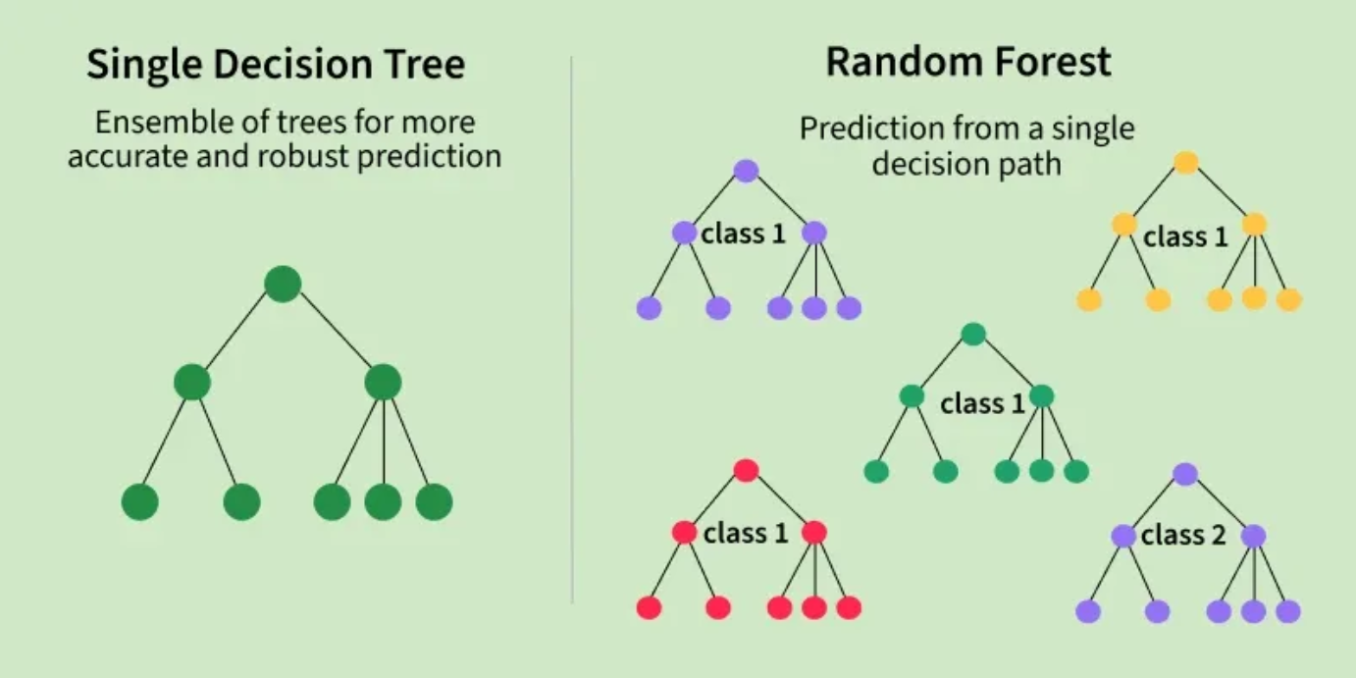
Random Forest Classifier

Slide 15
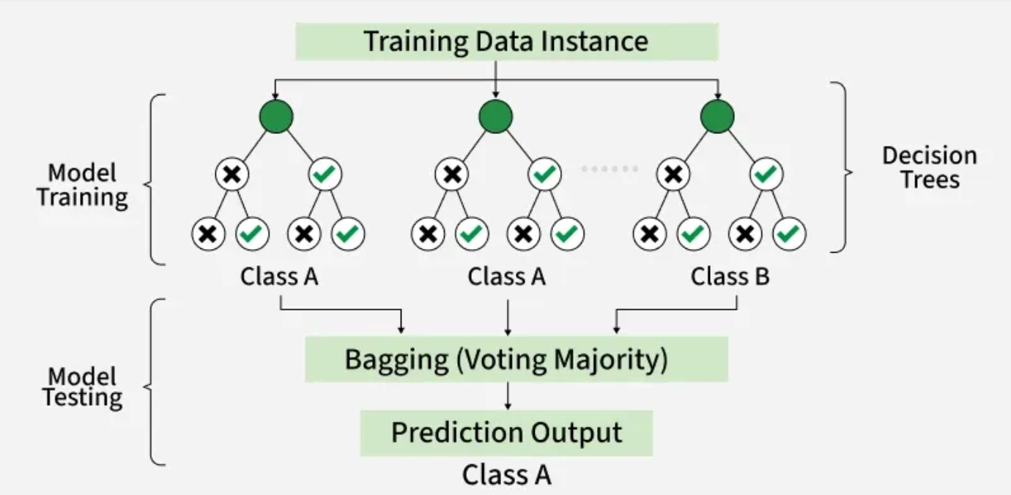
Random Forest Classifier

Slide 16
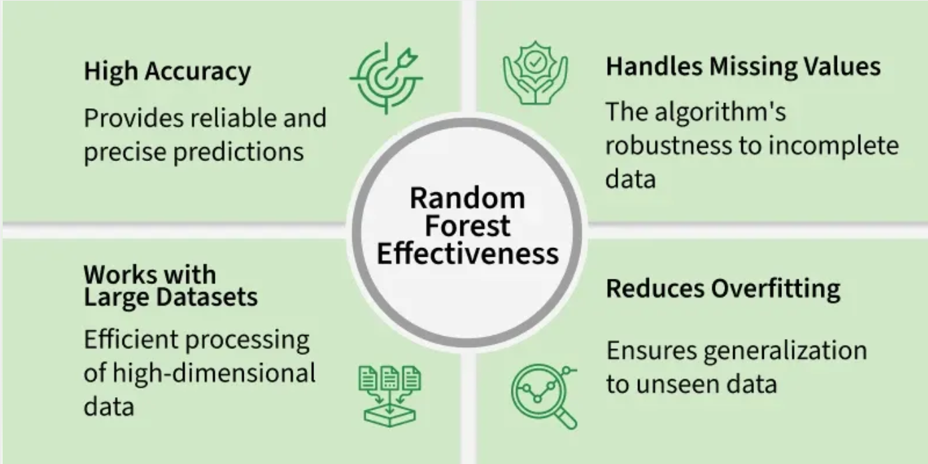
Random Forest Classifier

Slide 17
Why Random Forest is a useful first baseline
NOT NECESSARILY BEST—EXCELLENT FOR DIAGNOSIS
55–75 MIN
• Handles nonlinear decision boundaries without feature scaling.
• Works naturally with compact tabular summary features.
• Fast to train compared with a deep network.
• Provides a sanity check: are the engineered features carrying class information at all?
• Its accuracy is dataset/split/feature dependent—do not promise a fixed 60–65% ceiling.
Baseline ≠ target
A baseline should be reproducible, interpretable, and difficult to accidentally leak—not artificially impressive.
DSP + ML • Week 13 • Oppenheim & Schafer → Raschka
13

Slide 18
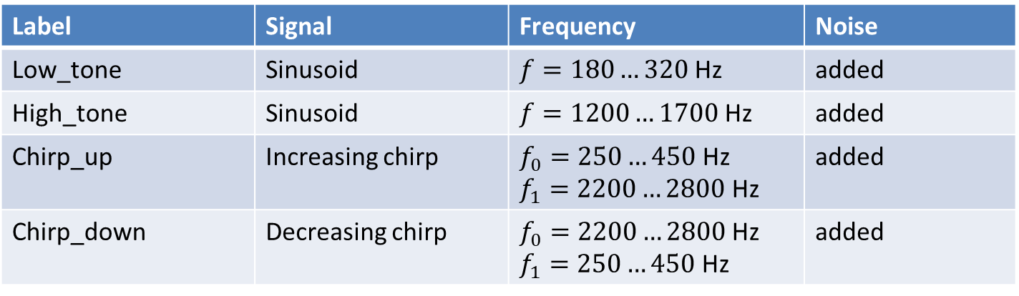
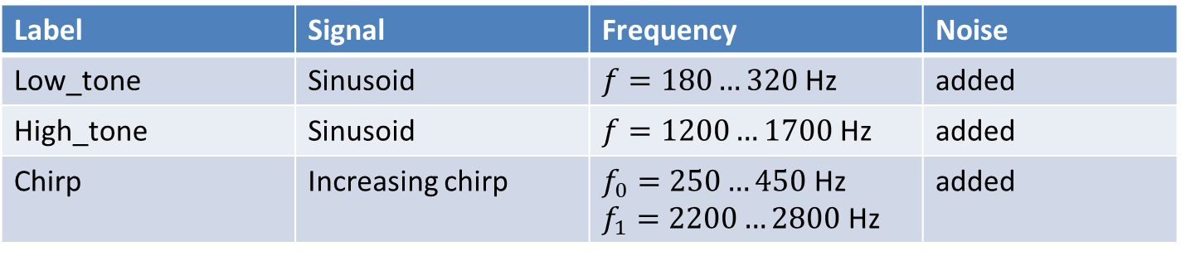
SVC Classifier in Scikit-Learn, Datasets
Dataset 1
Label | Signal | Frequency | Noise
Low_tone | Sinusoid | $f=180…320$ Hz | added
High_tone | Sinusoid | $f=1200…1700$ Hz | added
Chirp | Increasing chirp | $f_{0}=250…450$ Hz $f_{1}=2200…2800$ Hz | added
Easy to classify using MFCC_avg and MFCC_std.
Dataset 2
Label | Signal | Frequency | Noise
Low_tone | Sinusoid | $f=180…320$ Hz | added
High_tone | Sinusoid | $f=1200…1700$ Hz | added
Chirp_up | Increasing chirp | $f_{0}=250…450$ Hz $f_{1}=2200…2800$ Hz | added
Chirp_down | Decreasing chirp | $f_{0}=2200…2800$ Hz $f_{1}=250…450$ Hz | added
Easy to distinguish low_tone from high_tone, but difficult to distinguish chirp_up from chirp_down using MFCC_avg and MFCC_std.

Slide 19
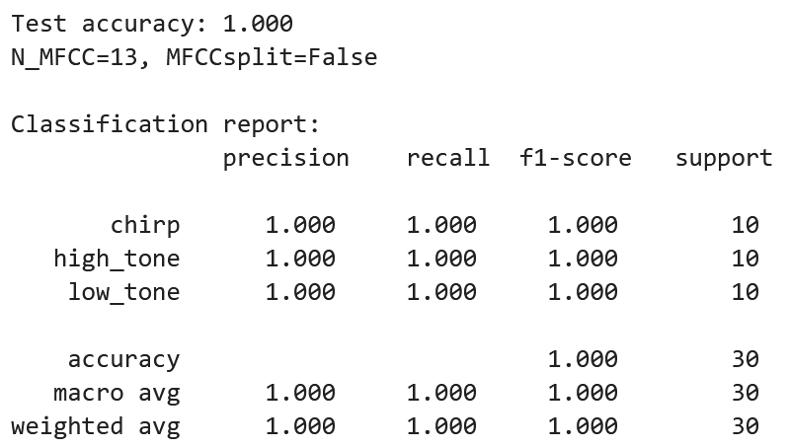
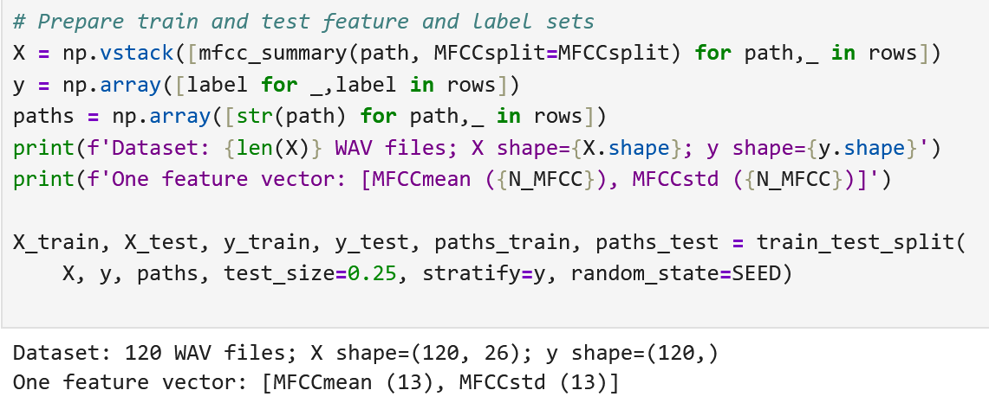
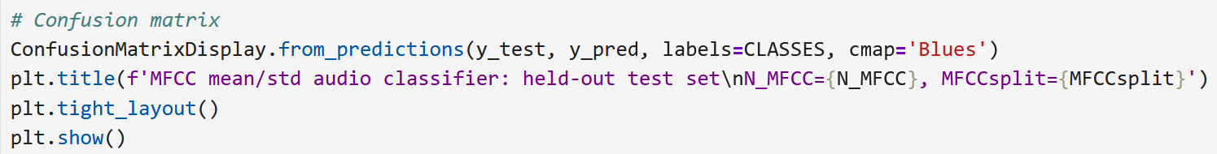
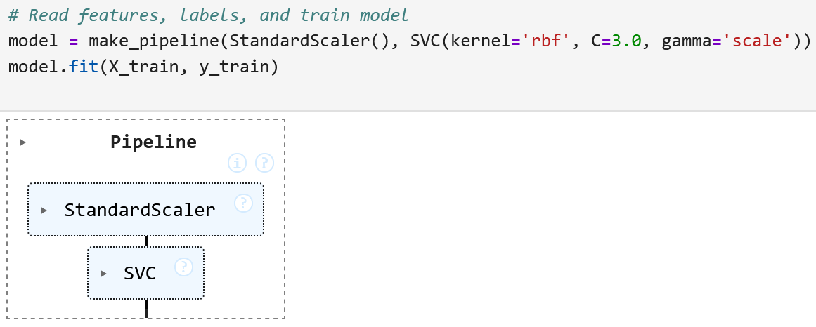
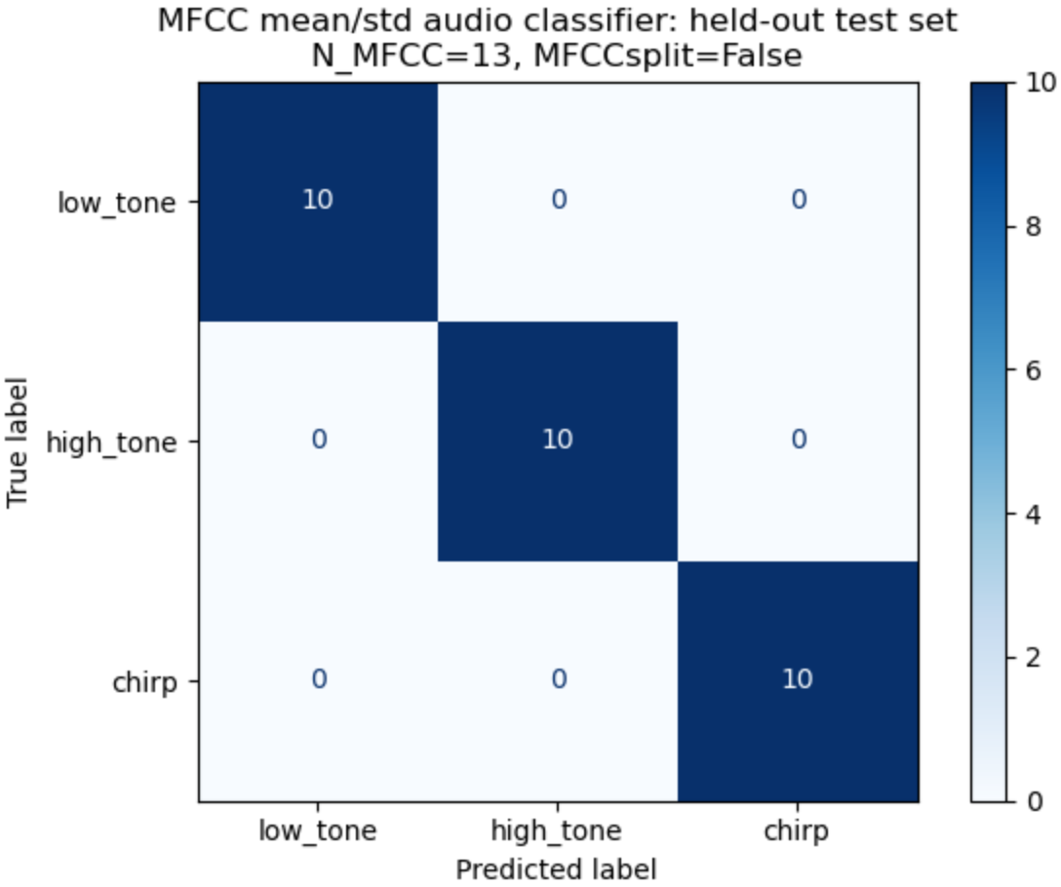
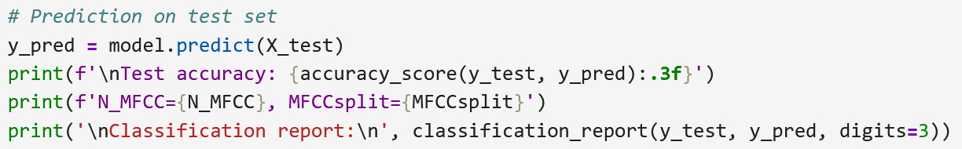
SVC Classifier in Scikit-Learn, Dataset 1

Slide 20
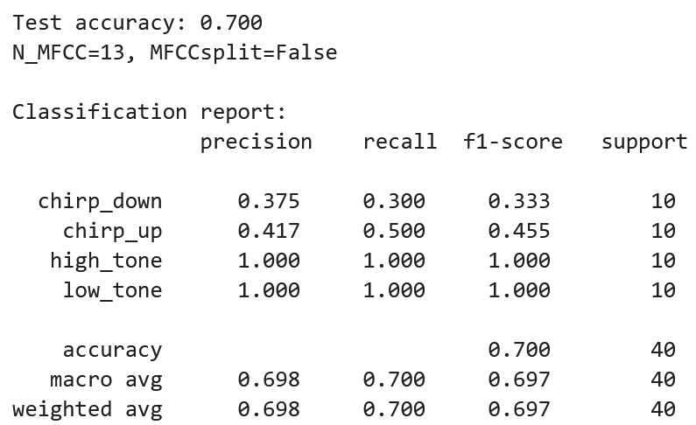
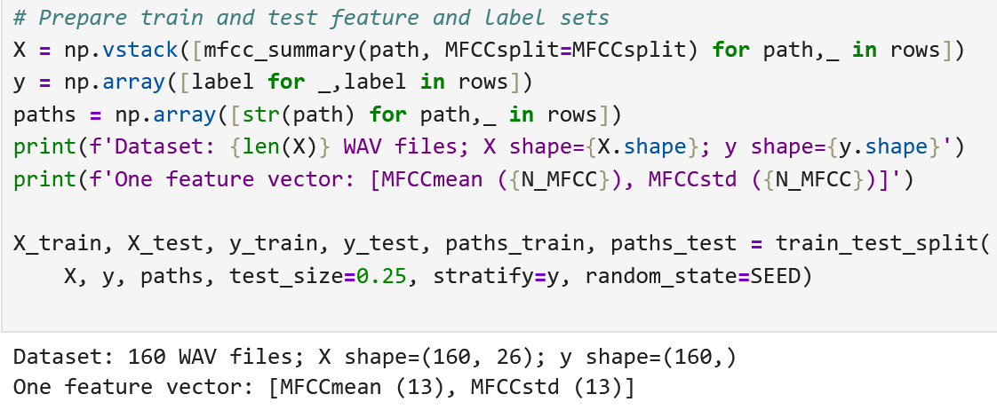

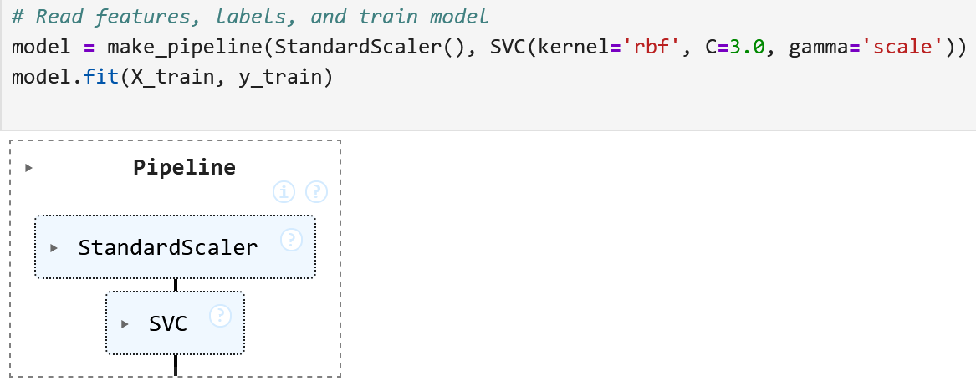
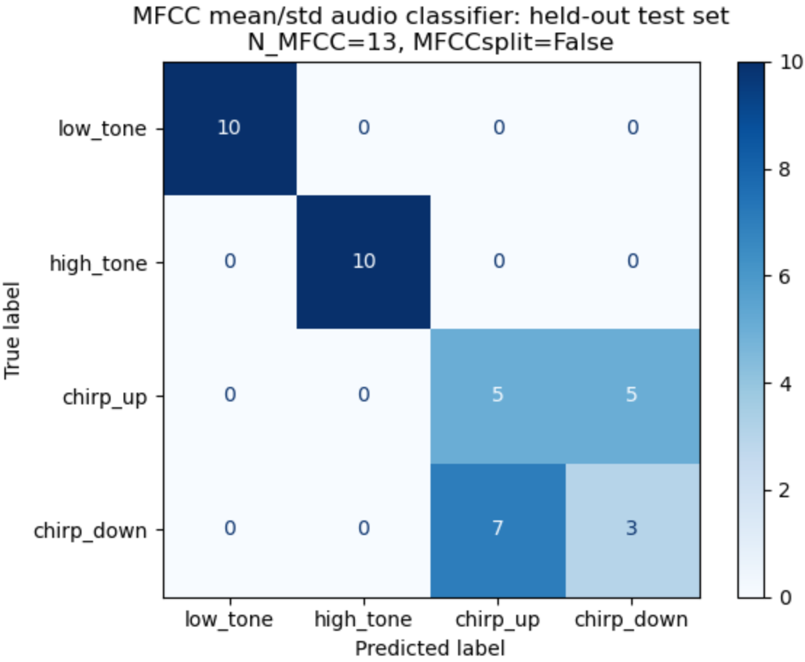
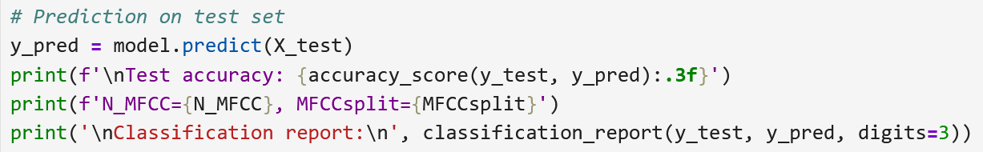
SVC Classifier in Scikit-Learn, Dataset 2

Slide 21
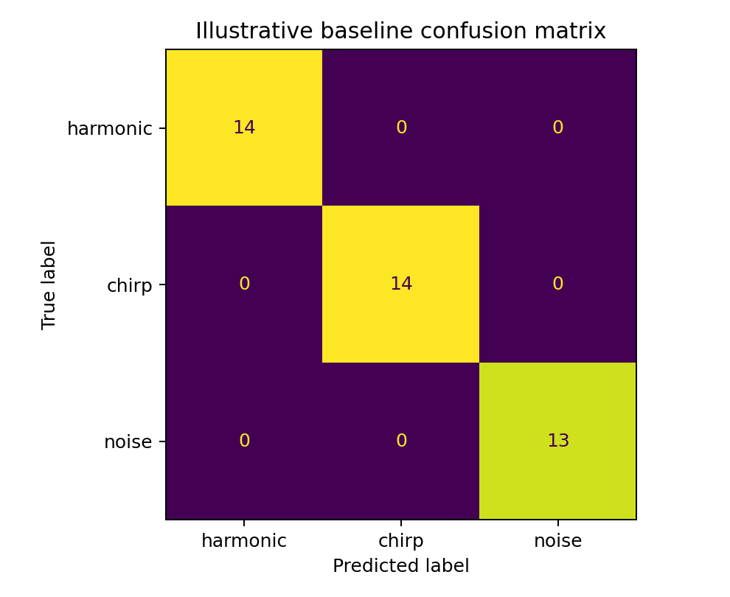
Confusion matrix: accuracy with structure
WHICH CLASSES ARE BEING CONFUSED WITH WHICH?
55–75 MIN
• Rows: true classes; columns: predicted classes in the displayed convention.
• Diagonal cells: correct classifications.
• Off-diagonal cells reveal systematic confusions.
• The example shown is synthetic only—it validates the workflow, not UrbanSound8K performance.
DSP + ML • Week 13 • Oppenheim & Schafer → Raschka
14

Slide 22
Accuracy is not the whole evaluation
USE CLASS-SENSITIVE METRICS AND ERROR ANALYSIS
55–75 MIN
accuracy = (# correct) / N
Precision
Recall
Macro-F1
• Class imbalance can make overall accuracy misleading.
• Macro-averaging gives each class equal weight.
• Inspect representative false positives and false negatives in the original audio.
• Ask whether errors come from the model, the feature representation, or preprocessing.
DSP + ML • Week 13 • Oppenheim & Schafer → Raschka
15

Slide 23
Live demo: build X and y without leakage
METADATA DRIVES THE SPLIT
55–75 MIN
meta = pd.read_csv(root / 'metadata' / 'UrbanSound8K.csv')
train = meta[meta['fold'].isin(range(1, 9))]
valid = meta[meta['fold'].eq(9)]
test = meta[meta['fold'].eq(10)]
X_train, y_train = featurize_rows(train, root)
X_valid, y_valid = featurize_rows(valid, root)
X_test, y_test = featurize_rows(test, root)
Instructor cue: Ask why splitting metadata first is safer than extracting all clips and shuffling later.
DSP + ML • Week 13 • Oppenheim & Schafer → Raschka
16

Slide 24
A robust baseline feature: MFCC mean + standard deviation
SMALL D, FAST EXPERIMENTS
55–75 MIN
mfcc = librosa.feature.mfcc(S=mel_db, n_mfcc=20)
feat = np.concatenate([
mfcc.mean(axis=1),
mfcc.std(axis=1),
])
# feat.shape == (40,)
• Mean captures typical spectral-envelope coordinates.
• Std captures how much those coordinates vary over time.
• Still destroys sequence order, but usually stronger than mean alone.
• A clean baseline lets next week’s CNN earn its complexity.
DSP + ML • Week 11 • Oppenheim & Schafer → Raschka
17

Slide 25
Reproducibility is part of engineering
A BASELINE SHOULD BE RERUNNABLE
55–75 MIN
• Freeze the split policy and record feature parameters.
• Set random_state for stochastic estimators.
• Cache extracted features when iteration becomes slow.
• Report class labels, fold assignments, and metrics alongside accuracy.
• Never tune on the test fold because “it is only a classroom project.”
Reproducibility checklist
sample rate
duration
n_fft / hop
n_mels / n_mfcc
split folds
model seed
DSP + ML • Week 13 • Oppenheim & Schafer → Raschka
18

Slide 26
Error analysis: listen to your mistakes
THE CONFUSION MATRIX TELLS YOU WHERE TO LOOK
55–75 MIN
• Find high-confidence wrong predictions.
• Listen to the clip and inspect its Mel-spectrogram.
• Check label ambiguity, background sounds, clipping, silence, and preprocessing artifacts.
• Compare two representation choices on the same failed example.
• A better feature may fix the problem more cheaply than a bigger model.
ML engineering loop
measure → inspect → hypothesize → change one thing → remeasure
DSP + ML • Week 13 • Oppenheim & Schafer → Raschka
19

Slide 27
Why can a classical baseline hit a ceiling?
REPRESENTATION MAY BE THE BOTTLENECK
BRIDGE
Mean MFCC
Random Forest
Decision
• Time averaging removes trajectories, modulation patterns, and event shape.
• Flattening keeps order but makes the model sensitive to exact alignment and creates thousands of coordinates.
• A CNN can treat the Mel-spectrogram as a 2D field and learn local patterns that repeat at different times.
Next week: preserve the picture, learn the filters.
DSP + ML • Week 13 • Oppenheim & Schafer → Raschka
20

Slide 28
Concept check
WHICH EVALUATION IS TRUSTWORTHY?
CHECK
• A. Randomly split all segmented clips, then standardize using the full dataset.
• B. Use source-aware predefined folds; fit preprocessing and model on training only; test once at the end.
• C. Tune hyperparameters until test accuracy stops improving.
• D. Report only training accuracy because the labels are known to be correct.
DSP + ML • Week 13 • Oppenheim & Schafer → Raschka
21

Slide 29
Concept check
WHICH EVALUATION IS TRUSTWORTHY?
CHECK
• A. Randomly split all segmented clips, then standardize using the full dataset.
• B. Use source-aware predefined folds; fit preprocessing and model on training only; test once at the end.
• C. Tune hyperparameters until test accuracy stops improving.
• D. Report only training accuracy because the labels are known to be correct.
Correct: B
DSP + ML • Week 13 • Oppenheim & Schafer → Raschka
21

Slide 30
Lecture 26 synthesis
A TRUSTWORTHY BASELINE IS A SCIENTIFIC INSTRUMENT
WRAP-UP
• Supervised learning learns f(x;θ) from labeled feature vectors.
• Data splitting is part of the model: leakage can make an invalid system look excellent.
• Classical models need fixed-length vectors, forcing an explicit choice about time structure.
• scikit-learn makes model APIs consistent; honest evaluation still depends on us.
• The baseline establishes what compact hand-engineered features can do before CNNs see the full 2D representation.
Exit ticket: Why can a more accurate random clip split be a worse scientific result?
DSP + ML • Week 13 • Oppenheim & Schafer → Raschka
22

