Slide 1

ECEN 4/5632 Theory and Application of Digital Filters
Lecture 11, 10-01-26, 10-06-26, 10-13-26
Peter Mathys*
* With generous help from Gemini Pro and ChatGPT

Slide 2
WEEK 6 ● LECTURE 11
The DFT and Fast Convolution
From frequency samples to efficient streaming FIR filtering
Oppenheim & Schafer • DFT / FFT / STFT | Raschka • CNN architecture and feature pipelines

Slide 3

Learning objectives
ROADMAP
0:00–0:03
• Interpret the N-point DFT as samples of the DTFT of a finite record.
• Distinguish linear convolution from N-point circular convolution.
• Choose zero-padding so DFT multiplication produces linear convolution.
• Explain and implement overlap-add and overlap-save block filtering.
• Connect FFT block processing to real-time preprocessing before ML inference.
Core question
How can an operation that is naturally defined for a whole sequence be implemented efficiently on an endless stream?
WEEK 10 • TIME-FREQUENCY ANALYSIS

Slide 4
DFT review: a finite set of frequency samples
DFT
0:03–0:09
X[k] = Σₙ₌₀ᴺ⁻¹ x[n] e^(−j2πkn/N), k = 0,…,N−1
• The DFT is exactly the DTFT of the N-sample finite record evaluated at ωₖ = 2πk/N.
• The inverse DFT reconstructs those N time samples exactly.
• The DFT assumes an N-periodic extension when we interpret algebra such as convolution.
Do not confuse
A larger FFT can sample the same finite-record DTFT more densely, but zero-padding does not create new time-domain information.
WEEK 10 • TIME-FREQUENCY ANALYSIS

Slide 5


Slide 6
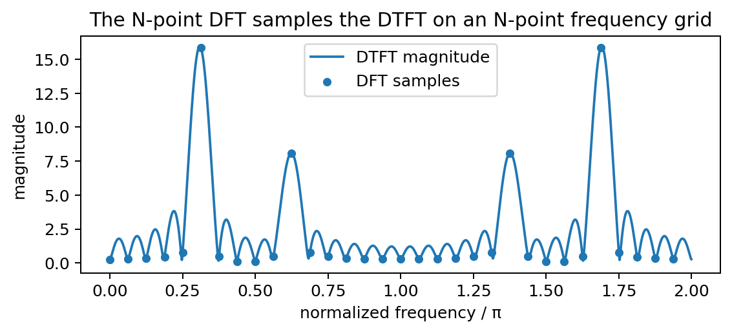


The DFT samples the DTFT
DFT
0:09–0:14
Reading the figure
The smooth curve is the finite record’s DTFT. The dots are the 32 DFT samples. An FFT is an algorithm for computing these samples efficiently.
Frequency grid: ωₖ = 2πk/N
WEEK 10 • TIME-FREQUENCY ANALYSIS

Slide 7
Why the FFT matters computationally
DFT
0:14–0:20
Direct DFT: approximately O(N²) operations
Example
For N = 4096, N² ≈ 16.8 million while N log₂N ≈ 49 thousand scale operations (constant factors omitted).
FFT: approximately O(N log₂N) operations
• This difference becomes decisive for long FIR filters and repeated streaming blocks.
• The FFT does not change the transform—it changes the computational algorithm.
• Fast convolution exploits the convolution theorem plus the FFT.
WEEK 10 • TIME-FREQUENCY ANALYSIS

Slide 9
DFT Computation

Slide 10



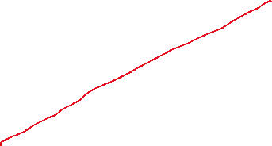


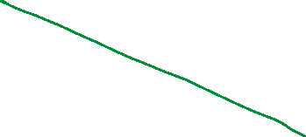


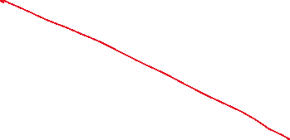
DFT Computation

Slide 11
Linear convolution versus circular convolution
CONVOLUTION
0:20–0:27
Linear: y[n] = Σₘ x[m] h[n−m]
Key issue
N-point circular: y_N[n] = Σₘ₌₀ᴺ⁻¹ x[m] h[(n−m) mod N]
If N is too small, the tail of the linear convolution wraps onto the beginning.
• Linear convolution has length Lx + Lh − 1 for finite sequences.
• Circular convolution wraps samples modulo N.
• DFT multiplication corresponds to circular convolution of the N-point sequences.
WEEK 10 • TIME-FREQUENCY ANALYSIS

Slide 12
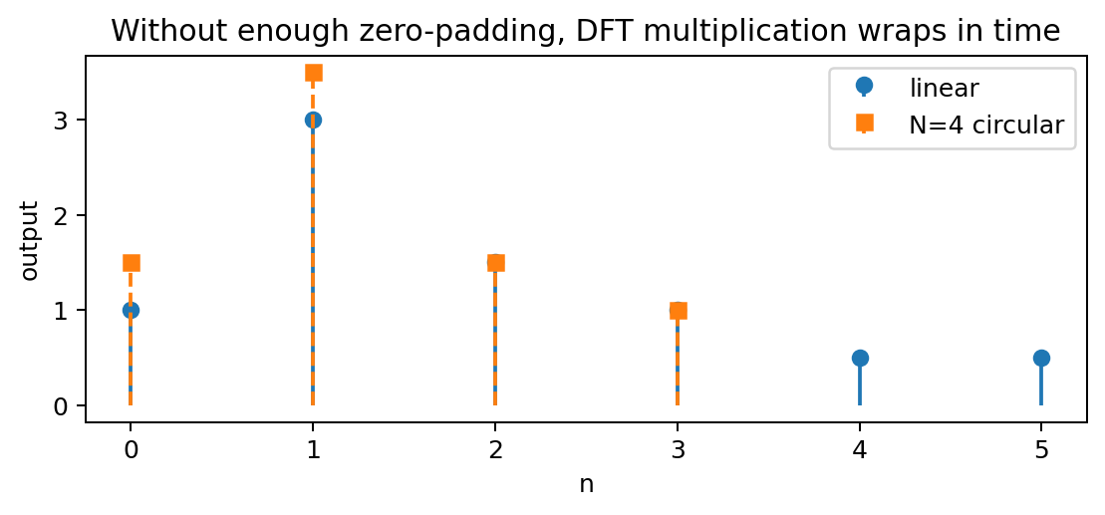
Wrap-around is the error
CONVOLUTION
0:27–0:32
What happened?
The N=4 circular result folds the samples that belong at n ≥ 4 back into n = 0,1,… .
Circular is not “wrong”—it is a different operation.
WEEK 10 • TIME-FREQUENCY ANALYSIS

Slide 13
Zero-padding makes DFT convolution linear
CONVOLUTION
0:32–0:38
Choose an FFT length satisfying
Example
NFFT ≥ Lx + Lh − 1
Lx = 1000 and Lh = 129 require at least 1128 points. In practice, 2048 may be chosen for FFT efficiency.
• Pad both x[n] and h[n] to NFFT.
• Multiply their NFFT-point DFTs.
• Take the inverse DFT.
• The first Lx + Lh − 1 samples equal the linear convolution.
WEEK 10 • TIME-FREQUENCY ANALYSIS

Slide 14
Concept check: padding requirement
CONCEPT CHECK
0:38–0:40
x[n] has length 80 and h[n] has length 33. What is the minimum FFT size for one-shot FFT-based linear convolution?
WEEK 10 • TIME-FREQUENCY ANALYSIS

Slide 15
Concept check: padding requirement
CONCEPT CHECK
0:38–0:40
x[n] has length 80 and h[n] has length 33. What is the minimum FFT size for one-shot FFT-based linear convolution?
Good answer
NFFT ≥ 80 + 33 − 1 = 112. Any NFFT of at least 112 works mathematically; an implementation may choose 128.
WEEK 10 • TIME-FREQUENCY ANALYSIS

Slide 16
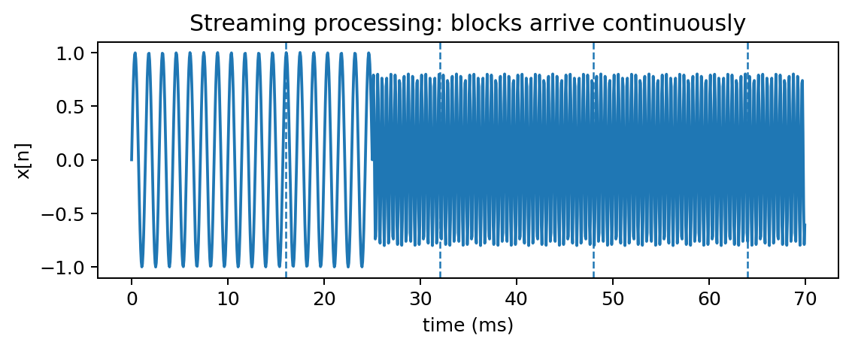
Why block processing is needed
STREAMING
0:40–0:46
• A microphone, sensor, or radio stream does not end so that we can take one giant FFT.
• We process finite blocks as they arrive.
• Each block must still reproduce the same linear FIR filtering result.
• Block length affects throughput, latency, memory, and FFT efficiency.
ML connection
Real-time inference often begins with streaming DSP: filtering, resampling, denoising, framing, and feature extraction.
WEEK 10 • TIME-FREQUENCY ANALYSIS

Slide 17
Overlap-Add: filter independent input blocks
OVERLAP-ADD
0:46–0:54
1. Split x[n] into non-overlapping blocks of B samples.
2. Zero-pad each block and h[n] so NFFT ≥ B + Lh − 1.
3. FFT → multiply by H[k] → IFFT.
4. Add the overlapping output tails.
Each block produces B + Lh − 1 valid linear-convolution samples.
Why “add”?
Adjacent block convolutions overlap in time because the FIR has memory. Those overlapping contributions must be summed.
WEEK 10 • TIME-FREQUENCY ANALYSIS

Slide 18







Slide 19
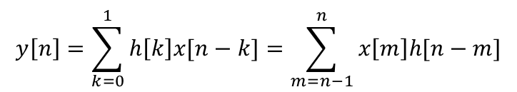
Overlap-Add Example B=3, Lh=2, NFFT=B+Lh-1=4, h[n]=[h0, h1]
x[n]-> x0 x1 x2 x3 x4 x5 x6 x7 x8 x9 ……
*h[n] *h[n] *h[n] *h[n]
x0h0 x0h1 x3h0 x3h1 x6h0 x6h1 x9h0 ……
x1h0 x1h1 x4h0 x4h1 x7h0 x7h1
x2h0 x2h1 x5h0 x5h1 x8h0 x8h1
----------------------------- ----------------------------- ----------------------------- -------
x0h0 x0h1+x1h0 x1h1+x2h0 x2h1 x3h0 x3h1+x4h0 x4h1+x5h0 x5h1 x6h0 x6h1+x7h0 x7h1+x8h0 x8h1 x9h0 ……
overlap x0h0 x0h1+x1h0 x1h1+x2h0 x2h1
and add x3h0 x3h1+x4h0 x4h1+x5h0 x5h1
x6h0 x6h1+x7h0 x7h1+x8h0 x8h1
x9h0 ……
y[n]-> x0h0 x0h1+x1h0 x1h1+x2h0 x2h1+x3h0 x3h1+x4h0 x4h1+x5h0 x5h1+x6h0 x6h1+x7h0 x7h1+x8h0 x8h1+x9h0 ……
$$y\left[n\right]=\sum_{k=0}^{1}{h\left[k\right]x[n−k]}=\sum_{m=n−1}^{n}{x\left[m\right]h[n−m]}$$

Slide 20
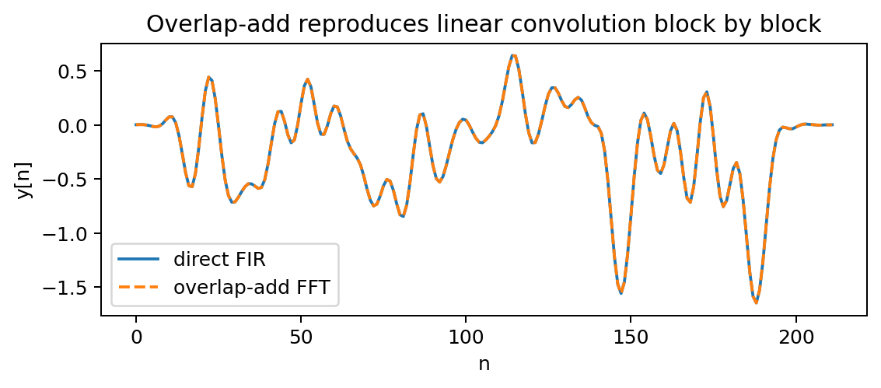
Overlap-Add gives the same FIR output
OVERLAP-ADD
0:54–0:58
Verification
The direct time-domain FIR and FFT overlap-add traces lie on top of one another to numerical precision.
This equivalence should be a coding unit test.
WEEK 10 • TIME-FREQUENCY ANALYSIS

Slide 21
Overlap-Save: overlap the input, discard invalid outputs
OVERLAP-SAVE
0:58–1:06
• Choose an FFT size NFFT and FIR length Lh.
• Each input block contains Lh − 1 old samples plus new samples.
• Perform NFFT-point circular convolution.
• Discard the first Lh − 1 output samples, which contain time-aliasing contamination.
• Keep the remaining NFFT − Lh + 1 valid samples.
Why “save”?
We save only the uncontaminated portion of each circular-convolution block and concatenate those portions.
Contrast
OLA overlaps and adds outputs. OLS overlaps inputs and discards corrupted outputs.
WEEK 10 • TIME-FREQUENCY ANALYSIS

Slide 23
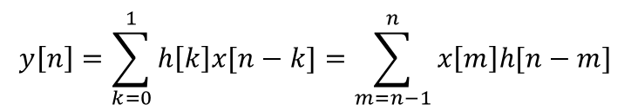
Overlap-Save Example B=3, Lh=2, NFFT=B+Lh-1=4, h[n]=[h0, h1]
x2 overlap x5 overlap
x[n]-> 0 x0 x1 x2 x2 x3 x4 x5 x5 x6 x7 x8
*h[n] *h[n] *h[n]
0h0 0h1 x2h0 x2h1 x5h0 x5h1
x0h0 x0h1 x3h0 x3h1 x6h0 x6h1
x1h0 x1h1 x4h0 x4h1 x7h0 x7h1
x2h0 x2h1 x5h0 x5h1 x8h0 x8h1
------------------------------- --------------------------------------- ---------------------------------------
0 x0h0 x0h1+x1h0 x1h1+x2h0 x2h1 x2h0 x2h1+x3h0 x3h1+x4h0 x4h1+x5h0 x5h1 x5h0 x5h1+x6h0 x6h1+x7h0 x7h1+x8h0 x8h1
wrap 0+x2h1 x0h0 x0h1+x1h0 x1h1+x2h0 x2h0+x5h1 x2h1+x3h0 x3h1+x4h0 x4h1+x5h0 x5h0+x8h1 x5h1+x6h0 x6h1+x7h0 x7h1+x8h0
mod NFFT
Discard and concatenate
y[n]-> x0h0 x0h1+x1h0 x1h1+x2h0 x2h1+x3h0 x3h1+x4h0 x4h1+x5h0 x5h1+x6h0 x6h1+x7h0 x7h1+x8h0 ……
$$y\left[n\right]=\sum_{k=0}^{1}{h\left[k\right]x[n−k]}=\sum_{m=n−1}^{n}{x\left[m\right]h[n−m]}$$

Slide 24
OLA versus OLS: engineering trade-offs
STREAMING
1:06–1:10
Overlap-Add
Overlap-Save
• Simple conceptual decomposition.
• Needs an output accumulation buffer.
• Input blocks are non-overlapping.
• Input blocks overlap by Lh − 1.
• No output addition step.
• Discard first Lh − 1 samples per block.
Both
Reuse H[k] for every block and can be much faster than direct convolution for long FIR filters.
WEEK 10 • TIME-FREQUENCY ANALYSIS

Slide 25
Choosing FFT and block sizes
STREAMING
1:10–1:13
• Larger FFTs often improve arithmetic efficiency per sample but increase buffering latency.
• Short blocks reduce latency but increase FFT overhead.
• Choose NFFT using measured platform performance, not only asymptotic complexity.
• On an edge device, memory movement and cache behavior can matter as much as multiply counts.
Design question
A classifier needs 10-ms latency. Would a huge “efficient” FFT block still be acceptable? No—the end-to-end latency constraint dominates.
WEEK 10 • TIME-FREQUENCY ANALYSIS

Slide 26
ML pipeline connection
ML BRIDGE
1:13–1:14
stream → fast FIR / resampling → framing → features → model
• Fast convolution lets expensive preprocessing run continuously without changing the filter response.
• The same block boundaries should not create artifacts that leak into ML features.
• Streaming DSP and streaming inference must share latency and buffer budgets.
Think like a system designer
Accuracy, throughput, latency, and numerical equivalence all matter.
WEEK 10 • TIME-FREQUENCY ANALYSIS

Slide 27
Lecture 11 wrap-up
WRAP-UP
1:14–1:15
• The DFT samples the finite-record DTFT.
• DFT multiplication gives circular convolution.
• Zero-padding prevents wrap-around and recovers linear convolution.
• Overlap-add and overlap-save extend FFT convolution to endless streams.
• Block size is both a DSP and systems-design parameter.
Exit ticket
Why is NFFT ≥ B + Lh − 1 required in overlap-add, and what fails if NFFT is smaller?
WEEK 10 • TIME-FREQUENCY ANALYSIS

Slide 28



Two Reasons to Consider Zero Padding for DFT/FFTs

Slide 29
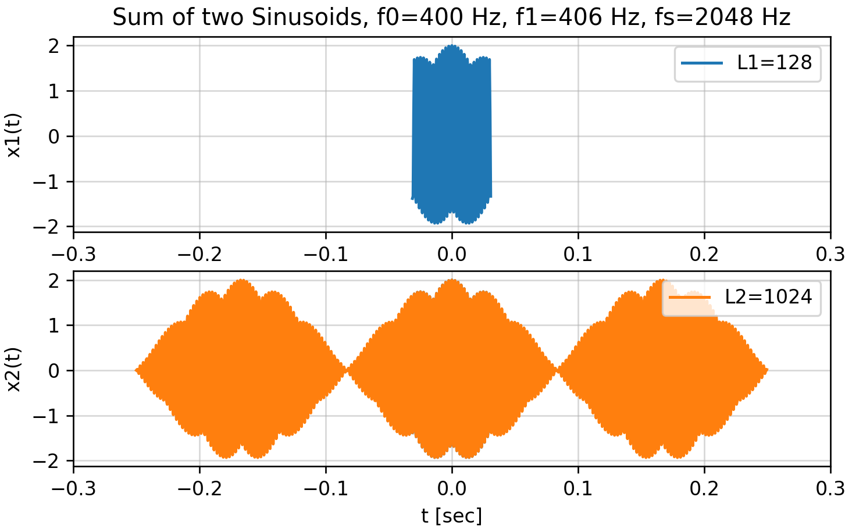
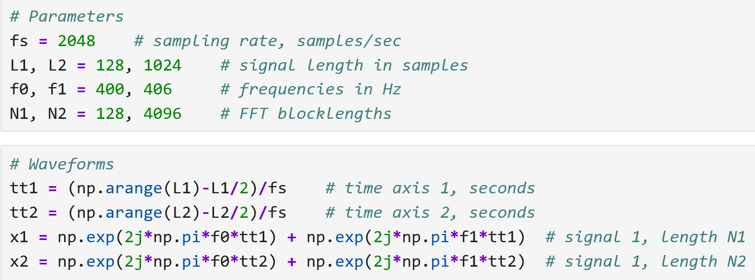
Two Sinusoids Close in Frequency

Slide 30
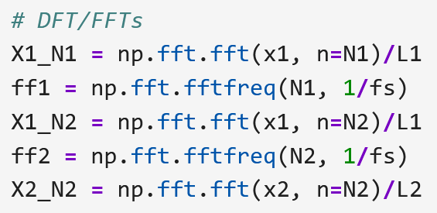
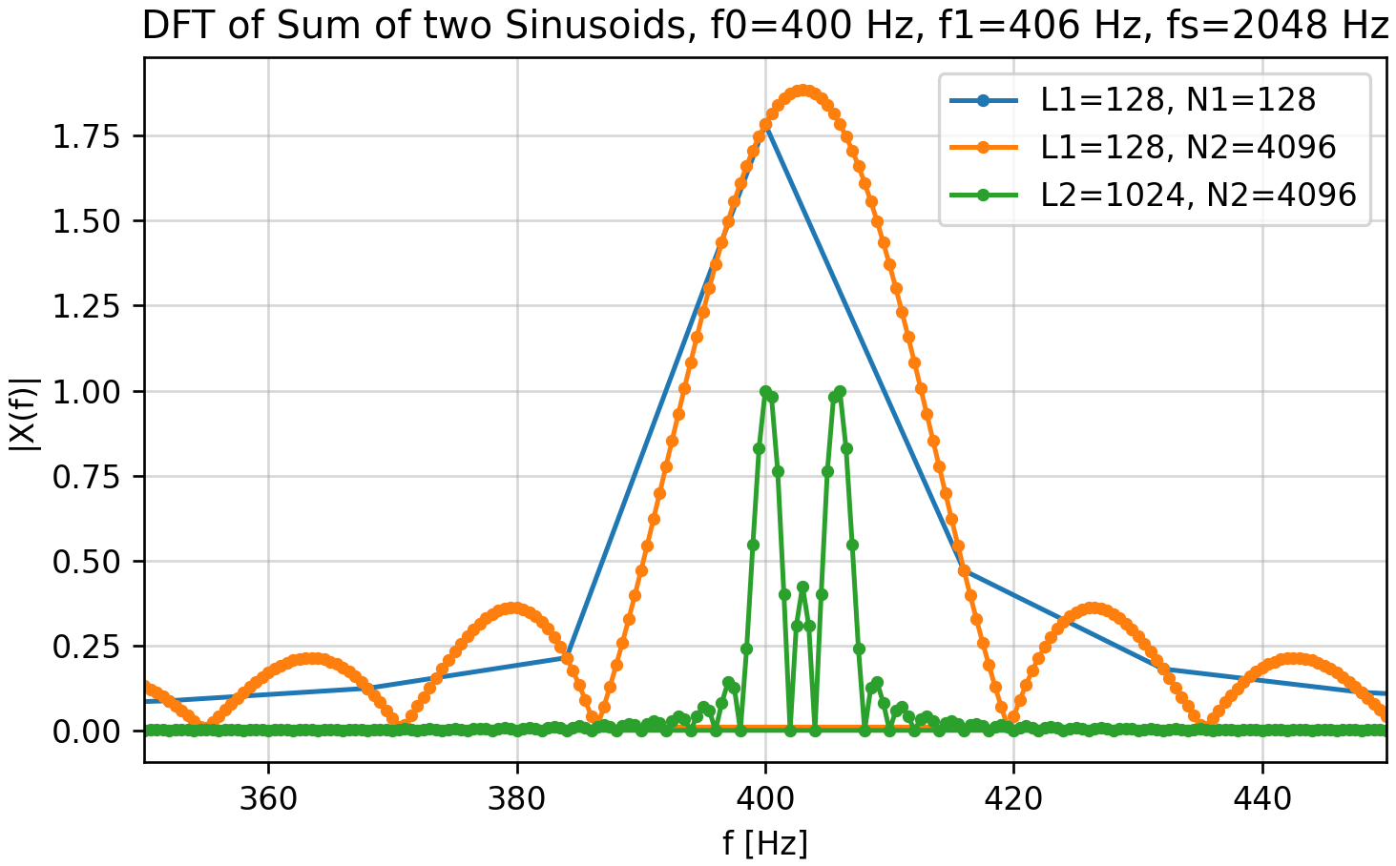
Two Sinusoids Close in Frequency
Blue to orange: Zero padding increases graph resolution but not frequency resolution.
Orange to green: More signal samples increases frequency resolution.

