Slide 1

ECEN 4/5632 Theory and Application of Digital Filters
Lecture 25, 11-10-26
Peter Mathys*
* With generous help from Gemini Pro and ChatGPT

Slide 2
Feature Engineering
From Physics to Perception
STFT → Mel filterbanks → log compression → MFCCs → fixed-size ML inputs
WEEK 13 • LECTURE 25 • 75 MINUTES

Slide 3
Week 13 changes the objective
THE TRANSITION FROM DSP ANALYSIS TO MACHINE LEARNING
00–15 MIN
• Classical DSP asks: can we represent, filter, or reconstruct the signal faithfully?
• ML asks: which representation makes the decision boundary easiest to learn?
• A feature may intentionally discard information that is irrelevant to the task.
• But discarded information cannot be recovered later—feature engineering encodes assumptions.
Preserve what matters for the label; compress what does not.
Feature engineering = physics + perception + task knowledge
Instructor cue: Ask for one task where perfect reconstruction is unnecessary: siren detection, keyword spotting, bearing-fault classification.
DSP + ML • Week 13 • Oppenheim & Schafer → Raschka
2

Slide 4

Learning outcomes
BY THE END OF LECTURE 21
00–15 MIN
• Explain why linear-Hz STFT bins are not always the most efficient coordinates for audio classification.
• Construct a Mel-spectrogram conceptually as a weighted sum of STFT power bins.
• Explain log compression and the DCT step used to form MFCCs.
• Standardize waveform geometry: channels, sample rate, duration, and feature shape.
• Choose between Mel-spectrograms, MFCC matrices, and summarized MFCC vectors for different model families.
DSP + ML • Week 13 • Oppenheim & Schafer → Raschka
3

Slide 5
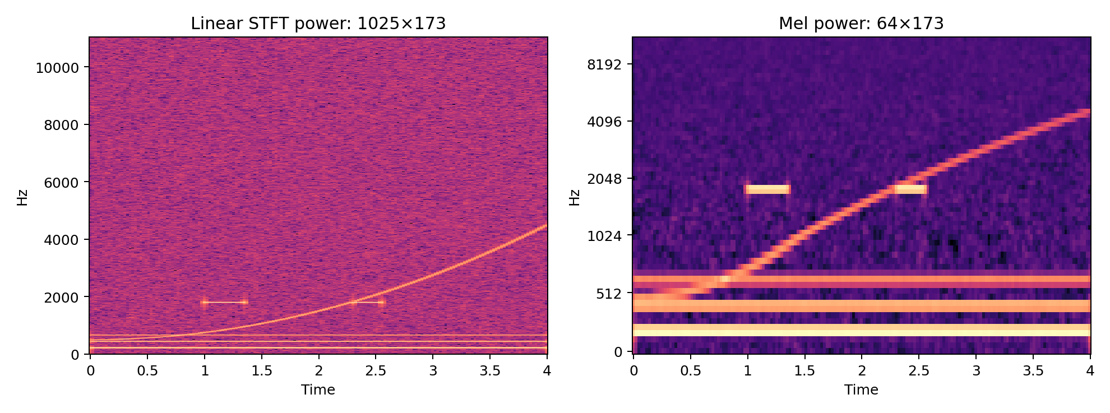
The problem with linear frequency
THE STFT IS PHYSICALLY NATURAL, NOT PERCEPTUALLY UNIFORM
00–15 MIN
• At 22.05 kHz with n_fft=2048, the one-sided STFT has 1025 frequency bins.
• For many audio tasks, fine resolution at the top of the band is less useful than fine resolution at low frequencies.
• Mel filterbanks pool neighboring bins nonuniformly, reducing dimension while keeping time structure.
STFT power P[k,m] → Mel power S_mel[b,m]
Instructor cue: Phrase “human hearing is logarithmic” carefully: Mel is a perceptual warping, not a universal law of hearing.
DSP + ML • Week 13 • Oppenheim & Schafer → Raschka
4

Slide 6
Physics coordinates vs perception-oriented coordinates
SAME SOUND, DIFFERENT REPRESENTATIONS
00–15 MIN
Linear Hz / STFT
Equal-width frequency bins
Direct physical meaning
Filter-analysis friendly
Mel
More low-frequency detail
Broader high-frequency bands
Compact audio front end
MFCC
DCT of log-Mel
Compact spectral envelope
Classical baseline friendly
CNN input
Keep full 2D map
Learn local patterns
Next week: CNNs
No representation is free: every compression trades detail for invariance or efficiency.
DSP + ML • Week 13 • Oppenheim & Schafer → Raschka
5

Slide 7
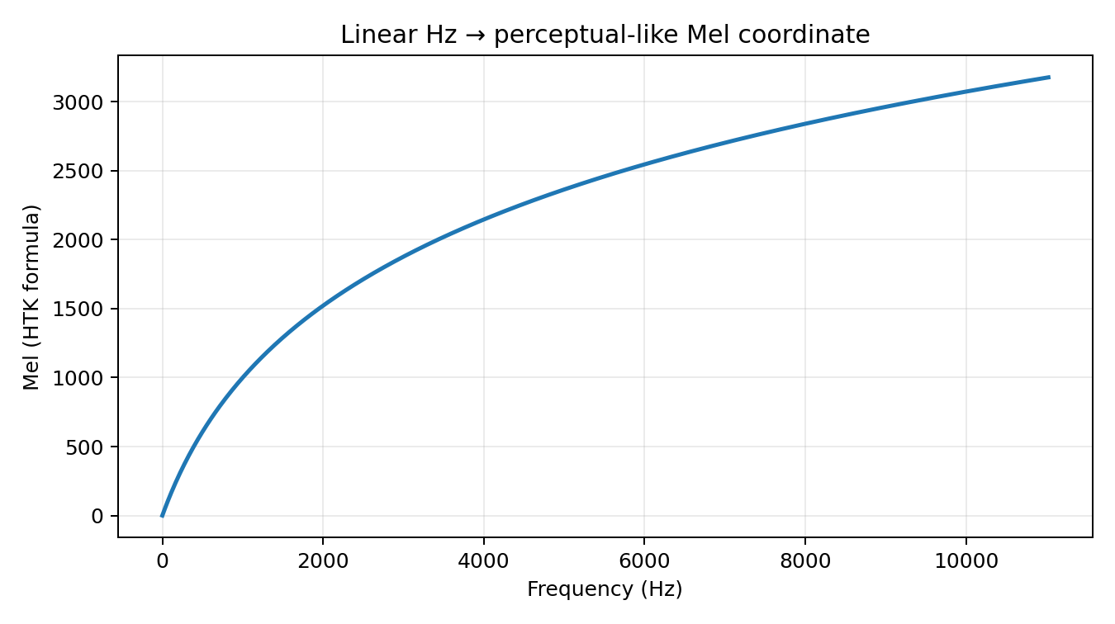


The Mel scale
ONE COMMON MAPPING FROM HZ TO A PERCEPTUAL-LIKE COORDINATE
15–35 MIN
m = 2595 log10(1 + f/700)
• The formula shown is the common HTK-style mapping.
• librosa defaults to a Slaney-style Mel definition; set htk=True for the HTK convention.
• The important idea is frequency warping—not memorizing one constant.
Instructor cue: Use 100→200 Hz versus 10,000→10,100 Hz as intuition; avoid claiming an exact perceptual threshold.
DSP + ML • Week 13 • Oppenheim & Schafer → Raschka
6

Slide 8
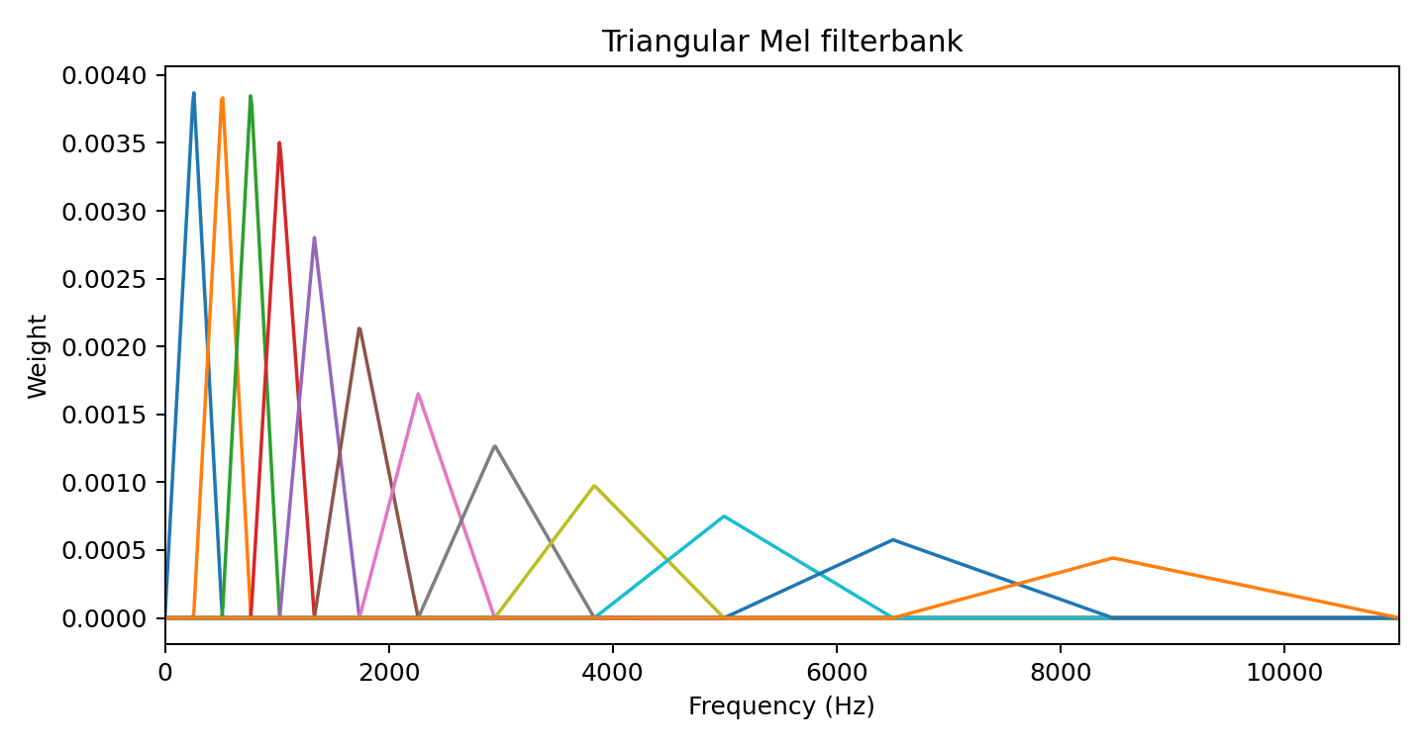
Mel filterbanks are weighted pooling
TRIANGULAR BANDS COMPRESS FREQUENCY WITHOUT DESTROYING TIME
15–35 MIN
• Each filter H_b[k] assigns weights to neighboring FFT bins.
• Low-frequency filters are relatively narrow; high-frequency filters cover more Hz.
• Overlapping filters provide smooth transitions between bands.
S_mel[b,m] = Σ_k H_b[k] |X[m,k]|²
DSP + ML • Week 13 • Oppenheim & Schafer → Raschka
7

Slide 9
Matrix view: Mel features are a linear map of power
A BRIDGE BACK TO LINEAR ALGEBRA
15–35 MIN
P
STFT power
[K × T]
H
Mel bank
[B × K]
S_mel = H P
Mel power
[B × T]
• Frequency compression happens independently in every time frame.
• Time resolution is inherited from the STFT hop length.
• Choosing n_mels controls the frequency-feature dimension.
DSP + ML • Week 13 • Oppenheim & Schafer → Raschka
8

Slide 10
librosa: compute a Mel-spectrogram
CODE SHOULD MIRROR THE MATH
15–35 MIN
M = librosa.feature.melspectrogram(
y=y, sr=22050,
n_fft=2048, hop_length=512,
n_mels=64,
power=2.0,
)
M_db = librosa.power_to_db(M, ref=np.max)
print(M.shape) # (64, time_frames)
print(M_db.max()) # 0 dB relative to peak
Instructor cue: Ask students to predict the first dimension. power=2 means power; power_to_db therefore uses 10 log10.
DSP + ML • Week 13 • Oppenheim & Schafer → Raschka
9

Slide 11
Why take the logarithm?
DYNAMIC RANGE COMPRESSION IS PART OF FEATURE DESIGN
15–35 MIN
S_dB = 10 log10(S / S_ref)
100× power ratio → +20 dB
• Spectral power can span orders of magnitude.
• Log compression turns ratios into differences and makes weak structure more visible.
• For power quantities use 10 log10(·); for amplitude ratios use 20 log10(·).
• A floor is required numerically because log(0) is undefined.
0.01× power ratio → −20 dB
DSP + ML • Week 13 • Oppenheim & Schafer → Raschka
10

Slide 12
MFCC pipeline
A COMPACT DESCRIPTION OF SPECTRAL-ENVELOPE SHAPE
35–55 MIN
Waveform
STFT power
Mel bank
log / dB
DCT
MFCCs
C[n,m] = DCT_b{ log S_mel[b,m] }
• Many classical pipelines retain roughly the first 13–40 coefficients.
• Coefficient 0 largely tracks overall log-energy; higher indices encode faster variation across Mel bands.
DSP + ML • Week 13 • Oppenheim & Schafer → Raschka
11

Slide 13
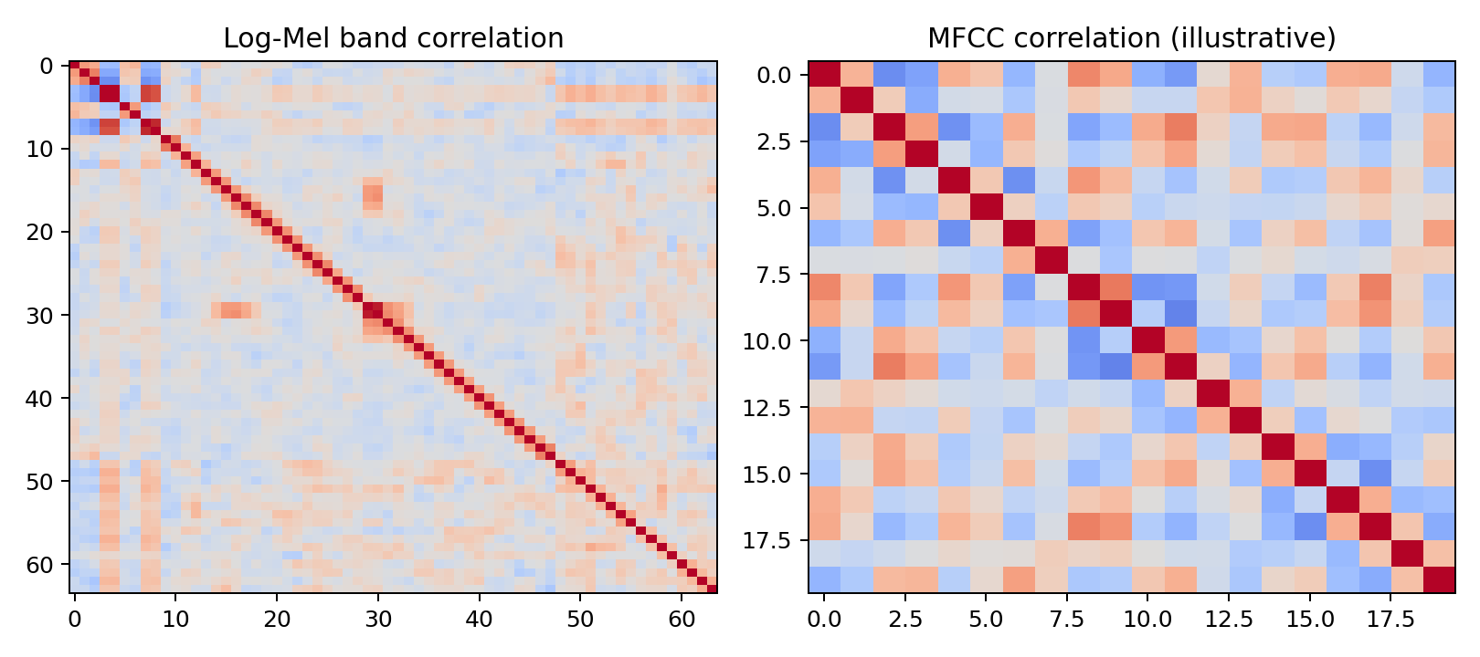

What does the DCT buy us?
APPROXIMATE DECORRELATION AND ENERGY COMPACTION
35–55 MIN
• Neighboring Mel bands overlap, so their log energies are correlated.
• The DCT rotates those coordinates into cosine-basis directions.
• Low-order coefficients often concentrate useful smooth spectral-envelope information.
• “Decorrelates” is approximate and data-dependent—not a universal guarantee.
Instructor cue: Connect to older Gaussian/diagonal-covariance models. The DCT is not magic statistical independence.
DSP + ML • Week 13 • Oppenheim & Schafer → Raschka
12

Slide 14
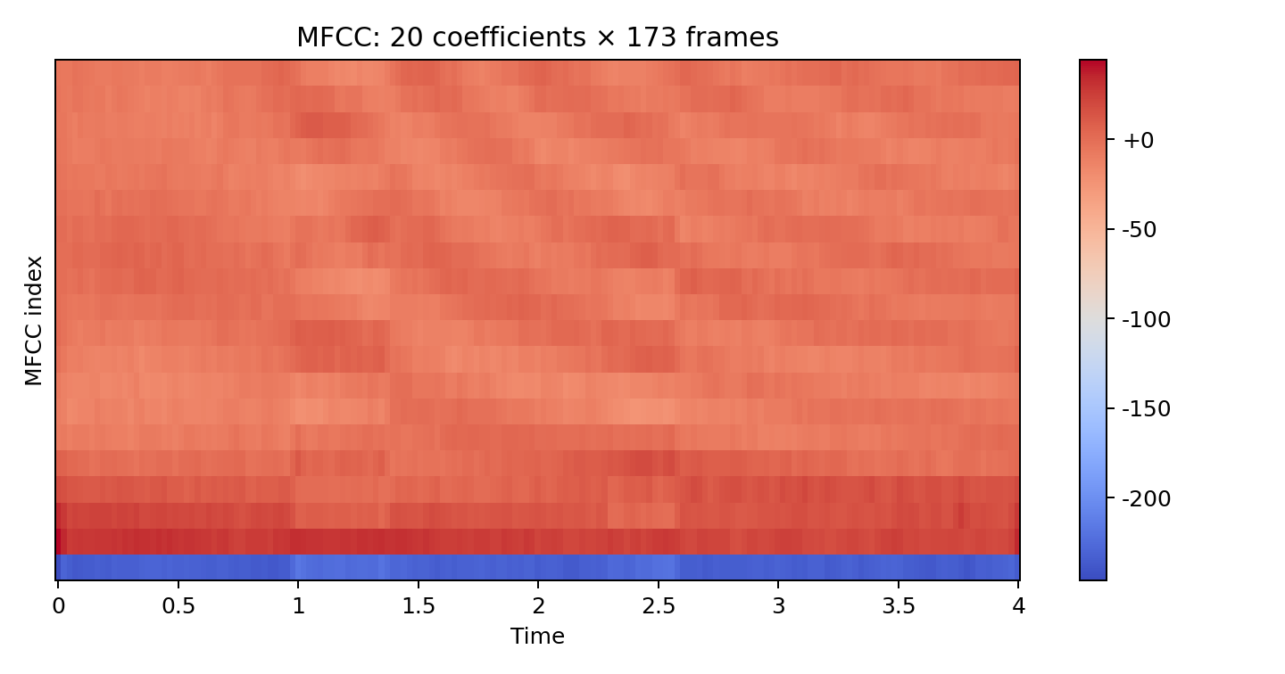
How should students interpret MFCC indices?
USE QUALITATIVE INTUITION, NOT ONE-TO-ONE PHYSICAL LABELS
35–55 MIN
• Low-order coefficients: broad spectral-envelope / tilt information.
• Higher-order coefficients: progressively finer variation across Mel bands.
• MFCCs intentionally discard much detailed harmonic structure.
• That compression can help a classical classifier—or hurt a task needing fine time–frequency detail.
DSP + ML • Week 13 • Oppenheim & Schafer → Raschka
13

Slide 15
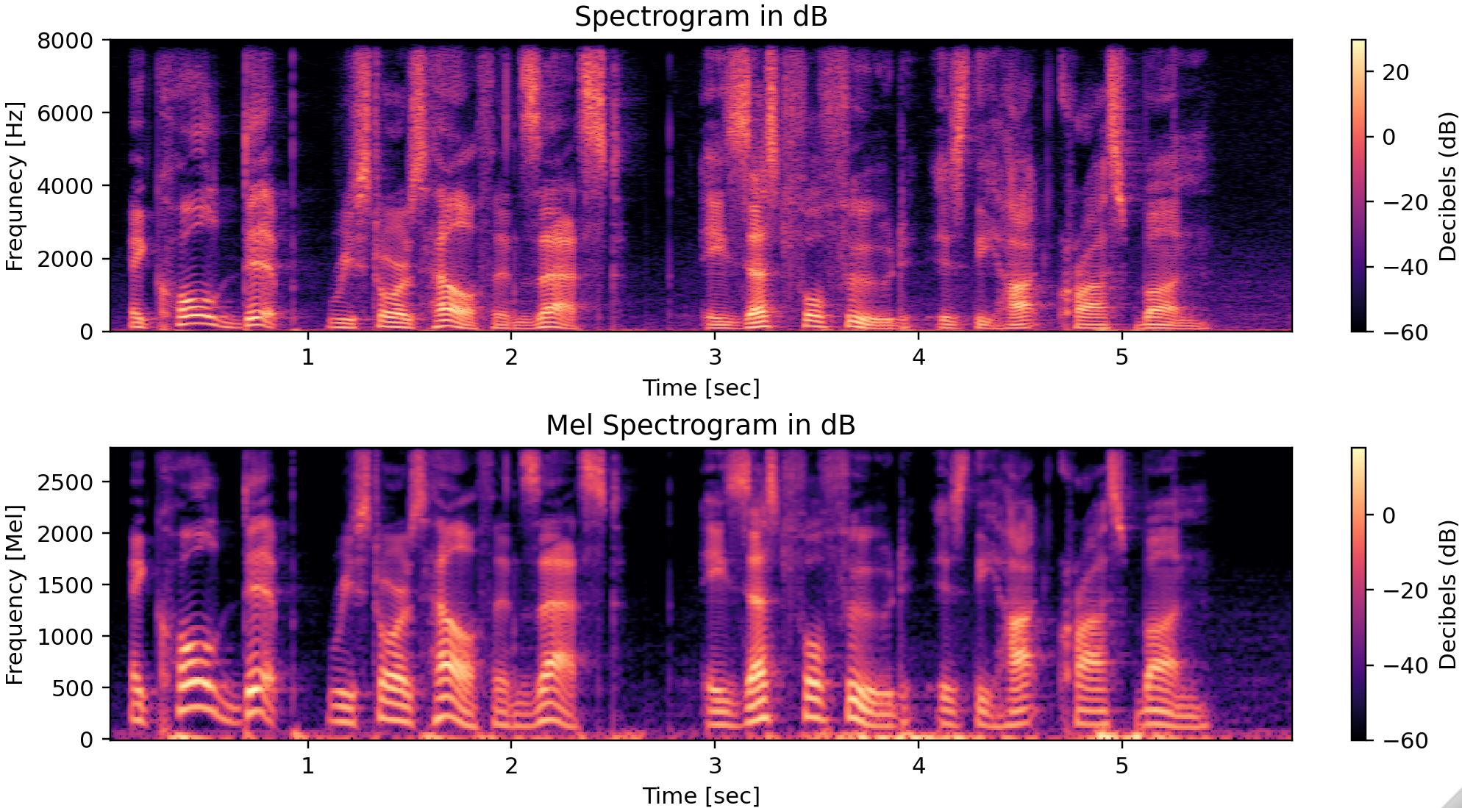
STFT Spectrogram in dB Compared to Mel Spectrogram in dB

Slide 16
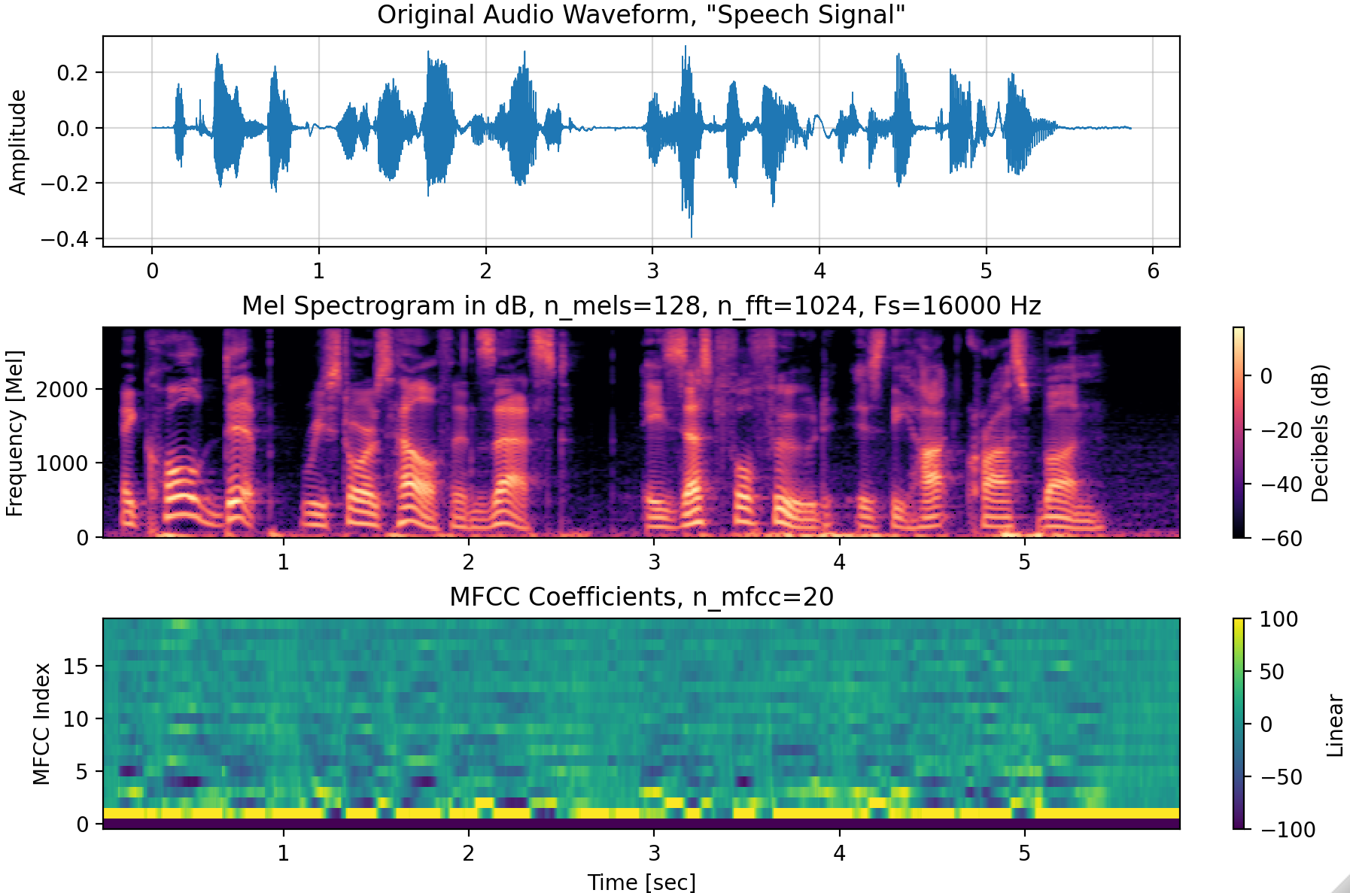
Log Mel Spectrogram and MFCCs for “Speech Signal”

Slide 17
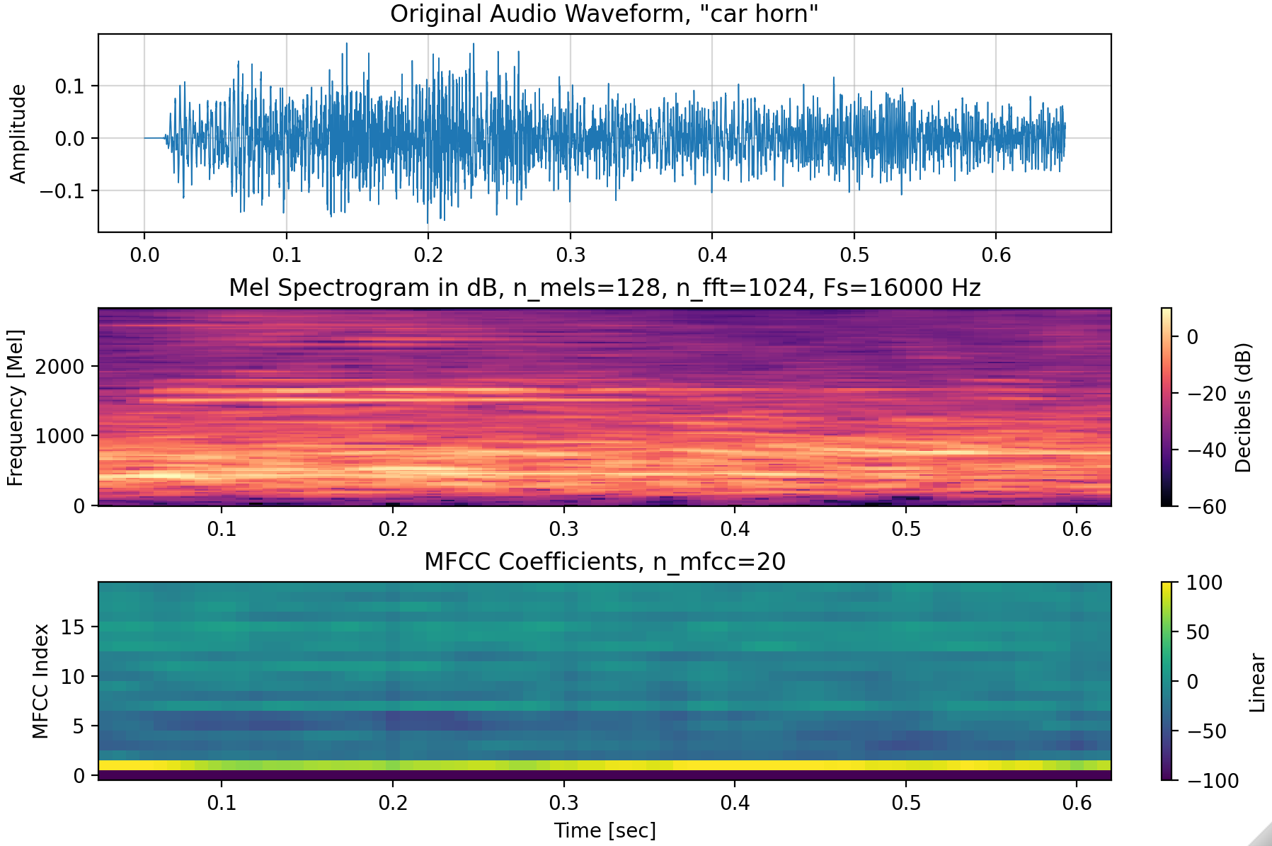
Log Mel Spectrogram and MFCCs for “Car Horn”

Slide 18
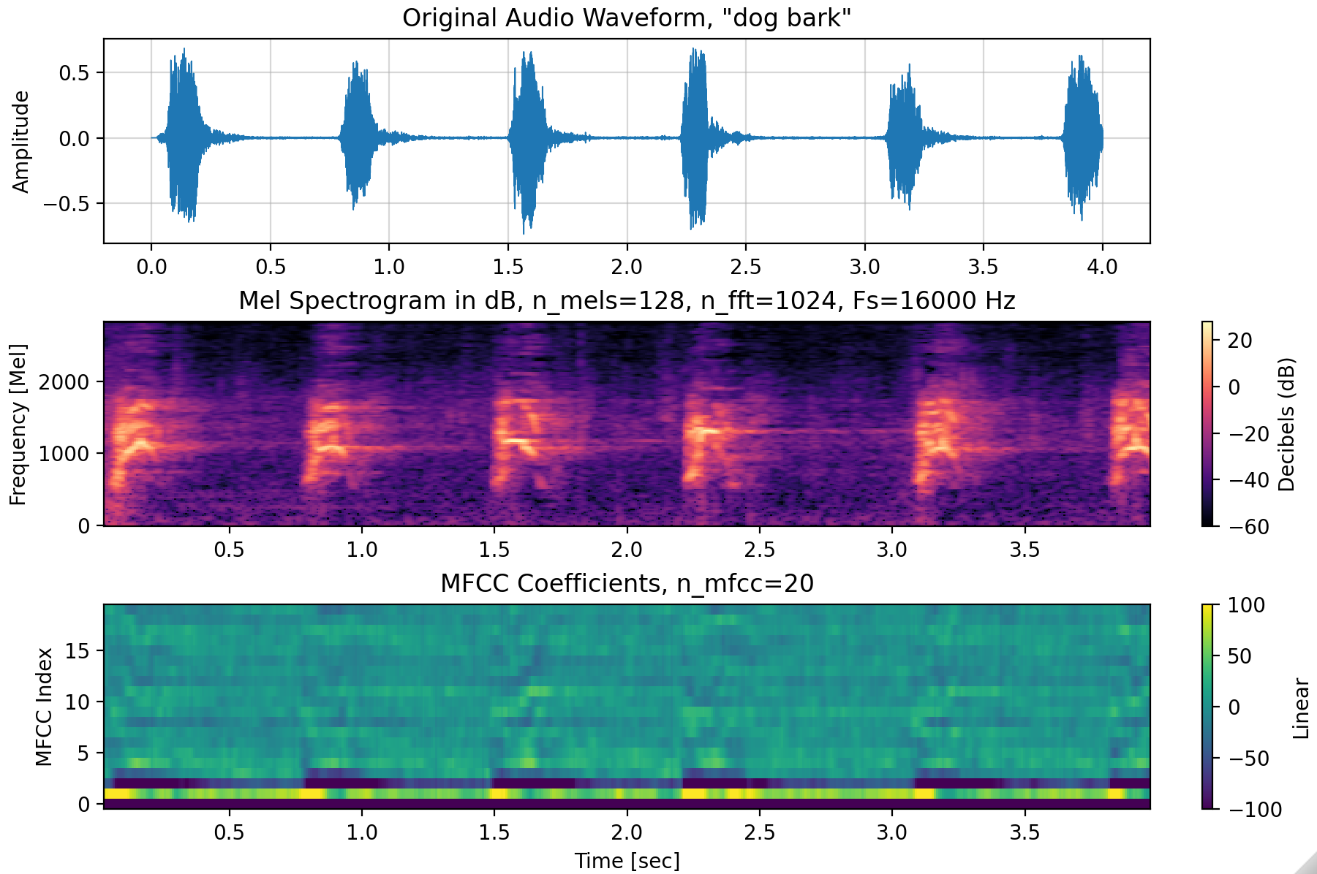
Log Mel Spectrogram and MFCCs for “Dog Bark”

Slide 19
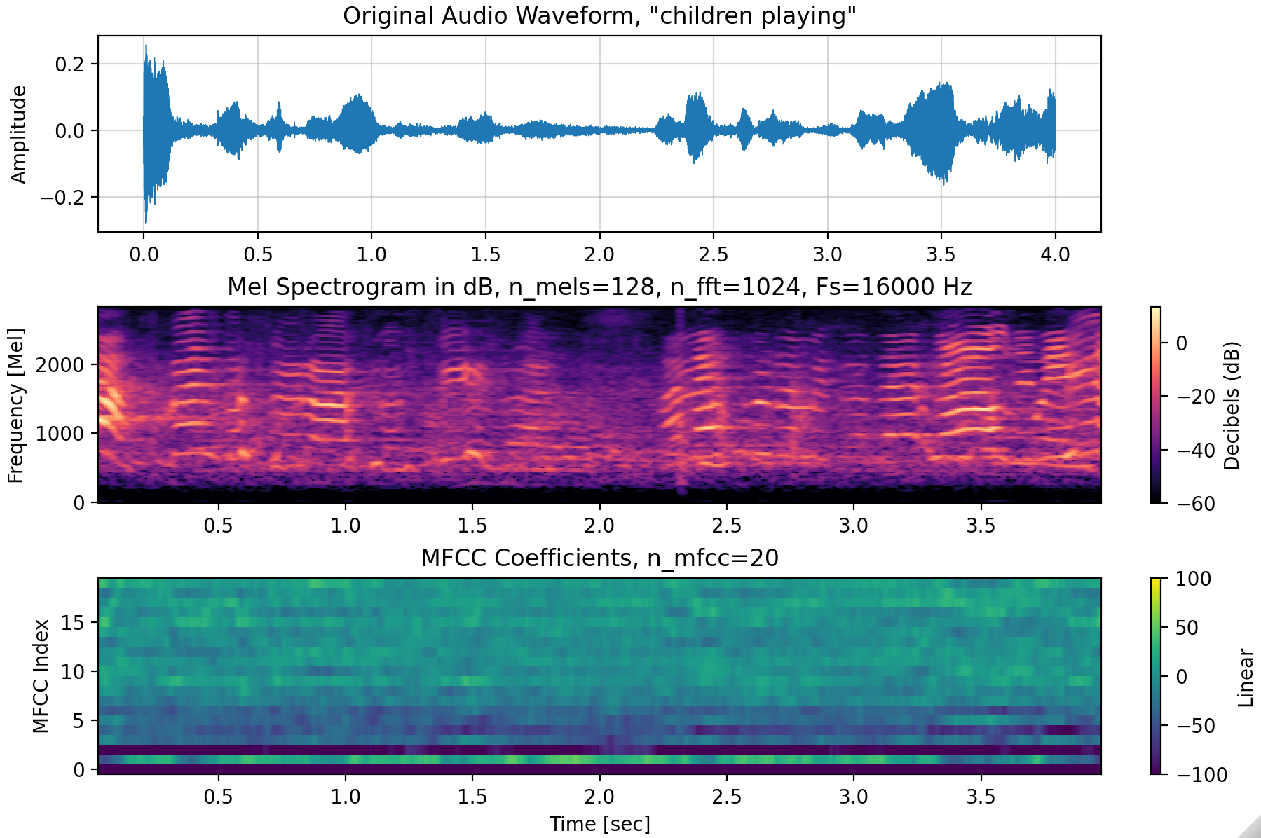
Log Mel Spectrogram and MFCCs for “Children Playing”

Slide 20
Mel-spectrogram or MFCC?
CHOOSE THE REPRESENTATION TO MATCH THE MODEL AND TASK
35–55 MIN
Mel-spectrogram
2D time–frequency geometry
Natural CNN input
More local detail
MFCC matrix
Compact spectral-envelope view
Still has time frames
Classical baseline friendly
MFCC summary
Mean/std over time
Fixed vector
Temporal order destroyed
No universally “best” feature: representation creates an inductive bias.
DSP + ML • Week 13 • Oppenheim & Schafer → Raschka
14

Slide 21
Standardizing waveform geometry
BEFORE FEATURES, MAKE EXAMPLES COMPARABLE
55–75 MIN
1
Channels
Stereo → mono or a defined multi-channel policy
2
Sample rate
Resample every clip to 22.05 kHz
3
Duration
Pad/truncate to exactly 4.0 s
4
Amplitude
Use a consistent numeric range; do not erase meaningful level without justification
5
Features
Same n_fft, hop, n_mels, and n_mfcc for every clip
DSP + ML • Week 13 • Oppenheim & Schafer → Raschka
15

Slide 22
Downmixing stereo to mono
A CHANNEL DECISION IS PART OF THE MEASUREMENT MODEL
55–75 MIN
y_mono[n] = 0.5(y_L[n] + y_R[n])
Feature engineering begins with deciding what information you are willing to throw away.
• Simple averaging is common when spatial information is irrelevant.
• Do not downmix blindly if direction or spatial cues are part of the label.
• librosa.load(..., mono=True) can downmix automatically.
DSP + ML • Week 13 • Oppenheim & Schafer → Raschka
16

Slide 23
Resampling: one physical frequency grid for every example
22.05 KHZ BECOMES THE COURSE CONVENTION
55–75 MIN
N_samples = duration × f_s = 4.0 × 22050 = 88,200
DSP prerequisite
Week 2 still matters: bad rate conversion can create aliases.
• A fixed sample rate makes FFT-bin frequencies and Mel bands comparable across files.
• Always use an anti-aliased resampler; naive sample dropping is not resampling.
• 22.05 kHz implies Nyquist = 11.025 kHz—acceptable only if the task does not need higher-frequency information.
DSP + ML • Week 13 • Oppenheim & Schafer → Raschka
17

Slide 24
Padding and truncation: force a fixed tensor shape
SAME DURATION → SAME NUMBER OF FRAMES
55–75 MIN
target_len = int(4.0 * 22050) # 88,200 samples
if len(y) < target_len:
y = np.pad(y, (0, target_len - len(y)))
else:
y = y[:target_len]
assert y.shape == (target_len,)
• Padding location is a design choice: right, left, or centered.
• Truncation can remove events—random crops or multiple crops may be better during training.
• For this week, deterministic right-padding/right-truncation keeps the baseline easy to debug.
DSP + ML • Week 13 • Oppenheim & Schafer → Raschka
18

Slide 25
Shape bookkeeping: predict dimensions before running code
A POWERFUL DEBUGGING HABIT
55–75 MIN
Waveform
[88,200]
STFT power
[1025, ~173]
Mel
[64, ~173]
MFCC
[20, ~173]
Mean+std
[40]
• Exact frame count depends on STFT centering/padding conventions.
• Flattening 20×173 MFCCs gives 3460 features; mean+std gives only 40.
• Dimensionality reduction is useful—but every reduction throws away structure.
DSP + ML • Week 13 • Oppenheim & Schafer → Raschka
19

Slide 26
Live code-along: one UrbanSound8K clip
MAKE EVERY PREPROCESSING DECISION VISIBLE
55–75 MIN
y, sr0 = librosa.load(path, sr=None, mono=True)
y = librosa.resample(y, orig_sr=sr0, target_sr=22050)
y = fix_length(y, int(4.0 * 22050))
mel = librosa.feature.melspectrogram(
y=y, sr=22050, n_fft=2048,
hop_length=512, n_mels=64, power=2.0)
mel_db = librosa.power_to_db(mel, ref=np.max)
mfcc = librosa.feature.mfcc(S=mel_db, n_mfcc=20)
Instructor cue: Pause after every line: what invariant did we establish, and what information might we have discarded?
DSP + ML • Week 13 • Oppenheim & Schafer → Raschka
20

Slide 27
Concept check
REASON ABOUT REPRESENTATION CHOICES
CHECK
• A. Increasing n_mels always improves classification accuracy.
• B. Converting stereo to mono is harmless for every audio task.
• C. Mean MFCCs reduce dimensionality but remove temporal ordering.
• D. Converting power to dB restores information lost by Mel pooling.
DSP + ML • Week 13 • Oppenheim & Schafer → Raschka
21

Slide 28
Concept check
REASON ABOUT REPRESENTATION CHOICES
CHECK
• A. Increasing n_mels always improves classification accuracy.
• B. Converting stereo to mono is harmless for every audio task.
• C. Mean MFCCs reduce dimensionality but remove temporal ordering.
• D. Converting power to dB restores information lost by Mel pooling.
Correct: C
• A, B, and D are not guaranteed. Each preprocessing choice encodes an assumption about which information matters.
DSP + ML • Week 13 • Oppenheim & Schafer → Raschka
21

Slide 29
Lecture 25 synthesis
FROM WAVEFORM PHYSICS TO ML-READY FEATURES
WRAP-UP
STFT
Mel pooling
log / dB
DCT
MFCC / Mel
• Mel features compress frequency according to a perceptual warping.
• MFCCs further rotate/compress log-Mel information for compact classical features.
• Fixed channels, rate, duration, and feature parameters give the model consistent geometry.
• Next lecture: feature matrices become X, labels become y, and evaluation discipline becomes central.
DSP + ML • Week 13 • Oppenheim & Schafer → Raschka
22

