Slide 1
Mel and MFCC Examples
ECEN 4/5632, P. Mathys

Slide 2
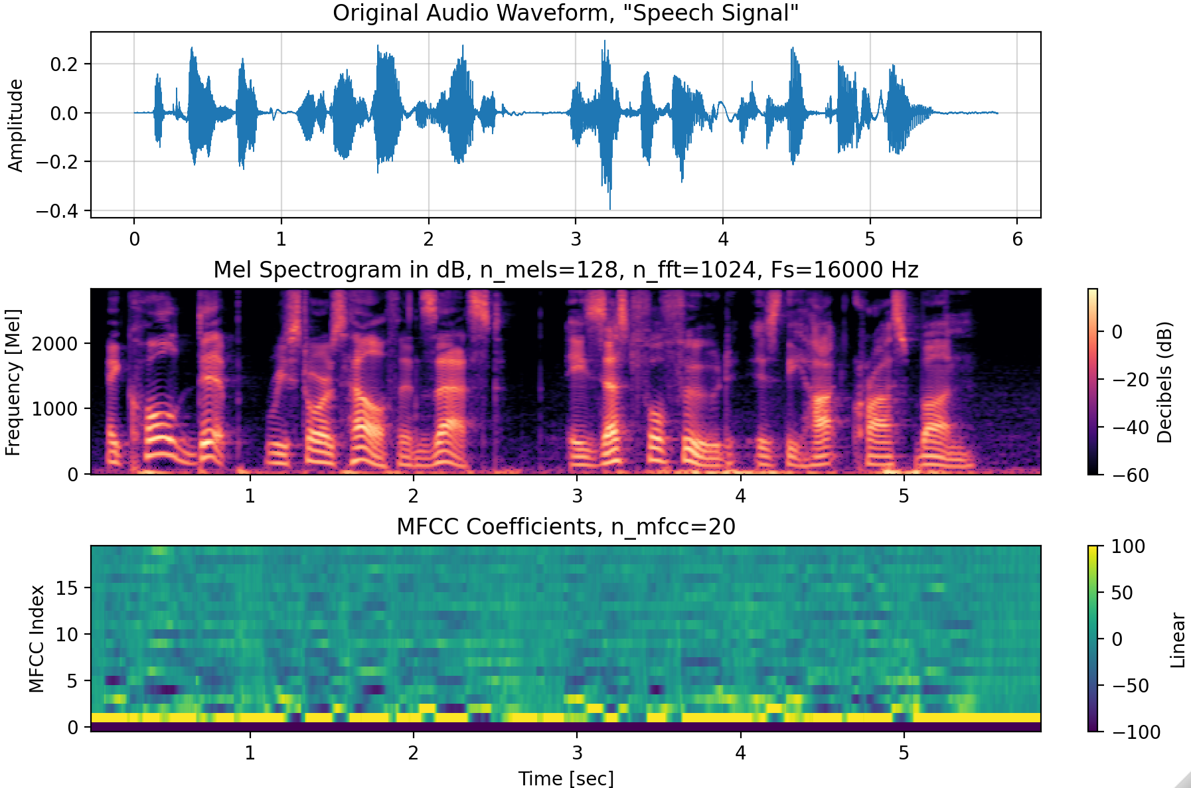
Speech Signal

Slide 3
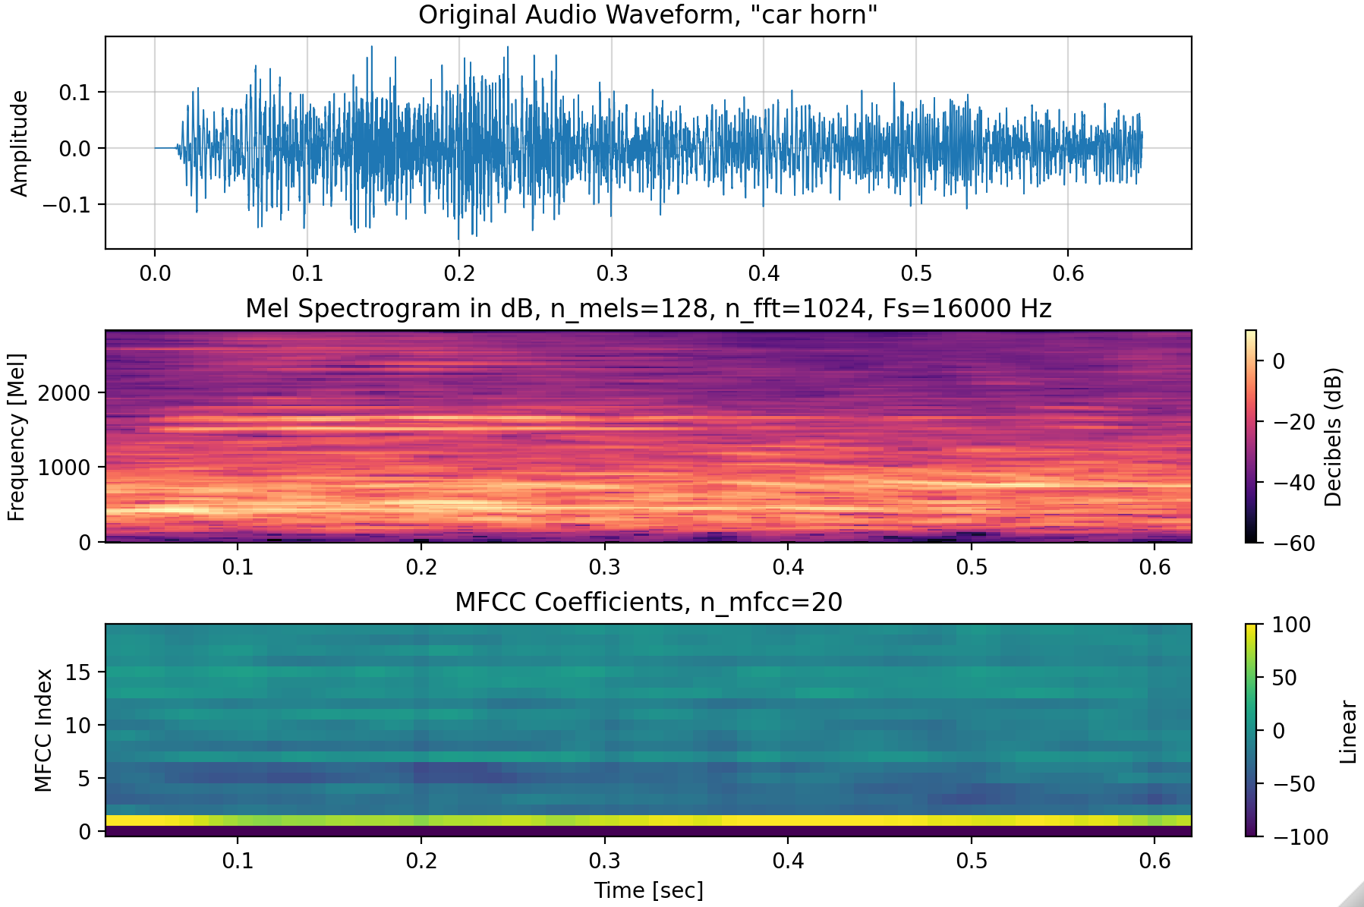
Car Horn

Slide 4
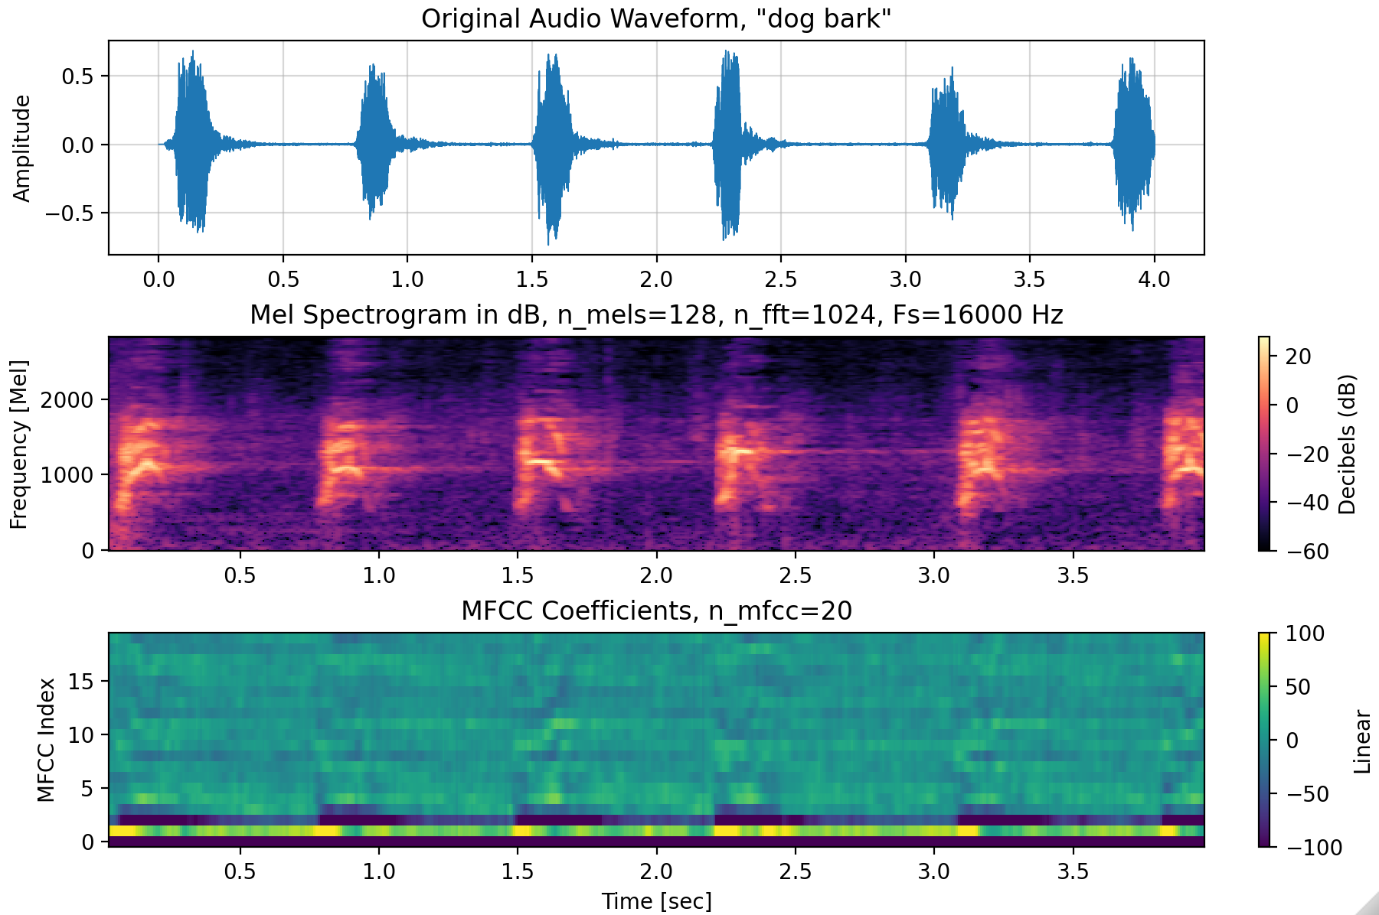
Dog Bark

Slide 5
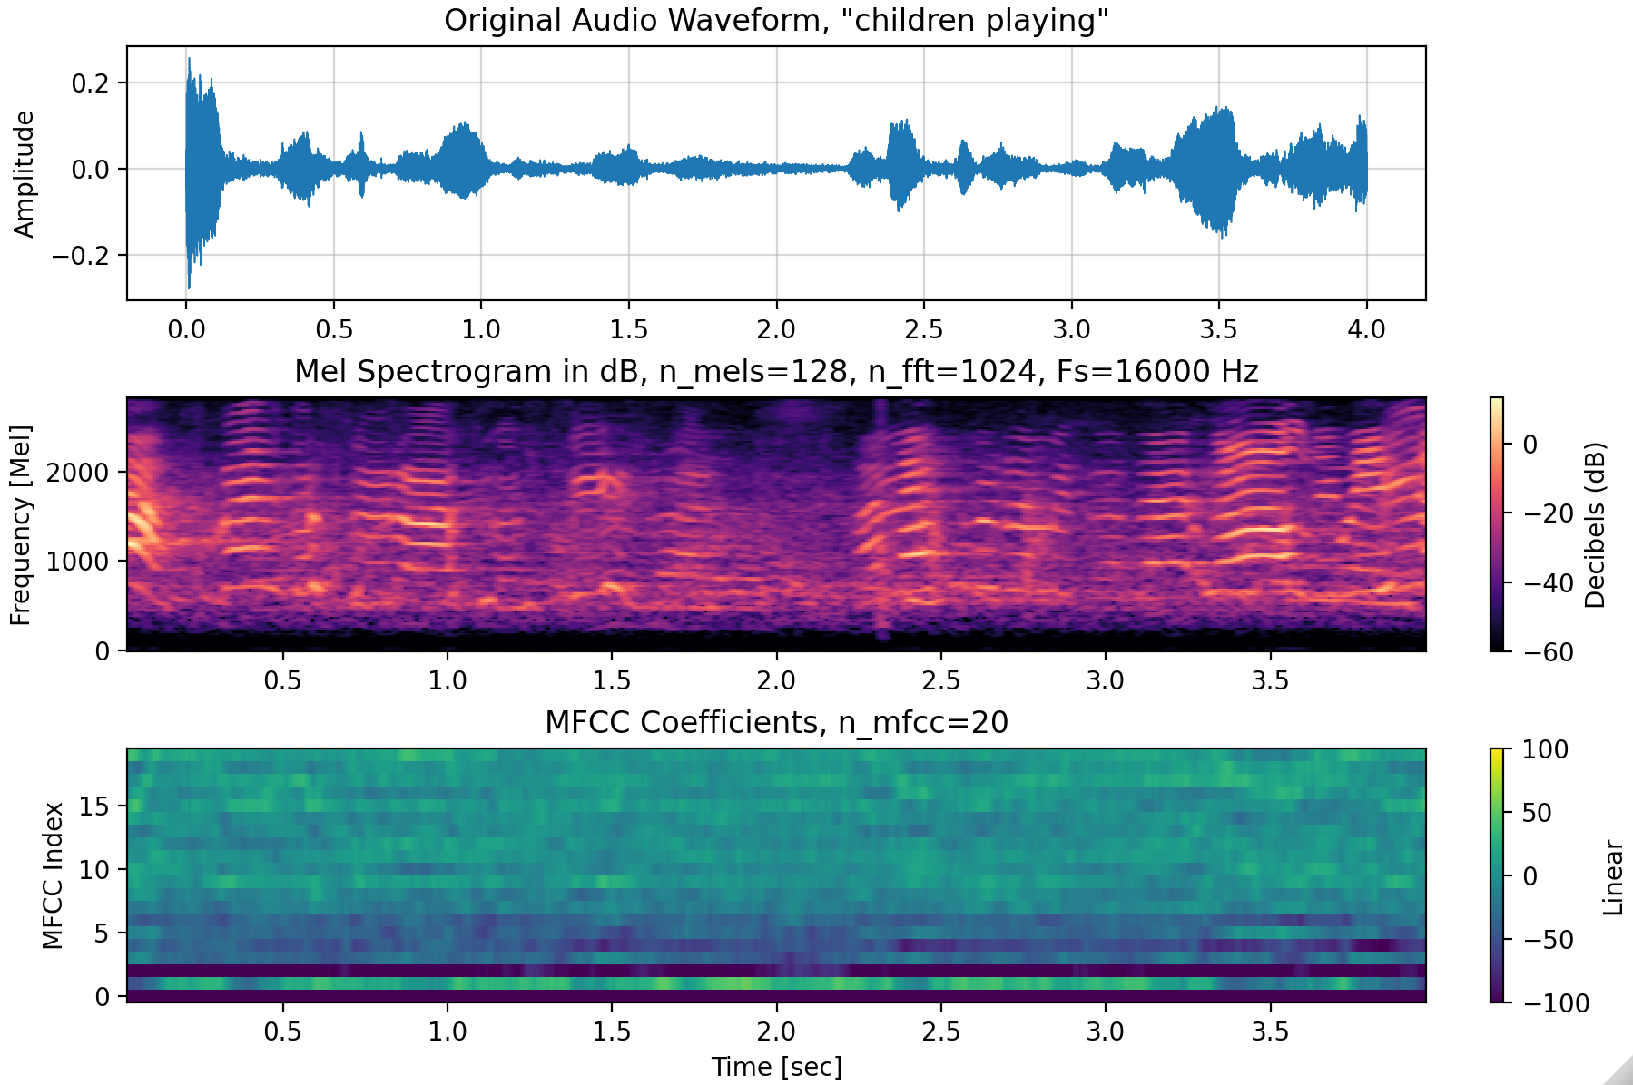
Children Playing

