Slide 1
Random Forest Classifiers
ECEN 4/5632, P. Mathys

Slide 2
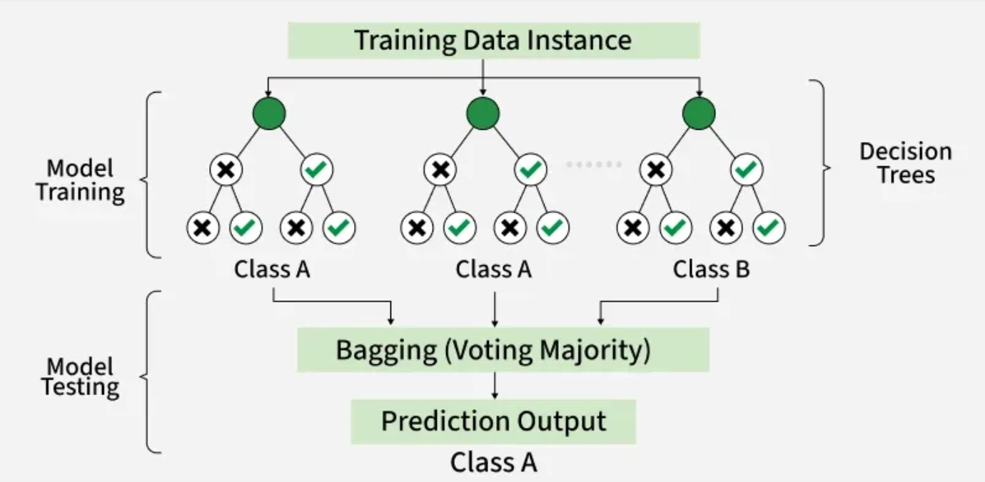
Random Forest Classifier

Slide 3
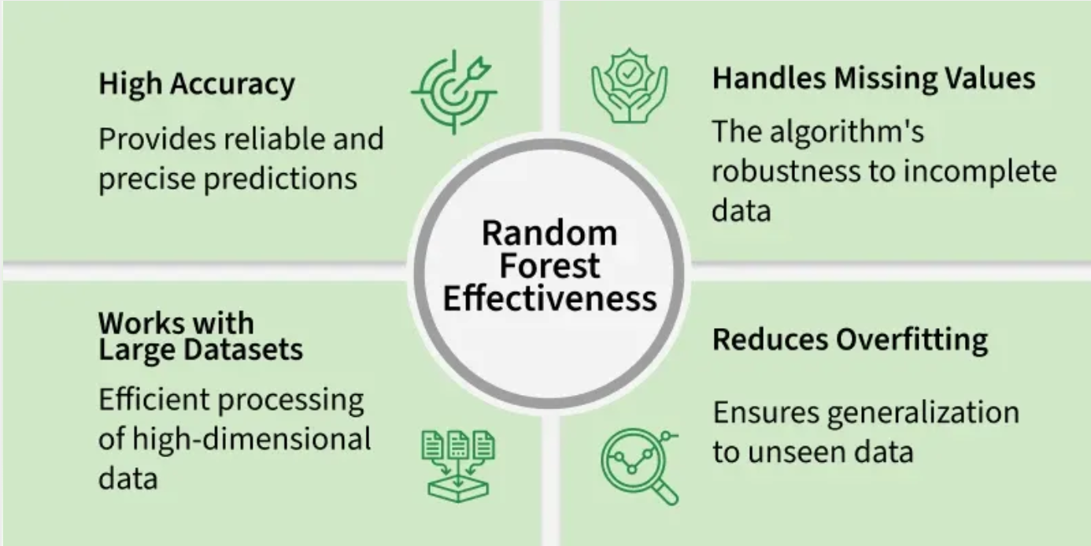
Random Forest Classifier

Slide 4
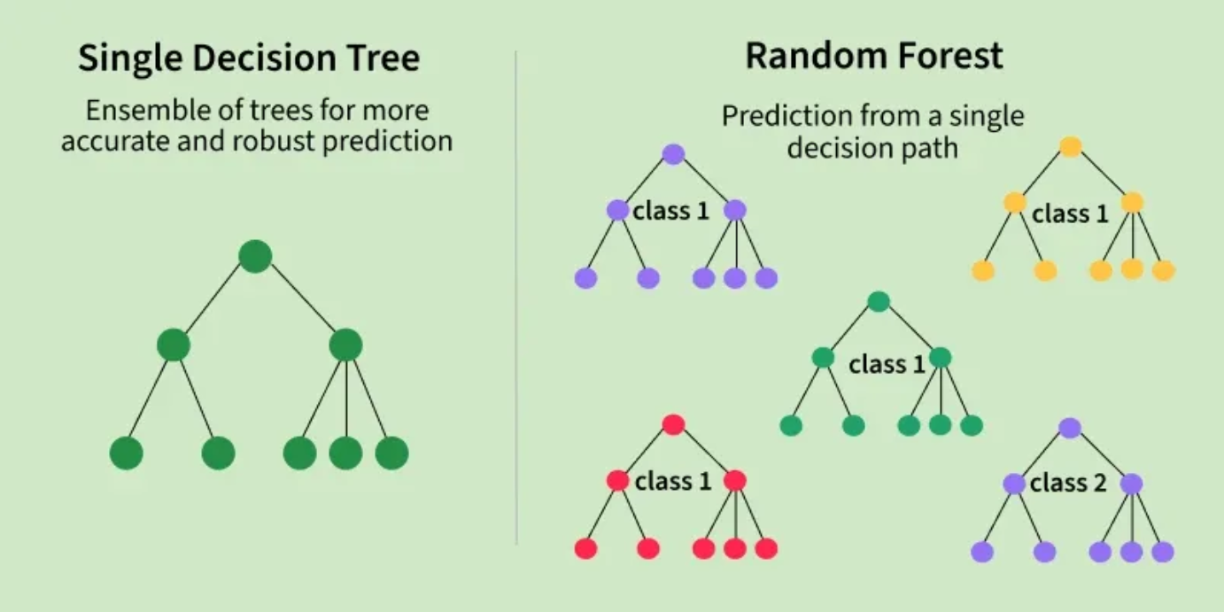
Random Forest Classifier

