Slide 1
WEEK 9 ● LECTURE 17
Power Spectral Density and the Periodogram
From second-order statistics to finite-data spectral estimates
Oppenheim & Schafer • Random processes / spectral analysis | Raschka • ML feature pipelines

Slide 2
Learning objectives
ROADMAP
0:00–0:03
Connect autocorrelation and PSD through the Wiener–Khinchin theorem.
Predict how an LTI filter reshapes the PSD of a WSS input.
Compute and interpret a finite-record periodogram.
Explain why a raw periodogram is noisy even when N is large.
Separate frequency-grid refinement from statistical variance reduction.
Core question
What can one finite realization tell us about the underlying distribution of signal power over frequency?
WEEK 9 • SPECTRAL ESTIMATION

Slide 3
PSD: “where does the average power live?”
WIENER–KHINCHIN
0:03–0:09
For a WSS process, the autocorrelation depends only on lag m:
Interpretation
rₓₓ[m] = E{x[n] x*[n+m]}
Correlation describes similarity across time lag. The PSD describes the same second-order information organized by frequency.
The power spectral density is its DTFT:
Sₓₓ(eʲω) = Σₘ rₓₓ[m] e⁻ʲωᵐ
WEEK 9 • SPECTRAL ESTIMATION

Slide 4
Wiener–Khinchin in both directions
WIENER–KHINCHIN
0:09–0:14
Forward transform
At m = 0
Sₓₓ(eʲω) = DTFT{rₓₓ[m]}
rₓₓ[0] = E{|x[n]|²} = average power = area under the PSD / 2π.
Inverse transform
rₓₓ[m] = (1/2π) ∫₋π^π Sₓₓ(eʲω)eʲωᵐ dω
Units matter
PSD is power per unit frequency. Changing from rad/sample to Hz changes the numerical scaling.
WEEK 9 • SPECTRAL ESTIMATION

Slide 5
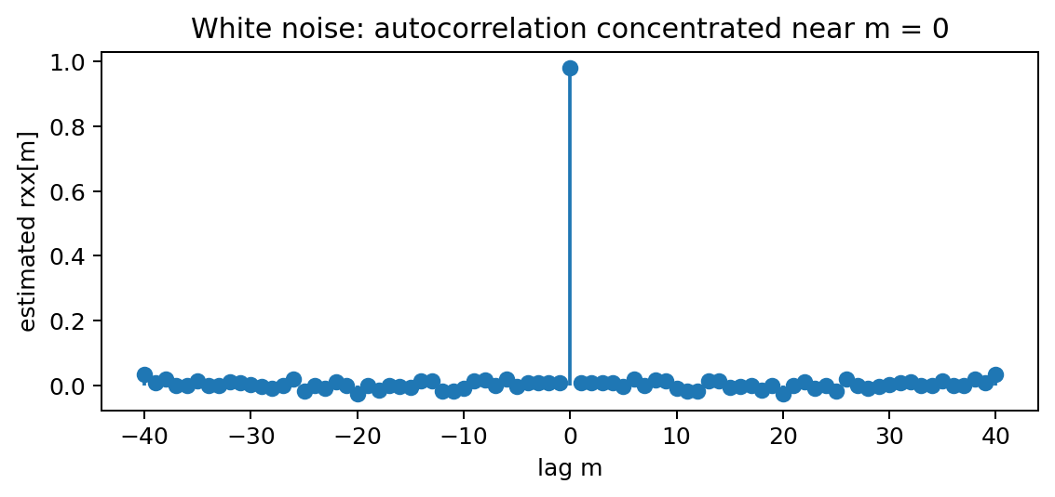
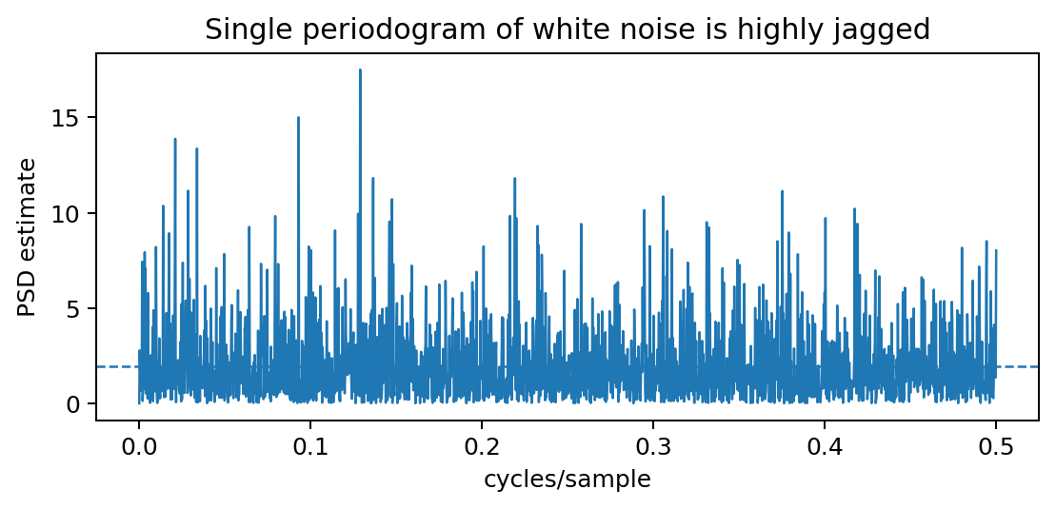
Example: white noise
WIENER–KHINCHIN
0:14–0:20
Theory: rₓₓ[m] = σ²δ[m] ⇔ Sₓₓ(eʲω) = σ²
Important
A flat theoretical PSD does not mean a single periodogram will look flat. The estimator itself has large random fluctuations.
WEEK 9 • SPECTRAL ESTIMATION

Slide 6
PSD through an LTI system
FILTERING
0:20–0:27
y[n] = h[n] * x[n]
White-noise special case
For a WSS input and stable LTI system:
If Sₓₓ = σ², then Sᵧᵧ = σ²|H|². Filtering “colors” white noise.
Sᵧᵧ(eʲω) = Sₓₓ(eʲω) |H(eʲω)|²
The filter multiplies amplitude spectra by H.
Power is proportional to squared magnitude, hence |H|².
Phase affects waveform relationships, but the output PSD depends on |H|².
WEEK 9 • SPECTRAL ESTIMATION

Slide 7
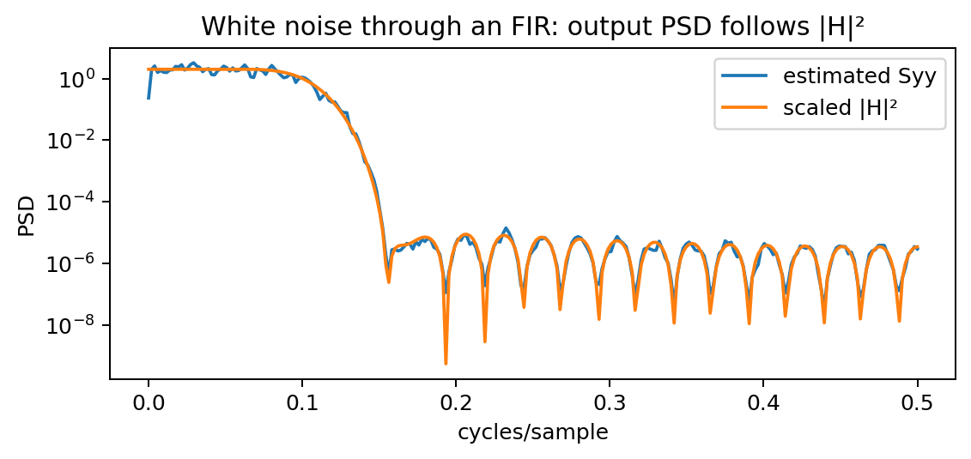
Numerical check: filtering colors white noise
FILTERING
0:27–0:35
What to notice
The random estimate fluctuates around the deterministic shape |H|². The filter imposes spectral structure on otherwise white input noise.
Concept check
If H has a deep notch at ω₀, what should happen to Sᵧᵧ at ω₀?
Good answer: the output PSD should also have a deep notch, scaled by the input PSD.
WEEK 9 • SPECTRAL ESTIMATION

Slide 8
From theory to finite data
PERIODOGRAM
0:35–0:39
Theory assumes ensemble statistics such as E{·}.
Key change
In practice we often have one finite record:
PSD is a property of the stochastic process. A spectral estimate is a random quantity computed from finite data.
x[0], x[1], …, x[N−1]
Question: how do we estimate Sₓₓ from those N samples?
WEEK 9 • SPECTRAL ESTIMATION

Slide 9
The periodogram
PERIODOGRAM
0:39–0:45
Compute a finite-length Fourier transform and square its magnitude:
I(ω) = (1/N) | Σₙ₌₀ᴺ⁻¹ x[n] e⁻ʲωⁿ |²
FFT evaluates this expression efficiently on a frequency grid.
Normalization conventions differ: always check one-sided/two-sided and density/spectrum scaling.
For real data, plotting only 0…Fₛ/2 is common.
Mental model
Periodogram = squared magnitude of a finite-record spectrum, normalized to estimate power.
WEEK 9 • SPECTRAL ESTIMATION

Slide 10
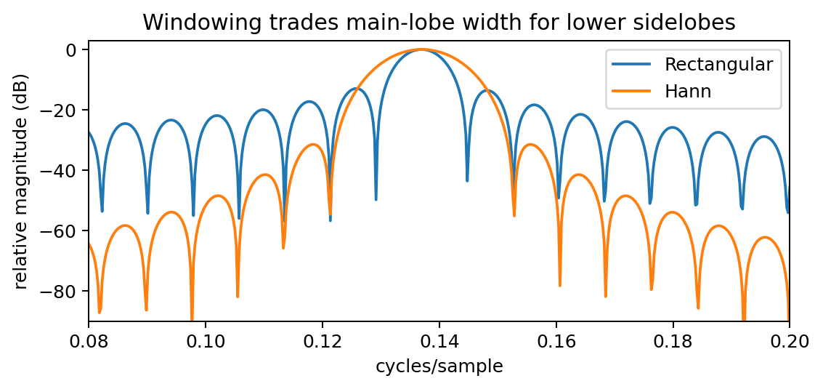
Why a tone leaks into nearby bins
PERIODOGRAM
0:45–0:50
Finite record = windowing
Observing only N samples multiplies the infinite process by a finite window. In frequency, that becomes convolution with the window spectrum.
Trade-off
Tapered windows reduce sidelobes (leakage) but widen the main lobe, reducing the ability to separate nearby tones.
WEEK 9 • SPECTRAL ESTIMATION

Slide 11
Resolution: what increasing N really improves
PERIODOGRAM
0:50–0:55
FFT-bin spacing for N samples at Fₛ:
Common misconception
Δf = Fₛ / N
“More FFT points” can mean zero-padding, which only interpolates the plotted spectrum. It does not create new information.
Longer records give a finer frequency grid.
Longer observation also narrows the rectangular-window main lobe.
But a raw periodogram does not become statistically smooth just because N is large.
WEEK 9 • SPECTRAL ESTIMATION

Slide 12
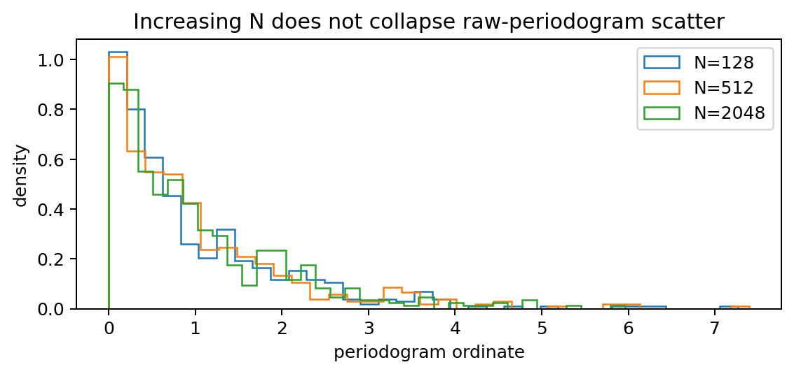
Why the raw periodogram is inconsistent
STATISTICAL FLAW
0:55–1:03
Consistency requires the estimator variance to vanish as N → ∞.
White Gaussian noise intuition
At a non-DC Fourier bin, the DFT coefficient remains random. Its squared magnitude is approximately exponential, so relative scatter stays large.
For an idealized white-noise bin: E{I} ≈ σ², Var{I} ≈ σ⁴
Coefficient of variation ≈ 1 — it does not shrink with N.
WEEK 9 • SPECTRAL ESTIMATION

Slide 13
What “inconsistent” does—and does not—mean
STATISTICAL FLAW
1:03–1:08
It does mean
It does not mean
The raw periodogram at a fixed frequency remains noisy across repeated realizations; its variance does not generally tend to zero.
The periodogram is useless. It can reveal strong tones, and it is the building block for lower-variance estimators such as Bartlett and Welch.
Estimator design question:
Can we trade some frequency resolution for lower variance by averaging?
That is exactly what Lecture 18 does.
WEEK 9 • SPECTRAL ESTIMATION

Slide 14
Concept check: two records of the same process
CONCEPT CHECK
1:08–1:12
Two long records come from the same zero-mean WSS process. Their raw periodograms look noticeably different.
Is that evidence that the process PSD changed?
Good answer
Not necessarily. A periodogram is itself random and has high variance. We need averaging or confidence reasoning before attributing differences to the underlying process.
WEEK 9 • SPECTRAL ESTIMATION

Slide 15
Coding demo: four things to verify
DEMO
1:12–1:14
1. Estimate white-noise autocorrelation and compare its PSD with a flat theoretical spectrum.
2. Filter white noise and verify Syy follows |H|².
3. Repeat many periodograms and observe that the scatter remains large as N grows.
4. Change only the FFT zero-padding and distinguish smoother plotting from true resolution.
Notebook
Week9_Spectral_Estimation_DSP_ML_Demos.ipynb reproduces these experiments with NumPy/SciPy.
WEEK 9 • SPECTRAL ESTIMATION

Slide 16
Lecture 17 wrap-up
WRAP-UP
1:14–1:15
Wiener–Khinchin: PSD and autocorrelation are a DTFT pair.
LTI systems reshape PSD by |H|².
A periodogram is a finite-record PSD estimate based on |FFT|².
Longer records improve frequency detail, but raw-periodogram variance remains high.
Averaging periodograms is the next step.
Exit ticket
Why does a longer record not automatically make a raw periodogram a low-variance PSD estimator?
WEEK 9 • SPECTRAL ESTIMATION

