Slide 1
WEEK 9 ● LECTURE 18
Non-Parametric Spectral Estimation
Bartlett, Welch, and the resolution–variance trade-off
Oppenheim & Schafer • Random processes / spectral analysis | Raschka • ML feature pipelines

Slide 2
Learning objectives
ROADMAP
0:00–0:03
Explain how averaging periodograms reduces estimator variance.
Construct Bartlett and Welch PSD estimates from finite data.
Explain what segmentation, window choice, and overlap each change.
Reason quantitatively about resolution versus variance.
Convert Welch PSDs into stable features for classical ML.
Core question
How much frequency detail are we willing to trade for a PSD estimate that is statistically more stable?
WEEK 9 • SPECTRAL ESTIMATION

Slide 3
The central trick: average noisy estimates
BARTLETT
0:03–0:08
One periodogram:
But where do K estimates come from?
high frequency detail + high variance
Split one long record into shorter segments. That gains averaging at the cost of shorter observation length per estimate.
Average K approximately independent periodograms:
variance roughly decreases like 1/K
WEEK 9 • SPECTRAL ESTIMATION

Slide 4
Bartlett’s method
BARTLETT
0:08–0:15
1. Split N samples into K non-overlapping segments of length L = N/K.
2. Compute a periodogram Iₖ(f) for each segment.
3. Average them:
Ŝ_B(f) = (1/K) Σₖ₌₀ᴷ⁻¹ Iₖ(f)
Trade-off
L smaller → more segments K → lower variance, but coarser frequency resolution.
WEEK 9 • SPECTRAL ESTIMATION

Slide 5
Bartlett: count the arithmetic and the information
BARTLETT
0:15–0:20
Example: N = 4096 samples
Compare with full record
K = 8 ⇒ L = 512 samples per segment
The 4096-sample periodogram has ~0.244 Hz bin spacing. Bartlett gives up that fine grid to obtain 8 estimates to average.
At Fₛ = 1000 Hz:
nominal bin spacing = Fₛ/L ≈ 1.95 Hz
WEEK 9 • SPECTRAL ESTIMATION

Slide 6
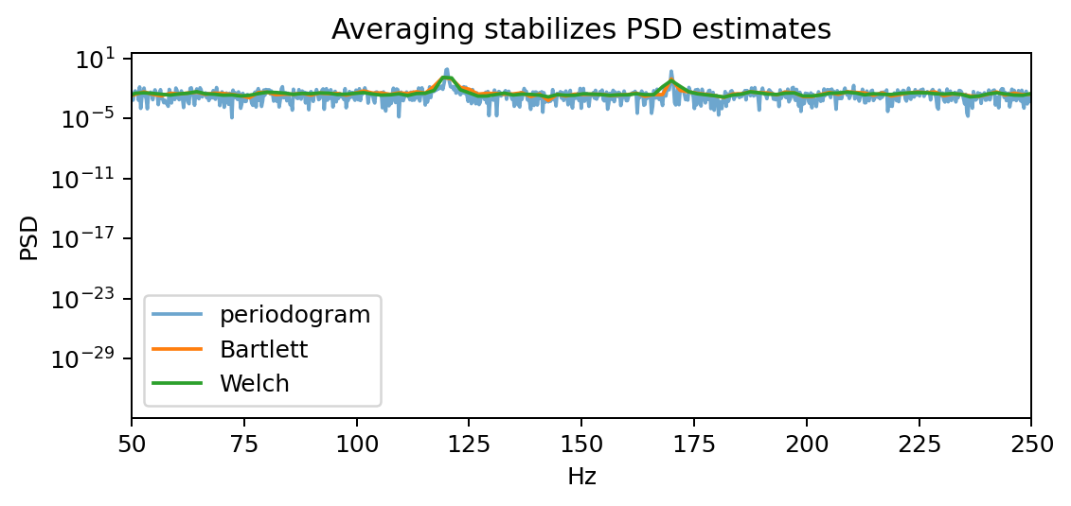
Periodogram vs. Bartlett vs. Welch
METHOD COMPARISON
0:20–0:24
What changes?
Periodogram is detailed but jagged. Bartlett is smoother. Welch adds tapering and overlap, typically yielding a stable practical estimate.
Do not interpret “smoother” as automatically “more accurate” at every frequency.
WEEK 9 • SPECTRAL ESTIMATION

Slide 7
Why Welch improves on Bartlett
WELCH
0:24–0:30
Use overlapping segments instead of disjoint segments.
Apply a tapering window to each segment before the FFT.
Normalize for window power so the PSD scale remains meaningful.
Average the modified periodograms.
Two goals
Windowing controls leakage. Overlap recovers more averaging opportunities after tapering discards weight near segment edges.
WEEK 9 • SPECTRAL ESTIMATION

Slide 8
Welch’s estimator: algorithm view
WELCH
0:30–0:36
For segment k with window w[n]:
Implementation
Xₖ(f) = Σₙ w[n] xₖ[n] e⁻ʲ2πfn/Fₛ
scipy.signal.welch handles window normalization, one-sided scaling, overlap, and FFT details.
Modified periodogram:
Iₖ(f) ∝ |Xₖ(f)|² / Σₙ w²[n]
Then average Iₖ(f) across segments.
WEEK 9 • SPECTRAL ESTIMATION

Slide 9
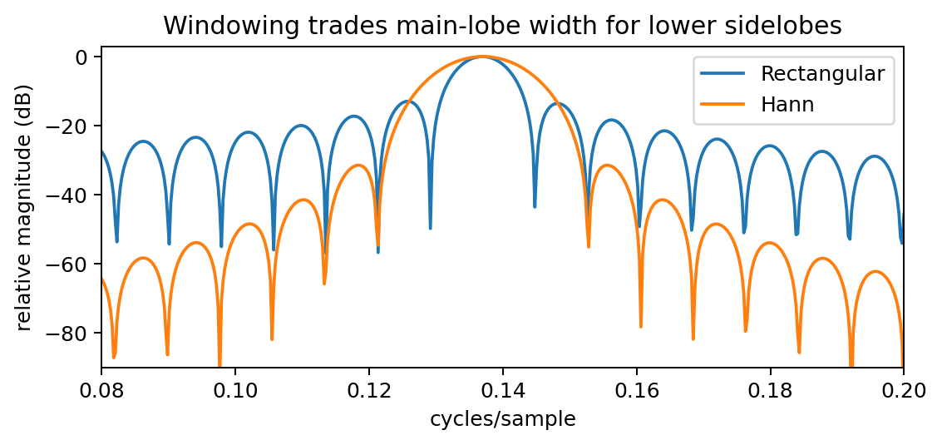
Window choice: leakage versus resolution
WELCH
0:36–0:42
Rectangular
Narrower main lobe, but high sidelobes. Good resolution for bin-centered tones; poor leakage behavior otherwise.
Hann / Hamming
Lower sidelobes and better leakage control, but wider main lobes. Nearby spectral features can blur together.
WEEK 9 • SPECTRAL ESTIMATION

Slide 10
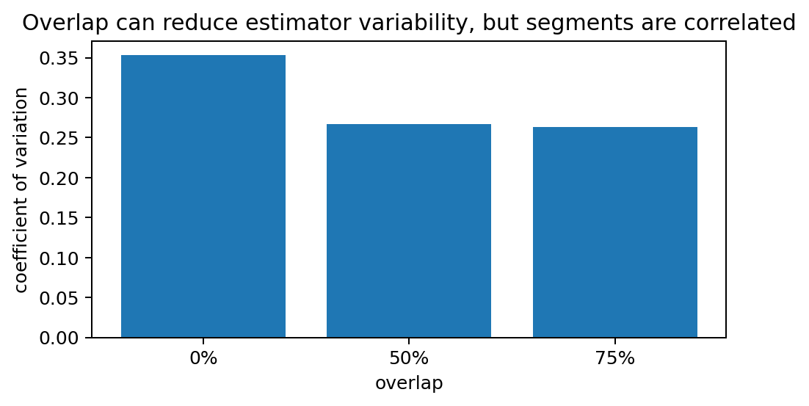
Overlap: more segments, not more independent data
WELCH
0:42–0:47
0% overlap: fewer, more nearly independent segments.
50% overlap: common with Hann; reuses samples while shifting the window support.
75% overlap: even more estimates, but substantial correlation between neighboring segments.
Key nuance
Variance reduction is not exactly 1/K when segments overlap because the estimates are correlated.
WEEK 9 • SPECTRAL ESTIMATION

Slide 11
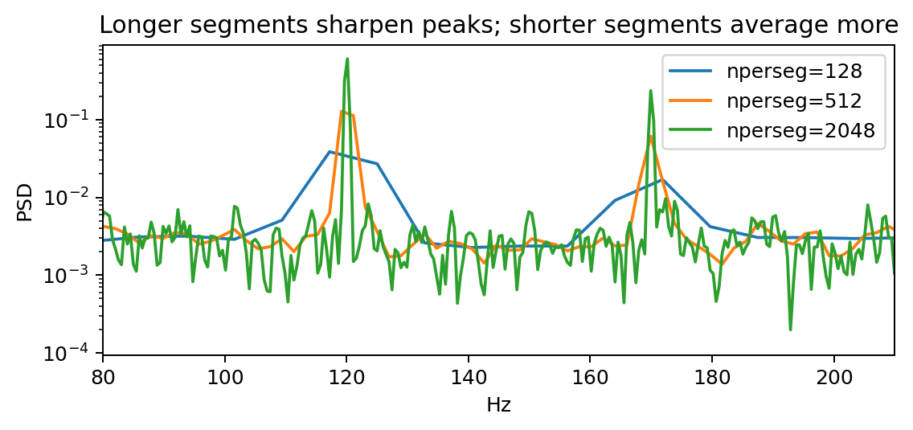
Segment length controls the main trade-off
RESOLUTION vs VARIANCE
0:47–0:53
Long segments
Sharper peaks and finer frequency detail, but fewer averages → higher estimator variance.
Short segments
More averages and smoother PSD, but broad peaks and reduced ability to separate nearby components.
WEEK 9 • SPECTRAL ESTIMATION

Slide 12
A quantitative design recipe
RESOLUTION vs VARIANCE
0:53–0:58
Start from the frequency detail you need.
Choose segment length L so Fₛ/L is comfortably smaller than the separation of important features.
Then choose a window and overlap.
Window: leakage suppression versus main-lobe width.
Overlap: number of averaged segments versus correlation/computation.
Validate on repeated records, not just one aesthetically smooth PSD.
Rule of thumb, not law
50% overlap with a Hann window is a strong default, but the signal and objective should determine the final design.
WEEK 9 • SPECTRAL ESTIMATION

Slide 13
Concept check: two close tones in noise
CONCEPT CHECK
0:58–1:02
You must distinguish tones at 120 Hz and 126 Hz in noisy data sampled at 1 kHz.
Which change is most likely to help?
A. Shorter Welch segments
B. Longer Welch segments
C. More zero-padding only
D. Heavier smoothing across frequency
Good answer: B
Longer segments provide narrower spectral main lobes and better true frequency resolution. Zero-padding alone only samples the same spectral estimate more densely.
WEEK 9 • SPECTRAL ESTIMATION

Slide 14
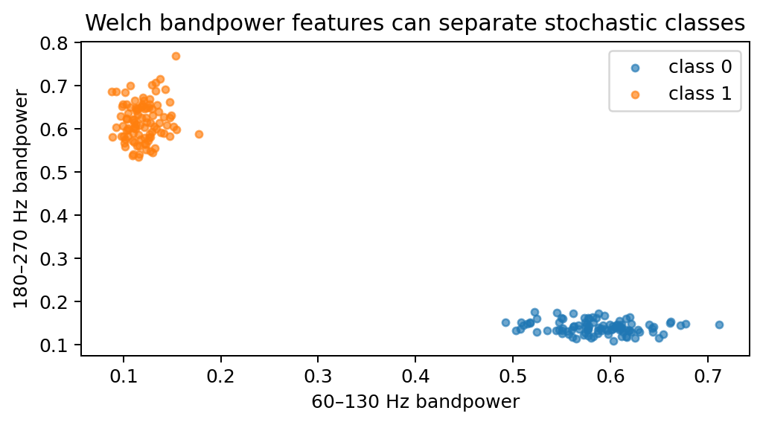
PSD as an ML feature map
ML BRIDGE
1:02–1:07
Raw waveform → Welch PSD → band powers / spectral shape → classifier
Welch features average away nuisance sample-to-sample randomness.
Bandpower compresses hundreds of PSD bins into interpretable features.
StandardScaler + SVM or Random Forest can then operate on stable vectors.
Caution
PSD features intentionally discard phase and precise time localization. That may be desirable—or fatal—depending on the task.
WEEK 9 • SPECTRAL ESTIMATION

Slide 15
Example ML pipeline
ML BRIDGE
1:07–1:11
For each record:
1. Compute Welch PSD with a fixed analysis configuration.
2. Integrate power in physically meaningful frequency bands.
3. Optionally add spectral centroid, roll-off, or log-band powers.
4. Standardize features using training data only.
5. Train SVM / logistic regression / random forest and cross-validate.
Leakage in ML can be literal
Never compute normalization statistics using the test set. Signal-processing leakage and data-set leakage are different problems—but both invalidate conclusions.
WEEK 9 • SPECTRAL ESTIMATION

Slide 16
Coding demo: design Welch instead of just calling it
DEMO
1:11–1:14
Compare custom Bartlett and scipy.signal.welch.
Sweep nperseg and observe peak separation versus smoothness.
Sweep overlap and measure repeated-estimate variability.
Build Welch bandpower features and train an SVM/Random Forest.
Student prediction first
Before running each cell, ask which curve should be smoother, which should resolve the tones better, and why.
The goal is estimator reasoning—not memorizing one “best” Welch configuration.
WEEK 9 • SPECTRAL ESTIMATION

Slide 17
Lecture 18 wrap-up
WRAP-UP
1:14–1:15
Bartlett reduces variance by averaging non-overlapping periodograms.
Welch adds windows and overlap for better leakage control and practical averaging.
Segment length is the primary resolution–variance knob.
Overlap helps, but overlapping segments are correlated.
Stable PSD summaries can be strong classical-ML features.
Exit ticket
If a Welch PSD looks too noisy, name one change that reduces variance and state the price you pay.
WEEK 9 • SPECTRAL ESTIMATION

