Slide 1

ECEN 4/5632 Theory and Application of Digital Filters
Lecture 7, 9-15-26
Peter Mathys*
* With generous help from Gemini Pro and ChatGPT

Slide 2
WEEK 4 ● LECTURE 7
FIR Filter Design, Windowing,
& 1D Convolutions
From ideal frequency responses to fixed or learnable convolution kernels
FIR / phase
→
ideal LPF
→
window method
→
Conv1d
75 minutes • senior + first-year graduate ECE
Oppenheim & Schafer + Raschka

Slide 3
ROADMAP
Where this 75-minute lecture is going
0–10 min • FIR vs. IIR
10–30 min • Ideal filter + Gibbs
30–55 min • Window method
55–75 min • DSP ↔ PyTorch
Linear phase, group delay, and why waveform alignment can matter.
Derive the sinc impulse response and see what truncation does.
Main-lobe width versus sidelobe attenuation.
Implement fixed FIR taps with Conv1d; then ask what changes when weights are learned.
DSP bridge: a mathematically designed FIR and a neural 1-D convolution use the same sliding weighted sum.
Classical DSP supplies structure and constraints; machine learning either reuses that structure or learns parameters inside it.
DSP + Machine Learning • Lectures 7–8
Oppenheim & Schafer + Raschka
2

Slide 4
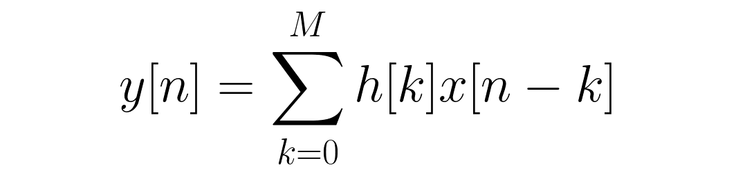



FIR VS. IIR
Same frequency-selective goal, different structures
FIR: feedforward
IIR: recursive
ML perspective
Finite impulse response. No feedback. Exact linear phase is available when the taps have the required symmetry.
Feedback permits sharp magnitude responses with fewer coefficients, but phase is generally nonlinear.
A fixed FIR can be the front end of an ML pipeline; a Conv1d layer uses the same local weighted sum but can make the coefficients trainable.
Do not oversell linear phase: it is valuable when temporal alignment and waveform shape should be preserved, but not every ML task requires it.
DSP + Machine Learning • Lectures 7–8
Oppenheim & Schafer + Raschka
3

Slide 5

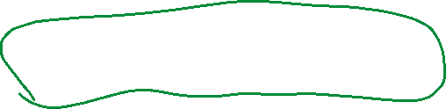






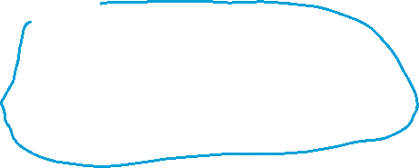





Slide 6

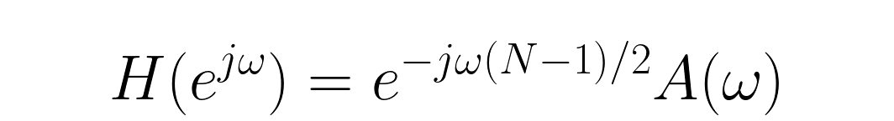
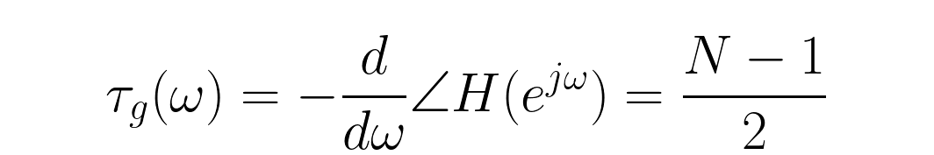


LINEAR PHASE
Symmetric FIR taps give a constant delay
Physical interpretation
Every passband frequency component is delayed by the same number of samples, apart from sign-related phase jumps where the real amplitude term changes sign.
ML connection
If a transient shape is a feature, constant delay avoids frequency-dependent smearing before MFCCs, peaks, onsets, or time-localized descriptors are computed.
DSP + Machine Learning • Lectures 7–8
Oppenheim & Schafer + Raschka
4

Slide 7



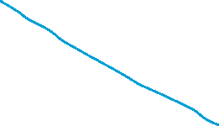





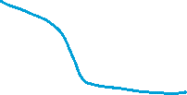

Slide 8
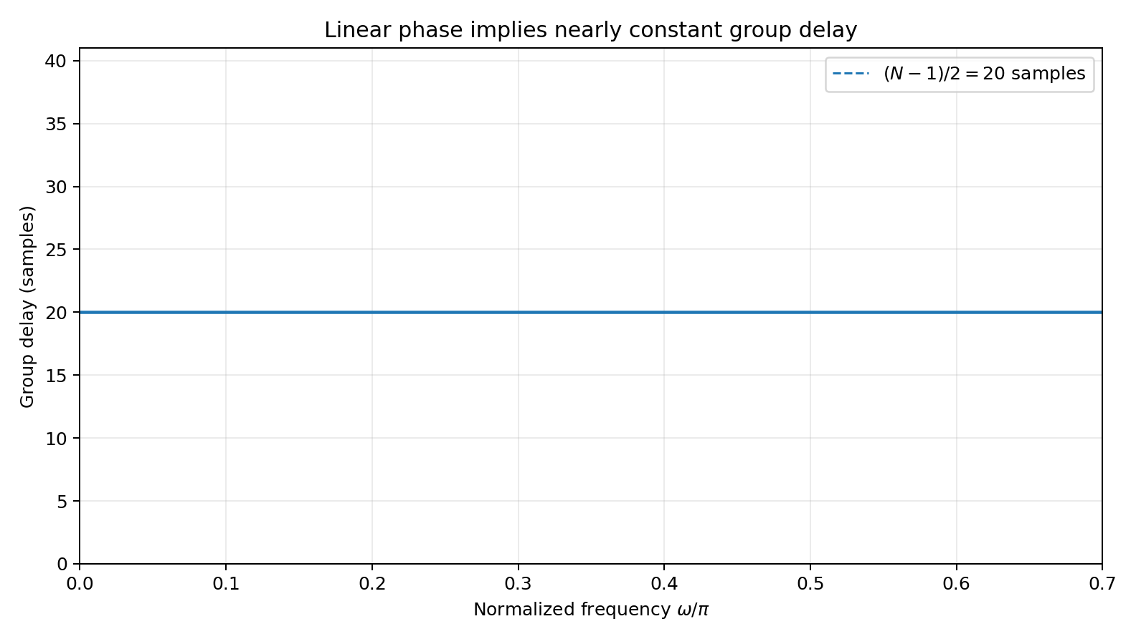



LINEAR PHASE
Group delay is the more intuitive diagnostic
Read the plot
For a 41-tap symmetric FIR, the expected delay is
Good answer
“Linear phase does not mean zero delay. It means a delay that is approximately constant with frequency.”
DSP + Machine Learning • Lectures 7–8
Oppenheim & Schafer + Raschka
5

Slide 9
CONCEPT CHECK
What would nonlinear phase do to a transient?
Question
Two filters have nearly identical magnitude responses. One has constant group delay; the other has strongly frequency-dependent group delay. What can differ at the output?
Good answer
Strong answer
The spectra can have almost the same magnitudes while the waveform shapes differ because frequency components arrive with different delays.
That distortion can alter time-localized features such as onset shape or peak timing. Whether it harms an ML model depends on what features and invariances the model uses.
DSP + Machine Learning • Lectures 7–8
Oppenheim & Schafer + Raschka
6

Slide 10
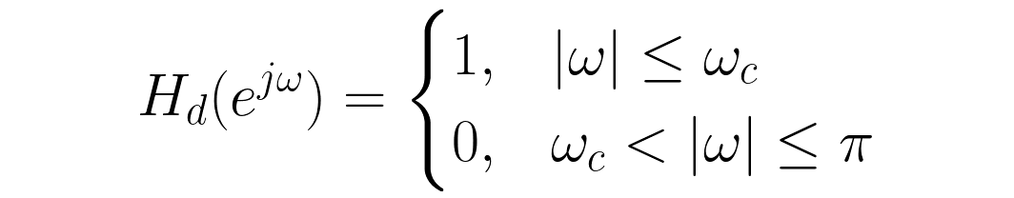
IDEAL LOWPASS
Start in the frequency domain
1
−ωc
ωc
Engineering dream
Reality
Perfectly flat passband, zero stopband, and an infinitely sharp transition.
The price is an infinite-duration, noncausal impulse response.
DSP + Machine Learning • Lectures 7–8
Oppenheim & Schafer + Raschka
7

Slide 11
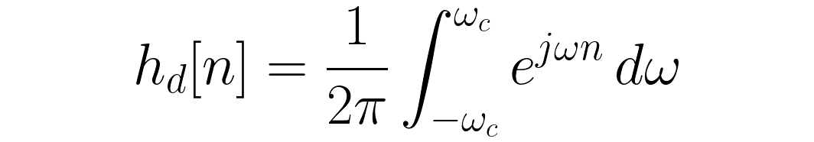
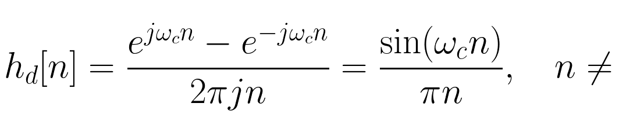


IDEAL LOWPASS
Inverse DTFT produces the sinc impulse response
Interpretation
A brick-wall frequency response requires a sinc extending forever in both time directions.
Senior/grad expectation
Students should be able to derive the sinc from the inverse DTFT, not only quote the result.
DSP + Machine Learning • Lectures 7–8
Oppenheim & Schafer + Raschka
8

Slide 12
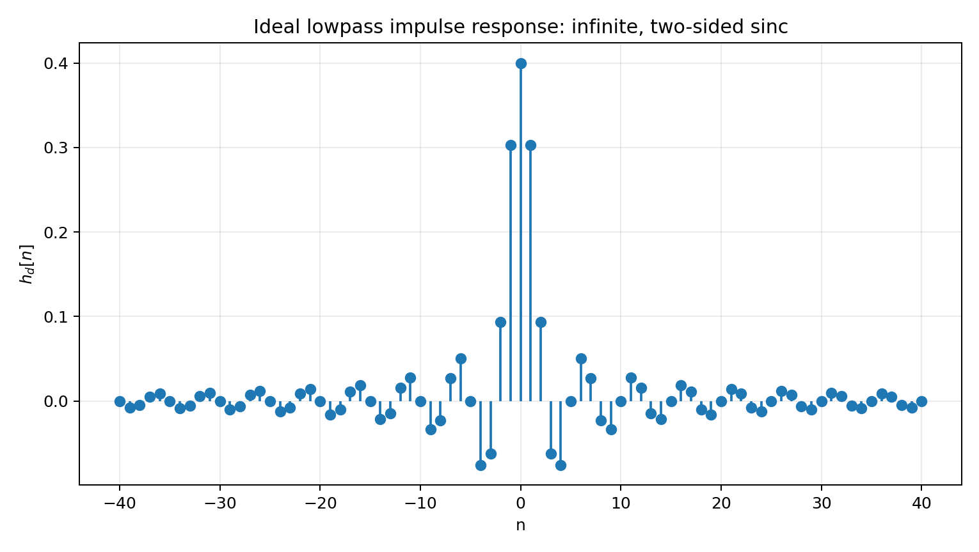
IDEAL LOWPASS
The ideal impulse response is infinite and two-sided
Problem 1: infinite length
A finite processor cannot store or multiply by infinitely many taps.
Problem 2: noncausal
Samples for negative time imply dependence on future inputs unless we delay/shift the finite approximation.
What we will do
Truncate the sinc, shift it to be causal, and shape the truncation with a window.
DSP + Machine Learning • Lectures 7–8
Oppenheim & Schafer + Raschka
9

Slide 13


FINITE FIR
Center first, then shift to a causal tap sequence
Example
For N = 51 taps, M = 50 and the delay is 25 samples.
For an FIR of order M with M+1 taps, centering the ideal response at M/2 gives the symmetry needed for linear phase.
Important
The shift changes phase, not magnitude. We are making the finite approximation causal by accepting a fixed delay.
DSP + Machine Learning • Lectures 7–8
Oppenheim & Schafer + Raschka
10

Slide 14

GIBBS PHENOMENON
Rectangular truncation is simple—but its sidelobes are not
A common misconception: “make the filter longer and the Gibbs ripple disappears.”
Time-domain action
A longer rectangular window makes the ripple region narrower, but the limiting peak overshoot near the discontinuity does not go to zero.
The rectangular window keeps a finite block of sinc samples and sets everything else to zero.
Frequency-domain consequence
Abrupt truncation has strong sidelobes. Convolution with the rectangular-window spectrum creates oscillatory passband/stopband ripple.
DSP + Machine Learning • Lectures 7–8
Oppenheim & Schafer + Raschka
11

Slide 15
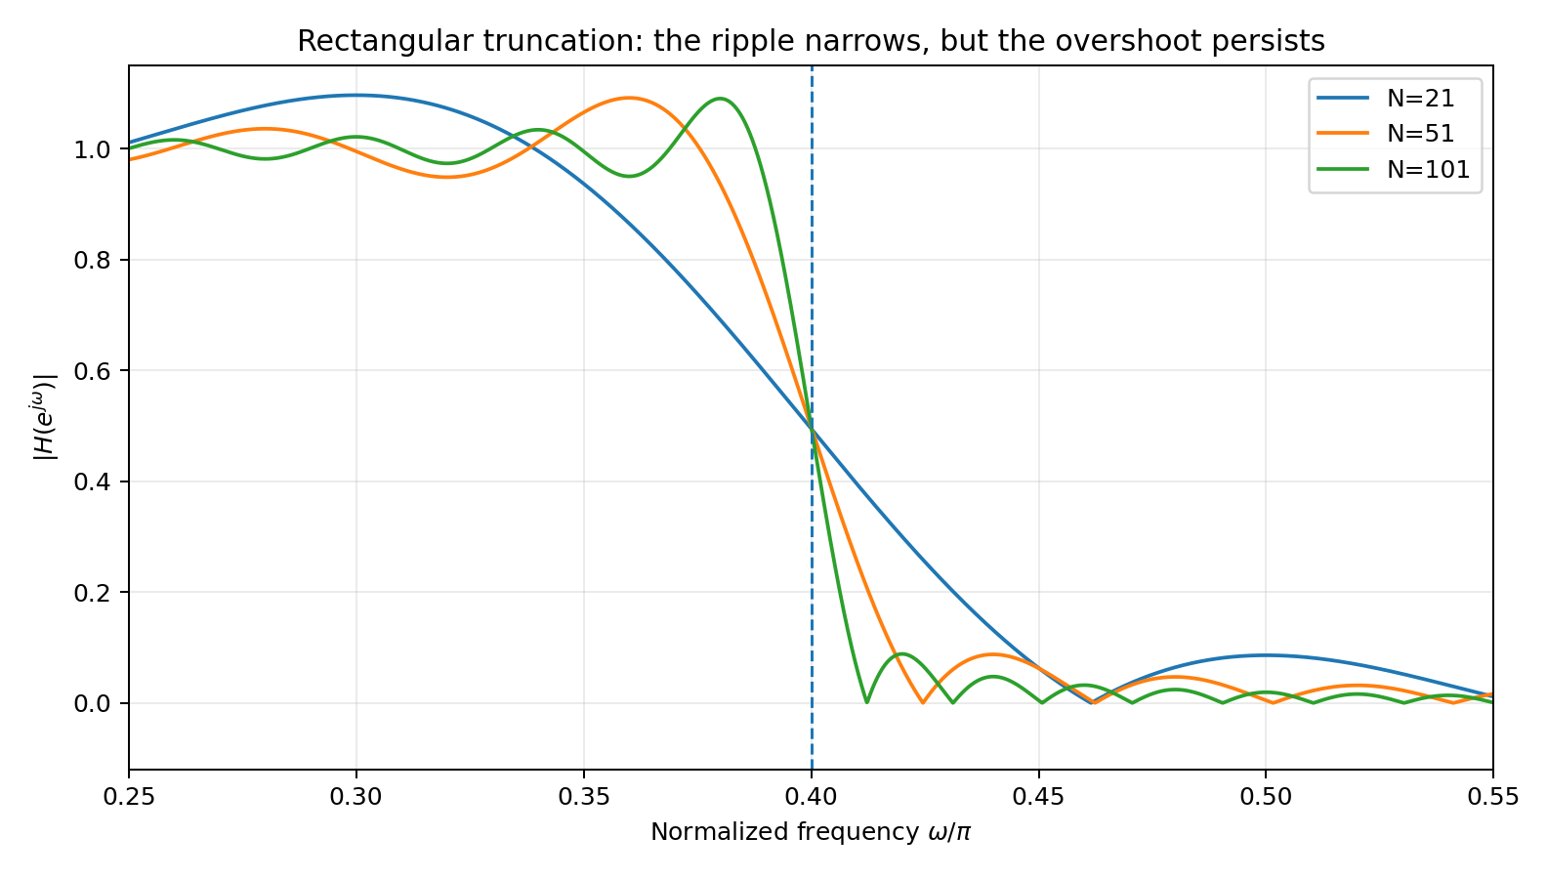

GIBBS PHENOMENON
Increasing length narrows the transition but does not eliminate overshoot
Read the plot
As N increases, the oscillation is compressed toward the cutoff.
But notice
The peak overshoot remains visible. Length and sidelobe level are different design knobs.
Next step
Use a smoother window to reduce sidelobes—accepting a wider transition.
DSP + Machine Learning • Lectures 7–8
Oppenheim & Schafer + Raschka
12

Slide 16
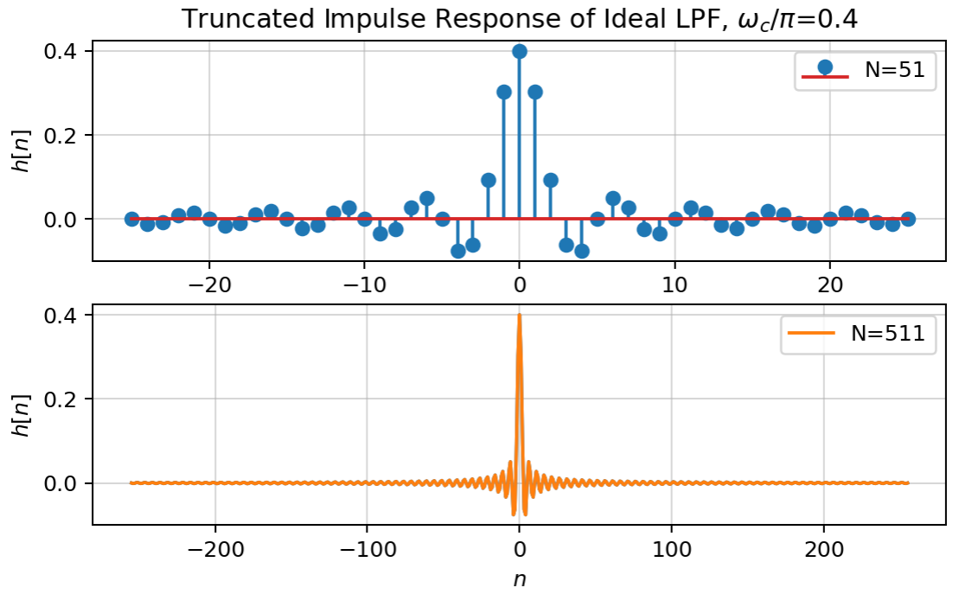
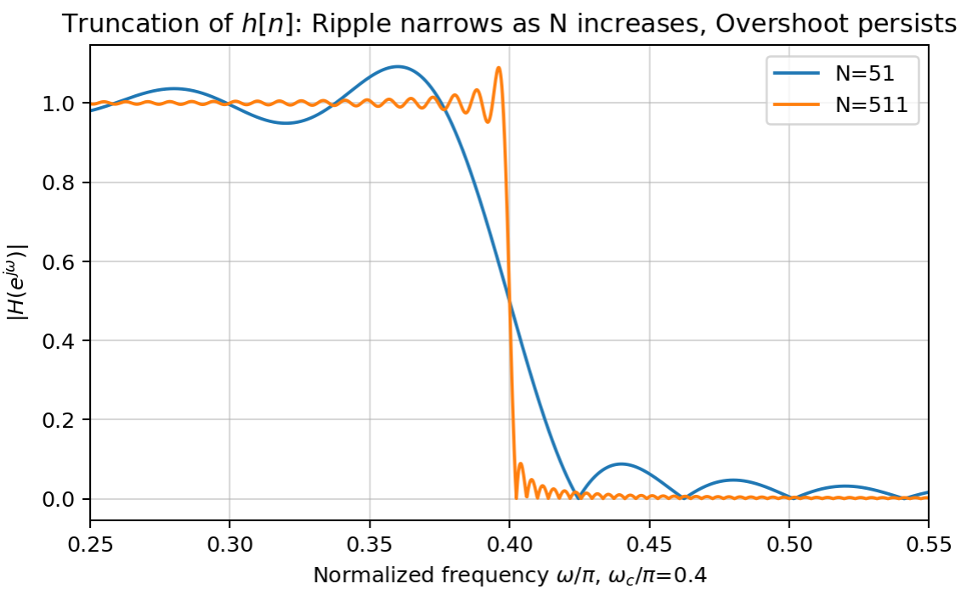
Gibbs’ Phenomenon

Slide 17

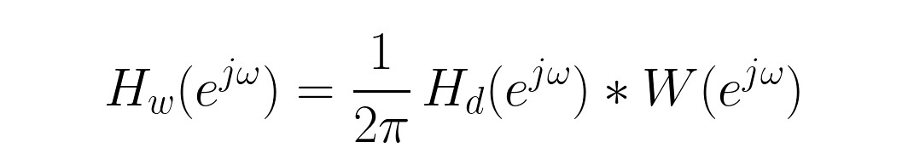
WINDOW METHOD
Shape the truncation instead of switching it off abruptly
Key duality
Multiplication in time corresponds to periodic convolution in frequency.
Design intuition
A smoother time-domain taper lowers spectral sidelobes but broadens the window main lobe, which broadens the filter transition band.
DSP + Machine Learning • Lectures 7–8
Oppenheim & Schafer + Raschka
13

Slide 18
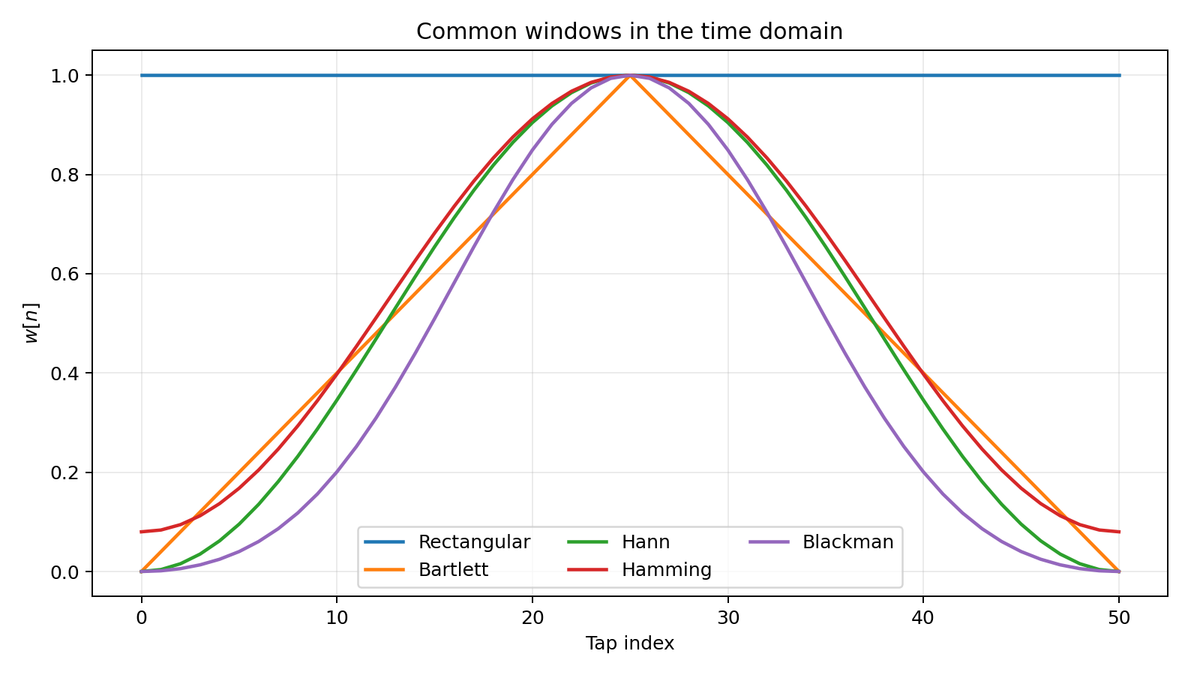
WINDOWS
Rectangular → Bartlett → Hann/Hamming → Blackman
Rectangular
Hardest edges; narrowest main lobe; high sidelobes.
Hann / Hamming
Smooth taper. Hamming is designed for a particularly low first sidelobe.
Blackman
Stronger taper and lower sidelobes, but a wider main lobe / transition.
“Hann” is the standard name; “Hanning” is common informal usage.
DSP + Machine Learning • Lectures 7–8
Oppenheim & Schafer + Raschka
14

Slide 19
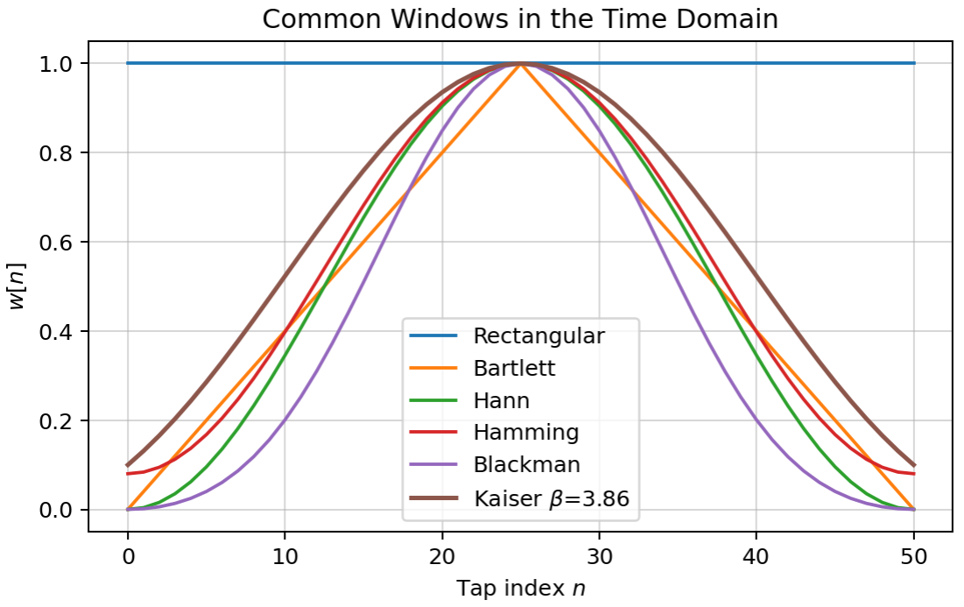
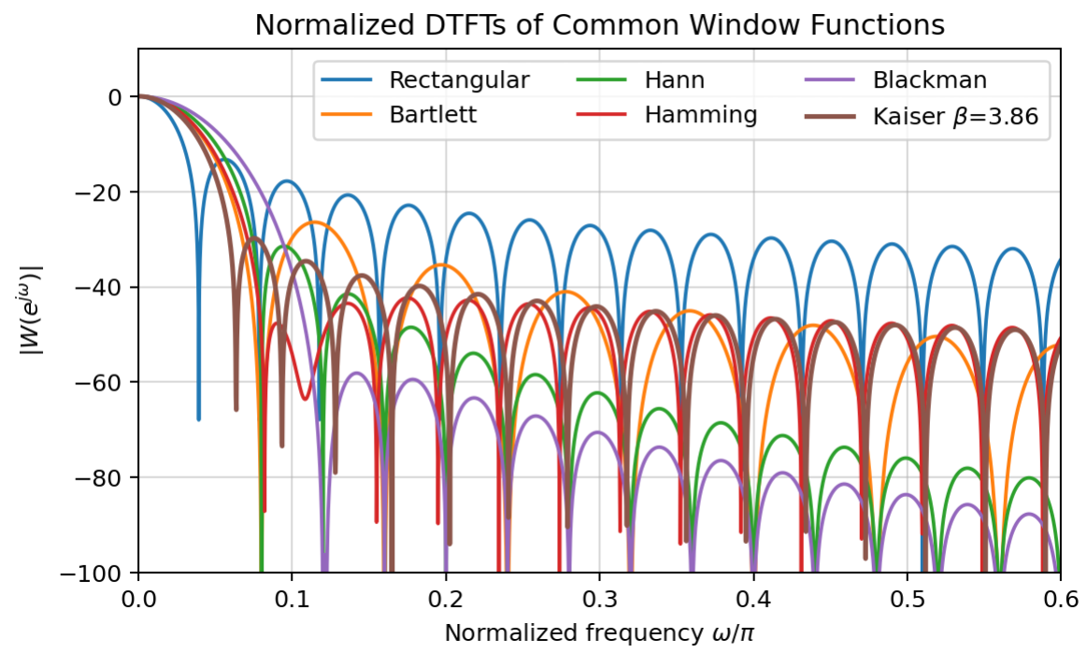
Window Functions in Time and Frequency, N=51

Slide 20
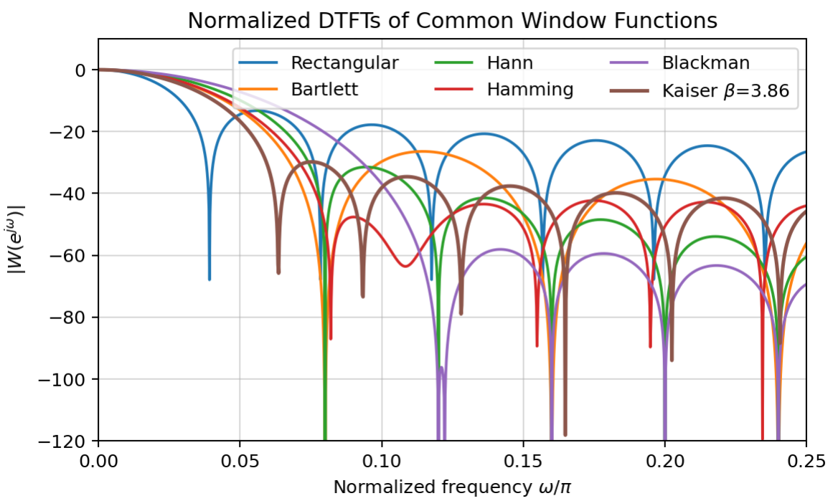
Window Functions in Time and Frequency, N=51

Slide 21
WINDOW TRADEOFF
Main-lobe width versus sidelobe attenuation
Window
Approx. first sidelobe
Approx. main-lobe width*
Use when...
Rectangular
≈ −13 dB
≈ 4π/N
Narrow transition dominates
Bartlett
≈ −26 dB
≈ 8π/N
Simple triangular taper
Hann
≈ −31 dB
≈ 8π/N
Balanced spectral leakage
Hamming
≈ −43 dB
≈ 8π/N
Better first sidelobe suppression
Blackman
≈ −58 dB
≈ 12π/N
Strong stopband suppression
*Width between the first nulls; approximate asymptotic rules for equal window length.
Good answer
There is no universally “best” window. The specification decides how much transition width can be traded for stopband suppression.
DSP + Machine Learning • Lectures 7–8
Oppenheim & Schafer + Raschka
15

Slide 22
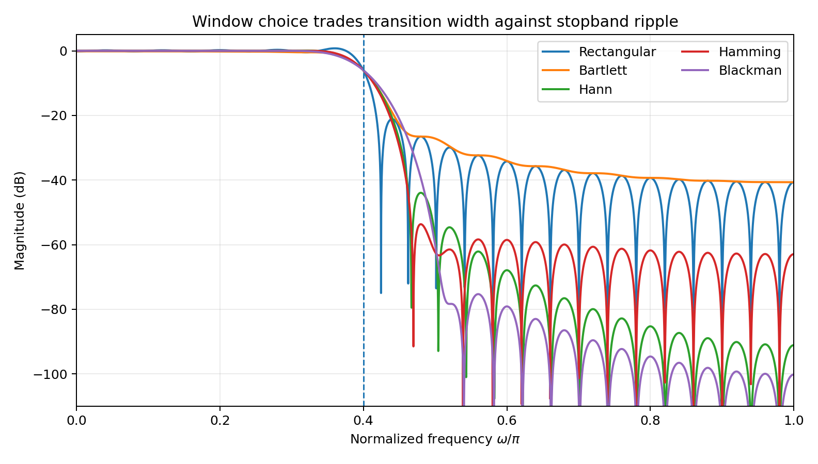
WINDOW TRADEOFF
Same length and cutoff; different transition/ripple behavior
Rectangular
Sharpest transition, worst sidelobes.
Hamming
A common compromise: wider transition, much lower first sidelobe.
Blackman
Strongest attenuation here, but broadest transition.
DSP + Machine Learning • Lectures 7–8
Oppenheim & Schafer + Raschka
16

Slide 23
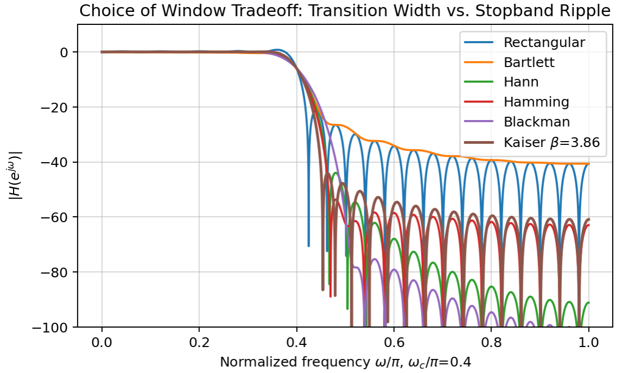
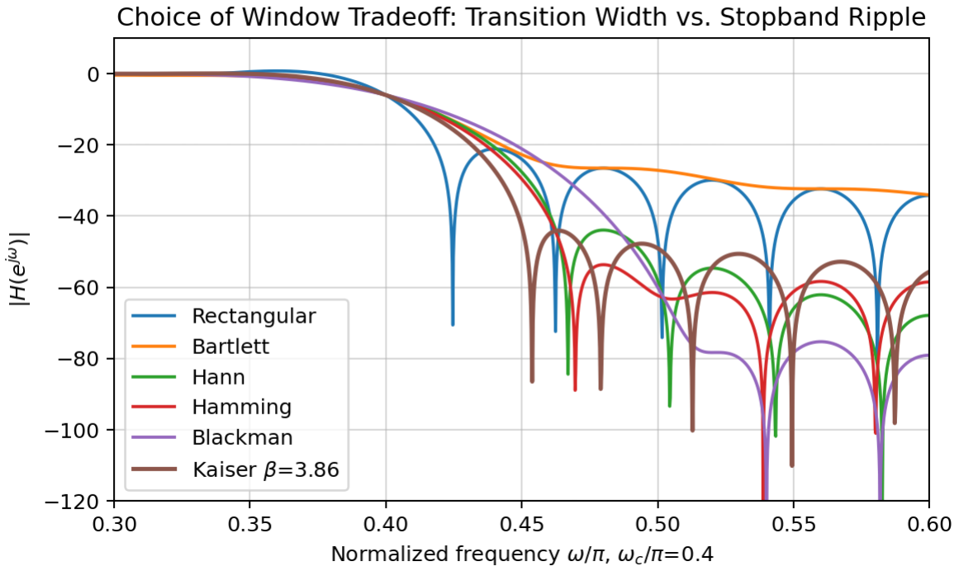
Truncated and Windowed Ideal LPF, N=51, $ω_{c}=0.4π$

Slide 24








DESIGN EXAMPLE
A practical 51-tap Hamming lowpass
Specification sketch
Why Hamming?
We accept a somewhat wider transition in exchange for much better sidelobe rejection than rectangular truncation.
DSP + Machine Learning • Lectures 7–8
Oppenheim & Schafer + Raschka
17

Slide 25


FILTER LENGTH
Longer FIRs buy a narrower transition—at a cost
Increase N
But pay for it
ML viewpoint
More taps generally narrow the transition for the same window family.
More multiplies, more memory, and larger linear-phase delay
A longer convolution kernel also means a larger temporal receptive field and more learned parameters if the kernel is trainable.
DSP + Machine Learning • Lectures 7–8
Oppenheim & Schafer + Raschka
18

Slide 26
CONCEPT CHECK
Choose the design knob that matches the problem
A • Prompt
B • Prompt
C • Prompt
Stopband leakage is unacceptable, but transition width may be wider.
Transition must be very narrow, but moderate ripple is acceptable.
The filtered waveform must maintain relative timing across the passband.
DSP + Machine Learning • Lectures 7–8
Oppenheim & Schafer + Raschka
19

Slide 27
CONCEPT CHECK
Choose the design knob that matches the problem
A • Prompt
B • Prompt
C • Prompt
Stopband leakage is unacceptable, but transition width may be wider.
Transition must be very narrow, but moderate ripple is acceptable.
The filtered waveform must maintain relative timing across the passband.
Good answer
Good answer
Good answer
Choose a stronger taper such as Blackman or increase length.
Rectangular can give a narrower main lobe for the same N; increasing N is another option.
Use a linear-phase FIR or another phase-preserving strategy.
DSP + Machine Learning • Lectures 7–8
Oppenheim & Schafer + Raschka
19

Slide 28
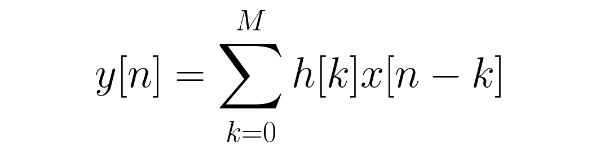

DSP ↔ PYTORCH
A 1-D convolution is a sliding dot product
DSP view
ML view
The impulse response h[k] is designed to satisfy magnitude/phase specifications.
The same local dot product becomes a layer. The kernel may be initialized from DSP knowledge or learned from data.
DSP + Machine Learning • Lectures 7–8
Oppenheim & Schafer + Raschka
20

Slide 29






Slide 30
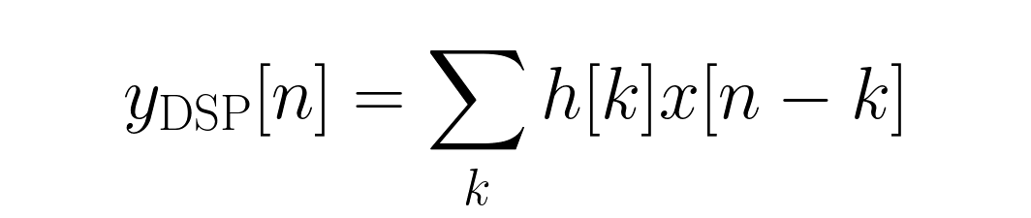


PYTORCH DETAIL
Conv1d uses cross-correlation ordering
To reproduce textbook causal FIR
Left-pad by M samples and reverse the coefficient order before calling Conv1d.
(Local-window correlation)
Good answer
The operation is not “wrong convolution”; deep-learning libraries use a correlation convention because the kernel is usually learned anyway.
DSP + Machine Learning • Lectures 7–8
Oppenheim & Schafer + Raschka
21

Slide 31
IMPLEMENTATION
Fixed FIR taps inside PyTorch
h = torch.tensor(h_np, dtype=torch.float32)
x = torch.tensor(x_np).view(1, 1, -1)
# causal textbook convolution
kernel = h.flip(0).view(1, 1, -1)
x_pad = F.pad(x, (len(h)-1, 0))
y = F.conv1d(x_pad, kernel)
Shape
Input is (N,C,L). A single mono signal is (1,1,L).
Fixed weights
Use a tensor or freeze a Conv1d layer so the taps do not receive gradient updates.
Learnable weights
Leave requires_grad=True and the same coefficients become trainable model parameters.
DSP + Machine Learning • Lectures 7–8
Oppenheim & Schafer + Raschka
22

Slide 32

TENSOR SHAPES
Batch, channel, and length carry physical meaning
N • Batch
C • Channel
L • Length
Independent clips/examples processed together.
Mono, stereo, microphones, sensors, or learned feature maps.
Discrete-time sample index / temporal extent.
Example: 32 stereo one-second clips at 16 kHz → (32, 2, 16000)
DSP + Machine Learning • Lectures 7–8
Oppenheim & Schafer + Raschka
23

Slide 33
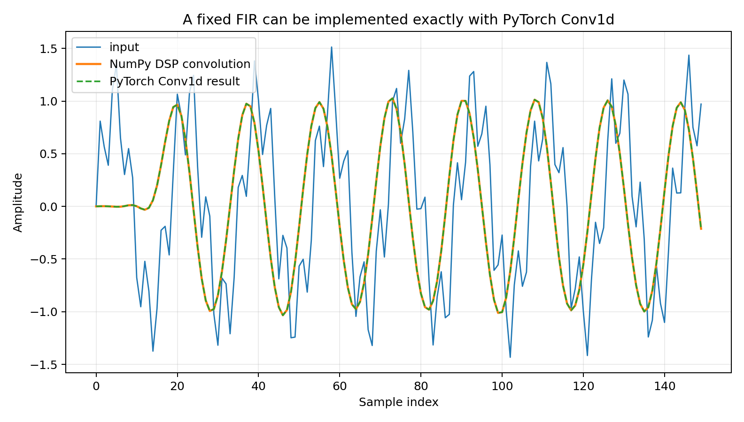
DEMONSTRATION
NumPy convolution and PyTorch Conv1d agree
Numerical check
The supplied script reports a maximum mismatch on the order of 10⁻⁷ in float32.
Teaching point
Same filter, same signal-processing operation. The distinction is whether the coefficients are fixed by design or optimized from data.
DSP + Machine Learning • Lectures 7–8
Oppenheim & Schafer + Raschka
24

Slide 34
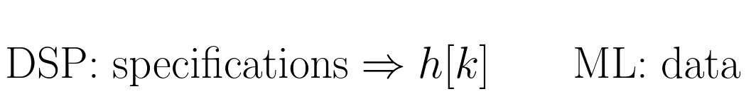
DSP ↔ ML
Designed taps versus learned taps
Classical FIR design
Hybrid approach
Fully learned convolution
Choose desired H(e^{jω}) → derive ideal h[n] → truncate/window → verify specifications.
Initialize Conv1d with a known bandpass/lowpass/filterbank and optionally fine-tune it.
Choose kernel size and channels; backpropagation learns coefficients that reduce task loss.
The arithmetic is the same local weighted sum; the source of the weights is what changes.
DSP + Machine Learning • Lectures 7–8
Oppenheim & Schafer + Raschka
25

Slide 35
CONTEXT
Translate the classical vocabulary into ML vocabulary
DSP concept
Mathematical role
ML connection
FIR filter
feedforward delay line
Conv1d with fixed or learnable kernel
Tap h[k]
impulse-response coefficient
kernel / weight
Window
controls truncation spectrum
inductive constraint on kernel support; not the same as ML regularization
Linear phase
constant group delay
preserves relative temporal alignment
Filter length
transition width + delay
receptive field + parameter count
Nuance: a classical window is a deterministic spectral-design device; calling it “kernel regularization” is only an analogy.
DSP + Machine Learning • Lectures 7–8
Oppenheim & Schafer + Raschka
26

Slide 36
WRAP-UP
Lecture 7 synthesis
Linear phase
Ideal → practical
Window tradeoff
PyTorch bridge
Symmetric FIR taps can provide constant group delay.
The brick-wall LPF becomes a sinc; finite implementation requires truncation and delay.
Lower sidelobes cost transition width.
Conv1d performs the same local weighted sum; its weights may be fixed or learned.
Minute paper: What does a neural 1-D convolution add to the FIR operation itself?
DSP + Machine Learning • Lectures 7–8
Oppenheim & Schafer + Raschka
27

Slide 37
WRAP-UP
Lecture 7 synthesis
Linear phase
Ideal → practical
Window tradeoff
PyTorch bridge
Symmetric FIR taps can provide constant group delay.
The brick-wall LPF becomes a sinc; finite implementation requires truncation and delay.
Lower sidelobes cost transition width.
Conv1d performs the same local weighted sum; its weights may be fixed or learned.
Minute paper: What does a neural 1-D convolution add to the FIR operation itself?
Strong answer
It does not change the local multiply-and-sum operation. It places that operation inside a trainable model so the kernel coefficients can be learned from a loss.
DSP + Machine Learning • Lectures 7–8
Oppenheim & Schafer + Raschka
27

Slide 38
HOMEWORK
Problems 1–4 • FIR and Conv1d
1 • Ideal LPF
2 • Window tradeoff
3 • Linear phase
4 • Conv1d
Derive the sinc from the inverse DTFT; explain noncausality; find delay for N=41.
Rectangular vs Hamming: transition, sidelobes, and Gibbs behavior.
Show symmetric FIR form and derive constant group delay.
Compute a 3-tap convolution and explain the PyTorch kernel flip.
Full worked solutions are included in Lectures7_8_Homework_Quiz_Solutions.md and the instructor package.
DSP + Machine Learning • Lectures 7–8
Oppenheim & Schafer + Raschka
28

Slide 39
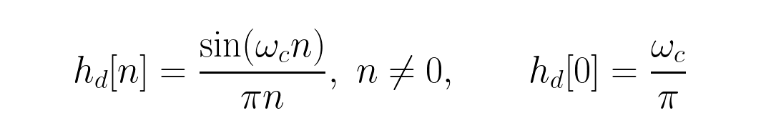
INSTRUCTOR APPENDIX
Homework solutions • Problems 1–2
1 • Ideal LPF
2 • Windows
Inverse DTFT gives the sinc; h_d[0]=ω_c/π. The ideal response is infinite and two-sided. For N=41, shift by 20 samples and τ_g=20.
Rectangular: narrower transition but ≈−13 dB first sidelobe. Hamming: wider transition but ≈−43 dB first sidelobe. Increasing rectangular-window length narrows the Gibbs region; it does not eliminate peak overshoot.
DSP + Machine Learning • Lectures 7–8
Oppenheim & Schafer + Raschka
29

Slide 40
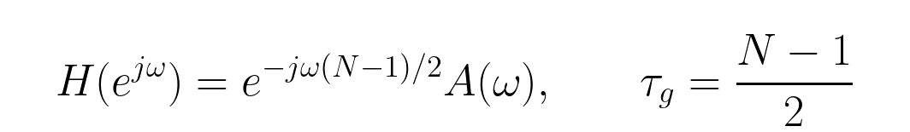
INSTRUCTOR APPENDIX
Homework solutions • Problems 3–4
3 • Symmetry
4 • Convolution
Pairing symmetric taps gives a real amplitude term times a pure delay. Therefore group delay is constant.
For h=[0.2,0.5,0.3] and x=[1,2,0,−1], the first four causal outputs are [0.2,0.9,1.3,0.4]. Conv1d uses correlation ordering, so flip the taps for textbook convolution.
DSP + Machine Learning • Lectures 7–8
Oppenheim & Schafer + Raschka
30

