Slide 1
WEEK 7 ● LECTURE 13
Polyphase Decomposition and Efficient Decimation
H(z) = Σ z⁻ᵏ Eₖ(zᴹ)
Reorganize the same FIR computation so we never calculate samples that will be discarded
↓M + polyphase = low-rate arithmetic
Oppenheim & Schafer §4.7–4.8 | Raschka: convolutional architectures / efficient ML
Notes:
0:00–0:02. Connect to Week 6: decimation requires filtering before downsampling. Today we do the same input-output operation, but reorganize it to avoid wasted arithmetic.

Slide 2
Roadmap and learning objectives
75 minutes • decomposition → Noble identity → efficient decimator → ML structured parallelism
Decompose an FIR impulse response into M polyphase subsequences.
Explain exactly where the M-fold decimation savings comes from.
Use the first Noble Identity correctly—and know when it does not apply.
Distinguish polyphase time-phase partitioning from grouped/channel convolution in ML.
0–20 min
Polyphase concept and index bookkeeping
20–55 min
Naive vs efficient decimation + Noble identity
55–75 min
Grouped convolutions / edge efficiency
Notes:
Core question: If only every Mth filtered sample survives, why compute the other M−1 outputs at all?

Slide 3
01
The polyphase concept
Partition FIR taps by their index modulo M. Nothing is approximated; this is an exact algebraic rearrangement.
Notes:
0:02–0:03. Emphasize exact equivalence, not a new filter design.

Slide 4
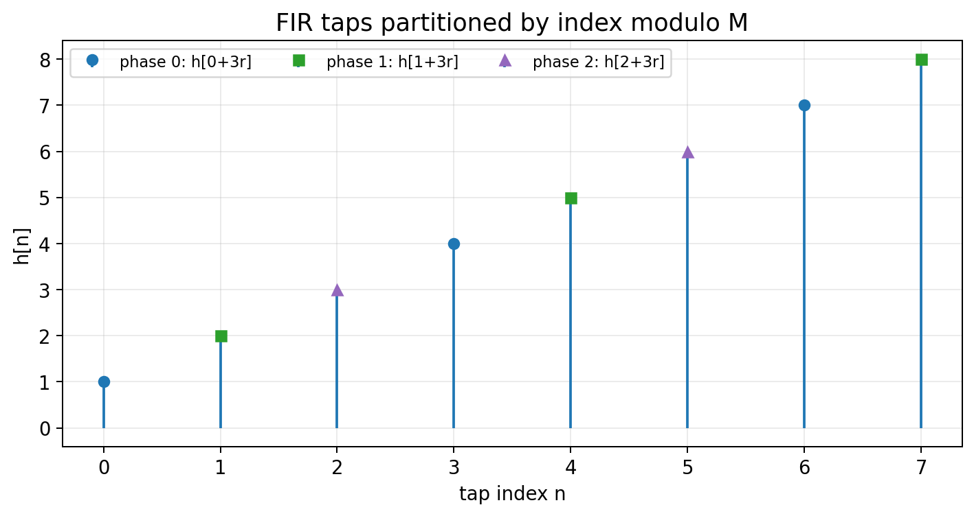
Start with one ordinary FIR filter
For h[n], separate taps whose indices have the same remainder modulo M.
eₖ[r] = h[rM + k], k = 0,1,…,M−1
Eₖ(z) = Σᵣ eₖ[r] z⁻ʳ
Interpretation
Phase k contains the FIR taps at indices k, k+M, k+2M, …
Why this helps
The same phase structure lines up naturally with keeping every Mth output sample.
Notes:
0:03–0:10. Work M=3 with h={1,…,8}: e0={1,4,7}, e1={2,5,8}, e2={3,6}. Ask students to identify phases before showing the plot.

Slide 5
Polyphase decomposition in the z-domain
Collect the M residue classes of tap indices.
H(z) = E₀(zᴹ) + z⁻¹E₁(zᴹ) + … + z⁻(ᴹ⁻¹)Eᴹ₋₁(zᴹ)
H(z) = Σₖ₌₀ᴹ⁻¹ z⁻ᵏ Eₖ(zᴹ)
Each Eₖ operates on every Mth FIR coefficient.
The delays z⁻ᵏ restore the original tap offsets when branches are recombined.
No coefficients are changed and no output samples are changed.
Memory aid
Polyphase = “group coefficients by n mod M, then express the slow-time branch with zᴹ.”
Notes:
0:10–0:16. Derive by writing n=rM+k. This index substitution is the heart of the formula.

Slide 6
CONCEPT CHECK
For M = 4, which FIR taps belong to phase E₂?
Notes:
0:16–0:20. This catches indexing errors before the efficient-decimator derivation.

Slide 7
CONCEPT CHECK
For M = 4, which FIR taps belong to phase E₂?
Good answer
Tap indices n = 2, 6, 10, 14, … because they satisfy n = 4r + 2. Equivalently, e₂[r] = h[4r+2].
Notes:
0:16–0:20. This catches indexing errors before the efficient-decimator derivation.

Slide 8
02
Efficient decimation and Noble identities
Move computation to the slow side of the rate changer—but only when the structure permits it.
Notes:
0:20. Transition: polyphase is valuable because decimation already contains a downsampler.

Slide 9
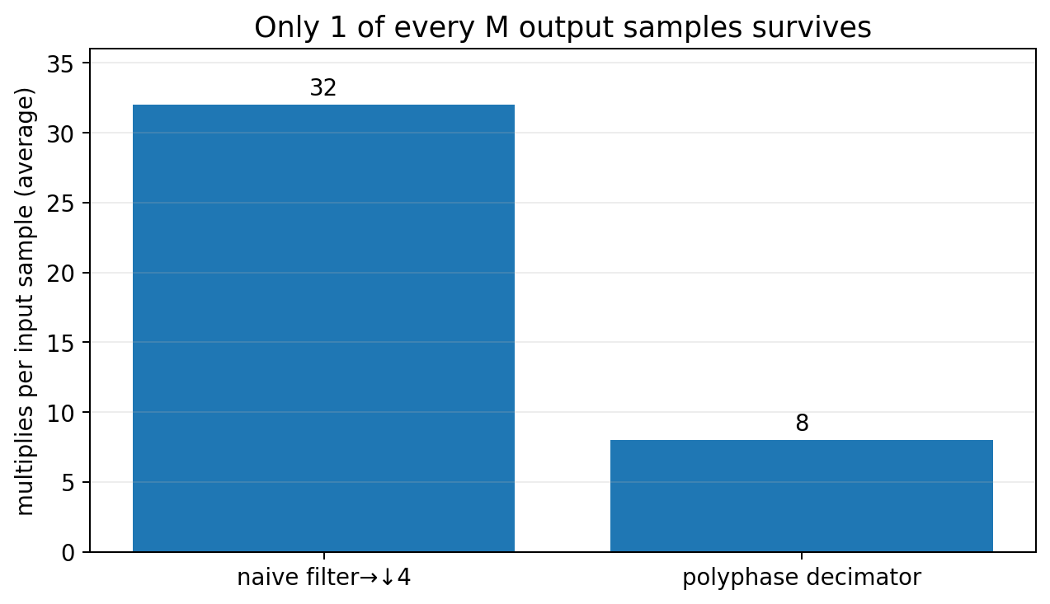
The naive decimator wastes most FIR outputs
Filter at Fₛ, then ↓M keeps only v[0], v[M], v[2M], …
x[n]
H(z)
↓ M
y[m]
v[n] = Σₖ h[k]x[n−k] → y[m] = v[mM]
Cost intuition
An N-tap FIR evaluates about N multiplies for every input sample, even though only 1/M of the outputs remain.
Target
Keep exactly the same y[m], but evaluate only the convolution sums associated with n = mM.
Notes:
0:20–0:28. Give a concrete number: N=32, M=4. Naive ≈32Fs multiplies/s; efficient ≈8Fs multiplies/s. Same filter, same output.

Slide 10
First Noble Identity: the precise statement
A rate changer commutes with a filter only after the filter has the required zᴹ structure.
x[n]
G(zᴹ)
↓ M
y[m]
≡
x[n]
↓ M
G(z)
y[m]
What changes
What does NOT work
On the right, G(z) runs at the lower sampling rate Fₛ/M.
You cannot commute ↓M through an arbitrary G(z) and expect the same system.
G(zᴹ) → ↓M ≡ ↓M → G(z)
Why polyphase matters
Every branch in H(z)=Σz⁻ᵏEₖ(zᴹ) contains exactly the form needed by the Noble Identity.
Notes:
0:28–0:36. This is a critical precision point. The phrase “move the filter through the downsampler” is dangerous unless students remember the z^M condition.

Slide 11
Efficient polyphase decimator
Decompose H(z), then move each Eₖ through the downsampler so it runs at the output rate.
y[m] = Σₖ Σᵣ eₖ[r] · x[(m−r)M − k]
phase 0
↓ M
E0(z)
Key result
All Eₖ filters execute at Fₛ/M, not Fₛ.
phase 1
↓ M
E1(z)
Σ
y[m]
phase 2
↓ M
E2(z)
Same math
Branches are phase-selective views of the same original convolution.
phase M−1
↓ M
Eᴹ₋₁(z)
Notes:
0:36–0:45. The branch input includes phase offsets/delays; do not imply all branches receive x[::M] identically. The implementation is often drawn with a commutator that distributes input samples by phase.

Slide 12
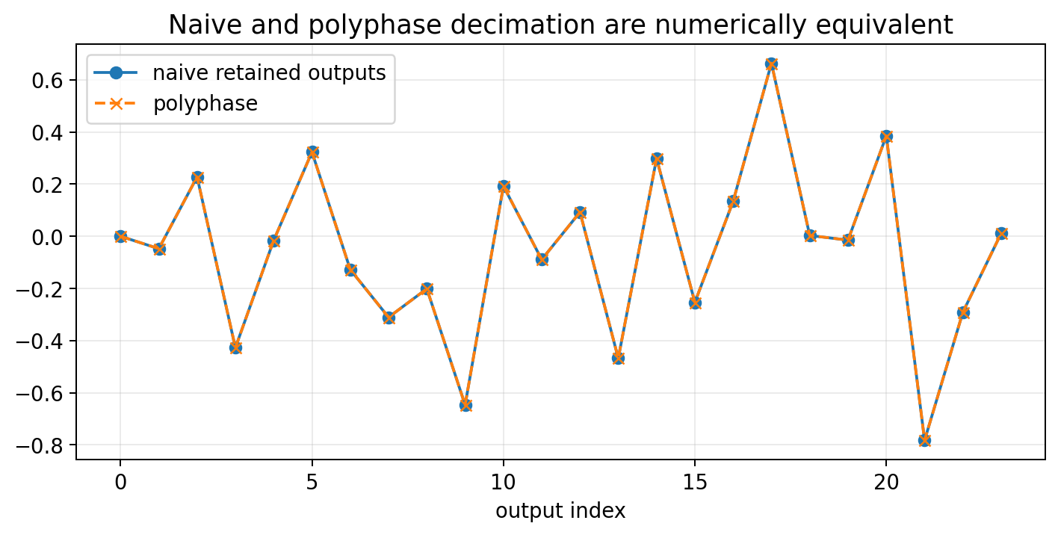
Where the M-fold savings comes from
The number of multiplies per retained output is not smaller; the number of unnecessary outputs is.
naive ≈ N·Fₛ mult/s
polyphase ≈ (N/M)·Fₛ mult/s
Ratio
Ideal arithmetic saving ≈ M for long FIRs and steady-state streaming.
Notes:
0:45–0:51. The polyphase algorithm still uses roughly N taps per output sample, but there are only Fs/M output samples per second.

Slide 13
CONCEPT CHECK
An N = 48 tap FIR decimator reduces the rate by M = 6. Roughly how many FIR multiplications per input sample are needed after polyphase reorganization?
Notes:
0:51–0:55. Accept “6× savings” if they explain the rate argument.

Slide 14
CONCEPT CHECK
An N = 48 tap FIR decimator reduces the rate by M = 6. Roughly how many FIR multiplications per input sample are needed after polyphase reorganization?
Good answer
About N/M = 8 multiplications per input sample on average, versus about 48 for filtering every full-rate output first.
Notes:
0:51–0:55. Accept “6× savings” if they explain the rate argument.

Slide 15
03
ML context: grouped convolutions
Both ideas partition a large computation into structured independent branches—but along different axes.
Notes:
0:55. Bridge carefully: analogy, not equivalence.

Slide 16
Grouped Conv1d: channel partitioning
PyTorch groups restrict which input channels can contribute to which output channels.
Conv1d(Cᵢₙ, Cₒᵤₜ, kernel_size=K, groups=G)
Standard convolution
Grouped convolution
Depthwise convolution
Every output channel can mix all input channels.
Channels are split into G independent convolution groups.
G = Cᵢₙ: each channel is filtered independently before later mixing.
Fewer cross-channel connections → fewer parameters and MACs.
A following 1×1 / pointwise convolution can restore channel mixing.
This structured factorization is a common edge-deployment idea.
Notes:
0:55–1:03. Mention MobileNet-style depthwise separable convolution as an example of factorizing spatial filtering and channel mixing. Do not claim it is a polyphase implementation.

Slide 17
Polyphase versus grouped convolution
Useful analogy: partition → parallel low-cost branches → recombine. Important difference: what is partitioned?
Polyphase DSP
Grouped CNN
Partitions sample/tap phases modulo M.
Goal: exact multirate equivalence while moving arithmetic to a lower sample rate.
Branches are determined by the rate-change factor.
Partitions feature channels.
Goal: constrain connectivity and reduce learnable computation.
Groups are an architectural choice and weights are learned.
shared principle: exploit structure instead of computing a dense operation
Notes:
1:03–1:10. This comparison is worth making explicit because students otherwise overgeneralize the analogy.

Slide 18
Coding demo: prove the equivalences
Use the notebook to compare outputs and perturbation paths.
Decompose h[n] into e₀,…,eᴹ₋₁ and reconstruct it exactly.
Compare filter→↓M with scipy.signal.upfirdn(..., down=M).
Numerically verify the First Noble Identity for G(zᴹ).
Perturb one input channel of a grouped Conv1d and observe that only outputs in its group change.
Prediction first
Ask students which outputs should match before running each cell.
Debugging habit
If a Noble-identity test fails, check whether the filter actually has zᴹ spacing.
Notebook
Week7_Polyphase_DSP_ML_Demos.ipynb
Notes:
1:10–1:14. A fast live demo works better than a long algebraic derivation here.

Slide 19
Lecture 13 wrap-up
Polyphase does not change the filter—it changes where and when the arithmetic happens.
H(z)=Σ z⁻ᵏEₖ(zᴹ) groups FIR taps by phase.
A naive decimator computes outputs that ↓M immediately discards.
The First Noble Identity moves Eₖ filters to the low-rate side because they arise as Eₖ(zᴹ).
Ideal arithmetic savings are approximately M.
Grouped convolution is a structural parallelism analogy, not the same decomposition.
EXIT QUESTION
Why is it incorrect to say “a downsampler can always be moved before a filter”?
Good answer
The Noble Identity only permits the move for the special G(zᴹ) structure; arbitrary filters do not commute with ↓M.
Notes:
1:14–1:15. This exit question targets the most dangerous misconception in the lecture.

Slide 20
References and instructor resources
Week 7 • Lecture 13
Oppenheim & Schafer, Discrete-Time Signal Processing, §4.7: polyphase structures and multirate implementations.
Raschka et al., Machine Learning with PyTorch and Scikit-Learn: convolutional neural-network architectures.
Accompanying notebook: Week7_Polyphase_DSP_ML_Demos.ipynb.
Homework and weekly quiz: Week7_Polyphase_Homework_Quiz_Solutions.docx.
Notes:
Appendix slide for course-site distribution.

