Slide 1
WEEK 7 ● LECTURE 14
Efficient Interpolation and Filter Banks
↑L + polyphase = no zero multiplies
Polyphase synthesis, perfect reconstruction, and fixed/learned subband front ends
analysis → subbands → synthesis
Oppenheim & Schafer §4.7–4.8 | Raschka: convolutional architectures / efficient ML
Notes:
0:00–0:02. Connect to Lecture 12: interpolation inserts L−1 zeros. Today we exploit that structure instead of multiplying all those zeros by FIR coefficients.

Slide 2
Roadmap and learning objectives
75 minutes • efficient interpolation → two-channel banks → ML subband front ends
Use the Second Noble Identity correctly in an interpolator.
Explain why polyphase interpolation saves about a factor L in arithmetic.
Describe analysis, decimation, synthesis, and perfect reconstruction in a two-channel bank.
Relate fixed DSP filter banks to compact feature extractors and learned front ends.
0–35 min
Efficient interpolation + Noble identity
35–55 min
Two-channel analysis / synthesis banks
55–75 min
Fixed and learned filter-bank features
Notes:
Core question: Can the same phase decomposition that accelerated decimation also construct high-rate outputs without doing work on inserted zeros?

Slide 3
01
Efficient interpolation
Compute low-rate branch outputs first, then interleave them onto the high-rate grid.
Notes:
0:02–0:03. Recall ↑L creates L output phases; polyphase makes those phases explicit.

Slide 4
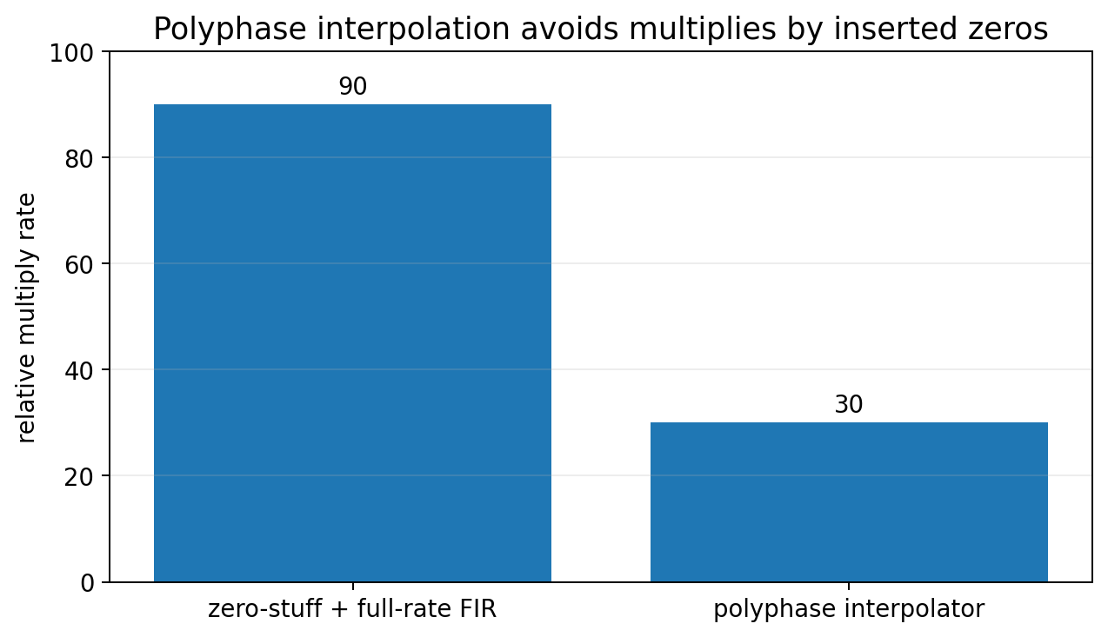
Why naive interpolation wastes arithmetic
Zero insertion creates L−1 zeros between input samples, then a full-rate FIR multiplies them anyway.
x[n]
↑ L
H(z)
y[n]
Naive viewpoint
The FIR runs at L·Fₛ even though most values entering it are known zeros.
Polyphase viewpoint
Each of the L output phases is a low-rate convolution of x[n] with one phase Eₖ(z).
H(z)=Σₖ₌₀ᴸ⁻¹ z⁻ᵏ Eₖ(zᴸ)
Notes:
0:03–0:10. Reuse the decomposition from Lecture 13, but now M is replaced by the interpolation factor L.

Slide 5
Second Noble Identity: the interpolation counterpart
Again, the commuting filter must have a special zᴸ structure.
x[n]
↑ L
G(zᴸ)
y[n]
≡
x[n]
G(z)
↑ L
y[n]
↑L → G(zᴸ) ≡ G(z) → ↑L
Efficiency
Caution
On the right, G(z) executes at the lower input rate.
An arbitrary G(z) cannot be commuted across ↑L.
Notes:
0:10–0:17. Numerical proof is in the notebook. This is the dual of the First Noble Identity.

Slide 6
Polyphase interpolator: L low-rate filters generate L output phases
Filter first at Fₛ, then a commutator interleaves branch samples.
E0(z)
E1(z)
E2(z)
Eᴸ₋₁(z)
phase 0
phase 1
phase 2
phase L−1
x[n]
interleave
y[n]
output phase k: y[mL+k] = (eₖ * x)[m]
Key idea
No branch ever multiplies an inserted zero. Each branch computes only the samples assigned to its output phase.
Notes:
0:17–0:27. This equation is highly intuitive: phase k produces all output indices congruent to k modulo L.

Slide 7
L-fold savings and exact equivalence
Polyphase changes the schedule, not the interpolation result.
Naive: roughly N·L·Fₛ coefficient multiplies/s for an N-tap full-rate FIR.
Polyphase: roughly N·Fₛ multiplies/s total across all phases.
Ideal steady-state saving ≈ L.
scipy.signal.upfirdn implements this multirate idea efficiently.
Amplitude reminder
Efficiency does not replace interpolation design: the anti-imaging filter still needs the appropriate cutoff and gain L.
Notes:
0:27–0:32. Connect back to Week 6: rate-change theory is unchanged; only implementation is reorganized.

Slide 8
CONCEPT CHECK
A 36-tap FIR interpolates by L = 4. Compared with a naive zero-stuff + full-rate FIR implementation, what ideal arithmetic saving should polyphase give?
Notes:
0:32–0:35. Do not require exact endpoint/transient operation counts.

Slide 9
CONCEPT CHECK
A 36-tap FIR interpolates by L = 4. Compared with a naive zero-stuff + full-rate FIR implementation, what ideal arithmetic saving should polyphase give?
Good answer
Approximately a factor of 4. The polyphase branches collectively perform about 36·Fₛ multiplies/s instead of about 36·4·Fₛ.
Notes:
0:32–0:35. Do not require exact endpoint/transient operation counts.

Slide 10
02
Two-channel filter banks
Split the signal into subbands, reduce each rate, then combine them again.
Notes:
0:35. This is the conceptual extension from rate conversion to multiple parallel bands.

Slide 11
Analysis bank: separate frequency content, then decimate
Each subband occupies less bandwidth, so each branch can often be represented at a lower sample rate.
H₀(z) LPF
↓ 2
low subband
Critical sampling
Two branches at half-rate contain the same total sample rate as the original.
x[n]
Why filtering first?
As in decimation, each branch needs bandlimiting before ↓2.
H₁(z) HPF
↓ 2
high subband
Uses
Compression, coding, denoising, subband features.
Notes:
0:35–0:43. Use audio example: low band carries slow spectral structure; high band carries transients/detail.

Slide 12
Synthesis bank: upsample, filter, and add
The synthesis filters cancel alias components and restore the desired signal response.
low subband
↑ 2
F₀(z)
Σ
x̂[n]
high subband
↑ 2
F₁(z)
perfect reconstruction: x̂[n] = c · x[n−d]
Notes:
0:43–0:48. Perfect reconstruction usually allows a scale c and pure delay d; the important requirement is no distortion beyond those trivial effects.

Slide 13
Perfect reconstruction has two simultaneous requirements
One condition cancels aliasing; the other preserves the desired signal path.
alias term: F₀(z)H₀(−z) + F₁(z)H₁(−z) = 0
distortion term: ½[F₀(z)H₀(z)+F₁(z)H₁(z)] = c z⁻ᵈ
Alias cancellation
Desired path
Downsampling creates spectral folding in each branch; synthesis combines branches so those alias terms cancel.
The remaining transfer function should be only a scale and delay—not frequency-dependent distortion.
Mixed-level strategy
First-year students can understand “split → downsample → upsample → recombine”; seniors can use the z-domain conditions above.
Notes:
0:48–0:53. Treat equations as enrichment for first-year students, core material for seniors.

Slide 14
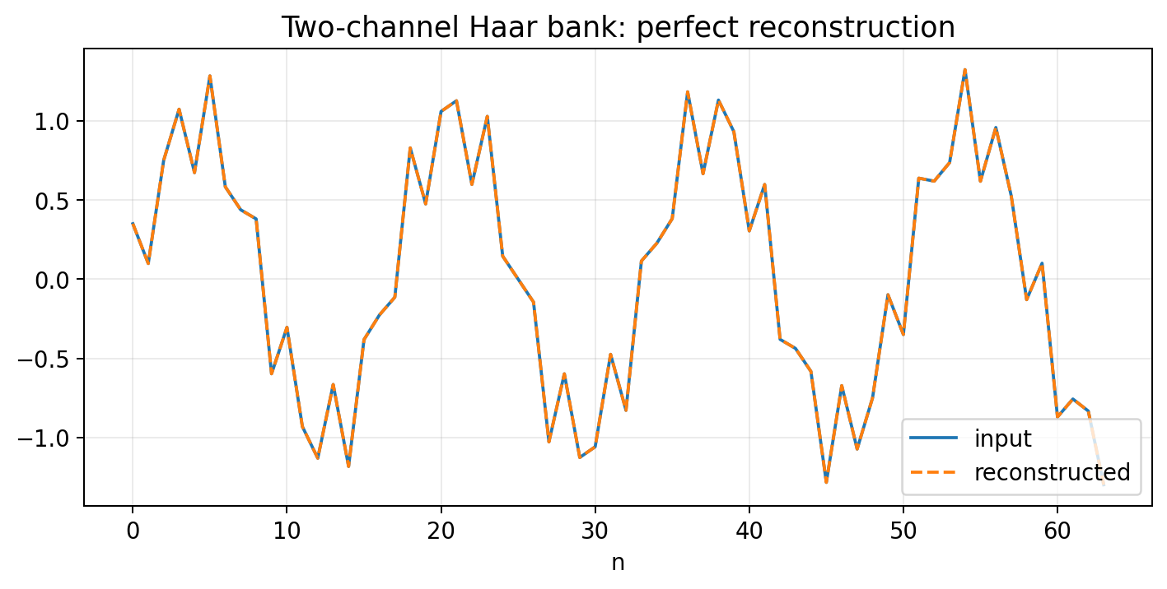
Haar bank: the simplest perfect-reconstruction example
Pairs become an average-like lowpass coefficient and a difference-like highpass coefficient.
a[m] = (x[2m] + x[2m+1]) / √2
d[m] = (x[2m] − x[2m+1]) / √2
x[2m] = (a[m]+d[m]) / √2
x[2m+1] = (a[m]−d[m]) / √2
Notes:
0:53–0:55. This pairwise form avoids indexing distractions and makes exact reconstruction obvious. It is also an orthonormal transform, so energy is preserved.

Slide 15
03
ML context: fixed and learned filter banks
Subband structure can be engineered, frozen, or learned—depending on data, compute, and robustness needs.
Notes:
0:55. Bridge from signal representation to feature engineering.

Slide 16
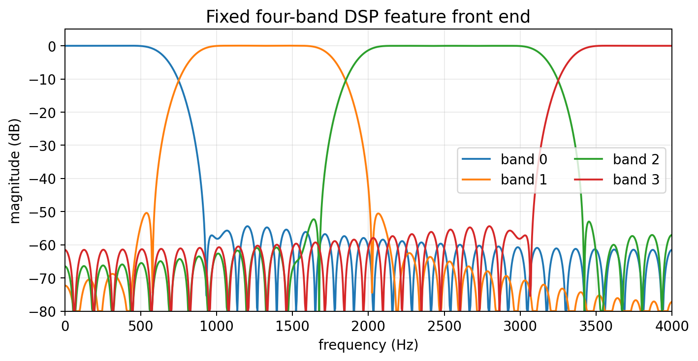
Fixed subband features can be an efficient front end
Filter → summarize each band → feed a small classifier.
Examples
Mel filter-bank energies, wavelet coefficients, scattering-style fixed transforms, hand-designed subbands.
Why useful
Few trainable parameters, predictable spectral behavior, potentially lower data and compute requirements.
Tradeoff
A fixed front end cannot adapt its filters to every task; useful information may be discarded.
Notes:
0:55–1:03. Clarify that Mel filter banks often operate on a magnitude/power spectrum rather than being implemented as time-domain PR filter banks. The common idea is fixed frequency partitioning.

Slide 17
Learned filter banks: let the data choose the subbands
Conv1d kernels can act as a trainable analysis bank, optionally with stride / pooling for rate reduction.
feature channel k: yₖ[n] = (hₖ * x)[n]
Fixed bank: interpretable, cheap, stable prior.
Learned bank: task-adaptive but needs data, training, and regularization.
Hybrid: initialize from DSP filters, then fine-tune.
Edge pattern: fixed or depthwise front end + small pointwise / linear classifier.
Connection to Week 6
Any stride/downsampling in the learned analysis bank still raises the anti-aliasing questions from multirate DSP.
Connection to polyphase
Efficient implementations exploit structure to avoid dense redundant computation.
Notes:
1:03–1:09. Avoid claiming learned conv filters automatically form a perfect-reconstruction bank. PR requires explicit architectural/filter constraints.

Slide 18
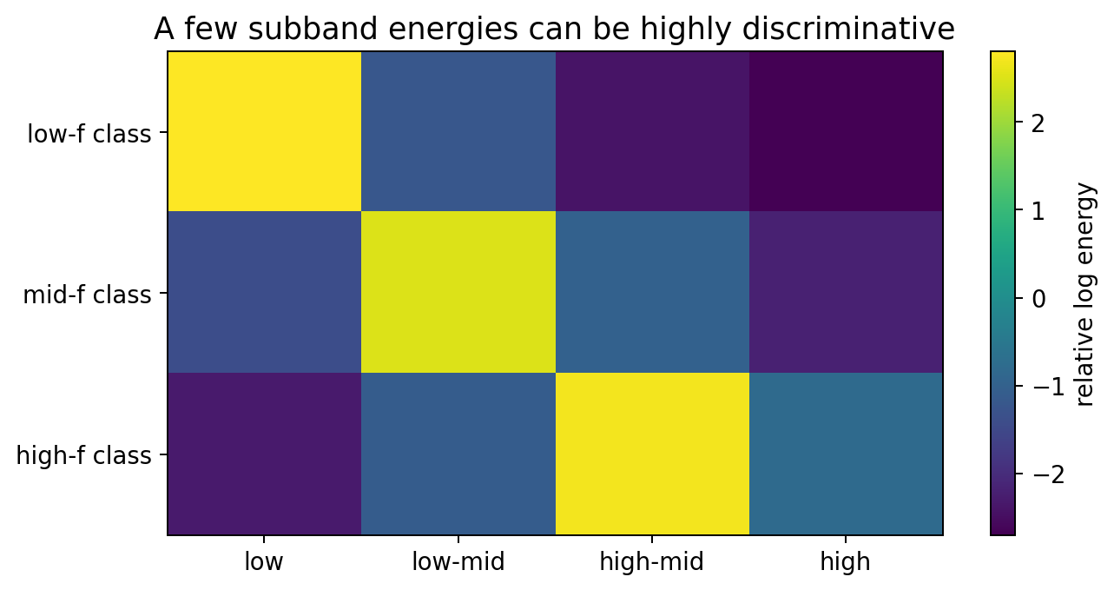
Scikit-Learn/PyTorch demo: four fixed bands, tiny classifier
A compact DSP feature vector can make a simple classification problem nearly linearly separable.
Generate noisy low-, mid-, and high-frequency signal classes.
Apply four fixed FIR bands.
Use log subband energy as a 4-D feature vector.
Train logistic regression—or a 4→3 PyTorch linear layer.
Compare with a learned raw-waveform front end as an extension.
Teaching point
Feature engineering can move complexity from the learned model into a known, efficient signal-processing transform.
Notes:
1:09–1:14. The accompanying notebook runs both scikit-learn and PyTorch variants. Ask whether the fixed bank would still be optimal if class frequencies changed.

Slide 19
Lecture 14 wrap-up
Polyphase is the implementation engine; filter banks turn the idea into parallel signal representations.
Second Noble Identity moves G(z) to the low-rate side of ↑L when the high-rate form is G(zᴸ).
Polyphase interpolation computes output phases directly and avoids zero multiplies.
Two-channel analysis/synthesis banks split, decimate, interpolate, and recombine subbands.
Perfect reconstruction requires alias cancellation plus an undistorted desired path.
Fixed or learned subband front ends provide a natural bridge to lightweight ML.
EXIT QUESTION
What is the key computational idea shared by efficient decimation and efficient interpolation?
Good answer
Use polyphase structure so filtering happens at the low rate and only samples that actually matter are computed.
Notes:
1:14–1:15. A stronger answer distinguishes “don’t compute discarded outputs” for decimation from “don’t multiply inserted zeros” for interpolation.

Slide 20
References and instructor resources
Week 7 • Lecture 14
Oppenheim & Schafer, Discrete-Time Signal Processing, §4.7–4.8: polyphase structures and filter banks.
Raschka et al., Machine Learning with PyTorch and Scikit-Learn: CNN architectures and feature-learning workflow.
Accompanying notebook: Week7_Polyphase_DSP_ML_Demos.ipynb.
Homework and weekly quiz: Week7_Polyphase_Homework_Quiz_Solutions.docx.
Notes:
Appendix slide for course-site distribution.

