Slide 1

ECEN 4/5632 Theory and Application of Digital Filters
Lecture 10, 9-29-26, 10-01-26
Peter Mathys*
* With generous help from Gemini Pro and ChatGPT

Slide 2
WEEK 5 ● LECTURE 10
Linear Phase, Generalized Phase, and ML Intersections
From symmetry constraints to the four FIR types and phase-aware Conv1d kernels
generalized phase → FIR Types I–IV → zero constellations → Conv1d bias
75 minutes • senior + first-year graduate ECE
Equations typeset in standard mathematical notation

Slide 3
DSP + Machine Learning • Week 5
Roadmap
0–25 min • Derive generalized linear phase and why practical exact linear-phase rational filters are FIR.
25–50 min • Use symmetry / antisymmetry to classify FIR Types I–IV and their forced endpoint zeros.
50–70 min • Interpret a Conv1d kernel as a trainable FIR and ask how to enforce linear-phase inductive bias.
70–75 min • Bridge to multirate filtering: alias suppression needs magnitude selectivity; linear phase is often desirable for alignment.
Oppenheim & Schafer + Raschka
2

Slide 4



DSP + Machine Learning • Week 5
Generalized linear phase
A(ω) is real for the standard real-coefficient linear-phase FIR cases.
Its sign can cause π phase jumps without changing the underlying constant group delay.
The physically important quantity is τg=α.
Oppenheim & Schafer + Raschka
3

Slide 5
DSP + Machine Learning • Week 5
Why exact linear phase points to FIR structure
A stable causal rational IIR has poles whose phase contributions vary with frequency.
To obtain exact constant group delay over the full usable band, reciprocal pole effects would need exact cancellation; stable causal cancellation reduces to trivial scale/delay behavior in the practical rational setting.
Thus the nontrivial exact linear-phase filters used in DSP are FIR filters with symmetry constraints.
Nuance
Pure delays and trivial scale/delay factors are FIR anyway; “only FIR” should be understood in the standard stable causal rational filter-design context.
Oppenheim & Schafer + Raschka
4

Slide 6



DSP + Machine Learning • Week 5
Symmetry gives generalized linear phase
Symmetric
Antisymmetric
Pairing n with M-n yields cosine terms after factoring out e^(-jω M/2).
Pairing produces sine terms and an additional ±π/2 phase offset.
Oppenheim & Schafer + Raschka
5

Slide 7




Slide 8
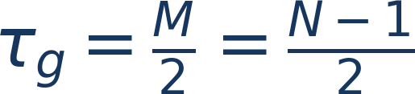
DSP + Machine Learning • Week 5
Symmetric derivation by pairing taps
Start with H(e^(jω))=Σₙ₌₀^(M)h[n]e^(-jω n).
Pair n with M-n using h[n]=h[M-n].
Each pair becomes a real cosine factor times e^(-jω M/2).
Therefore all non-sign phase is the pure delay term -ω M/2.
Oppenheim & Schafer + Raschka
6

Slide 9
DSP + Machine Learning • Week 5
Antisymmetry gives a sine-weighted amplitude
For h[n]=-h[M-n], paired terms become proportional to sin((M/2-n)ω).
The frequency response is again a pure delay times a real amplitude, with a fixed quadrature factor.
That symmetry forces endpoint zeros that determine which responses are possible.
Oppenheim & Schafer + Raschka
7

Slide 10
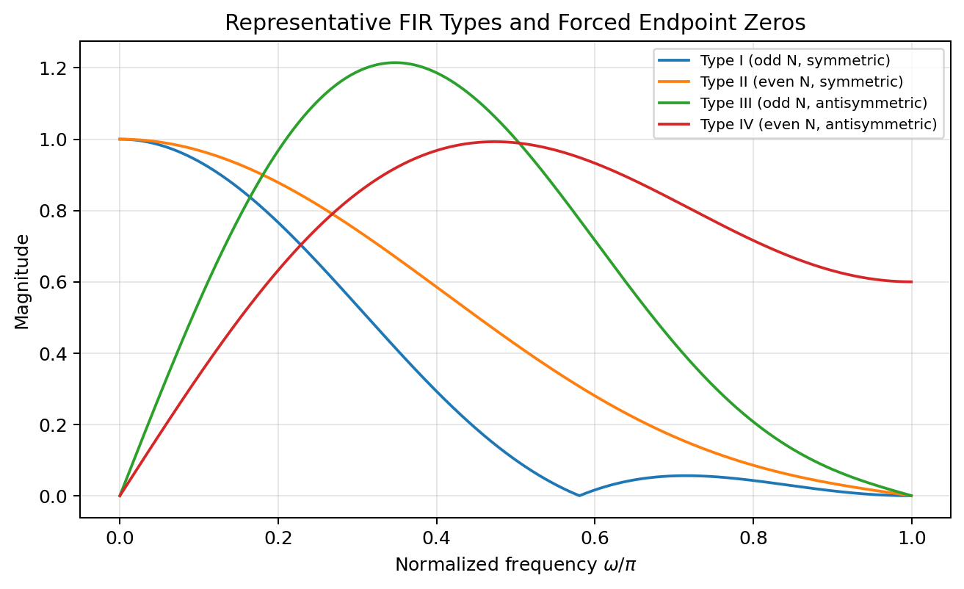

DSP + Machine Learning • Week 5
The four real FIR linear-phase types
Type I • odd N, symmetric.
Type II • even N, symmetric.
Type III • odd N, antisymmetric.
Type IV • even N, antisymmetric.
Why four?
Parity of length and choice of symmetry determine whether the midpoint is a sample or half-sample and which endpoint zeros are forced.
Oppenheim & Schafer + Raschka
8

Slide 11







Slide 12
DSP + Machine Learning • Week 5
Type I: odd length, symmetric
Group delay is integer: M/2=(N-1)/2.
No zero at z=1 or z=-1 is forced by symmetry alone.
Can realize low-pass, high-pass, band-pass, band-stop, and many other real linear-phase responses.
Oppenheim & Schafer + Raschka
9

Slide 13
DSP + Machine Learning • Week 5
Type II: even length, symmetric
Group delay is half-integer.
Because gain must vanish at Nyquist, a Type II filter cannot realize a high-pass response with nonzero H(e^(jπ)).
Oppenheim & Schafer + Raschka
10

Slide 14
DSP + Machine Learning • Week 5
Type III: odd length, antisymmetric
Forced zeros at z=1 and z=-1.
Cannot have nonzero DC or Nyquist gain.
Useful for differentiator-like or Hilbert-transform structures over an interior band.
Oppenheim & Schafer + Raschka
11

Slide 15

DSP + Machine Learning • Week 5
Type IV: even length, antisymmetric
Forced zero at DC, but not necessarily at Nyquist.
Half-integer group delay.
Well suited to Hilbert transformers and differentiators, where zero DC response is natural.
Oppenheim & Schafer + Raschka
12

Slide 16

DSP + Machine Learning • Week 5
Concept check: why Type II cannot be high-pass
A high-pass normally requires appreciable gain near ω=π.
Type II symmetry forces H(e^(jπ))=0.
Therefore the required endpoint behavior contradicts the symmetry constraint.
Strong answer: this is not a matter of filter order; it is structural and holds for every Type II FIR.
Oppenheim & Schafer + Raschka
13

Slide 17
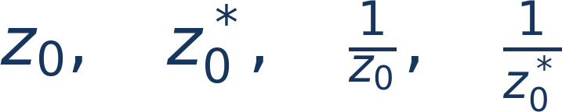
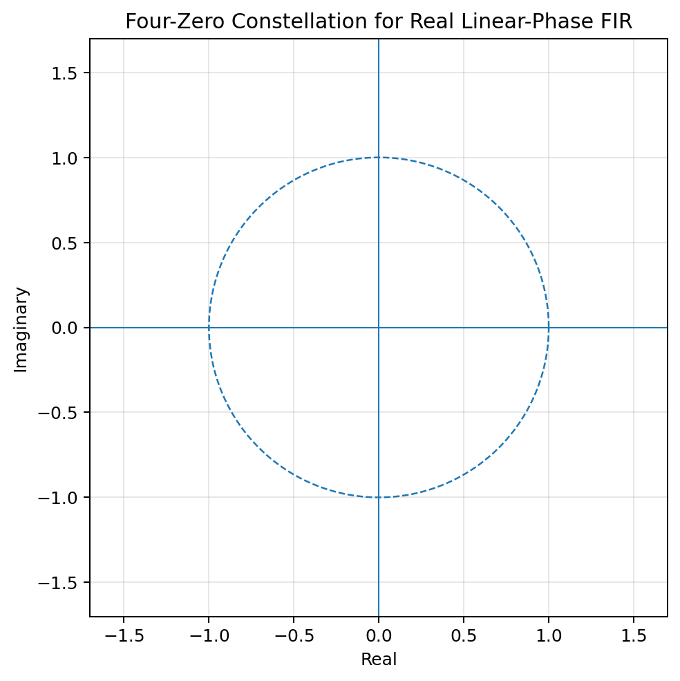




DSP + Machine Learning • Week 5
Zero symmetry for real linear-phase FIR filters
Why four?
Degenerate cases
Real coefficients give conjugate symmetry; palindromic / anti-palindromic linear-phase structure gives reciprocal symmetry.
Zeros on the unit circle or real axis can collapse the four-point set into pairs or individual points.
Oppenheim & Schafer + Raschka
14

Slide 18

DSP + Machine Learning • Week 5
Polynomial viewpoint
A symmetric FIR has a palindromic coefficient polynomial; an antisymmetric FIR has an anti-palindromic one.
If z₀ is a zero, reciprocal symmetry forces 1/z₀ (with conjugation as required for real coefficients).
This zero geometry is the z-plane fingerprint of linear phase.
Oppenheim & Schafer + Raschka
15

Slide 19



DSP + Machine Learning • Week 5
Generalized phase: sign changes create apparent phase jumps
When the real amplitude factor A(ω) crosses zero, its sign changes.
A negative real amplitude contributes an additional π to the displayed phase.
The unwrapped phase may show jumps, but the underlying delay term remains -ω M/2.
Use group delay away from magnitude zeros to diagnose the physical timing behavior.
Oppenheim & Schafer + Raschka
16

Slide 20
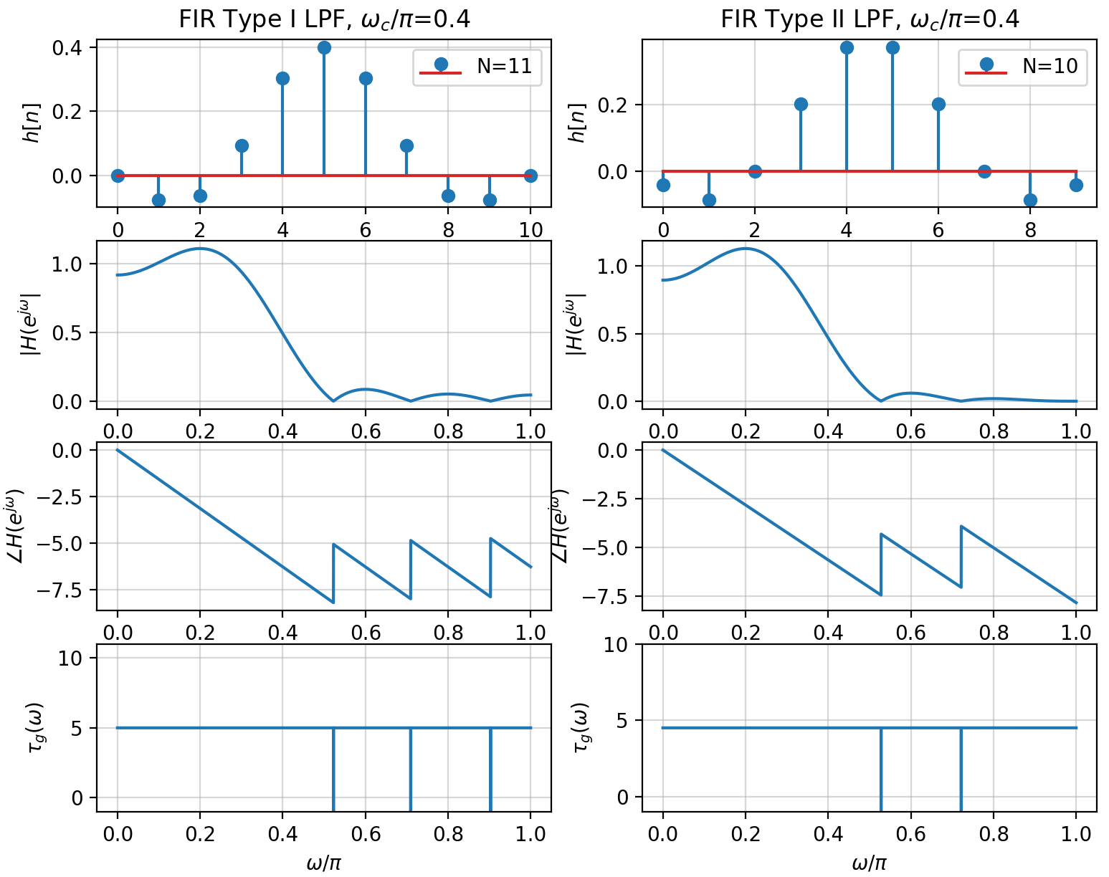
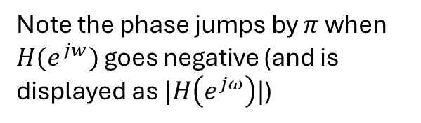
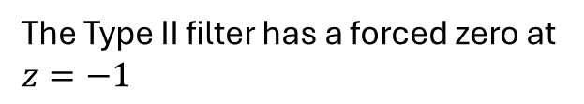
Type I and II FIR Filter Examples
The Type II filter has a forced zero at $z=−1$
Note the phase jumps by $π$ when $H(e^{jw})$ goes negative (and is displayed as $|H\left(e^{jω}\right)|$)

Slide 21
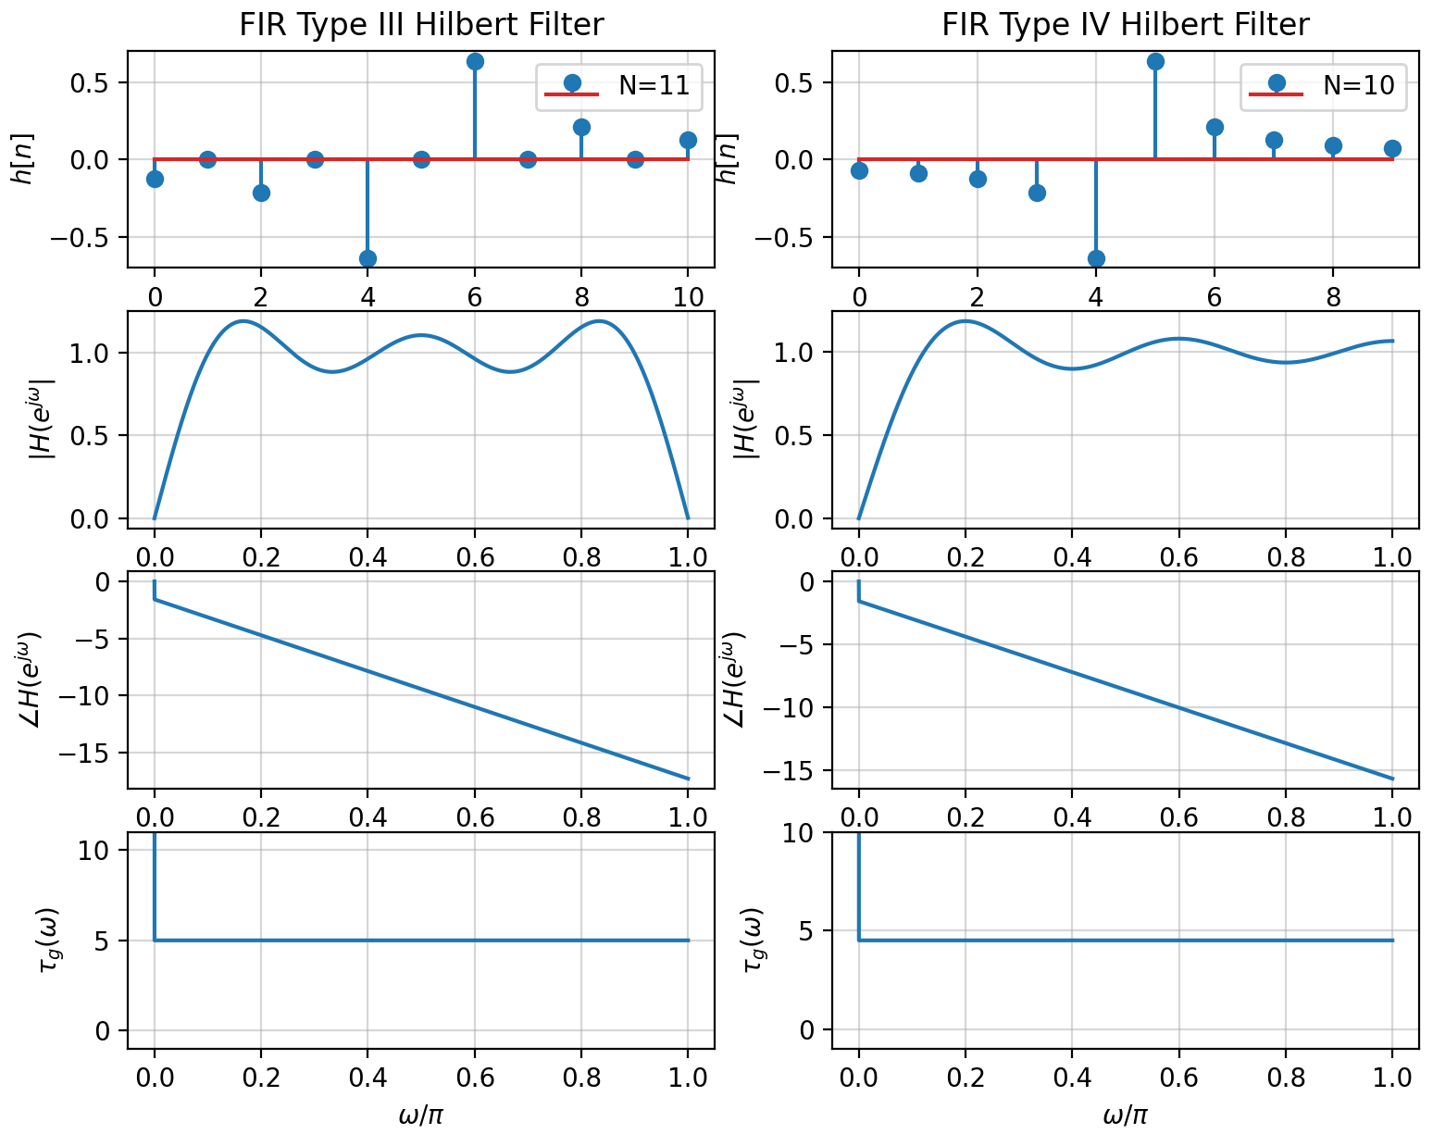
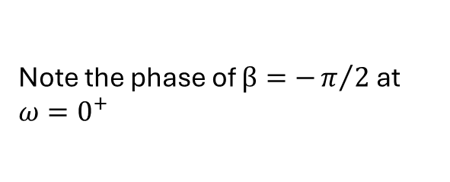
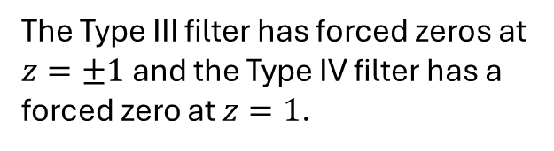
Type III and IV FIR Filter Examples
The Type III filter has forced zeros at $z=±1$ and the Type IV filter has a forced zero at $z=1$.
Note the phase of $β=−π/2$ at $ω=0^{+}$

Slide 22
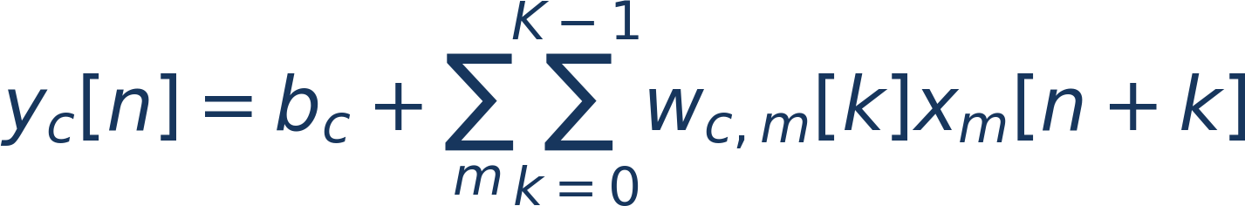

DSP + Machine Learning • Week 5
Conv1d is a trainable FIR-like local operator
For one input/output channel, the kernel is simply a finite set of tap weights.
Multiple channels generalize one FIR to a bank of learned finite-support cross-correlations.
Deep-learning libraries use correlation ordering, but the FIR interpretation remains useful.
Oppenheim & Schafer + Raschka
17

Slide 23
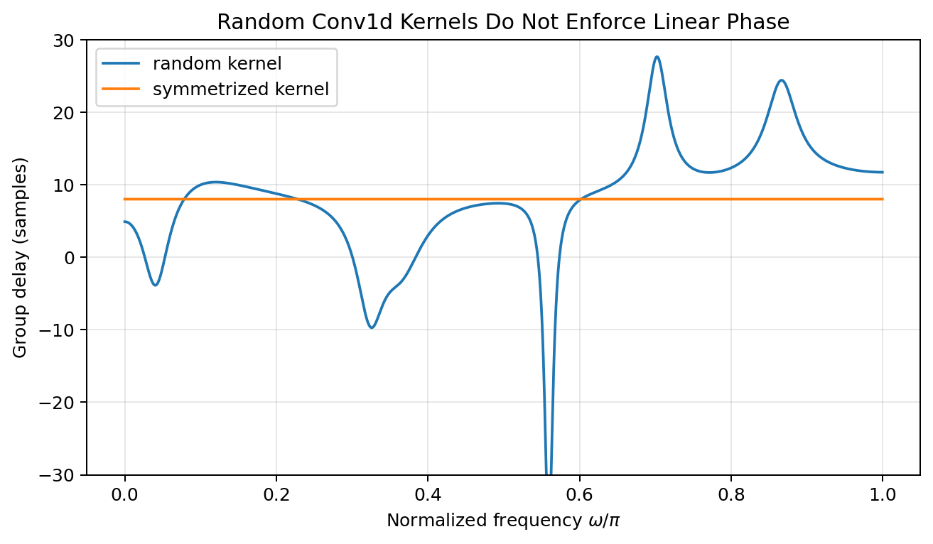
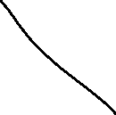
DSP + Machine Learning • Week 5
A random Conv1d kernel does not have linear phase by default
Read the plot
A generic random kernel has no symmetry constraint, so its group delay varies. Symmetrizing the coefficients forces the FIR into a linear-phase family.
Oppenheim & Schafer + Raschka
18

Slide 24

DSP + Machine Learning • Week 5
How to impose symmetry in a trainable kernel
Learn only one half of the taps (and the center tap for odd length).
Construct the other half by reversal inside the forward pass.
Autograd still trains the independent parameters, but every realized kernel remains symmetric.
This is an architectural inductive bias, not a post-hoc correction.
Oppenheim & Schafer + Raschka
19

Slide 25
DSP + Machine Learning • Week 5
PyTorch symmetry parameterization
half = nn.Parameter(torch.randn(R))
center = nn.Parameter(torch.randn(1))
def kernel(self):
return torch.cat([
self.half,
self.center,
torch.flip(self.half, dims=[0])
])
# Use the constructed kernel in conv1d.
# Symmetry is exact at every optimizer step.
Oppenheim & Schafer + Raschka
20

Slide 26
DSP + Machine Learning • Week 5
What inductive bias are we adding?
Benefit: exact generalized linear phase and fewer independent parameters.
Benefit: preserves relative timing when that invariance is known to matter.
Cost: the model cannot learn an arbitrary nonlinear-phase kernel even if the task would benefit from one.
Engineering principle: constrain only what physics or deployment requirements justify.
Oppenheim & Schafer + Raschka
21

Slide 27
DSP + Machine Learning • Week 5
Fixed, constrained, or fully learned front end?
Fixed DSP
Constrained learned
Unconstrained learned
Design taps from a frequency specification; no learning.
Learn taps but enforce symmetry / band structure / sparsity.
Let the task loss select arbitrary finite kernels.
These are not competing religions; they are different locations on the bias–flexibility spectrum.
Oppenheim & Schafer + Raschka
22

Slide 28
DSP + Machine Learning • Week 5
Multirate transition: what linear phase does and does not guarantee
Anti-alias filtering requires adequate stopband attenuation before downsampling.
Linear phase is not mathematically required to suppress aliases.
However, linear-phase FIRs are often preferred when relative waveform timing and alignment must be preserved across sample-rate conversion.
Next week: polyphase / multirate structure makes FIR implementation especially attractive.
Oppenheim & Schafer + Raschka
23

Slide 29
DSP + Machine Learning • Week 5
Concept check
A 16-tap symmetric FIR is which type?
What endpoint must be zero?
Can it be a conventional high-pass with nonzero Nyquist gain?
Oppenheim & Schafer + Raschka
24

Slide 30
DSP + Machine Learning • Week 5
Concept check
A 16-tap symmetric FIR is which type?
Answer: Type II because N is even and the taps are symmetric.
What endpoint must be zero? H(e^(jπ))=0.
Can it be a conventional high-pass with nonzero Nyquist gain? No.
Oppenheim & Schafer + Raschka
24

Slide 31
DSP + Machine Learning • Week 5
Python demo: random versus symmetry-constrained kernels
rng = np.random.default_rng(4)
h_rand = rng.normal(size=17)
h_sym = 0.5*(h_rand + h_rand[::-1])
_, gd_rand = signal.group_delay((h_rand, [1.0]), w=2048)
_, gd_sym = signal.group_delay((h_sym, [1.0]), w=2048)
# PyTorch fixed FIR equivalence
kt = torch.tensor(h[::-1].copy()).view(1,1,-1)
yt = F.conv1d(F.pad(xt, (len(h)-1,0)), kt)
Oppenheim & Schafer + Raschka
25

Slide 32
DSP + Machine Learning • Week 5
Lecture 10 synthesis
Generalized linear phase means a constant delay plus a real amplitude factor.
Symmetry / antisymmetry creates exactly four real FIR types with structural endpoint constraints.
Linear-phase zero patterns appear in conjugate-reciprocal constellations.
Conv1d kernels are not linear phase unless the architecture or parameterization enforces it.
Oppenheim & Schafer + Raschka
26

Slide 33
DSP + Machine Learning • Week 5
Homework — Lecture 10
5 • Derive the pure-delay factor from symmetric FIR taps.
6 • Classify four examples as Types I–IV and state forced endpoint zeros.
7 • Complete the four-zero constellation for z₀=0.7e^(j0.6).
8 • Design a symmetry-constrained trainable Conv1d parameterization and discuss its inductive bias.
Oppenheim & Schafer + Raschka
27

Slide 34
DSP + Machine Learning • Week 5
Weekly quiz — Questions 1–4
Q1 • What geometric quantities determine |H(e^(jω))| from a pole-zero plot?
Q2 • State τₚ(ω) and τg(ω).
Q3 • What property defines an all-pass system?
Q4 • Why can equal magnitude responses still produce different transient waveforms?
Oppenheim & Schafer + Raschka
28

Slide 35
DSP + Machine Learning • Week 5
Weekly quiz — Questions 5–8
Q5 • A real symmetric FIR has N=21. What is its group delay?
Q6 • Which type is even-length and symmetric, and what forced zero does it have?
Q7 • If a complex zero z₀ is off the unit circle, what other three zeros accompany it in a real linear-phase FIR?
Q8 • Does a random `nn.Conv1d` kernel automatically have linear phase? Why?
Oppenheim & Schafer + Raschka
29

Slide 36
DSP + Machine Learning • Week 5
Instructor quiz solutions
A1: zero-vector lengths in numerator divided by pole-vector lengths in denominator.
A2: τₚ=-∠ H/ω and τg=-d(∠ H)/dω.
A3: |Hₐₚ(e^(jω))|=1 for all ω.
A4: phase / group-delay differences alter relative arrival times of frequency components.
A5: 10 samples.
A6: Type II; forced zero at z=-1 or ω=π.
A7: z₀*, 1/z₀, and 1/z₀*.
A8: no; generic kernels are unconstrained, so symmetry is not guaranteed.
Oppenheim & Schafer + Raschka
30

Slide 37
DSP + Machine Learning • Week 5
Instructor homework solution sketch — Lecture 10
P5: H(e^(jω))=e^(-jω M/2)A(ω), so τg=M/2=(N-1)/2.
P6: I = odd/symmetric; II = even/symmetric with ω=π zero; III = odd/antisymmetric with 0 and π zeros; IV = even/antisymmetric with 0 zero.
P7: z₀, z₀*, 1/z₀, 1/z₀*.
P8: learn half + center, mirror the half; exact symmetry is maintained during every update.
Oppenheim & Schafer + Raschka
31

