Slide 1
Feature Engineering
From Physics to Perception
STFT → Mel filterbanks → log compression → MFCCs → fixed-size ML inputs
WEEK 11 • LECTURE 21 • 75 MINUTES

Slide 2
Week 11 changes the objective
THE TRANSITION FROM DSP ANALYSIS TO MACHINE LEARNING
00–15 MIN
• Classical DSP asks: can we represent, filter, or reconstruct the signal faithfully?
• ML asks: which representation makes the decision boundary easiest to learn?
• A feature may intentionally discard information that is irrelevant to the task.
• But discarded information cannot be recovered later—feature engineering encodes assumptions.
Preserve what matters for the label; compress what does not.
Feature engineering = physics + perception + task knowledge
Instructor cue: Ask for one task where perfect reconstruction is unnecessary: siren detection, keyword spotting, bearing-fault classification.
DSP + ML • Week 11 • Oppenheim & Schafer → Raschka
2

Slide 3
Learning outcomes
BY THE END OF LECTURE 21
00–15 MIN
• Explain why linear-Hz STFT bins are not always the most efficient coordinates for audio classification.
• Construct a Mel-spectrogram conceptually as a weighted sum of STFT power bins.
• Explain log compression and the DCT step used to form MFCCs.
• Standardize waveform geometry: channels, sample rate, duration, and feature shape.
• Choose between Mel-spectrograms, MFCC matrices, and summarized MFCC vectors for different model families.
DSP + ML • Week 11 • Oppenheim & Schafer → Raschka
3

Slide 4
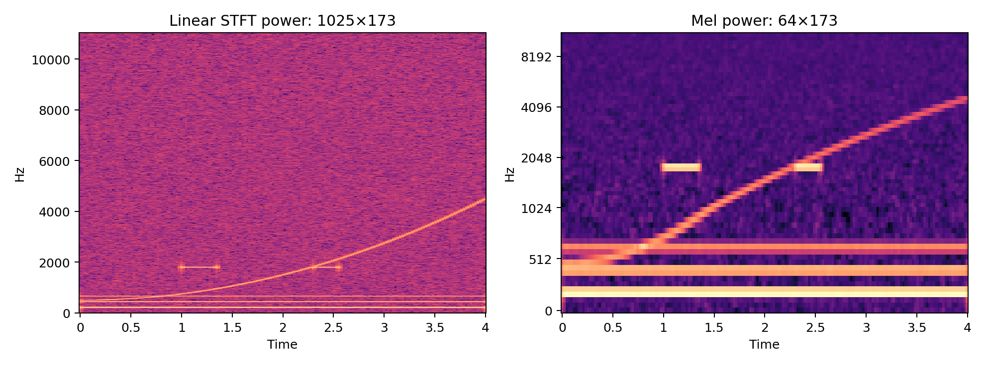
The problem with linear frequency
THE STFT IS PHYSICALLY NATURAL, NOT PERCEPTUALLY UNIFORM
00–15 MIN
• At 22.05 kHz with n_fft=2048, the one-sided STFT has 1025 frequency bins.
• For many audio tasks, fine resolution at the top of the band is less useful than fine resolution at low frequencies.
• Mel filterbanks pool neighboring bins nonuniformly, reducing dimension while keeping time structure.
STFT power P[k,m] → Mel power S_mel[b,m]
Instructor cue: Phrase “human hearing is logarithmic” carefully: Mel is a perceptual warping, not a universal law of hearing.
DSP + ML • Week 11 • Oppenheim & Schafer → Raschka
4

Slide 5
Physics coordinates vs perception-oriented coordinates
SAME SOUND, DIFFERENT REPRESENTATIONS
00–15 MIN
Linear Hz / STFT
Equal-width frequency bins Direct physical meaning Filter-analysis friendly
Mel
More low-frequency detail Broader high-frequency bands Compact audio front end
MFCC
DCT of log-Mel Compact spectral envelope Classical baseline friendly
CNN input
Keep full 2D map Learn local patterns Next week: CNNs
No representation is free: every compression trades detail for invariance or efficiency.
DSP + ML • Week 11 • Oppenheim & Schafer → Raschka
5

Slide 6
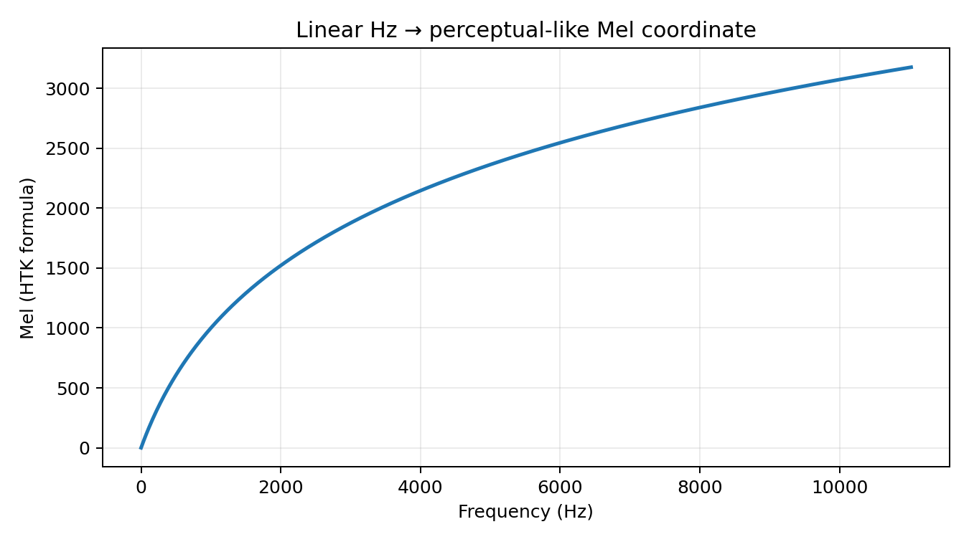
The Mel scale
ONE COMMON MAPPING FROM HZ TO A PERCEPTUAL-LIKE COORDINATE
15–35 MIN
m = 2595 log10(1 + f/700)
• The formula shown is the common HTK-style mapping.
• librosa defaults to a Slaney-style Mel definition; set htk=True for the HTK convention.
• The important idea is frequency warping—not memorizing one constant.
Instructor cue: Use 100→200 Hz versus 10,000→10,100 Hz as intuition; avoid claiming an exact perceptual threshold.
DSP + ML • Week 11 • Oppenheim & Schafer → Raschka
6

Slide 7
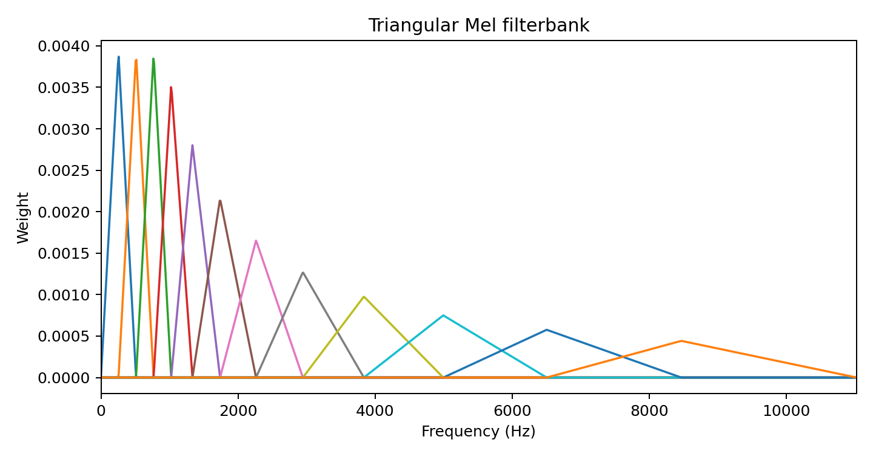
Mel filterbanks are weighted pooling
TRIANGULAR BANDS COMPRESS FREQUENCY WITHOUT DESTROYING TIME
15–35 MIN
• Each filter H_b[k] assigns weights to neighboring FFT bins.
• Low-frequency filters are relatively narrow; high-frequency filters cover more Hz.
• Overlapping filters provide smooth transitions between bands.
S_mel[b,m] = Σ_k H_b[k] |X[m,k]|²
DSP + ML • Week 11 • Oppenheim & Schafer → Raschka
7

Slide 8
Matrix view: Mel features are a linear map of power
A BRIDGE BACK TO LINEAR ALGEBRA
15–35 MIN
P
STFT power [K × T]
H
Mel bank [B × K]
S_mel = H P
Mel power [B × T]
• Frequency compression happens independently in every time frame.
• Time resolution is inherited from the STFT hop length.
• Choosing n_mels controls the frequency-feature dimension.
DSP + ML • Week 11 • Oppenheim & Schafer → Raschka
8

Slide 9
librosa: compute a Mel-spectrogram
CODE SHOULD MIRROR THE MATH
15–35 MIN
M = librosa.feature.melspectrogram( y=y, sr=22050, n_fft=2048, hop_length=512, n_mels=64, power=2.0, ) M_db = librosa.power_to_db(M, ref=np.max) print(M.shape) # (64, time_frames) print(M_db.max()) # 0 dB relative to peak
Instructor cue: Ask students to predict the first dimension. power=2 means power; power_to_db therefore uses 10 log10.
DSP + ML • Week 11 • Oppenheim & Schafer → Raschka
9

Slide 10
Why take the logarithm?
DYNAMIC RANGE COMPRESSION IS PART OF FEATURE DESIGN
15–35 MIN
S_dB = 10 log10(S / S_ref)
100× power ratio → +20 dB
• Spectral power can span orders of magnitude.
• Log compression turns ratios into differences and makes weak structure more visible.
• For power quantities use 10 log10(·); for amplitude ratios use 20 log10(·).
• A floor is required numerically because log(0) is undefined.
0.01× power ratio → −20 dB
DSP + ML • Week 11 • Oppenheim & Schafer → Raschka
10

Slide 11
MFCC pipeline
A COMPACT DESCRIPTION OF SPECTRAL-ENVELOPE SHAPE
35–55 MIN
Waveform
STFT power
Mel bank
log / dB
DCT
MFCCs
C[n,m] = DCT_b{ log S_mel[b,m] }
• Many classical pipelines retain roughly the first 13–40 coefficients.
• Coefficient 0 largely tracks overall log-energy; higher indices encode faster variation across Mel bands.
DSP + ML • Week 11 • Oppenheim & Schafer → Raschka
11

Slide 12
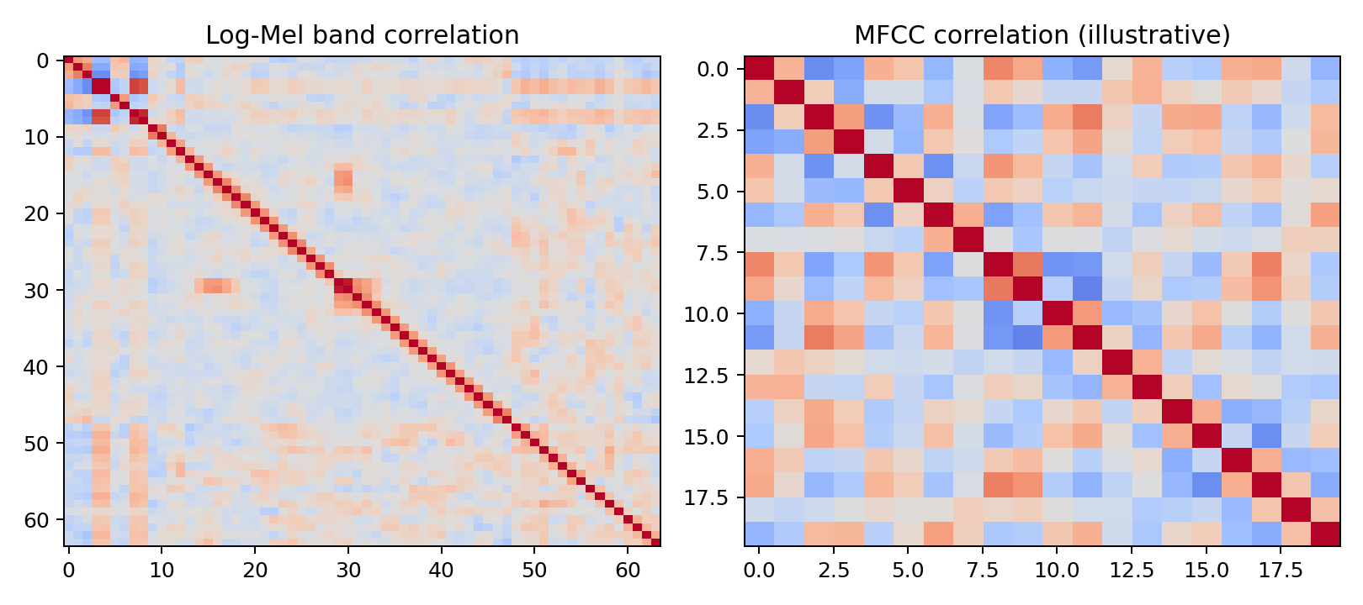
What does the DCT buy us?
APPROXIMATE DECORRELATION AND ENERGY COMPACTION
35–55 MIN
• Neighboring Mel bands overlap, so their log energies are correlated.
• The DCT rotates those coordinates into cosine-basis directions.
• Low-order coefficients often concentrate useful smooth spectral-envelope information.
• “Decorrelates” is approximate and data-dependent—not a universal guarantee.
Instructor cue: Connect to older Gaussian/diagonal-covariance models. The DCT is not magic statistical independence.
DSP + ML • Week 11 • Oppenheim & Schafer → Raschka
12

Slide 13
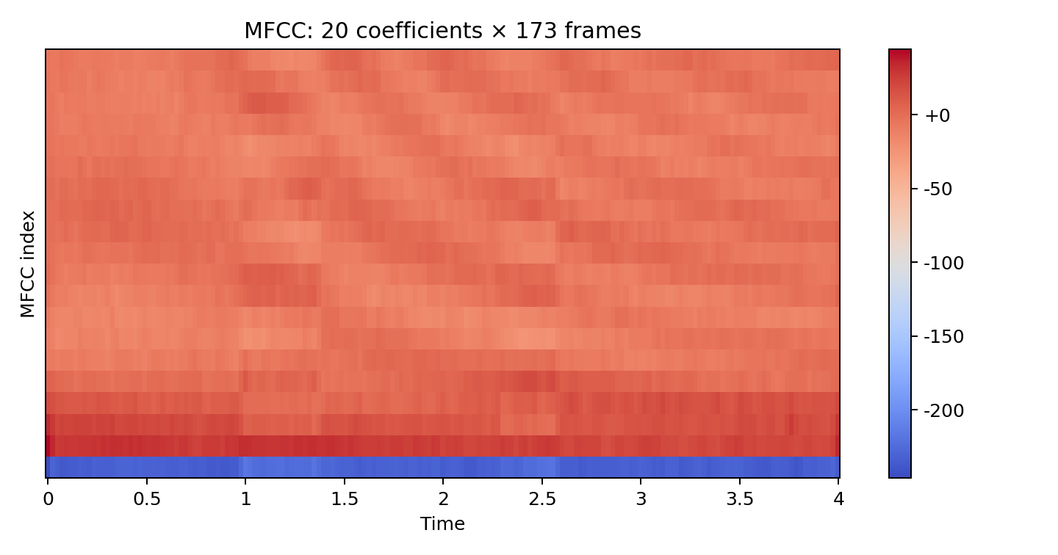
How should students interpret MFCC indices?
USE QUALITATIVE INTUITION, NOT ONE-TO-ONE PHYSICAL LABELS
35–55 MIN
• Low-order coefficients: broad spectral-envelope / tilt information.
• Higher-order coefficients: progressively finer variation across Mel bands.
• MFCCs intentionally discard much detailed harmonic structure.
• That compression can help a classical classifier—or hurt a task needing fine time–frequency detail.
DSP + ML • Week 11 • Oppenheim & Schafer → Raschka
13

Slide 14
Mel-spectrogram or MFCC?
CHOOSE THE REPRESENTATION TO MATCH THE MODEL AND TASK
35–55 MIN
Mel-spectrogram
2D time–frequency geometry Natural CNN input More local detail
MFCC matrix
Compact spectral-envelope view Still has time frames Classical baseline friendly
MFCC summary
Mean/std over time Fixed vector Temporal order destroyed
No universally “best” feature: representation creates an inductive bias.
DSP + ML • Week 11 • Oppenheim & Schafer → Raschka
14

Slide 15
Standardizing waveform geometry
BEFORE FEATURES, MAKE EXAMPLES COMPARABLE
55–75 MIN
1
Channels
Stereo → mono or a defined multi-channel policy
2
Sample rate
Resample every clip to 22.05 kHz
3
Duration
Pad/truncate to exactly 4.0 s
4
Amplitude
Use a consistent numeric range; do not erase meaningful level without justification
5
Features
Same n_fft, hop, n_mels, and n_mfcc for every clip
DSP + ML • Week 11 • Oppenheim & Schafer → Raschka
15

Slide 16
Downmixing stereo to mono
A CHANNEL DECISION IS PART OF THE MEASUREMENT MODEL
55–75 MIN
y_mono[n] = 0.5(y_L[n] + y_R[n])
Feature engineering begins with deciding what information you are willing to throw away.
• Simple averaging is common when spatial information is irrelevant.
• Do not downmix blindly if direction or spatial cues are part of the label.
• librosa.load(..., mono=True) can downmix automatically.
DSP + ML • Week 11 • Oppenheim & Schafer → Raschka
16

Slide 17
Resampling: one physical frequency grid for every example
22.05 KHZ BECOMES THE COURSE CONVENTION
55–75 MIN
N_samples = duration × f_s = 4.0 × 22050 = 88,200
DSP prerequisite
Week 2 still matters: bad rate conversion can create aliases.
• A fixed sample rate makes FFT-bin frequencies and Mel bands comparable across files.
• Always use an anti-aliased resampler; naive sample dropping is not resampling.
• 22.05 kHz implies Nyquist = 11.025 kHz—acceptable only if the task does not need higher-frequency information.
DSP + ML • Week 11 • Oppenheim & Schafer → Raschka
17

Slide 18
Padding and truncation: force a fixed tensor shape
SAME DURATION → SAME NUMBER OF FRAMES
55–75 MIN
target_len = int(4.0 * 22050) # 88,200 samples if len(y) < target_len: y = np.pad(y, (0, target_len - len(y))) else: y = y[:target_len] assert y.shape == (target_len,)
• Padding location is a design choice: right, left, or centered.
• Truncation can remove events—random crops or multiple crops may be better during training.
• For this week, deterministic right-padding/right-truncation keeps the baseline easy to debug.
DSP + ML • Week 11 • Oppenheim & Schafer → Raschka
18

Slide 19
Shape bookkeeping: predict dimensions before running code
A POWERFUL DEBUGGING HABIT
55–75 MIN
Waveform
[88,200]
STFT power
[1025, ~173]
Mel
[64, ~173]
MFCC
[20, ~173]
Mean+std
[40]
• Exact frame count depends on STFT centering/padding conventions.
• Flattening 20×173 MFCCs gives 3460 features; mean+std gives only 40.
• Dimensionality reduction is useful—but every reduction throws away structure.
DSP + ML • Week 11 • Oppenheim & Schafer → Raschka
19

Slide 20
Live code-along: one UrbanSound8K clip
MAKE EVERY PREPROCESSING DECISION VISIBLE
55–75 MIN
y, sr0 = librosa.load(path, sr=None, mono=True) y = librosa.resample(y, orig_sr=sr0, target_sr=22050) y = fix_length(y, int(4.0 * 22050)) mel = librosa.feature.melspectrogram( y=y, sr=22050, n_fft=2048, hop_length=512, n_mels=64, power=2.0) mel_db = librosa.power_to_db(mel, ref=np.max) mfcc = librosa.feature.mfcc(S=mel_db, n_mfcc=20)
Instructor cue: Pause after every line: what invariant did we establish, and what information might we have discarded?
DSP + ML • Week 11 • Oppenheim & Schafer → Raschka
20

Slide 21
Concept check
REASON ABOUT REPRESENTATION CHOICES
CHECK
• A. Increasing n_mels always improves classification accuracy.
• B. Converting stereo to mono is harmless for every audio task.
• C. Mean MFCCs reduce dimensionality but remove temporal ordering.
• D. Converting power to dB restores information lost by Mel pooling.
DSP + ML • Week 11 • Oppenheim & Schafer → Raschka
21

Slide 22
Concept check
REASON ABOUT REPRESENTATION CHOICES
CHECK
• A. Increasing n_mels always improves classification accuracy.
• B. Converting stereo to mono is harmless for every audio task.
• C. Mean MFCCs reduce dimensionality but remove temporal ordering.
• D. Converting power to dB restores information lost by Mel pooling.
Correct: C
• A, B, and D are not guaranteed. Each preprocessing choice encodes an assumption about which information matters.
DSP + ML • Week 11 • Oppenheim & Schafer → Raschka
21

Slide 23
Lecture 21 synthesis
FROM WAVEFORM PHYSICS TO ML-READY FEATURES
WRAP-UP
STFT
Mel pooling
log / dB
DCT
MFCC / Mel
• Mel features compress frequency according to a perceptual warping.
• MFCCs further rotate/compress log-Mel information for compact classical features.
• Fixed channels, rate, duration, and feature parameters give the model consistent geometry.
• Next lecture: feature matrices become X, labels become y, and evaluation discipline becomes central.
DSP + ML • Week 11 • Oppenheim & Schafer → Raschka
22

