Slide 1
LECTURE 23
Dimensionality Reduction & Maximum-Margin Classifiers
Taming high-dimensional audio features and finding robust boundaries.
75 minutes • PCA → SVM → pipeline
Senior + first-year graduate ECE
Notes:
[object Object],[object Object]

Slide 2
MOTIVATION
The feature vector has exploded
A 2 s clip with 20 ms frames can produce ~100 frames × 13 MFCCs — before adding energy, centroid, flux, roll-off, deltas, and statistics.
High dimension is not automatically “more information”: many features are correlated, noisy, or redundant.
Classification cost, sample complexity, visualization, and distance-based reasoning all become harder.
Notes:
[object Object],[object Object]

Slide 3
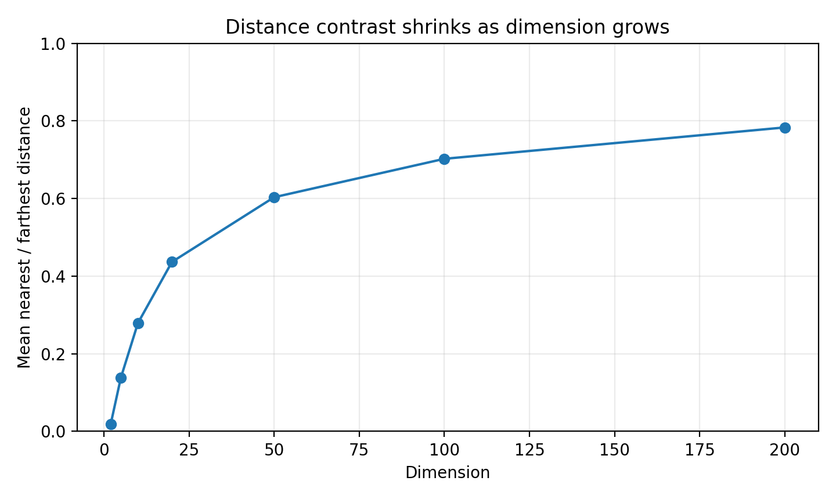
CURSE OF DIMENSIONALITY
Distance loses contrast in high dimensions
What changes?
Nearest and farthest neighbors become less distinguishable. A distance metric can still work, but it needs more data and careful feature scaling / selection.
Audio connection
MFCCs, deltas, flux, energy and spectral shape often contain correlated evidence. PCA attacks redundancy, not “bad dimensions” one-by-one.
Notes:
[object Object],[object Object],[object Object]

Slide 4
PCA
PCA: the engineering goal
Find orthogonal directions that capture as much variance in the standardized feature cloud as possible.
Project each clip onto the first few directions to obtain a compact set of principal-component scores.
Throw away low-variance directions only when that compression does not remove task-relevant structure.
Notes:
[object Object],[object Object]

Slide 5
PCA
Geometry first: rotate, then drop directions
PC2: next, orthogonal
Projection
PC1: maximum variance
A data point becomes its coordinates along PC1, PC2, … . Keeping only PC1 is the best 1-D linear least-squares reconstruction subspace.
Not feature selection
PC1 is usually a mixture of centroid, roll-off, MFCCs, etc. PCA creates new axes; it does not merely pick original features.
Notes:
[object Object],[object Object]

Slide 6
PCA
Step 0: standardize heterogeneous DSP features
Centroid might be in Hz, RMS is amplitude-like, ZCR is a rate, and MFCCs have unrelated numerical scales.
Without scaling, a feature with large numerical variance can dominate the covariance matrix.
Fit mean and standard deviation on the training set only; apply the same transform to validation/test data.
Exception
If physical scale itself carries meaning and you intentionally want variance in those units to dominate, standardization is a modeling choice — not a universal law.
Notes:
[object Object],[object Object]

Slide 7
PCA
From covariance to eigenvectors
Eigenvector vₖ
Eigenvalue λₖ
A direction in feature space. Orthogonal covariance eigenvectors become the PCA axes.
Variance captured along that direction. Larger λ means the projected cloud spreads more.
Scores
For centered data, zₖ = Xvₖ. Each clip gets a coordinate along each principal direction.
Notes:
[object Object],[object Object]

Slide 8
WORKED EXAMPLE
A 2-D PCA calculation by hand
Centered standardized feature samples give the covariance matrix
Interpretation
DSP reading
PC1 is the “both features rise together” direction and captures 3/(3+1)=75% of total variance.
If the two features were centroid and roll-off, PC1 would represent their common spectral-brightness trend; PC2 measures their disagreement.
Notes:
[object Object],[object Object],[object Object]

Slide 9
DSP CONNECTION
PCA vs. the DCT in MFCC processing
Both are orthogonal linear transforms that express a vector in a new basis.
The DCT basis is fixed and data-independent; PCA learns its basis from the covariance structure of the training data.
The DCT is chosen for useful signal-compaction properties on correlated sequences; PCA is optimal for variance capture on the observed distribution.
MFCC pipeline: mel log energies → DCT → cepstral coefficients. PCA can then operate across a larger engineered feature vector.
Notes:
[object Object],[object Object]

Slide 10
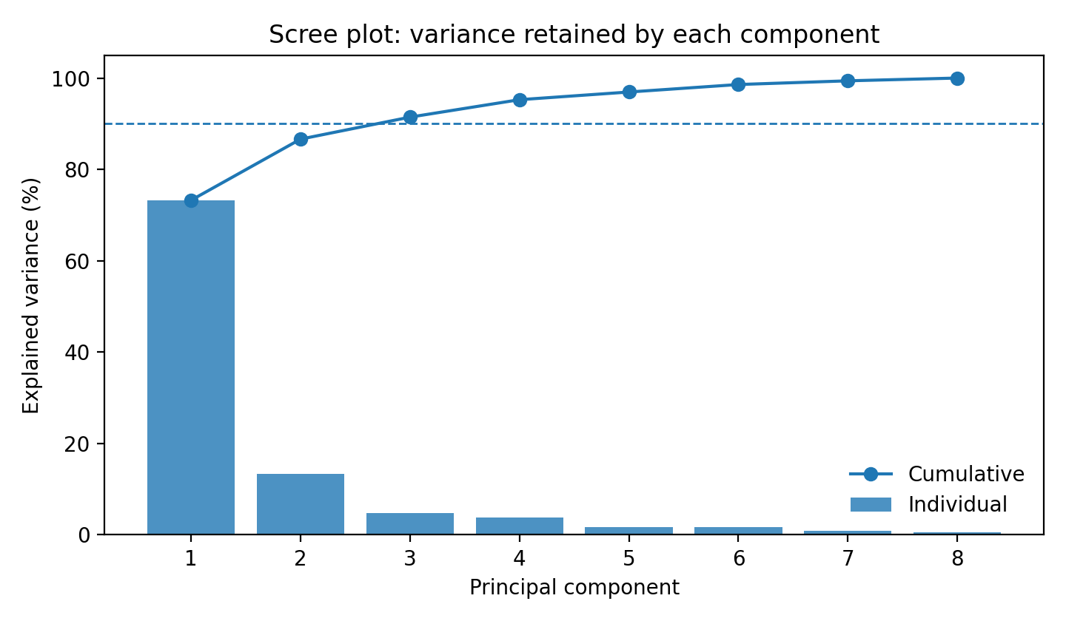
PCA
How many components? Use a scree plot + task validation
Common rule
Choose the smallest k that retains a target fraction such as 90–95% variance — then verify downstream accuracy and stability.
Do not say
“95% variance means 95% classification accuracy.” Explained variance is not a class-performance metric.
Notes:
[object Object],[object Object]

Slide 11
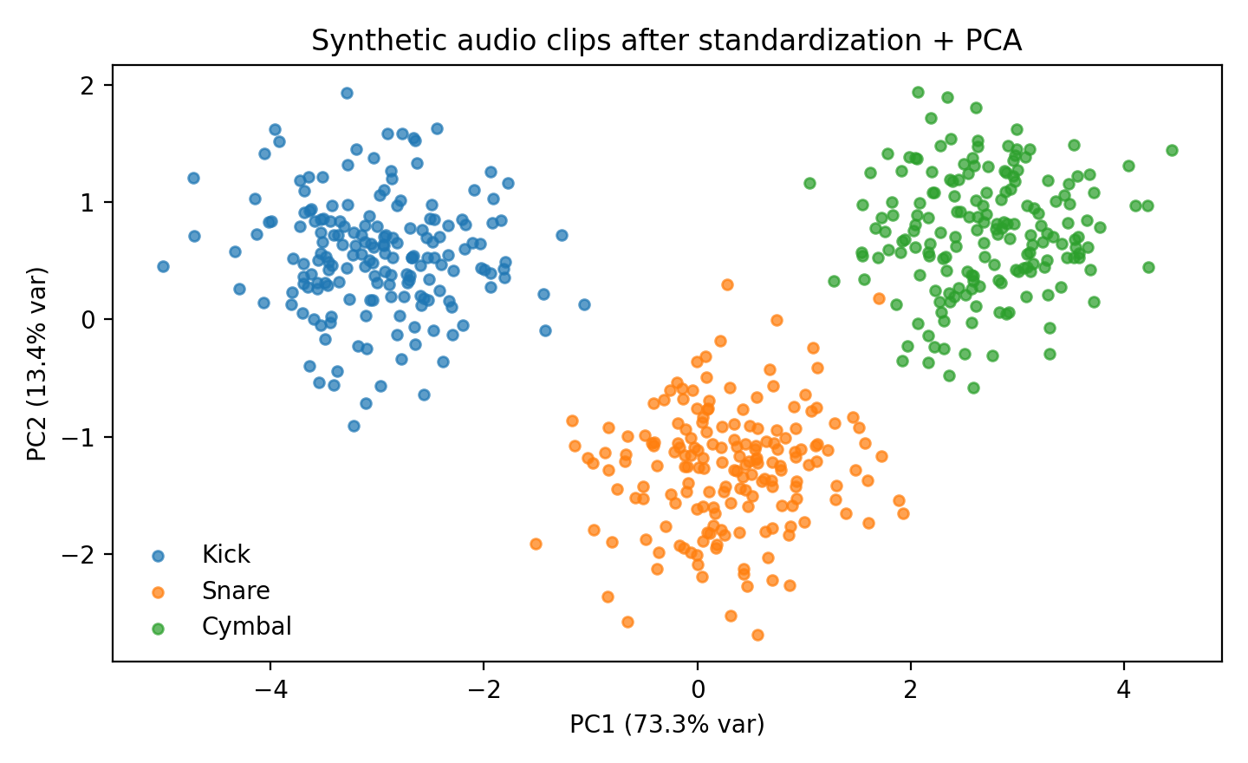
PCA IN PRACTICE
What PCA reveals in our synthetic audio features
Read the plot
Classes separate substantially along combinations of features rather than along one raw feature.
Important caveat
This plot is synthetic and intentionally teachable. Real audio often has overlap from room acoustics, performer, microphone, gain, and recording context.
Notes:
[object Object],[object Object]

Slide 12
CONCEPT CHECK
Pause & predict: PCA
Question
A low-variance feature direction cleanly separates two classes, while high-variance directions contain performer and microphone variation. What can PCA do wrong?
Notes:
[object Object],[object Object]

Slide 13
CONCEPT CHECK
Pause & predict: PCA
Question
A low-variance feature direction cleanly separates two classes, while high-variance directions contain performer and microphone variation. What can PCA do wrong?
Good answer
If we keep only high-variance PCs, PCA may discard the low-variance discriminative direction. PCA optimizes reconstruction variance, not label separation.
Extension: Which method would explicitly use labels? → supervised feature selection, LDA, or a classifier trained on the full feature set.
Notes:
[object Object],[object Object]

Slide 14
IMPLEMENTATION
scikit-learn: scaling → PCA
Leakage-safe preprocessing
from sklearn.pipeline import Pipeline
from sklearn.preprocessing import StandardScaler
from sklearn.decomposition import PCA
prep = Pipeline([
("scale", StandardScaler()),
("pca", PCA(n_components=0.95)),
])
Z_train = prep.fit_transform(X_train)
Z_test = prep.transform(X_test)
Why a Pipeline?
During cross-validation, each fold learns its own scaler and PCA basis from that fold’s training samples only.
Notebook
Lecture23_PCA_SVM.ipynb includes scree plots, loadings, GridSearchCV, and a leakage-safe implementation.
Notes:
[object Object],[object Object]

Slide 15
SVM
Now classify: what boundary should we trust?
A linear classifier can separate classes with a hyperplane — but infinitely many separating hyperplanes may exist.
SVM asks for the separating boundary with the largest margin to the closest training examples.
Those closest examples are the support vectors: they determine the boundary.
Notes:
[object Object],[object Object]

Slide 16
SVM
Maximum-margin hyperplane
support vectors sit on / inside margin
Notes:
[object Object],[object Object]

Slide 17
SVM
Hard margin becomes soft margin
Small C
Wider / smoother effective margin; tolerates more violations. More regularization, potentially more bias.
Large C
Penalizes violations strongly. Fits training labels more aggressively; can increase variance / overfit.
Notes:
[object Object],[object Object]

Slide 18
SVM
Support vectors: why only a few points matter
Points far from the margin can move slightly without changing the optimal boundary.
Support vectors are the training examples at or inside the margin; they carry the geometric constraint.
This gives SVMs a sparse geometric description of the boundary, even though kernel prediction may still be computationally significant.
Notes:
[object Object],[object Object]

Slide 19
SVM
When a straight line is not enough: kernels
γ small
Broad influence; smoother decision function. Too small can underfit.
Kernel trick
Compute inner-product-like similarities corresponding to a higher-dimensional feature map without explicitly building that map.
γ large
Very local influence; intricate boundary. Too large can memorize local details.
Notes:
[object Object],[object Object]

Slide 20
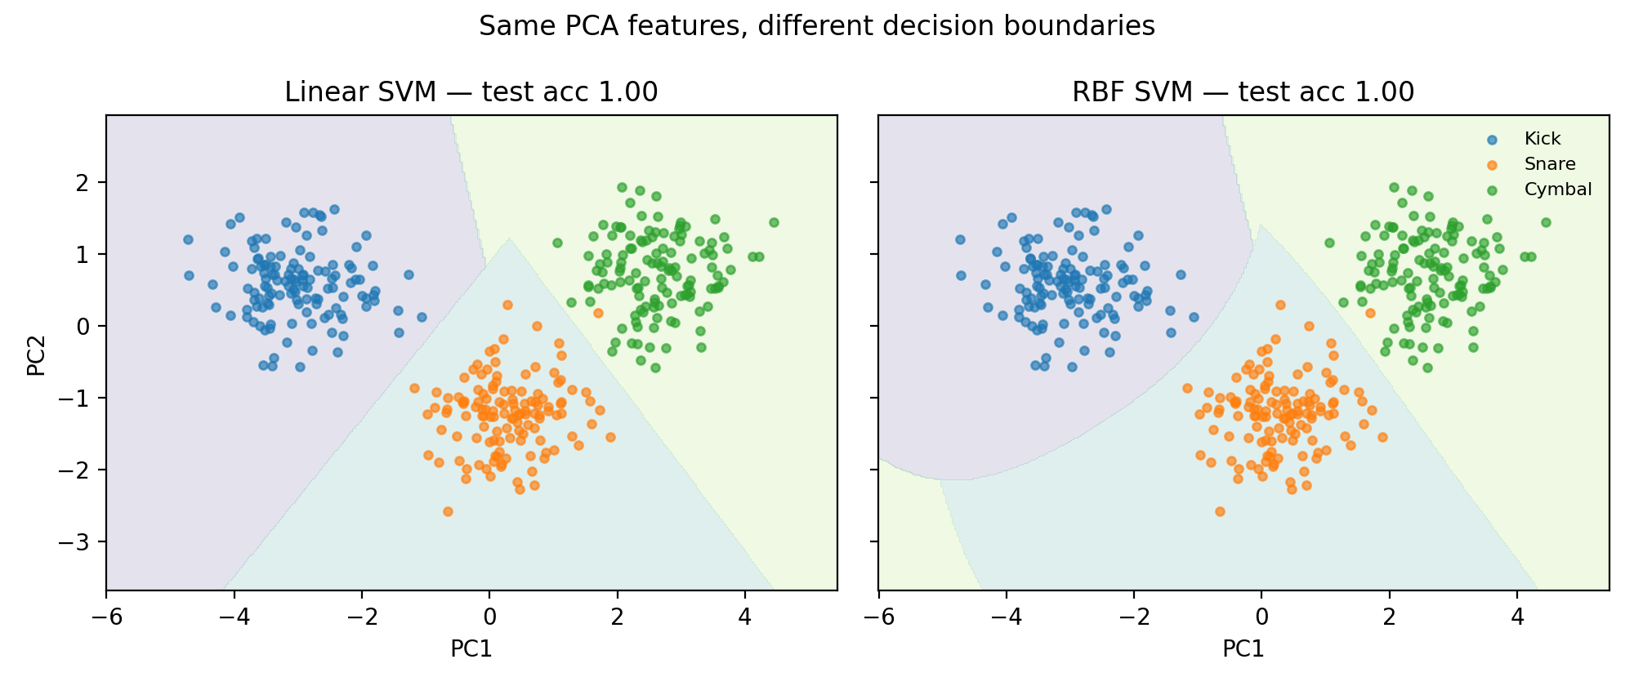
SVM IN PRACTICE
Linear vs. RBF on the same PCA coordinates
Do not infer too much from 2-D
The full classifier may use more PCs. A pretty 2-D boundary is for intuition, not proof of generalization.
Select by validation
Tune C, γ, and PCA dimensionality with cross-validation — then report the final held-out test result once.
Notes:
[object Object],[object Object]

Slide 21
IMPLEMENTATION
One pipeline: PCA → SVM
PCA + RBF SVM
Scale because both PCA and SVM depend on geometry.
Keep transforms inside the pipeline so cross-validation is honest.
Grid-search C, γ, and potentially PCA dimensionality on training folds only.
from sklearn.svm import SVC
model = Pipeline([
("scale", StandardScaler()),
("pca", PCA(n_components=0.95)),
("svm", SVC(kernel="rbf", C=3, gamma="scale")),
])
model.fit(X_train, y_train)
print(model.score(X_test, y_test))
Notes:
[object Object],[object Object]

Slide 22
WRAP-UP
Lecture 23 synthesis: what each step is buying you
Feature engineering
PCA
SVM
Inject DSP knowledge: summarize spectra, dynamics, timbre, energy.
Compress correlated geometry; improve visualization / conditioning; may reduce noise and compute.
Choose a robust margin-based decision surface; use kernels when justified.
Raw audio → DSP features → scale → PCA? → classifier → validation
Notes:
[object Object],[object Object]

