Slide 1
LECTURE 24
Tree-Based Models & Ensemble Learning
Nonlinear decision rules, overfitting, bagging, and feature importance.
75 minutes • Trees → pruning → forests
Senior + first-year graduate ECE
Notes:
[object Object],[object Object]

Slide 2
INTUITION
Whiteboard exercise: classify by rules
Prompt
Possible first rule
How would you distinguish trumpet vs. piano using only engineered audio features? Build a human-readable flowchart.
Is spectral flux high? A piano attack may be transient, while a sustained trumpet frame may have lower flux.
Possible second rule
Teaching point
Is harmonic structure / spectral envelope consistent with a sustained source? Use MFCCs or spectral shape next.
A decision tree formalizes “if feature j < threshold, go left; else go right” and learns the thresholds from data.
Notes:
[object Object],[object Object]

Slide 3
DECISION TREES
A decision tree is a recursive partition
At each node, choose one feature and one threshold that makes the child nodes “purer” in class labels.
Each root-to-leaf path is an AND of threshold rules.
In 2-D, repeated threshold splits carve the plane into axis-aligned rectangles.
Notes:
[object Object],[object Object]

Slide 4
DECISION TREES
Gini impurity: probability of class mixing
Pure node
Balanced 3-class node
[30, 0, 0] → G = 0. One class only.
[10, 10, 10] → G = 1 − 3(1/3)² = 2/3.
Candidate splits are scored by weighted child impurity.
Choose the threshold that produces the largest impurity decrease.
Notes:
[object Object],[object Object]

Slide 5
DECISION TREES
Entropy and information gain
Gini vs entropy
They usually choose similar splits. Gini is slightly cheaper; entropy has a direct information-theoretic interpretation.
Engineering habit
Focus on the weighted decrease in impurity — not on memorizing which criterion is “better.” Validate performance.
Notes:
[object Object],[object Object]

Slide 6
DECISION TREES
Worked split: does this threshold help?
Parent: 20 kick, 20 cymbal
Candidate split:
Left: 18 kick, 2 cymbal
Right: 2 kick, 18 cymbal
Interpretation
Large impurity decrease: the threshold creates two much purer children.
Notes:
[object Object],[object Object]

Slide 7
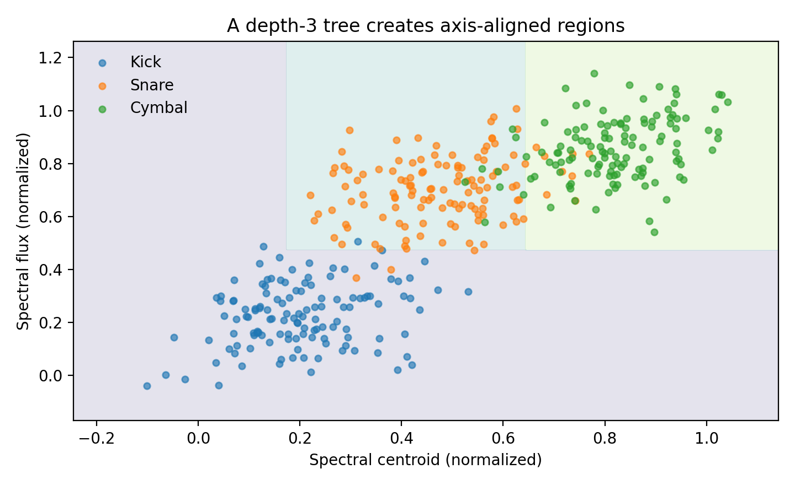
VISUALIZING
How a tree partitions audio-feature space
Axis-aligned boundaries
Each split is perpendicular to one feature axis. Nonlinear overall regions emerge from many rectangular pieces.
Interpretability
A shallow path can be read as a rule: centroid < τ₁ AND flux ≥ τ₂ → class.
Notes:
[object Object],[object Object]

Slide 8
DECISION TREES
Trees do not need feature standardization
A split depends on ordering: x_j < threshold. Monotonic rescaling preserves the ordering of samples.
Therefore standardizing Hz, energy, and MFCC values is not necessary for a standard decision tree.
But missing values, outliers, categorical encodings, and leakage still require careful preprocessing.
Notes:
[object Object],[object Object]

Slide 9
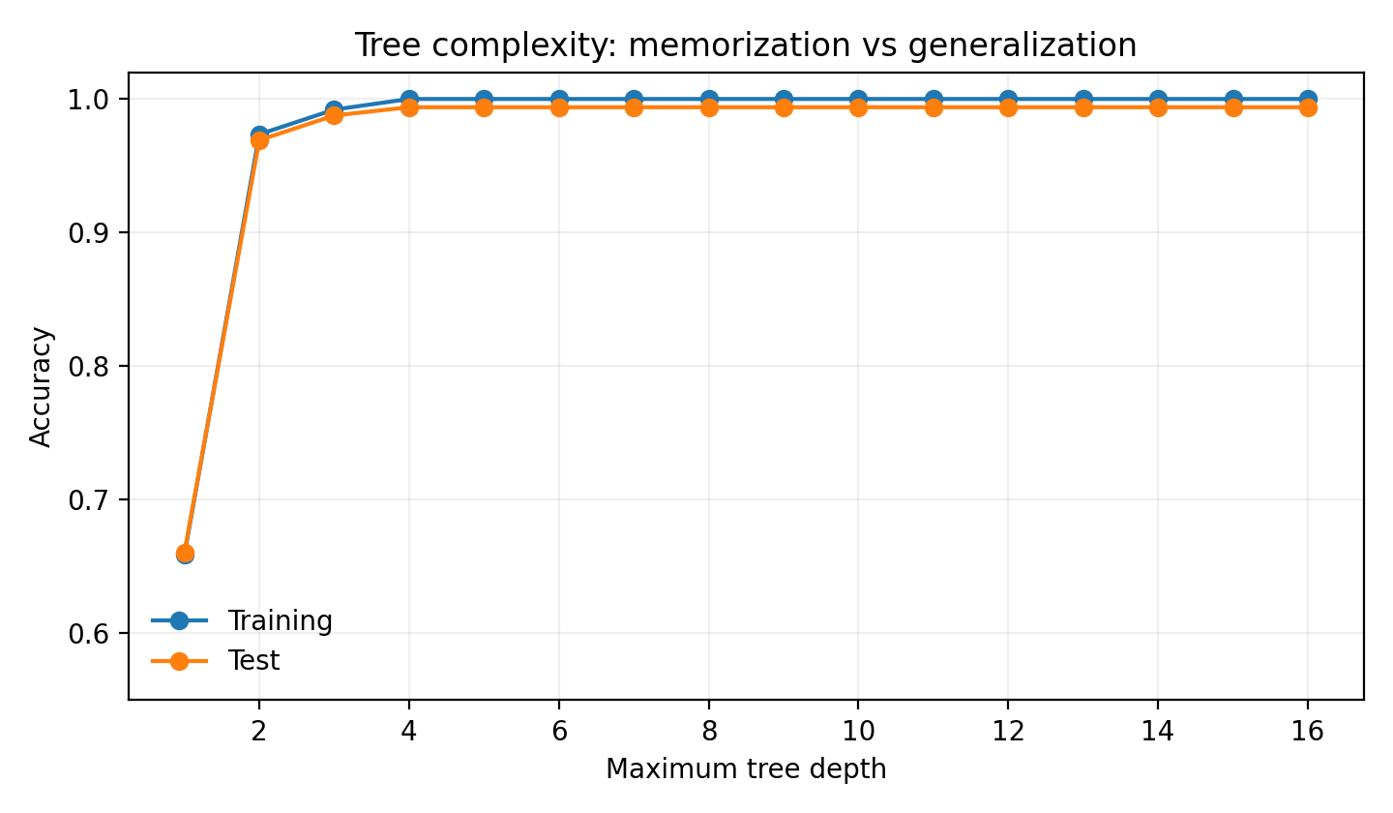
OVERFITTING
The danger: a deep tree can memorize the room
Audio-specific overfit
A deep tree may split on microphone hiss, room noise, gain, performer, or recording-session artifacts rather than instrument identity.
Symptom
Training accuracy keeps rising while validation/test accuracy stalls or drops.
Notes:
[object Object],[object Object]

Slide 10
REGULARIZATION
Control tree complexity before it controls you
`max_depth`: maximum number of decision levels.
`min_samples_leaf`: require evidence before creating a tiny leaf.
`min_samples_split`: require enough samples to attempt a split.
`max_leaf_nodes`: cap the number of terminal regions.
`ccp_alpha`: post-prune branches using cost-complexity pruning.
Notes:
[object Object],[object Object]

Slide 11
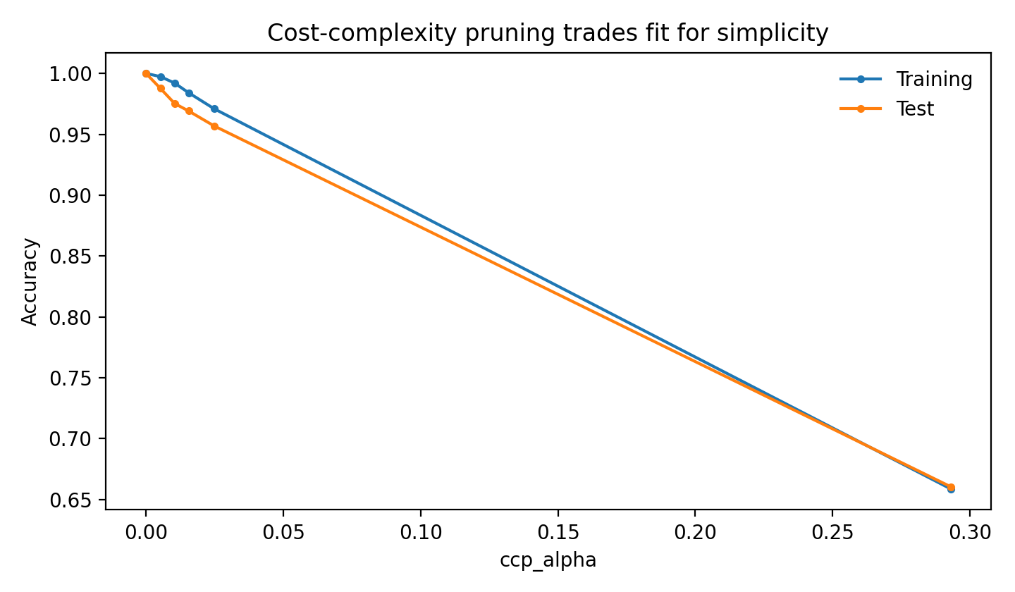
REGULARIZATION
Cost-complexity pruning
α = 0
No complexity penalty; retain the fully grown candidate tree.
Larger α
Pay more for extra leaves; prune branches that add too little reduction in error / impurity.
Notes:
[object Object],[object Object]

Slide 12
ENSEMBLES
Bagging: average unstable learners
bootstrap sample 1
(with replacement)
tree 1
Vote / average
Classification: majority vote (or averaged class probabilities). Variance falls when individual tree errors are not perfectly correlated.
training set
bootstrap sample 2
(with replacement)
tree 2
bootstrap sample 3
(with replacement)
tree 3
Notes:
[object Object],[object Object]

Slide 13
RANDOM FORESTS
Random forest = bagging + random feature subsets
Each tree trains on a bootstrap sample.
At each split, only a random subset of candidate features is considered.
This prevents one dominant feature from making every tree look the same.
Averaging many de-correlated trees typically reduces variance while retaining flexible nonlinear boundaries.
Notes:
[object Object],[object Object]

Slide 14
RANDOM FORESTS
Why averaging helps
B
ρ
Design implication
Number of trees. The independent part of variance shrinks roughly with 1/B.
Correlation between tree errors. If trees make the same mistakes, averaging cannot remove them.
Bootstrap samples + random feature subsets aim to keep trees strong but less correlated.
Notes:
[object Object],[object Object]

Slide 15
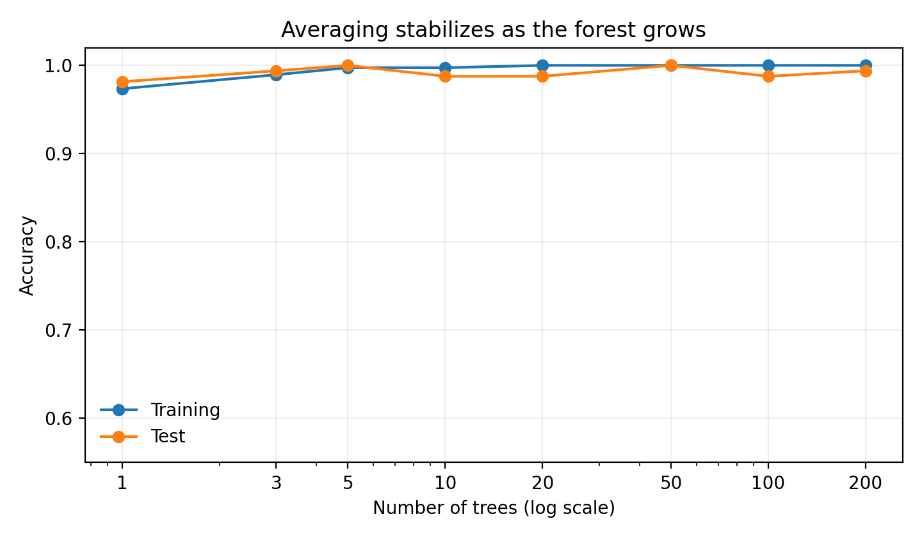
RANDOM FORESTS
As the forest grows, predictions stabilize
More trees usually do not overfit like more depth
Increasing B mainly reduces Monte Carlo variance; training each tree more deeply is a different complexity choice.
Cost
More trees increase memory and inference / training time. Stop when validation performance and uncertainty stabilize.
Notes:
[object Object],[object Object]

Slide 16
RANDOM FORESTS
Out-of-bag (OOB) evaluation
A bootstrap sample leaves out roughly 36.8% of the training examples for a given tree.
For each training example, predict using only trees that did not train on that example.
Aggregate those predictions to obtain an internal generalization estimate without a separate validation split.
Notes:
[object Object],[object Object],[object Object]

Slide 17
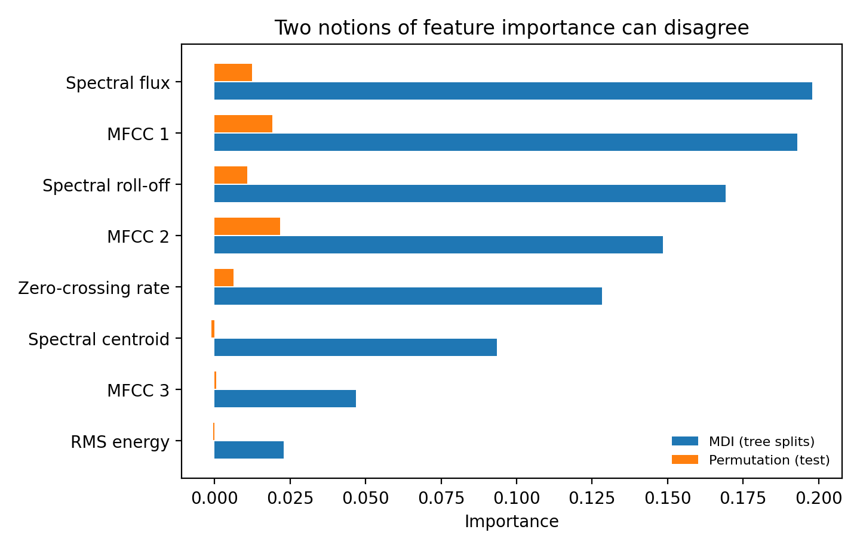
INTERPRETABILITY
Feature importance: useful, but ask “importance for what?”
MDI
Mean decrease in impurity: how much tree splits using a feature reduce impurity across the forest.
Permutation
Shuffle one feature on held-out data; measure how much prediction degrades.
Caution
Correlated features can share or mask importance. High importance is not causality.
Notes:
[object Object],[object Object]

Slide 18
MODEL COMPARISON
Tree vs. forest vs. SVM: choose by structure, not fashion
Single tree
Random forest
Scaled SVM
Readable rules
Fast inference
High variance unless regularized
Axis-aligned regions
Flexible nonlinear model
Robust average
Good default on tabular features
Less transparent than one tree
Margin-based geometry
Excellent in moderate/high dimension
Scaling essential
RBF needs C/γ tuning
Best engineering answer: compare candidates with the same leakage-safe cross-validation protocol and inspect failure modes.
Notes:
[object Object],[object Object]

Slide 19
IMPLEMENTATION
scikit-learn: tree and forest
Models
from sklearn.tree import DecisionTreeClassifier
from sklearn.ensemble import RandomForestClassifier
tree = DecisionTreeClassifier(
max_depth=4, min_samples_leaf=8, random_state=1)
forest = RandomForestClassifier(
n_estimators=300, max_features="sqrt",
min_samples_leaf=2, oob_score=True,
random_state=1, n_jobs=-1)
No StandardScaler required
Threshold-based splits are invariant to monotonic rescaling of each feature.
Notebook
Lecture24_Trees_RandomForests.ipynb includes impurity calculations, tree plots, pruning, OOB score, cross-validation, and permutation importance.
Notes:
[object Object],[object Object]

Slide 20
WRAP-UP
Lecture 24 synthesis
Tree
Regularization
Forest
Greedy hierarchical threshold rules; intuitive but unstable.
Depth, leaf size, and pruning prevent memorizing recording artifacts.
Average many de-correlated trees to reduce variance.
Interpretation
Importance answers a predictive question, not a causal one; correlated audio features complicate attribution.
Notes:
[object Object]

