Slide 1

ECEN 4/5632 Theory and Application of Digital Filters
Lecture 12, 10-13-26, 10-15-26
Peter Mathys*
* With generous help from Gemini Pro and ChatGPT

Slide 2
WEEK 6 ● LECTURE 12
The STFT and Spectrograms
Local spectra for non-stationary signals and 2-D ML features
Oppenheim & Schafer • DFT / FFT / STFT | Raschka • CNN architecture and feature pipelines

Slide 3
Learning objectives
ROADMAP
0:00–0:03
• Explain why a single global spectrum can fail for non-stationary signals.
• Interpret the STFT as a sequence of windowed local Fourier transforms.
• Predict the time–frequency resolution trade-off from window duration.
• Read and construct a spectrogram.
• Format spectrograms as structured tensors for PyTorch CNNs.
Core question
How do we preserve both when a frequency occurs and what that frequency is?
WEEK 10 • TIME-FREQUENCY ANALYSIS

Slide 4
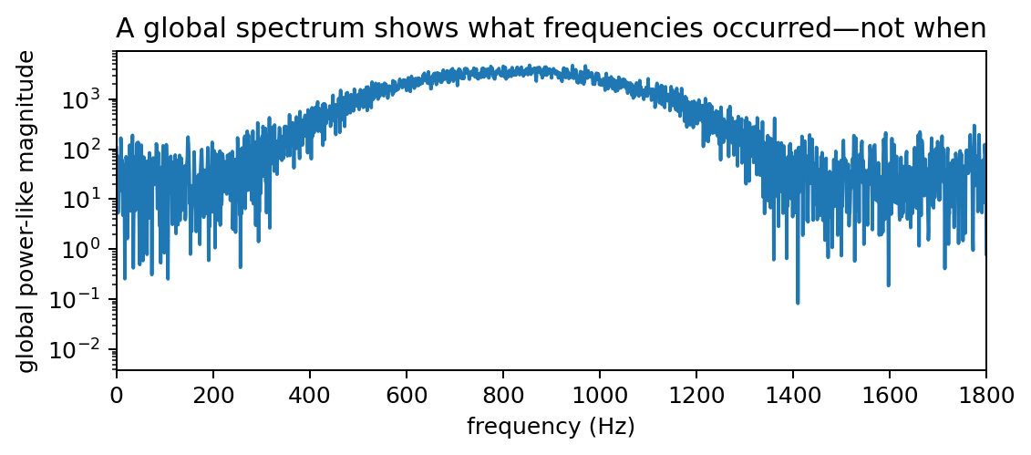
Why a global spectrum is not enough
NON-STATIONARY SIGNALS
0:03–0:10
What it tells us
Many frequencies occurred during the record.
What it loses
It does not tell us that the dominant frequency swept upward with time.
Speech, radar, machinery faults, ECG/EEG, and transient events are often non-stationary.
WEEK 10 • TIME-FREQUENCY ANALYSIS

Slide 5
Localize before transforming
STFT
0:10–0:15
Take a short window around a time location, then compute a Fourier transform of that local segment.
X(r,ω) = Σₘ x[m] w[m−rR] e^(−jωm)
• r = frame index
• R = hop size between frames
• w[n] = analysis window
• Each frame produces one local spectrum.
Equivalent notation
Texts place the window as w[rR−m] or w[m−rR]. For real symmetric windows, the practical idea is the same: select a neighborhood around the frame time.
WEEK 10 • TIME-FREQUENCY ANALYSIS

Slide 6
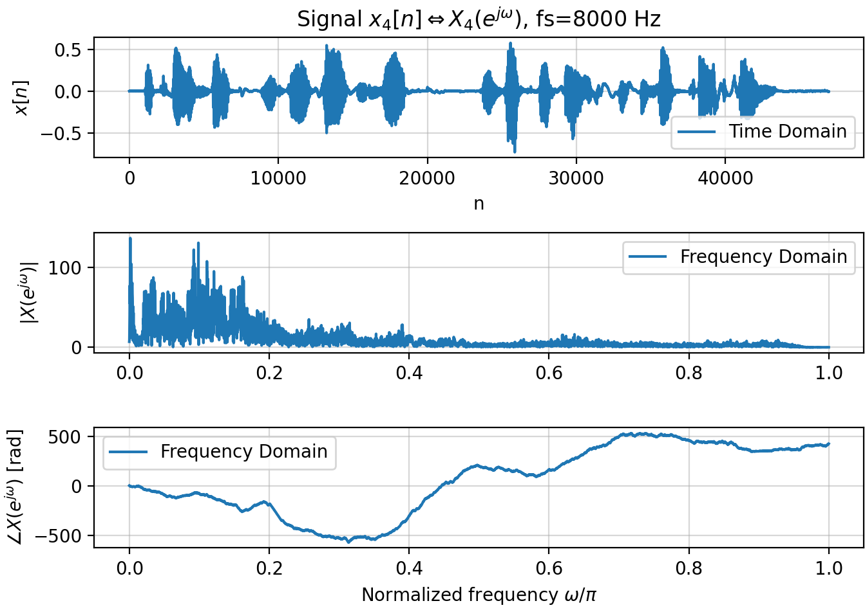
Example: Speech Signal
Looking only at time domain, frequency content is not visible.
Looking at magnitude in the frequency domain, time domain information is not visible.
Looking at the phase in the frequency domain does not reveal any interesting information.

Slide 7
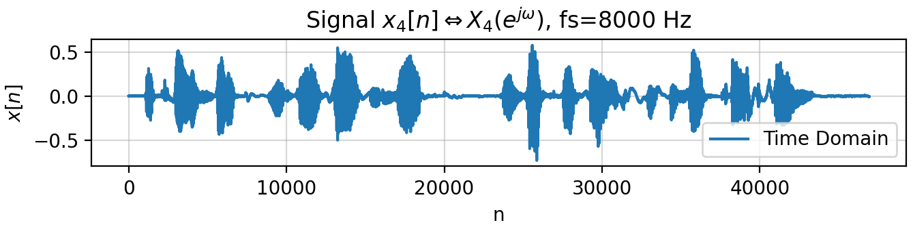
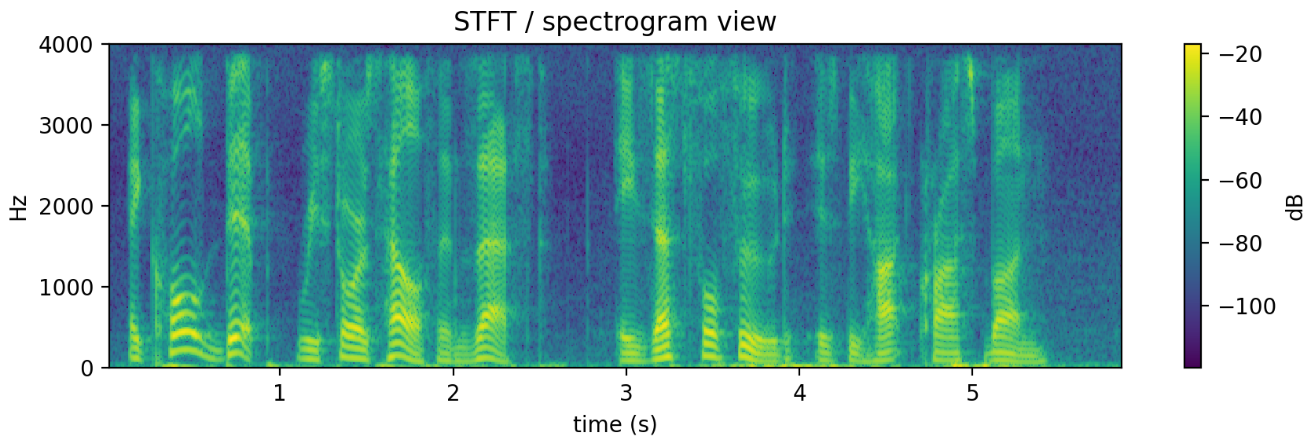
Example: Speech Signal
A spectrogram visualizes both time and frequency by dividing up an audio signal into overlapping blocks and taking Short Time Fourier Transforms (STFTs) of each block that are then displayed as two dimensional images.
“A cold dip restores health and zest, a zestful food is the hot cross bun”

Slide 8
From frames to a time–frequency matrix
STFT
0:15–0:22
• Frame the signal into overlapping segments.
• Multiply each segment by a window.
• Take an FFT along the sample dimension.
• Stack the spectra as columns (or rows).
PyTorch viewpoint
That matrix is already a structured tensor. Add batch and channel dimensions and it looks like an image input to a CNN.
STFT output shape ≈ frequency bins × time frames
WEEK 10 • TIME-FREQUENCY ANALYSIS

Slide 9
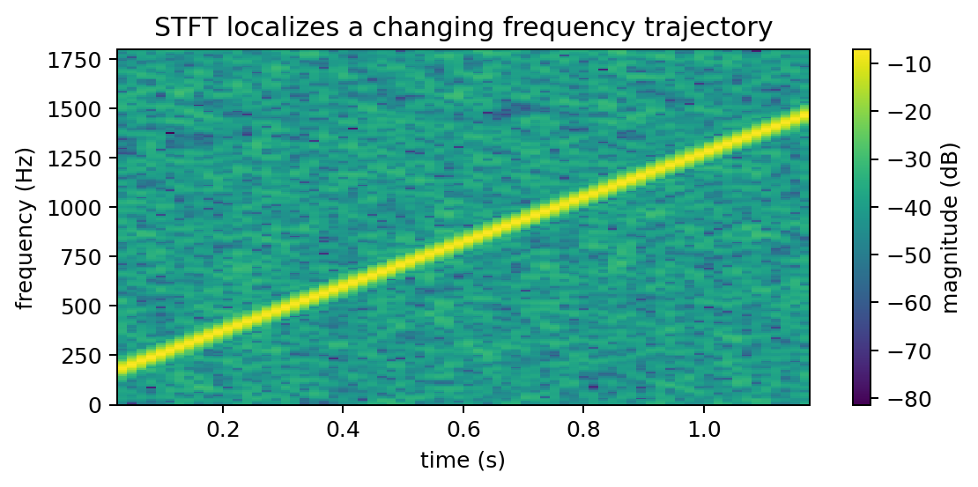
The STFT reveals the chirp trajectory
STFT
0:22–0:28
Read it
Horizontal position = time. Vertical position = frequency. Brightness/color = local magnitude or power.
The upward ridge is the time-varying instantaneous frequency.
WEEK 10 • TIME-FREQUENCY ANALYSIS

Slide 10


Window length sets the central trade-off
RESOLUTION
0:28–0:34
Short window
Long window
• Good time localization.
• Few samples → broad spectral main lobe.
• Fast events are separated more clearly.
• Good frequency localization.
• Many samples → narrower spectral features.
• Rapid changes are smeared over time.
No free lunch
You cannot make a window arbitrarily narrow in time and simultaneously arbitrarily narrow in frequency.
WEEK 10 • TIME-FREQUENCY ANALYSIS

Slide 11
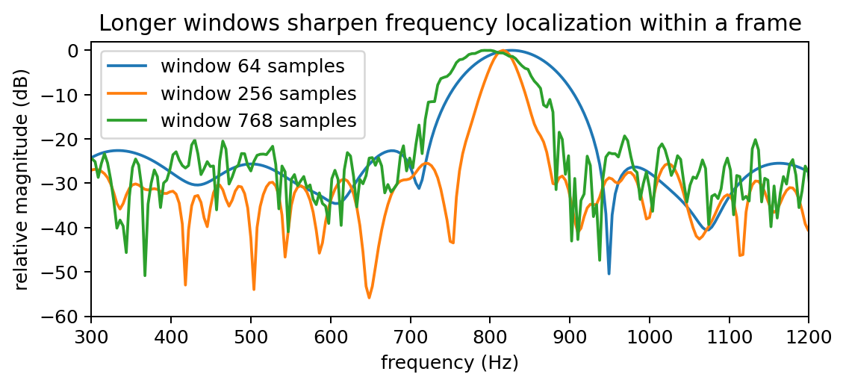
Frequency view of the window trade-off
RESOLUTION
0:34–0:39
Interpretation
At one time frame, longer windows produce sharper frequency localization. But they average over a longer interval of the chirp.
Resolution is not the same as FFT display density.
WEEK 10 • TIME-FREQUENCY ANALYSIS

Slide 12
Hop size and overlap
STFT
0:39–0:43
Hop R = number of new samples between adjacent frames
• Small R → many overlapping frames and a dense time grid.
• Large R → fewer frames, less computation, coarser time sampling.
• Overlap does not undo the fundamental window resolution trade-off.
• For reconstruction, window/hop choices must also satisfy overlap-add conditions.
Common choice
For analysis with Hann windows, 50–75% overlap is common, but the application should set the hop.
WEEK 10 • TIME-FREQUENCY ANALYSIS

Slide 13
Spectrogram = squared STFT magnitude
SPECTROGRAM
0:43–0:49
Spectrogram(r,ω) = |X(r,ω)|²
Important
A spectrogram is not just a pretty picture—it is a numerical matrix whose axes and normalization matter.
• Discard phase and visualize local energy/power-like content.
• Often displayed in decibels: 10 log₁₀(power + ε).
• Color scaling strongly affects what patterns are visible.
• One-sided display is common for real-valued signals.
WEEK 10 • TIME-FREQUENCY ANALYSIS

Slide 14


Slide 15






Slide 16


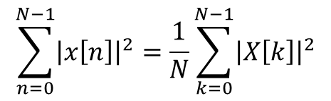
$$\sum_{n=0}^{N−1}{{\left|x\left[n\right]\right|}^{2}=\frac{1}{N}\sum_{k=0}^{N−1}{{\left|X\left[k\right]\right|}^{2}}}$$
Parseval’s Identity:

Slide 17
How to read a spectrogram
SPECTROGRAM
0:49–0:55
• Horizontal ridge → sustained tone.
• Vertical stripe → broadband transient.
• Sloped ridge → chirp or changing pitch.
• Harmonic stacks → periodic voiced or rotating behavior.
• Diffuse background → broadband noise.
Ask students
What time-domain event would create a narrow vertical stripe across many frequencies?
WEEK 10 • TIME-FREQUENCY ANALYSIS

Slide 18


Concept check: two close tones that switch
CONCEPT CHECK
0:55–0:58
A signal contains 500 Hz for the first 50 ms and 550 Hz for the next 50 ms.
Would you begin with a very short or very long STFT window?
Good answer
Neither extreme. The window must be long enough to distinguish 50-Hz-separated tones but short enough not to smear the 50-ms transition. The problem is inherently a time–frequency trade-off.
WEEK 10 • TIME-FREQUENCY ANALYSIS

Slide 19
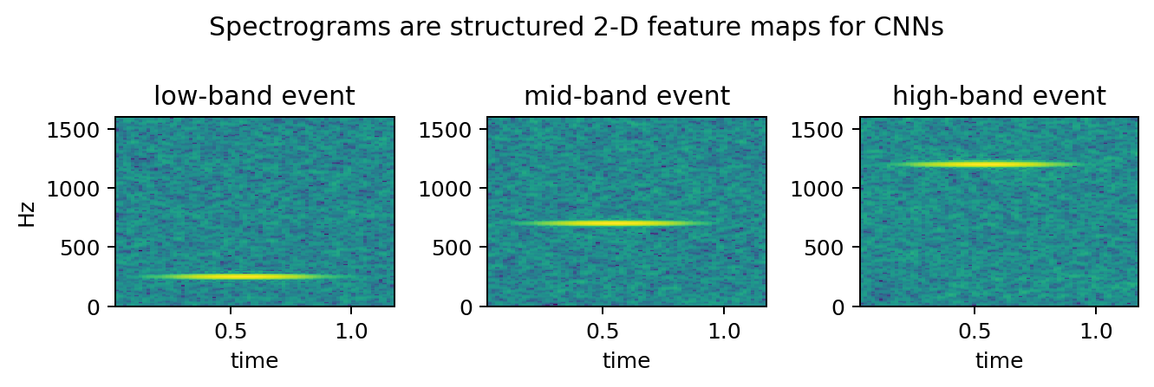
Spectrograms as CNN inputs
ML BRIDGE
0:58–1:04
• Frequency bins behave like a vertical spatial axis.
• Time frames behave like a horizontal spatial axis.
• Local 2-D filters can learn ridges, transients, harmonic patterns, and modulations.
• Typical tensor shape: [batch, channel, frequency, time].
Example: [32, 1, 257, 101]
WEEK 10 • TIME-FREQUENCY ANALYSIS

Slide 20
Magnitude scaling and normalization before ML
ML BRIDGE
1:04–1:08
• Use magnitude or power consistently.
• Log compression reduces extreme dynamic range and often makes weak structure more visible.
• Normalize using training-set statistics, not statistics from the test set.
• Keep sample rate, STFT parameters, and frequency range fixed across examples.
• Avoid data leakage when computing normalization or augmentations.
Pipeline reproducibility
The STFT is part of the model input definition. Changing window length or hop changes the feature space just like changing a network layer.
WEEK 10 • TIME-FREQUENCY ANALYSIS

Slide 21

PyTorch: from waveform to image tensor
ML BRIDGE
1:08–1:11
waveform [B,N] → STFT → magnitude → log → [B,1,F,T] → Conv2d
Z = torch.stft(x, n_fft=512, hop_length=128, window=win, return_complex=True)
S = torch.log1p(torch.abs(Z)**2).unsqueeze(1)
Why Conv2d?
The model can exploit local patterns jointly across neighboring times and neighboring frequencies.
WEEK 10 • TIME-FREQUENCY ANALYSIS

Slide 22
When not to treat the spectrogram as a generic image
ML BRIDGE
1:11–1:13
• Time and frequency axes are not interchangeable.
• A one-bin translation in frequency may have a different physical meaning at different scales.
• Image augmentations such as arbitrary rotation or vertical flipping are usually physically nonsensical.
• DSP-informed augmentations should preserve plausible signal behavior.
Good ML habit
Use domain knowledge to decide which invariances the model should learn rather than importing image tricks blindly.
WEEK 10 • TIME-FREQUENCY ANALYSIS

Slide 23
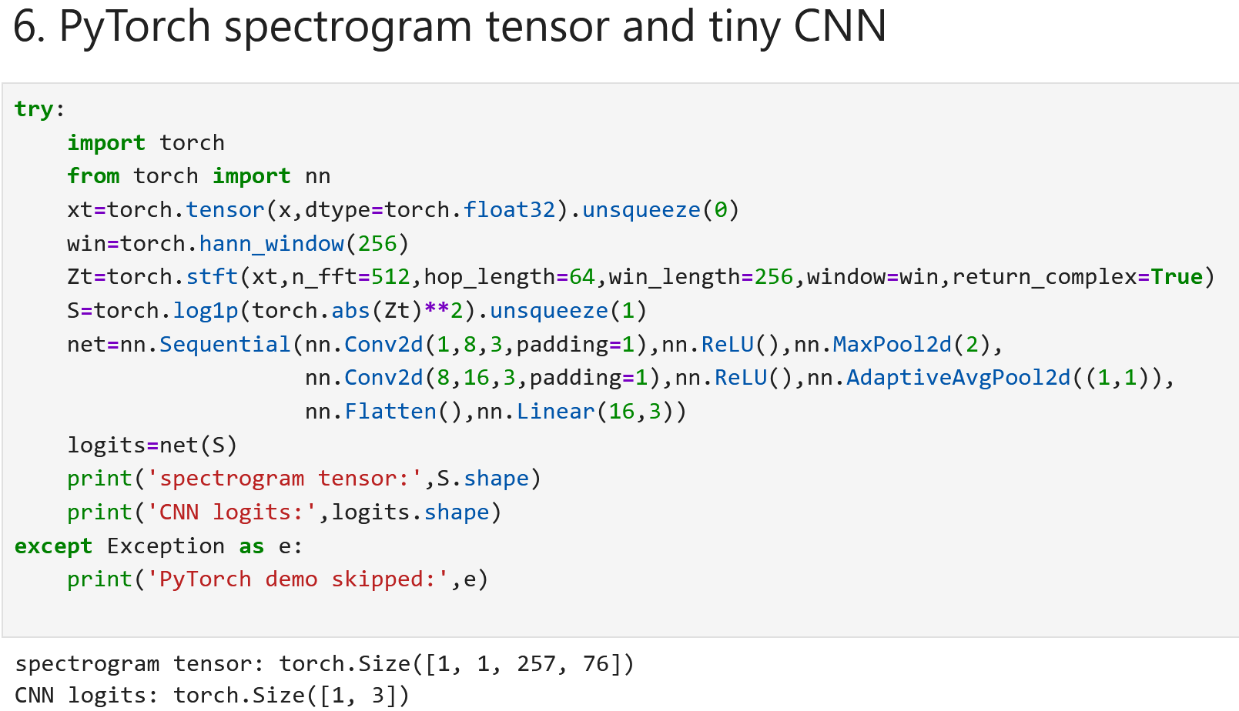
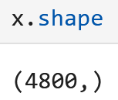
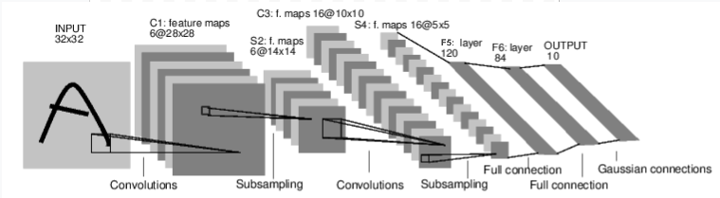

Slide 24
Lecture 12 wrap-up
WRAP-UP
1:13–1:15
• A global transform loses when frequency content occurs.
• The STFT computes local windowed spectra over time.
• Window duration trades time resolution against frequency resolution.
• The spectrogram is |STFT|² and is a structured time–frequency matrix.
• Spectrograms create a direct bridge from DSP to 2-D CNNs.
Exit ticket
A transient lasts 8 ms. Why might a 200-ms STFT window be a poor choice even if it gives excellent frequency resolution?
WEEK 10 • TIME-FREQUENCY ANALYSIS

