Slide 1

ECEN 4/5632 Theory and Application of Digital Filters
Lecture 6, 9-10-26
Peter Mathys*
* With generous help from Gemini Pro and ChatGPT

Slide 2

WEEK 3 • LECTURE 6
Transfer Functions, Stability,
and Pole–Zero Plots
poles push up
zeros pull down
Turn rational algebra into geometric intuition about filters.
75 minutes • rigorous DSP foundations • audio examples • Python sandbox • ML bridge
Week 3 • DSP + ML • Oppenheim & Schafer
1

Slide 3
Learning outcomes
00–20 MIN
By the end, students should predict filter behavior before plotting.
• Derive H(z) directly from a linear constant-coefficient difference equation.
• Identify poles, zeros, gain, and ROC constraints.
• Use z-domain rules to test causality and BIBO stability.
• Estimate frequency-response shape geometrically from a pole-zero plot.
• Design and test a hum notch and a resonator in Python.
Week 3 • DSP + ML • Oppenheim & Schafer
2

Slide 4



Difference equation → transfer function
00–20 MIN
Zero initial conditions turn shifts into powers of z⁻¹.
Example
• Numerator roots → zeros.
• Denominator roots → poles.
• Overall scale → gain.
• ROC is determined by the intended system support/causality, not merely by the polynomial ratio.
y[n] − 1.2y[n−1] + 0.32y[n−2]
= x[n] + 0.3x[n−1]
H(z)= (1+0.3z⁻¹)/(1−1.2z⁻¹+0.32z⁻²)
Week 3 • DSP + ML • Oppenheim & Schafer
3

Slide 5






Slide 6










Slide 7



Factor H(z): poles and zeros are the important landmarks
00–20 MIN
Root locations are more informative than raw coefficients.
For the example
zero: z = −0.3
poles: z = 0.8, 0.4
All poles and zeros are distinct, so the pole–zero plot directly exposes the second-order dynamics.
Engineering habit: factor before you sketch.
Week 3 • DSP + ML • Oppenheim & Schafer
4

Slide 8
Causality in the z-domain
20–40 MIN
For a rational LTI system, a causal impulse response is right-sided.
Causal rule
Why?
ROC lies outside the outermost pole.
If poles are at radii 0.4 and 0.8:
causal ROC ⇒ |z| > 0.8
• Causal h[n] is right-sided.
• Right-sided rational sequences have exterior ROCs.
• The outermost pole sets the convergence boundary.
Week 3 • DSP + ML • Oppenheim & Schafer
5

Slide 9
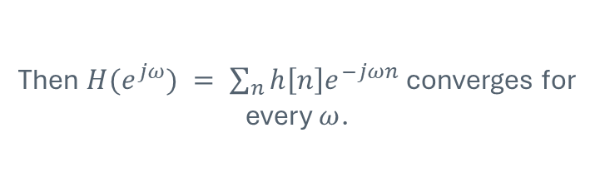
BIBO stability in the z-domain
20–40 MIN
For LTI systems, stability means the unit circle is in the ROC.
Time-domain condition
z-plane condition
Σ |h[n]| < ∞
unit circle ⊂ ROC
The frequency response is finite all the way around |z|=1.
Then $H(e^{jω}) = \sum_{n}{h\left[n\right]e^{−jωn}}$converges for every $ω$.
Week 3 • DSP + ML • Oppenheim & Schafer
6

Slide 10





The golden combination: causal + stable
20–40 MIN
For a causal rational system, every pole must lie strictly inside the unit circle.
Reasoning chain
• Causal ⇒ ROC is outside the outermost pole.
• Stable ⇒ ROC must include |z|=1.
• Therefore outermost pole radius must be < 1.
• Pole exactly on |z|=1 is not BIBO stable for the causal rational case.
Important nuance: “all poles inside unit circle” is the causal + stable rule—not a stability rule without an ROC/support assumption.
Week 3 • DSP + ML • Oppenheim & Schafer
7

Slide 11
Classify three systems from poles + ROC
20–40 MIN
Require one sentence of justification.
A
poles 0.3, 0.8; ROC |z|>0.8
B
pole 1.1; ROC |z|>1.1
C
pole 1.1; ROC |z|<1.1
Week 3 • DSP + ML • Oppenheim & Schafer
8

Slide 12
Classify three systems from poles + ROC
20–40 MIN
Require one sentence of justification.
A
poles 0.3, 0.8; ROC |z|>0.8
Good answer: causal & stable
B
pole 1.1; ROC |z|>1.1
Good answer: causal, unstable
C
pole 1.1; ROC |z|<1.1
Good answer: anti-causal, stable
Week 3 • DSP + ML • Oppenheim & Schafer
8

Slide 13

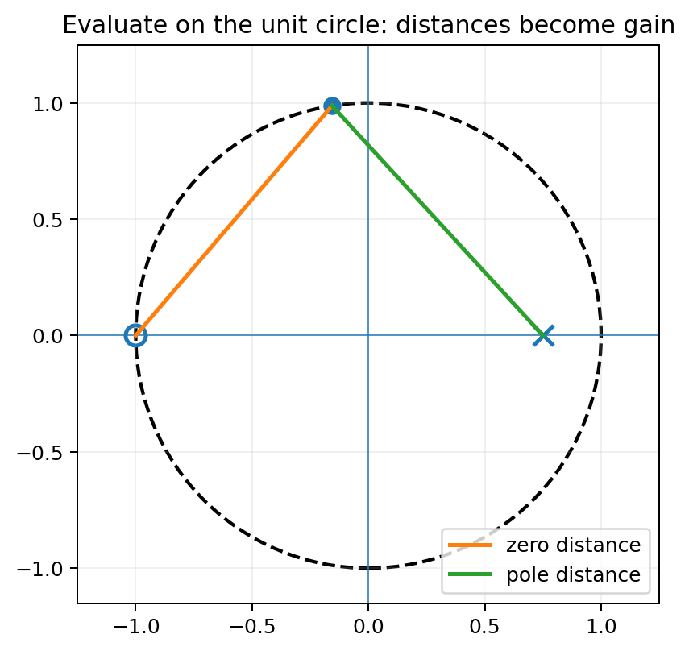



Geometric frequency response
40–60 MIN
Evaluate H(z) at a point moving around the unit circle.
• Numerator: multiply distances from the unit-circle point to each zero.
• Denominator: multiply distances to each pole.
• Near a zero → a short numerator vector → small magnitude.
• Near a pole → a short denominator vector → large magnitude.
Week 3 • DSP + ML • Oppenheim & Schafer
9

Slide 14
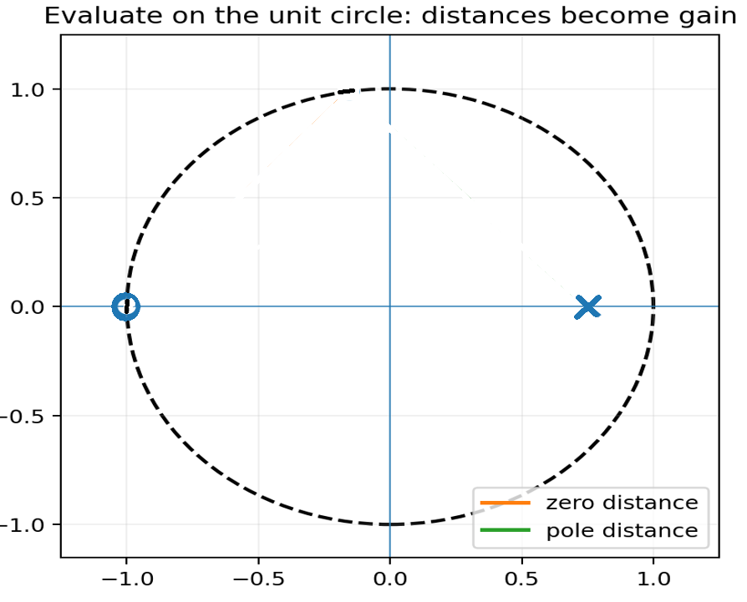
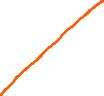


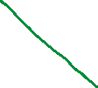
Geometric frequency response

Slide 15
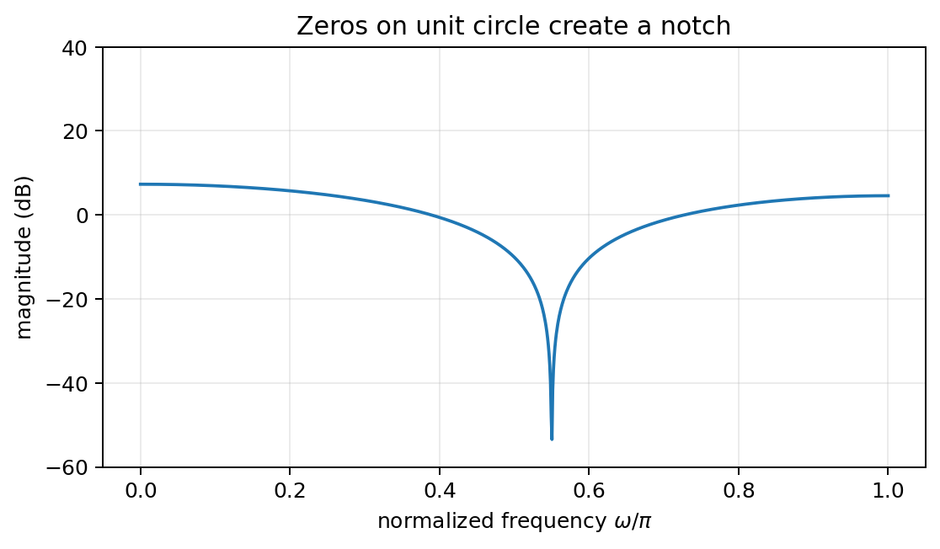





Zeros pull the magnitude down
40–60 MIN
A zero on the unit circle creates exact cancellation at its angle.
Geometric story
• At ω equal to the zero angle, $e^{jω}=z_{0}$
• The zero distance is exactly 0.
• Product in the numerator becomes 0.
• Therefore |H|=0: a perfect notch.
Week 3 • DSP + ML • Oppenheim & Schafer
10

Slide 16
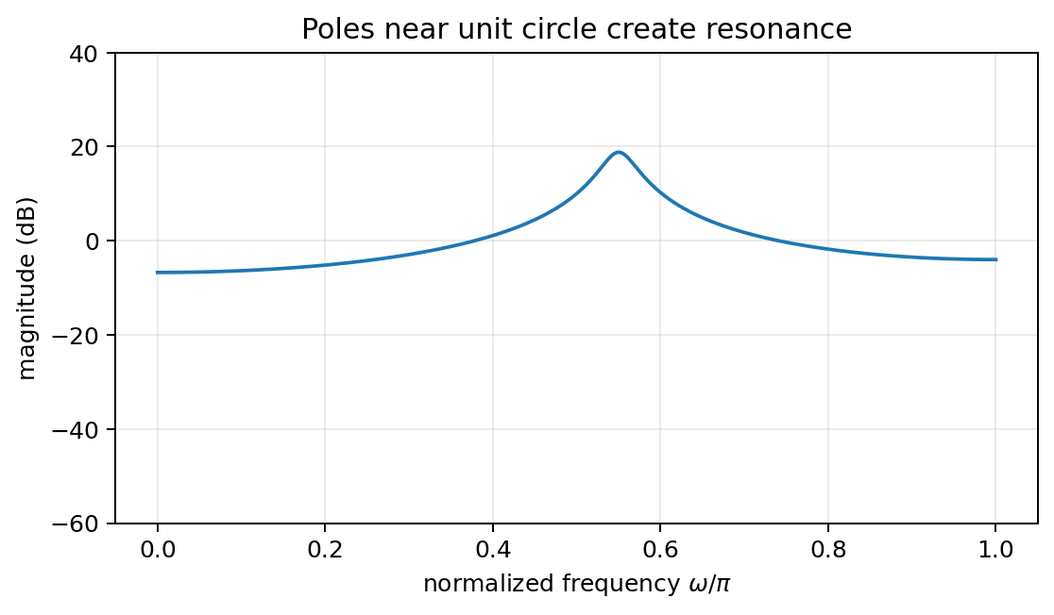
Poles push the magnitude up
40–60 MIN
A pole close to the unit circle creates a resonant peak near its angle.
Geometric story
• At a nearby unit-circle angle, the pole distance becomes small.
• That distance is in the denominator.
• Smaller denominator → larger magnitude.
• Closer pole radius → sharper, longer-lived resonance.
Week 3 • DSP + ML • Oppenheim & Schafer
11

Slide 17
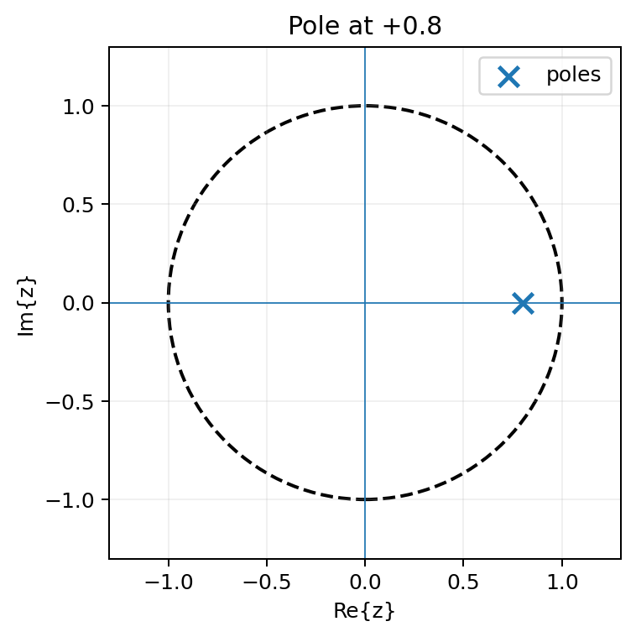

First-order example: pole location predicts low-pass behavior
40–60 MIN
H(z)=1/(1−0.8z⁻¹) has a pole at +0.8 on the real axis.
• ω=0 corresponds to z=+1, close to the pole at +0.8 → large gain.
• ω=π corresponds to z=−1, far from the pole → smaller gain.
• So the response favors low frequency before we compute a single formula.
• This recovers the one-pole smoother from Week 1.
Week 3 • DSP + ML • Oppenheim & Schafer
12

Slide 18
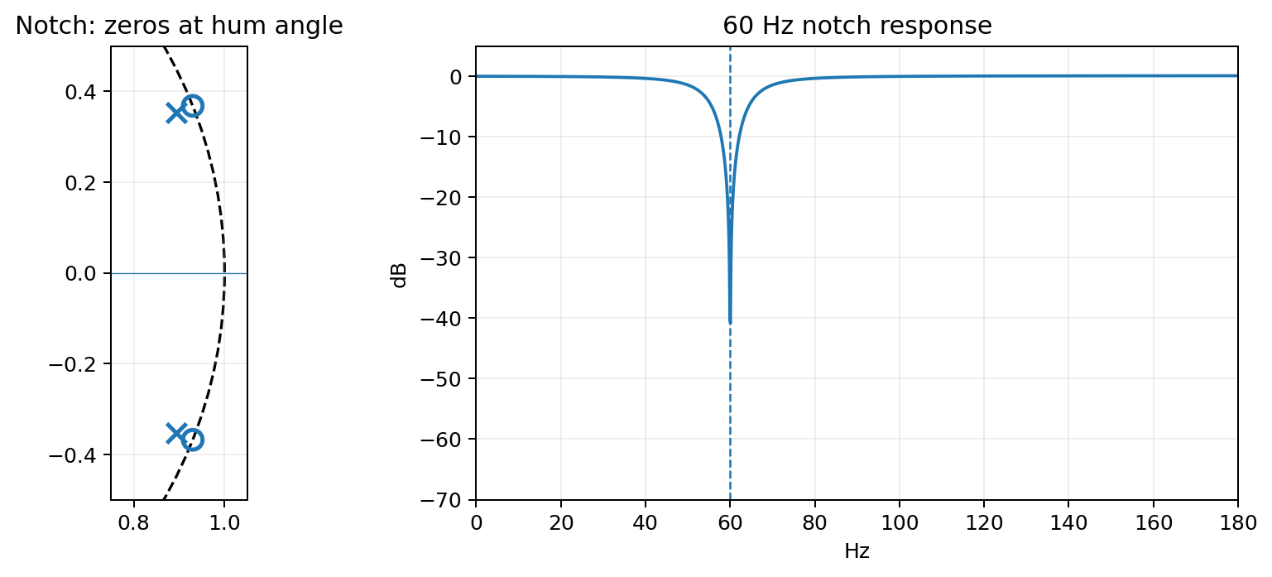


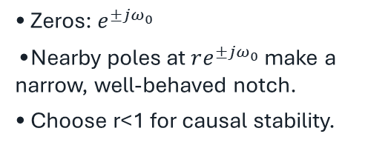


Design example: notch out 60 Hz hum
60–75 MIN
Place conjugate zeros on the unit circle at the unwanted frequency.
At fₛ=1000 Hz
ω₀ = 2π·60/1000
≈ 0.377 rad/sample
• Zeros: $e^{±jω_{0}}$
• Nearby poles at $re^{±jω_{0}}$ make a narrow, well-behaved notch.
• Choose r<1 for causal stability.
Week 3 • DSP + ML • Oppenheim & Schafer
13

Slide 19
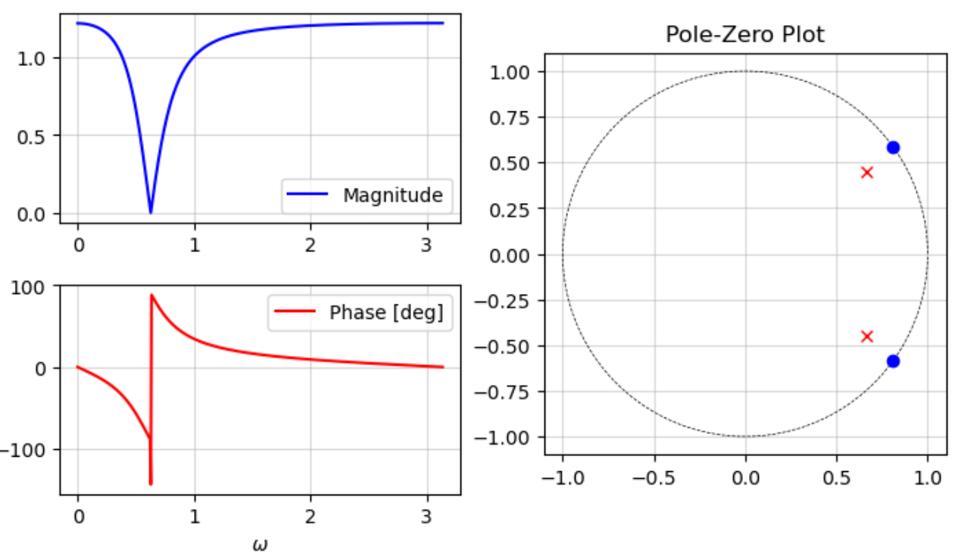
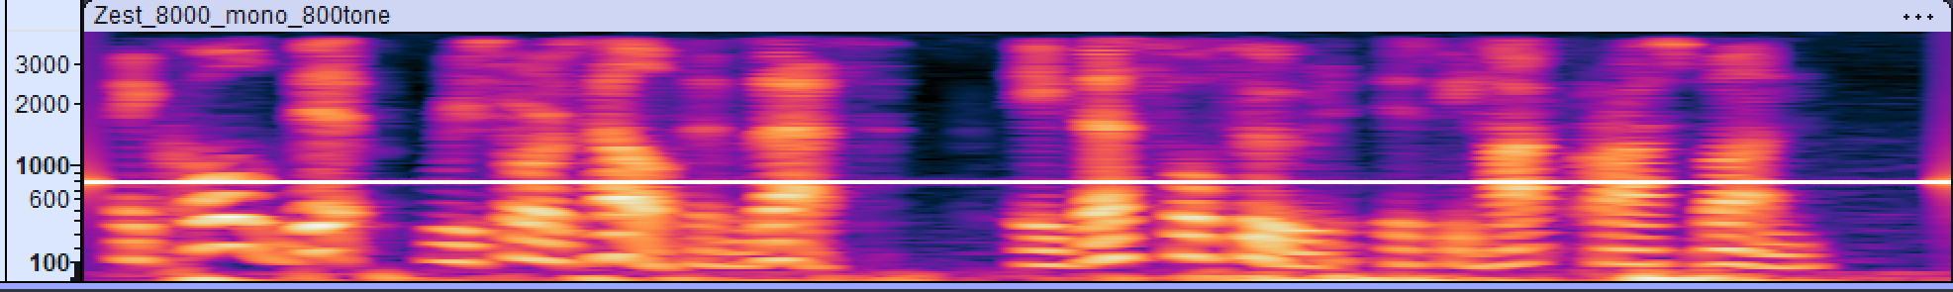
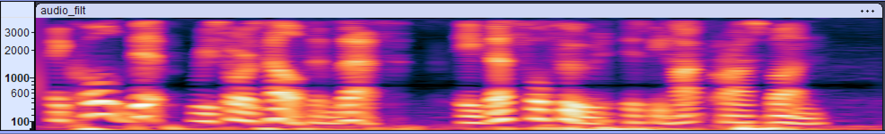

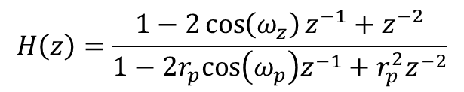
Design example: notch out 800 Hz tone
Notch filter:
$$H\left(z\right)=\frac{1−2\cos\left(ω_{z}\right)z^{−1}+z^{−2}}{1−2r_{p}cos\left(ω_{p}\right)z^{−1}+r_{p}^{2}z^{−2}}$$
$ω_{z}={36}^{°}$, $r_{p}=0.8$, $ω_{p}={34}^{°}$, $f_{s}=8000$ Hz
Before filtering
Spectrograms
After filtering

Slide 20
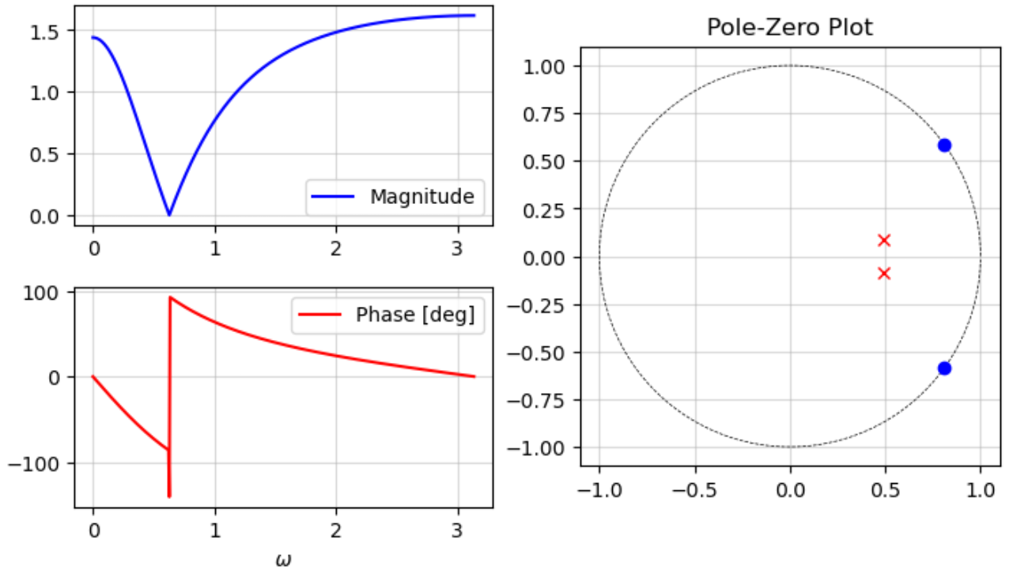
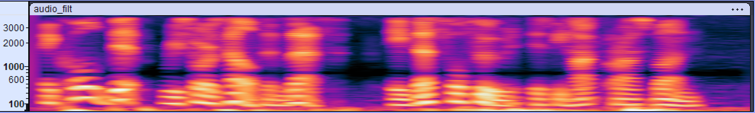


Design example: notch out 800 Hz tone
Notch filter:
$$H\left(z\right)=\frac{1−2\cos\left(ω_{z}\right)z^{−1}+z^{−2}}{1−2r_{p}cos\left(ω_{p}\right)z^{−1}+r_{p}^{2}z^{−2}}$$
$ω_{z}={36}^{°}$, $r_{p}=0.5$, $ω_{p}={10}^{°}$, $f_{s}=8000$ Hz
Smaller $r_{p}$ => Wider notch
Before filtering
Spectrograms
After filtering

Slide 21
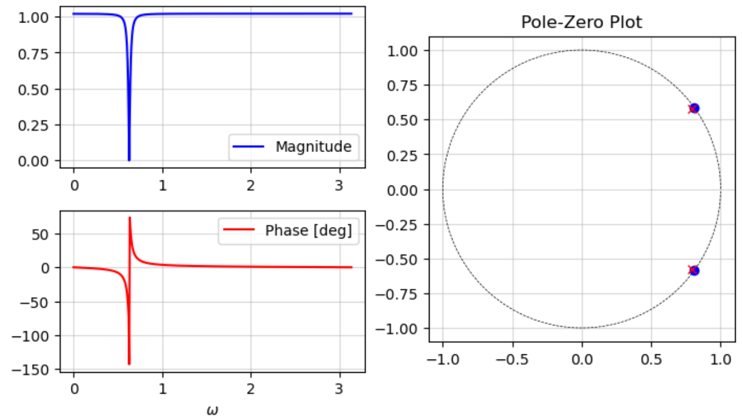
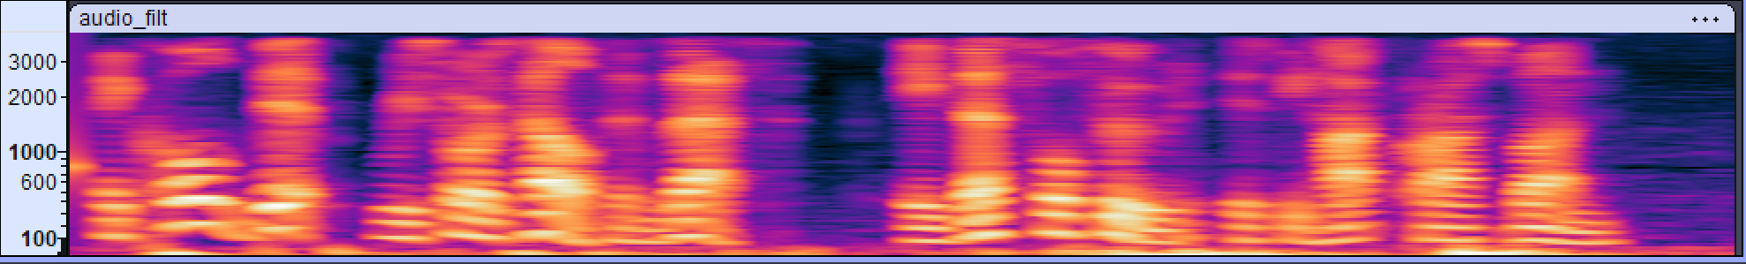

Design example: notch out 800 Hz tone
Notch filter:
$$H\left(z\right)=\frac{1−2\cos\left(ω_{z}\right)z^{−1}+z^{−2}}{1−2r_{p}cos\left(ω_{p}\right)z^{−1}+r_{p}^{2}z^{−2}}$$
$ω_{z}={36}^{°}$, $r_{p}=0.5$, $ω_{p}={10}^{°}$, $f_{s}=8000$ Hz
$r_{p}$ close to unit circle => Sharper notch
Before filtering
Spectrograms
After filtering

Slide 22
Notch-filter equation
60–75 MIN
A second-order section gives an interpretable audio filter.
H(z) = K · (1 − 2cosω₀ z⁻¹ + z⁻²) / (1 − 2r cosω₀ z⁻¹ + r²z⁻²)
Zeros
Poles
Gain K
exactly on unit circle at ±ω₀ → ideal zero response at the hum frequency
same angle but radius r<1 → control notch width / transient response
often chosen to make DC or passband gain approximately 1
Audio intuition: zeros do the cancellation; poles nearby keep the rest of the spectrum from being unnecessarily attenuated.
Week 3 • DSP + ML • Oppenheim & Schafer
14

Slide 23
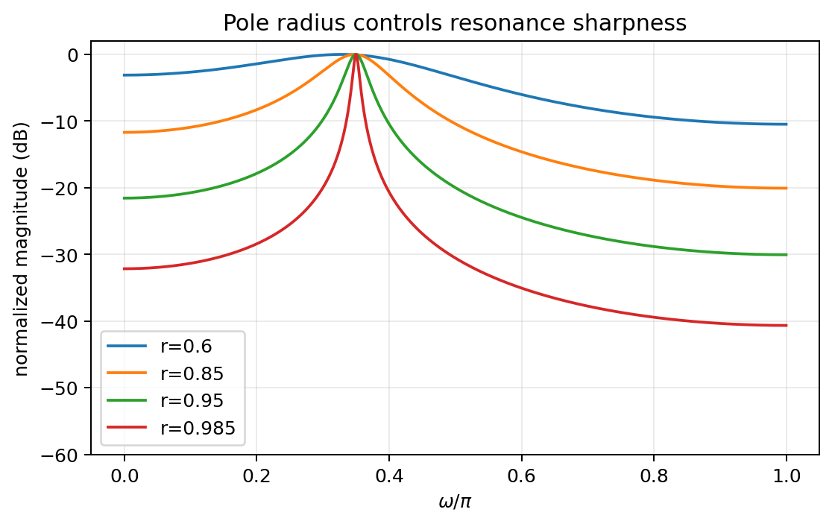
Pole radius controls resonance and memory
60–75 MIN
Move the pole radially without changing its preferred frequency.
• Same angle ⇒ same resonance center.
• r closer to 1 ⇒ smaller distance to unit circle.
• Peak becomes sharper and stronger.
• Impulse response decays roughly like rⁿ, so ringing lasts longer.
• r≥1 breaks causal BIBO stability.
Week 3 • DSP + ML • Oppenheim & Schafer
15

Slide 24
Pole–zero sandbox activity
60–75 MIN
Predict first. Move a pole or zero. Then listen / plot.
1
Start with no poles/zeros: flat response.
2
Put a zero on |z|=1 at an angle: predict the notch.
3
Move the zero inside the circle: does the notch remain perfect?
4
Add a pole at the same angle with r=0.9, then 0.98.
5
Listen to the 60-Hz hum example before and after filtering.
Notebook: pole_zero_sandbox()
Week 3 • DSP + ML • Oppenheim & Schafer
16

Slide 25
Python demo: poles, zeros, and freqz
60–75 MIN
Use code as a geometry checker.
import numpy as np
from scipy import signal
zeros = np.exp(1j*np.array([w0, -w0]))
poles = r * zeros
b = np.poly(zeros).real
a = np.poly(poles).real
w, H = signal.freqz(b, a, fs=fs)
# plot zeros, poles, |H|
• `np.roots` moves coefficients → roots.
• `np.poly` moves roots → coefficients.
• `signal.freqz` evaluates on the unit circle numerically.
• The pole-zero plot should let you predict the major features before `freqz` confirms them.
Week 3 • DSP + ML • Oppenheim & Schafer
17

Slide 26
Audio demo: removing hum without erasing the signal
60–75 MIN
The notch should target a narrow frequency, not broadly low-pass the recording.
Before
After
Synthetic voice-like harmonics + 60 Hz and 120 Hz hum.
Listen: 01_voice_with_60Hz_hum.wav
Second-order 60-Hz notch with pole radius r=0.985.
Listen: 02_voice_after_60Hz_notch.wav
Good observation: a very narrow notch removes the targeted hum component while leaving nearby useful content mostly intact. A broad low-pass filter would solve the hum problem by throwing away far more information.
Week 3 • DSP + ML • Oppenheim & Schafer
18

Slide 27
ML bridge: filter geometry shapes the features a model sees
BRIDGE
Front-end filtering changes spectra, spectrograms, and therefore learned patterns.
Notch zeros
Resonant poles
Stability
Remove a nuisance line such as power hum before spectral feature extraction.
Can emphasize a narrow band—useful or dangerous depending on the task.
A numerically exploding front end corrupts every downstream feature and gradient.
Design question for ML: are you removing a known nuisance, imposing a useful inductive bias, or accidentally deleting information that the classifier needs?
Week 3 • DSP + ML • Oppenheim & Schafer
19

Slide 28
Concept check
CHECK
Reason geometrically—no full algebra is needed.
A conjugate pole pair is moved from radius 0.7 to radius 0.97 at the same angle. What changes?
A
Resonant frequency moves drastically.
B
Peak becomes sharper; ringing lasts longer.
C
A perfect notch appears.
D
The system becomes time varying.
Week 3 • DSP + ML • Oppenheim & Schafer
20

Slide 29
Concept check
CHECK
Reason geometrically—no full algebra is needed.
A conjugate pole pair is moved from radius 0.7 to radius 0.97 at the same angle. What changes?
A
Resonant frequency moves drastically.
B
Peak becomes sharper; ringing lasts longer.
C
A perfect notch appears.
D
The system becomes time varying.
Correct: B. Same angle → same center frequency; radius closer to 1 → stronger/narrower resonance and slower decay.
Week 3 • DSP + ML • Oppenheim & Schafer
20

Slide 30
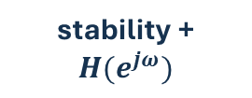
Lecture 6 synthesis
WRAP-UP
Poles, zeros, ROC, and the unit circle tell one coherent story.
difference eq.
factor
ROC
unit circle
geometry
coefficients
poles + zeros
causality
stability + $H(e^{jω})$
sound / response
Exit ticket: Why does a zero on the unit circle create a notch?
Week 3 • DSP + ML • Oppenheim & Schafer
21

Slide 31
Lecture 6 synthesis
WRAP-UP
Poles, zeros, ROC, and the unit circle tell one coherent story.
difference eq.
factor
ROC
unit circle
geometry
coefficients
poles + zeros
causality
stability + $H(e^{jω})$
sound / response
Exit ticket: Why does a zero on the unit circle create a notch? Good answer: at that frequency the evaluation point e^{jω} coincides with the zero, making a numerator distance—and therefore H(e^{jω})—equal to zero.
Week 3 • DSP + ML • Oppenheim & Schafer
21

