Slide 1

ECEN 4/5632 Theory and Application of Digital Filters
Lecture 9, 9-22-26
Peter Mathys*
* With generous help from Gemini Pro and ChatGPT

Slide 2
WEEK 5 ● LECTURE 9
Time/Frequency Responses and Group Delay
From pole-zero geometry to waveform dispersion and all-pass phase equalization
pole-zero geometry → group delay → all-pass → ML feature timing
75 minutes • senior + first-year graduate ECE
Equations typeset in standard mathematical notation

Slide 3
DSP + Machine Learning • Week 5
Roadmap
0–15 min • Read magnitude and phase directly from pole-zero geometry.
15–40 min • Distinguish phase delay from group delay and connect nonlinear phase to dispersion.
40–60 min • Build all-pass systems from reciprocal pole-zero structure.
60–75 min • Ask whether preprocessing preserves the timing features an ML model actually uses.
Oppenheim & Schafer + Raschka
2

Slide 4

DSP + Machine Learning • Week 5
Frequency response is the z-transform evaluated on the unit circle
Every digital frequency ω corresponds to one point e^(jω) on the unit circle.
Magnitude and phase can be read geometrically from vectors drawn from poles and zeros to that point.
Oppenheim & Schafer + Raschka
3

Slide 5


DSP + Machine Learning • Week 5
Pole-zero geometry: magnitude is a distance ratio
Interpretation
Zeros pull the response toward zero when the unit-circle point passes nearby. Poles push the response upward when the unit-circle point passes nearby.
Oppenheim & Schafer + Raschka
4

Slide 6

DSP + Machine Learning • Week 5
Pole-zero geometry: phase is an angle sum
Each zero contributes a vector angle.
Each pole contributes a vector angle with the opposite sign.
Phase can vary rapidly even when magnitude looks smooth.
Oppenheim & Schafer + Raschka
5

Slide 7


DSP + Machine Learning • Week 5
Worked geometry example
At ω=0
The unit-circle point is z=1. The zero-distance is 0.2 and pole-distance is 0.5, so |H(1)|=0.4.
At ω=π
The point is z=-1. The distances are 1.8 and 1.5, so |H(-1)|=1.2. Predict a high-frequency tilt before plotting.
Oppenheim & Schafer + Raschka
6

Slide 8


Worked geometry example

Slide 9


Worked geometry example

Slide 10


Worked geometry example

Slide 11
DSP + Machine Learning • Week 5
Concept check: move a pole toward the unit circle
A pole at angle ω₀ moves radially from radius 0.5 to radius 0.95. What happens near ω₀?
Oppenheim & Schafer + Raschka
7

Slide 12


DSP + Machine Learning • Week 5
Phase delay and group delay answer different questions
Phase delay
Group delay
For a single sinusoidal component, how much phase corresponds to an equivalent delay?
For a narrowband packet, how does the envelope / modulation arrive versus frequency?
Do not conflate them
They are equal for pure linear phase through the origin, but generally differ.
Oppenheim & Schafer + Raschka
8

Slide 13
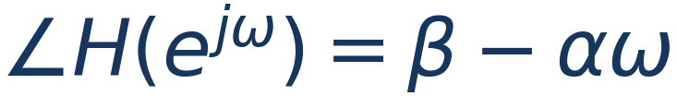

DSP + Machine Learning • Week 5
Linear phase gives constant group delay
All passband frequency components receive the same local delay.
The constant β can shift phase without changing the group-delay slope.
Possible π jumps from a real amplitude sign change should not be mistaken for physical dispersion.
Oppenheim & Schafer + Raschka
9

Slide 14


DSP + Machine Learning • Week 5
Nonlinear phase produces frequency-dependent delay
Read both plots
The phase curvature becomes group-delay variation. The derivative makes rapid phase changes easier to interpret as timing dispersion.
Oppenheim & Schafer + Raschka
10

Slide 15

DSP + Machine Learning • Week 5
A transient is a superposition of many frequencies
A sharp onset or pulse requires many spectral components.
If each component experiences a different delay, the components no longer reassemble at the same relative times.
The result can be peak shift, ringing, smearing, or altered onset slope—even if |H(e^(jω))| looks acceptable.
Oppenheim & Schafer + Raschka
11

Slide 16

DSP + Machine Learning • Week 5
Demonstration: causal IIR dispersion versus zero-phase offline filtering
Good observation
The causal IIR can shift and reshape the transient. Forward-backward filtering restores timing much better, but it is noncausal and changes the effective magnitude response.
Oppenheim & Schafer + Raschka
12

Slide 17

DSP + Machine Learning • Week 5
All-pass systems: magnitude one does not mean “does nothing”
An all-pass changes phase without changing magnitude.
That makes it a phase / group-delay design element rather than a magnitude-shaping element.
Useful for phase equalization, fractional-delay structures, and decomposing a system into minimum-phase and all-pass parts.
Oppenheim & Schafer + Raschka
13

Slide 18

DSP + Machine Learning • Week 5
First-order all-pass structure
Pole at z=a lies inside the unit circle.
Zero at z=1/a* lies at the conjugate reciprocal location outside the unit circle.
On |z|=1, numerator and denominator distances match, so magnitude is unity.
Oppenheim & Schafer + Raschka
14

Slide 19
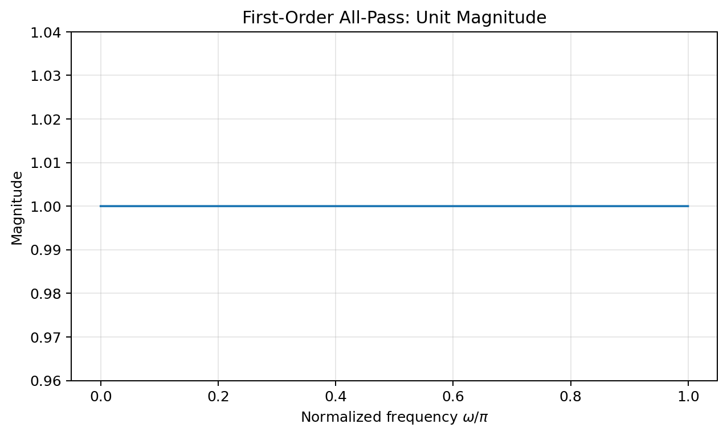
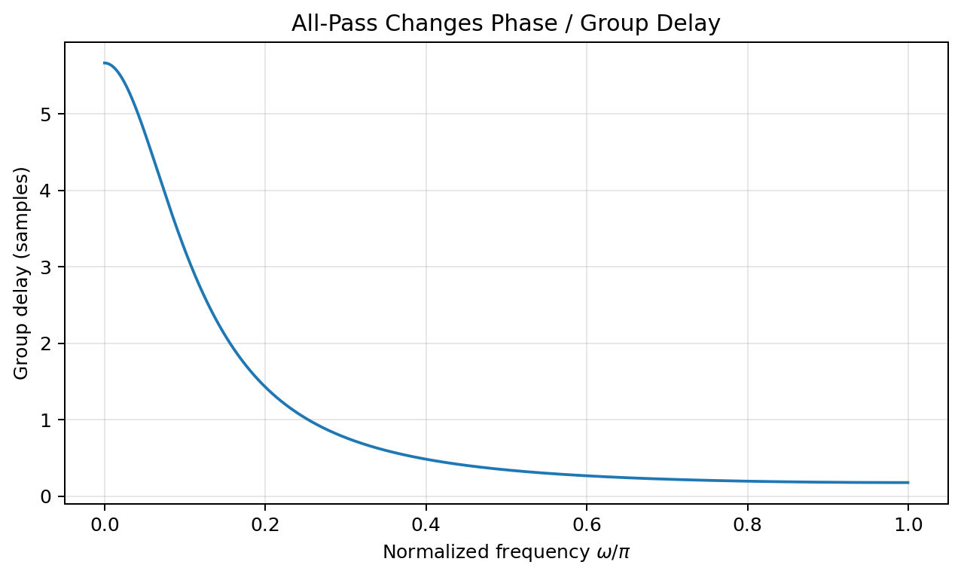
DSP + Machine Learning • Week 5
All-pass magnitude is flat while group delay is not
Key insight
An all-pass can produce substantial timing changes without leaving any trace in a magnitude-only plot.
Oppenheim & Schafer + Raschka
15

Slide 20
DSP + Machine Learning • Week 5
Phase equalization with an all-pass
Suppose a magnitude response is acceptable but group delay is uneven.
Cascading an all-pass leaves total magnitude unchanged because |Hₜₒₜ|=|H||Hₐₚ|=|H|.
Choose the all-pass phase so its group-delay contribution makes the total delay flatter over the band of interest.
Oppenheim & Schafer + Raschka
16

Slide 21
DSP + Machine Learning • Week 5
What can an all-pass equalizer not fix?
It cannot repair magnitude notches, stopband leakage, or insufficient bandwidth because its magnitude is exactly one.
It can only redistribute phase / group delay.
A causal stable all-pass generally adds nonnegative group delay; “flattening” often means adding delay where the original system was too fast rather than subtracting delay where it was too slow.
Oppenheim & Schafer + Raschka
17

Slide 22
DSP + Machine Learning • Week 5
ML context: feature distortion happens before the model
ECG anomaly detection: QRS peak timing and slope may be predictive.
Audio event detection: onset rise time and inter-channel timing may be predictive.
Vibration fault detection: impulse spacing and envelope timing may be predictive.
A preprocessing filter that disperses these structures changes the features before an SVM, RF, MLP, or CNN can use them.
Oppenheim & Schafer + Raschka
18

Slide 23
DSP + Machine Learning • Week 5
Good ML engineering question
Ask before filtering
Does the downstream task depend primarily on long-term spectral magnitude, or on timing / waveform morphology?
If magnitude statistics dominate, nonlinear phase may be harmless.
If local timing is predictive, preserve phase or make training/deployment use the same causal distortion.
Do not assume “denoised” means “more informative for the classifier.”
Oppenheim & Schafer + Raschka
19

Slide 24
DSP + Machine Learning • Week 5
Python demo: inspect response and delay
b = np.array([1.0, -0.8])
a = np.array([1.0, -0.5])
w, H = signal.freqz(b, a, worN=2048)
phase = np.unwrap(np.angle(H))
w_gd, gd = signal.group_delay((b, a), w=2048)
# Pole-zero geometry
zeros = np.roots(b)
poles = np.roots(a)
# Compare causal IIR and zero-phase offline filtering
y_causal = signal.sosfilt(sos, x)
y_zero = signal.sosfiltfilt(sos, x)
Oppenheim & Schafer + Raschka
20

Slide 25
DSP + Machine Learning • Week 5
Concept check
Two filters have identical |H(e^(jω))| but different ∠ H(e^(jω)). Must their outputs be identical for every input?
Oppenheim & Schafer + Raschka
21

Slide 26
DSP + Machine Learning • Week 5
Lecture 9 synthesis
Pole-zero distance ratios explain magnitude; vector-angle sums explain phase.
Group delay turns phase slope into a timing diagnostic.
All-pass systems have unit magnitude but can strongly reshape phase and delay.
ML preprocessing must preserve—or consistently reproduce—the temporal features the model needs.
Oppenheim & Schafer + Raschka
22

