Slide 1
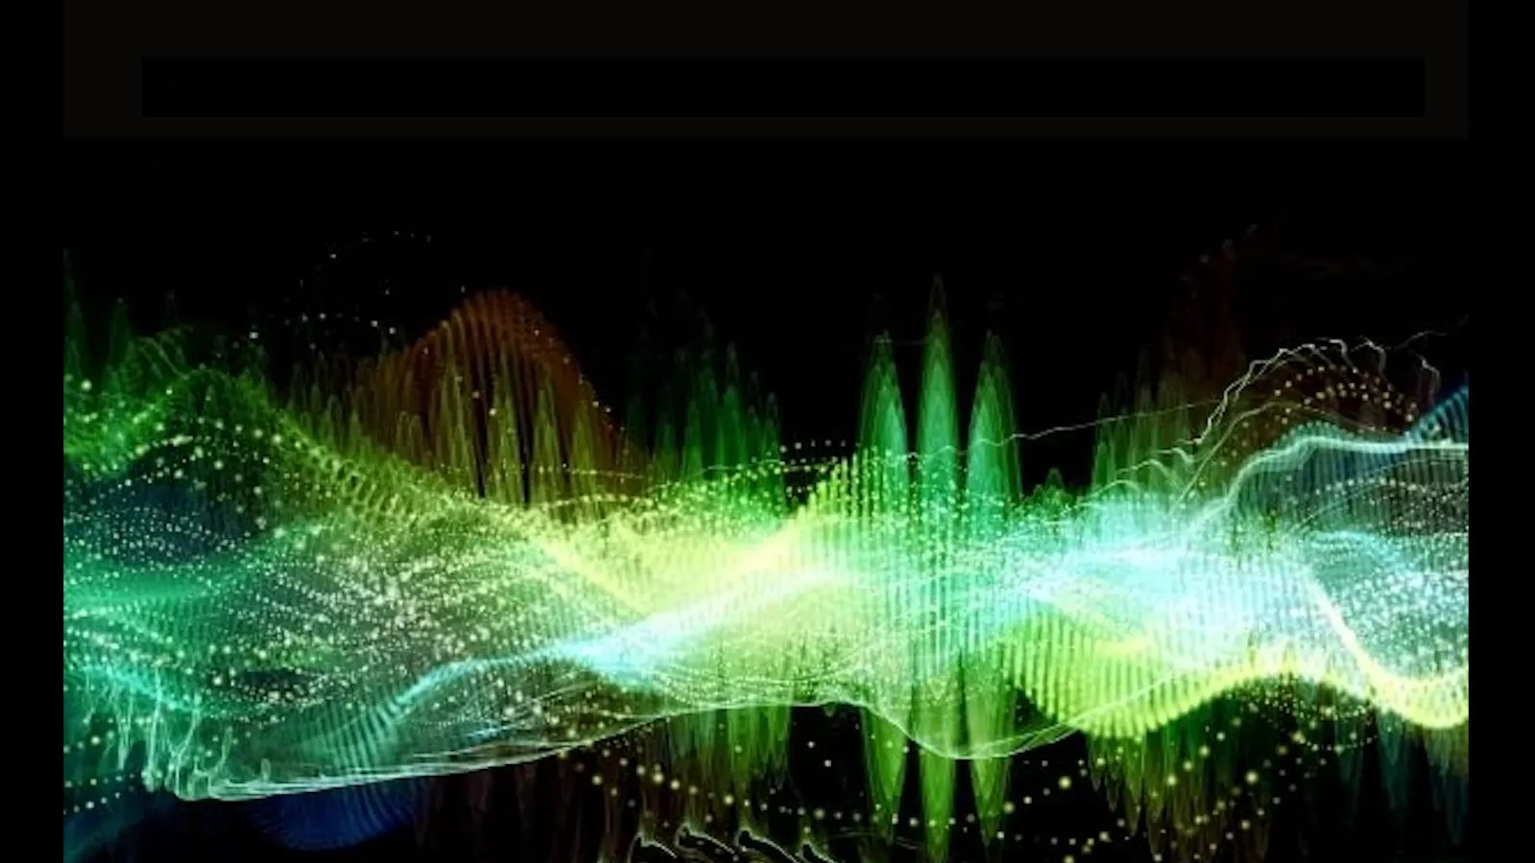
ECEN 4/5632 Theory and Application of Digital Filters
Lecture 4, 9-03-26
Peter Mathys*
* With generous help from Gemini Pro and ChatGPT

Slide 2
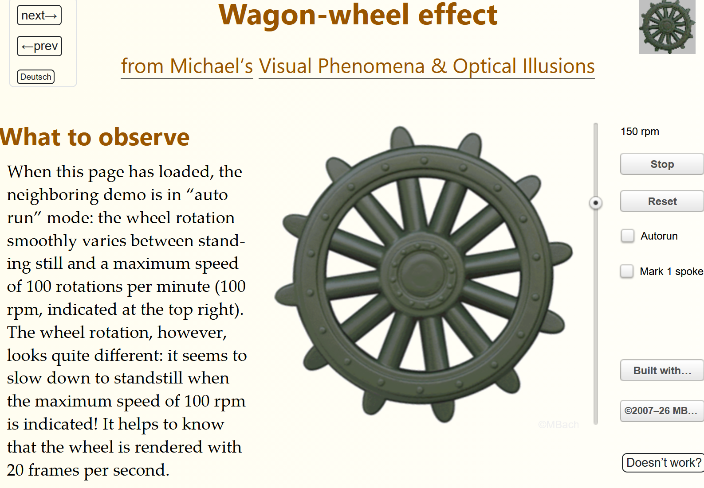
https://michaelbach.de/ot/mot-wagonWheel/

Slide 3
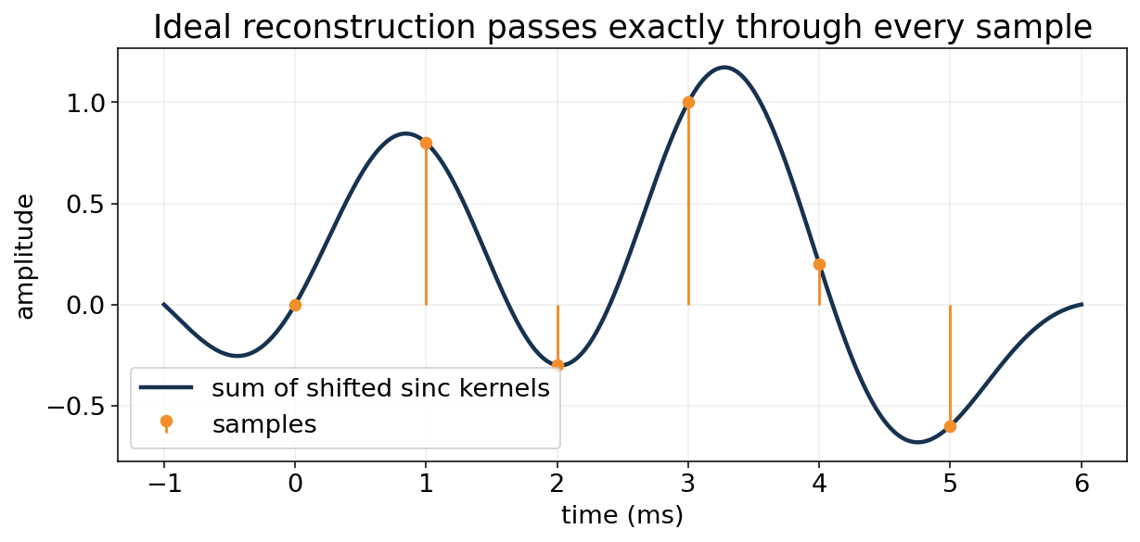
WEEK 2 • LECTURE 4
Reconstruction, D/A,
and Quantization Noise
Ideal interpolation gives the theory; ZOH and finite bit depth explain what hardware actually does.
75 minutes • ideal D/C • sinc interpolation • zero-order hold • quantization • SQNR • PyTorch dtype bridge
Notes:
[object Object]

Slide 4
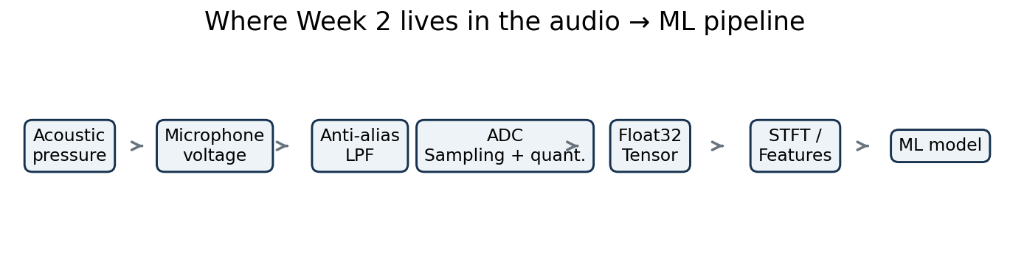
Recap: after Lecture 3, we trust the sample times
Now we ask how to reconstruct between samples and represent amplitudes.
Sampling error
Quantization error
Aliasing moves energy to the wrong frequency. It is fundamentally non-unique.
Quantization maps a continuous amplitude to one of finitely many levels.
Notes:
[object Object],[object Object]

Slide 5
Learning outcomes
By the end of Lecture 4, students should be able to move between ideal theory and real hardware.
Derive the ideal bandlimited interpolation formula from the reconstruction low-pass filter.
Explain zero-order hold behavior in time and its sinc-shaped magnitude droop.
Model a uniform B-bit quantizer and compute Δ and quantization-error variance.
Derive and use SQNR ≈ 6.02B + 1.76 dB for a full-scale sine.
Explain the difference between 16-bit PCM storage and float32 computation in PyTorch.
Notes:
[object Object],[object Object]

Slide 6


Ideal reconstruction in the frequency domain
If spectral replicas do not overlap, simply isolate the baseband copy.
The factor T cancels the 1/T introduced by ideal sampling.
Choose Ω_M < Ω_c < Ω_s − Ω_M so only one replica passes.
Notes:
[object Object],[object Object]

Slide 7
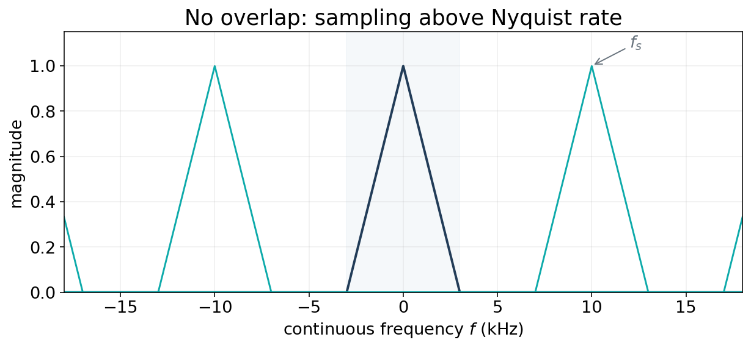

What the sampled spectrum looks like
Every copy contains the same analog information—until the copies overlap.
Replica spacing = f_s. Baseband can be isolated only when neighboring replicas do not overlap.
Notes:
[object Object],[object Object]

Slide 8
From ideal low-pass filtering to sinc interpolation
The inverse transform of a brick-wall low-pass filter is a sinc.
Here sinc(u)=sin(πu)/(πu). Every sample contributes one shifted, scaled interpolation kernel.
Notes:
[object Object],[object Object]

Slide 9
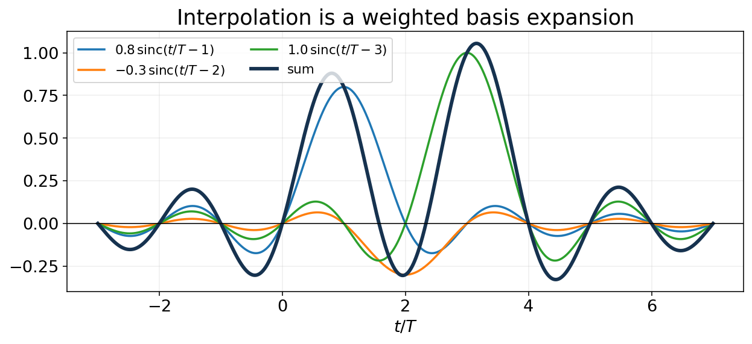


Why the sinc basis passes through every sample
At integer offsets, normalized sinc is zero—except at the center.
At t=mT, only the n=m kernel survives → x_r(mT)=x[m].
Notes:
[object Object],[object Object]

Slide 10

A finite illustration of ideal interpolation
The true ideal sum is infinite; a finite example still shows the geometry.
Notes:
[object Object],[object Object]

Slide 11





Why a real DAC does not implement ideal sinc directly
The ideal impulse response is infinite in duration and noncausal when centered at t=0.
Ideal mathematical interpolator
Practical hardware strategy
Infinite support in time.
Symmetric around the interpolation instant.
Brick-wall frequency response.
Perfect only under ideal bandlimiting assumptions.
Generate a simple analog waveform from each code.
Zero-order hold is extremely natural in a DAC.
Follow with an analog reconstruction / anti-imaging filter.
Oversampling reduces the burden on analog filtering.
Ideal theory tells us the target; implementation approximates it.
Notes:
[object Object]

Slide 12
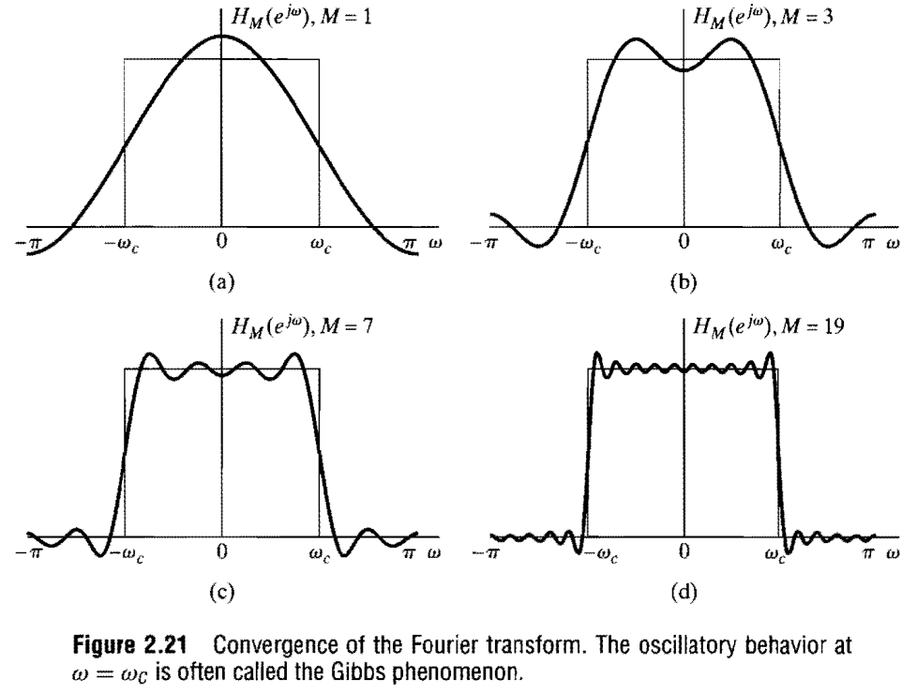
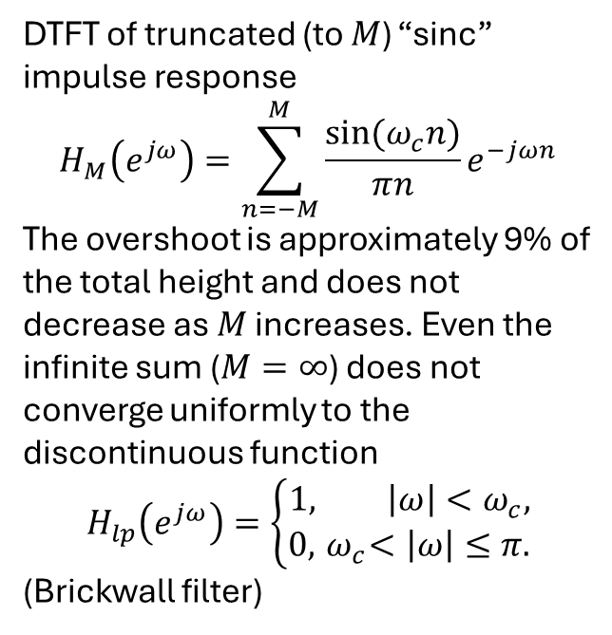
Illustration of the Gibbs Phenomenon
DTFT of truncated (to $M$) “sinc” impulse response
$$H_{M}\left(e^{jω}\right)=\sum_{n=−M}^{M}{\frac{sin⁡(ω_{c}n)}{πn}e^{−jωn}}$$
The overshoot is approximately 9% of the total height and does not decrease as $M$ increases. Even the infinite sum ($M=∞$) does not converge uniformly to the discontinuous function
$$H_{lp}\left(e^{jω}\right)=\left\{\begin{aligned}1, \left|ω\right|<ω_{c}, \\ 0, { ω}_{c}<\left|ω\right|≤π.\end{aligned}\right.$$
(Brickwall filter)

Slide 13
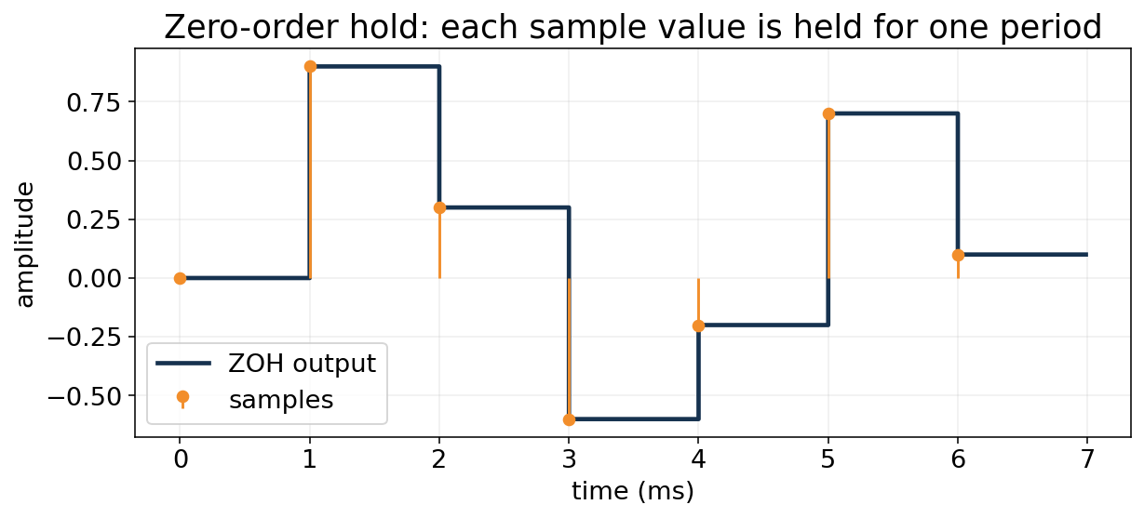


Zero-order hold (ZOH): hold each sample for one period
A rectangular pulse is convolved with the weighted impulse train.
This staircase is already a continuous-time waveform—but it contains spectral images and amplitude droop.
Notes:
[object Object],[object Object]

Slide 14
Deriving the ZOH frequency response
Transform the rectangular hold pulse.
Linear phase term: e^{-jΩT/2} corresponds to a T/2 delay.
Magnitude term: sinc-shaped envelope.
High frequencies are attenuated more than low frequencies.
At ΩT=π: |H|/T = 2/π ≈ 0.637 → −3.92 dB.
Notes:
[object Object],[object Object]

Slide 15
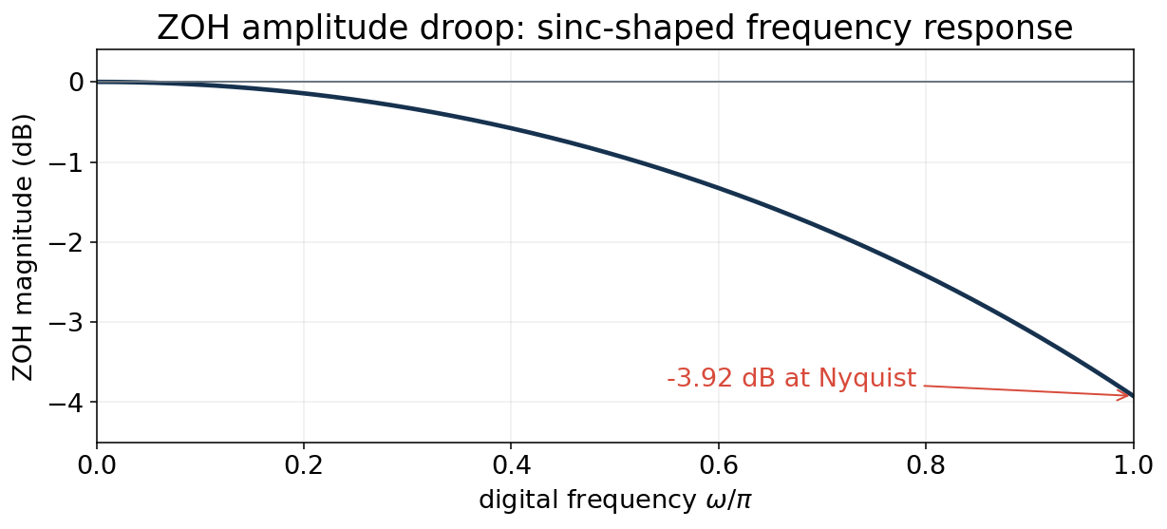
The ZOH creates sinc-shaped amplitude droop
This is deterministic frequency response—not random noise.
Reconstruction filtering can both suppress images and compensate some passband droop.
Notes:
[object Object],[object Object]

Slide 16

A practical D/A chain
ZOH is only one stage; analog filtering completes the reconstruction.
Digital samples
$x[n]$
DAC code +
zero-order hold
Analog
reconstruction LPF
Continuous output
$x_r(t)$
The analog LPF removes spectral images around multiples of f_s; oversampling gives the filter more transition width.
Notes:
[object Object]

Slide 17
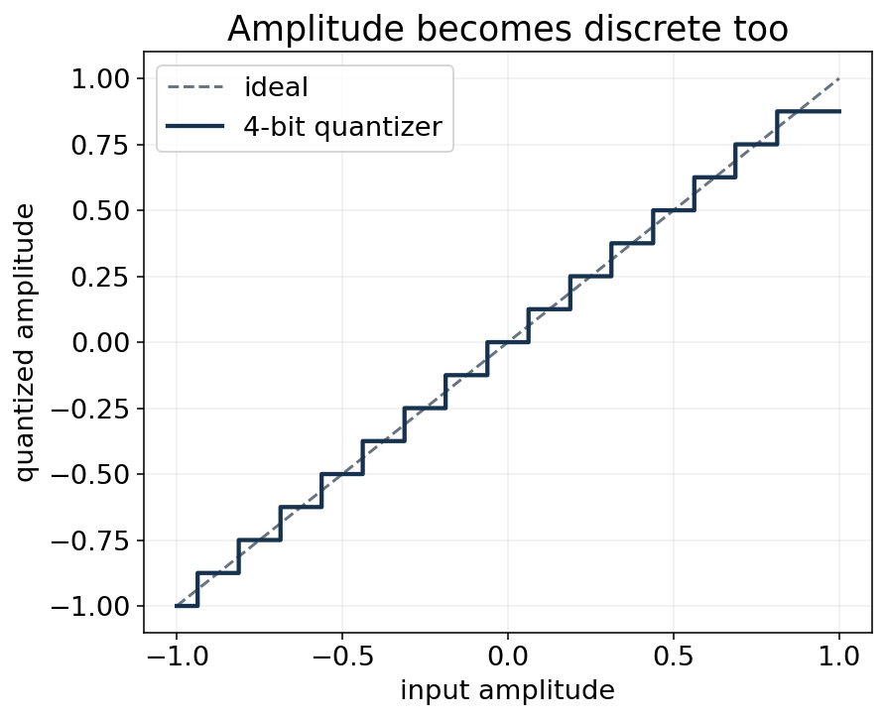
Quantization: the second discretization
Sampling discretizes time. Quantization discretizes amplitude.
B bits → 2^B nominal levels.
Δ is the quantizer step for full-scale range roughly [−A,A].
Overload/clipping is a separate failure mode when |x| exceeds the designed range.
Notes:
[object Object],[object Object]

Slide 18
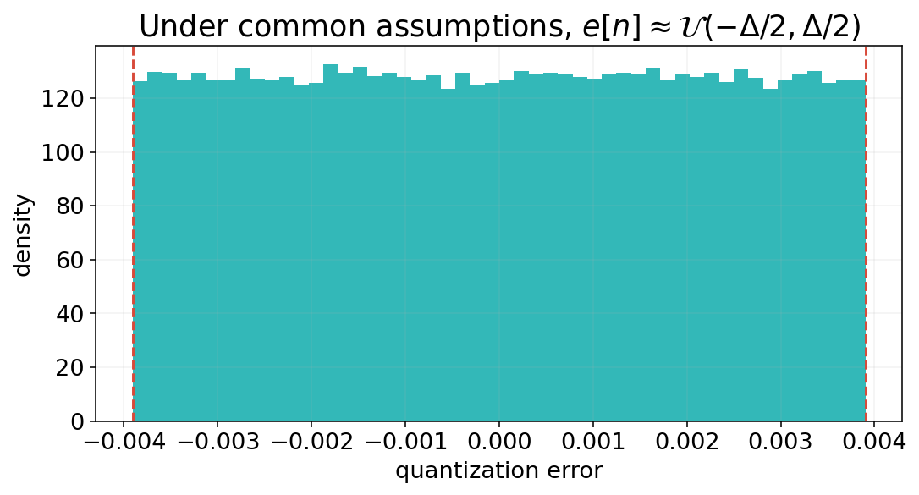


The additive quantization-noise model
Useful—but only under assumptions.
Good approximation when the signal spans many levels and the error is sufficiently decorrelated from the signal.
Notes:
[object Object],[object Object]

Slide 19
Derive the quantization-noise variance
Uniform error over one quantization interval.
Every additional bit halves Δ → noise power falls by a factor of 4 → about 6 dB improvement.
Notes:
[object Object],[object Object]

Slide 20

Full-scale sine SQNR: where 6.02B + 1.76 dB comes from
This is not an arbitrary rule of thumb; it follows from signal and error power.
The +1.76 dB constant is specific to a full-scale sine and the ideal uniform-quantizer model.
Notes:
[object Object],[object Object]

Slide 21
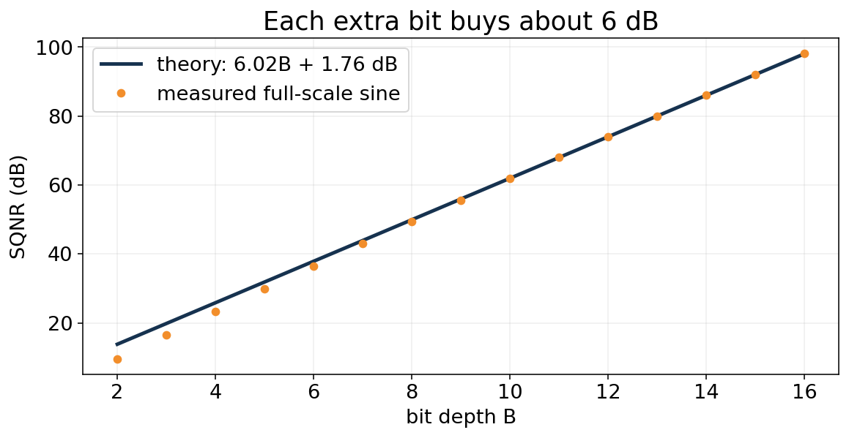
About 6 dB per bit—verified numerically
The simple model is remarkably accurate at moderate/high resolution.
4-bit results deviate more because the high-resolution assumptions are weak.
16-bit full-scale sine theory: 98.08 dB SQNR.
Notes:
[object Object],[object Object]

Slide 22
16-bit audio: “96 dB” and “98 dB” can both appear
They refer to slightly different reference calculations.
6 dB/bit rule of thumb
Full-scale sine SQNR
96.3 dB is the amplitude ratio across 16 binary bits.
98.1 dB includes the RMS power of a full-scale sine and uniform error model.
Be precise about what quantity is being compared.
Notes:
[object Object]

Slide 23
PCM storage is not the same thing as ML compute dtype
Casting to float changes representation—not the information already captured.
pcm = np.array(..., dtype=np.int16)
x = pcm.astype(np.float32) / 32768.0
xt = torch.from_numpy(x)
# xt.dtype == torch.float32
16-bit PCM: discrete integer codes from the recording/ADC pipeline.
float32 tensor: convenient numerical format for DSP and neural-network arithmetic.
Converting int16 → float32 cannot recreate amplitude values between the original quantization levels.
A float32 tensor can still contain badly aliased or coarsely quantized data.
More bits in the variable ≠ more bits of information in the measurement.
Notes:
[object Object]

Slide 24
Live audio demo: listen in this order
The package includes pre-generated WAV files and notebook code.
1
Clean 48 kHz
reference
2
Naive 48→12 kHz
3
Filtered 48→12 kHz
4
8-bit quantized
5
4-bit quantized
Ask students to predict what changes before playing each file.
Notes:
[object Object],[object Object]

Slide 25
Live audio demo: listen in this order
The package includes pre-generated WAV files and notebook code.
1
Clean 48 kHz
reference
2
Naive 48→12 kHz
hear aliasing
3
Filtered 48→12 kHz
compare controlled bandwidth loss
4
8-bit quantized
notice noise floor
5
4-bit quantized
strong granular/fuzzy error
Ask students to predict what changes before playing each file.
Notes:
[object Object],[object Object]

Slide 26
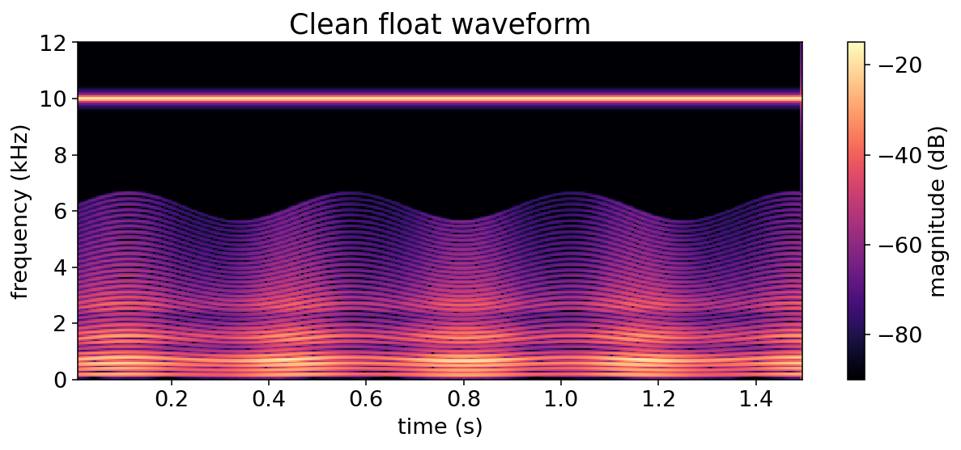
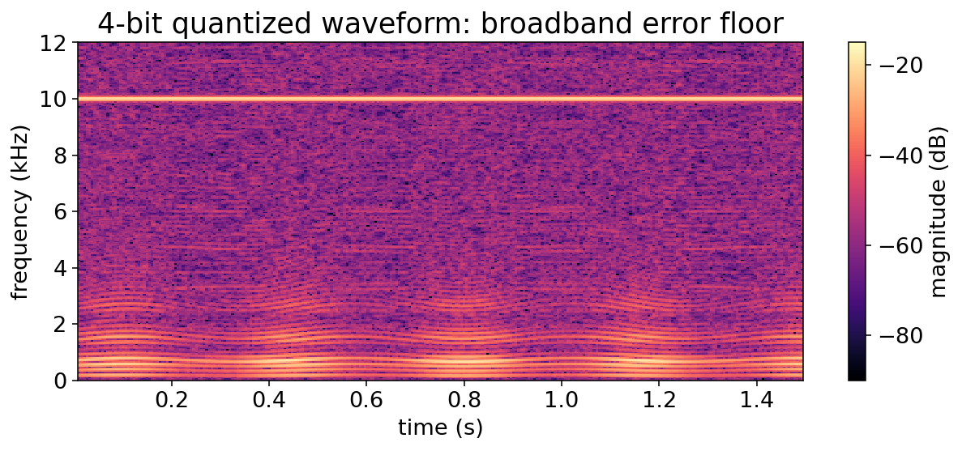
What 4-bit quantization does to a spectrogram
The error is often broad-band, but it need not be perfectly white or independent.
Clean
4-bit
Notes:
[object Object],[object Object]

Slide 27
Graduate nuance: when the “white quantization noise” story breaks
Dither is one tool for trading correlated distortion for more noise-like error.
Low-level sinusoids can produce periodic, signal-correlated error rather than white noise.
Overload clipping is nonlinear distortion and is not captured by Δ²/12.
Dither intentionally adds noise before quantization to decorrelate the quantization error.
Noise shaping can push quantization noise toward frequency regions that matter less—but requires feedback/oversampling ideas beyond today.
Modeling lesson for ML: know which “noise assumptions” are physics and which are convenient approximations.
Notes:
[object Object]

Slide 28
Exit check
Students answer individually; collect or discuss in the last two minutes.
1 Why does ideal reconstruction use sinc functions?
2 What deterministic frequency-domain effect does a ZOH introduce?
3 A full-scale 12-bit sine has approximately what ideal SQNR?
Notes:
[object Object]

Slide 29
Exit check
Students answer individually; collect or discuss in the last two minutes.
1 Why does ideal reconstruction use sinc functions?
2 What deterministic frequency-domain effect does a ZOH introduce?
3 A full-scale 12-bit sine has approximately what ideal SQNR?
Answers: 1) sinc is the impulse response of the ideal bandlimiting reconstruction filter. 2) sinc-shaped magnitude droop (plus linear phase/delay). 3) ≈ 74 dB.
Notes:
[object Object]

Slide 30
Lecture 4 summary: faithful digital audio needs both time and amplitude integrity
Sampling theory, reconstruction, and quantization are one end-to-end system.
Ideal D/C isolates one spectrum replica and yields sinc interpolation.
A zero-order hold is practical but imposes sinc-shaped passband droop and spectral images.
A B-bit uniform quantizer has step Δ≈2A/2^B; under standard assumptions σ_e²≈Δ²/12.
A full-scale sine gives SQNR≈6.02B+1.76 dB.
int16→float32 is a computational conversion; it does not undo aliasing or quantization.
Week 2 principle:
Bad acquisition creates “features” that no downstream ML method can reliably repair.
Notes:
[object Object]

