Slide 1
Lecture 26, DFT/FFT
ECEN 3300 Linear Systems, Spring 2026
Peter Mathys

Slide 2
Final Exam, Mon Apr 27, 1:30 – 4:00 pm
In classroom MBE 154 (Special accommodations in STC).
Cumulative, covers Chapters 1-7 and 9, 10 in the book, plus additional materials covered in class and homeworks.
Closed book, notes, electronics, basic calculator ok.
Two pages (8.5x11", both sides) with your own notes.
Tables (Laplace, z-Transform, Fourier Transforms) will be handed out.

Slide 3
Today’s Class
Discrete Fourier Transform (DFT)
  Definition
  Computation, FFT
  Examples
Short Review

Slide 4
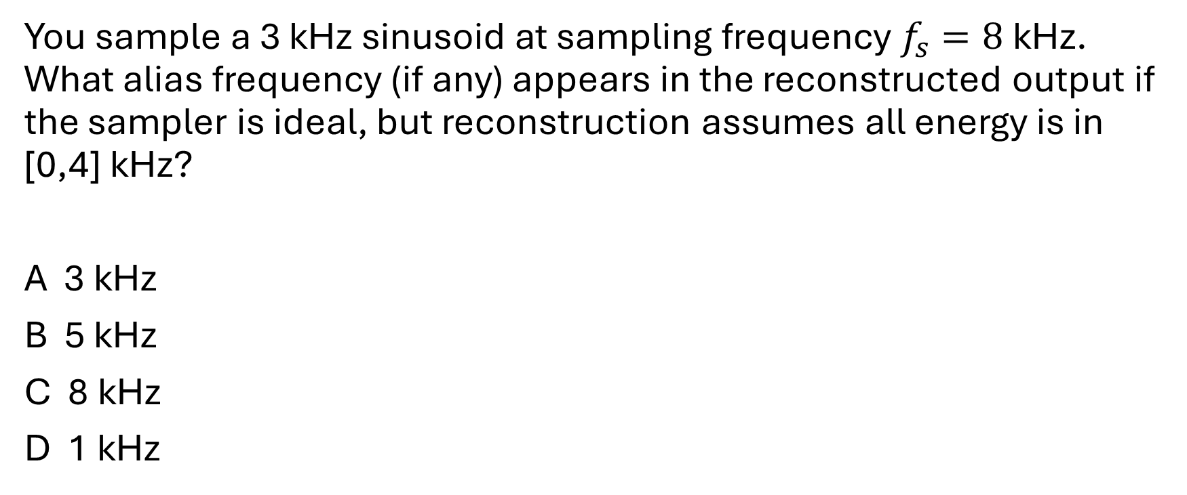
Clicker Question
You sample a 3 kHz sinusoid at sampling frequency $f_{s}=8$ kHz. What alias frequency (if any) appears in the reconstructed output if the sampler is ideal, but reconstruction assumes all energy is in [0,4] kHz?
A 3 kHz
B 5 kHz
C 8 kHz
D 1 kHz

Slide 5






Discrete Fourier Transform (DFT)

Slide 6









Discrete Fourier Transform (DFT)

Slide 7




DFT indexes k,n, taken Modulo N

Slide 8
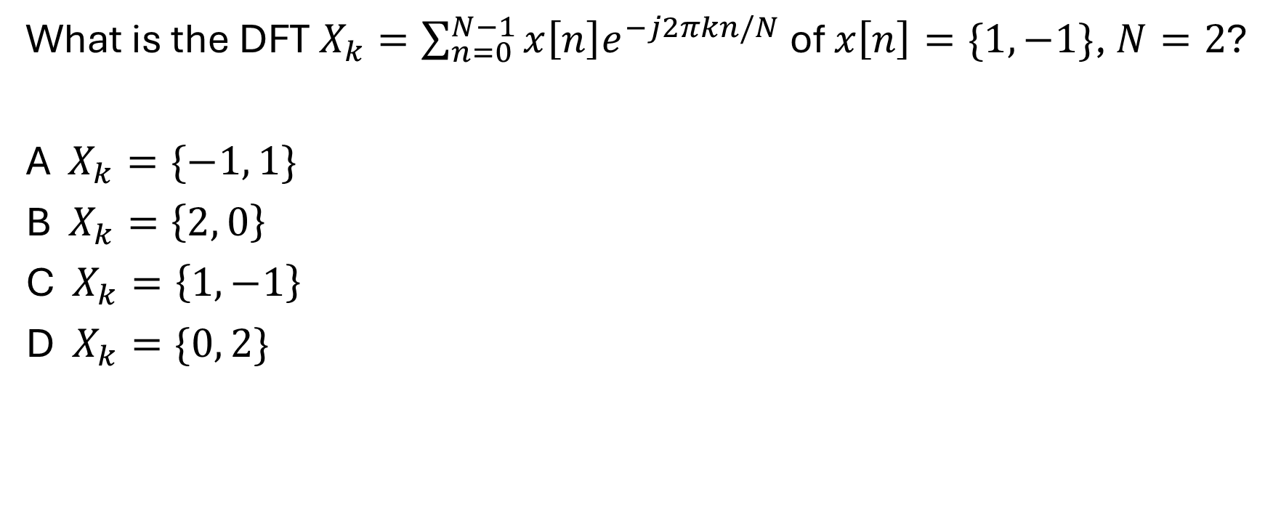
Clicker Question
What is the DFT $X_{k}=\sum_{n=0}^{N−1}{x\left[n\right]e^{−j2πkn/N}}$ of $x\left[n\right]=\{1, −1\}$, $N=2$?
A $X_{k}=\{−1, 1\}$
B $X_{k}=\left\{2, 0\right\}$
C $X_{k}=\left\{1, −1\right\}$
D $X_{k}=\{0, 2\}$

Slide 9
DFT Computation

Slide 10



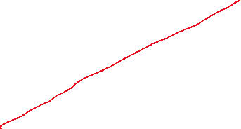





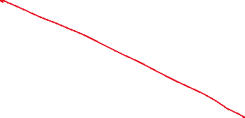
DFT Computation

Slide 11

































































N=8 DFT/FFT

Slide 12
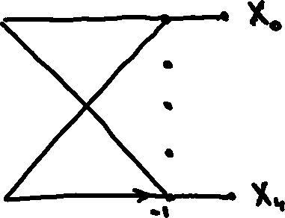




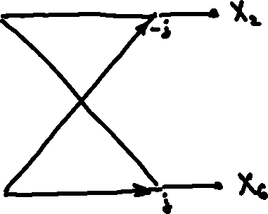



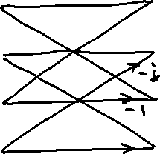


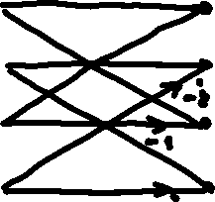

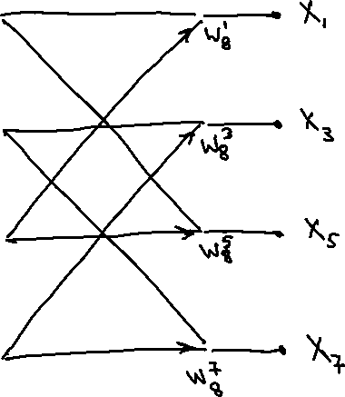

N=8 DFT/FFT

Slide 13
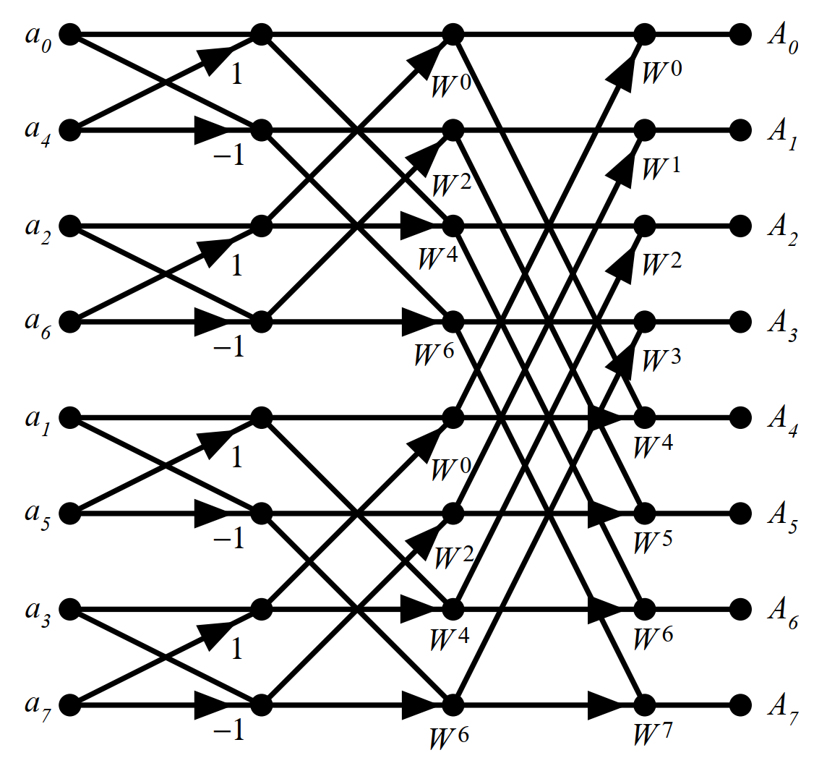






N=8 FFT

Slide 14
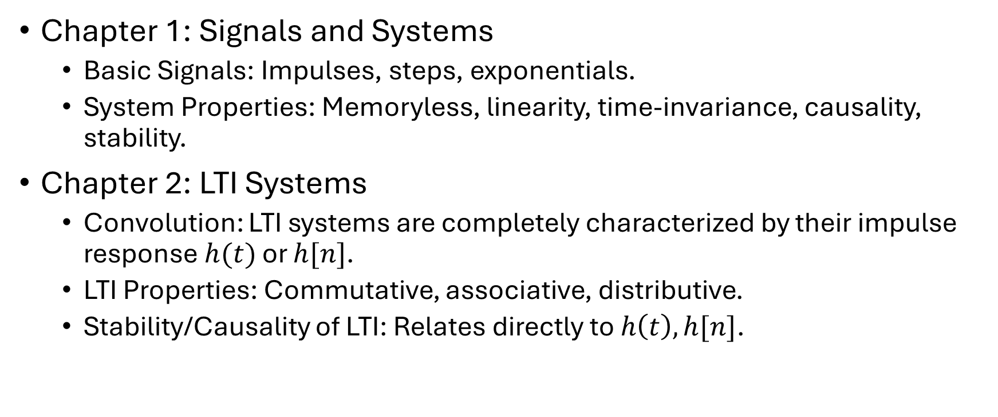
Review
Chapter 1: Signals and Systems
  Basic Signals: Impulses, steps, exponentials.
  System Properties: Memoryless, linearity, time-invariance, causality, stability.
Chapter 2: LTI Systems
  Convolution: LTI systems are completely characterized by their impulse response $h(t)$ or $h[n]$.
  LTI Properties: Commutative, associative, distributive.
  Stability/Causality of LTI: Relates directly to $h\left(t\right), h[n]$.

Slide 15
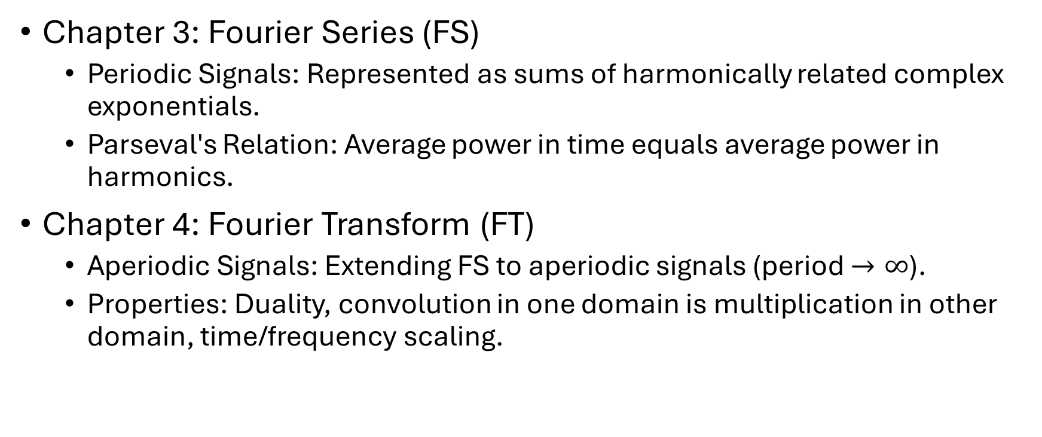
Review
Chapter 3: Fourier Series (FS)
  Periodic Signals: Represented as sums of harmonically related complex exponentials.
  Parseval's Relation: Average power in time equals average power in harmonics.
Chapter 4: Fourier Transform (FT)
  Aperiodic Signals: Extending FS to aperiodic signals (period $→∞$).
  Properties: Duality, convolution in one domain is multiplication in other domain, time/frequency scaling.

Slide 16
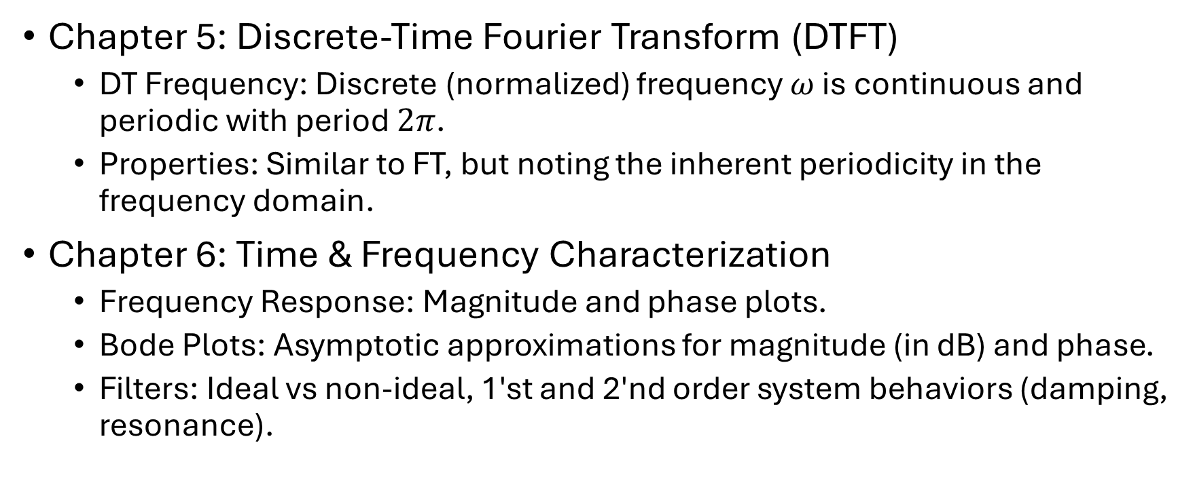
Review
Chapter 5: Discrete-Time Fourier Transform (DTFT)
  DT Frequency: Discrete (normalized) frequency $ω$ is continuous and periodic with period $2π$.
  Properties: Similar to FT, but noting the inherent periodicity in the frequency domain.
Chapter 6: Time & Frequency Characterization
  Frequency Response: Magnitude and phase plots.
  Bode Plots: Asymptotic approximations for magnitude (in dB) and phase.
  Filters: Ideal vs non-ideal, 1'st and 2'nd order system behaviors (damping, resonance).

Slide 17
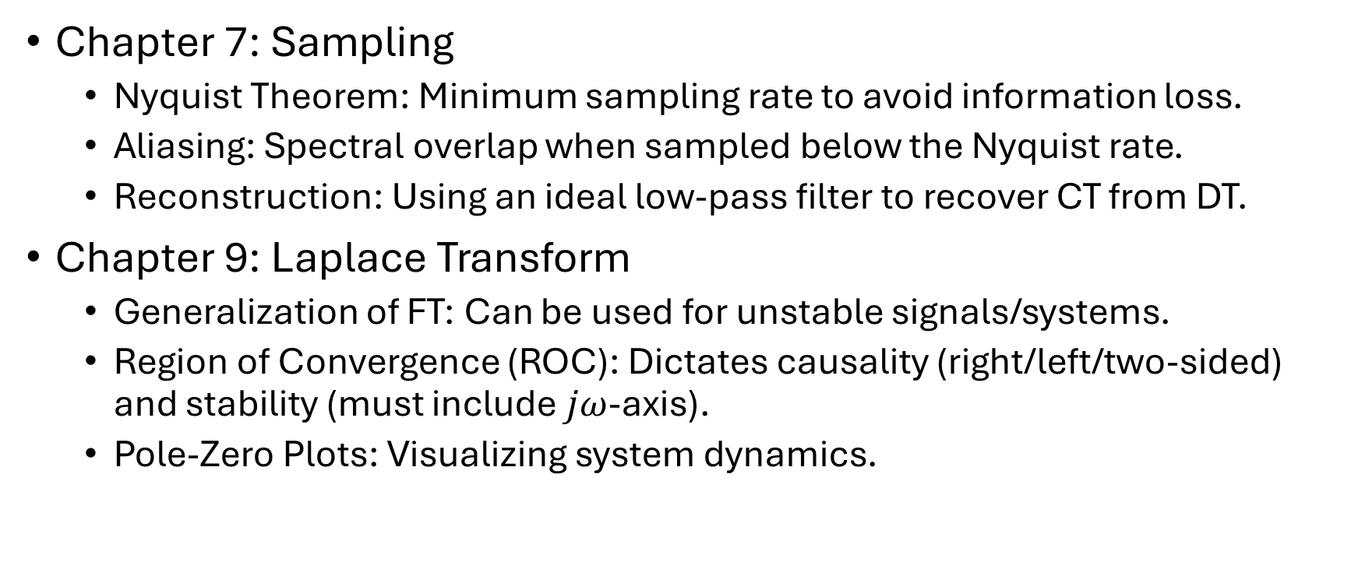
Review
Chapter 7: Sampling
  Nyquist Theorem: Minimum sampling rate to avoid information loss.
  Aliasing: Spectral overlap when sampled below the Nyquist rate.
  Reconstruction: Using an ideal low-pass filter to recover CT from DT.
Chapter 9: Laplace Transform
  Generalization of FT: Can be used for unstable signals/systems.
  Region of Convergence (ROC): Dictates causality (right/left/two-sided) and stability (must include $jω$-axis).
  Pole-Zero Plots: Visualizing system dynamics.

Slide 18
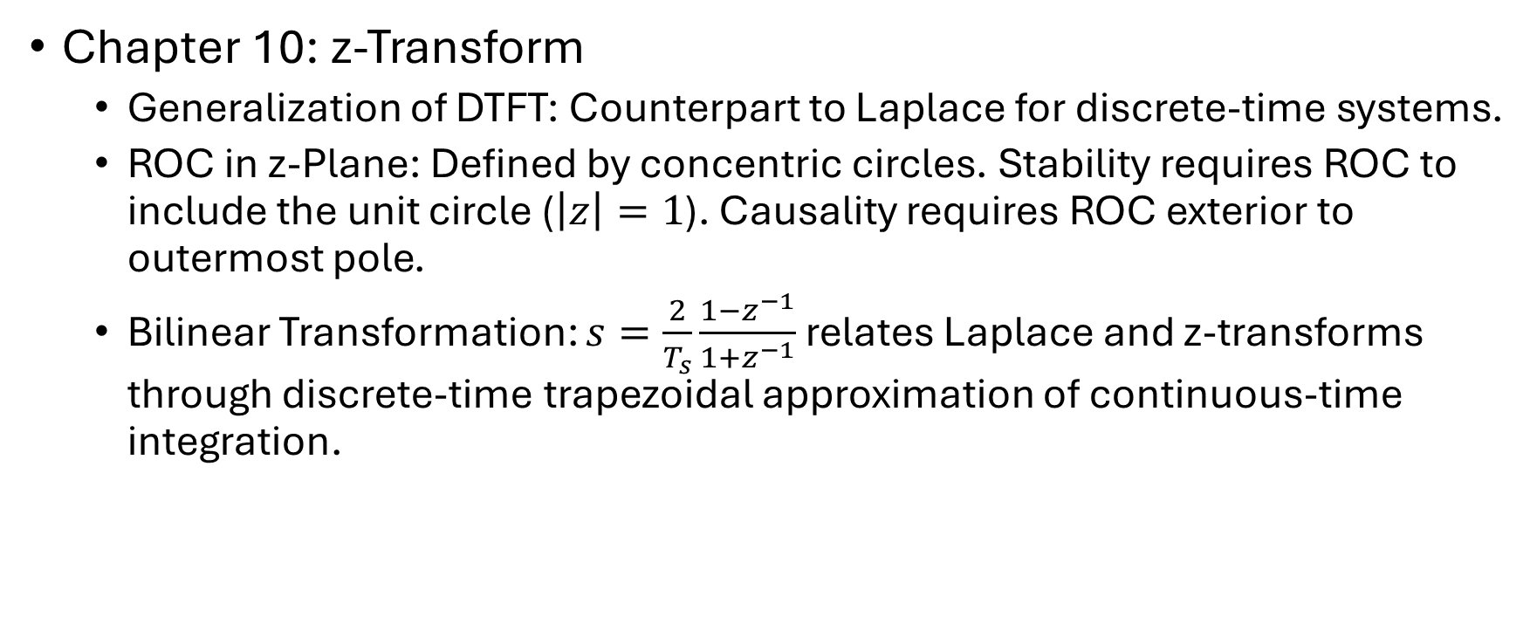
Review
Chapter 10: z-Transform
  Generalization of DTFT: Counterpart to Laplace for discrete-time systems.
  ROC in z-Plane: Defined by concentric circles. Stability requires ROC to include the unit circle ($\left|z\right|=1$). Causality requires ROC exterior to outermost pole.
  Bilinear Transformation: $s=\frac{2}{T_{s}}\frac{1−z^{−1}}{1+z^{−1}}$ relates Laplace and z-transforms through discrete-time trapezoidal approximation of continuous-time integration.

