Slide 1
LECTURE 15
Characterizing Random Signals
μₓ = E{x[n]}
From individual waveforms to ensembles, stationarity, and correlation
rₓₓ[m] = E{x[n]x[n+m]}
Oppenheim & Schafer • Random signals and LTI systems | Raschka • preprocessing / PyTorch
Notes:
0:00–0:02. Frame the transition: deterministic DSP asks “what is this signal?” Random-signal DSP asks “what properties are predictable across realizations or time?”

Slide 2
Roadmap and learning objectives
75 minutes • stochastic-process vocabulary → WSS → correlation → ML alignment
Distinguish a random variable, a random process, an ensemble, and one realization.
Explain strict-sense stationarity (SSS) and wide-sense stationarity (WSS).
Compute / interpret mean, autocorrelation, cross-correlation, and correlation matrices.
Use correlation as a feature-alignment and template-matching operation before ML.
0–15 min
Stochastic processes and ensembles
15–35 min
SSS vs WSS; what “stationary” buys us
35–60 min
Mean, correlation, matrices
60–75 min
ML bridge: alignment
Notes:
Core question: What can we estimate reliably from one finite realization, and under what assumptions does that estimate represent the process?

Slide 3
01
From a random variable to a random process
A signal value is random; a whole sequence of random variables is a stochastic process.
Notes:
0:02–0:03. Keep notation light: X[n] is a random variable at each n; x[n] is one realized sequence.

Slide 4
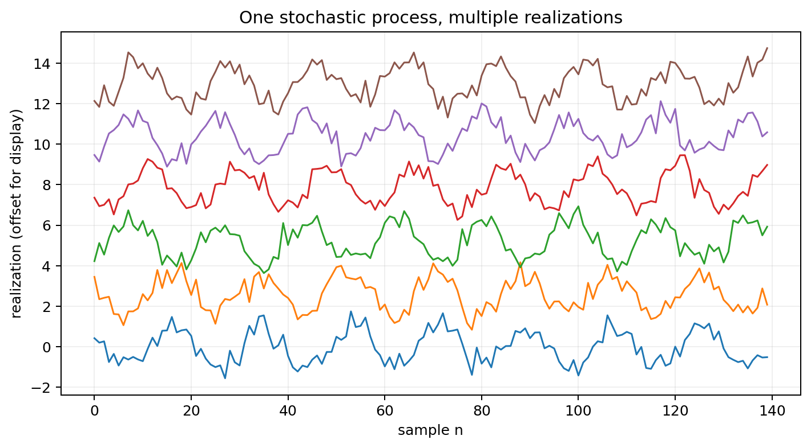
Random process = indexed family of random variables
At each time index n, X[n] has a distribution; a realization picks one value at every n.
X[n] : random variable at each n
xᵢ[n] : the i-th realization (sample path)
Ensemble
The set of all possible realizations generated by the same probabilistic mechanism.
One realization
What a sensor normally gives us: one finite sample path, not the whole ensemble.
Notes:
0:03–0:10. Example: microphone noise recorded six times under nominally identical conditions. Each recording is a realization. The process is the probabilistic source model.

Slide 5
Ensemble average vs time average
Expectation is defined over the ensemble; experiments often estimate it from time samples.
μₓ[n] = E{X[n]}
These are not automatically the same thing.
Stationarity removes explicit dependence on n for key statistics.
Ergodicity is the additional idea that lets time averages estimate ensemble averages.
time estimate: μ̂ = (1/N) Σₙ x[n]
Teaching nuance
Do not say “WSS means time averages equal expectations.” That is ergodicity, not stationarity.
Notes:
0:10–0:15. Introduce ergodicity only as a preview. This distinction prevents a common misconception.

Slide 6
02
Stationarity
Can the process statistics be treated as unchanged when we shift the time origin?
Notes:
0:15. Motivate: without some stability assumption, every n could need a different model.

Slide 7
Strict-sense stationarity (SSS)
Every joint probability distribution is invariant to a common time shift.
(X[n₁],…,X[nₖ]) ≍ (X[n₁+ℓ],…,X[nₖ+ℓ])
The strongest common stationarity definition.
It constrains all orders of statistics, not just the mean and variance.
Powerful mathematically, but often more than a DSP design actually needs.
Example
Independent identically distributed Gaussian noise with fixed mean and variance is SSS.
Non-example
A process whose variance grows with n is not stationary.
Notes:
0:15–0:22. “≍” means equal in distribution. Avoid spending too long on joint-CDF notation unless the cohort is mathematically ready.

Slide 8
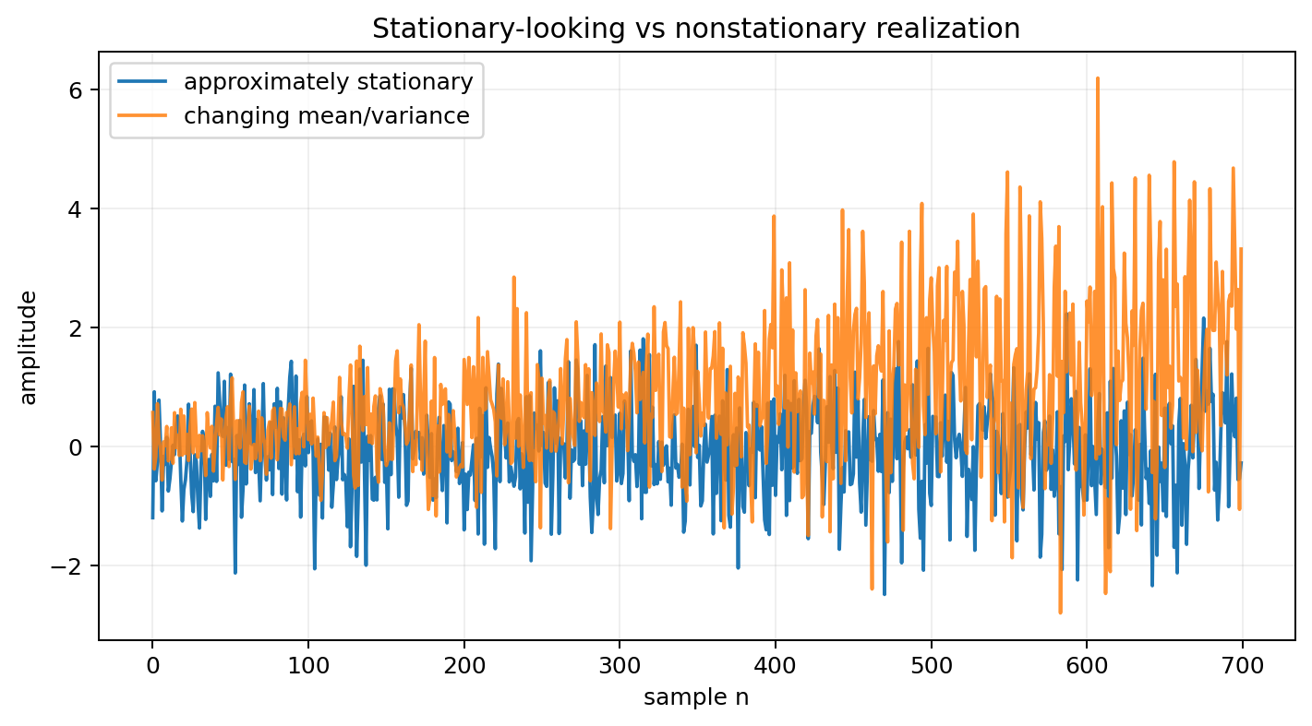
Wide-sense stationarity (WSS)
Most linear DSP analysis only needs first- and second-order statistics.
E{X[n]} = μₓ (constant)
Finite second moment.
Mean does not depend on absolute time.
Autocorrelation depends only on lag, not on where the pair occurs.
Exactly the structure needed for correlation, power, and LTI-system analysis.
rₓₓ[n₁,n₂] = rₓₓ[n₂−n₁]
Why ML cares
Stable preprocessing statistics and lag features are much easier to learn from when the data distribution is approximately stationary.
Notes:
0:22–0:30. Stress that WSS is not “signal looks flat.” It is a statement about first and second moments.

Slide 9
CONCEPT CHECK
A process has constant mean but variance σ²[n] = 1 + 0.01n. Is it WSS?
Good answer
No. WSS requires the second-order statistics to be time-shift invariant. A variance that changes with n violates that requirement even though the mean is constant.
Notes:
0:30–0:35. Let students answer in pairs. Good answer must mention variance / autocorrelation at lag zero, not just “it changes.”

Slide 10
03
Time-domain statistics
Mean describes level; correlation describes similarity across lag.
Notes:
0:35. Move from definitions to things students can estimate and use.

Slide 11
Mean and variance: what fluctuates around what?
For WSS, these do not depend on n.
μₓ = E{X[n]}
Interpretation
Mean = DC / baseline level. Variance = average squared fluctuation around that level.
σₓ² = E{|X[n]−μₓ|²}
rₓₓ[0] = E{|X[n]|²} = σₓ² + |μₓ|²
Zero-mean case
If μₓ = 0, then rₓₓ[0] = σₓ². This is why white-noise autocorrelation is often written σ²δ[m].
Finite data
Use sample estimates, but remember they are random quantities with bias/variance of their own.
Notes:
0:35–0:42. Connect rxx[0] to average signal power.

Slide 12
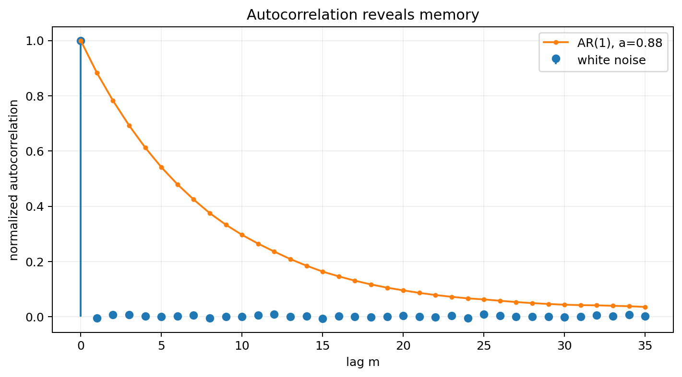
Autocorrelation: how similar is the process to a delayed copy?
With the convention used here: rₓₓ[m] = E{X[n]X*[n+m]}.
rₓₓ[m] = E{X[n] X*[n+m]}
Large |rₓₓ[m]| means samples m apart are statistically related.
White noise: correlation collapses to lag 0.
Smooth / filtered processes keep correlation over several lags.
For real WSS processes, rₓₓ[m] = rₓₓ[−m].
Notes:
0:42–0:49. Explain that “uncorrelated at nonzero lags” is a second-order statement; it does not automatically imply independence unless special distributions such as jointly Gaussian apply.

Slide 13
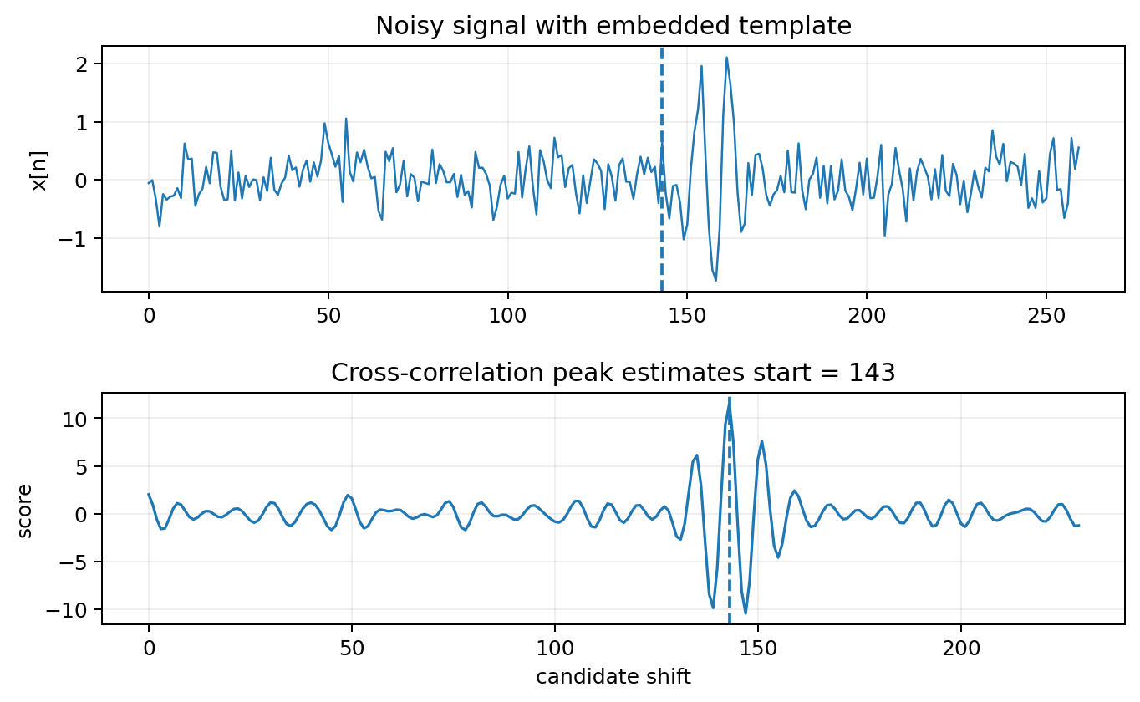
Cross-correlation: similarity between two signals as a function of lag
Our convention: rₓᵧ[m] = E{X[n]Y*[n+m]}.
rₓᵧ[m] = E{X[n] Y*[n+m]}
Peak lag estimates relative delay / alignment.
Useful for synchronization, matched-template detection, and feature registration.
Sign conventions differ across books/software; define the convention before deriving formulas.
Notes:
0:49–0:55. This convention choice matters in Lecture 16. The user outline had a reversed h formula inconsistent with this definition; the next lecture explicitly reconciles the two conventions.

Slide 14
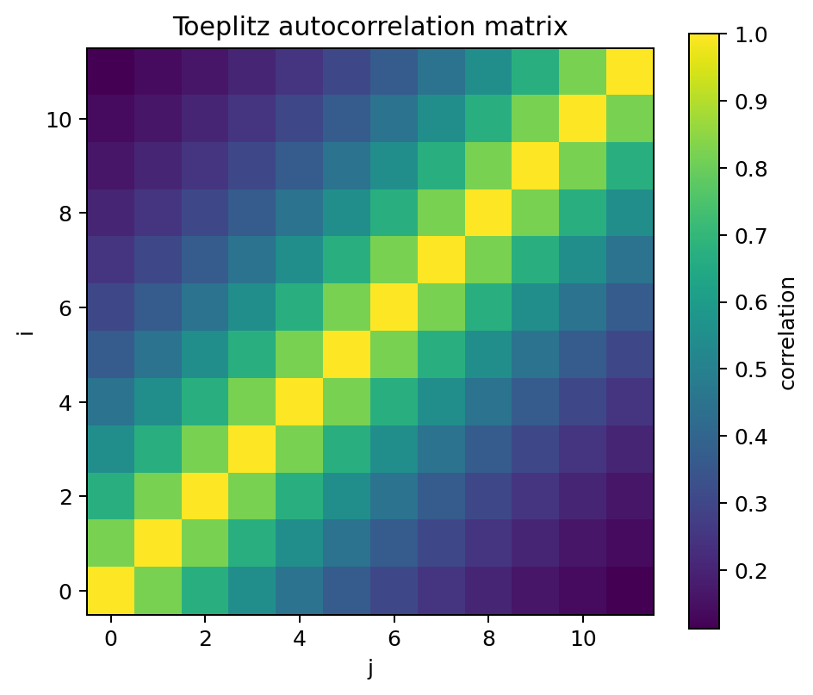
The autocorrelation matrix packages many lags at once
A finite vector of WSS samples has a Toeplitz covariance/correlation structure.
Rₓ[i,j] = rₓₓ[j−i]
Hermitian / symmetric for complex / real processes.
Toeplitz for WSS: entries depend only on lag.
Positive semidefinite: aᴴRₓa ≥ 0 for every vector a.
Eigenvalues cannot be negative (up to numerical roundoff).
Notes:
0:55–1:00. Derive PSD property from E{|a^H x|^2} ≥ 0. This connects directly to PCA/covariance matrices later.

Slide 15
CONCEPT CHECK
Why must an autocorrelation matrix be positive semidefinite?
Good answer
For any coefficients a, the quadratic form aᴴRₓa equals the expected squared magnitude E{|Σ aₖ*X[k]|²}. A squared magnitude cannot have negative expectation.
Notes:
1:00–1:03. This is a high-value bridge to linear algebra and ML covariance matrices.

Slide 16
04
ML bridge: alignment before prediction
Correlation can turn “same event at different times” into aligned features.
Notes:
1:03. Ask students why a classifier might fail when the same waveform arrives at different offsets.

Slide 17
Template matching as preprocessing
Correlation converts unknown time shift into an estimated alignment parameter.
Compute correlation between an observation and a known template.
Find the lag with the largest correlation score.
Shift / crop the example into a common coordinate system.
Then compute features and feed fixed-size vectors to a Scikit-Learn model.
Important
Correlation is not a classifier by itself; here it is an alignment / feature-engineering step.
Notes:
1:03–1:11. Example: machinery impulse appears at variable trigger delay. Aligning before extracting RMS, spectral, or learned features reduces irrelevant timing variability.

Slide 18
Coding prompt: estimate lag from noisy data
Predict first; then run the notebook.
1
Generate
What to discuss
Insert a known pulse / waveform at an unknown offset inside noise.
How does SNR change the peak? What if the template amplitude changes? What if the signal is stretched, not merely shifted? Why might normalized correlation be preferable?
2
Correlate
Use scipy.signal.correlate(observation, template).
3
Estimate
argmax gives the best candidate alignment under this simple model.
Notes:
1:11–1:14. Use this as a mini-lab or exit prediction.

Slide 19
Lecture 15 wrap-up
The stochastic framework lets us describe what is repeatable even when individual samples are unpredictable.
A random process is an ensemble; a sensor usually provides one realization.
WSS means constant mean and lag-only autocorrelation.
Autocorrelation measures memory; cross-correlation measures lagged similarity.
Correlation matrices are symmetric/Hermitian, Toeplitz (for WSS), and positive semidefinite.
Correlation can align examples before ML feature extraction.
EXIT QUESTION
A process has constant mean and rₓₓ[n₁,n₂] = exp(−0.2|n₂−n₁|). What property makes it WSS?
Good answer
Its mean is constant and its autocorrelation depends only on lag n₂−n₁, not absolute time.
Notes:
1:14–1:15. Collect one-sentence responses.

Slide 20
References and instructor resources
Oppenheim & Schafer, Discrete-Time Signal Processing: random signals, correlation, and LTI systems.
Raschka et al., Machine Learning with PyTorch and Scikit-Learn: preprocessing and PyTorch workflows.
Accompanying notebook: Week8_Random_Signals_DSP_ML_Demos.ipynb.
Homework and weekly quiz: Week8_Random_Signals_Homework_Quiz_Solutions.docx.

