Slide 1
LECTURE 16
LTI Systems with Random Inputs
μᵧ = μₓ Σ h[k]
Predict output statistics without predicting the exact waveform
rᵧᵧ = rₓₓ * h * h_rev
Oppenheim & Schafer • Random signals and LTI systems | Raschka • preprocessing / PyTorch
Notes:
0:00–0:02. Reframe LTI analysis: for a random input we rarely know x[n] exactly, but WSS lets us predict mean, correlation, variance, and spectrum.

Slide 2
Roadmap and learning objectives
75 minutes • mean → input/output correlation → white-noise coloring → augmentation
Propagate the mean of a WSS process through an LTI system.
Derive input-output and output autocorrelation relationships under a stated correlation convention.
Compute output variance from the input covariance / autocorrelation.
Explain why an LTI filter turns white noise into colored noise.
Use controlled noise models for PyTorch data augmentation.
0–20 min
Mean and variance
20–50 min
Correlation dynamics
50–65 min
White noise → colored noise
65–75 min
PyTorch augmentation
Notes:
Core question: Which output properties can be computed from h[n] and the input second-order statistics alone?

Slide 3
01
Mean and variance through an LTI system
Linearity lets expectation pass through convolution.
Notes:
0:02–0:03. Start from y[n] = Σ h[k]X[n−k].

Slide 4
Output mean is controlled by the DC gain
For a WSS input, E{X[n−k]} = μₓ for every k.
Y[n] = Σₖ h[k] X[n−k]
DC gain = 1
Mean passes through unchanged.
μᵧ = E{Y[n]} = μₓ Σₖ h[k] = μₓ H(eʲ⁰)
DC gain = 0
A constant mean is removed; e.g., a difference / highpass filter.
DC gain > 1
The mean is amplified by the same gain.
Notes:
0:03–0:11. Example h={1/2,1/2}: DC gain 1, so mean unchanged. Difference h={1,-1}: DC gain 0, so output mean is zero even if input mean is nonzero.

Slide 5
CONCEPT CHECK
Input X[n] has mean 3. The filter is h[n] = {1, −1}. What is μᵧ?
Good answer
μᵧ = 3(1−1) = 0. The first-difference filter has zero DC gain, so it removes the constant mean component.
Notes:
0:11–0:14. Good answer should mention DC gain, not just arithmetic.

Slide 6
Variance needs second-order information
Mean alone is not enough to predict random fluctuations at the output.
σᵧ² = E{|Y[n]−μᵧ|²}
cₓₓ[m] is the input autocovariance (mean removed).
Correlated input samples can add constructively or destructively through the filter.
For white noise, all off-zero covariance lags vanish, giving a much simpler result.
σᵧ² = Σₖ Σₗ h[k] h*[l] cₓₓ[k−l]
White-noise special case
σᵧ² = σₓ² Σₖ |h[k]|²
Notes:
0:14–0:20. For the mixed cohort, present the double sum as an interpretation rather than a derivation. Matrix form: var(a^T x)=a^T C a.

Slide 7
02
Input-output correlation dynamics
Convolution of waveforms becomes convolution of correlation sequences.
Notes:
0:20. Pause to state the correlation convention before any derivation.

Slide 8
Correlation convention: define it before using reversal formulas
Different texts/software place the lag on different arguments.
This lecture: rₓᵧ[m] = E{X[n] Y*[n+m]}
Alternate: r̃ₓᵧ[m] = E{X[n+m]Y*[n]}
Then: rₓᵧ[m] = (rₓₓ * h*)[m] for y = h*x
Then: r̃ₓᵧ[m] = (rₓₓ * h_rev*)[m]
Why this matters
The user-facing formula rₓᵧ = rₓₓ*h[−m] is correct under the alternate lag convention, but not under the Lecture 15 definition rₓᵧ[m] = E{X[n]Y[n+m]}. Keep one convention consistent throughout.
Notation
For real-valued filters, h* = h. Define h_rev[m] = h[−m].
Notes:
0:20–0:27. This slide intentionally resolves a common sign/reversal ambiguity. The deck uses the Lecture 15 convention consistently.

Slide 9
Deriving rₓᵧ[m] with the Lecture 15 convention
Move expectation through the deterministic sum.
Y[n+m] = Σₖ h[k] X[n+m−k]
Interpretation
The system smears the input autocorrelation by the same impulse response that filters the signal.
rₓᵧ[m] = E{X[n]Y*[n+m]}
= Σₖ h*[k] rₓₓ[m−k]
Sanity check
If h[n] = δ[n], then rₓᵧ[m] = rₓₓ[m].
= (rₓₓ * h*)[m]
Complex signals
The conjugation follows from the correlation definition.
Notes:
0:27–0:35. For real signals, drop conjugates to match the course’s earlier notation.

Slide 10
Output autocorrelation: filter once on each side
The output contains two filtered copies inside the second-order product.
rᵧᵧ[m] = rₓₓ[m] * h[m] * h_rev*[m]
For real h[n], h_rev*[m] = h[−m].
rₕₕ is deterministic autocorrelation of the impulse response.
At m = 0, rᵧᵧ[0] gives average output power; subtract |μᵧ|² for variance.
rₕₕ[m] = h[m] * h_rev*[m]
Therefore: rᵧᵧ[m] = rₓₓ[m] * rₕₕ[m]
Notes:
0:35–0:43. Connect to the frequency-domain result Syy = Sxx |H|^2, which students will encounter with PSDs.

Slide 11
CONCEPT CHECK
If h[n] = δ[n] + 0.5δ[n−1], does a white-noise input remain white?
Good answer
No. Adjacent output samples share one of the same input samples, so they become correlated. The filter “colors” the white noise.
Notes:
0:43–0:47. Ask students to reason without equations first.

Slide 12
A matrix view: filtering transforms covariance
Useful bridge to linear algebra and ML.
y = Hx
If Cₓ = σ²I (white), then Cᵧ = σ²HHᴴ.
Filtering creates off-diagonal covariance unless H is trivial / orthogonal in a special way.
This is the same covariance propagation idea used in estimation, Kalman filtering, and uncertainty-aware ML.
Cᵧ = H Cₓ Hᴴ
Connection
The scalar correlation formulas are the Toeplitz / infinite-length version of Cᵧ = H Cₓ Hᴴ.
Notes:
0:47–0:50. Keep this as a conceptual bridge, not a matrix-algebra detour.

Slide 13
03
White noise and filtering
“White” means flat second-order spectrum / zero correlation away from lag 0.
Notes:
0:50. Transition to the cleanest random-input example.

Slide 14
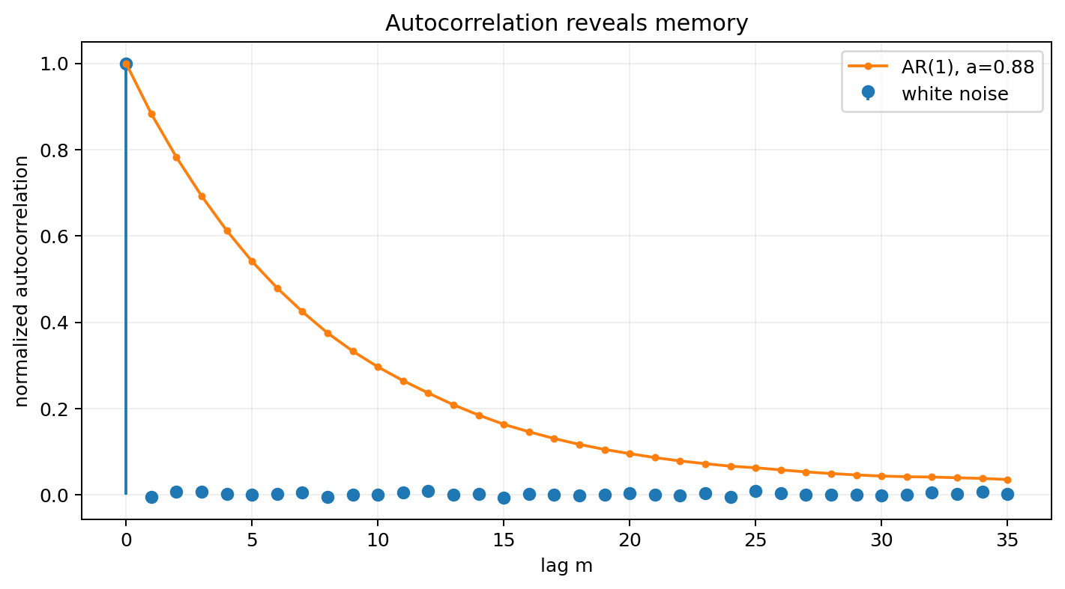
White noise: uncorrelated across nonzero lags
Zero-mean white noise has one nonzero autocorrelation sample.
rₓₓ[m] = σ² δ[m]
rₓₓ[0] = σ²: finite average power.
rₓₓ[m] = 0 for m ≠ 0: no linear second-order memory.
“White” does not mean Gaussian. Gaussian white noise is one important special case.
Notes:
0:50–0:56. Correct a common misconception: whiteness is about autocorrelation / PSD; Gaussian describes the amplitude distribution.

Slide 15
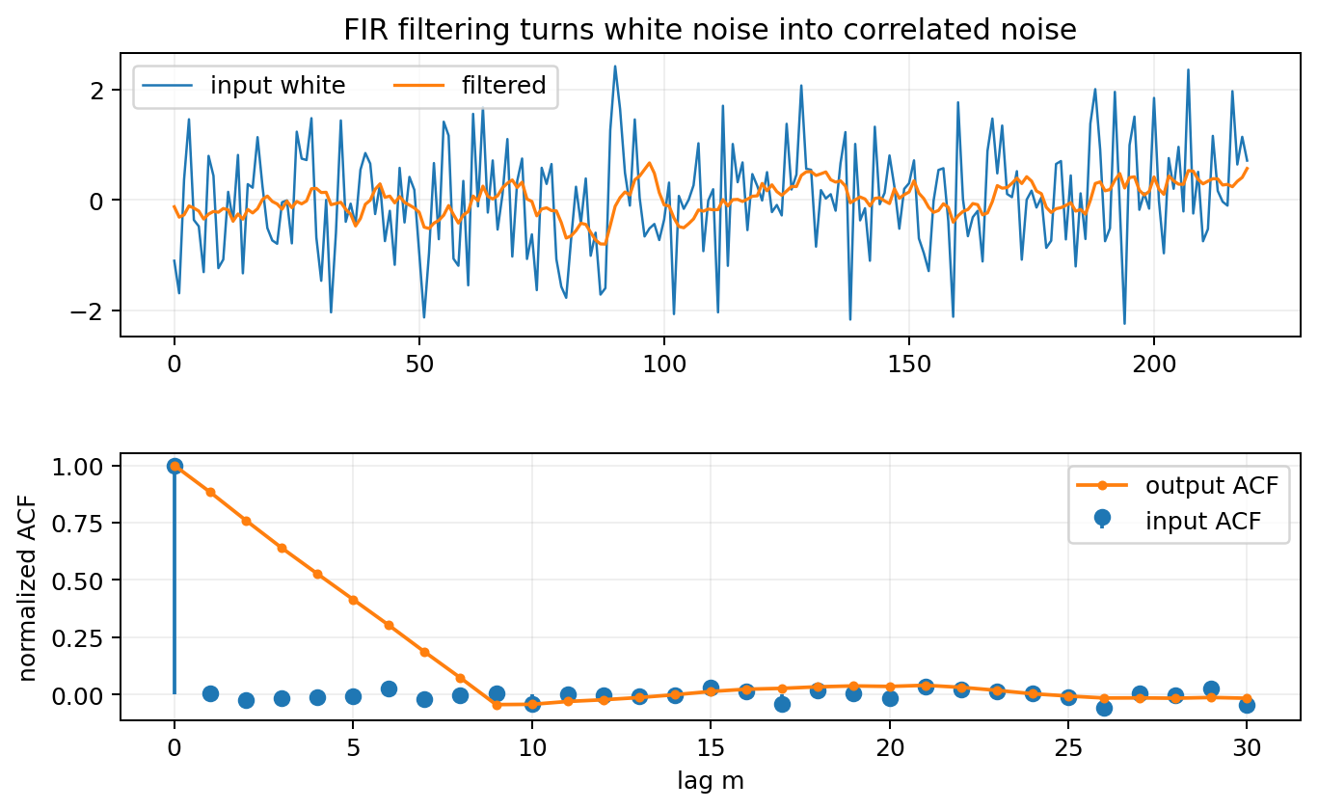
Filtering white noise creates colored noise
The output autocorrelation becomes a scaled autocorrelation of h[n].
rᵧᵧ[m] = σ² rₕₕ[m]
σᵧ² = rᵧᵧ[0] = σ² Σₖ |h[k]|²
Meaning of “colored”
The filter introduces correlation across time, so some frequencies become stronger than others.
Example
A moving-average lowpass makes neighboring output samples similar and suppresses high-frequency noise.
Notes:
0:56–1:02. Have students predict output variance for h={1/2,1/2}: σy²=σ²(1/4+1/4)=σ²/2.

Slide 16
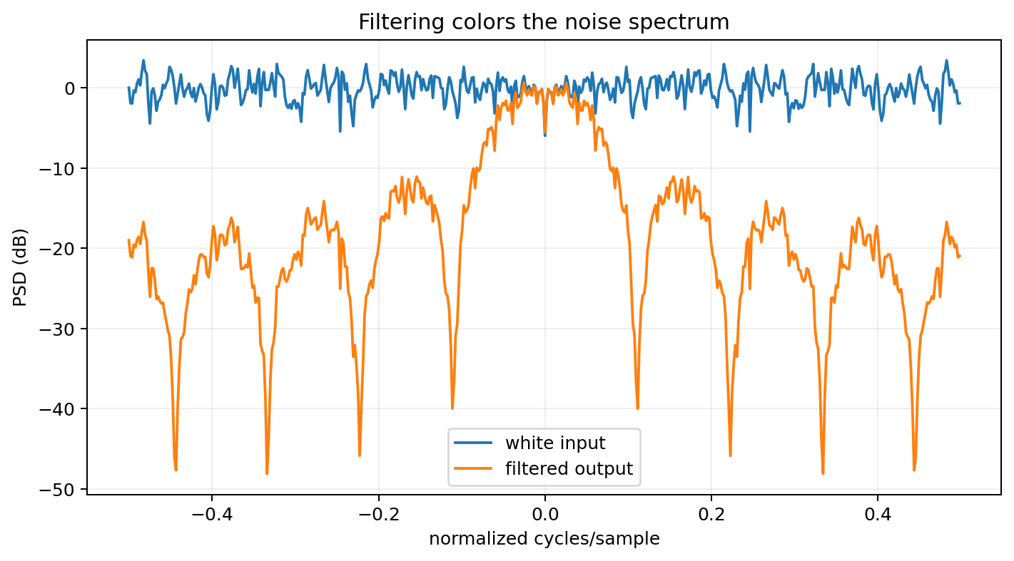
Frequency-domain preview: the filter shapes the noise PSD
Second-order time-domain convolution becomes multiplication in frequency.
Sᵧᵧ(eʲω) = Sₓₓ(eʲω) |H(eʲω)|²
white input: Sₓₓ(eʲω) = σ²
Interpretation
A lowpass H makes low-frequency noise survive and high-frequency noise shrink. The output is no longer spectrally flat.
Notes:
1:02–1:05. This is a preview if PSD is covered next; keep it intuitive if students have not yet formally defined PSD.

Slide 17
04
ML bridge: noise augmentation
Noise injection is a modeling decision, not just “add random numbers.”
Notes:
1:05. Connect noise statistics to realistic data augmentation.

Slide 18
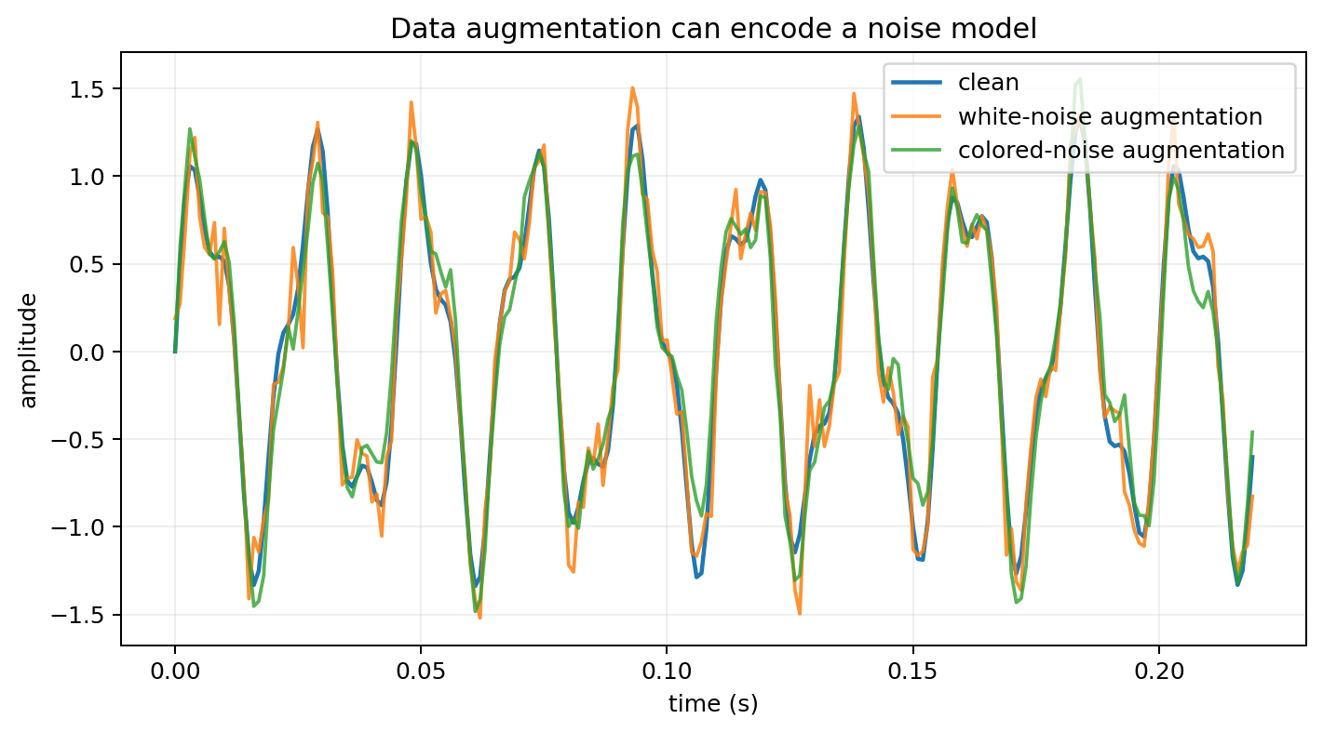
Synthetic noise augmentation in PyTorch
Match the nuisance process you expect the model to encounter.
White Gaussian noise: simple baseline; independent samples.
Colored noise: filter white noise to create temporal correlation.
Scale noise by target SNR or by a random severity range.
Apply augmentation only to training data, not validation/test data.
ML principle
Augmentation should preserve the label while varying nuisance factors the deployed model will face.
Notes:
1:05–1:11. Example: microphone / sensor noise is often colored, so white-only augmentation may be an unrealistic prior.

Slide 19
Coding prompt: white vs colored augmentation
Use the same clean waveform and the same noise RMS.
A • White
B • Colored
C • Compare
noise = torch.randn_like(x)
Generate white noise, then filter it with a stable FIR/IIR.
Plot ACF / PSD and listen or inspect waveforms.
Keep RMS equal: differences then come from correlation / spectrum, not total power.
Train a small classifier with each augmentation and compare robustness to matched and mismatched test noise.
Ask whether the augmentation distribution is physically plausible for the sensing problem.
Notes:
1:11–1:14. Notebook includes NumPy/SciPy and PyTorch versions.

Slide 20
Lecture 16 wrap-up
An LTI system transforms second-order statistics in a predictable way.
Mean is multiplied by the filter DC gain Σh[k].
Output variance depends on the input covariance and the filter energy / structure.
With rₓᵧ[m] = E{X[n]Y[n+m]}, rₓᵧ = rₓₓ*h for real h.
Output autocorrelation is rᵧᵧ = rₓₓ*h*h_rev.
Filtering white noise creates correlated, spectrally colored noise.
Noise augmentation should encode realistic nuisance statistics.
EXIT QUESTION
White noise with variance 4 drives h[n] = {1/2, 1/2}. What is the output variance?
Good answer
σᵧ² = 4[(1/2)²+(1/2)²] = 2. The lowpass reduces total noise variance while introducing correlation.
Notes:
1:14–1:15. Collect a numerical answer plus one sentence of interpretation.

Slide 21
References and instructor resources
Oppenheim & Schafer, Discrete-Time Signal Processing: random signals, correlation, and LTI systems.
Raschka et al., Machine Learning with PyTorch and Scikit-Learn: preprocessing, tensors, and training workflows.
Accompanying notebook: Week8_Random_Signals_DSP_ML_Demos.ipynb.
Homework and weekly quiz: Week8_Random_Signals_Homework_Quiz_Solutions.docx.

