Slide 1
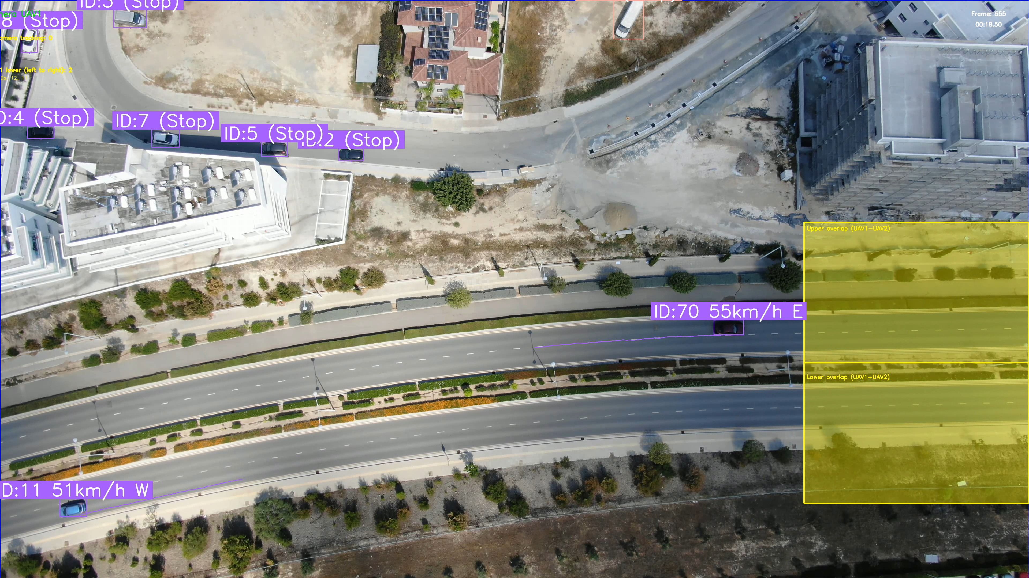
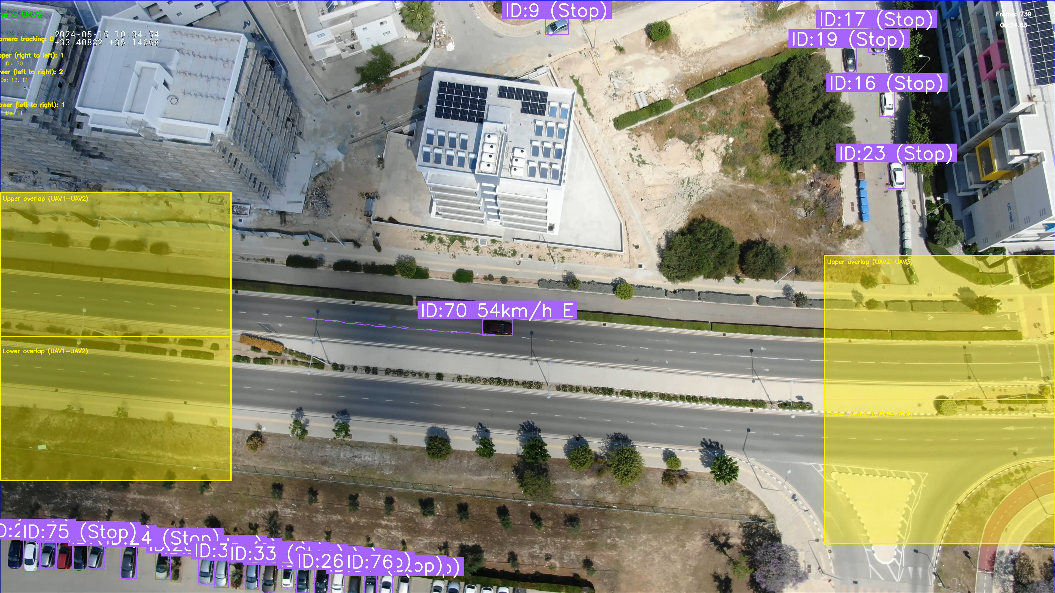
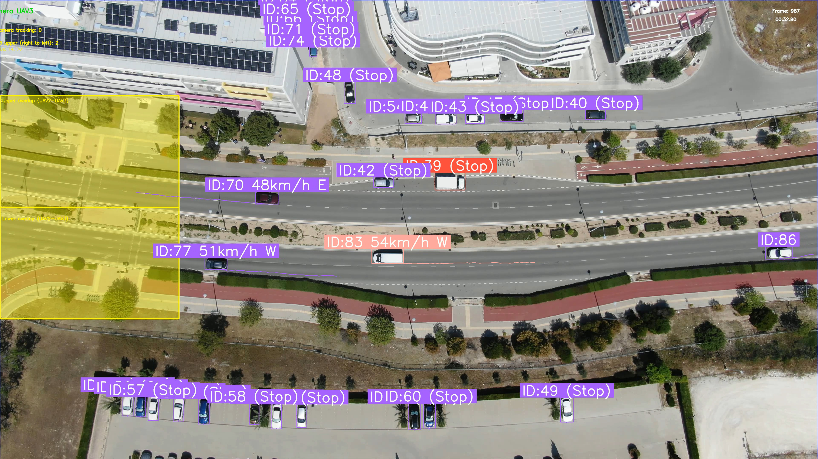
DATASET
Three synchronized UAV views of the same traffic scene
A small, image-led pilot for cross-camera vehicle tracking
UAV 1
UAV 2
UAV 3
What the release provides
3 synchronized one-minute UAV clips
Per-camera boxes + local tracker IDs
Cross-camera global IDs and overlap regions
Use as a synchronized tracking pilot; it is not a broad recognition or calibrated 3-D benchmark.
Source: Hugging Face dataset card and project repository; raw videos are not copied into this repository.

Slide 2
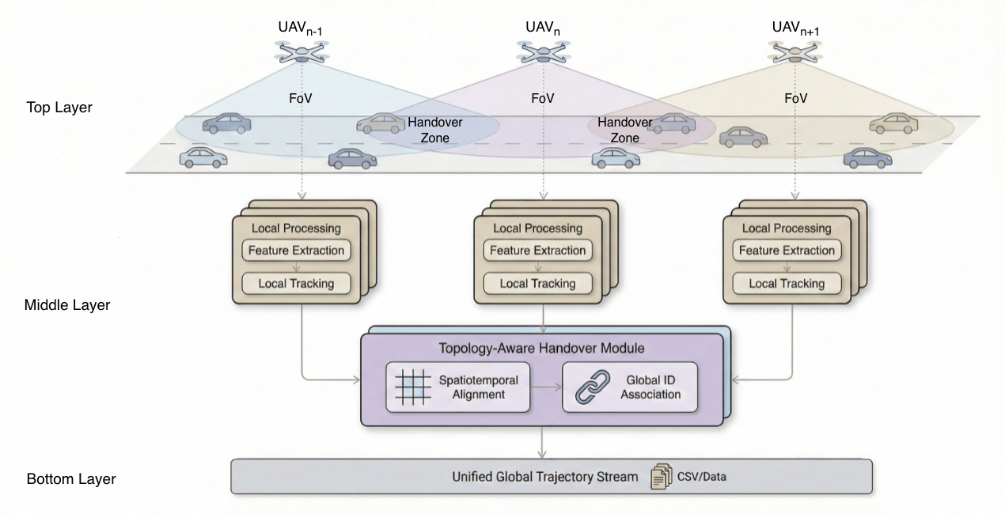
ALGORITHM
Reference algorithm: local tracks to global ID
The repository supplies an engineering baseline, not a new tracking method.
1
YOLO detector
Find vehicles in each UAV frame.
2
ByteTrack
Maintain a camera-local track.
3
Overlap matching
Compare compatible tracks in overlap regions.
4
global_id
Export a cross-camera identity and trajectory.
Important boundary: global_id is an application association result, not an NDN producer identity or cryptographic proof.
Source: project README; the implementation uses Ultralytics YOLO, Supervision/ByteTrack, and overlap-region matching.

Slide 3
INTEGRATION
NDNSF-UAV mapping: each selected stream is a Provider
Keep the video payload out of Request and Selection; publish bounded Named Data after Selection.
Tracking
Provider
User
/uav/A
/uav/B
/uav/C
Request
ACK
Selection
View Data
Result
protected descriptor
positive / negative
role assignment
signed named object
tracking output
Protocol tests enabled by this dataset
wrong producer
undeclared dependency
missing or late stream
stale attempt / cache replay
The Tracking Provider accepts View Data only after producer, dependency, attempt, and cache checks.
NDNSF mapping is the proposed project integration; it is not a claim made by the dataset authors.

