Slide 1

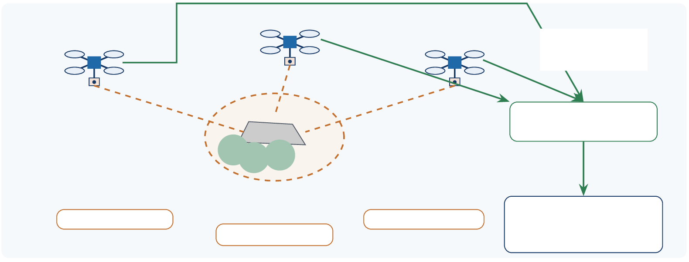
What Is Near This Map Pin? Combine Partial Views
Request: inspect this approximate region. The target’s identity is unknown.
UAV B: elevated view
UAV A: low-angle view
UAV C: opposite view
Images + pose
+ timestamps
Joint Analyzer
Ground node or UAV
?
Approximate region
Partly hidden object
Operator
Hypothesis + evidence
or uncertain
A: wheel-like feature?
C: vehicle-like outline?
B: flat upper surface?
Evidence: Illustrative clues, not measured detections. Orange: sight lines; green: named-data retrieval. No individual view is assumed sufficient.
NDNSF-UAV: data-driven collaboration work in progress
1/5

Slide 2

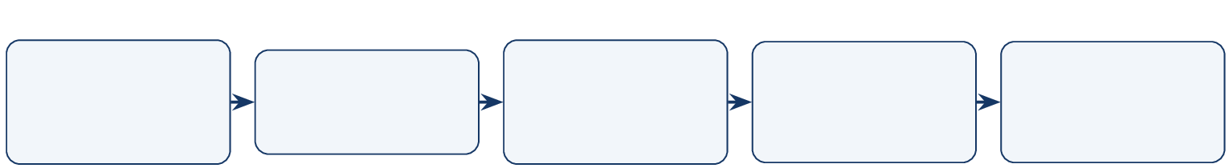
Complementary Evidence Supports a Joint Judgment
Request Data
Region +
question
Selection Data
Application
Response Data
ACK Data
Provider offers
Views +
Associate
Judgment
Analyzer
+ infer
+ evidence
Cameras: receive a region and viewpoint, without a target class.
Analyzer: match the same object across views and combine complementary cues.
NDNSF: select Providers, assign roles and retrieve protected evidence.
Key point
Multiple views can reduce ambiguity. Multiple UAVs add parallel capture; compare against one UAV changing viewpoint.
Evidence: Proposed workflow. Conflicting or insufficient evidence yields uncertainty. Three cameras are illustrative.
NDNSF-UAV: data-driven collaboration work in progress
2/5

Slide 3
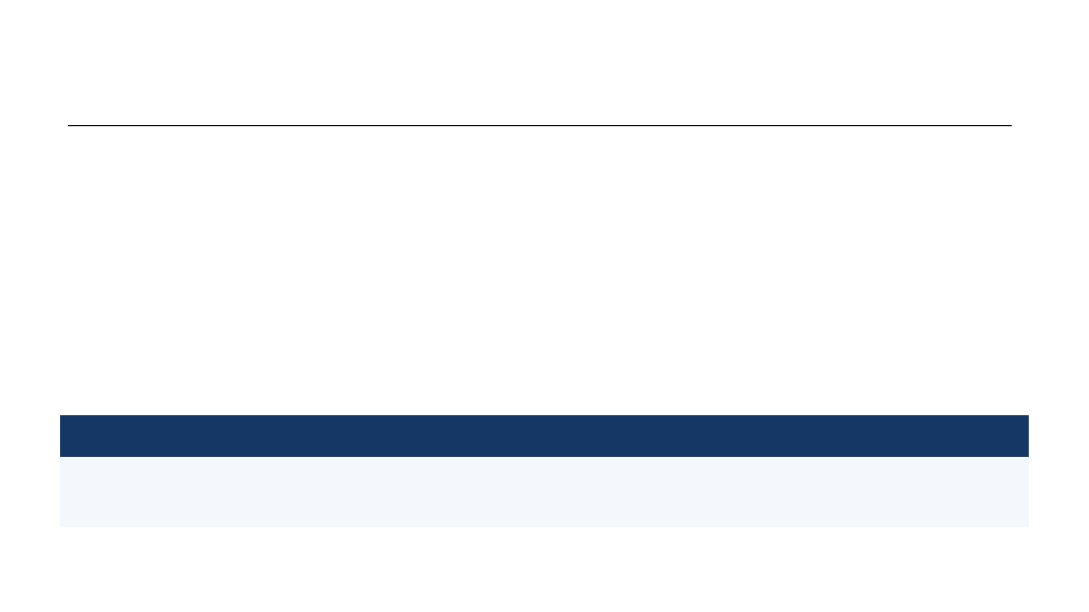
Three Gaps Between Simulation and the Field
Gap
Simplified example
Real deployment needs
Position / pointing
Known coordinates; assigned views
GPS + IMU, camera-to-body calibration, coordinate frames, synchronized pose and exposure
Useful views
Target assumed visible
Region search, camera control, visibility checks and complementary viewpoints
Joint judgment
Views assumed to match
Same-object association, time alignment, multi-view inference and uncertainty checks
Key point
Nearby images may show different objects. Validate cross-view association and joint judgment against ground truth.
Evidence: Candidate tools: MAVSDK control/telemetry; OpenCV calibration/geometry. Hardware support and integration remain to be verified.
NDNSF-UAV: data-driven collaboration work in progress
3/5

Slide 4
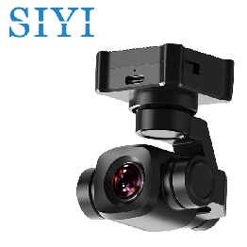
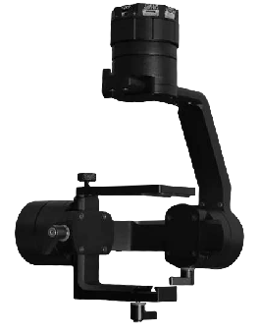
Optional Gimbal Upgrade: Not the Current Setup
SIYI A8 mini
Gremsy Pixy U
Camera + three-axis gimbal in one unit.
Gimbal only; add a compatible camera.
Ethernet UDP / UART control; Ethernet video.
SDK / MAVLink control; verify camera support.
Current choice: fixed camera. Gimbal hardware is a possible later upgrade.
Evidence: Product images: SIYI official store and Gremsy official site. Images not to scale. Candidate hardware; verify power, payload and mounting
before selection.
NDNSF-UAV: data-driven collaboration work in progress
4/5

Slide 5
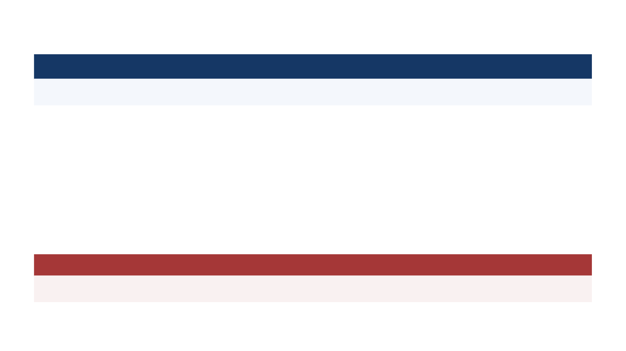
Current Solution: Fixed Camera
Why start here?
Simpler hardware; constant camera-to-body geometry.
Calibrate: camera intrinsics and the fixed camera-to-body transform.
Capture: reposition the UAV; prefer low-motion intervals and short exposures when feasible.
Record: pair each image with capture-time position, attitude and timestamp.
Analyze: estimate viewing direction from attitude and calibration; verify same-object matches before combining views.
Limitation
Attitude estimates do not prevent blur or jitter. Reject poor frames.
Evidence: Implementation plan; calibration and timing require validation. Metadata reference: MAVLink capture metadata.
NDNSF-UAV: data-driven collaboration work in progress
5/5

