Slide 1
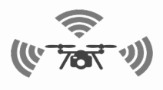
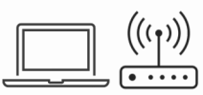
Flight Control Service Provider
Drone 1
Flight Control Service Provider
Drone 2
Service Request/Coordination
Service ACK/Response
Service Request
/Coordination
Service ACK/Response
Ground Station
Flight Control Service User
Service Controller
Drone 3
Flight Control Service Provider

Slide 2
provider-policies
{
provider-policy
{
for /UAVNET/drone1
allow
{
/FlightControl/Takeoff
/FlightControl/Land
/ImageProc/YOLO12
}
}
provider-policy
{
for /UAVNET/drone2
allow
{
/FlightControl/Takeoff
/FlightControl/Land
/ImageProc/YOLO12
}
}
provider-policy
{
for /UAVNET/drone3
allow
{
/FlightControl/Takeoff
/FlightControl/Land
/Sensor/HyperSpectral
}
}
}
user-policies
{
user-policy
{
for /UAVNET/gs/
allow
{
/UAVNET/drone1/FlightControl/Takeoff
/UAVNET/drone1/FlightControl/Land
/UAVNET/drone2/FlightControl/Takeoff
/UAVNET/drone2/FlightControl/Land
/UAVNET/drone3/FlightControl/Takeoff
/UAVNET/drone3/FlightControl/Land
}
}
user-policy
{
for /UAVNET/drone2/
allow
{
/UAVNET/drone3/Sensor/HyperSpectral
}
}
user-policy
{
for /UAVNET/drone3/
allow
{
/UAVNET/drone1/ImageProc/YOLO12
/UAVNET/drone2/ImageProc/YOLO12
}
}
}

