Slide 1
Figures on website

Slide 4
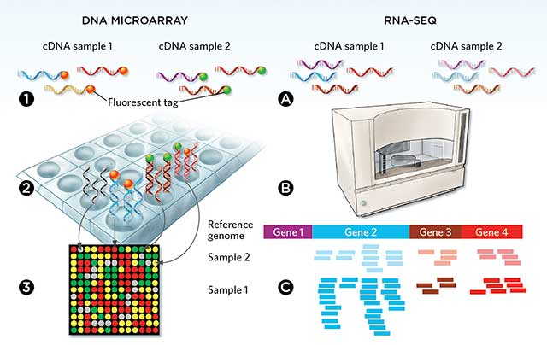
CBM
Continuous intensity
Read counts
 | sample 1 | sample 2 | .... | sample N
gene 1 | 5.161 | 5.168 | ... | 5.280
gene 2 | 6.538 | 6.727 | ... | 6.773
. . . | . . . | . . . | . . . | . . .
gene G | 6.713 | 6.825 | ... | 7.697
 | sample 1 | sample 2 | .... | sample N
gene 1 | 3 | 28 | ... | 10
gene 2 | 2304 | 1609 | ... | 1900
. . . | . . . | . . . | . . . | . . .
gene G | 30 | 122 | ... | 301
BayesMetaSeq

Slide 5
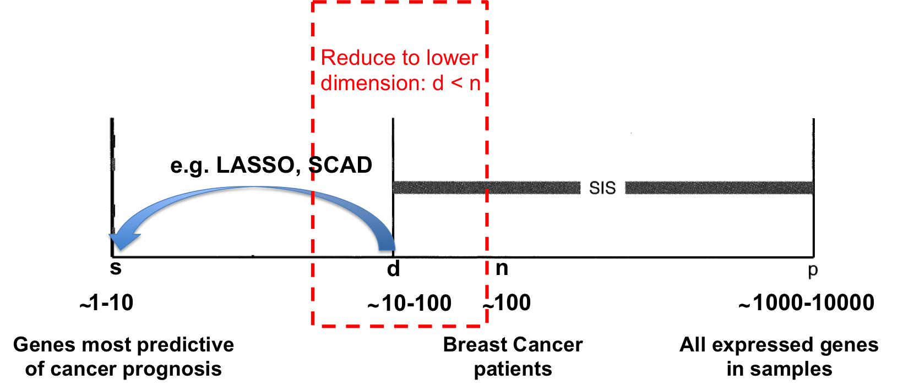
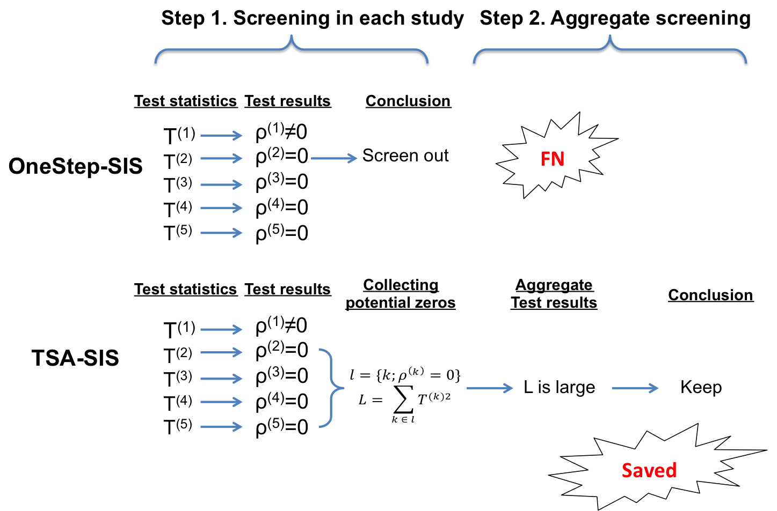

Slide 6
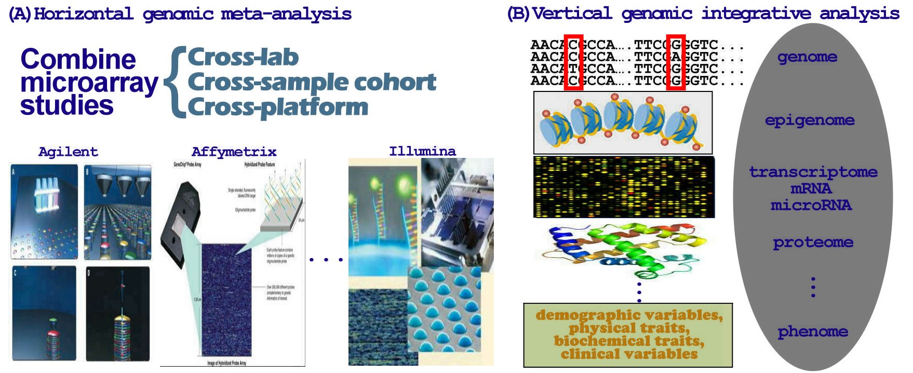
G₁ SNP×
S samples
E₁
D₁
D₂
….
D_{K}
G₂ gene expression ×
S samples
E₂
…
G genes×
S₁ samples
G genes×
S₂ samples
G genes×
S_{K} samples
G_{H} miRNA×
S samples
E_{H}
Same kind of omics data on K
different patient cohorts
(GWAS, gene expression, methylation, eQTL…)
Same patient cohort analyzed using
H different omics technology
Tseng et al. 2012, Nucleic Acids Res.

