Slide 1
Figures on website

Slide 4
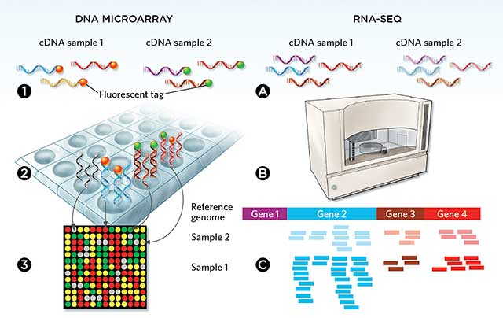
CBM
Continuous intensity
Read counts
 | sample 1 | sample 2 | .... | sample N
gene 1 | 5.161 | 5.168 | ... | 5.280
gene 2 | 6.538 | 6.727 | ... | 6.773
. . . | . . . | . . . | . . . | . . .
gene G | 6.713 | 6.825 | ... | 7.697
 | sample 1 | sample 2 | .... | sample N
gene 1 | 3 | 28 | ... | 10
gene 2 | 2304 | 1609 | ... | 1900
. . . | . . . | . . . | . . . | . . .
gene G | 30 | 122 | ... | 301
BayesMetaSeq

Slide 5
