Slide 1




Combining Deep Learning Methods and Human Knowledge to Identify Abnormalities in Computed Tomography (CT) Reports
Matias Benitez, James Tian, Mark Kelly, Vignesh Selvakumaran, Matthew Phelan, Maciej Mazurowski, Joseph Lo, Geoffrey Rubin, Ricardo Henao
Duke Clinical Research Institute, Durham, NC
Department of Computer Science, Duke University, Durham, NC
Department of Radiology, Duke University School of Medicine, Durham, NC
2018 CAD
Notes:
Delete any logos that are not applicable!

Slide 2
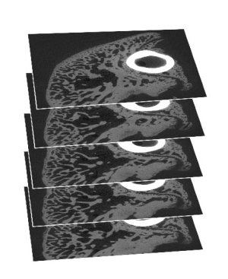
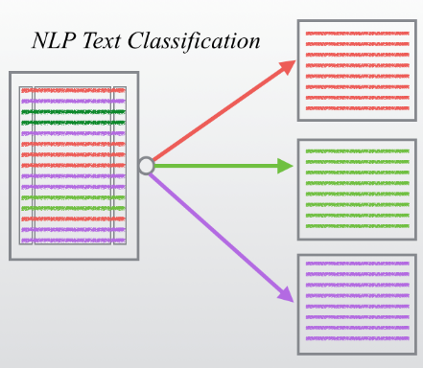
Introduction| Motivation
Problem 1: Creating labels for models based on CT scans.
Solution: Using text-based CT reports.
Problem 2: Creating labels for CT reports.
Solution: Developing a text-classification model.
Problem 3: Optimizing clinicians’ efforts.
Solution: Active Learning

Slide 3
Introduction| Objective
Goal:
To develop a model that identifies abnormalities within the CT reports and requires a significant reduced set of labeled reports.
Approach:
No random selection.
Select reports actively while training the model.
Select reports that most impact the variance of the model.

Slide 4

Data| Overview
4,805 CT reports from Duke University Health System.
January-March, 2017.
Report’s structure:
Clinical history
Findings
Impression
Signature
Example of a CT report

Slide 5
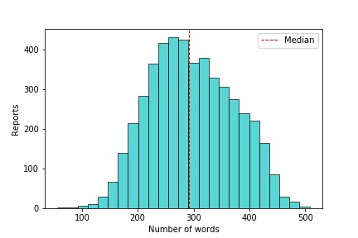
Data| Overview
Inclusion Criteria:
CT of the chest, abdomen and pelvis
Findings and Impressions sections
Data cleaning:
Eliminated text before findings
Eliminated signature
Number of words per report after data cleaning

Slide 6
Data| Labeled Data
Medical students and radiologists created binary labels for every organ.
Validation, Test and Initial sets: randomly selected.
Description of initial, validation and test sets.
Sets | Kidneys (%) |  | Lungs (%) |  | Size | Purpose
 | Abnormal | Normal | Abnormal | Normal
Initial | 47 | 53 | 80 | 20 | 99 | Pre-training
Validation | 45 | 55 | 79 | 21 | 100 | Tune Hyper-parameters
Test | 40 | 60 | 86 | 14 | 201 | Evaluate performance

Slide 7
Methods| Overview
Selecting report with highest uncertainty reduction
Clinicians create label for the selected report
Adding new data to training set
Training the model
Developing a classification model
Initialization: Training on initial set (99 reports).
Created a web interface to speed up the process.

Slide 8
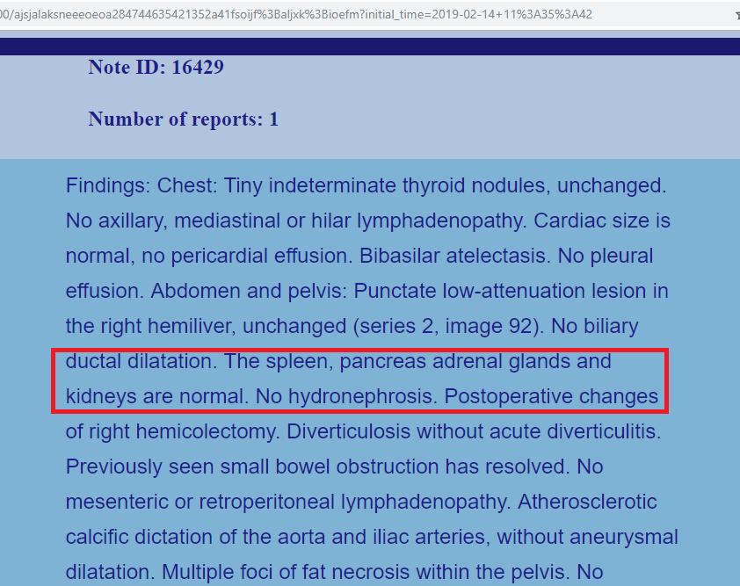
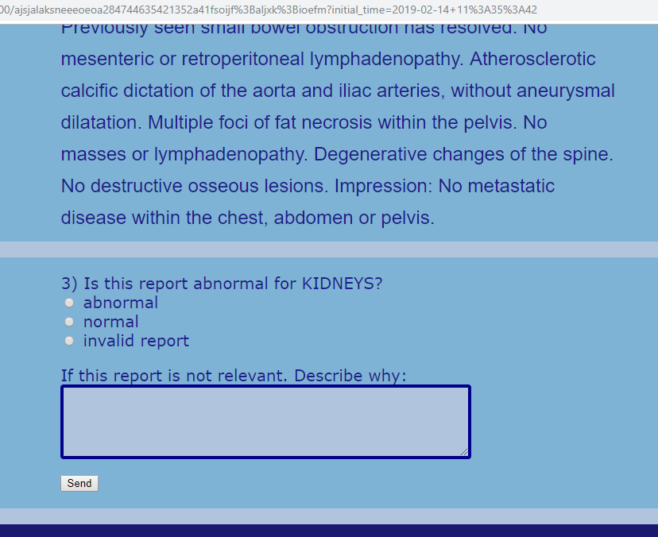
Methods| Web Interface

Slide 9
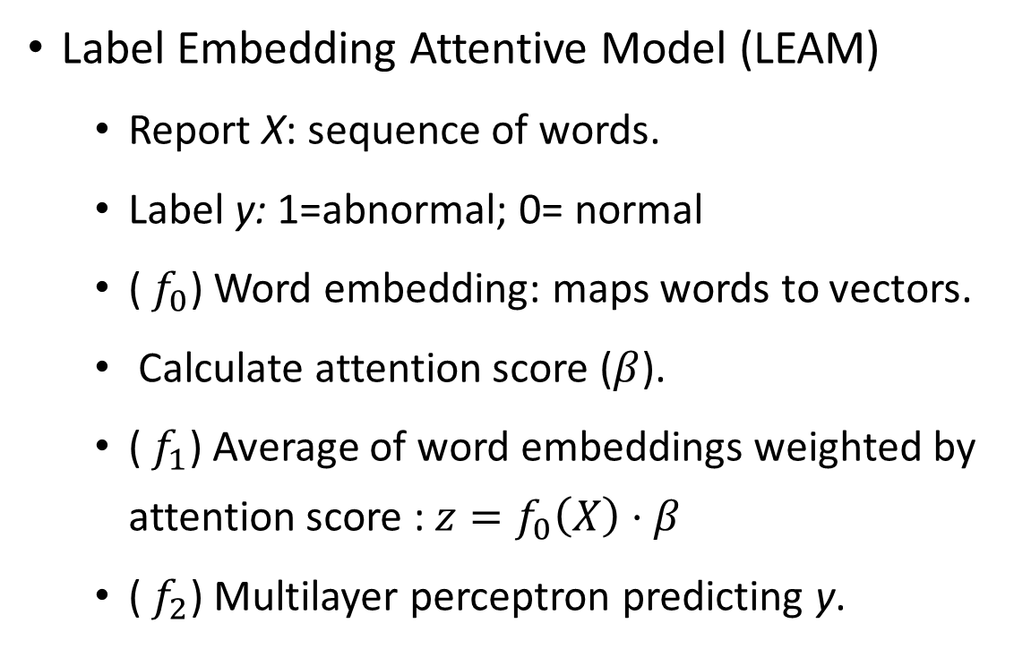
Methods| Model
Label Embedding Attentive Model (LEAM)
Report X: sequence of words.
Label y: 1=abnormal; 0= normal
(${ f}_{0}$) Word embedding: maps words to vectors.
Calculate attention score ($β$).
(${ f}_{1}$) Average of word embeddings weighted by attention score : $z=f_{0}\left(X\right)⋅β$
(${ f}_{2}$) Multilayer perceptron predicting y.

Slide 10
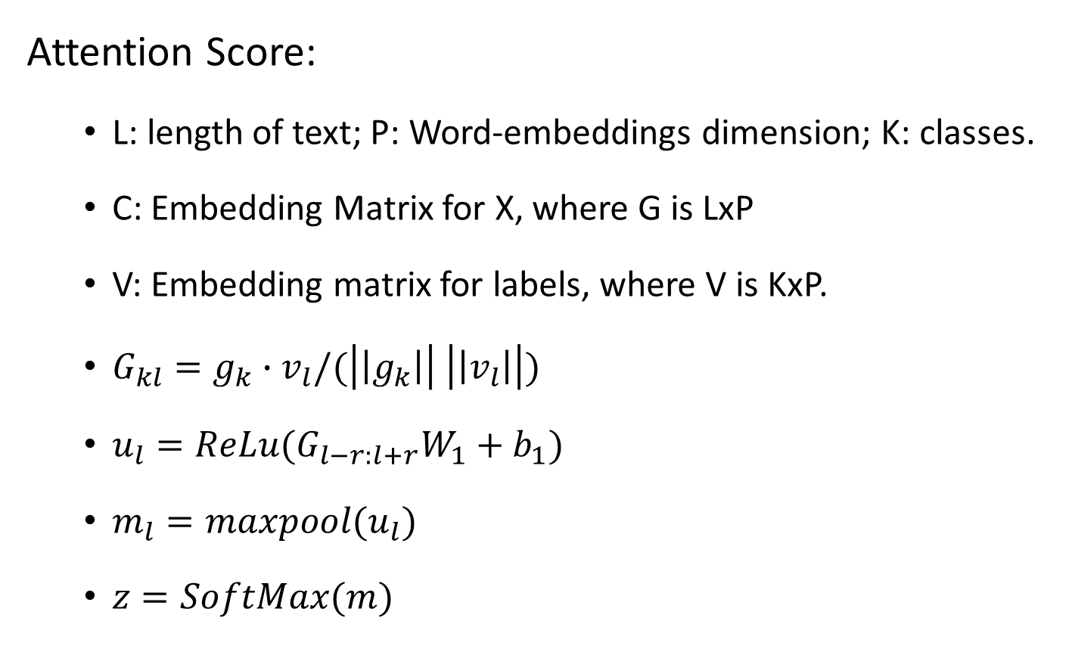
Methods| Model
Attention Score:
L: length of text; P: Word-embeddings dimension; K: classes.
C: Embedding Matrix for X, where G is LxP
V: Embedding matrix for labels, where V is KxP.
$G_{kl}=g_{k}∙v_{l}/(\left|\left|g_{k}\right|\right| \left|\left|v_{l}\right|\right|)$
$u_{l}=ReLu(G_{l−r:l+r}W_{1}+b_{1})$
$m_{l}=maxpool(u_{l})$
$z=SoftMax(m)$
Cosine similarity
Convolution
Attention Score

Slide 11
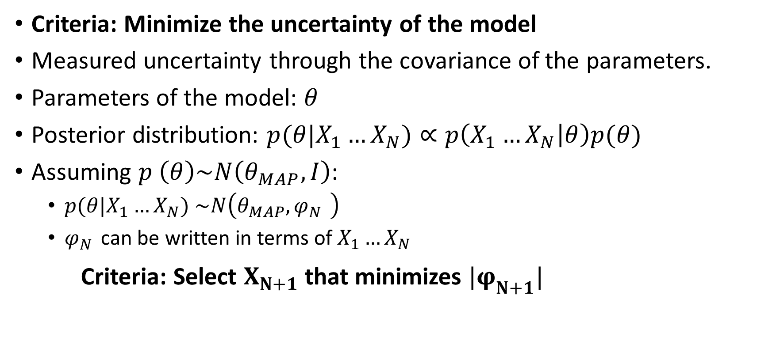
Methods| Selection Criteria
Criteria: Minimize the uncertainty of the model
Measured uncertainty through the covariance of the parameters.
Parameters of the model: $θ$
Posterior distribution: $p(θ|X_{1}…X_{N})∝p\left(X_{1}…X_{N} | θ\right)p(θ)$
Assuming $p \left(θ\right)\sim N\left(θ_{MAP},I\right)$:
$p(θ|X_{1}…X_{N})$ $\sim N\left(θ_{MAP},φ_{N}^{} \right)$
$φ_{N}^{}$ can be written in terms of $X_{1}…X_{N}$
Criteria: Select $X_{N+1}$ that minimizes $|φ_{N+1}^{}|$

Slide 12
Methods| Experiment
Hypothesis: Active learning requires less iterations than random sampling to achieve a comparable performance.
Passive Learning: Selects report randomly
Active Learning: Selects report using the Selection Criteria.
Selecting report
Clinicians create label for the selected report
Adding new data to training set
Training the model
Developing classification model

Slide 13
Methods| Experiment
Hypothesis: Active learning requires less iterations than random sampling to achieve a comparable performance.
Set A
Set B
Initial
Set
Random Sampling
Set B
Simulated Active Learning
Set B
Active Learning
Set A
Added one report at a time
Sequential selection: Random
Sequential selection: Active
Sequential selection: Active
Web-interface
Added one report at a time
Added one report at a time
Labeled Unlabeled

Slide 14
Methods| Experiment
Organs: lungs and kidneys.
Active Learning only for kidneys.
297 iterations.
Monitored AUC on test set and time spent by clinician at every iteration.
All methods used the same initial model (99 reports).
Repeated random sampling 10 times.

Slide 15
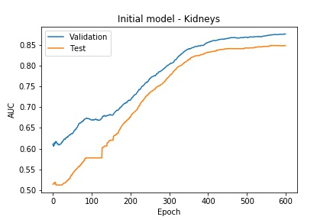
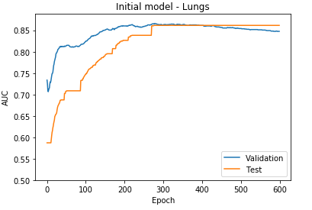
Results| Initial Models

Slide 16
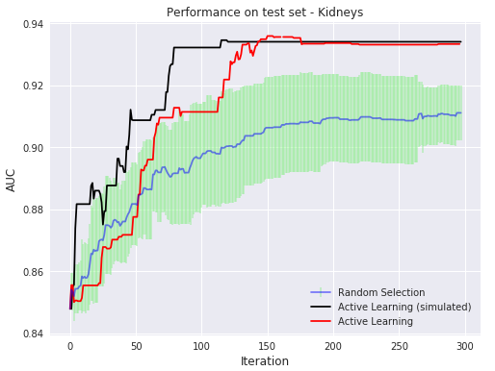
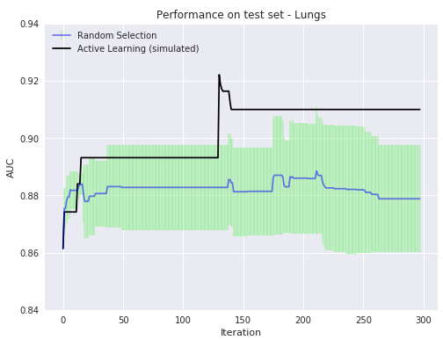
Results| Active Learning vs Random Sampling

Slide 17
Conclusions|
Active learning method can achieve better performance with smaller labeled datasets compared to the random sampling.
Active learning method selected cases from a larger and more variable pool than simulated and random selection experiments.
Results presented by active learning are a more realistic representation of the proposed approach in practice.
Median time including experts labeling and model refinement: 63 seconds
Full training of the model can be accomplished in approximately four hours.

Slide 18

Thank You! | matias.benitez@duke.edu

