Slide 1
MAM01
AI Tutor – Pre-Master: Computer Programming

Slide 2

Demo

Slide 3
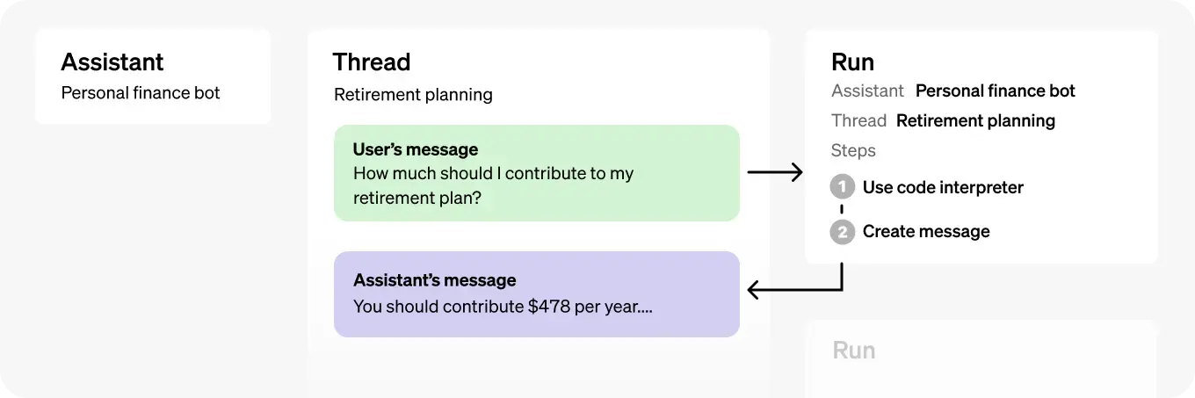
Source: OpenAI

Slide 4
Red Teaming: Some Examples
Scenario 1:
Tried to break the tutor by forcing it to give the full answer.
Easy to break. Tried strategies like few-shot prompting, adding context, and stronger personality, but struggled to fix this.
Scenario 2:
Tested if the tutor’s guidance helps me reach the solution.
Worked well. The tutor guided me through helpful Socratic conversation without giving away the answer if I was not trying to break it on purpose.
Focused on making the tutor guide without directly giving solutions.

Slide 5
Reproducibility and Replicability
Reproducibility
Tested the same problem across different threads.
Also tested with similar problems to check if answers stayed consistent.
Outcome: Results were consistent in the limited tests conducted.
Didn’t have time for extensive testing, but early results were promising.
Replicability
Tested if the tutor’s answers stay consistent for different students and skill levels.
Same problem given to different threads to see if feedback stayed the same.
Outcome: Uniform responses, worked well with different skill levels in the tests.

Slide 6
Environmental Impact and Bias
Environmental Impact
Read a few articles to learn about the impacts.
Didn’t give it much thought when choosing the model for my project. Only I didn’t pick GPT-4o since I didn’t need the extra features = smaller environmental footprint.
Made efforts to keep prompts efficient and network traffic to a minimum
Removed unnecessary steps and cut down redundancy to minimize impact.
Bias
Briefly tested for biases with a few sample prompts.
Couldn’t spot any obvious biases or maybe I’m just ignorant ☺
Focused on making sure feedback stays fair and neutral.

Slide 7
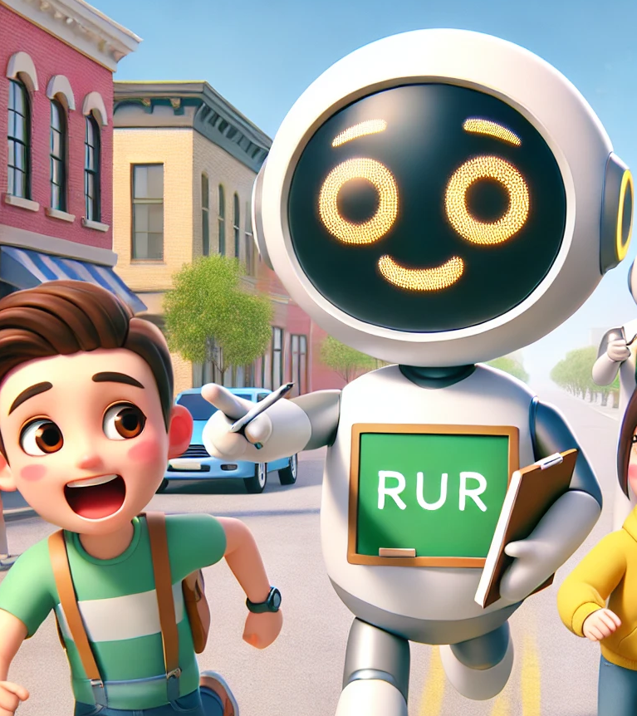
Thank you

