Slide 1


London Fire Brigade
Vehicle mobilisation and arrival times
Clemente Ibarra and Matías Muñoz Hoffmann
Business Intelligence C1
29 September 2026
Notes:
PRESENTER: Clemente
ENGLISH SCRIPT
Good afternoon. We are Clemente Ibarra and Matías Muñoz. Our project studies vehicle mobilisation and arrival times in London. We use public records from the London Fire Brigade. Our aim is to identify areas and dispatch hours that deserve further operational review. Today, we will explain our question, how the analysis prepares the data, and what the results show. We will also explain the limits of the evidence. This is the first stage of our Business Intelligence project.
SPANISH STUDY NOTE
Presentar el tema y el propósito del análisis.
SOURCES
README.md; docs/CASE_BRIEF.md
Repository version reviewed: 87938e79d91e2e929bcc77c2feb00e4393f50800
Official data catalogue: https://data.london.gov.uk/dataset/london-fire-brigade-mobilisation-records-24r65

Slide 2
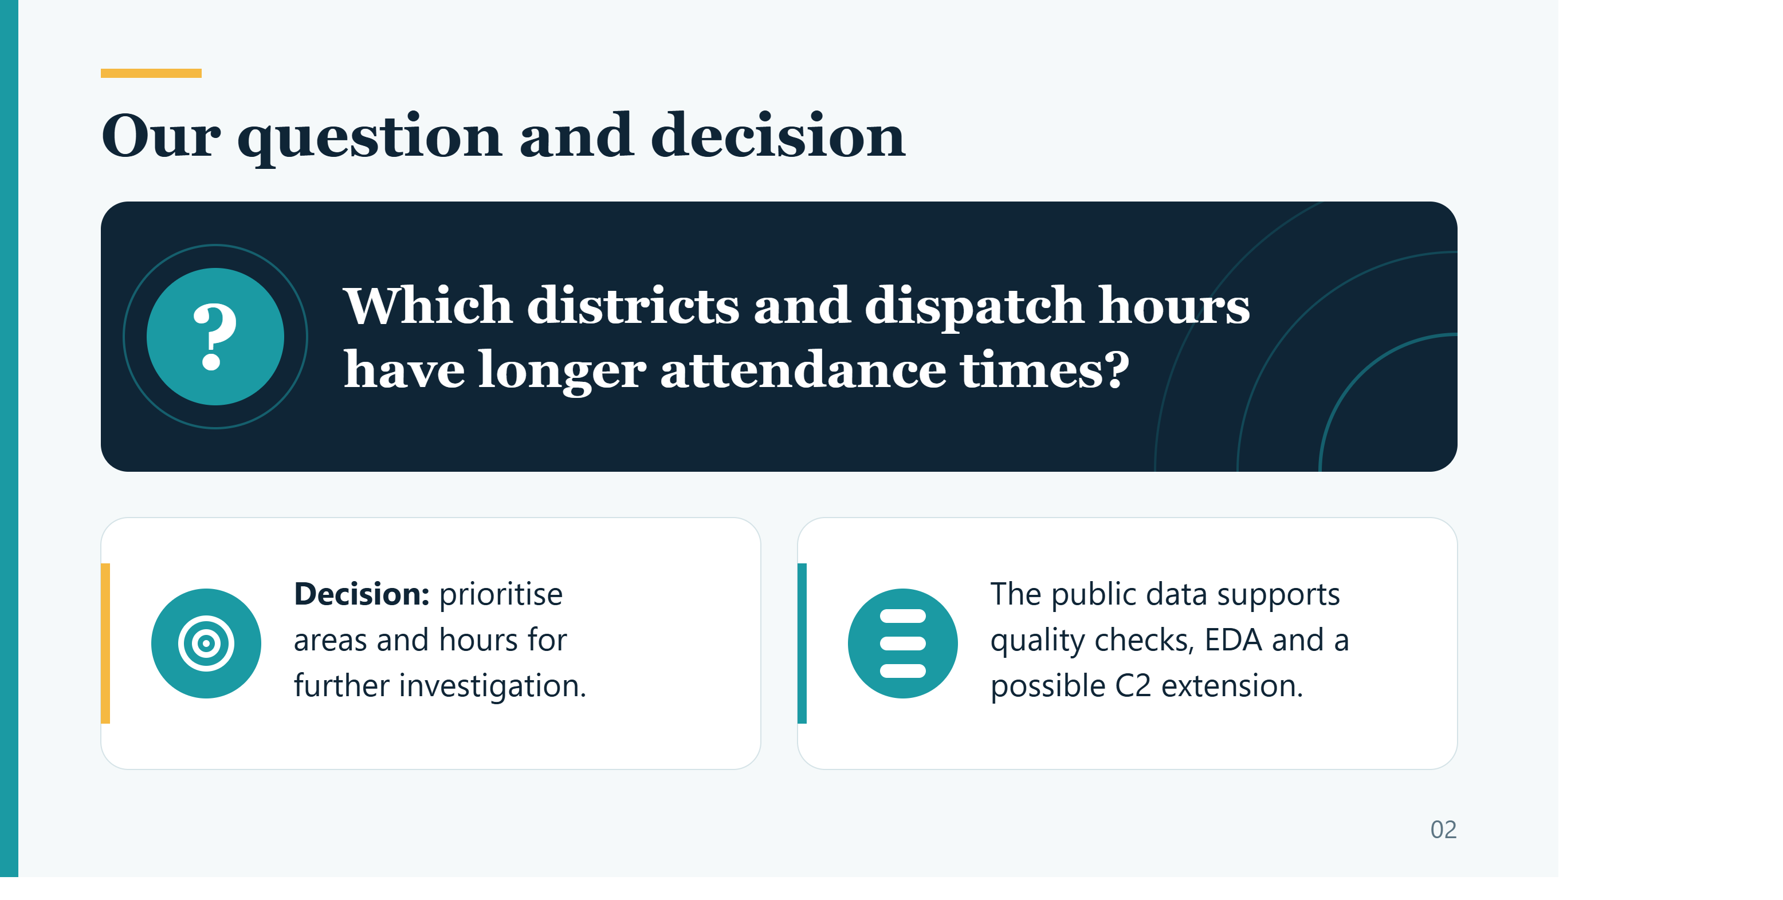



Our question and decision
Which districts and dispatch hours have longer attendance times?
Decision: prioritise areas and hours for further investigation.
The public data supports quality checks, EDA and a possible C2 extension.
02
Notes:
PRESENTER: Clemente
ENGLISH SCRIPT
Our main question is: which London districts and dispatch hours have longer attendance times? The intended user is an operations planning analyst. The decision is where to investigate first. We chose this case because the public data includes dates, times and operational categories. These fields allow us to study data quality and compare patterns. The project can also support a later prediction task. At this stage, the evidence supports a review. It does not support a direct decision to add vehicles or change staffing levels.
SPANISH STUDY NOTE
Explicar qué decisión apoya el proyecto y por qué se eligió este caso.
SOURCES
docs/CASE_BRIEF.md
Repository version reviewed: 87938e79d91e2e929bcc77c2feb00e4393f50800
Official data catalogue: https://data.london.gov.uk/dataset/london-fire-brigade-mobilisation-records-24r65

Slide 3
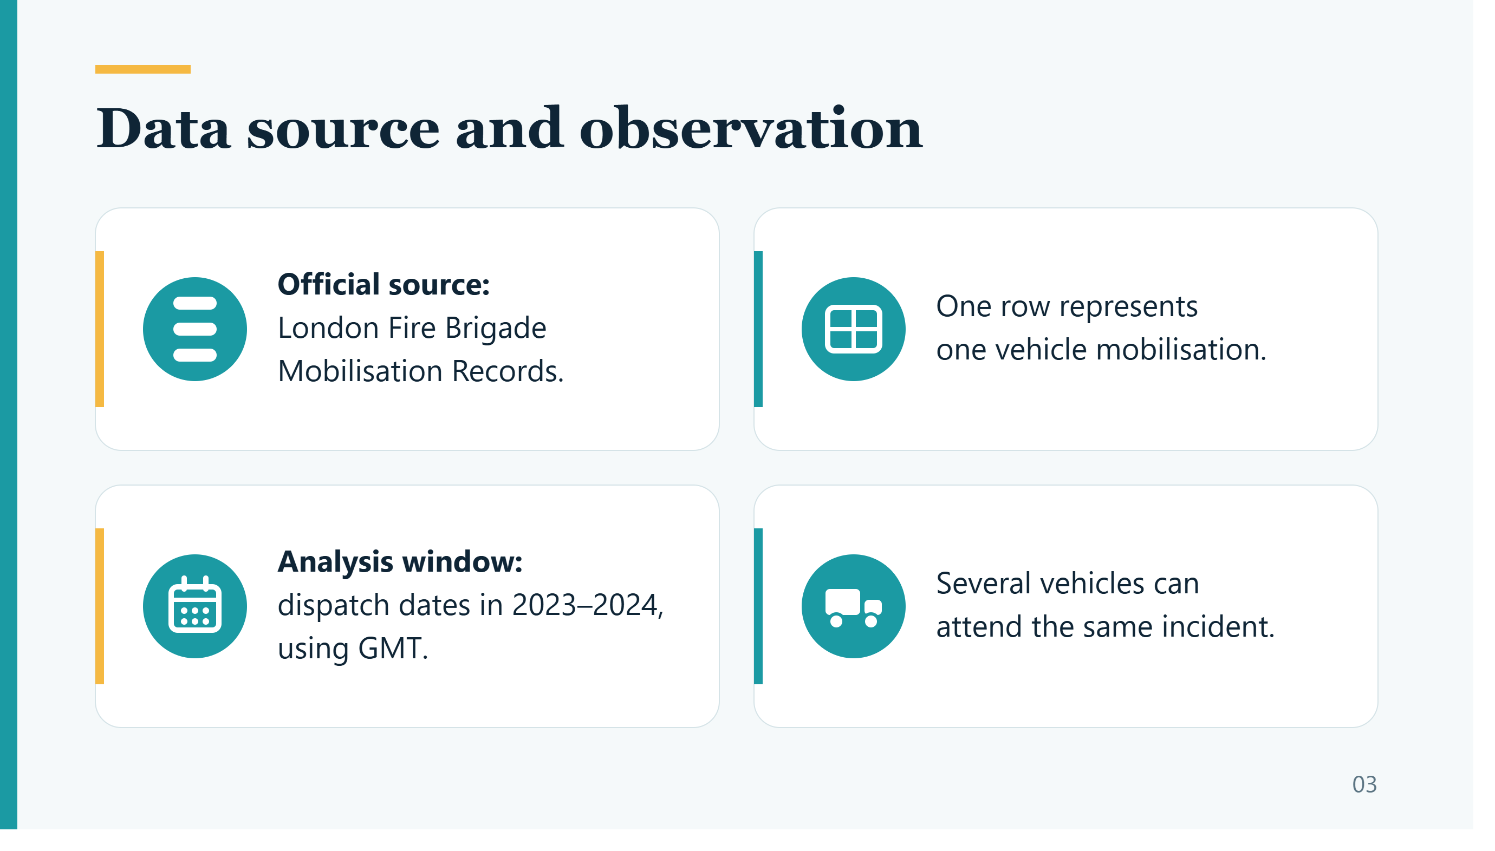



Data source and observation
Official source: London Fire Brigade Mobilisation Records.
One row represents one vehicle mobilisation.
Analysis window: dispatch dates in 2023–2024, using GMT.
Several vehicles can attend the same incident.
03
Notes:
PRESENTER: Clemente
ENGLISH SCRIPT
The original file covers twenty twenty-one to twenty twenty-four. The analysis selects dispatch dates in twenty twenty-three and twenty twenty-four. This gives a defined period for monthly and yearly comparisons. One row represents one vehicle mobilisation. One incident can therefore have several valid rows. For example, an incident with three vehicles can contribute three observations. This distinction matters when checking duplicates and interpreting the indicator. The published population includes pumping-appliance responses and is not limited to fires. The analysis uses the GMT time basis stated in the source dictionary.
SPANISH STUDY NOTE
Una movilización no equivale a un incidente. El filtro usa la fecha de despacho.
SOURCES
README.md; docs/CASE_BRIEF.md; outputs/source_dictionary.csv; data/source_manifest.json
Repository version reviewed: 87938e79d91e2e929bcc77c2feb00e4393f50800
Official data catalogue: https://data.london.gov.uk/dataset/london-fire-brigade-mobilisation-records-24r65

Slide 4
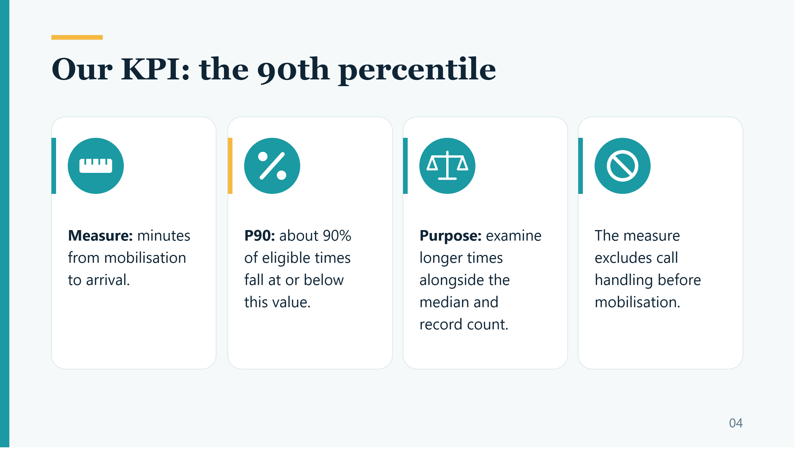




Our KPI: the 90th percentile
Measure: minutes from mobilisation to arrival.
P90: about 90% of eligible times fall at or below this value.
Purpose: examine longer times alongside the median and record count.
The measure excludes call handling before mobilisation.
04
Notes:
PRESENTER: Clemente
ENGLISH SCRIPT
Our main indicator is the ninetieth percentile, which we will call P ninety. We calculate it from attendance time in seconds divided by sixty. About ninety percent of eligible times fall at or below this value. We use it because our question concerns longer times. The median describes the centre, while P ninety helps us examine the upper part of the distribution. We report both, together with the number of records. The clock starts at mobilisation and ends at arrival. It excludes call handling before mobilisation and includes all eligible vehicle arrivals. We do not claim an official service target.
SPANISH STUDY NOTE
Justificar P90 sin confundirlo con promedio, proporción de viaje ni meta oficial.
SOURCES
docs/KPI.md; scripts/analysis.py
Repository version reviewed: 87938e79d91e2e929bcc77c2feb00e4393f50800
Official data catalogue: https://data.london.gov.uk/dataset/london-fire-brigade-mobilisation-records-24r65

Slide 5
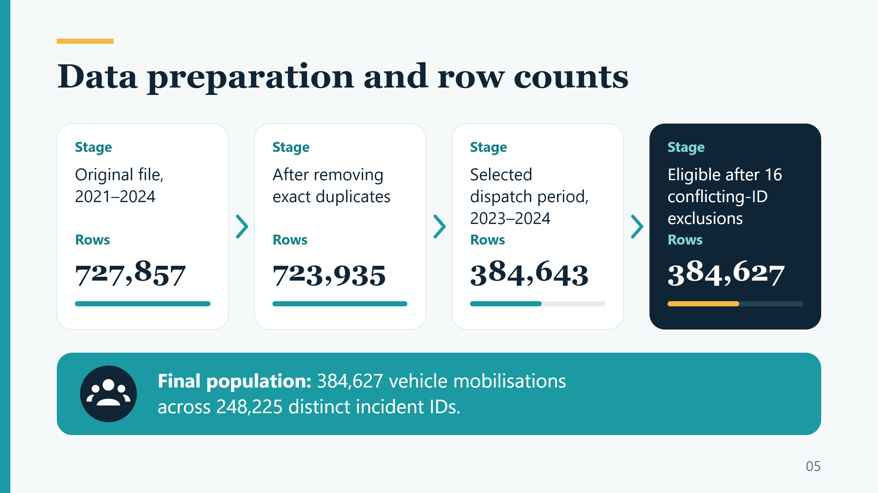


Data preparation and row counts
Stage
Stage
Stage
Stage
Original file, 2021–2024
After removing exact duplicates
Selected dispatch period, 2023–2024
Eligible after 16 conflicting-ID exclusions
Rows
Rows
Rows
Rows
727,857
723,935
384,643
384,627
Final population: 384,627 vehicle mobilisations across 248,225 distinct incident IDs.
05
Notes:
PRESENTER: Clemente
ENGLISH SCRIPT
The original file contains seven hundred and twenty-seven thousand, eight hundred and fifty-seven rows. The pipeline first removes three thousand, nine hundred and twenty-two exact duplicate rows after normalising formats. It then selects the two-year dispatch window, leaving three hundred and eighty-four thousand, six hundred and forty-three rows. Within this period, sixteen rows have conflicting mobilisation identifiers. The analysis excludes these rows because it cannot safely choose one version. The final population contains three hundred and eighty-four thousand, six hundred and twenty-seven eligible mobilisations. These correspond to about two hundred and forty-eight thousand distinct incidents. Selecting the period changes the scope. It is separate from removing data errors.
SPANISH STUDY NOTE
Separar deduplicación, selección del período y exclusiones por calidad.
SOURCES
outputs/row_flow.csv; outputs/audit.json; scripts/analysis.py
Repository version reviewed: 87938e79d91e2e929bcc77c2feb00e4393f50800
Official data catalogue: https://data.london.gov.uk/dataset/london-fire-brigade-mobilisation-records-24r65

Slide 6
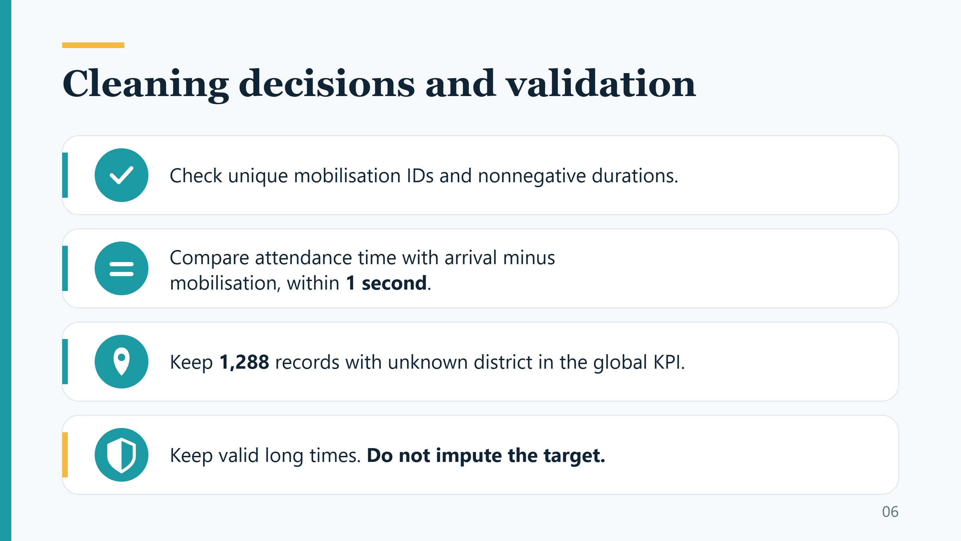




Cleaning decisions and validation
Check unique mobilisation IDs and nonnegative durations.
Compare attendance time with arrival minus mobilisation, within 1 second.
Keep 1,288 records with unknown district in the global KPI.
Keep valid long times. Do not impute the target.
06
Notes:
PRESENTER: Clemente
ENGLISH SCRIPT
The cleaning rules depend on the role of each field. The pipeline checks unique mobilisation identifiers and nonnegative attendance times. It also compares the recorded duration with arrival time minus mobilisation time. The allowed difference is one second. Missing geography does not make a valid duration unusable, so one thousand, two hundred and eighty-eight records remain in an Unknown group. The analysis does not fill missing target times with an average. It also keeps long times when they pass the checks. Finally, it reconciles the row counts and recalculates P ninety independently. These checks test internal consistency. They cannot prove that every operational record is true. Matías will now explain the results.
SPANISH STUDY NOTE
Explicar reglas y sus razones, distinguiendo coherencia interna de verdad.
SOURCES
outputs/audit.json; scripts/analysis.py; docs/KPI.md
Repository version reviewed: 87938e79d91e2e929bcc77c2feb00e4393f50800
Official data catalogue: https://data.london.gov.uk/dataset/london-fire-brigade-mobilisation-records-24r65

Slide 7
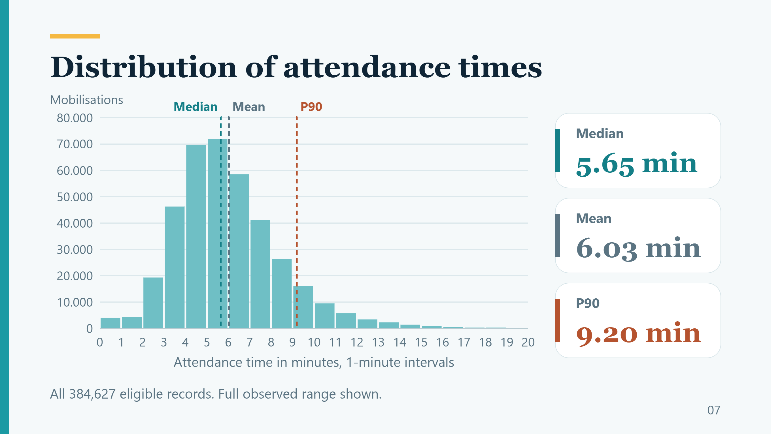
Distribution of attendance times
Median
5.65 min
Mean
6.03 min
P90
9.20 min
All 384,627 eligible records. Full observed range shown.
07
Notes:
PRESENTER: Matías
ENGLISH SCRIPT
Thank you, Clemente. This histogram shows how many mobilisations fall within each one-minute interval. The median is five point six five minutes. The mean is about six point zero three minutes, and P ninety is nine point two zero minutes. That is nine minutes and twelve seconds. These measures describe different parts of the distribution. The mean is above the median, which is consistent with longer times pulling the average upward. This slide includes the full observed range from zero to twenty minutes. The notebook uses a different display limit for its histogram, but both versions keep all eligible observations in the KPI.
SPANISH STUDY NOTE
Leer frecuencia, mediana y P90. Este histograma usa todo el rango observado.
SOURCES
outputs/deck_data.json histogram; outputs/summary.json; scripts/prepare_deck_data.py
Repository version reviewed: 87938e79d91e2e929bcc77c2feb00e4393f50800
Official data catalogue: https://data.london.gov.uk/dataset/london-fire-brigade-mobilisation-records-24r65

Slide 8
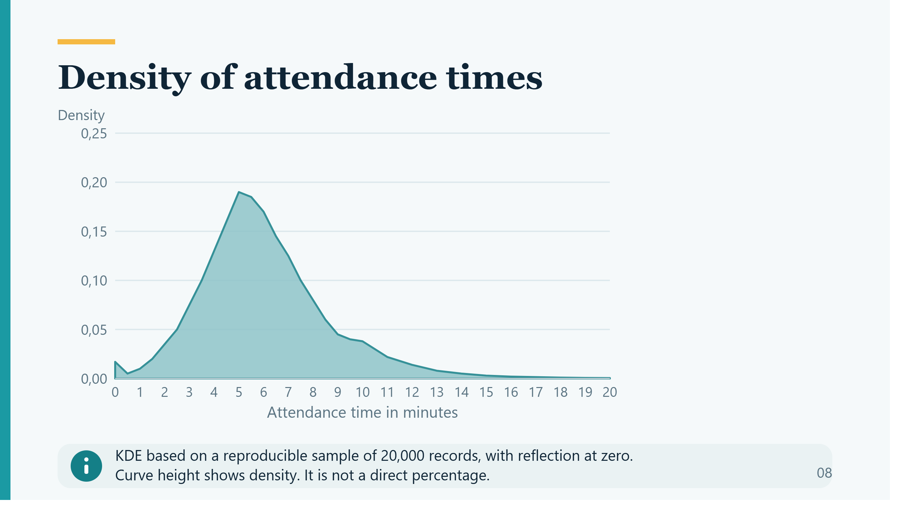

Density of attendance times
KDE based on a reproducible sample of 20,000 records, with reflection at zero.
Curve height shows density. It is not a direct percentage.
08
Notes:
PRESENTER: Matías
ENGLISH SCRIPT
The density curve provides a smooth view of the same distribution. A higher curve indicates greater concentration around that time. The vertical axis shows density, so its height is not a direct percentage. The pipeline uses a repeatable random sample of twenty thousand records to calculate this curve. It also applies a correction near zero because negative attendance times are not meaningful here. This sampling step is only for the density chart. The main KPI still uses every eligible record. The curve helps us describe the shape of the data. It does not predict future response times.
SPANISH STUDY NOTE
La curva muestra concentración. Densidad no es porcentaje directo.
SOURCES
outputs/deck_data.json density; scripts/prepare_deck_data.py
Repository version reviewed: 87938e79d91e2e929bcc77c2feb00e4393f50800
Official data catalogue: https://data.london.gov.uk/dataset/london-fire-brigade-mobilisation-records-24r65

Slide 9
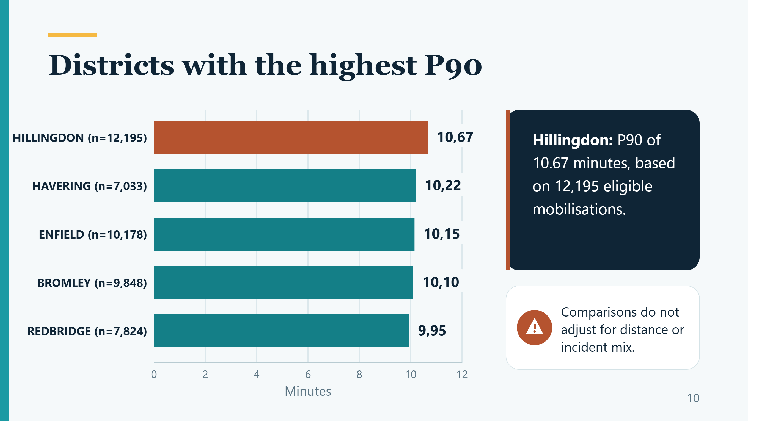

Districts with the highest P90
Hillingdon: P90 of 10.67 minutes, based on 12,195 eligible mobilisations.
Comparisons do not adjust for distance or incident mix.
10
Notes:
PRESENTER: Matías
ENGLISH SCRIPT
This chart shows the five identified districts with the highest observed P ninety. Hillingdon has the highest value, at about ten point six seven minutes, based on twelve thousand, one hundred and ninety-five eligible mobilisations. This makes it a useful area for further investigation. However, a higher percentile does not mean every vehicle was slower. It also does not prove poor staff performance. Differences in distance, incident mix and resource availability may matter. The next step is to examine that context before proposing an operational change. The chart shows the record count for each district so that we can consider the size of each group.
SPANISH STUDY NOTE
Una comparación descriptiva permite priorizar revisión, no evaluar desempeño causalmente.
SOURCES
outputs/borough_metrics.csv
Repository version reviewed: 87938e79d91e2e929bcc77c2feb00e4393f50800
Official data catalogue: https://data.london.gov.uk/dataset/london-fire-brigade-mobilisation-records-24r65

Slide 10
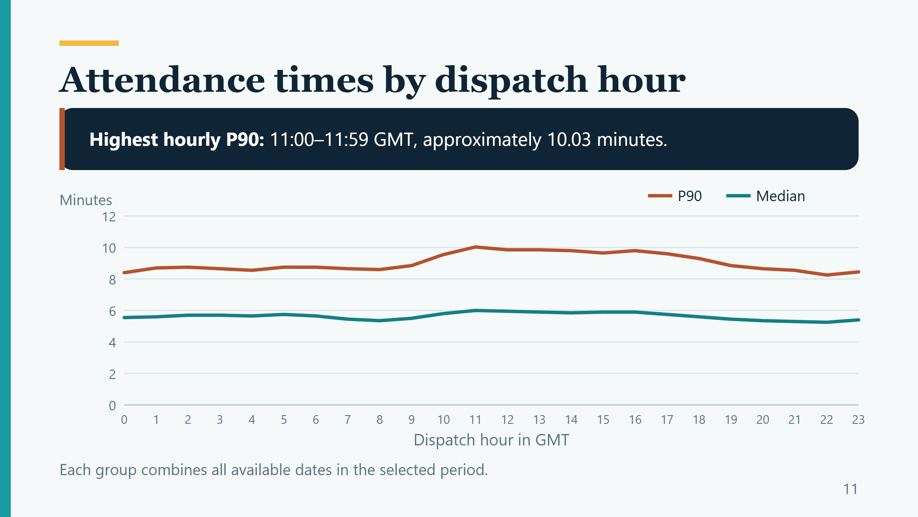
Attendance times by dispatch hour
Highest hourly P90: 11:00–11:59 GMT, approximately 10.03 minutes.
Each group combines all available dates in the selected period.
11
Notes:
PRESENTER: Matías
ENGLISH SCRIPT
Here we group mobilisations by dispatch hour across the whole study period. The highest hourly P ninety occurs in the eleven a.m. GMT group, at about ten point zero three minutes. This group includes dispatches from eleven o'clock up to, but not including, twelve o'clock. It combines many different dates. The pattern does not show that every day was slow at this hour. It also does not prove that traffic caused the longer times. Finally, a higher P ninety does not necessarily mean more mobilisations. Duration and volume are different measures.
SPANISH STUDY NOTE
Hora de despacho GMT, no hora de llamada. P90 alto no equivale a volumen alto.
SOURCES
outputs/hour_metrics.csv
Repository version reviewed: 87938e79d91e2e929bcc77c2feb00e4393f50800
Official data catalogue: https://data.london.gov.uk/dataset/london-fire-brigade-mobilisation-records-24r65

Slide 11
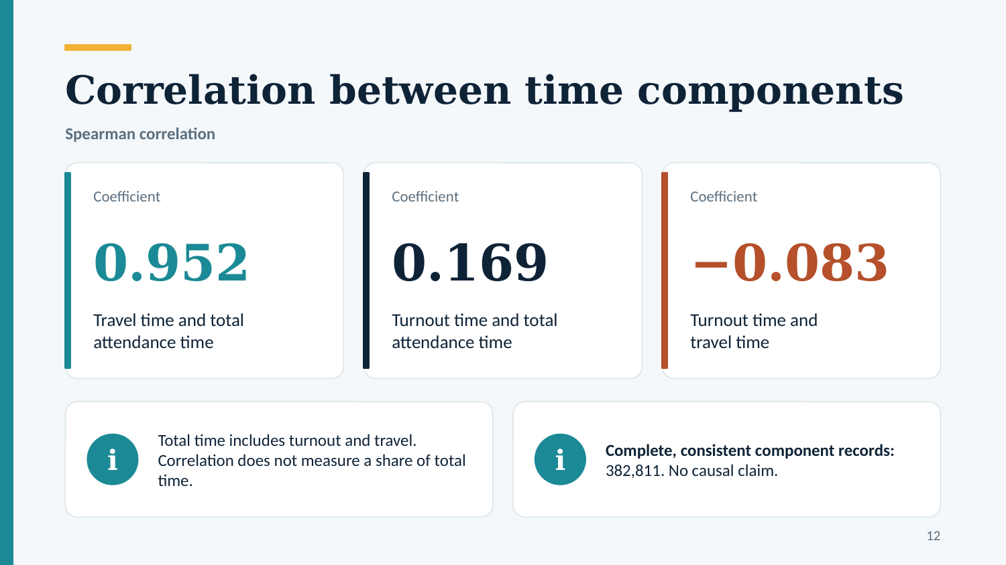
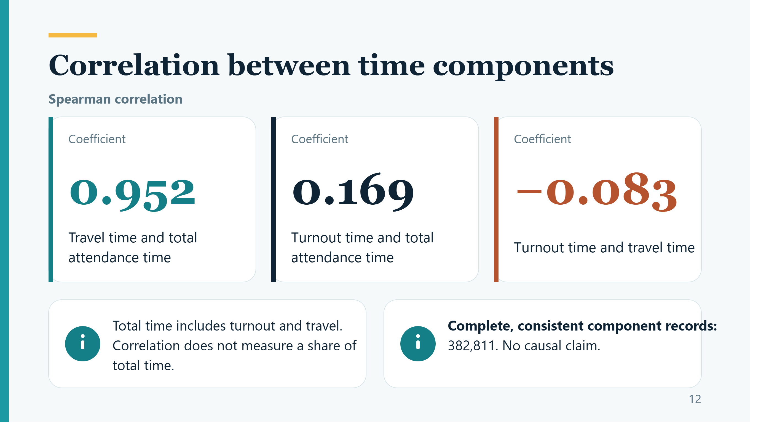
Correlation between time components
Spearman correlation
Coefficient
Coefficient
Coefficient
0.952
0.169
−0.083
Travel time and total attendance time
Turnout time and total attendance time
Turnout time and travel time
Total time includes turnout and travel. Correlation does not measure a share of total time.
Complete, consistent component records: 382,811. No causal claim.
12
Notes:
PRESENTER: Matías
ENGLISH SCRIPT
The project also compares attendance time with its components using Spearman correlation. This method compares the order of observations. The correlation between travel time and total attendance time is about zero point nine five. Longer travel times therefore tend to occur with longer total times. This does not mean that travel takes ninety-five percent of the total. Travel time is already part of total attendance time, so part of the association comes from that relationship. The calculation uses complete and consistent component records. It does not identify the effect of traffic. Also, realised travel time would be unavailable at dispatch, so it should not be a predictor for a dispatch-time model in C two.
SPANISH STUDY NOTE
0,952 expresa asociación de rangos, no porcentaje del total ni causalidad.
SOURCES
outputs/spearman_components.csv; outputs/audit.json; scripts/analysis.py
Repository version reviewed: 87938e79d91e2e929bcc77c2feb00e4393f50800
Official data catalogue: https://data.london.gov.uk/dataset/london-fire-brigade-mobilisation-records-24r65

Slide 12
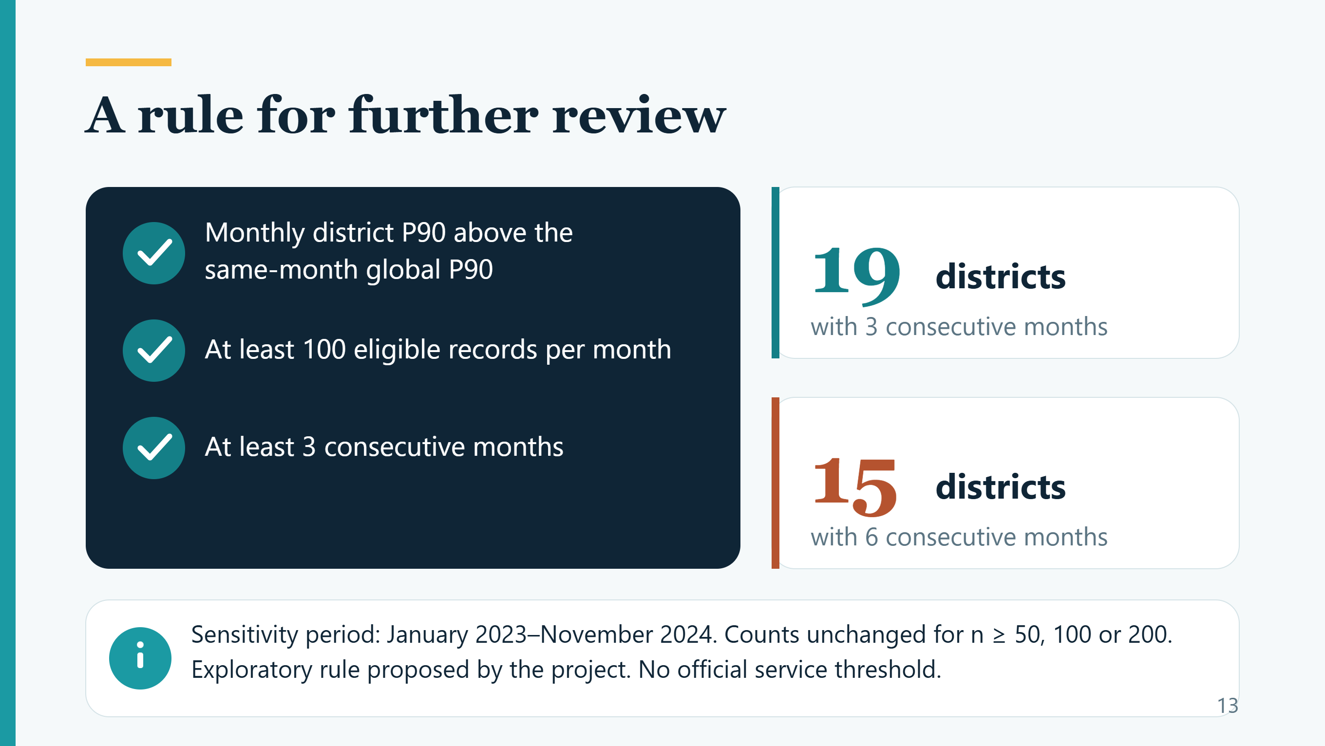

A rule for further review
Monthly district P90 above the same-month global P90
19 districts
with 3 consecutive months
At least 100 eligible records per month
15 districts
At least 3 consecutive months
with 6 consecutive months
Sensitivity period: January 2023–November 2024. Counts unchanged for n ≥ 50, 100 or 200.
Exploratory rule proposed by the project. No official service threshold.
13
Notes:
PRESENTER: Matías
ENGLISH SCRIPT
The proposed review rule looks for persistence. A district must have at least one hundred eligible mobilisations in each qualifying month. Its P ninety must exceed the global P ninety for the same month for at least three consecutive months. This is an academic rule, not an official London Fire Brigade standard. The sensitivity analysis excludes incomplete December twenty twenty-four. It finds nineteen candidate districts with three consecutive months and fifteen with six months. Changing the minimum monthly count between fifty and two hundred leaves these counts unchanged. The rule provides a first list for investigation. It does not provide a final order for allocating resources. Clemente will now explain the limits and our conclusion.
SPANISH STUDY NOTE
Regla exploratoria y sensibilidad. Usar enero 2023 a noviembre 2024.
SOURCES
outputs/review_sensitivity.csv; docs/KPI.md; scripts/analysis.py
Repository version reviewed: 87938e79d91e2e929bcc77c2feb00e4393f50800
Official data catalogue: https://data.london.gov.uk/dataset/london-fire-brigade-mobilisation-records-24r65

Slide 13
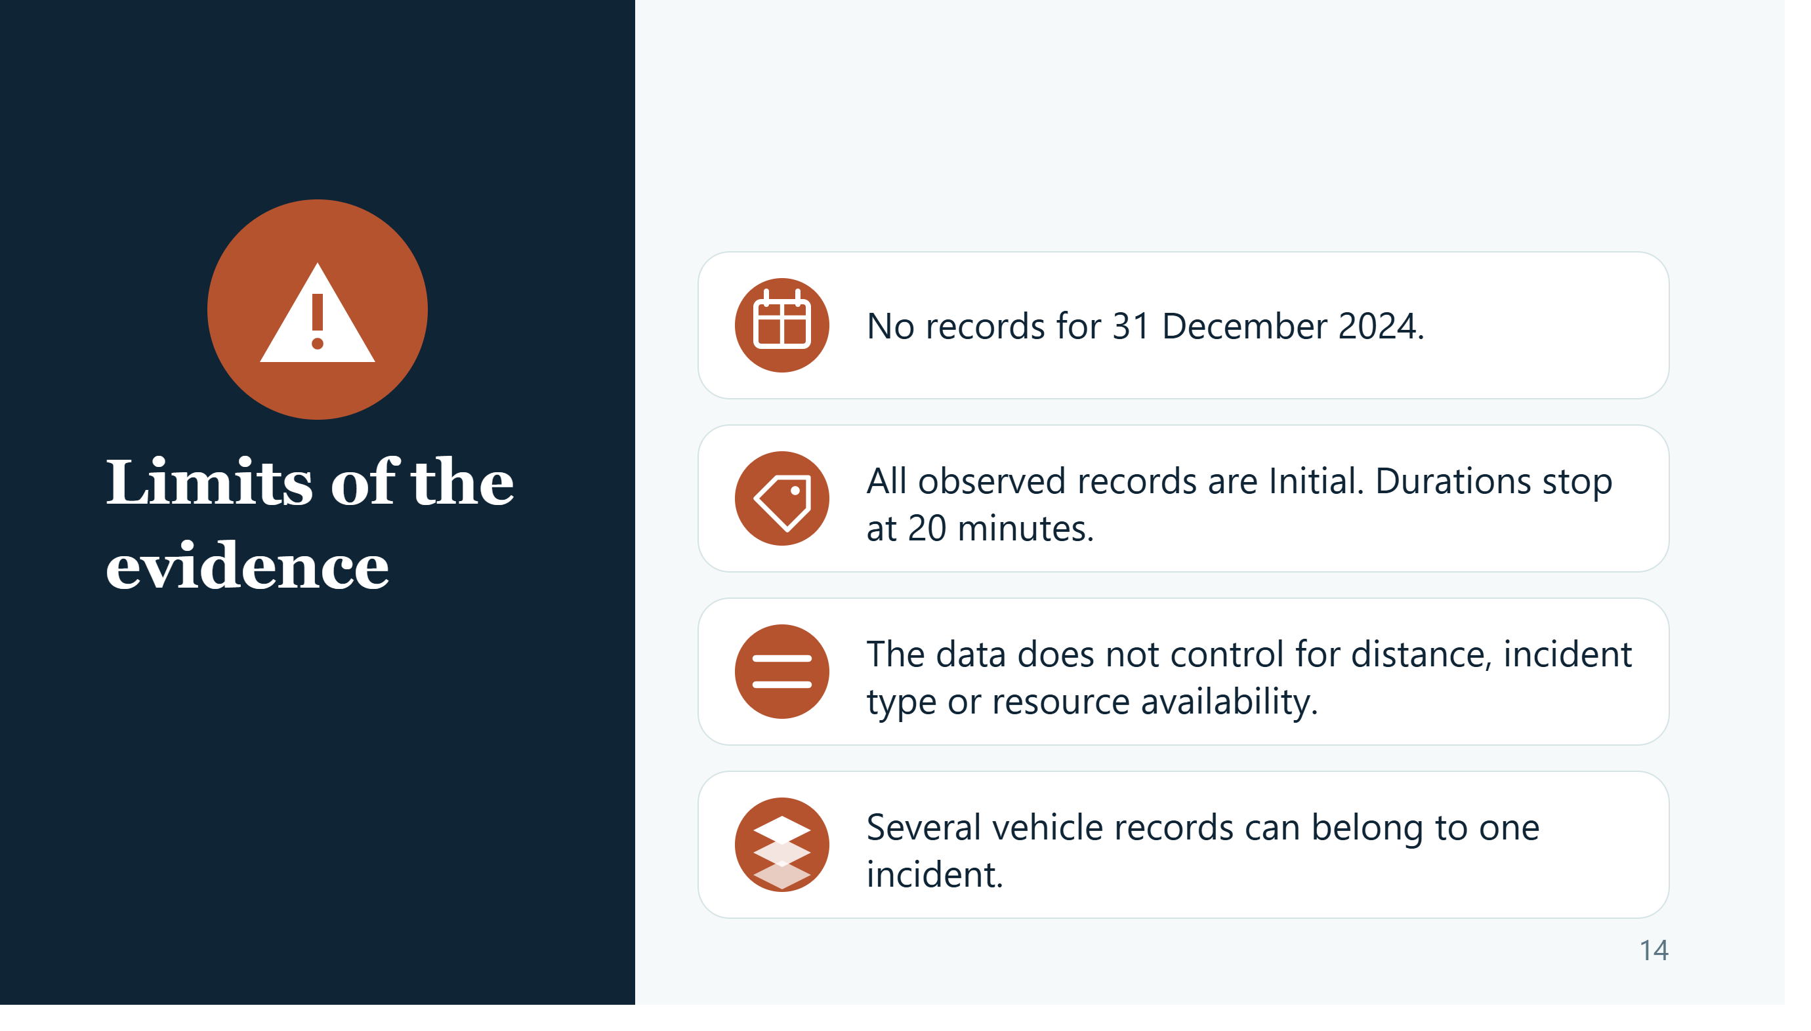



No records for 31 December 2024.
All observed records are Initial. Durations stop at 20 minutes.
Limits of the evidence
The data does not control for distance, incident type or resource availability.
Several vehicle records can belong to one incident.
14
Notes:
PRESENTER: Clemente
ENGLISH SCRIPT
Thank you, Matías. Our conclusions concern the published records in this extract. We found no records for the final day of twenty twenty-four. All observed records are labelled Initial, and no duration exceeds twenty minutes. We did not impose that time limit during cleaning. A published methodology discusses exclusions above twenty minutes in performance calculations, but we have not confirmed every selection rule for this CSV. We therefore cannot describe the missing extreme tail. We also lack important context, such as incident type, distance and resource availability. Finally, several records can belong to one incident. These limits affect comparisons and prevent causal conclusions.
SPANISH STUDY NOTE
Explicar alcance sin afirmar filtros de publicación no confirmados.
SOURCES
docs/SOURCES.md; docs/CASE_BRIEF.md; outputs/audit.json; outputs/summary.json; LFB FOI 8420.1
Repository version reviewed: 87938e79d91e2e929bcc77c2feb00e4393f50800
Official data catalogue: https://data.london.gov.uk/dataset/london-fire-brigade-mobilisation-records-24r65

Slide 14
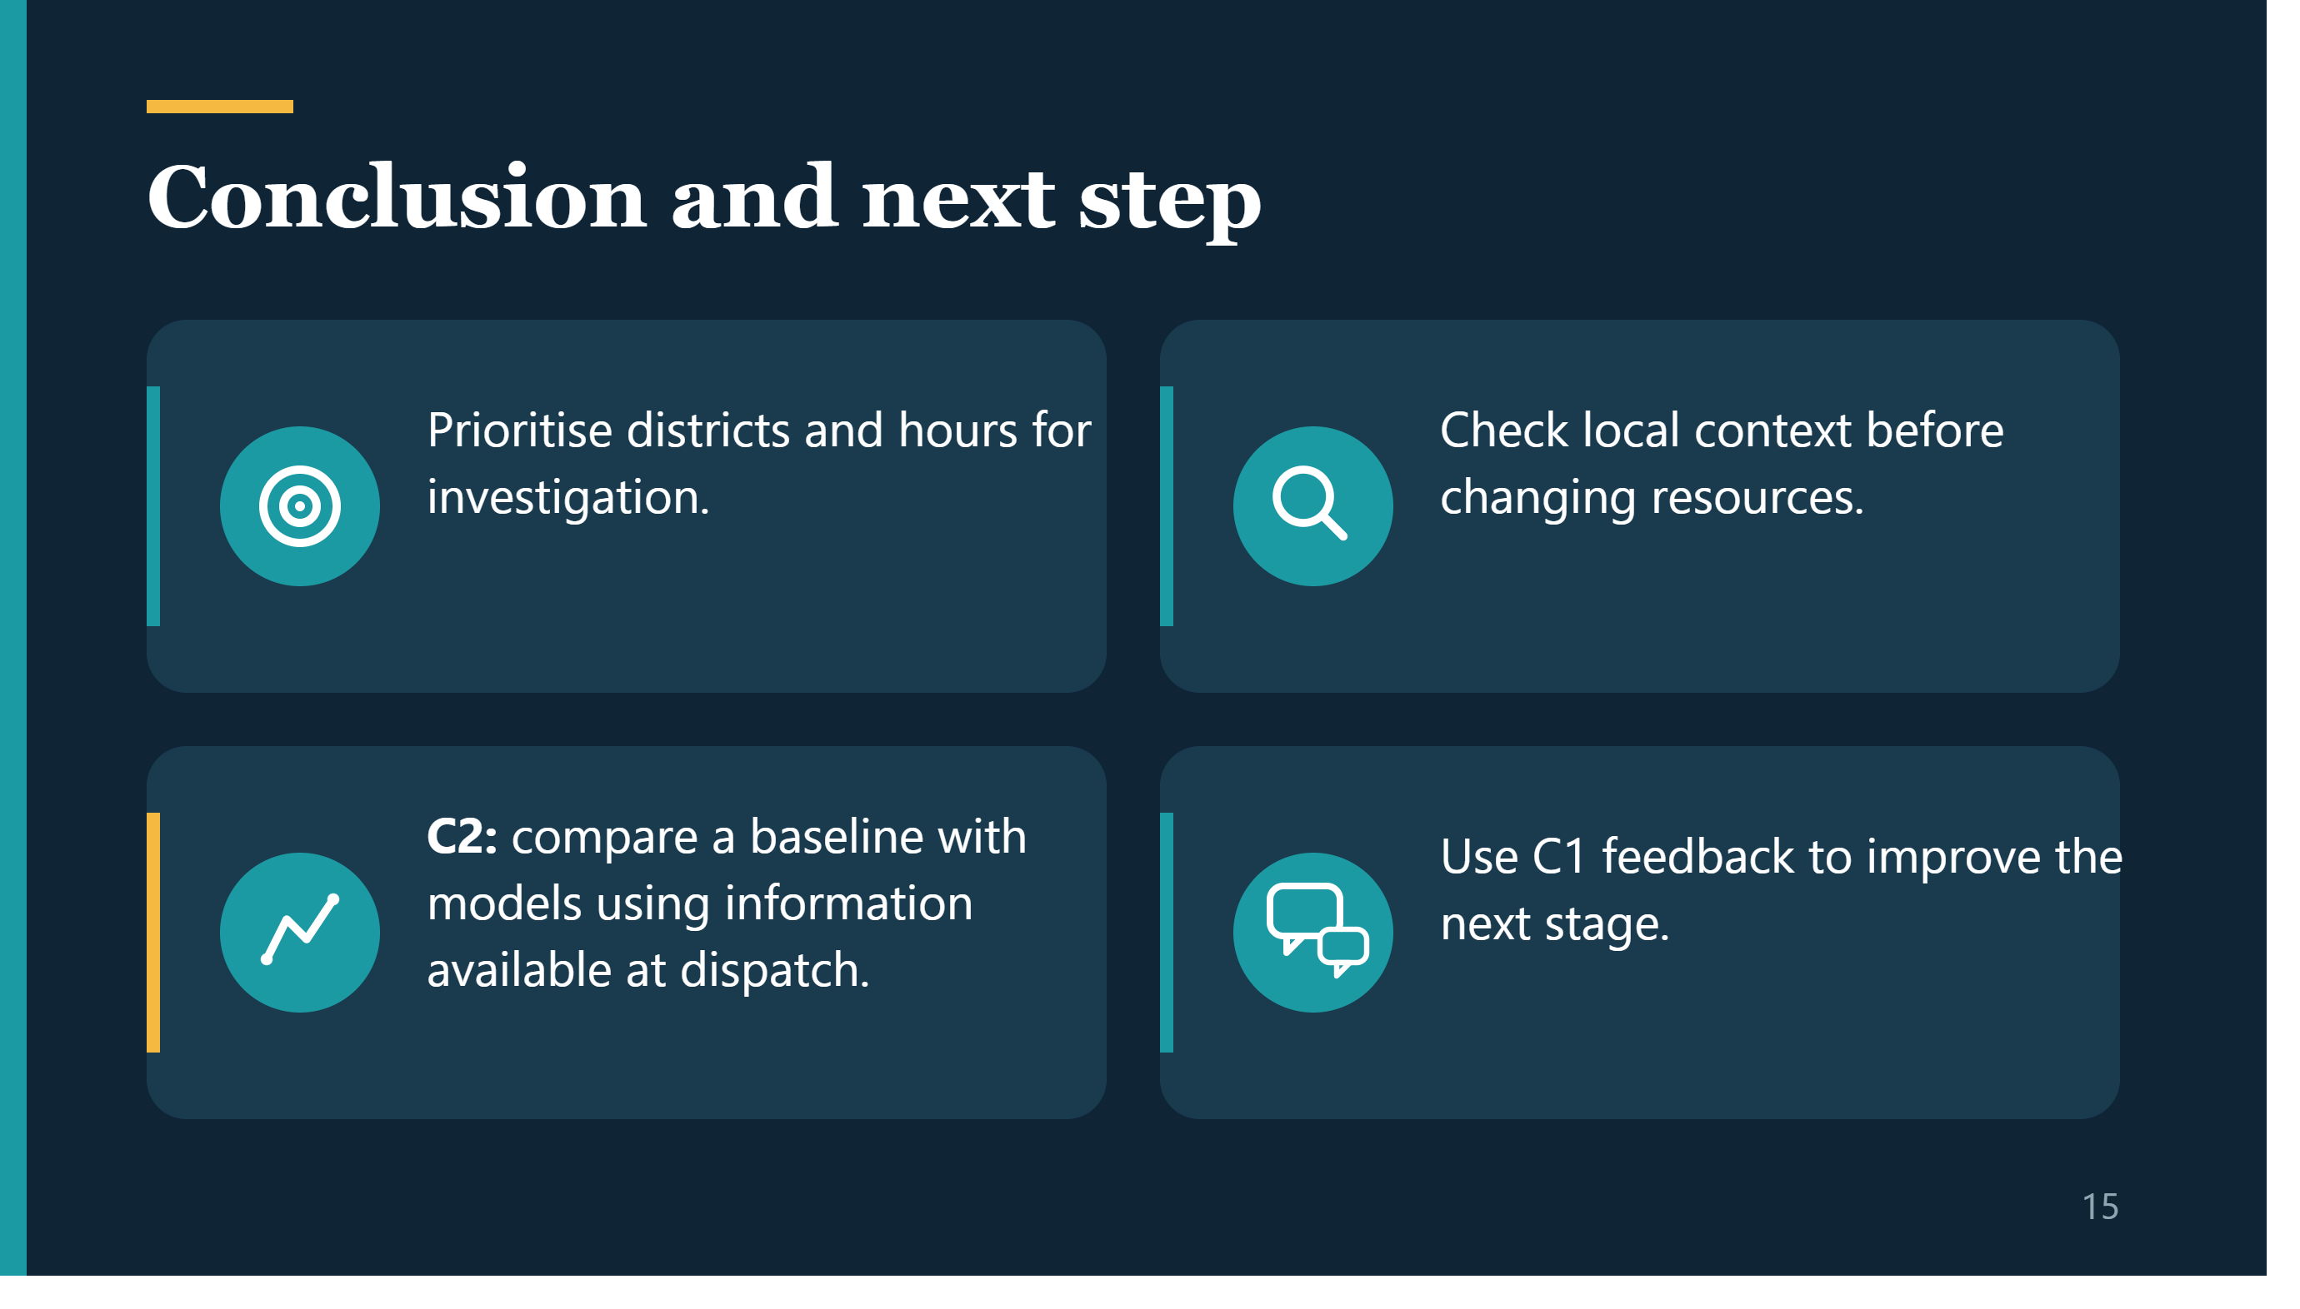



Conclusion and next step
Prioritise districts and hours for investigation.
Check local context before changing resources.
C2: compare a baseline with models using information available at dispatch.
Use C1 feedback to improve the next stage.
15
Notes:
PRESENTER: Clemente
ENGLISH SCRIPT
Our main conclusion is that this analysis can help prioritise districts and dispatch hours for further review. Hillingdon and the eleven a.m. GMT group are examples of higher observed P ninety values. Before changing resources, an analyst should examine local conditions and source coverage. For C two, a possible next step is to predict attendance time using information available at dispatch. We would compare a simple baseline with candidate models and evaluate them on later dates. We would avoid information recorded after arrival. The model would still inherit the limits of this source. Feedback from C one will guide the next stage.
SPANISH STUDY NOTE
Cerrar la conexión pregunta-evidencia-decisión y la extensión C2.
SOURCES
docs/CASE_BRIEF.md; outputs/borough_metrics.csv; outputs/hour_metrics.csv
Repository version reviewed: 87938e79d91e2e929bcc77c2feb00e4393f50800
Official data catalogue: https://data.london.gov.uk/dataset/london-fire-brigade-mobilisation-records-24r65

Slide 15





Reproducibility and AI use
GitHub contains the code, notebook, results and documentation.
AI supported the code and analytical preparation.
The source manifest records download details and file hashes.
Each student remains responsible for the submitted decisions and claims.
16
Notes:
PRESENTER: Clemente
ENGLISH SCRIPT
The repository contains the code, the executed notebook, the results and the supporting documents. A source manifest records the download details and a file hash, which identifies the data version. This makes it possible to check whether another run uses the same file. AI supported the code and analytical preparation, as described in the process log. Each student remains responsible for understanding and accepting the submitted decisions. The log must reflect the review each person actually completes. The value of the project depends on the link between the question, the data and a careful interpretation. Thank you. We are ready for your questions.
SPANISH STUDY NOTE
Declarar uso de IA sin inventar contribuciones o revisión de Matías.
SOURCES
README.md; PROCESS_LOG.md; data/source_manifest.json; notebooks/C1_LFB.ipynb
Repository version reviewed: 87938e79d91e2e929bcc77c2feb00e4393f50800
Official data catalogue: https://data.london.gov.uk/dataset/london-fire-brigade-mobilisation-records-24r65

Slide 16
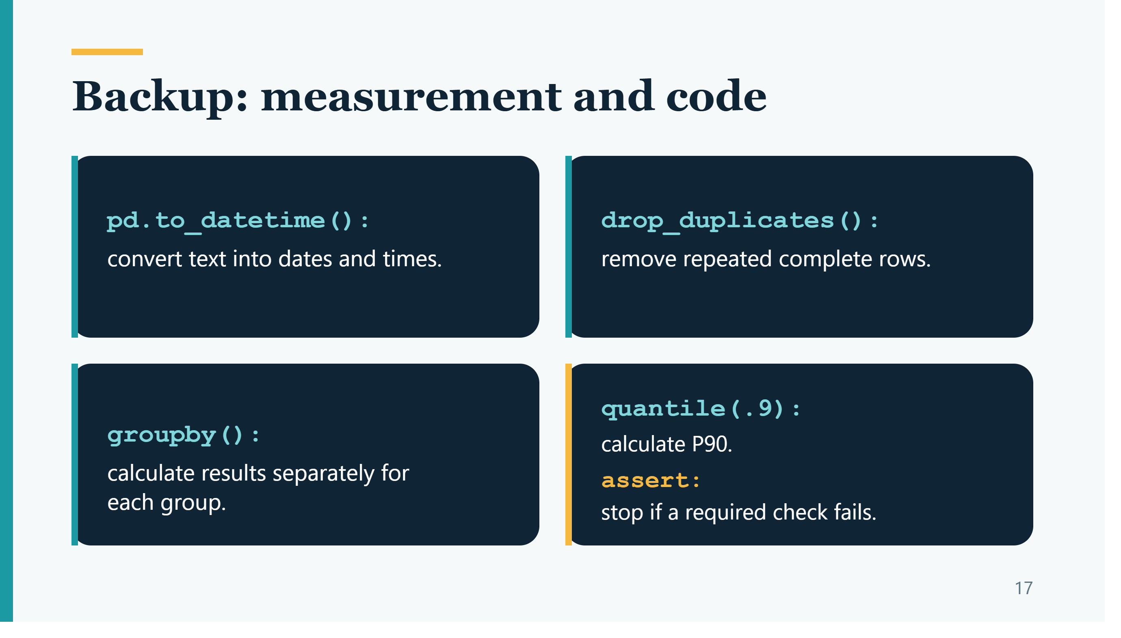
Backup: measurement and code
pd.to_datetime():
convert text into dates and times.
drop_duplicates():
remove repeated complete rows.
groupby():
calculate results separately for each group.
quantile(.9):
calculate P90.
assert:
stop if a required check fails.
17
Notes:
PRESENTER: Either presenter
ENGLISH SCRIPT
The code first converts dates and numbers. A successful conversion does not prove that a value is valid. The cleaning rules then check identifiers, durations and timestamps. The groupby command creates groups, such as districts or months. The quantile command calculates a percentile within each group. An assert statement stops execution when a required condition fails. The main transformations are in scripts slash analysis dot py, which the notebook calls.
SPANISH STUDY NOTE
Apoyo para preguntas técnicas. No se lee durante la exposición principal.
SOURCES
scripts/analysis.py; notebooks/C1_LFB.ipynb
Repository version reviewed: 87938e79d91e2e929bcc77c2feb00e4393f50800
Official data catalogue: https://data.london.gov.uk/dataset/london-fire-brigade-mobilisation-records-24r65

Slide 17
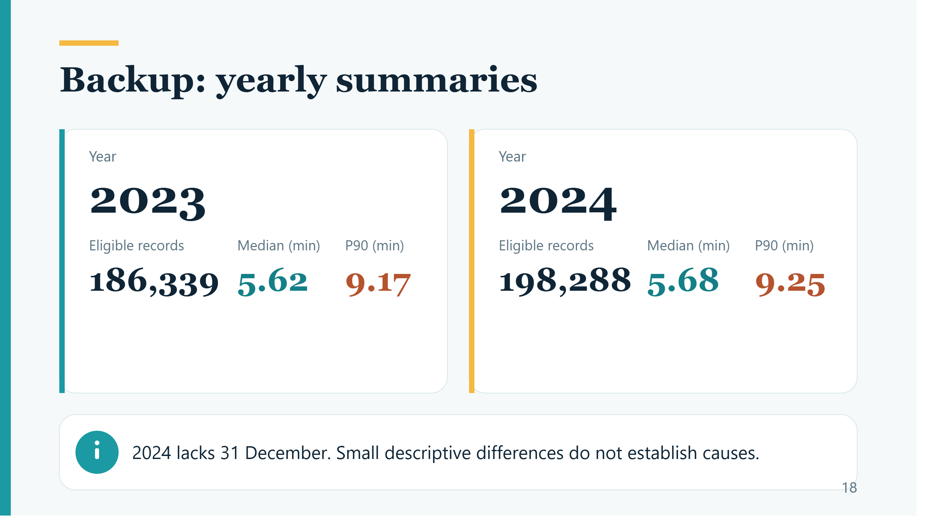
Backup: yearly summaries
Year
Year
2023
2024
Eligible records
Median (min)
P90 (min)
Eligible records
Median (min)
P90 (min)
186,339
5.62
9.17
198,288
5.68
9.25
2024 lacks 31 December. Small descriptive differences do not establish causes.
18
Notes:
PRESENTER: Either presenter
ENGLISH SCRIPT
The annual summaries show slightly higher median and P ninety values in twenty twenty-four. However, the final day is missing and the case mix may differ. We therefore describe the difference without claiming a proven decline in service performance. Record counts describe this published population. They do not establish complete annual demand.
SPANISH STUDY NOTE
Diferencias pequeñas descriptivas, no prueba de deterioro.
SOURCES
outputs/year_metrics.csv; outputs/audit.json
Repository version reviewed: 87938e79d91e2e929bcc77c2feb00e4393f50800
Official data catalogue: https://data.london.gov.uk/dataset/london-fire-brigade-mobilisation-records-24r65

Slide 18
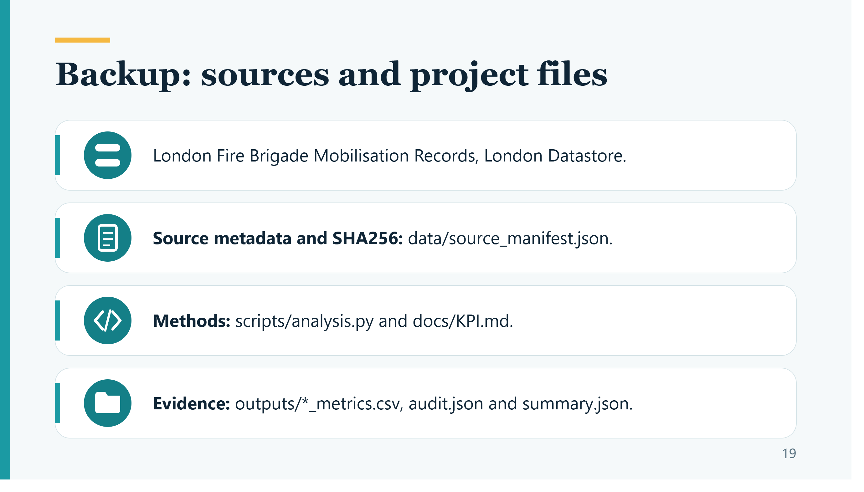



Backup: sources and project files
London Fire Brigade Mobilisation Records, London Datastore.
Source metadata and SHA256: data/source_manifest.json.
Methods: scripts/analysis.py and docs/KPI.md.
Evidence: outputs/*_metrics.csv, audit.json and summary.json.
19
Notes:
PRESENTER: Either presenter
ENGLISH SCRIPT
The numerical source is the official mobilisation CSV. The source dictionary explains the original fields. The manifest records the exact download links and hashes. The analytical tables support the figures in this presentation. The source caveat about published performance calculations refers to LFB freedom of information response eight four two zero point one. That document does not confirm every filter applied to our CSV.
SPANISH STUDY NOTE
Rutas para localizar evidencia y enlace público de la fuente en las notas.
SOURCES
https://data.london.gov.uk/dataset/london-fire-brigade-mobilisation-records-24r65; https://www.london-fire.gov.uk/media/8863/foia84201-response-times-of-fire-brigades-and-data-collation-response.pdf; docs/SOURCES.md
Repository version reviewed: 87938e79d91e2e929bcc77c2feb00e4393f50800
Official data catalogue: https://data.london.gov.uk/dataset/london-fire-brigade-mobilisation-records-24r65

