Slide 1
Stories from the wild side of the Information Super-highway
Disclaimer: All of the following is strictly hearsay; none of this probably ever happened. However, with the presented tools and techniques, it probably could!

Slide 2
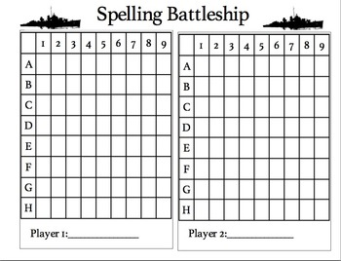
Cheating in Battleship
A little fun & games to start with
A memory scanning tool such as scanmem is your key to success.
Notes:
http://anonymouse.org/cgi-bin/anon-www.cgi/http://www.aapeli.com/pelaa/klassikot/laivanupotus/

Slide 3
Battleship cont'd...
  You get five shots to begin with.
  Search for process memory containing five. Shoot.
  Search “ “ “ 4. Shoot again.
  Same same, but with 3. Shoot, if more than one result.
  Usually stops at 2 or 1. Now edit the (writable) memory address. 9999999 shots oughta cover the grid. You win; total annihilation :)
Notes:
- “pokefinder”
- ugtrain on Github
- the lesson: never trust user input

Slide 4
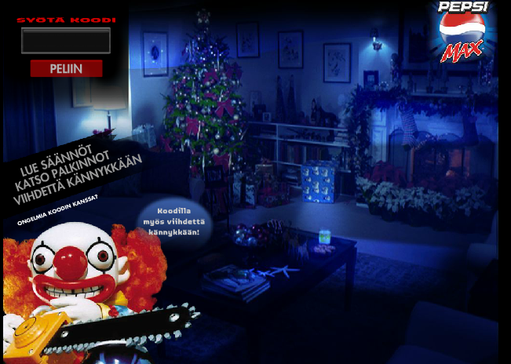
A simple case
HTTP GET
http://www.pepsi.fi/flashservices/gateway.php?uName=[name]&fName=[1stname]&lName=[2ndname]&email=[email]&phoneNr=[numba]&newScore=1049650
Notes:
Don't remember why I used an anonymizer, here...

Slide 5
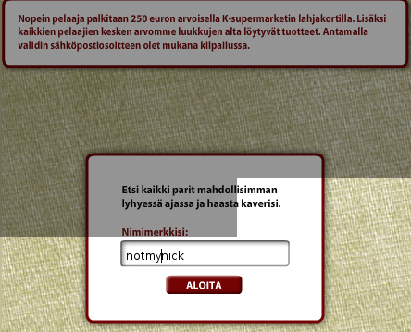
The name of the game:

Slide 6
Citymarket's compo hack
Tools of the trade:
  Free Flash Decompiler (link in source slide)
  Burp proxy (intercepting proxy suite)
http://www.ooo.fi/muistipeli/index.php?method=participate&
etunimi=[name]&
sukunimi=[family name&
puhelin=[phone numba]&
plussanumero=&
vuosi=[year of birth]&
kuukausi=[month of birth]&
email=[email]&
emailMarkkinointi=0&
puhelinMarkkinointi=0&
nimimerkki=[nick]&
aika=85953 = (root as MovieClip).lsekunnitString <from the .fla
Notes:
- Show Burp Proxy
- Show Flash Decompiler

Slide 7
Second request: http://www.ooo.fi/muistipeli/index.php?method=score&
score=85953&
name=[nick]&
hash=&
score_hash=11330a38d561a168c774bd7b0671cf34&advertiser=k-supermarket
<result name="saveScore" status="true">
<params>
<param name="id" value="17068" />
<param name="hash" value="9b33250fc97ca029a37af56af3e4542f" />
</params>
</result>
score_hash = MD5.encrypt(lsekunnitString + "lammasfarmi");
Checklist:
  Hash method? ☑
  Salt? ☑
  Seed? ☑

Slide 8

Next up Coke Hax
Tools of the trade:
  Flash decompiler
  Burp Suite
POST /cooler/softsignup HTTP/1.0
User-Agent: Opera/9.64 (Windows NT 5.1; U; en) Presto/2.1.1
Host: coke.fi
Accept: text/html, application/xml;q=0.9, application/xhtml+xml, image/png, image/jpeg, image/gif, image/x-xbitmap, */*;q=0.1
Accept-Language: en-US,en;q=0.9
Accept-Charset: iso-8859-1, utf-8, utf-16, *;q=0.1
Accept-Encoding: deflate, gzip, x-gzip, identity, *;q=0
Referer: http://coke.fi/summer/CokeSummer_index.swf
Cookie: JSESSIONID=0000KoV5JWueMnwZXS0UxIWUXLW:13fjalfgg
Cookie2: $Version=1
Proxy-Connection: Keep-Alive
Content-type: application/x-www-form-urlencoded
Content-Length: 249
Notes:
Mention Burp's automatic content length updater!

Slide 9
Cont'd: a little hazy, with amnesia...
passwordRepeat=[chosen pwd]&
foo=1244997214187&
username=[name]&dateOfBirth=[DOB, URL encoded, thusly:YYYY%2DMM%2DDD]&isAcceptConditions=true&password=[pwd]&email=[Email, URLencoded;some%2Esome%40domain&isAcceptContact=false&firstname=[name]&hshKey=23762fb7eeae39af176957656f8d18b8
x_loc_6.isRight = _loc_5.@key == MD5.hash("true" + "JORGE" +_loc_6.id);
Checklist:
  Secret params? ☑
  Hash method? ☑
  Salt? ☑
Notes:
- Show Burp URL Encoder!
- Once again, trusting user input – could be checked server-side

Slide 10
A little break into the world of the Nokia N-Gage
A handy-dandy lil' app called AgileMessenger (Jabber/ICQ/other IM client)
Nagware :(
Hex editor to the rescue!
  Search for purchase link
  00 out the URL
  Something went ka-blewie, and it worked without this annoying splash then :)
  Nothin' else needed!

Slide 11
Flora collection campaign
Collect codes from margarine lids, gain Moomin mugs.
Tools of the trade:
  Burp for recon
  vvvv (link in the source slide) for bot
Checklist:
  Simple HTTP POST protocol? ☑
  No timeouts? Nope! ☑
  > Brutable? Yessireebob! ☑

Slide 12
http://www.nettikamppis.fi/flora/php/handler.php
method = POST
vars = new URLVariables();
vars.method = "submitCode";
vars.code = code;
vars.userId = UserInfo.ID;
req.data = vars;
responses:
  in_use
  ok
  false_code
V4 “Patch” for brute force trial-and-error bot

Slide 13
Some stats
66805 37 191
Notes:
- Remember to point out the logarithmic scale!

Slide 14

The result? A coupl'a these for a coupl'a cups...
Notes:
So why not falsify the coupon? Well, because there's the checksum, which is generated server-side, so it's easier to exploit client-side trust.

Slide 15
JaffHax
Tools of the trade:
  vvvv
  Burp
  Flash Decompiler

Slide 16

Yet another case study...

Slide 17
At the start = PING_START, ping = true
Each draw = PING, ping = true
At the end = PING_STOP, ping = true
After sending = http://s0b.bluestreak.com/ix.e?bb&t=42689
form.info:
postvar:"sid", value:String(SHA1.encrypt("_KERKKO-snickers_" + this._points + "_karhuemo-LOL_"))});
Notes:
- Create vvvv spoofer bot

Slide 18
HTTP GET req:
http://www.jaffa.fi/fruithunt/php/save/submit?
puhelinnumero=[numba]&
kuva=no%5Fimage&
sid=1405fff58888e8476e2cf9f4753653ce8a0a0f1c&
sahkopostiosoite=[URL encoded mail]
nimi=[name, same encoding]
pisteet=415%2E3&
nimimerkki=appas&
suoramarkkinointi=0
Notes:
- Burp has tools for various encoding methods, check'em out maybe

Slide 19
Checklist:
  HTTP req structure? ☑
  Hash algo? ☑
  Hash salt(s)? ☑
  Anti-cheat countermeasures? ☑
vvvv bot for sending pings
Results: A coupl'a bottles… or nothing at all. Move along!

Slide 20
A different approach...
The tools:
  MacroExpress: a macro editor for Windows
The name of the game: PenaltyShootout
The aim of the game: shoot max amount of goals with a max of 3 successful interventions by the goalie
Found a surefire goal (impossible to deter) in the upper corner of the goal
Macro'd the 'puter to shoot in that spot only
Waited
???
Profit!
Notes:
A funny little mention: I actually came in second, but still got the prize, because the first place “winner” was disqualified for cheating :D
Here's to cheating fair and square – the honorable way! Hoorah!

Slide 21
They cheat!
Case in point: a shady little loaner house
A safe-cracking contest, made in Flash. Time to break out the ol' decompiler…
There's >9001 € at stake!
But what's this?
The flash is simply a static, locked-on red safe, with an animated, yet non-functional keypad. Oh that's not fair…
They don't respond kindly to my contact...

Slide 22
I say again: They cheat
Some sanity napkin company (coulda been EvilCorp…) had a flash contest, where you “could” win an iPod.
There were supposedly n iPods to be given out in a scratch-and-win lottery
All the Flash did was a scratch anim, a number and a “Sorry! No dice!”
Well, that's marketing for ya...

Slide 23
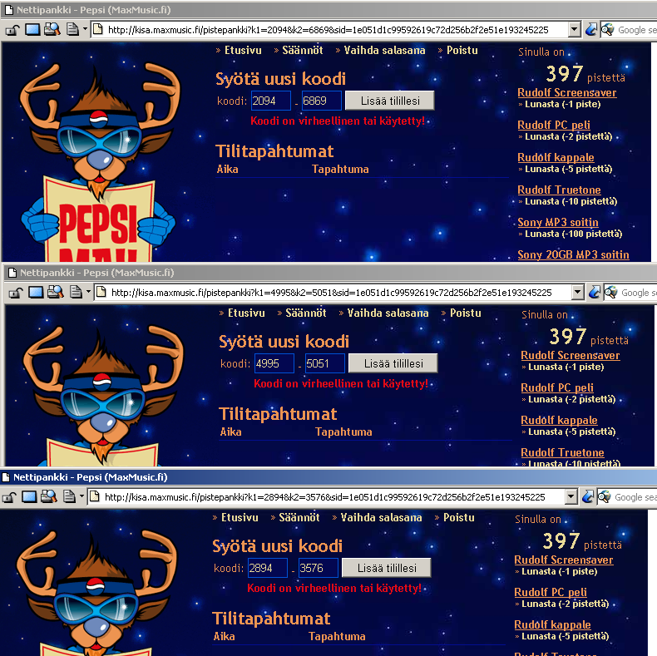
Could there be more than one hacker on the move..?
It's more likely than you think!
Notes:
Codes that were legit from bought bottles were rejected
→ Somebody must've bruteforced them!

Slide 24
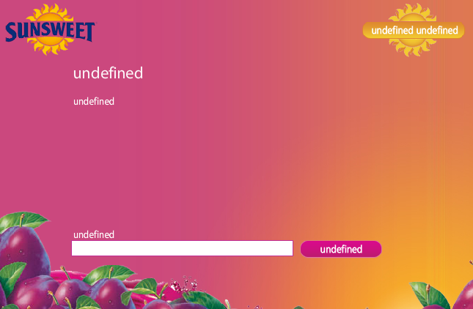
Another dummie case
sendit=1
f3= friends
f2=
F1=
f=0
c=565 PlayerSum
L=2 level
s=256 Playerscore
m=0 agree (spam)
g=[M/F]
v=[YYYY]
e=[email]
a=[address]
ni=[nick]
n=[playername], len=ex.14
_loc1 = Playerscore.toString();
PlayerSum = int(playername.length * _loc1.length * int(Playerscore) / 19);
Roll your own crypto? ISHYGDDT!
Notes:
Also, this compo was a quiz, that sent all the Q&A's at the beginning over the wire as XML. But why bother to look up the answers, when you can just edit the score that's sent back, along with that measly “checksum”...

Slide 25
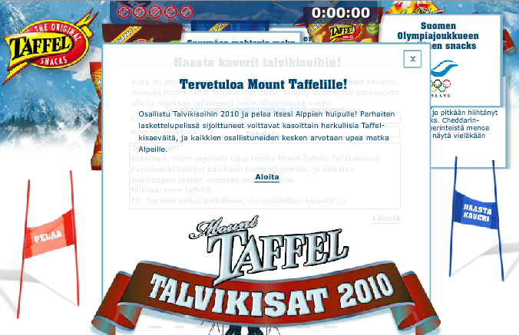
Ok, one more for the road...
Bag'o'trix:
  vvvv
  Burp
  Flash decompiler

Slide 26
HTTP GET, yet again
http://www.taffel-talvikisat.fi/save2.php?
faults=9 < maybe try 0?
&etunimi=[fname]
&aika=102578 < time, in ms
&puhelin=[numba]
&nimimerkki=[nick]
&email=[email, URL encoded]
&sukunimi=[lname]
&id=c640da040227fb00ff4d6bbfd56c7ac7
key = new String("um7myeoi");
id = calcMD5(String(goalTime) + String(form.email.text) + key);

Slide 27
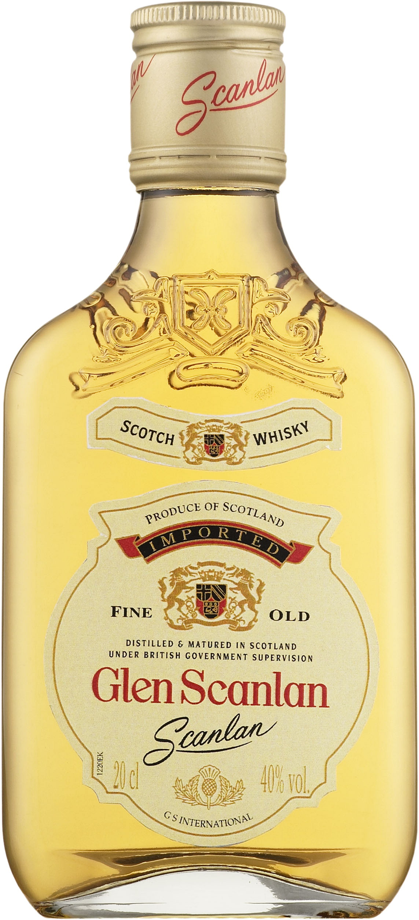
And now, for something completely different!
sudo arp-scan --localnet
10.130.160.1 #64:9e:f3:51:bc:47 (Unknown)
10.130.160.20 #00:19:35:00:54:c9 Duerr Dental GmbH & Co. KG
10.130.160.30 #2c:44:fd:04:1f:73 (Unknown)
10.130.160.32 #00:80:91:52:87:e0 TOKYO ELECTRIC CO.,LTD
10.130.160.33 #08:2e:5f:27:f2:51 (Unknown)
10.130.160.36 #2c:41:38:92:a7:4c (Unknown)
10.130.160.37 #08:2e:5f:25:6a:8d (Unknown)
10.130.160.35 #b8:ca:3a:89:2e:06 (Unknown)
10.130.160.34 #08:2e:5f:27:c3:35 (Unknown)
10.130.160.38 #24:be:05:04:9a:95 (Unknown)
10.130.160.39 #08:2e:5f:24:c8:a8 (Unknown)
10.130.160.40 #2c:44:fd:64:51:6b (Unknown)
10.130.160.41 #00:23:24:28:65:9a G-PRO COMPUTER
...
Notes:
Get to know your local neighbourhood…
Hell-o! Who have we here..?
Mention ARP poisoning

Slide 28
“Another visitor...”
nmap -Pn -sV -O --open --reason -e eth0 -iL ~/ip2.txt
Starting Nmap 6.47 ( http://nmap.org ) at 2015-07-02 11:00 EEST
Nmap scan report for dirogatipotie.tre.t.verkko (10.130.160.20)
Host is up, received arp-response (0.00053s latency).
Not shown: 994 closed ports
Reason: 994 resets
PORT STATE SERVICE REASON VERSION
21/tcp open ftp syn-ack GNU Inetutils FTPd 1.4.1
22/tcp open ssh syn-ack Dropbear sshd 0.49 (protocol 2.0)
23/tcp open telnet syn-ack Linux telnetd
111/tcp open rpcbind syn-ack 2 (RPC #100000)
2005/tcp open deslogin? syn-ack
2006/tcp open invokator? syn-ack
1 service unrecognized despite returning data. If you know the service/version, please submit the following fingerprint at http://www.insecure.org/cgi-bin/servicefp-submit.cgi :
SF-Port2005-TCP:V=6.47%I=7%D=7/2%Time=5594F167%P=x86_64-pc-linux-gnu%r(NUL
SF:L,718,"Welcome\x20at\x20DUERR\x20DENTAL\x20IDC\n\r\x1b\[3;45H13\x20\x20
SF:Fifo:\x20\x20\x200/100\x20\x20\x20\x200B\x1b\[K\x1b\[6;45H8degC\x20\x20
SF:\x20\x20\x20Prisma\x20\x20\x20:\x20FAIL\x208000rpm\x20\x20SOL:\x20\x20\
SF:x20\x20\x20\x200\x20N/A\x20\x1b\[K\x1b\[19;38H4\x20PID:\x200\x1b\[K\x1b
SF:\[20;61H\x1b\[3;45H10\x20\x20Fifo:\x20\x20\x200/100\x20\x20\x20\x200B\x
SF:1b\[K\x1b\[20;61H\x1b\[3;45");
MAC Address: 00:19:35:00:54:C9 (Duerr Dental AG)
Device type: general purpose
Running: Linux 2.6.X
OS CPE: cpe:/o:linux:linux_kernel:2.6
OS details: Linux 2.6.13 - 2.6.32
Network Distance: 1 hop
Service Info: Host: 2141-000-80; OS: Linux; CPE: cpe:/o:linux:linux_kernel
Notes:
Just like Trinity in the Matrix 2! I even had cmatrix running in a shell prompt. Shit was so cash...

Slide 29
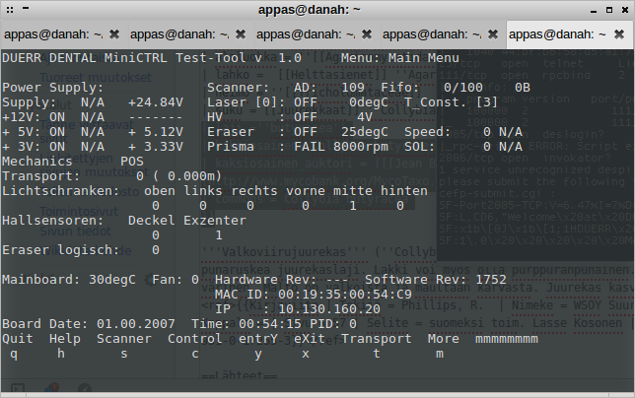
netcat host port, eg.
netcat 10.130.160.20 2005
Notes:
Too bad I couldn't get it to respond to input!As you can clearly see in the picture, the sent characters are echoed back, but nothing happens. I tried EOL's and EOF's, but no dice. Maybe I should try once more, with a Group Separator.
I enquired about this from Dűrr, but got no response :(

Slide 30

Links to tools & such
https://www.free-decompiler.com/flash/ Free/Libre Flash Decompiler
http://vvvv.org vvvv, a multipurpose patching toolkit
http://www.macros.com/ MacroExpress
nmap, arp-scan, netcat, scanmem: check your local, friendly package manager (yum, apt, macports/brew…)
https://portswigger.net/burp/ Burp suite

Slide 31
