Slide 1

Using SVM to determine critical temperature
Mateusz Bulanda-Gorol
Mateusz Rokicki

Slide 2
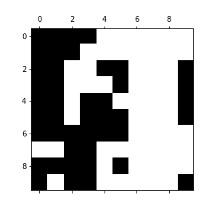
2D Ising Model
Notes:
Ising model is a statistical model for ferromagnetic and antiferromagnetic systems. In our projet we decided to use 2D model to generate spin configurations for our calculations. This model is a representation of spins in a square lattice where they can have only 2 spin values equal +1 or -1 as on figure on the left side where black squares are represent value -1 and white squares +1. In this model, we used only nearest neighbours interactions for spins, what is shown on the picture on the right side.

Slide 3
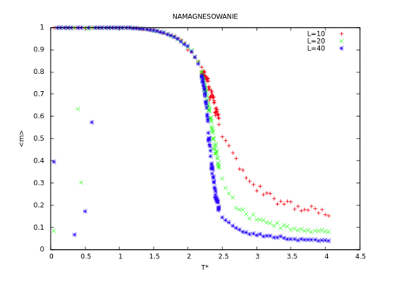
Phase transition and parameters
Steps = 50 000
T = 0.1 – 4.0
ΔT = 0.1
Lattice size:
10
20
30
40
50
Notes:
To create proper configurations we used Monte Carlo simulations for parameters steps, T and delta T. Configuartions were create for 5 differenet sizes of systems. Our goal was to get proper value of critical temperaturę for phase transition in ising model. Analytical value of this tempearature is aroud 2.27 (witouht unit, because it is so called reduced temperature).

Slide 4
Methods
Method I
Analysis of the dependence of the average phase adjustment on the temperature. We can easily calculate critical temperature from this relationship, using linear regression.
Method II
Based on analysis Mean Square Error and temperature, critical temperature should appear at the point were this dependency increases rapidly. To accomplish this computations, necessary was to calculate the magnetization of the system.
Notes:
To achieve our goal, which was getting correct value of critical temperature, we used Support Vector Machine. At the beggin, we trained our model for 2 temperatures 0.1 and 4.0 which are extreme temperatures for our monte carlo simulations were we get 100% efficiency for testing data. For low temperatures we had so called cold-phase which for SVM was value 1 and for high temperautre – hot phase – value -1
In the first method we predicted phase type for every configuration in every temperature and then averaged. After averaging the results, we obtained the temperature dependence of the phase adjustment. As we know, the phase transition takes place at the critical temperature, so we can easily calculate Tc from this relationship, using linear regression. We also expect, that it will be possible to calculate the critical temperature, which will be at the point of the breakdown of the plot.
The second method we used to predict the critical temperature was closely related to Mean Squared Error (MSE). This function has a value close to zero at low temperatures. We have postulated that it is possible to determine the critical temperature based on the temperature dependence of MSE. According to our expectations, the dependence of MSE on temperature will increase rapidly at the critical temperature. For this, it was necessary to assign the individual configurations to the respective phases in order to be able to assess the correctness of the assignment by the SVM. We therefore counted the magnetization, which is non-zero below the
critical temperature and zero above.

Slide 5
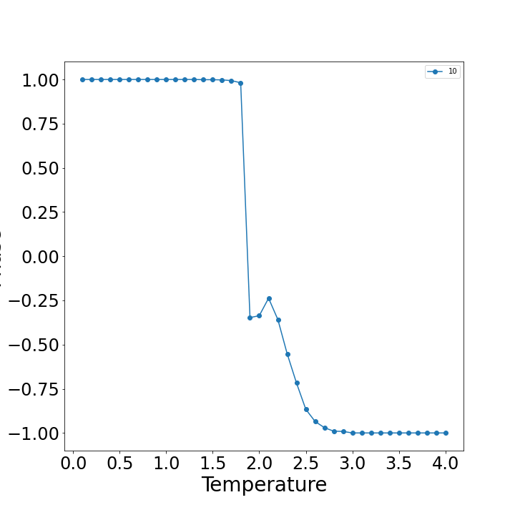
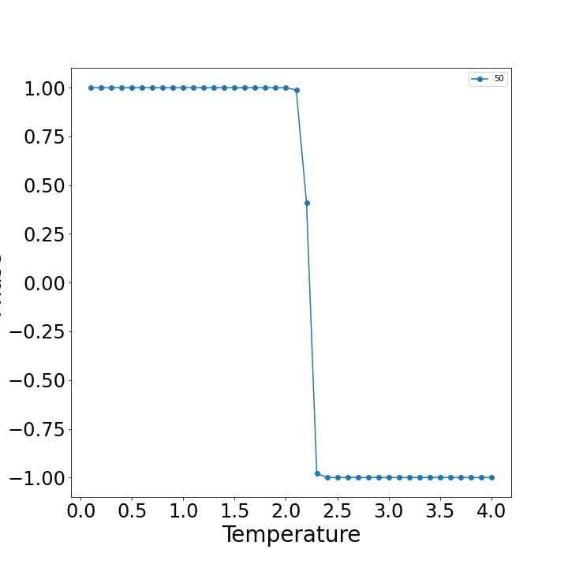
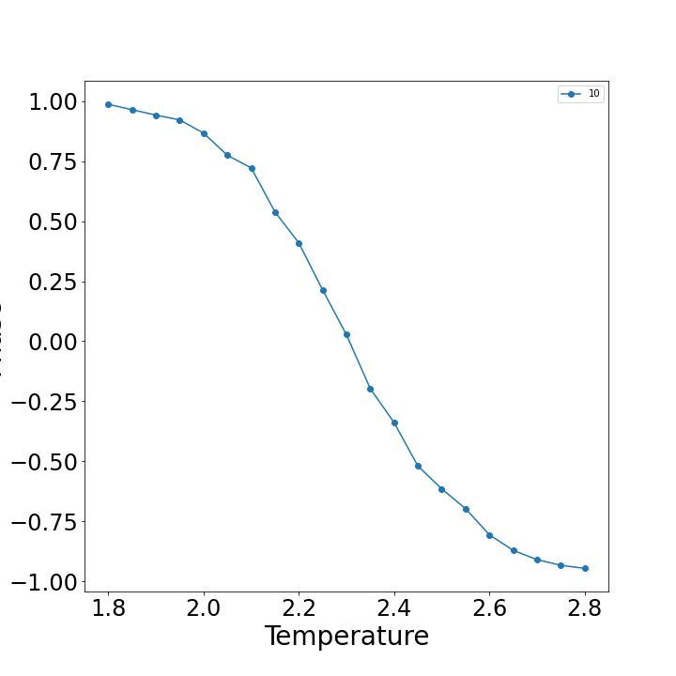
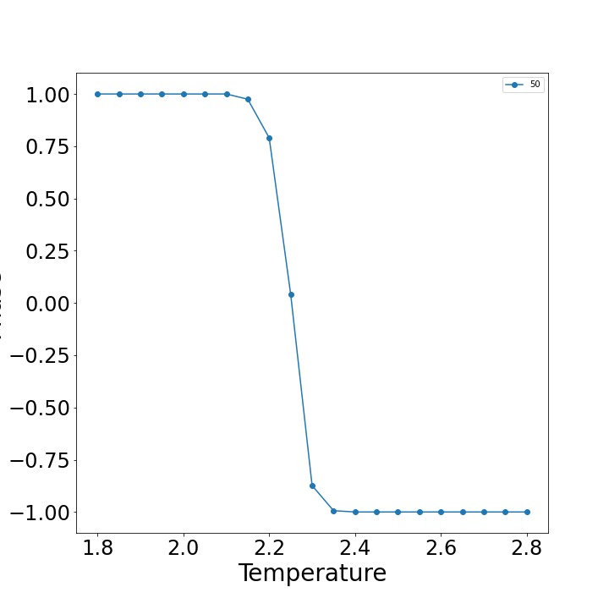
Results
Method I
Notes:
For first method we get really promising data, as you can see on our graphs. On the top you can see the dependence for average phase adjustment on the temperature for full range of tempreature from 0.1 to 4.0. On the left there is graph for size L=10 and on the right side for 50. From this graph we noticed that the critical temperature should be in range of tempreature from 2.0 to 2.8, so we created new configurationsi in this reange with step equal 0.05. Thanks to this, transition was smoother what let us calcualte Tc more precisely. This range of tempratures is shown on the bottom graphs

Slide 6
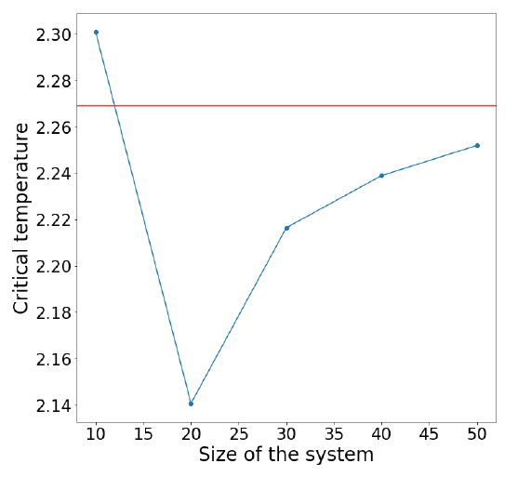
Results
Method I
System size L | 10 | 20 | 30 | 40 | 50
Critical temperature | 2.3009 | 2.1407 | 2.2165 | 2.2390 | 2.2520
2.2692
Notes:
By using linear regression we were able to calcualte this critical tempreatures for different systems size. As you can see, for L equal 10 we get value pretty close towhat we expected, but it was probably some luck, because for smaller systems, temperature deviates from theoritcal value as you can for values 20 and 30. While, system size is increasing, value of critical temperature trends to value 2.2692, what is analytical tempeature for 2D Ising model. Due to lack of computer resources we were unable to create configurations for bigger systems, which should give more accurate results.

Slide 7
Results
Method II
System size L | 10 | 20 | 30 | 40 | 50
Critical temperature | 2.7 | 2.5 | 2.4 | 2.3 | 2.3
Notes:
Second method also gave some pretty accurate result for bigger systems, what is also visible in graphs, were on the left is MSE of temperature for L equal 10 and on the right for L = 50. As a result, this method of calculating the critical temperature is still an open question when using the SVM machine learning model. At this point, we can only give approximate values of the critical temperature for the systems. In this method to get more precise values of crticial temperatures we also should do calculations for bigger systems, but what more important, create configurations with smaller temperature step e.g. 0.01 around critical temperature.

Slide 8
Thank you for your attention
Notes:
SVM and 2 presented method are accurate even for our data and with access to confiigurations of bigger systems, we should be able to define very precisely the critical temperature and also we should be able to investigate behaviour of the system near the phase transition.

