Slide 1
Stream Programming
Krzysztof Issel, Mateusz Bulanda-Gorol, Mateusz Rokicki

Slide 2

Frugal Median
Pseudocode:
Set l=0
for i = 0 to n do:
if ($a_{i}$ > l) then:
l += 1
else if ($a_{i}$ < l) then:
l -= 1
return l

Slide 3

Frugal Median
s = 5, 9, 2, 3, 4, 10, 5, 2, 3, 4
l = 0
$a_{i}$ = 5 l= 1
$a_{i}$ = 9 l= 2
$a_{i}$ = 2 l= 2
$a_{i}$ = 3 l= 3
$a_{i}$ = 4 l= 4
$a_{i}$ = 10 l= 5
$a_{i}$ = 5 l= 5
$a_{i}$ = 2 l= 4
$a_{i}$ = 3 l= 3
$a_{i}$ = 4 l= 4
Median = 4

Slide 4
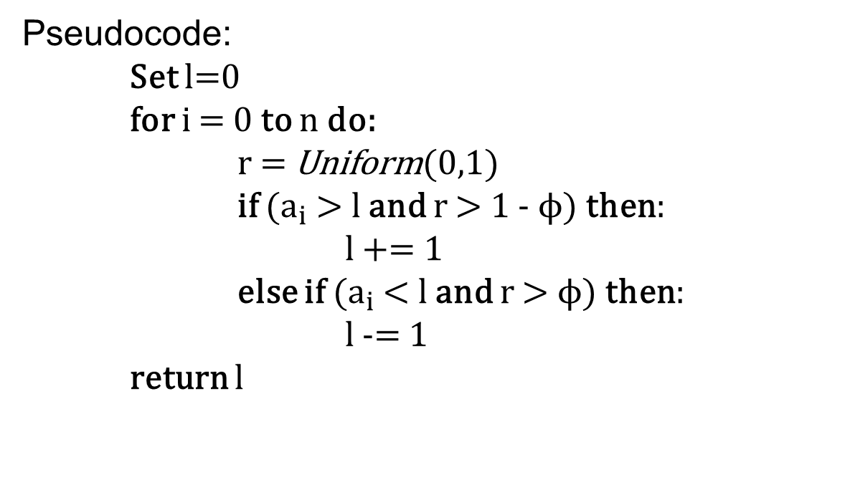
Frugal Quantile
Pseudocode:
Set l=0
for i = 0 to n do:
r = Uniform(0,1)
if ($a_{i}$ > l and r > 1 - ϕ) then:
l += 1
else if ($a_{i}$ < l and r > ϕ) then:
l -= 1
return l

Slide 5

Frugal Quantile
s = 5, 9, 2, 3, 4, 10, 5, 2, 3, 4
Φ = 0.75
l=0
$a_{i}$= 5 r= 0.19897777 l= 0
$a_{i}$= 9 r= 0.7822547 l= 1
$a_{i}$= 2 r= 0.68043905 l= 2
$a_{i}$= 3 r= 0.21908289 l= 2
$a_{i}$= 4 r= 0.88227886 l= 3
$a_{i}$= 10 r= 0.8710085 l= 4
$a_{i}$= 5 r= 0.13034159 l= 4
$a_{i}$= 2 r= 0.4591481 l= 4
$a_{i}$= 3 r= 0.95468134 l= 3
$a_{i}$= 4 r= 0.07402307 l= 3
Quantile = 3.0

Slide 6
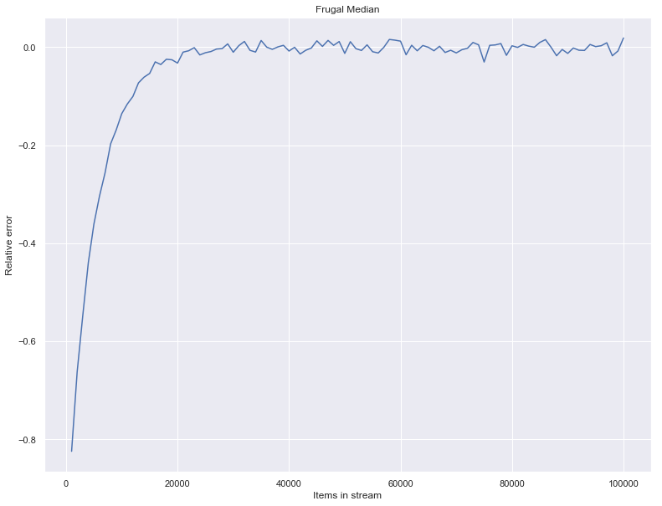
Error for Frugal Median

Slide 7
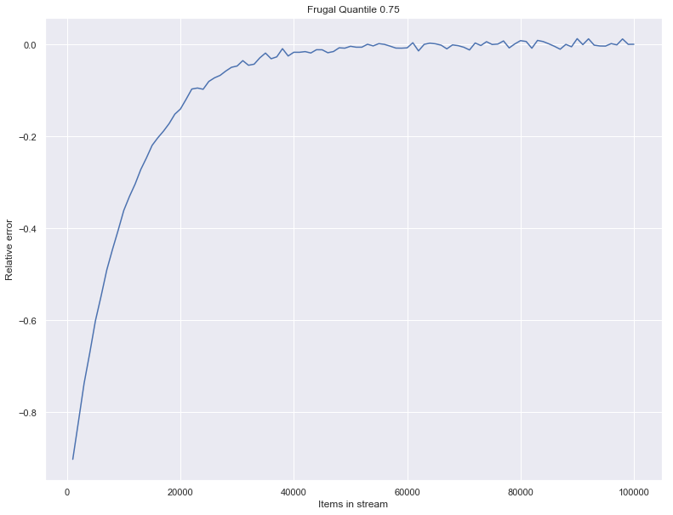
Error for Frugal Quantile

Slide 8
Thank you for attention

