Slide 1





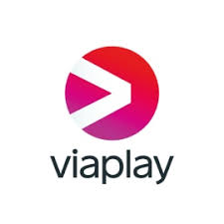





Cloud Platform Services
Technical Platform: Dynamic and Scalable ”Pay as you Go”
Application: Json Development
Solution: E2E Global Solution Blueprint Template
- Ready to configure and Roll-out as per ”Spotlight” concept design priciples
Digital Communication
Safe and approved
Allready available
Recommended to use
Cost only kicks in when breaching 10. 000 calls/ Day
The Media Platform Navigation and Search concept
”High Level Data” directs the user search to the area to start the manual browsing to get to desired content
”Big data” – The more granualar level is needed to automate browsing. Real time searching in ”Big Data” doesn’t (yet) meet end user expectations in response times. Such searches can put unhealthy load on the platform as well.
But, if the mountain won’t come to Mohammed.. Spotlight can help!
If (youTube.keyWord === 1) {
Cloud DB
Data Store
Solution
Search for Keyword…
Social Media
Micro Clips
IPTV Streaming services
Providing End Users a feed with links, based on interests
Providing shortcuts to relevant segments or chapters of the media offering
API
Influencers and Content Creators
Video Streaming Platforms
Audio streaming plattforms
Return mediaDocuments where ’keyWord’
AI and ML driven Post-processing of Media Meta Data
Structuring and Enriching the data to be searchable
Creating ”Warp” links to your your cherry in the pie
Players in the Value Chain
Content Creators (Youtubers, Infleuncers, SMEs)
Internet Media Platforms
Marketing Sponsors and Advertisers
3rd Party Media Content Retail distrubuters (Like ”Spotlight”)
Customer, the end User representing the Demand
ANALYTICS
Native KYC
Customer Segementation
Statistics and follow-up
APPLICATION
Front-end UI service
SDK and
SECURITY
Best Practice Authorization concept
Data Privacy Governance
INFRASTRUCTURE
Operations
Administration
INTERFACES – Media Platform Policy
Provided and Supported OR
3rd Party Recommended
Fully integrated and supported!!! (Platform As A Service)

Slide 2
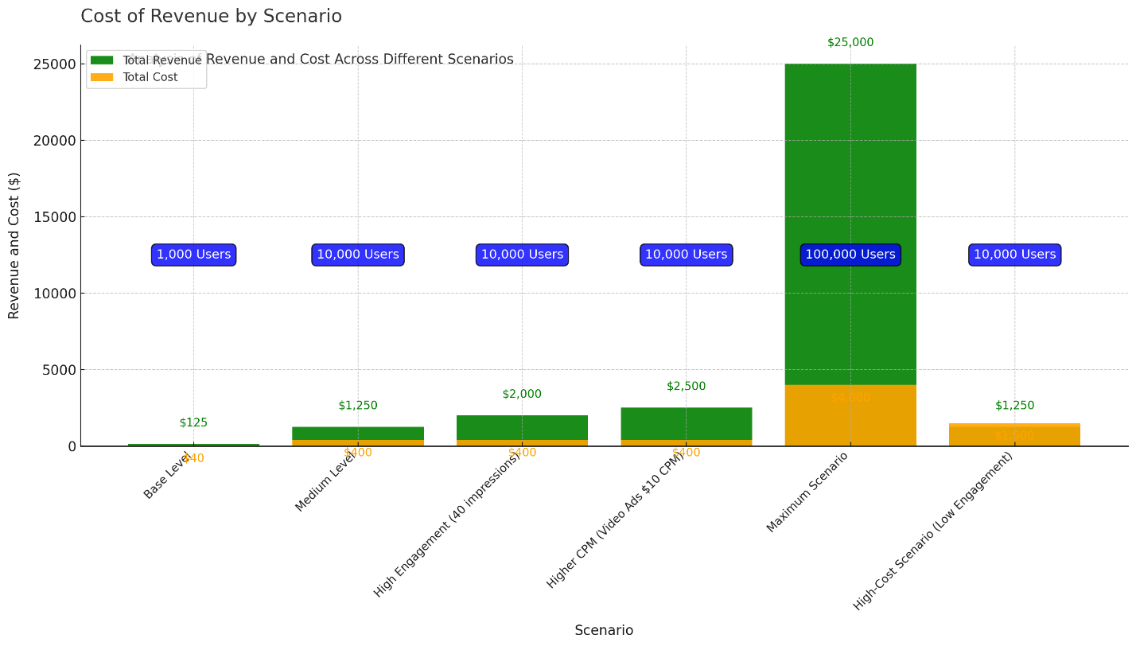
Cost of Revenue

Slide 3
Appendix Consulting Firms' Visions for the Future of the Media Ecosystem

Slide 4
McKinsey & Company: "Personalized Media Experiences and Data-Driven Content"
Vision: McKinsey envisions a future where personalized media experiences and data-driven content are essential for creating user engagement and loyalty. They see future media consumption as dependent on delivering exactly the right content to the right audience, based on each individual’s interests and behavior patterns.
Relevance: This highlights the importance of using data to refine content delivery and create an experience tailored to user preferences. A solution that can effectively segment and highlight relevant parts of content saves time for the user and boosts engagement, aligning perfectly with McKinsey’s vision for a personalized media experience.

Slide 5
Deloitte: "Digital Media Trends and the AI-Driven Media Supply Chain"
Vision: Deloitte describes a future where AI is a driving factor throughout the entire media production chain, from creation to distribution. They foresee an industry where content can be continuously analyzed and adapted based on direct feedback from users. Deloitte emphasizes how data can inform decision-making across the ecosystem to create higher relevance and efficiency.
Relevance: This vision underscores the value of having a solution that can gather, analyze, and provide insights to content creators. By using AI to understand and act on user preferences, a dynamic feedback loop is created, forming an AI-driven supply chain where content is continuously adapted to audience demand.

Slide 6
Accenture: "Data and Analytics in the Media Industry"
Vision: Accenture emphasizes data and analytics as the key to understanding and enhancing media consumption. They advocate for an industry where media companies use advanced analytics and AI to create relevant and engaging user experiences, with the entire ecosystem optimized and customer-oriented through data.
Relevance: This underscores the importance of using data and analytics to identify and present the right content to users. A solution that provides both users and creators with the information needed to optimize consumption and production aligns well with the data-driven future that Accenture envisions.

Slide 7
PwC: "Global Entertainment & Media Outlook"
Vision: PwC highlights that future media consumers will expect immediate, seamless access to relevant content across multiple platforms. Data- and insight-driven strategies are increasingly important for creating value in the ecosystem, and companies must invest in technologies that can offer customized experiences for users.
Relevance: This supports the need for a solution that can act as a central hub where users can easily find relevant segments across different platforms. A seamless user experience and data-driven content targeting align with PwC’s vision of a future media industry where customized experiences are at the core.

Slide 8
Gartner: "The Future of the Media Ecosystem and Data-Driven Personalization"
Vision: Gartner predicts a future media ecosystem that is entirely data-driven, where content creation and consumption are integrated into a self-learning system. They stress the importance of collecting and analyzing data on an individual level to deliver personalized media experiences and advocate for close collaboration between platforms and third-party actors to achieve a cohesive user experience.
Relevance: A solution that connects various ecosystem players – platforms, third-party providers, and end-users – and enables a dynamic feedback loop for creators to optimize their content aligns perfectly with Gartner’s vision of a self-learning media ecosystem. Collecting data from users to improve and customize content is exactly what Gartner envisions as the core of future media experiences.
These visions from leading consulting firms underline the value and relevance of developing an integrated, data-driven media ecosystem. Our solution aligns with these visions by leveraging existing technologies and data to create a personalized, seamless experience for users and a self-learning process for content creators. By collecting, analyzing, and sharing data between platforms, third-party actors, and creators, a future can be built where content is produced and consumed with even higher relevance and efficiency.

