Slide 1
Music Generation
Matija & Sami

Slide 2
Dataset Selection: From IrishMAN to Leadsheets
Dataset Overview
IrishMAN: A large corpus of over 200,000 Irish folk songs
We filtered and kept only 34,211 songs
Why Not Use All of It?
Most songs are monophonic melodies (they have no harmony or chord structure)
Such songs were less useful for our goal: generating harmonically rich songs
Our Selection
All songs that contained chord annotation
These songs are more musically interesting

Slide 3
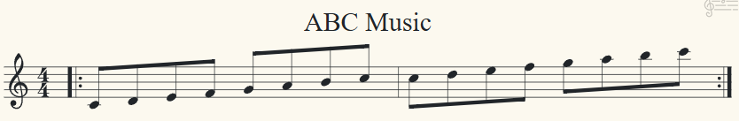
What Does a Song Look Like — ABC format
ABC Notation (Raw Text Format)
Sheet Music Equivalent

Slide 4
Why It Matters
We generate and train on ABC strings, not audio or images of sheet music
Then, we use a readily available ABC notation converter to render the ABC string into standard sheet music and play it back as audio
The ABC format lets us treat music generation like a language modeling task

Slide 5
Tokenization
What Are We Really Modeling?
Given a sequence of tokens, the model learns to predict the next one.
Example: - Input: ["M:4/4”, “K:D”, “|:”, “D”, “F”, “A”, “F”, “|"] - Target: "A"
BUT WAIT! Why Predict The Next Token? Why Not Just Predict The Next Character?

Slide 6
Why Not Just Use One Character = One Token?
At First Glance, It Sounds Simple...
ABC notation is just a sequence of characters — so why not feed one character at a time?
"|:DFA AFD|" → ['|', ':', 'D', 'F', 'A', ' ', 'A', 'F', 'D', '|']
Here's the Problem:
Characters don’t always align with musical meaning:
"M:6/8" would be split into 'M', ':', '6', '/', '8' — totally disconnected
Chords like [Am] become '[', 'A', 'm', ']' — harder to learn

Slide 7
Why Tokenization Is Better
We group characters into meaningful units:
"M:6/8" → "M:6/8"
"[Am]" → "[Am]"
This leads to:
Faster learning (less confusion about context)
Shorter sequences → more musical awareness

Slide 8
The Challenge: Noisy, Messy Real-World Data
The dataset contained a lot of noise, making tokenization tricky
Strange/invalid sequences of characters like “^*”
Irrelevant sequences for music generation like "^\"Hugh Gillespie's version:\""
Musically valid sequences like !fermata! that are ignored by the ABC-to-audio converter
To simplify the learning task:
We cleaned the data and removed tokens that were very infrequent, irrelevant, or unsupported by the ABC converter

Slide 9
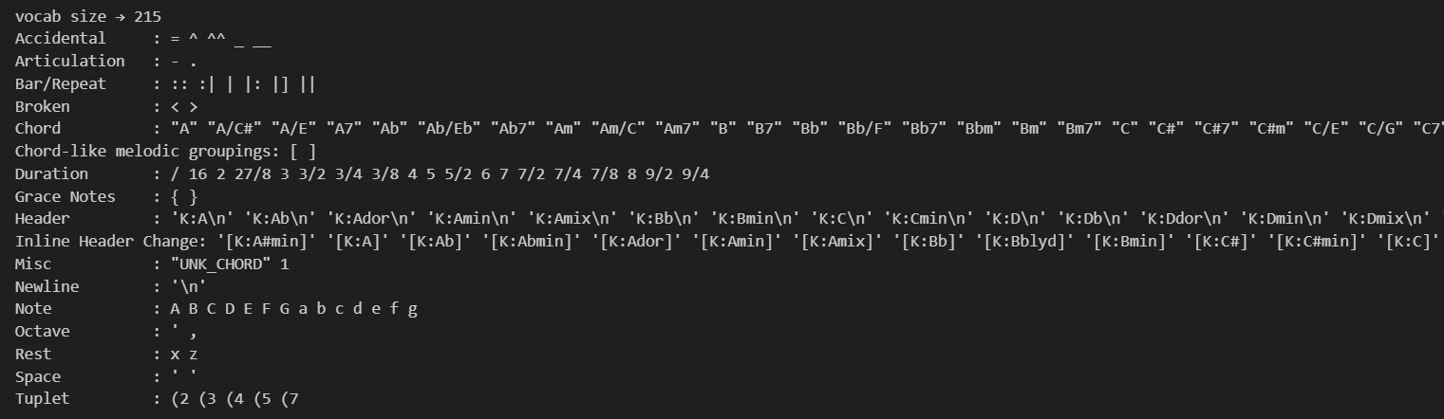
Our Final Vocabulary

Slide 10
Model Design
Appropriate Model Types: Recurrent neural networks are well-suited for sequential data like music
Two Architectures Compared:
LSTM (Long Short-Term Memory) network
GRU (Gated Recurrent Unit) network
Task Approach: Next-token prediction (autoregressive generation)

Slide 11
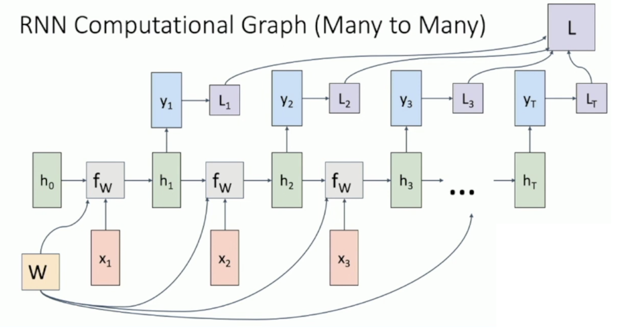
The Problem with RNNs
[Credits to Michigan Online, lecture 12: Recurrent Networks]

Slide 12
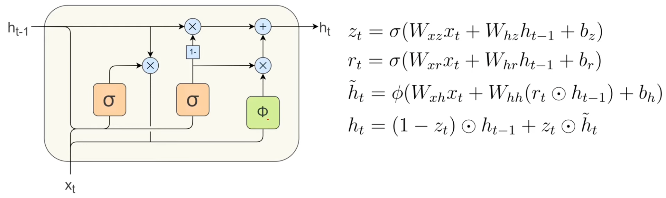
GRU (Gated Recurrent Unit)
Variant of RNNs, solves the vanishing gradient problem
Uses gating mechanisms to control information flow
GRU Architecture Components:
Reset Gate (r): Determines how much of the previous state to forget
Update Gate (z): Controls how much of the previous state to keep vs. new candidate state
How GRUs mitigate vanishing and exploding gradients
Vanishing Gradients: The update gate creates direct linear paths through time, allowing gradients to flow unimpeded for relevant information
Exploding Gradients: By controlling information flow with gates that use sigmoid activations (0-1 range), GRUs naturally constrain values and prevent exponential growth
[Credits to DataMListic, Gated Recurrent Unit (GRU) Equations Explained]

Slide 13
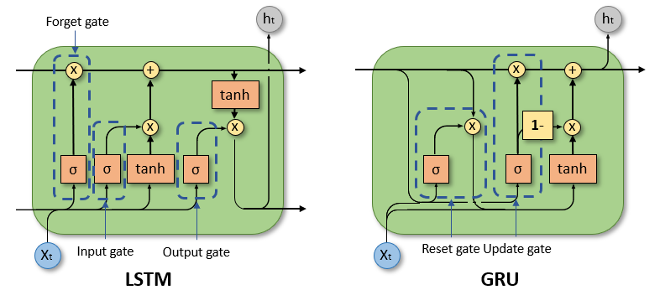
Comparing GRUs to LSTMs
Architectural Differences:
LSTM: 3 gates (forget, input, output) + separate cell state and hidden state
GRU: 2 gates (update, reset) + single hidden state
Parameter Efficiency:
LSTM: More parameters (~1.33× the number of GRU parameters)
GRU: Fewer parameters, more computationally efficient
Memory Retention:
LSTM: Better at remembering long-term dependencies
GRU: Slightly less effective for very long sequences, but excellent for medium-range dependencies
Performance Comparison for Music Generation:
LSTM: Generated more coherent musical structure with better long-term consistency
GRU: Faster training, sometimes more creative variations, but occasionally less musically consistent
[Credits to RNN, LSTM and GRU: Why Do We Need Them, Suvankar Maity ]

Slide 14
Models Architecture
GRU:
Embedding layer: 256
Hidden states: 512
Num of layers: 1
Dropout: 0%
Learning Rate: 0.001
Total parameters: 1,348,055
LSTM:
Embedding layer: 256
Hidden states: 512
Num of layers: 2
Dropout: 50%
Learning Rate: 0.001
Total parameters: 3,843,543

Slide 15
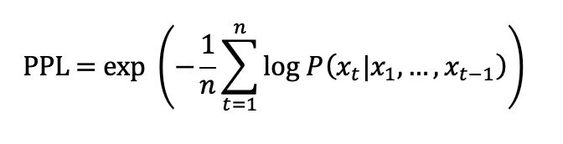
Perplexity Loss
What is Perplexity?
Exponential of the average cross-entropy loss: PPL = exp(loss)
Measures how "surprised" the model is by new data
Lower perplexity = better predictions
Mathematical Definition:
For a sequence of tokens x₁, x₂, ..., xₙ:
Why Use Perplexity for Music Generation?
Natural metric for next-token prediction tasks
Directly relates to the quality of generated sequences
Standard in language modeling, applicable to any symbolic sequence
Intuitively it answers: On average, how many equally-likely tokens is the model still confused between?

Slide 16
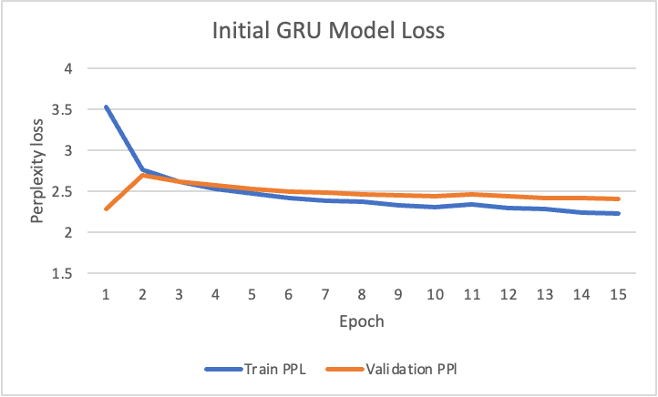
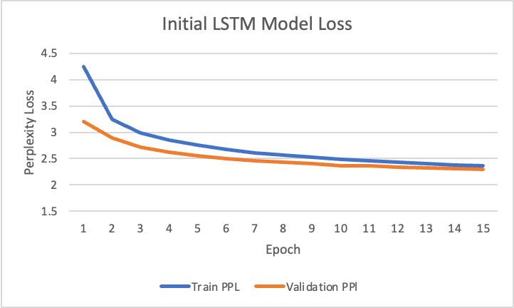
Initial Training
Test Perplexity Loss: 2.56
Test Perplexity Loss: 2.50

Slide 17
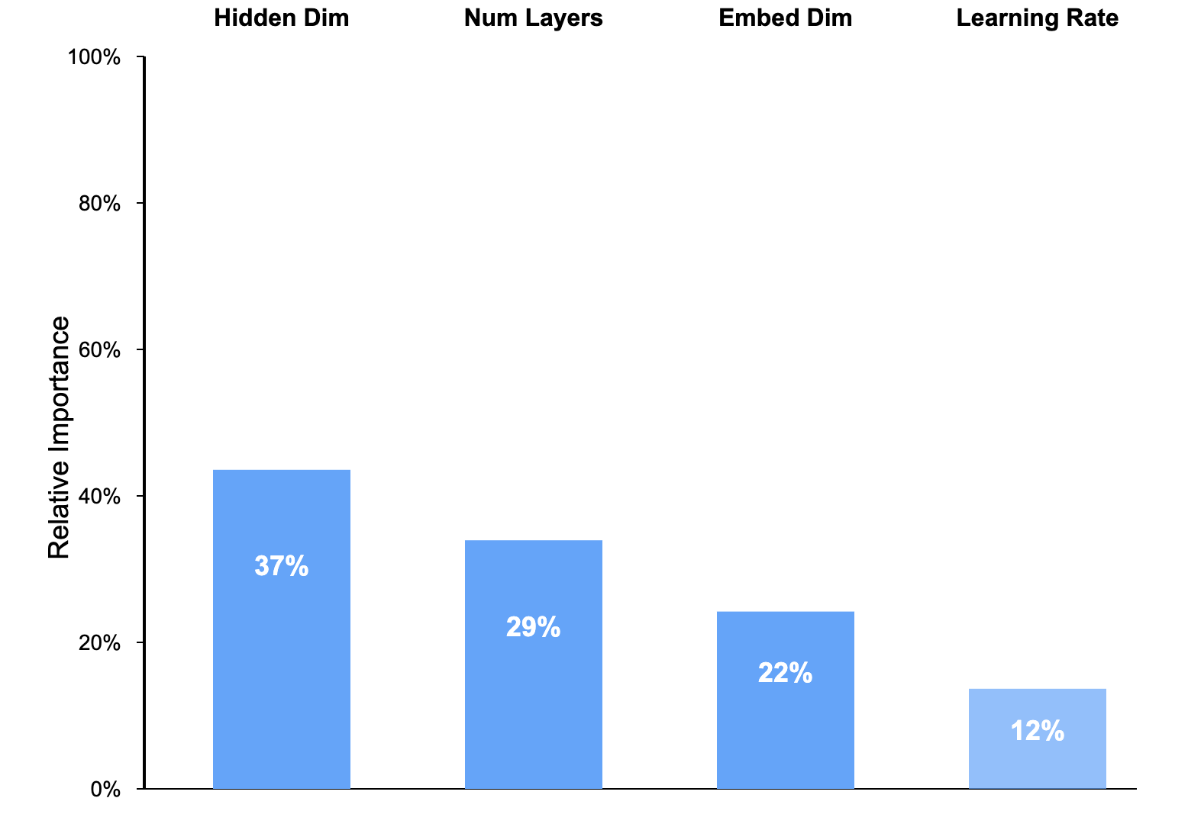
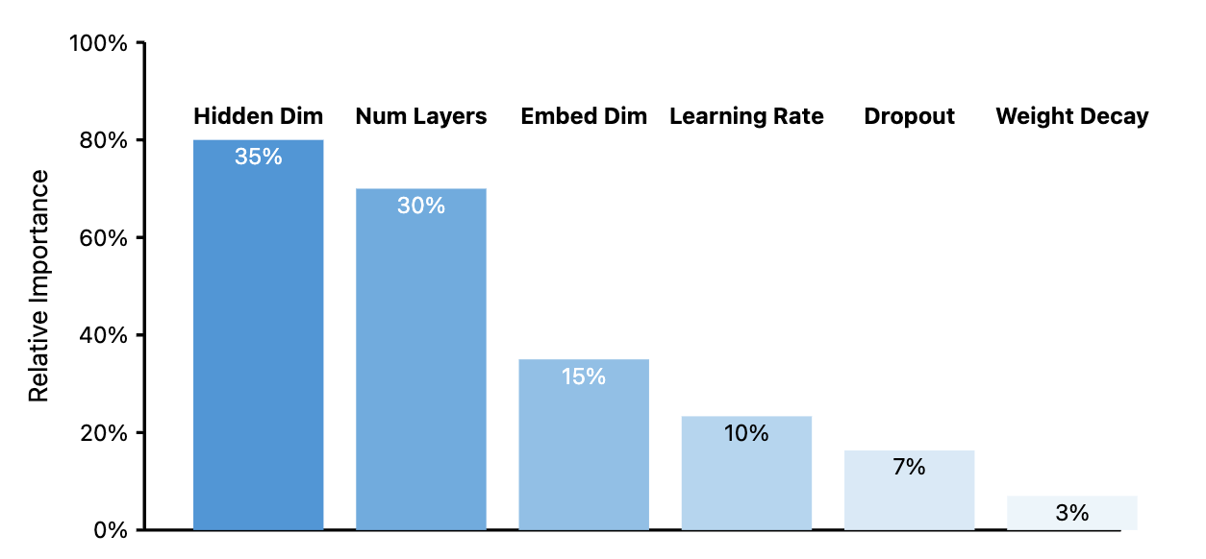
Hyperparameter optimization with Optuna
Hyperparameters relative importance GRU
What is Optuna?
A hyperparameter optimization framework for machine learning
Uses Bayesian optimization to efficiently search parameter space
Pruning capability to stop unpromising trials early
Parameters Optimized in Our Project:
Embedding dimensions: [ 256, 384, 512, 1024]
Hidden dimensions: [256, 512, 768, 1024]
Number of layers: 1-3
Dropout rates: 0.0-0.6
Learning rate: 1e-4 to 1e-2 (log scale)
Weight decay: 1e-6 to 1e-3 (L2 regularization)
Hyperparameters relative importance LSTM

Slide 18
Final Models Architectures
GRU:
Embedding layer: 512
Hidden states: 1024
Num of layers: 2
Dropout: 20%
Learning rate: 0.0001
Weight decay: ~9.4 e^-04
Total parameters: 11,352,791
LSTM:
Embedding layer: 512
Hidden states: 1024
Num of layers: 2
Dropout: 30%
Learning rate: ~0.012
Weight decay: ~2.6 e-05
Total parameters: 15,026,903

Slide 19
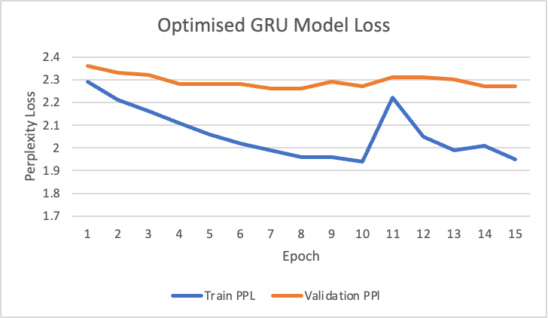
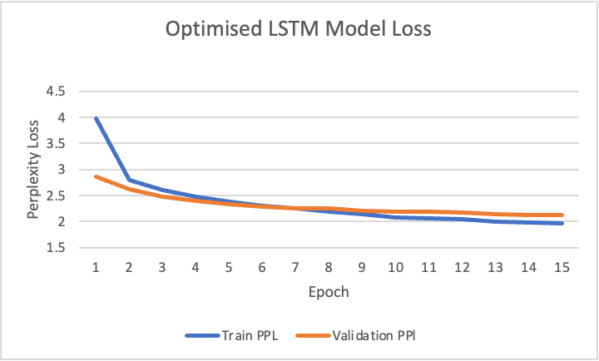
Final Evaluation: Model Performance
Test Perplexity Loss: 2.20
Test Perplexity Loss: 2.15

Slide 20
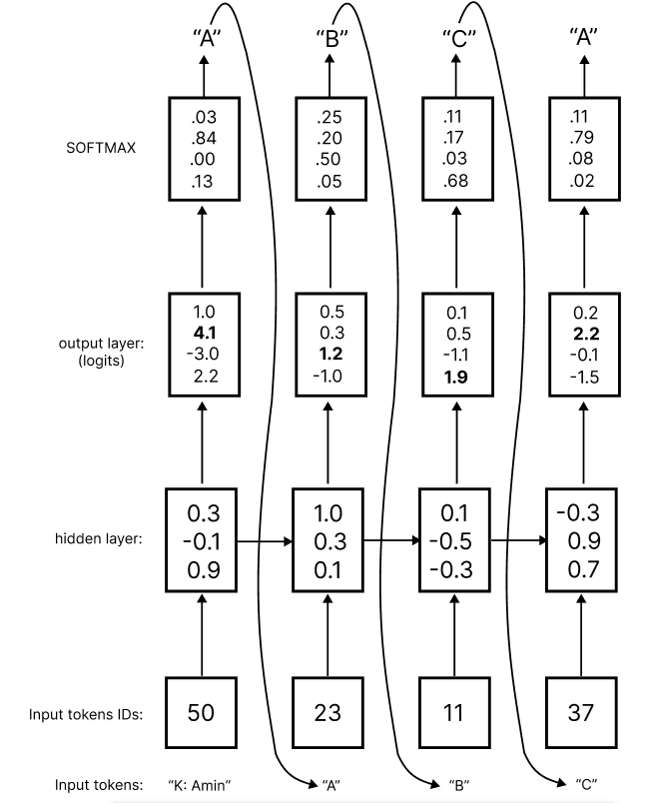
How does generating work?
At test time, generate new song: sample characters one at a time, and feed them back to the model!
Vocabulary: - [“K: Amin”, “A”, “B”, “C”]
Respective mapping from token to integer ID: - [ 50, 23, 11, 37 ]

Slide 21
How does sampling work?
But if we just use the highest softmax probability as the next prediction, we will generate the same song every time.
Instead, to get variety, we use top-p (nucleus) sampling

Slide 22
Top-p nucleus sampling
Sort tokens in softmax by probability
Accumulate (add) until the running total ≥ p (we used p=0.9)
Throw away the rest
Draw one at random from the fewest tokens that added to p

Slide 23
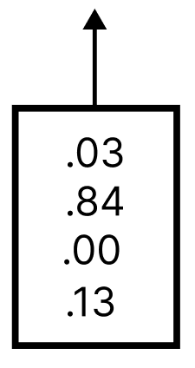
Top-p nucleus sampling example:
Vocabulary: [“K: Amin”, “A”, “B”, “C”]
Fewest tokens to get 0.9:
.84 + .13 = 0.97 >= 0.9
Therefore, we predict at random from “A” and “C”
SOFTMAX

Slide 24
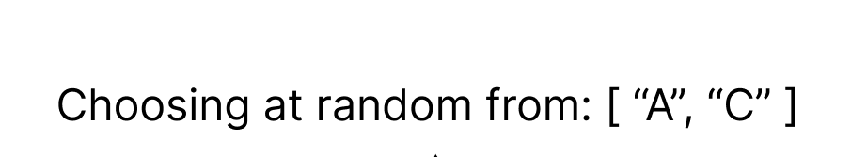
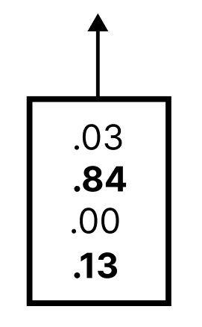
Top-p nucleus sampling example:
Vocabulary: [“K: Amin”, “A”, “B”, “C”]
Fewest tokens to get 0.9:
.84 + .13 = 0.97 >= 0.9
Therefore, we predict at random from “A” and “C”
SOFTMAX

Slide 25
Final Evaluation: Sample music
Interesting Samples

Slide 26
Conclusion
Learning Outcomes:
Custom tokenization approach was critical for handling music-specific notation, bulk of the time was spent here
Specialized handling of rare tokens improved model training as it reduced vocabulary size
LSTM and GRU performed similarly with GRU sampled music faster (3 secs vs 15 secs)
Optuna hyperparameter tuning significantly improved model performance
Future Work:
Incorporate attention mechanisms to better capture long-range dependencies
Implement Transformer architecture for comparison
Add conditioning on style, tempo, or mood for controlled generation
Develop better evaluation metrics for generated music quality
Create a user interface for interactive music generation

Slide 27
References
Narang, Rajnish. "Bayesian Optimization Concept Explained in Layman Terms." Medium, 9 Mar. 2021, medium.com/data-science/bayesian-optimization-concept-explained-in-layman-terms-1d2bcdeaf12f.
YouTube. "Lecture 12: Recurrent Networks." YouTube, uploaded by Michigan Online, www.youtube.com/watch?v=dUzLD91Sj-o&list=PL5-TkQAfAZFbzxjBHtzdVCWE0Zbhomg7r&index=13&t=3953s.
YouTube. "Gated Recurrent Units (GRU) Equations Explained." YouTube, uploaded by DataMlistic, www.youtube.com/watch?v=hkJNjxlEO-s&t=56s.
Jain, Abhishek. "All About GRU (Gated Recurrent Unit)." Medium, 12 Sept. 2022, medium.com/@abhishekjainindore24/all-about-gru-gated-recurring-unit-d8990b2724cf.
Maity, Suvankar. "RNN, LSTM, GRU — Why Do We Need Them?" LinkedIn, www.linkedin.com/pulse/rnn-lstm-gru-why-do-we-need-them-suvankar-maity-joegc/.

