Slide 1
Students Portal
I created a portal resembling ems that shall allow your system to automatically login and register students as soon as they input their credentials.
Note : This portal behaves phishing so students in trial mode should not keep their true credentials rather credentials that will make them login for the next time they are in testing mode.
-Student can register and login for the first time via : https://ifmstudent2024.000webhostapp.com/
For the next time they can login directly via : https://ifmstudent2024.000webhostapp.com/student/

Slide 2
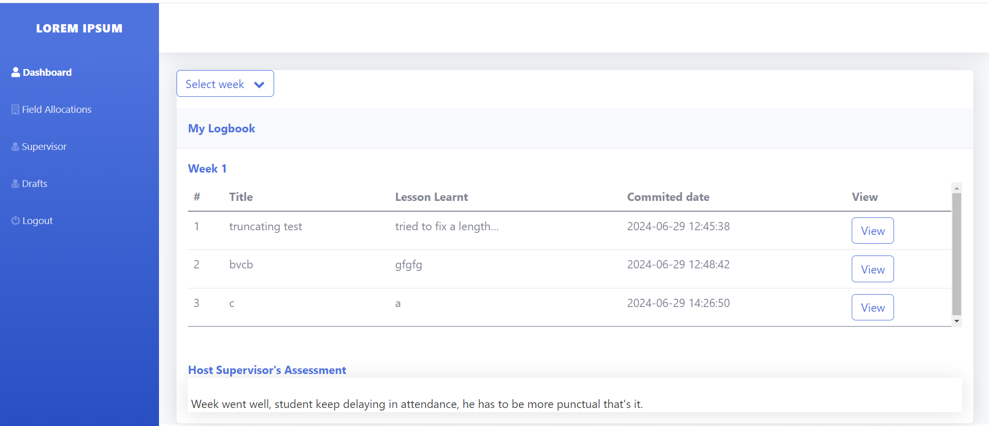
Students Portal
-NB: Student form for filling daily login will appear only when a student signs in into a specific organization and the sign in time is from 06:00am - 08:00am.

Slide 3
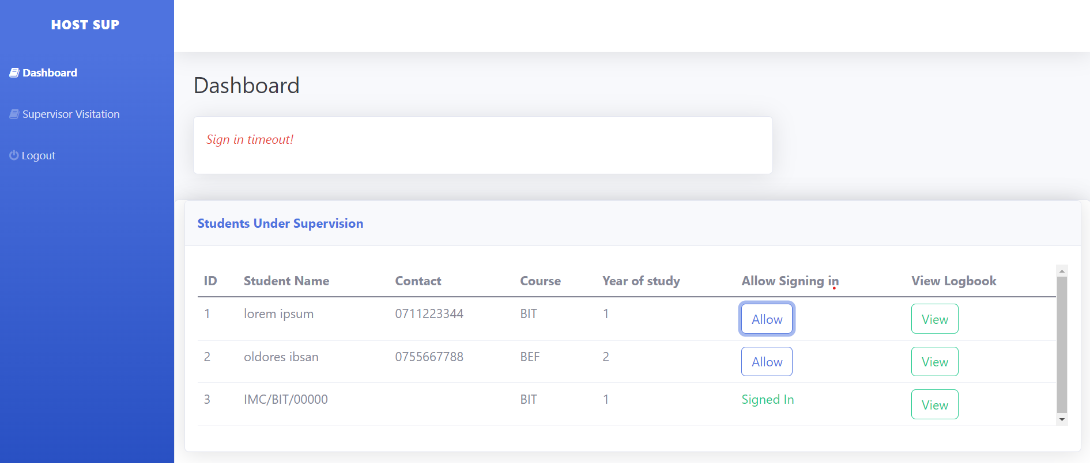
host supervisor’s Portal
Url : https://ifmstudent2024.000webhostapp.com/host/
Username : host
Password : host

Slide 4
visiting supervisor’s Portal
Url : https://ifmstudent2024.000webhostapp.com/visiting/
First visitor : Username : visitor ,Password : visitor
Second visitor : Username : visitor1,Password : visitor1

Slide 5
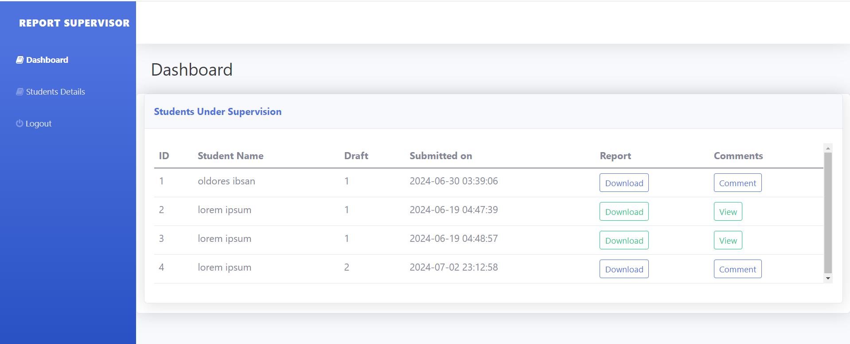
report supervisor’s Portal
Url : https://ifmstudent2024.000webhostapp.com/report/
Username : reporter
Password : reporter

Slide 6
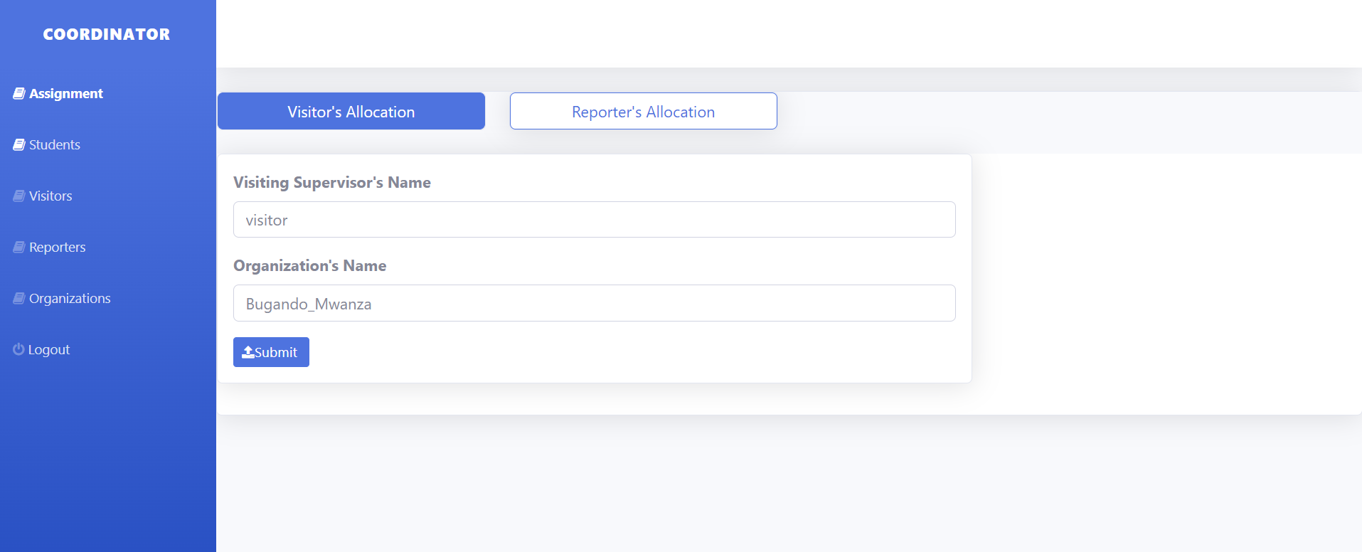
Field coordinator’s Portal
Url : https://ifmstudent2024.000webhostapp.com/coordinator/
Username : coordinator
Password : coordinator

