Slide 1


Introduction to MIPS ISA 32-bit Processor
This presentation explains the design and implementation of a 32-bit processor based on the MIPS Instruction Set Architecture (ISA)
The MIPS (Microprocessor without Interlocked Pipeline Stages) Instruction Set Architecture (ISA) is a widely used 32-bit processor design. It provides a simple and efficient instruction set for various computing applications.

Slide 2
Processor Architecture Overview
Datapath
Control Unit
Memory Interface
The datapath is responsible for executing instructions and performing arithmetic and logical operations.
The control unit manages the flow of instructions and coordinates the various components of the processor.
The memory interface allows the processor to read and write data to and from main memory.

Slide 3
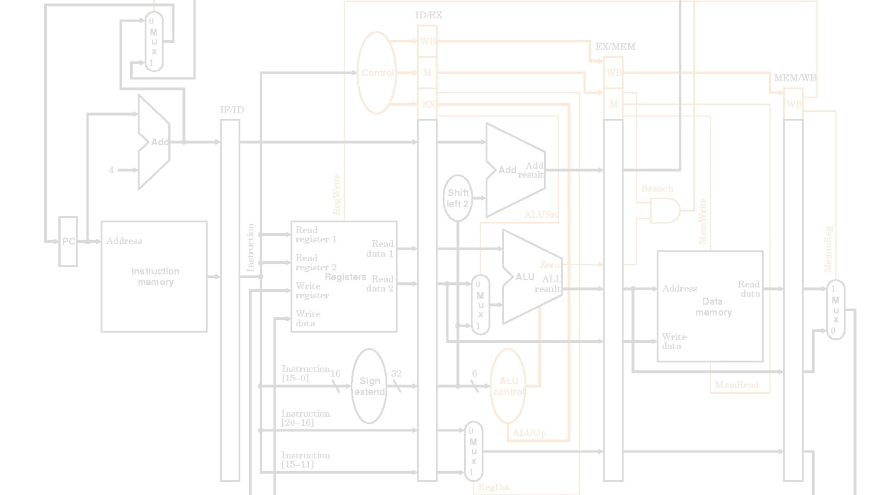
Instruction Fetch and Decode
Operand Fetch
Instruction Fetch
The required operands are fetched from the register file or memory, preparing for the execution stage.
The processor fetches instructions from memory and loads them into the instruction register.
1
2
3
Instruction Decode
The control unit decodes the instruction, determining the operation to be performed and the necessary operands.

Slide 4
Execution Unit Design
1
ALU
2
Branch Unit
The Arithmetic Logic Unit (ALU) performs arithmetic and logical operations on data.
The branch unit evaluates branch conditions and updates the Program Counter (PC) accordingly.
3
Memory Access
4
Register File
The memory access unit handles load and store operations, interfacing with the memory system.
The register file stores the processor's general-purpose registers, providing fast access to operands.

Slide 5
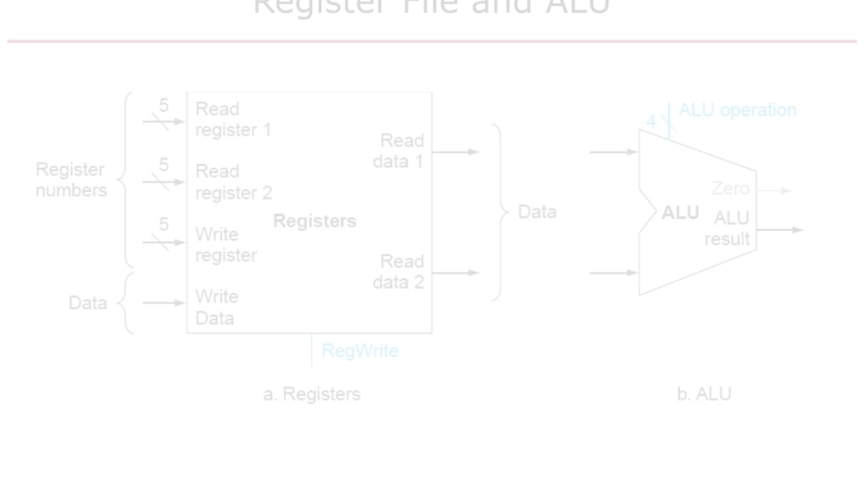
Register File and ALU
1
Register File
2
Arithmetic Logic Unit (ALU)
3
Operand Forwarding
The register file provides a set of high-speed storage locations for operands and results, enabling fast access during instruction execution.
The MIPS processor often employs operand forwarding to bypass the register file and directly provide data to the ALU, improving performance.
The ALU performs a variety of arithmetic and logical operations, such as addition, subtraction, bitwise logic, and comparison, to support the MIPS instruction set.

Slide 6




Explain all components
Central Processing Unit
Memory Subsystem
Input/Output
Bus System
The I/O system allows the processor to communicate with external devices and peripherals.
The bus system, including address, data, and control buses, facilitates communication between components.
The CPU is the heart of the MIPS processor, executing instructions and coordinating the flow of data.
The memory subsystem, including cache and main memory, provides storage for instructions and data.

Slide 7




Execution and Memory Access
Execution
The ALU (Arithmetic Logic Unit) performs the specified operation on the fetched operands.
Memory Access
For memory-related instructions, the processor accesses the appropriate memory location to read or write data.
Result Writeback
The final result is written back to the register file or memory, completing the instruction execution.

Slide 8
Register File and ALU
1
Register File
2
Arithmetic Logic Unit (ALU)
3
Operand Forwarding
The register file provides a set of high-speed storage locations for operands and results, enabling fast access during instruction execution.
The MIPS processor often employs operand forwarding to bypass the register file and directly provide data to the ALU, improving performance.
The ALU performs a variety of arithmetic and logical operations, such as addition, subtraction, bitwise logic, and comparison, to support the MIPS instruction set.

Slide 9



Timing and Control Signals
Clock Synchronization
Control Signals
Pipeline Stages
The processor's internal clock signals coordinate the timing of various components, ensuring synchronization and proper instruction execution.
Control signals manage the flow of data and the behavior of different processor components, enabling the execution of MIPS instructions.
The MIPS processor often utilizes a pipelined architecture, with distinct stages for instruction fetch, decode, execute, and memory access.

Slide 10
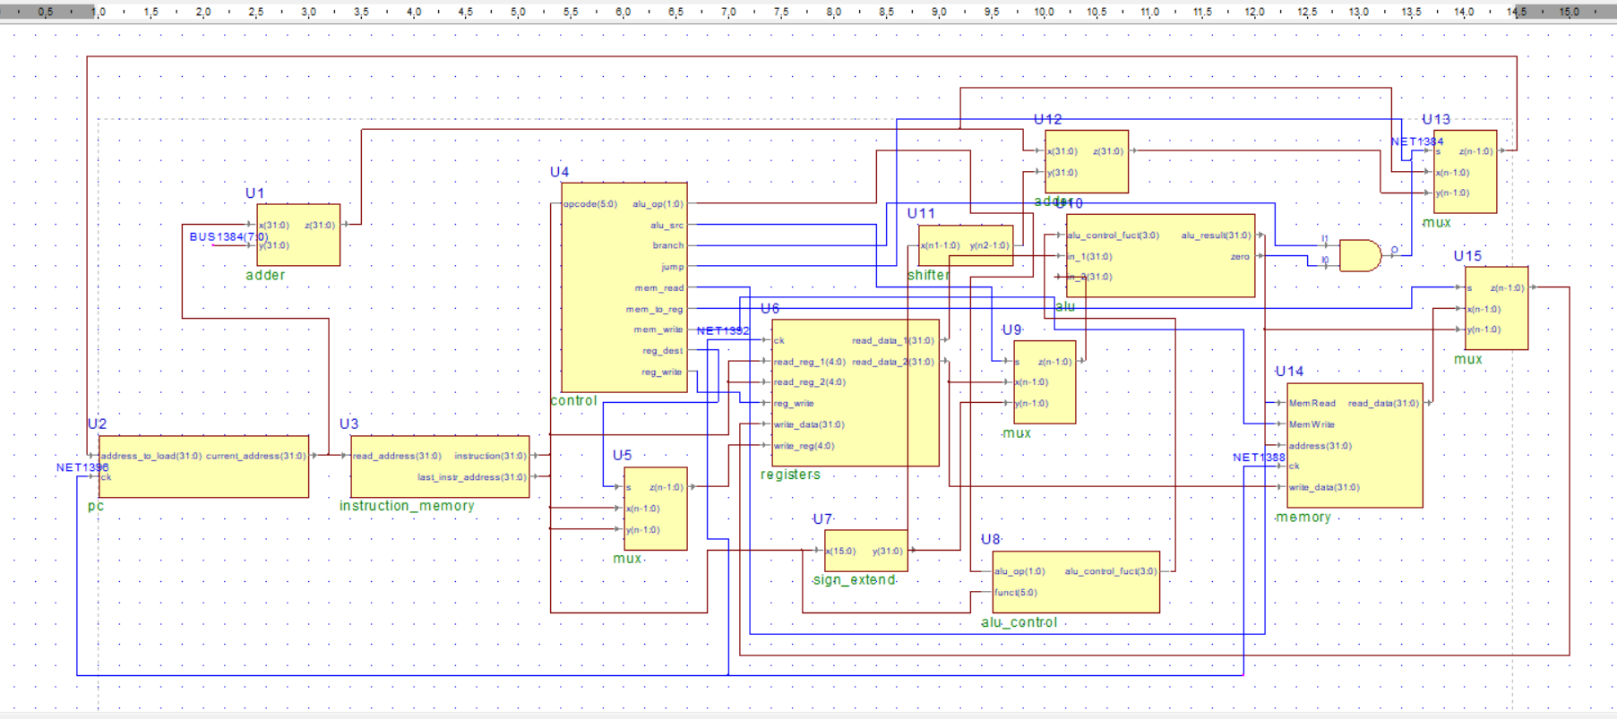
The Schematic diagram

Slide 11
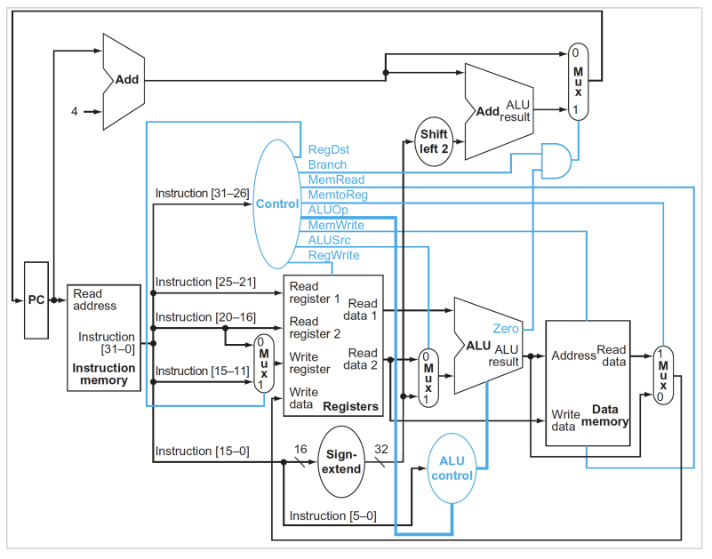

Slide 12
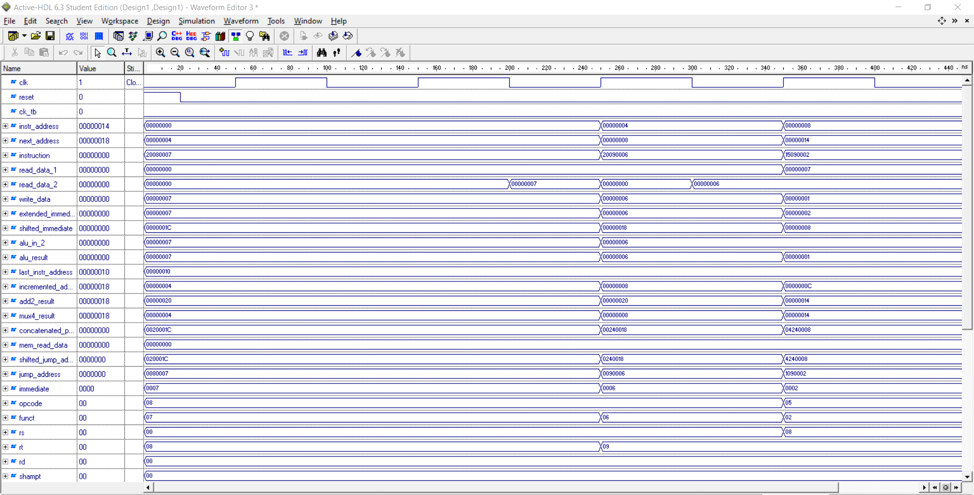
Simulate result

Slide 13
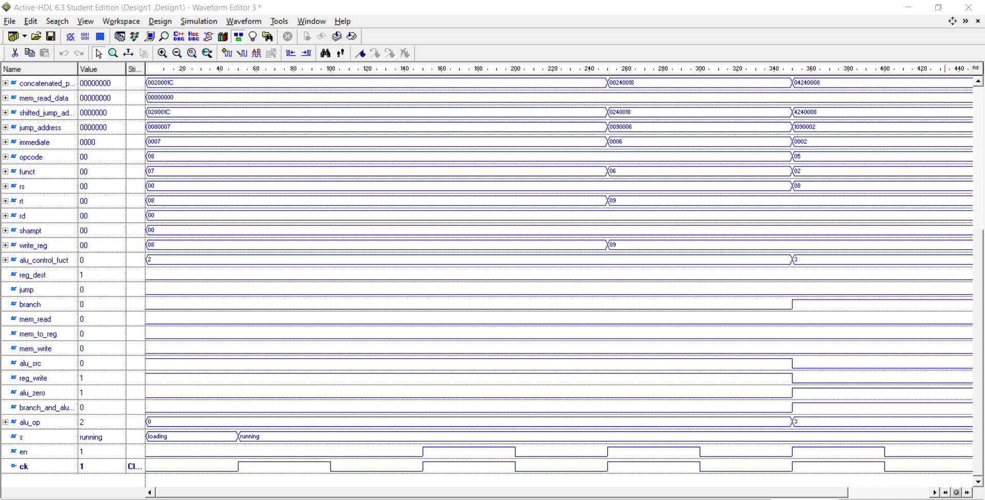

Slide 14



Conclusion and Future Enhancements
Scalability
Energy Efficiency
Compatibility
Expanding the processor's capabilities to handle more complex workloads and increased parallelism.
Developing power-efficient designs to meet the growing demand for mobile and embedded applications.
Maintaining backward compatibility while introducing new features to support evolving software requirements.
The MIPS ISA 32-bit processor provides a solid foundation for efficient computing. As technology advances, future enhancements will focus on improving scalability, energy efficiency, and compatibility to meet the evolving needs of the computing landscape.

Slide 15


