Slide 1
VideoGames Genre Prediction
Advanced data mining and machine learning
2019/2020
Cds: ARTIFICIAL INTELLIGENCE AND DATA ENGINEERING
STUDENT: MATILDE MAZZINI

Slide 2
Table of contents
Introduction
Multi-label or Multi-class?
Dataset
Data Preprocessing
Mining Process
Tests Summary
Application
Implementation

Slide 3
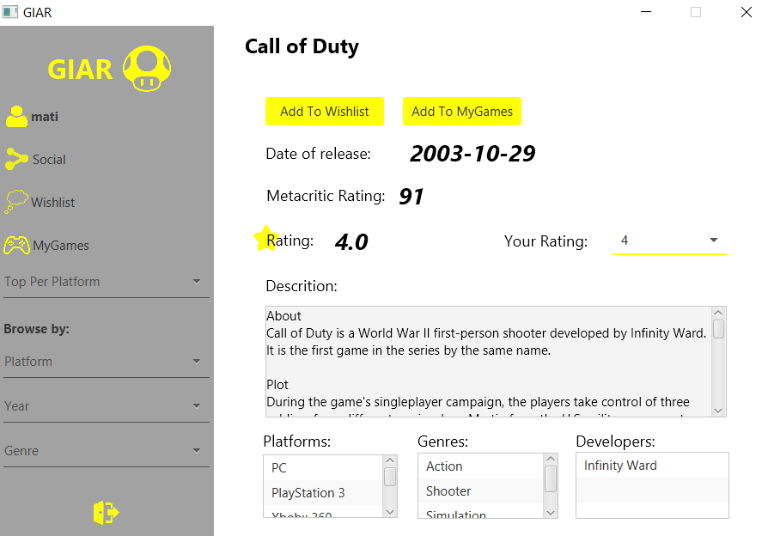
Introduction
The existing GIAR app

Slide 4
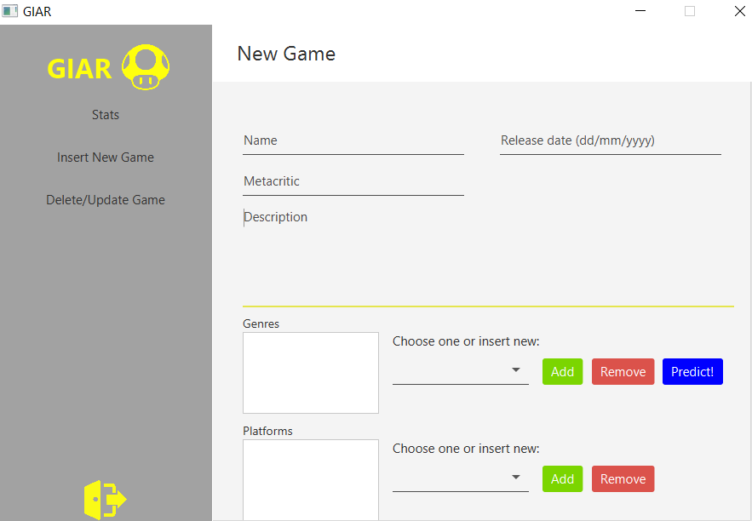
Introduction
Admin actions
Genre prediction

Slide 5
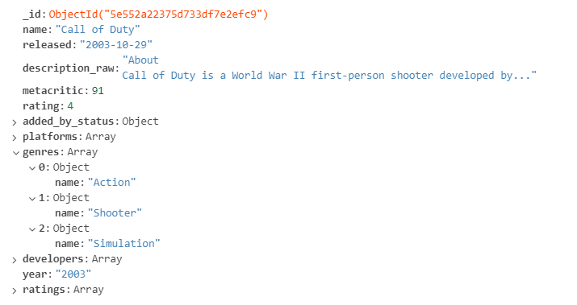
Giar Database Structure

Slide 6
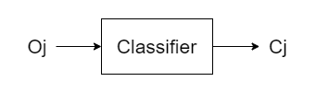
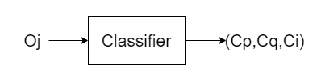
Multi-class or Multi-label?
MULTI-CLASS
MULTI-LABEL
Many class values c={c1,c2,...ck}
An object may belong to only one class. Oj -> Cj
Standard confusion matrix
Many class values c={c1,c2,...ck}
An object may belong to multiple class. Oj -> (Cj,Cp,Cq)

Slide 7
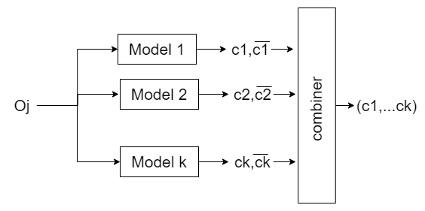
Possible Solution
Creating a 2-class classifier per each class like binary classifiers (recognize one class, discard others).
Use those models in parallel.

Slide 8
Dataset: Genre Distribution
Genre | Count | Percentage
Action | 20322 | 26%
Adventure | 15707 | 20%
RPG | 7493 | 10%
Simulation | 7943 | 10%
Strategy | 7263 | 9%
Puzzle | 7145 | 9%
Shooter | 3561 | 5%
Sports | 2665 | 3%
Racing | 2475 | 3%
BoardGames | 1484 | 2%
Fighting | 899 | 1%
Educational | 857 | 1%

Slide 9
Data Preprocessing
Retrieved only name, the description and the list of genres.
Name | Description | Genre
007 legends | Gamers and Bond aficionados alike will become James Bond, reliving the world-famous spy’s most iconic and intense undercover missions from throughout the entire Bond film franchise — including this year’s highly anticipated new installment, “SKYFALL” available as a free download on November 9, 2012. | ['Action', 'Shooter']
Records in which the genres list or the description were empty were removed.
Removed from the description: numbers, commas, links and words made by only two letters.
Records of games not written in English were removed.

Slide 10
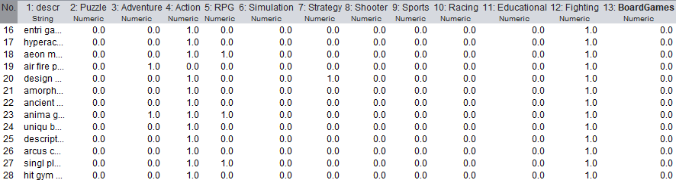
Data Preprocessing
New csv was created with a script in Python.
The new dataset substitutes the list of genres attribute with a vector of 0 and 1, each one corresponding to the different genres attributes.
Dimension of dataset: 2103 instances.
About 200 items per genre.

Slide 11
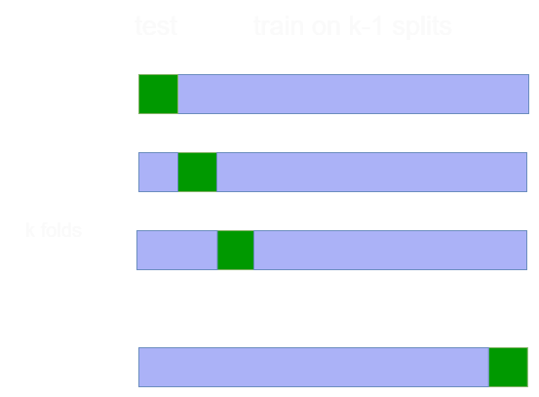
Mining Process: Cross validation
…
The overall dataset is divided in 10 fold of equal size to perform the cross validation.
For every fold a new training and test sets were defined.

Slide 12
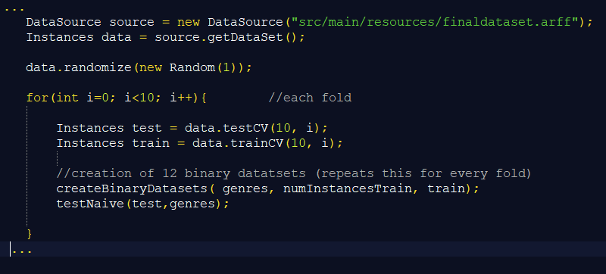
Code

Slide 13
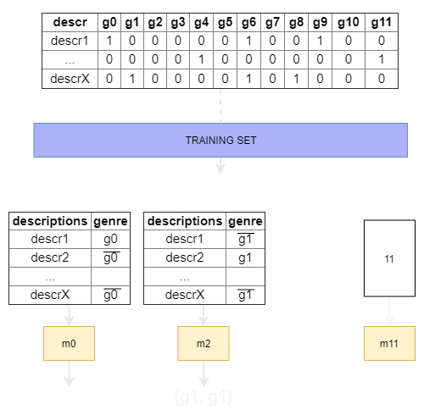

Mining Process: Train the classifiers
Binary Training sets
for genre i
…
Binary Classifiers
for genre i
…

Slide 14
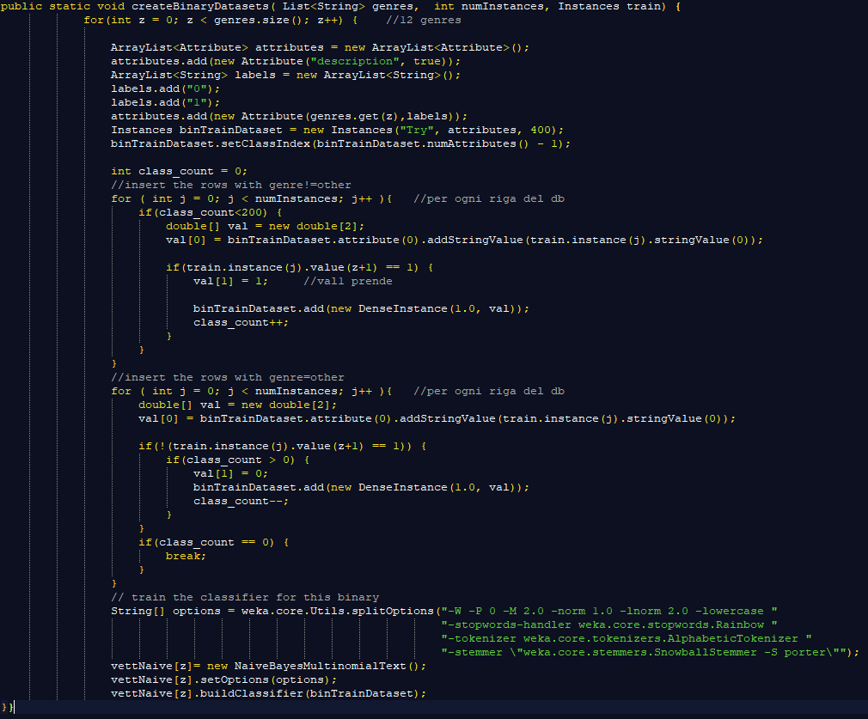
Code

Slide 15
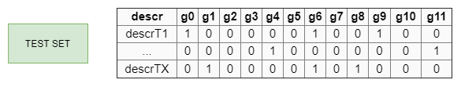
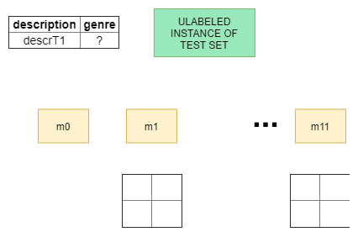
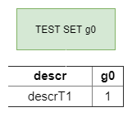
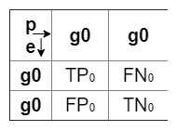
Mining Process: Test the classifiers
…
EXPECTED =? PREDICTED

Slide 16
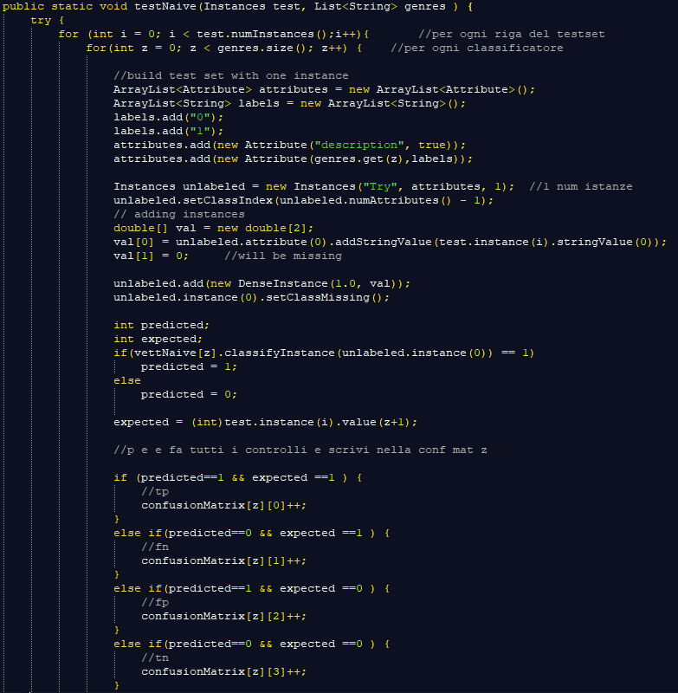
Code

Slide 17





Mining Process: Evaluate the classifiers
PrecisionAvg= $\frac{1}{12}$ ${\text{∑}}_{j=1}^{12} {precision}_{j}$
RecallAvg= $\frac{1}{12}$ ${\text{∑}}_{j=1}^{12} {recall}_{j}$
AccuracyAvg= $\frac{1}{12}$ ${\text{∑}}_{j=1}^{12} {accuracy}_{j}$
FMeasure= $\frac{2×precisionAvg×recallAvg}{precisionAvg+recallAvg}$
For each label j the metrics (eg. precision, recall) were computed from each confusion matrix and then aggregated.
Hence, compute the precision/recall for each label over the entire dataset, as for a binary classification, then aggregate it.
General formulas:
Precision = $\frac{TP}{TP+FP}$
Recall = $\frac{TP}{TP+FN}$
Accuracy = $\frac{TP+TN}{TP+FP+TN+FN}$
Fmeasure = $\frac{2×precision×recall}{precision+recall}$

Slide 18
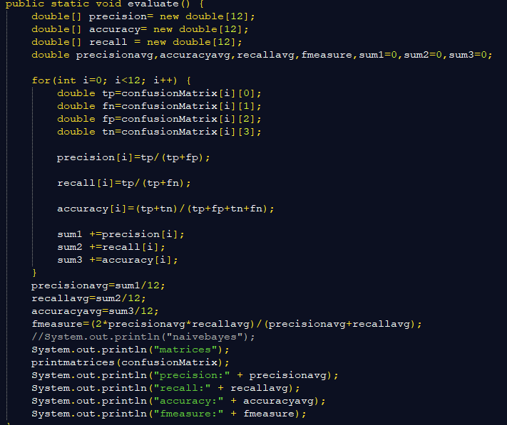
Code

Slide 19
Tests Summary
Classifiers | Accuracy | Recall | Precision | FMeasure
Naive Bayes Multinomial Text | 0.756 | 0.788 | 0.265 | 0.397
RandomForest | 0.706 | 0.744 | 0.224 | 0.345
SMO | 0.699 | 0.702 | 0.208 | 0.321

Slide 20
Application
In the Insert New Game page the admin:
Loads the description of the new game.
Presses the Predict! Button.
Sees the list of predicted genres in the ListView under the description box.
Can remove or add genres if needed.

Slide 21
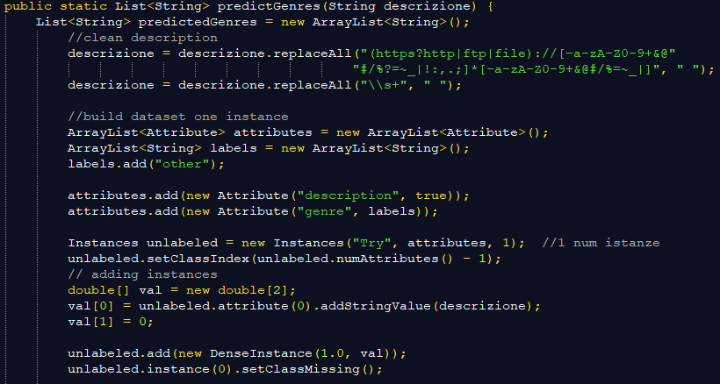
Implementation
The description is cleaned from links and commas.
The tokenization, stop-word removal and stemming are embedded in the classifier.
A new dataset with the description as single instance is created.
The attribute of the class is set to missing.

Slide 22
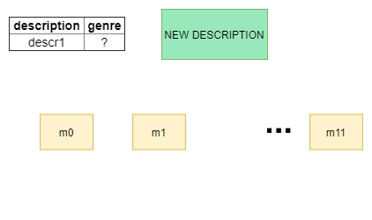
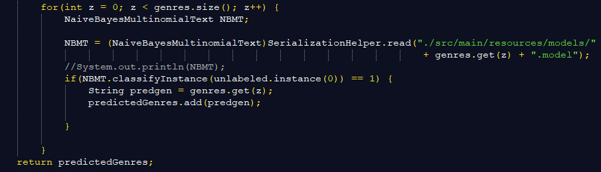
Implementation
The 12 models are loaded from file.
The dataset with the new description is classified by each classifier.
The positive outputs are loaded in the predictedGenres list.
…

Slide 23
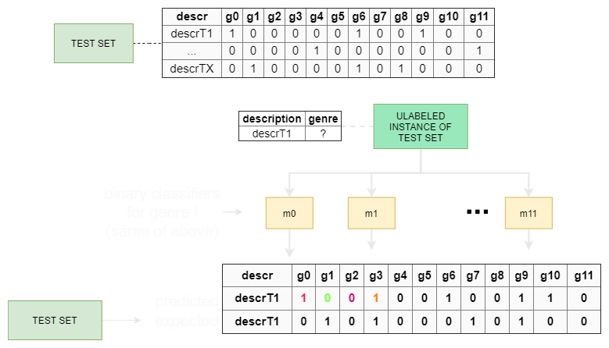
Test: Why not evaluating vector of results vs vector of results?
If we want to evaluate it as a single classifier with an unique matrix, we have to create a column and a row for every possible result from both predicted and expected results!
That would be an enormous matrix!!

Slide 24
Thank you!

