Slide 1

A Project Report on
News24x7
Submitted To:
HEMCHANDRACHARYA NORTH GUJARAT UNIVERSITY
For Partial Fulfillment towards the Award of Degree
Of
Submitted by:
Bachelor of Computer Applications (BCA)
September - 2025
Matin Abbassi (Roll No 45)
Pravin Kumar (Roll No 32)
Utkarsh (Roll No 28)
D.L. PATEL INSTITUTE OF MANAGEMENT & TECHNOLOGY BCA COLLEGEVIDHYANAGARI, HIMATNAGAR

Slide 2
Acknowledgement
We are thrilled to present our project titled "News24x7" as a part of our Bachelor of Computer Applications (BCA) curriculum. Its successful completion would not have been possible without the support and guidance of several individuals, to whom we would like to express our sincere gratitude.
First and foremost, we wish to express our profound gratitude to our project guide, MR SR Vandan Upadhyaya, Faculty of the Computer Science Department at D.L. Patel Institute of Management & Technology B.C.A. & M.C.A College, Vidhyanagar. Their unwavering support, invaluable guidance, and insightful feedback at every stage were instrumental in shaping this project. Their patience and motivation kept us on track, especially when we encountered challenges.

Slide 3
We are also thankful to our Head of Department, I/C Principle Prof. Dr. Vishal R. Trivedi, and the entire faculty and staff of the Computer Science department for providing us with the necessary resources and a conducive environment for learning and innovation.
Our heartfelt thanks go to our lab assistants and the college staff for their timely technical support during the development and testing phases of our project.
We are incredibly grateful for the seamless collaboration and relentless effort of our team members, Matin, Pravin & Utkarsh. Their dedication, hard work, and constructive discussions were the backbone of this project. It was a truly enriching experience to work together and combine our skills to achieve this goal.
Lastly, we would be remiss if we did not thank our families and friends for their constant encouragement, unwavering belief in our abilities, and for providing us with the moral support needed to complete this work.

Slide 4
Declaration
Project Overview
Project Title: News24x7 - Modern News Aggregation Platform
Technology Stack: Django, MySQL, HTML/CSS/JavaScript, Bootstrap, jQuery, slick slider, fancy box, chart s, Sun editor
Project Duration: 3 Months
Project Type: Web Application Development
Team Structure & Roles
Developed by: Matin
Content written by: Pravin
Documentation by: Utkarsh

Slide 5
Project Features
User Features
Login & Registration: To securely authenticate users, create a unique identity on the platform, and enable personalized experiences.
User Profile: To provide a centralized hub for users to manage their identity, preferences, and activity on the platform.
Bookmark: To allow users to save content for later consumption, creating a personalized reading list.
Follow & Like: Stay connected with your favorite topics and show your support.
Topics Following: Personalize your news feed by choosing the categories you care about most.
Comments on News: Share your opinions and join discussions with other readers.
Report News: Help improve the platform by reporting false or inappropriate content.
Language Options: Access news in Hindi and Gujarati for wider reach.

Slide 6
Admin & Staff Features
Admin Panel: To be the one and only control center for all administrative tasks.
WYSIWYG Editor: for Content Creation: To allow admins and staff to write and format news articles and pages easily, without needing to know any code.
Internal Messaging System (Admin & Staff Only): To provide a private channel for the website team to communicate and coordinate. Regular users cannot see or access these messages.
Comprehensive Statistics & Reporting: To make informed decisions by understanding how the website is performing.

Slide 7
Project Profile
Project Type: Web-based Application
Project Title: News24x7
Technology Used:
Technology Used
Frontend
Backen
HTML
CSS
JavaScript
Bootstrap
jQuery
slick slider
Fancy box
chart JS
Python
Django,
Django REST framework
python weather
Google trans
django-background-tasks

Slide 8
Database: MySQL team members roles
The project “News24x4” is an online news portal designed to deliver real time news and information to users in a simple, effective, and interactive way. It enables readers to explore news articles across various categories such as politics, sports, entertainment, technology, and world news.
The system provides features such as bookmarking articles, following updates, and adding comments, which enhance user engagement. Admins can easily upload, edit, and manage content, ensuring the website remains dynamic and up to date.

Slide 9
Objectives of the Project:
To design a reliable and user-friendly online news platform.
To allow users to access news articles anytime, anywhere.
To implement interactive features like bookmarking, commenting, and following.
To ensure secure user authentication and data management.
To provide an efficient backend system for managing content dynamically.

Slide 10
Scope of the Project:
The project has been developed for educational purposes, but it can be expanded into a fully functional commercial news portal. With additional features like live notifications, multimedia content, and AI-driven recommendations, the platform can cater to a large user base in the future.
Thus, the “News24x4” project provides both information access and interactivity, combining technology and usability to create an effective news delivery platform.

Slide 11
System Analysis
Existing System
In the existing news websites or portals, most systems provide static content with limited interactivity. Users can only read the news but have minimal options to engage or customize the content. Many platforms also lack efficient content management and user-friendly navigation.
Limitations of Existing System:
Content updates are often manual and delayed.
No options for bookmarking or following favorite news categories.
Commenting and interactive features are limited or absent.
Websites may not be fully responsive across devices.
Lack of real-time notifications or alerts

Slide 12
Proposed System
The proposed system, “News24x7”, is a dynamic and interactive news portal that aims to improve user experience and content management. Users can register, bookmark articles, follow topics, and comment on news posts. Administrators can easily manage news content, categories, and user interactions through a secure backend system.
Features of Proposed System:
Dynamic news content management using Django framework.
User registration and secure login system.
Bookmarking, following, and commenting functionality.
Responsive design for desktop and mobile devices.
Real-time content updates and notifications.

Slide 13
Hardware Requirements
Processor: A modern dual-core or quad-core processor is generally sufficient.
RAM: 4GB to 8GB of RAM is typically adequate for a smooth development experience, especially when running a local development server and potentially other tools like a text editor or IDE.
Storage: A solid-state drive (SSD) is highly recommended for faster boot times and application loading, even a modest 256GB SSD would be fine.
Operating System: Django runs on Windows, macOS, and various Linux distributions.

Slide 14
System Design

Slide 15
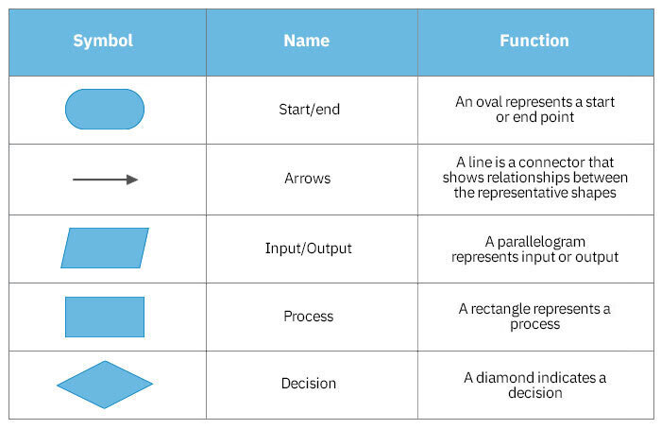
Flow Chart

Slide 16
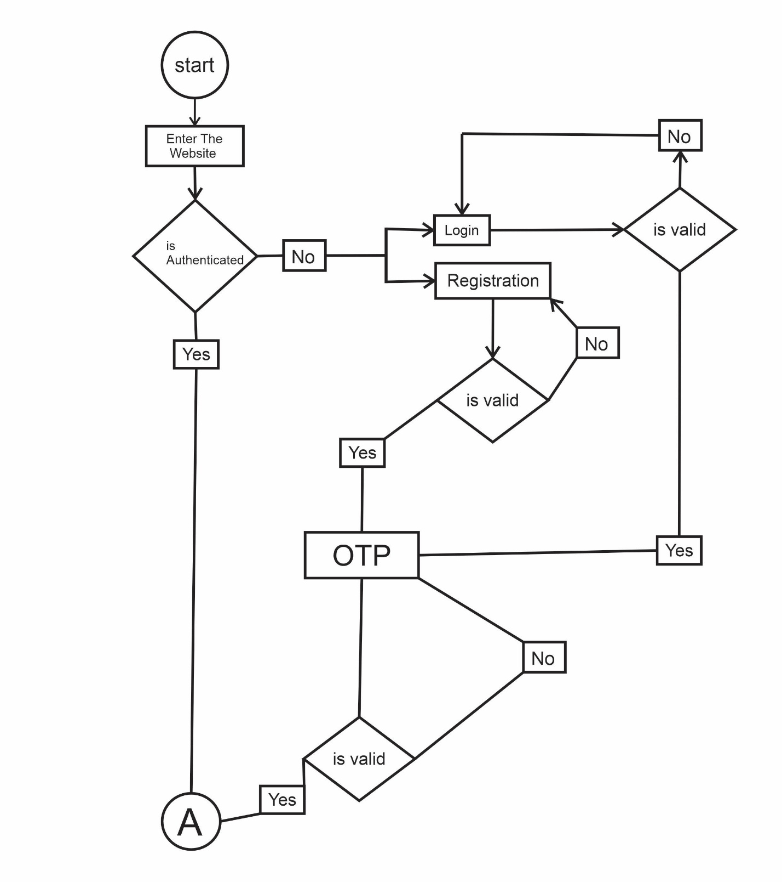

Slide 17
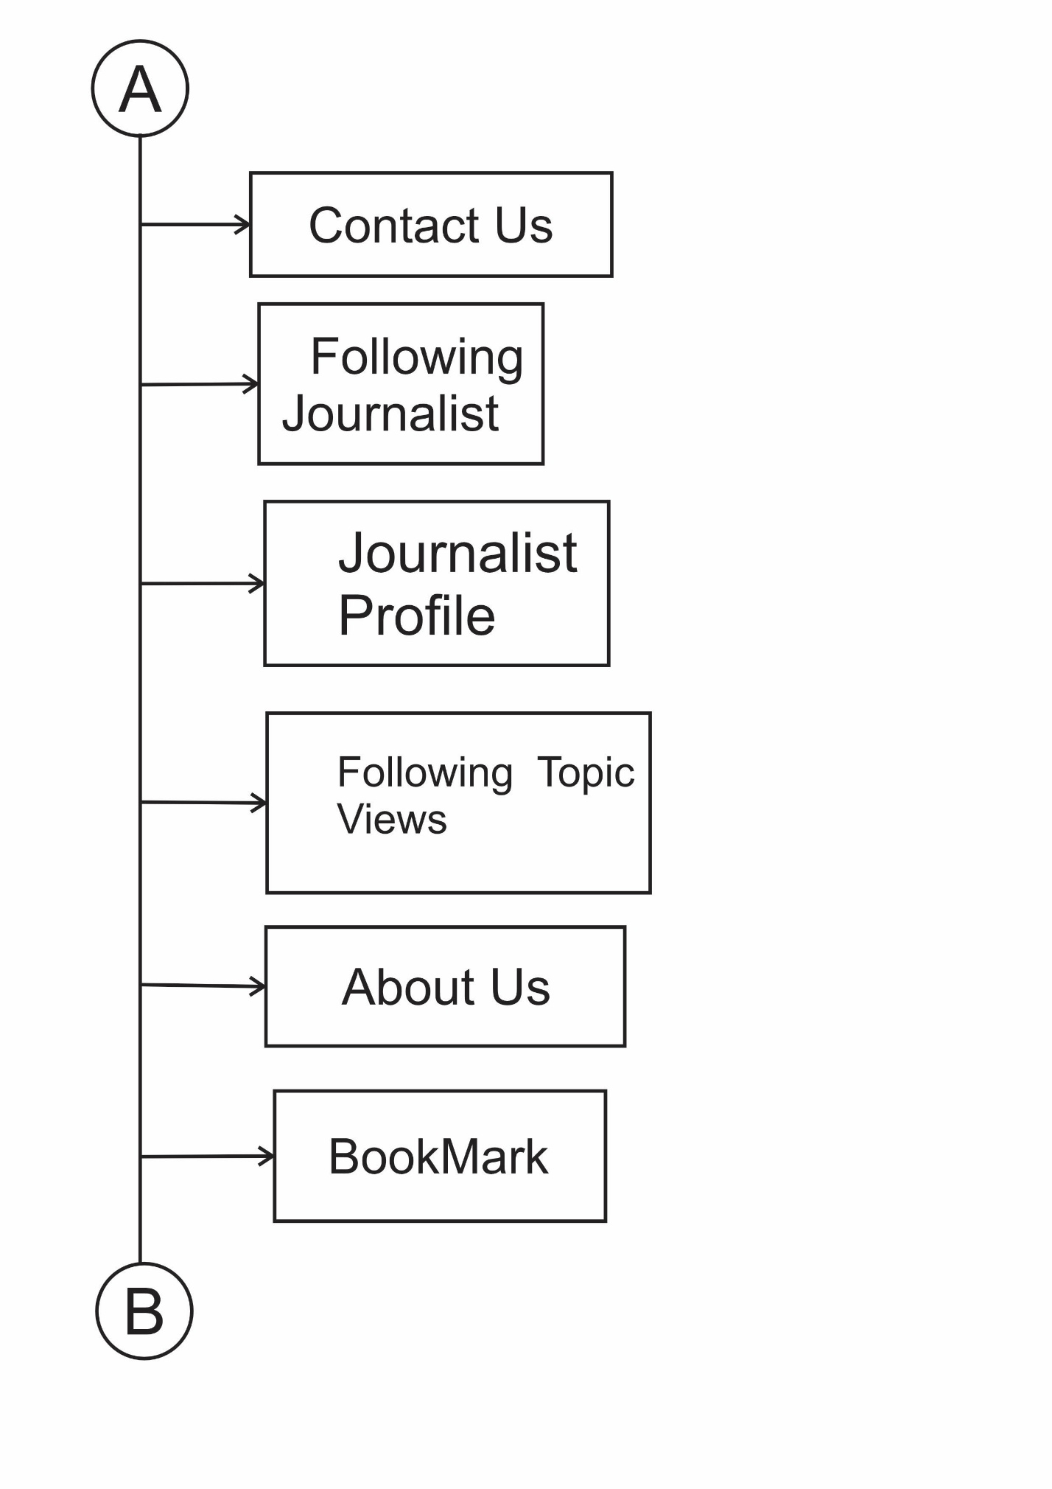

Slide 18
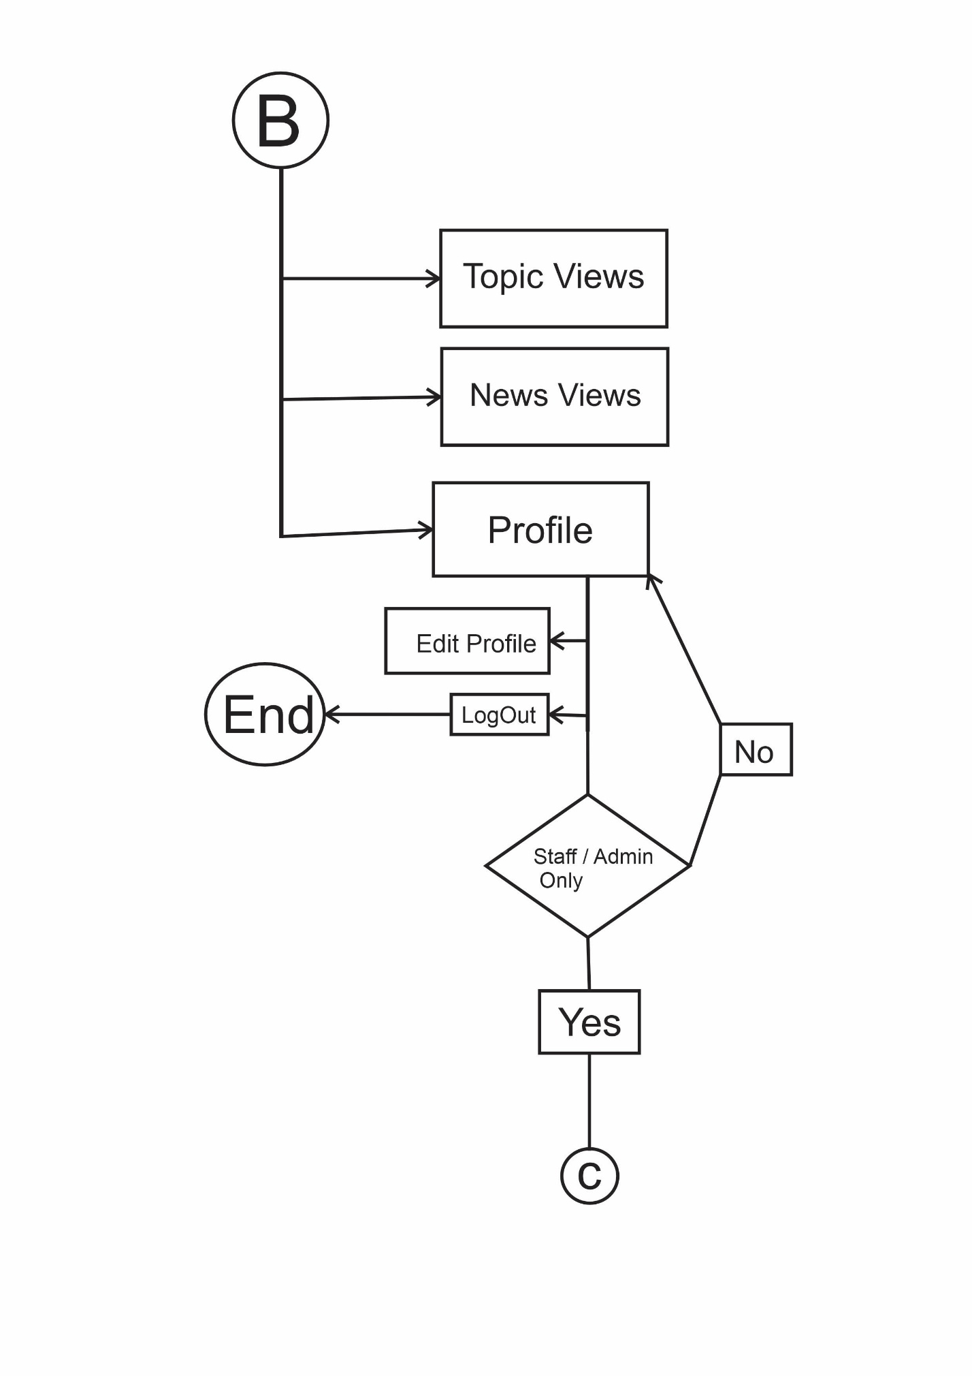

Slide 19
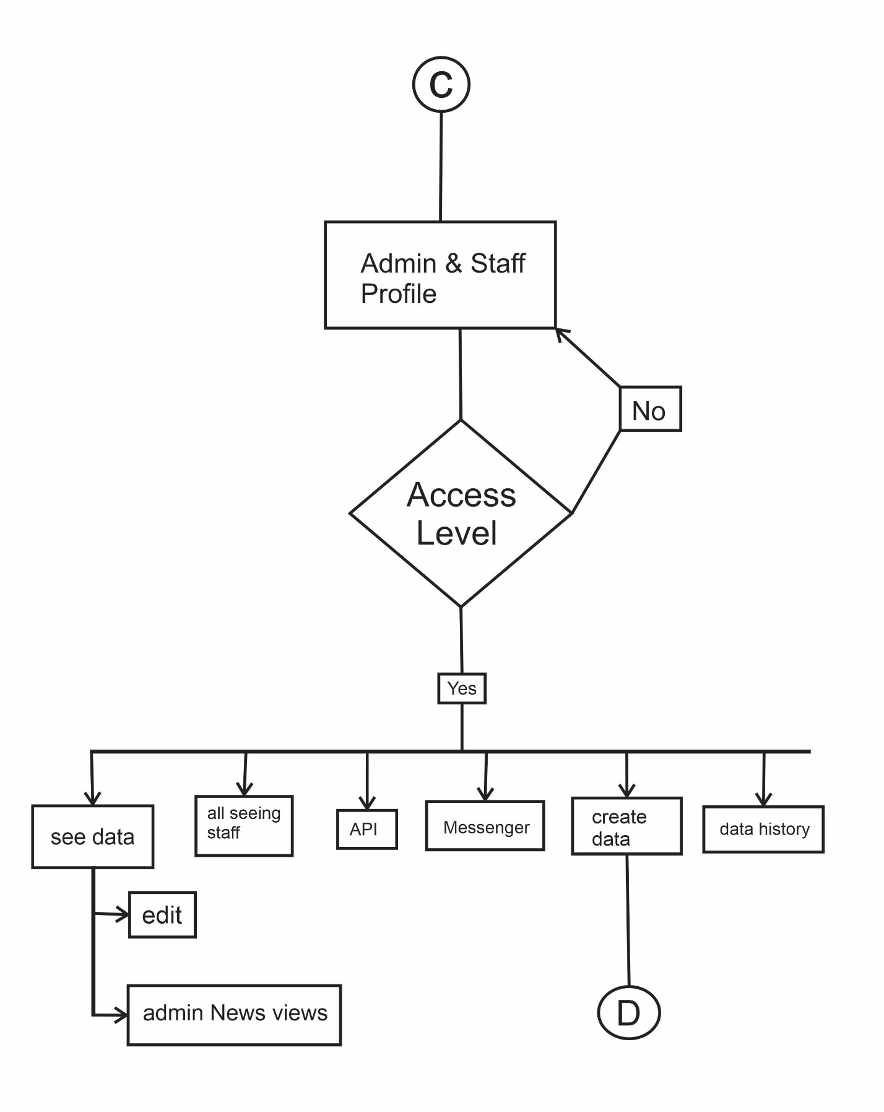

Slide 20
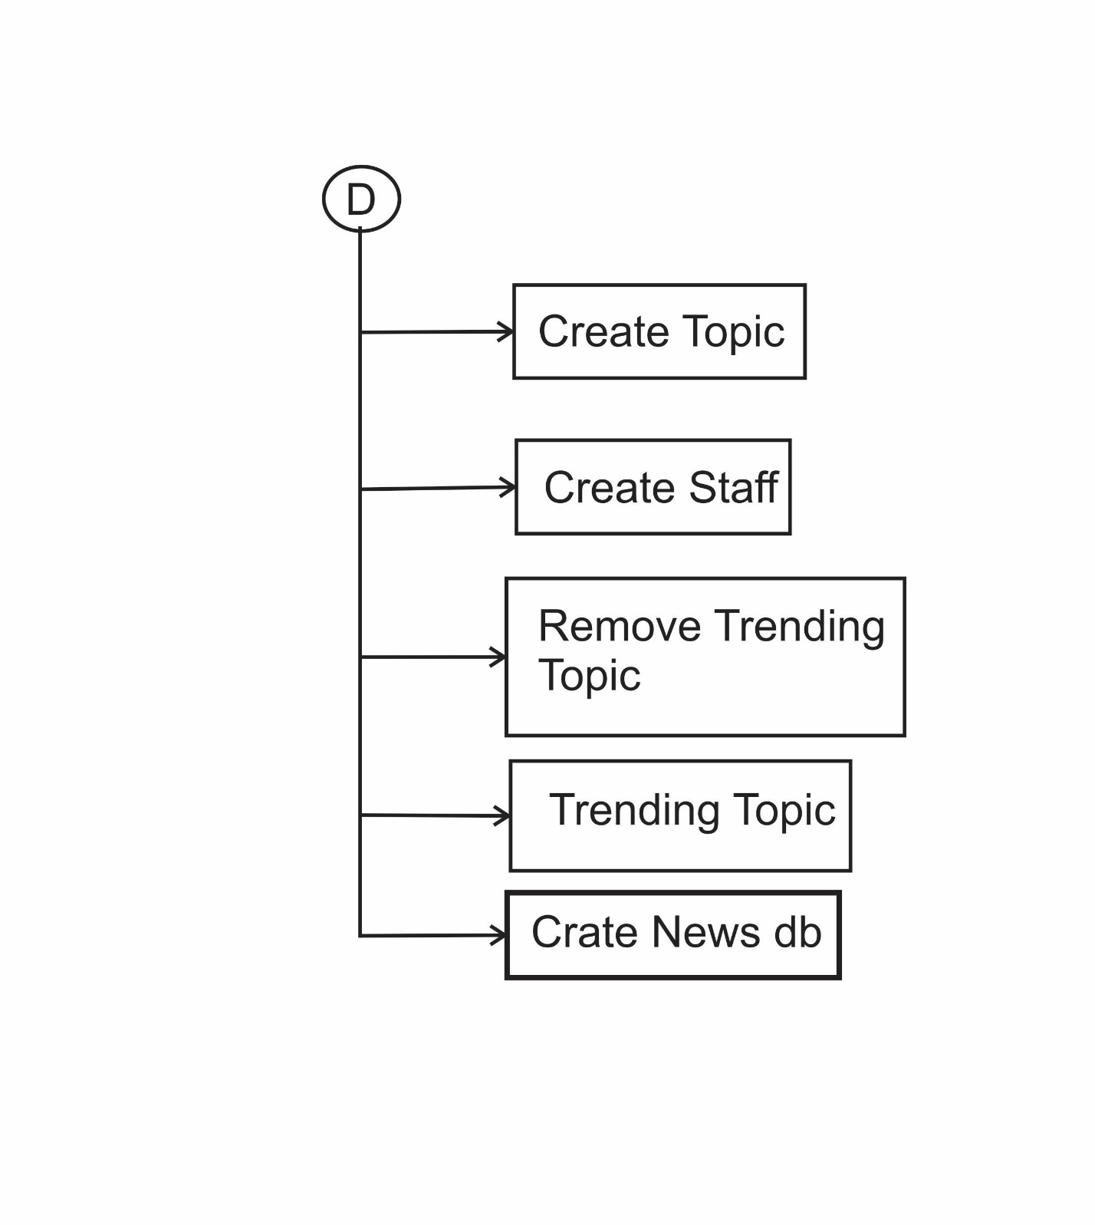

Slide 21
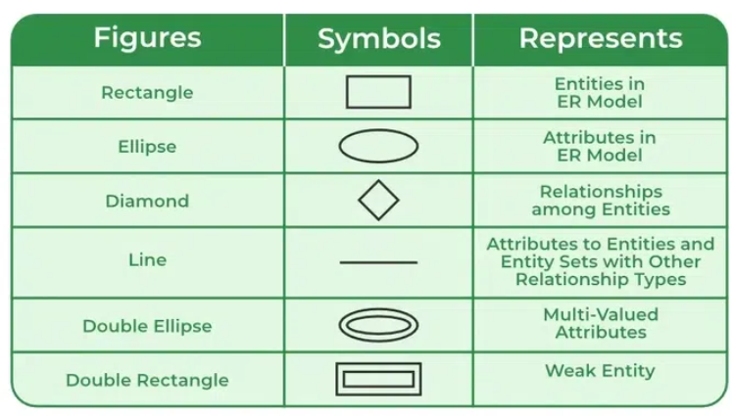
E-R DIAGRAM

Slide 22
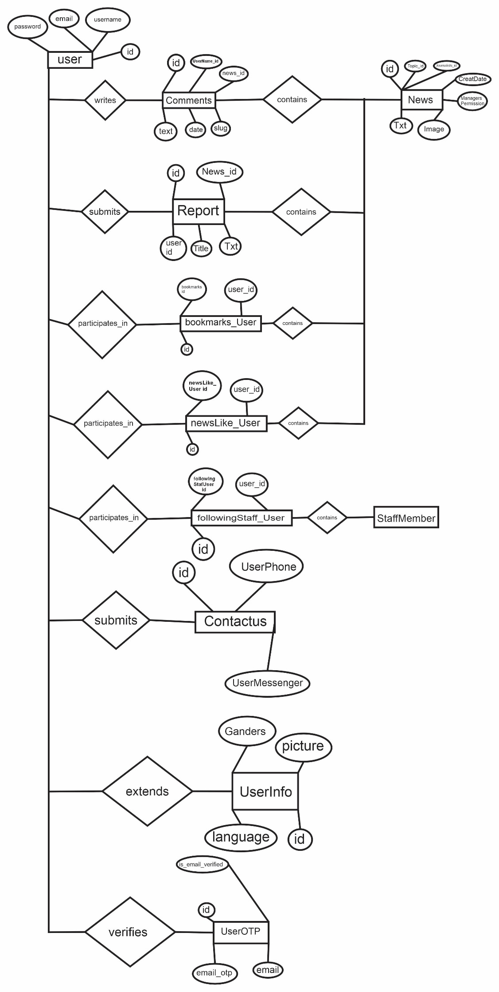

Slide 23
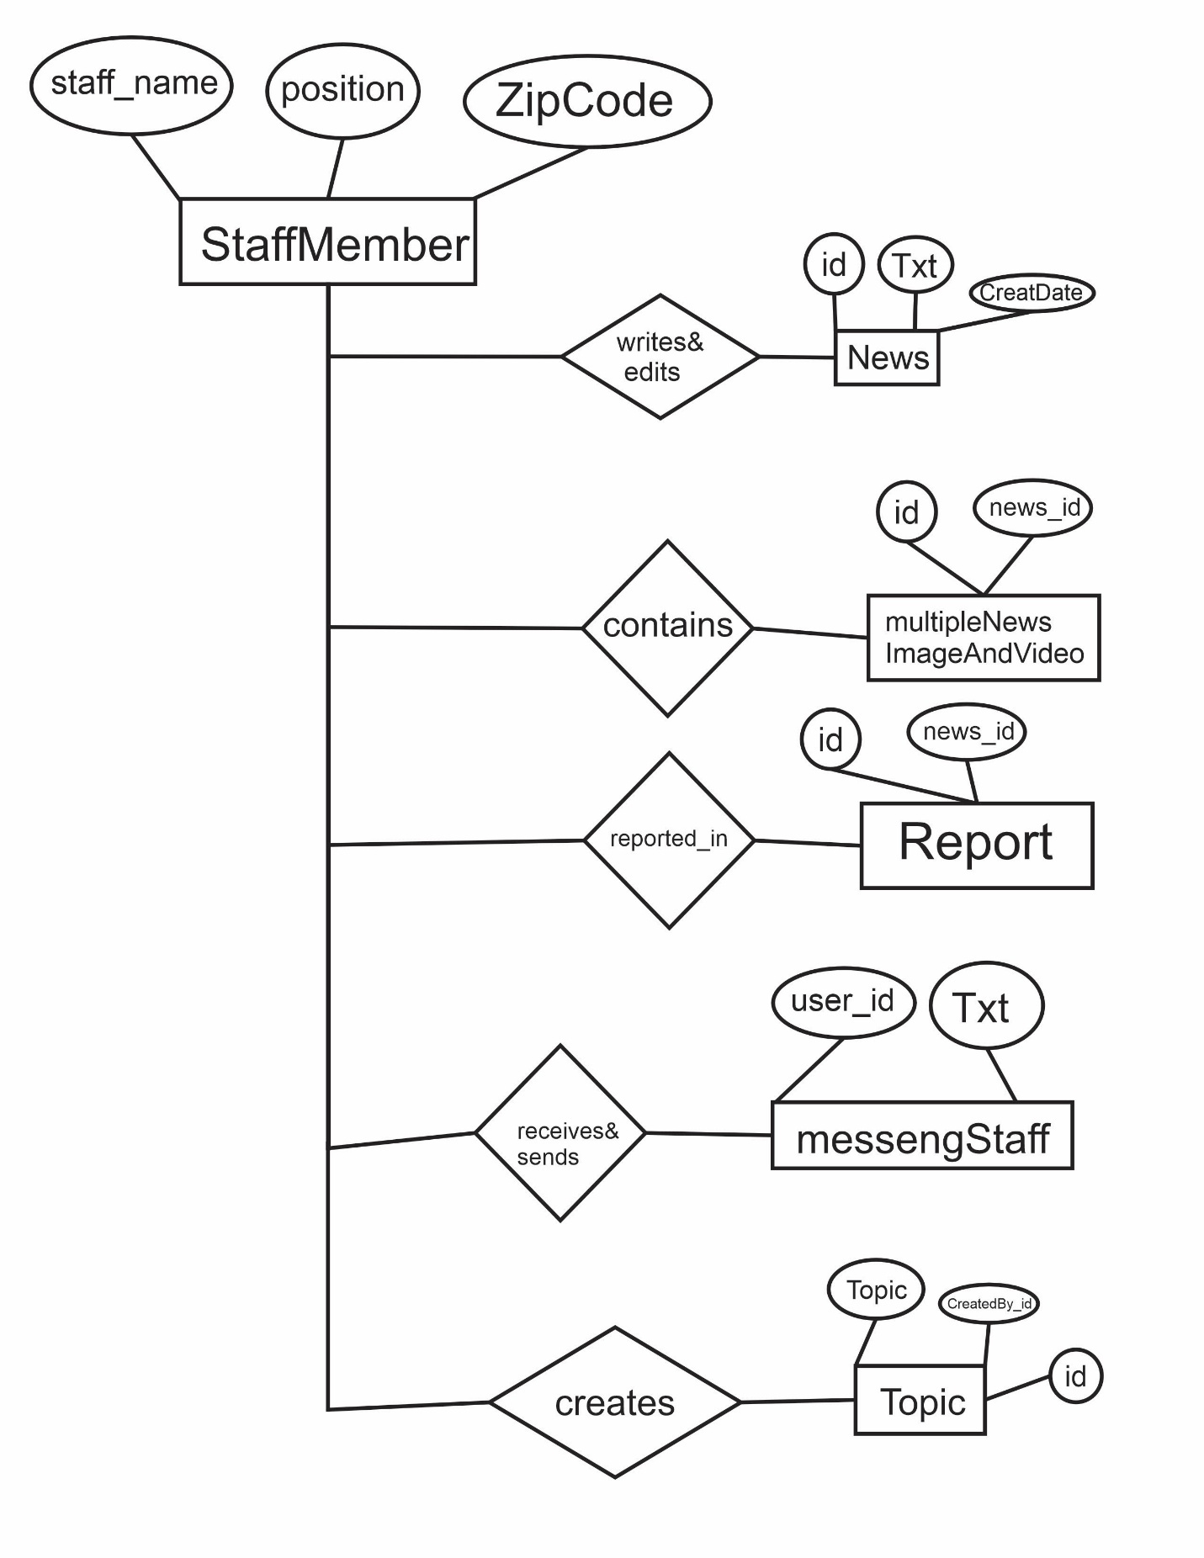

Slide 24
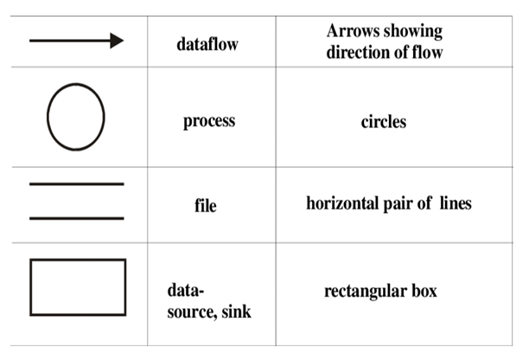
Data Flow Diagram

Slide 25
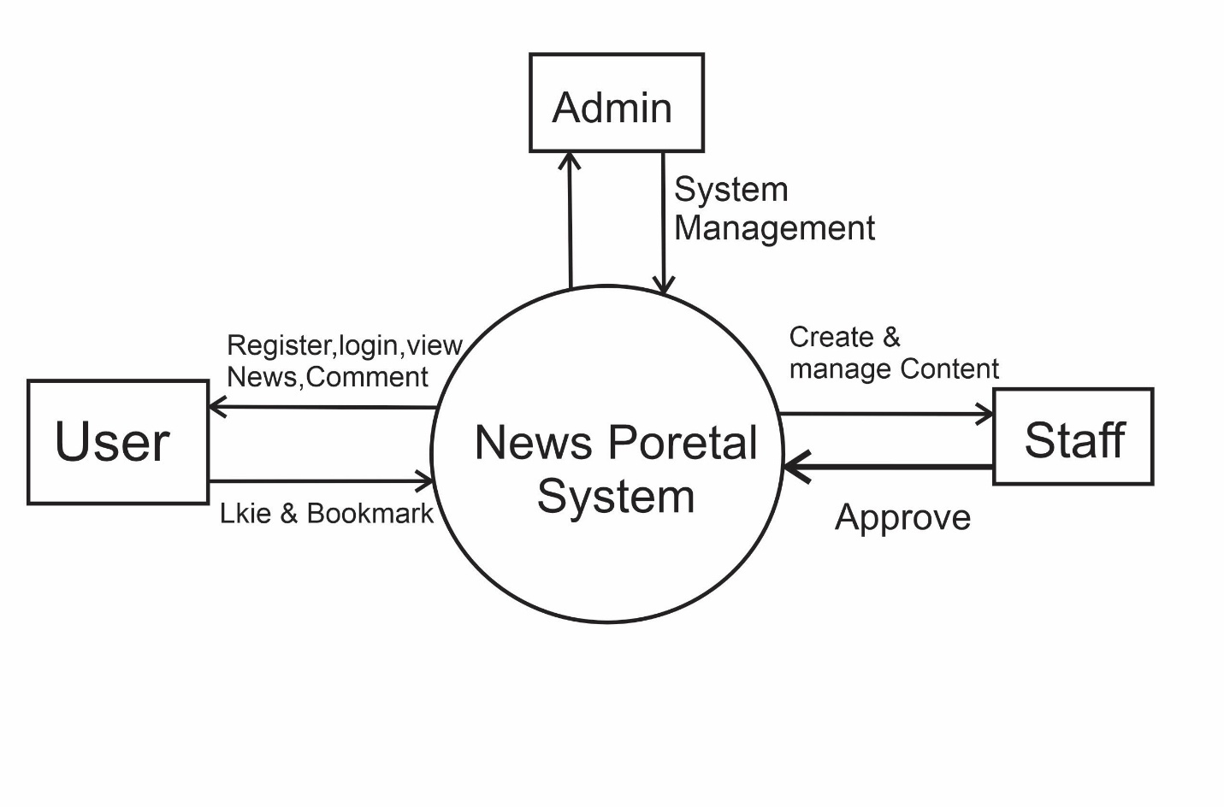
DFD LEVEL 0

Slide 26
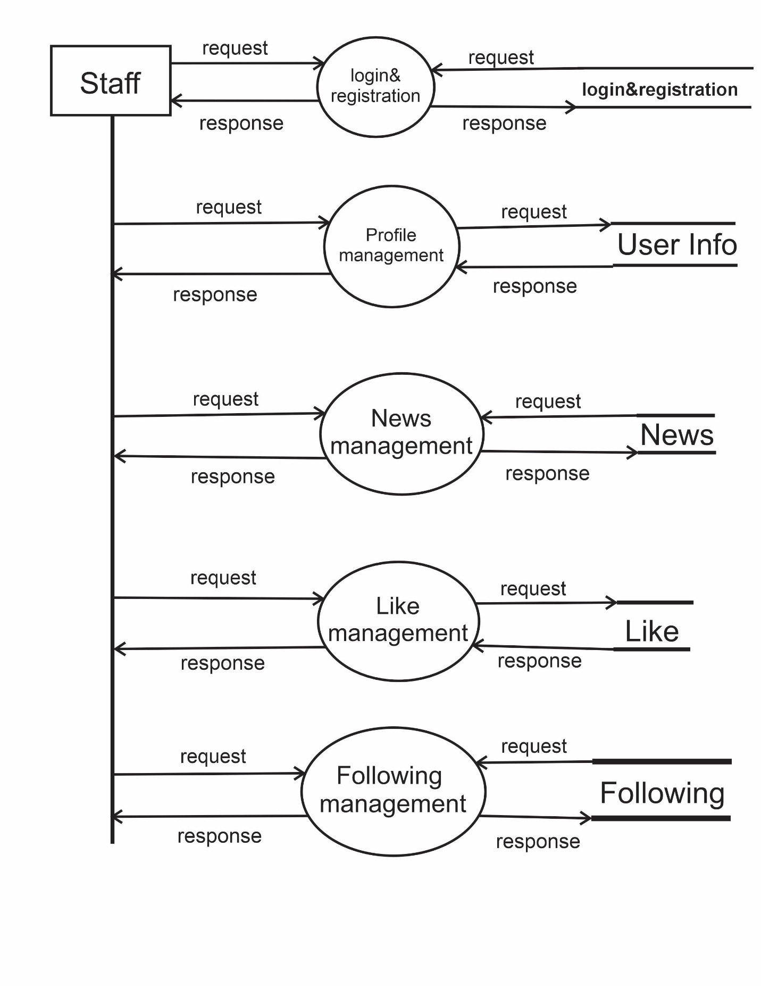
DFD LEVEL 1
user

Slide 27
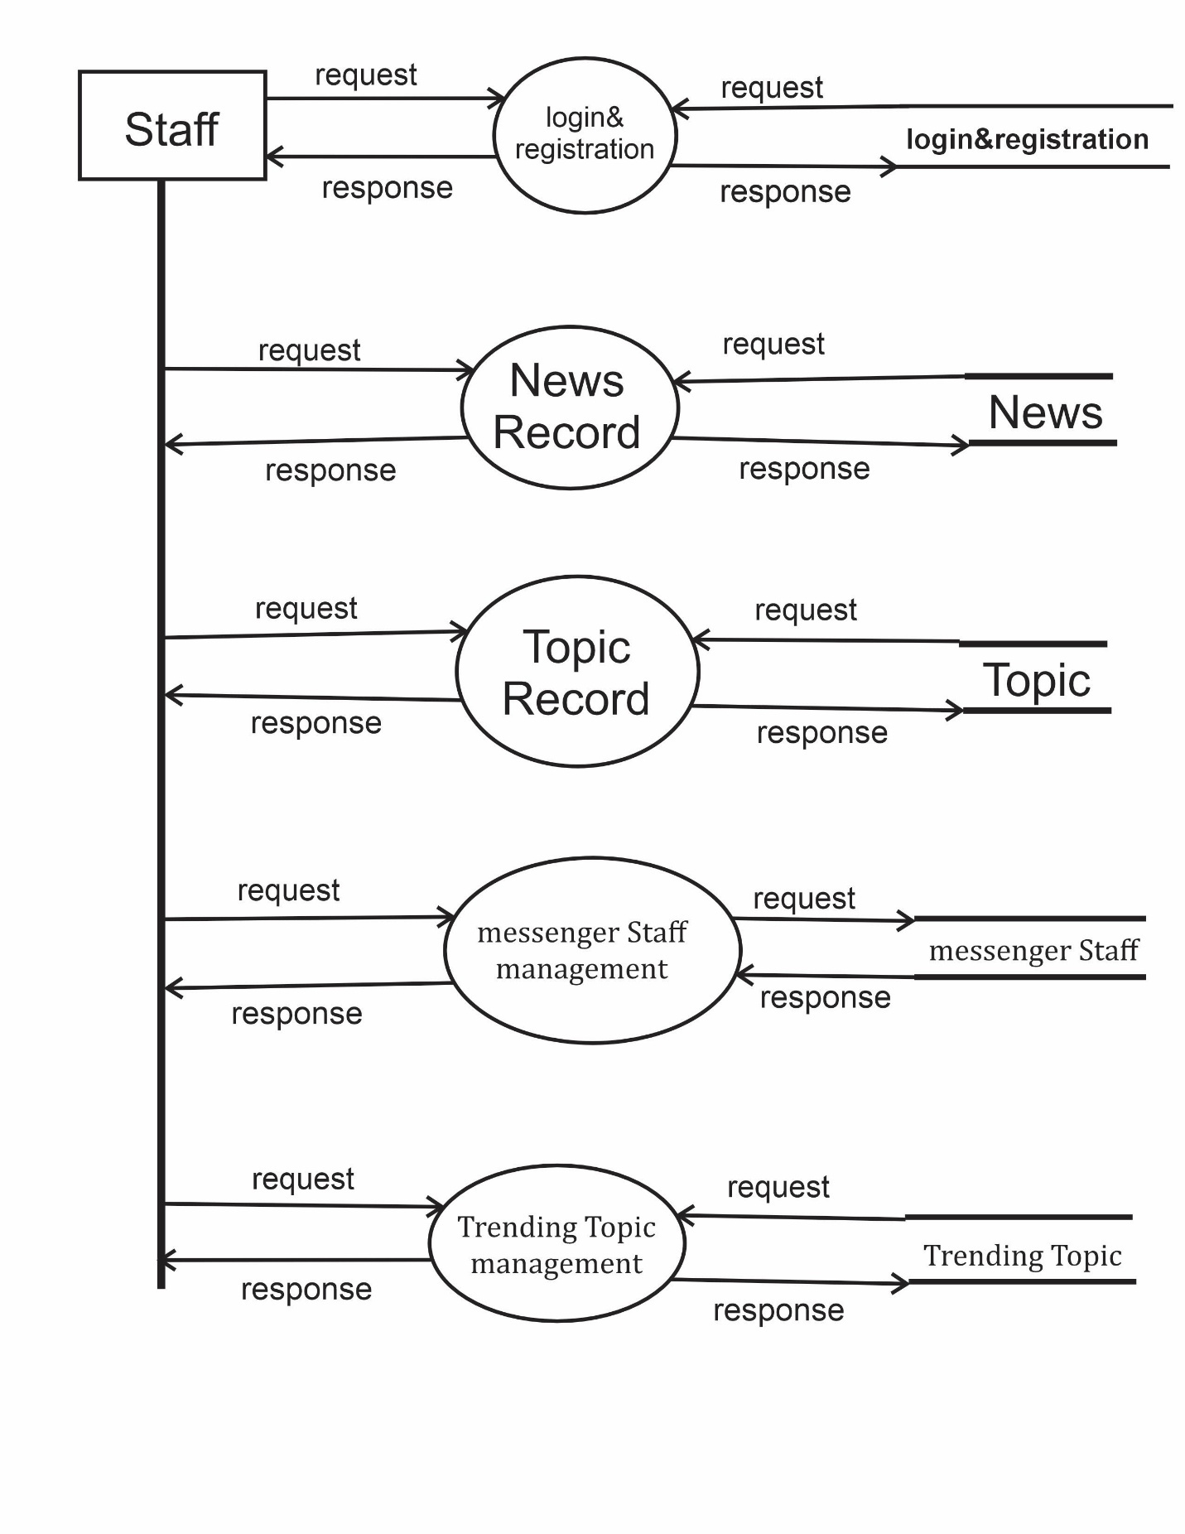

Slide 28
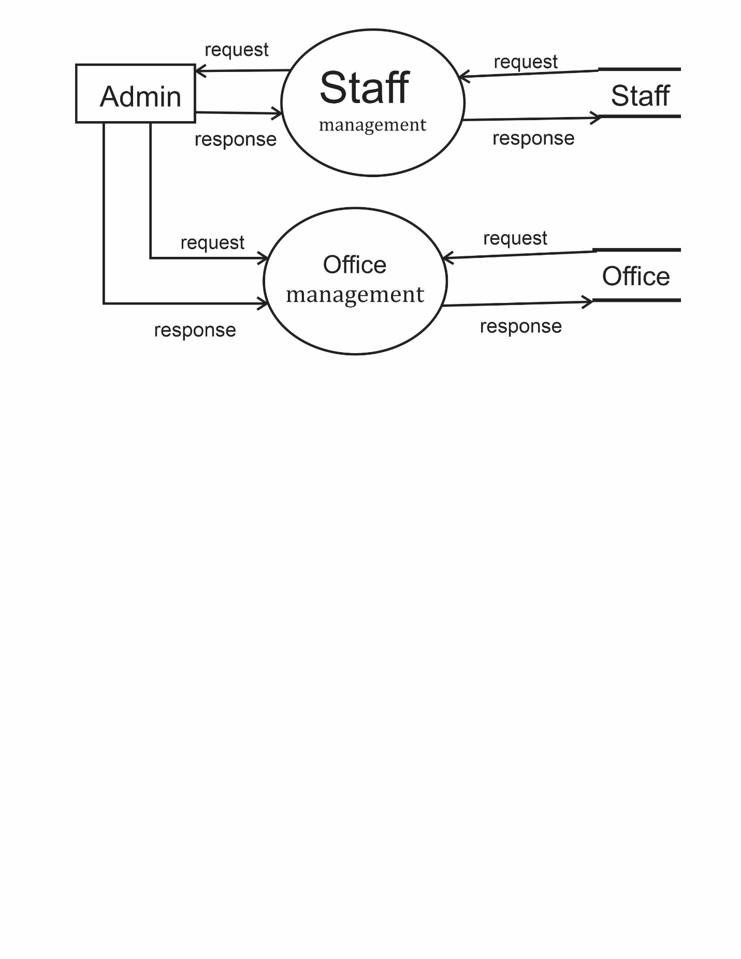

Slide 29
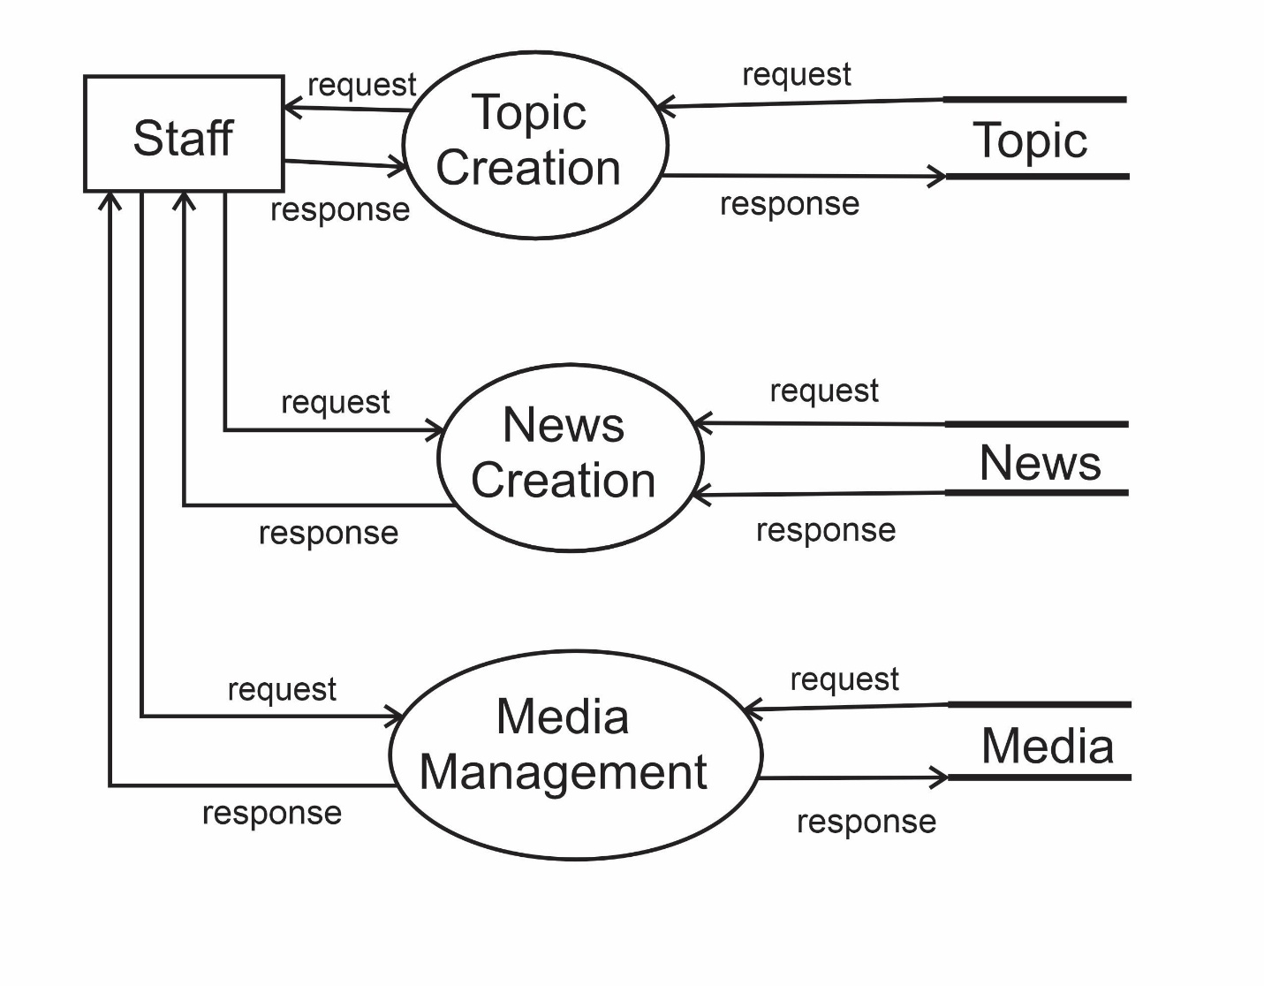
DFD LEVEL 2

Slide 30
Data Dictionary
Table: UserOTP
Column Name | Data Type | Constraints | Description
id | INT | PRIMARY KEY, AUTO_INCREMENT | Unique identifier for OTP record
email | VARCHAR(254) | UNIQUE, NOT NULL | User's email address
is_email_verified | BOOLEAN | DEFAULT FALSE | Whether email has been verified
email_otp | VARCHAR(6) | NULL | 6-digit OTP code for verification

Slide 31
Table: UserInfo
Column Name | Data Type | Constraints | Description
id | INT | PRIMARY KEY, AUTO_INCREMENT | Unique identifier for user info
UserName_id | INT | UNIQUE, NOT NULL, FOREIGN KEY (auth_user.id) | Reference to main user account
Ganders | VARCHAR(15) | CHECK (Male, Other, Female) | User's gender (note: typo in column name)
address | VARCHAR(150) | NULL | User's physical address
picture | VARCHAR(100) | NULL | Profile picture file path
language | VARCHAR(100) | DEFAULT 'English', CHECK (English, Hindi, Gujarati) | User's preferred language

Slide 32
Table: Contact us
Column Name | Data Type | Constraints | Description
id | INT | PRIMARY KEY, AUTO_INCREMENT | Unique contact record identifier
UserChoice | VARCHAR(25) | NOT NULL | Reason for contact/category
UserEmail | VARCHAR(254) | NOT NULL | Contact email address
UserFullName | VARCHAR(200) | NOT NULL | Contact person's full name
UserPhone | VARCHAR(30) | NOT NULL | Contact phone number
UserMessenger | TEXT | NOT NULL | Message content
Date | DATETIME | DEFAULT CURRENT_TIMESTAMP | Submission timestamp

Slide 33
Table: Office
Column Name | Data Type | Constraints | Description
id | INT | PRIMARY KEY, AUTO_INCREMENT | Unique office identifier
address | VARCHAR(200) | UNIQUE, NOT NULL | Office physical address
manger | VARCHAR(100) | NOT NULL | Office manager name (note: typo)

Slide 34
Table: Staff Member
Column Name | Data Type | Constraints | Description
id | INT | PRIMARY KEY, AUTO_INCREMENT | Unique staff identifier
user_id | INT | UNIQUE, NOT NULL, FOREIGN KEY (auth_user.id) | Associated user account
staff_name | VARCHAR(200) | NOT NULL | Staff member's full name
Office_id | INT | NOT NULL, FOREIGN KEY (Office.id) | Associated office
position | VARCHAR(100) | CHECK (none, Admin, CEO, Manager, ...) | Staff position/role
DateOfBirth | DATE | NOT NULL | Staff birth date
PhoneNumber | VARCHAR(100) | NOT NULL | Contact phone number
ZipCode | VARCHAR(15) | NOT NULL | Postal zip code
OneAddress | TEXT | NOT NULL | Primary address
TwoAddress | TEXT | NULL | Secondary address
picture | VARCHAR(100) | NOT NULL | Staff profile picture
JoinDate | DATE | NOT NULL | Employment start date
LeaveDate | DATE | NULL | Employment end date (if applicable)
aboutme | TEXT | NULL | Staff biography/description

Slide 35
Table: Topic
Column Name | Data Type | Constraints | Description
id | INT | PRIMARY KEY, AUTO_INCREMENT | Unique topic identifier
Topic | VARCHAR(20) | UNIQUE, NOT NULL | Topic name
Date | DATE | DEFAULT CURRENT_DATE | Topic creation date
CreatedBy_id | INT | NOT NULL, FOREIGN KEY (StaffMember.id) | Staff who created the topic

Slide 36
Table: News
Column Name | Data Type | Constraints | Description
id | INT | PRIMARY KEY, AUTO_INCREMENT | Unique news identifier
Topic_id | INT | NULL, FOREIGN KEY (Topic.id) | News topic/category
Journalists_id | INT | NULL, FOREIGN KEY (StaffMember.id) | Journalist staff member
Writers_id | INT | NULL, FOREIGN KEY (StaffMember.id) | Writer staff member
Editors_id | INT | NULL, FOREIGN KEY (StaffMember.id) | Editor staff member
NewsTitle | VARCHAR(250) | NULL | News article title
Txt | LONGTEXT | NULL | News article content
Image | VARCHAR(100) | NULL | Primary image file path
Video | VARCHAR(100) | NULL | Video file path
CreatDate | DATE | DEFAULT CURRENT_DATE | Creation date
onlyvideo | BOOLEAN | DEFAULT FALSE | Whether content is video-only
JournalistsPermission | BOOLEAN | NULL | Journalist approval status
WritersPermission | BOOLEAN | NULL | Writer approval status
EditorsPermission | BOOLEAN | NULL | Editor approval status
ManagersPermission | BOOLEAN | NULL | Manager approval status
slug | VARCHAR(255) | NULL | URL-friendly identifier

Slide 37
Table: Report
Column Name | Data Type | Constraints | Description
id | INT | PRIMARY KEY, AUTO_INCREMENT | Unique report identifier
News_id | INT | NOT NULL, FOREIGN KEY (News.id) | Reported news article
user_id | INT | UNIQUE, NOT NULL, FOREIGN KEY (auth_user.id) | User who submitted report
Title | VARCHAR(75) | NOT NULL | Report title
Txt | TEXT | NOT NULL | Report details
slug | VARCHAR(255) | NULL | URL-friendly identifier

Slide 38
Table: newsLike
Column Name | Data Type | Constraints | Description
id | INT | PRIMARY KEY, AUTO_INCREMENT | Unique relationship identifier
newslike_id | INT | NOT NULL, FOREIGN KEY (newsLike.id) | Reference to like record
user_id | INT | NOT NULL, FOREIGN KEY (auth_user.id) | User who liked the news

Slide 39
Table: FollowingNewsTopic
Column Name | Data Type | Constraints | Description
id | INT | PRIMARY KEY, AUTO_INCREMENT | Unique relationship identifier
followingnewstopic_id | INT | NOT NULL, FOREIGN KEY (FollowingNewsTopic.id) | Reference to follow record
user_id | INT | NOT NULL, FOREIGN KEY (auth_user.id) | User following the topic

Slide 40
Table: Comments
Column Name | Data Type | Constraints | Description
id | INT | PRIMARY KEY, AUTO_INCREMENT | Unique comment identifier
UserName_id | INT | NOT NULL, FOREIGN KEY (auth_user.id) | User who commented
news_id | INT | NOT NULL, FOREIGN KEY (News.id) | News article being commented on
text | TEXT | NOT NULL | Comment content
date | DATE | DEFAULT CURRENT_DATE | Comment date
slug | VARCHAR(255) | NULL | URL-friendly identifier

Slide 41
Table: multipleNewsImageAndVideo
Column Name | Data Type | Constraints | Description
id | INT | PRIMARY KEY, AUTO_INCREMENT | Unique media identifier
news_id | INT | NOT NULL, FOREIGN KEY (News.id) | Associated news article
image | VARCHAR(100) | NULL | Additional image file path
video | VARCHAR(100) | NULL | Additional video file path

Slide 42
TrendingTopic
Column Name | Data Type | Constraints | Description
id | INT | PRIMARY KEY, AUTO_INCREMENT | Unique trending record identifier
NewsTopic_id | INT | UNIQUE, NOT NULL, FOREIGN KEY (Topic.id) | Trending topic
Date | DATETIME | DEFAULT CURRENT_TIMESTAMP | When trend was recorded

Slide 43
Table: bookmarks
Column Name | Data Type | Constraints | Description
id | INT | PRIMARY KEY, AUTO_INCREMENT | Unique relationship identifier
bookmarks_id | INT | NOT NULL, FOREIGN KEY (bookmarks.id) | Reference to bookmark record
user_id | INT | NOT NULL, FOREIGN KEY (auth_user.id) | User who bookmarked the news

Slide 44
Table: followingStaff_User
Column Name | Data Type | Constraints | Description
id | INT | PRIMARY KEY, AUTO_INCREMENT | Unique relationship identifier
followingstaff_id | INT | NOT NULL, FOREIGN KEY (followingStaff.id) | Reference to follow record
user_id | INT | NOT NULL, FOREIGN KEY (auth_user.id) | User following the staff

Slide 45
Table: NewsGujarati
Column Name | Data Type | Constraints | Description
id | INT | PRIMARY KEY, AUTO_INCREMENT | Unique translation identifier
News_id | INT | UNIQUE, NOT NULL, FOREIGN KEY (News.id) | Original news article
Topic_id | INT | NOT NULL, FOREIGN KEY (TopicGujarati.id) | Gujarati topic reference
title | VARCHAR(200) | NOT NULL | Gujarati news title
text | TEXT | NULL | Gujarati news content
Date | DATE | DEFAULT CURRENT_DATE | Translation date

Slide 46
Table: NewsHindi
Column Name | Data Type | Constraints | Description
id | INT | PRIMARY KEY, AUTO_INCREMENT | Unique translation identifier
News_id | INT | UNIQUE, NOT NULL, FOREIGN KEY (News.id) | Original news article
Topic_id | INT | NOT NULL, FOREIGN KEY (TopicHindi.id) | Hindi topic reference
title | VARCHAR(200) | NOT NULL | Hindi news title
text | TEXT | NULL | Hindi news content
Date | DATE | DEFAULT CURRENT_DATE | Translation date

Slide 47
Interface Design

Slide 48
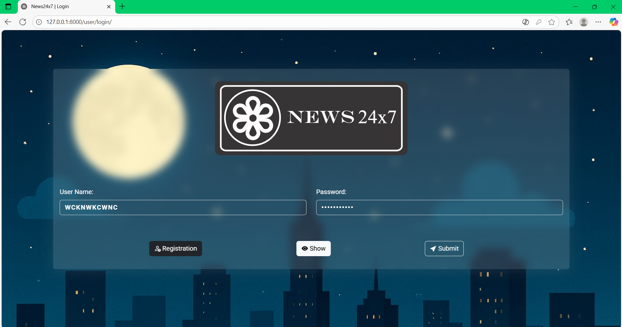

Slide 49
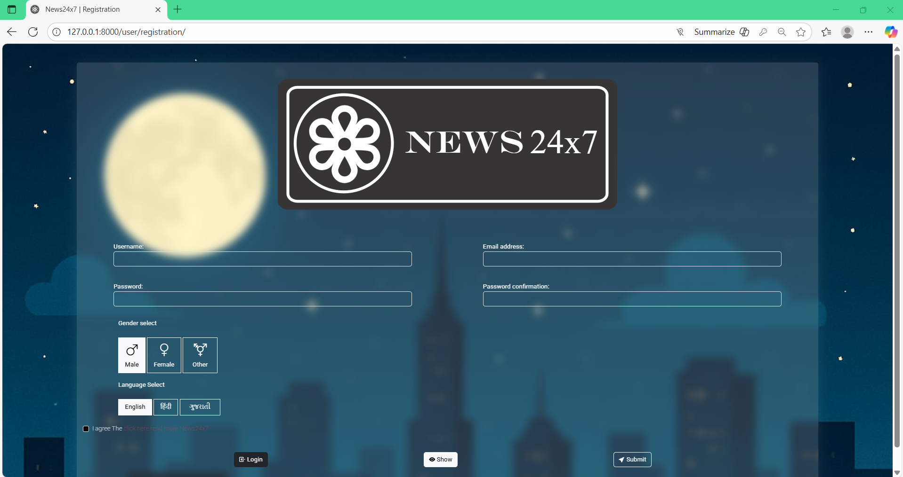

Slide 50
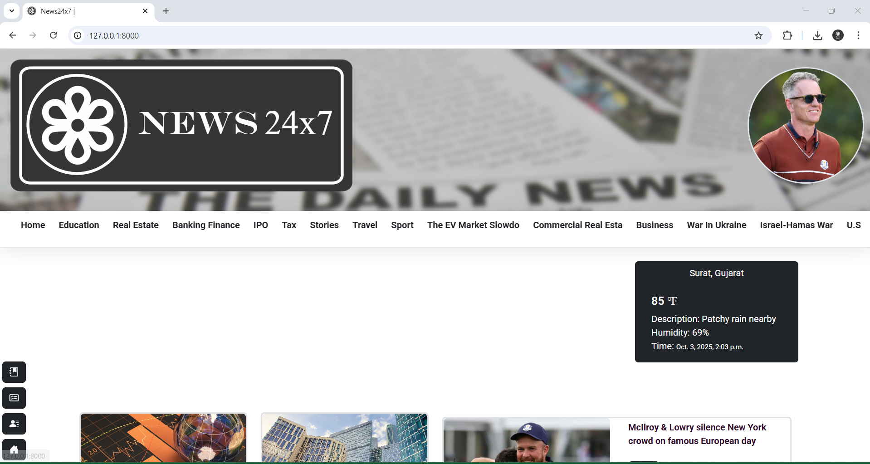

Slide 51
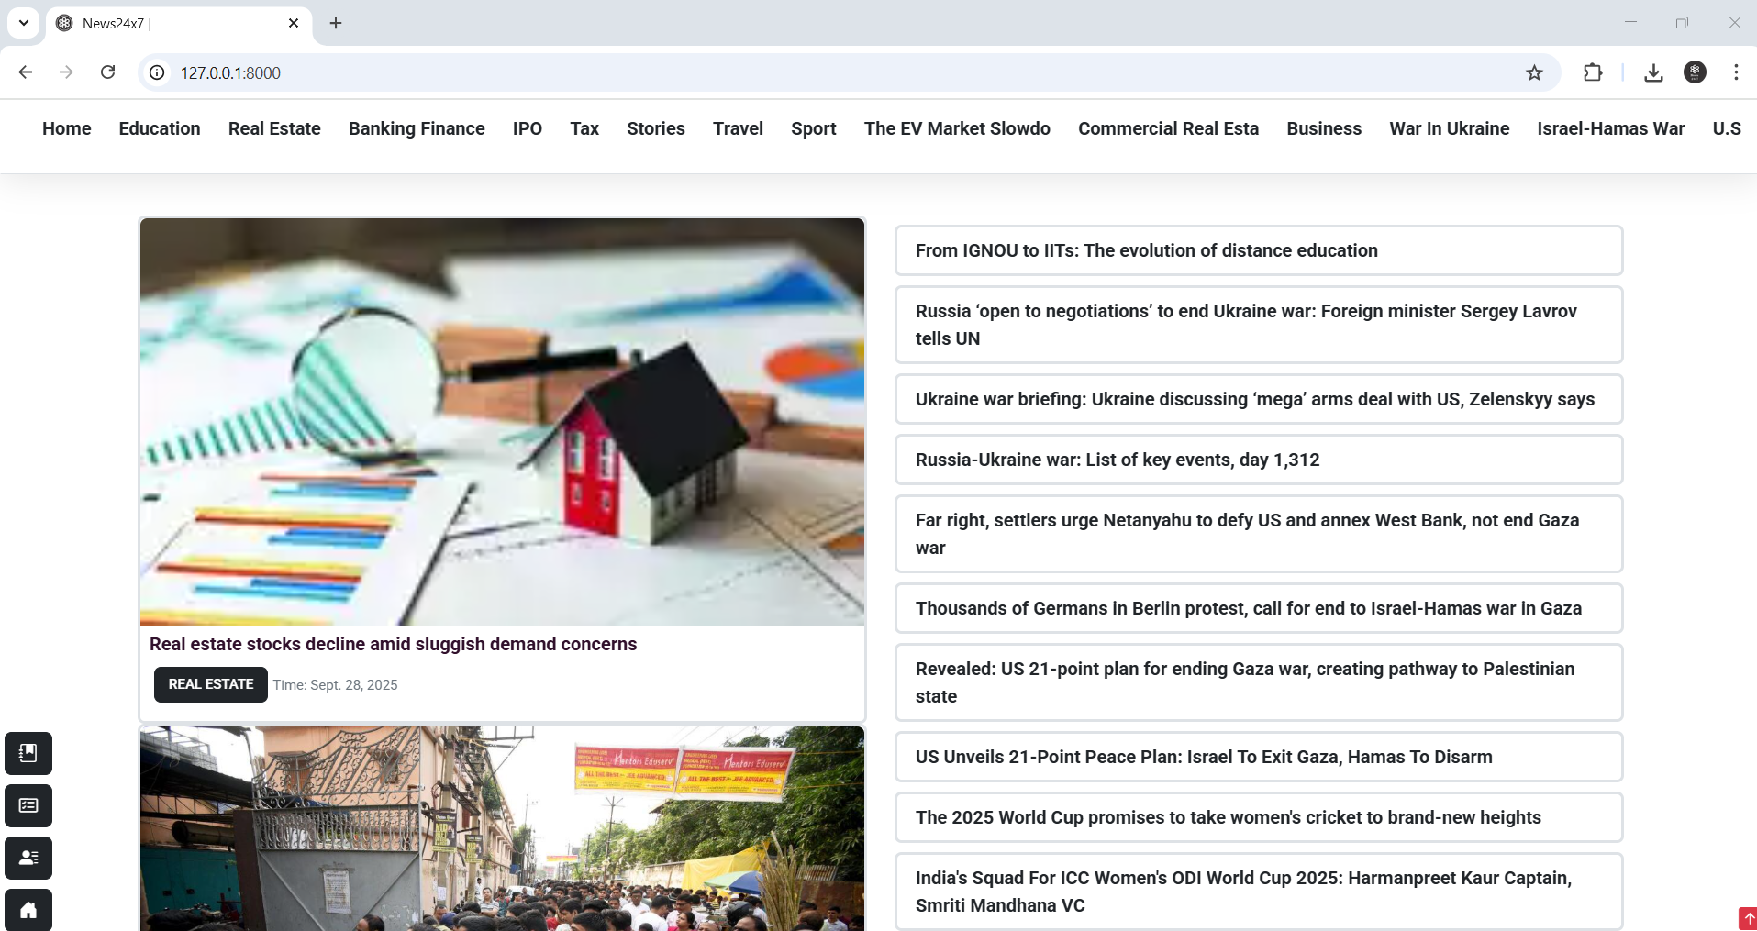

Slide 52
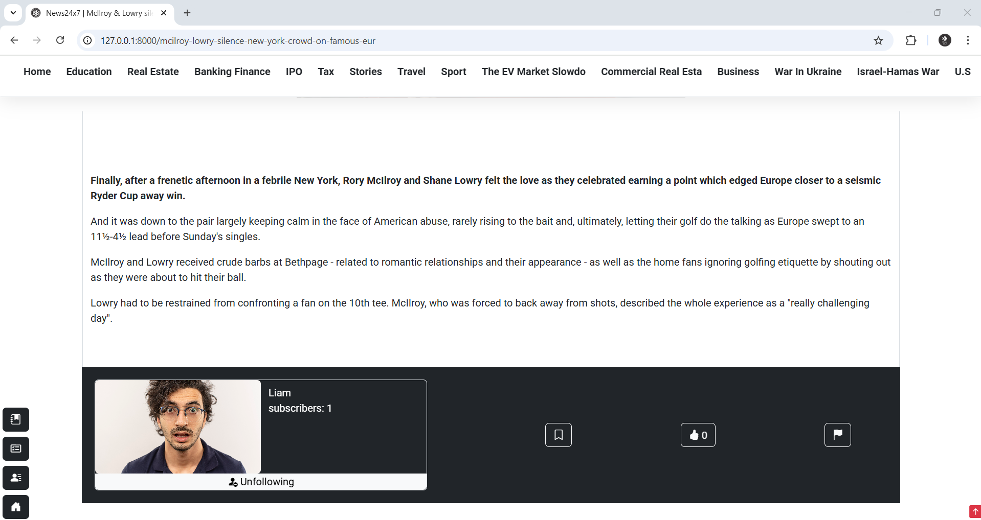

Slide 53
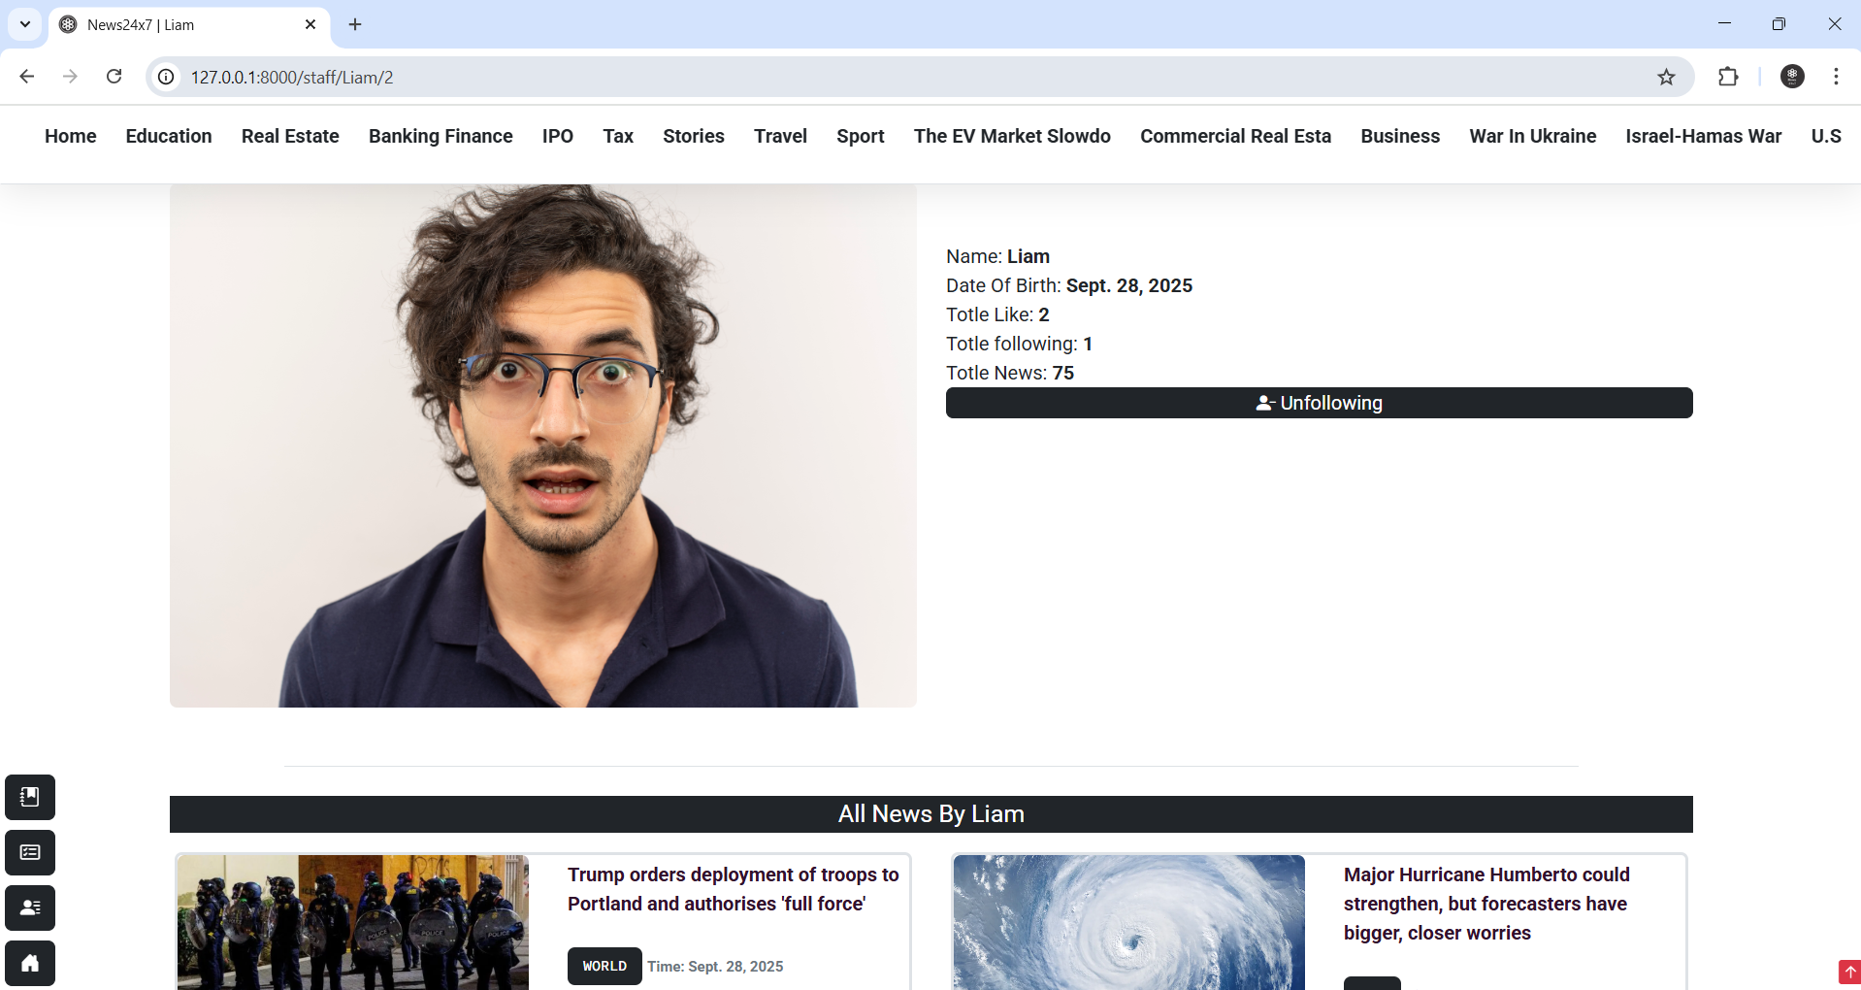

Slide 54
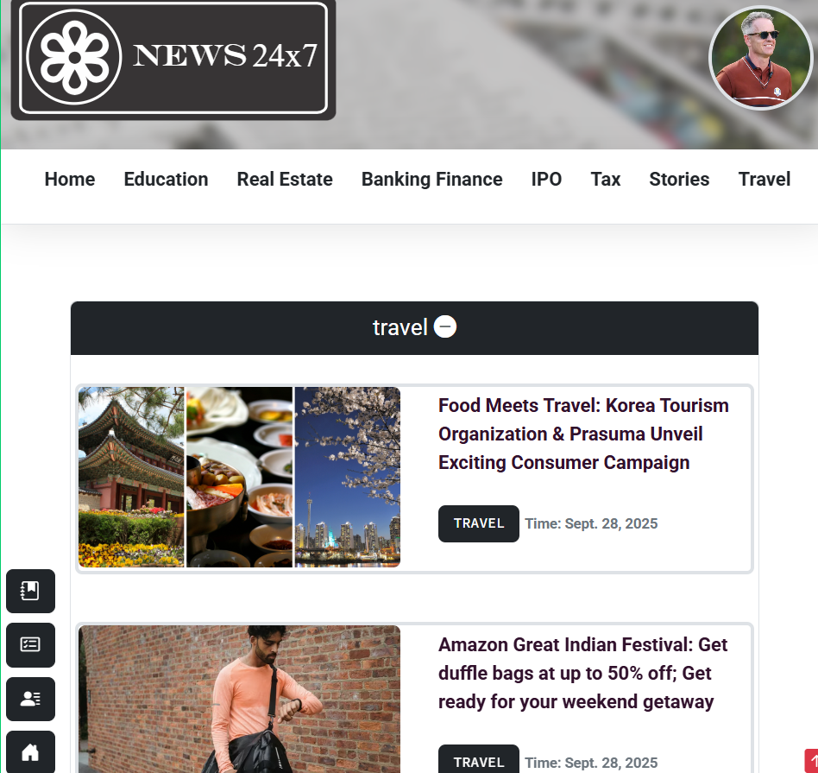

Slide 55
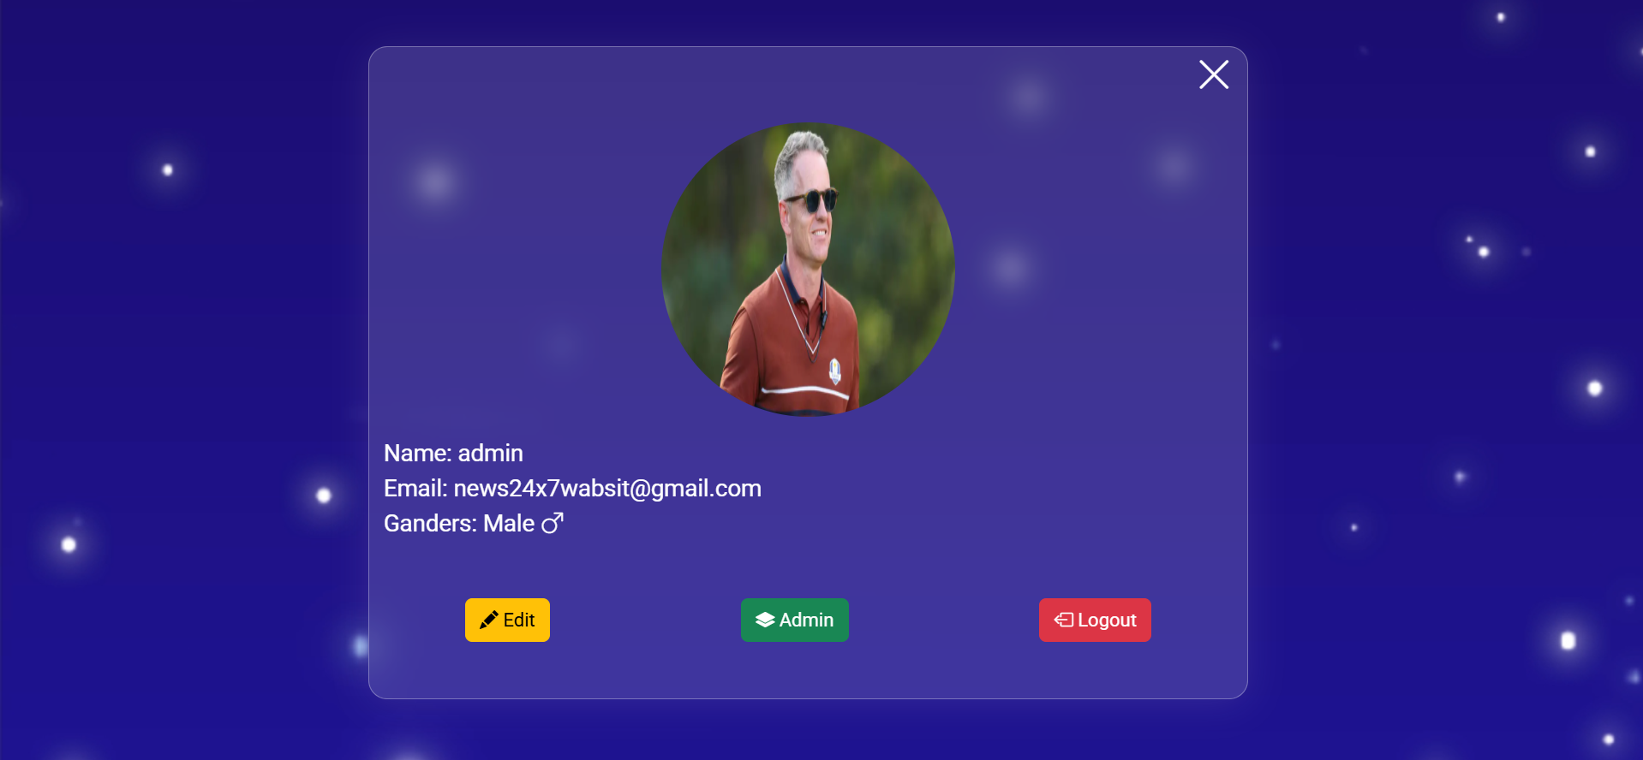

Slide 56
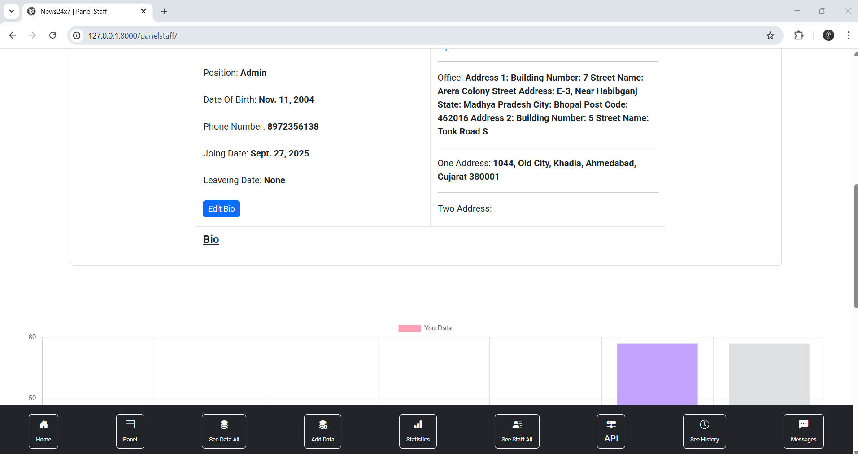

Slide 57
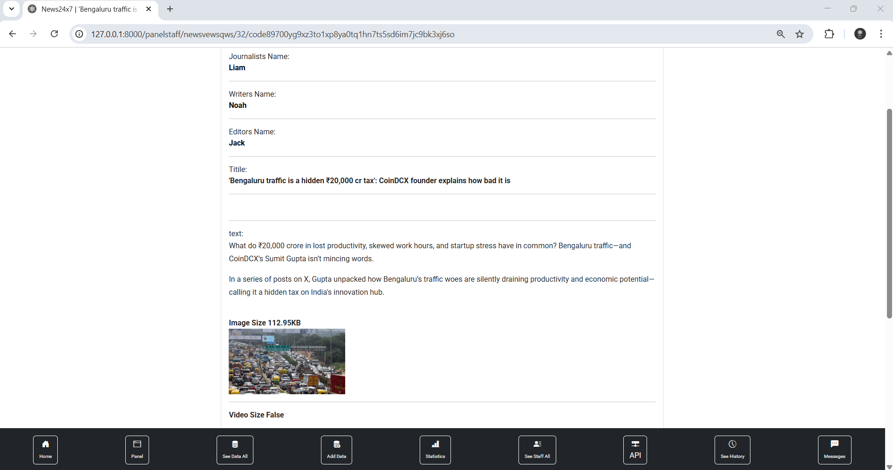

Slide 58
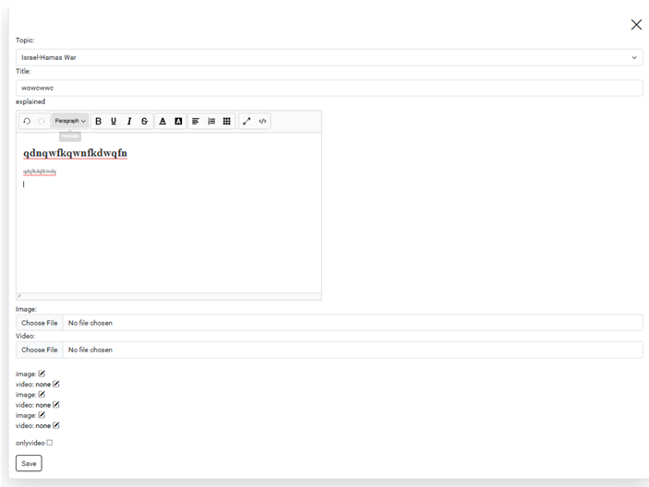

Slide 59
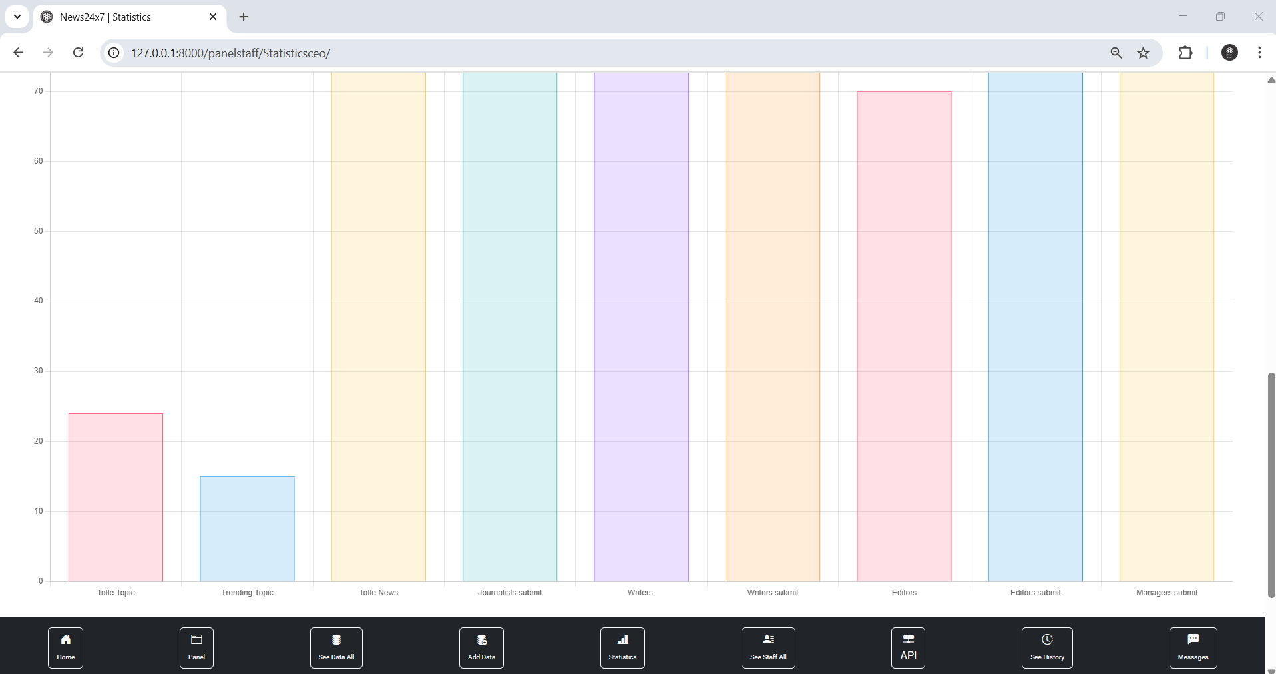

Slide 60
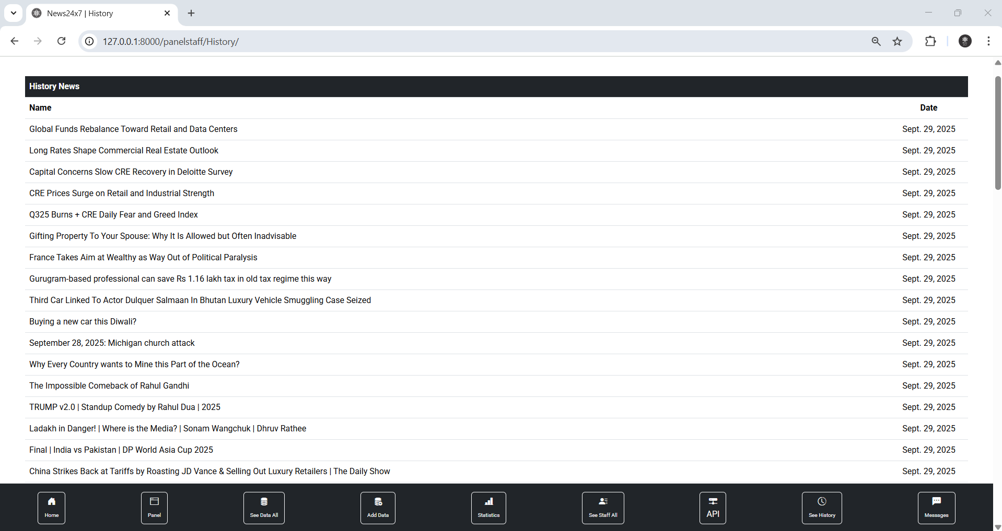

Slide 61
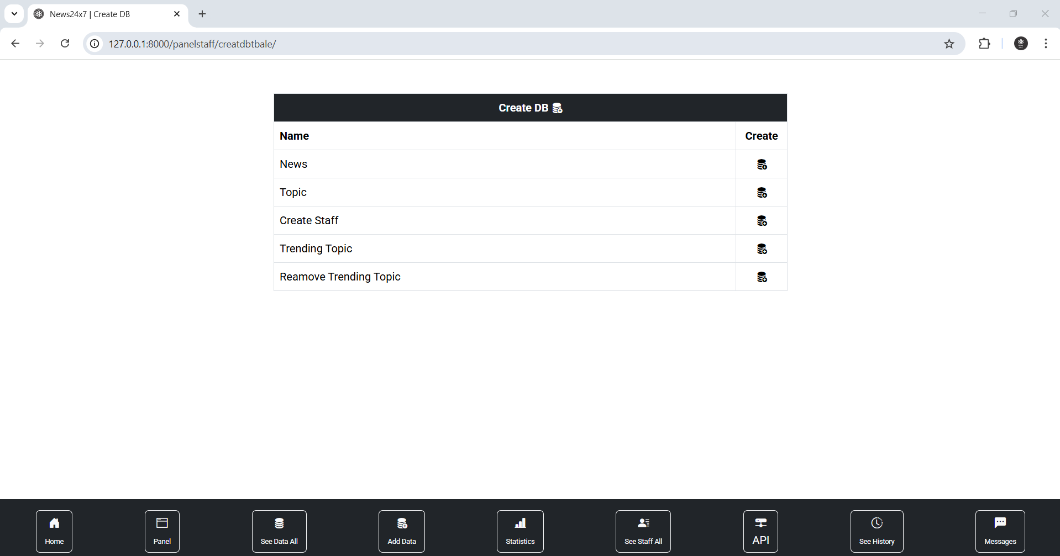

Slide 62
Bibliography
GeeksforGeeks, "Page Title," GeeksforGeeks. [Online].
Available: https://www.geeksforgeeks.org/.
W3Schools, "Page Title," W3Schools. [Online].
Available: https://www.w3schools.com/.
JavaTpoint, "Page Title," JavaTpoint. [Online].
Available: https://www.javatpoint.com/
CodeWithHarry, "Video Title," YouTube. [Online].
Available: https://www.youtube.com/@CodeWithHarry.

Slide 63
The End

