Slide 1


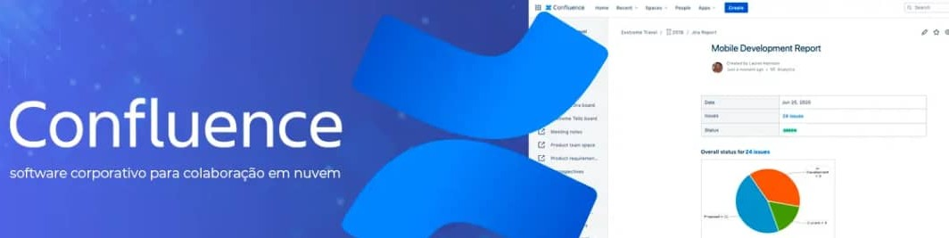
Atlassian
CONFLUENCE. COM
CONFLUENE
EMPOWERING COLLABORATION AND PRODUCTIVITY
Notes:
"Welcome to our presentation on Confluence: Empowering Collaboration and Productivity. Today, we'll explore how Confluence can enhance team collaboration and productivity by providing a dynamic workspace for creating, capturing, and collaborating on projects and ideas."

Slide 2





ABOUT US
Atlassian is a global software company that empowers teams to collaborate effectively. Our mission is to unleash the potential of every team.
Founded by Mike Cannon- Brookes and Scott Farquhar in 2002 , Atlassian has grown into a powerhouse with a presence in 13 countries.
Confluence is a team workspace where knowledge and collaboration converge.
Dynamic pages allow your team to create, capture, and collaborate on any project or idea.
I t ’ s a hub for documentation, project collaboration, Jira integrations, and more.
Notes:
"Atlassian is a global software company that empowers teams to collaborate effectively. Our mission is to unleash the potential of every team. Founded by Mike Cannon-Brookes and Scott Farquhar in 2002, Atlassian has grown into a powerhouse with a presence in 13 countries.
Confluence is a team workspace where knowledge and collaboration converge. Dynamic pages allow your team to create, capture, and collaborate on any project or idea. It’s a hub for documentation, project collaboration, Jira integrations, and more."

Slide 3


Confluence: Boost Teamwork and Knowledge Sharing
01 02 03 04
CENTRALIZED
KNOWLEDGE BASE
Collaboratively create, edit, and share
documents and web pages.
ORGANIZED WORKSPACES
Group related content in " Spaces" for easy
access and navigation.
REAL-TIME
COLLABORATION
Work together on documents
simultaneously and see edits as they happen.
ADVANCED FEATURES
Integrate calendars, automate tasks, and
leverage powerful add- ons for even greater
functionality.
Confluence keeps your team on the same page and your information organized.
Notes:
"Confluence boosts teamwork and knowledge sharing through:
1. Centralized Knowledge Base: Collaboratively create, edit, and share documents and web pages.
2. Organized Workspaces: Group related content in 'Spaces' for easy access and navigation.
3. Real-Time Collaboration: Work together on documents simultaneously and see edits as they happen.
4. Advanced Features: Integrate calendars, automate tasks, and leverage powerful add-ons for even greater functionality.
Confluence keeps your team on the same page and your information organized."

Slide 4

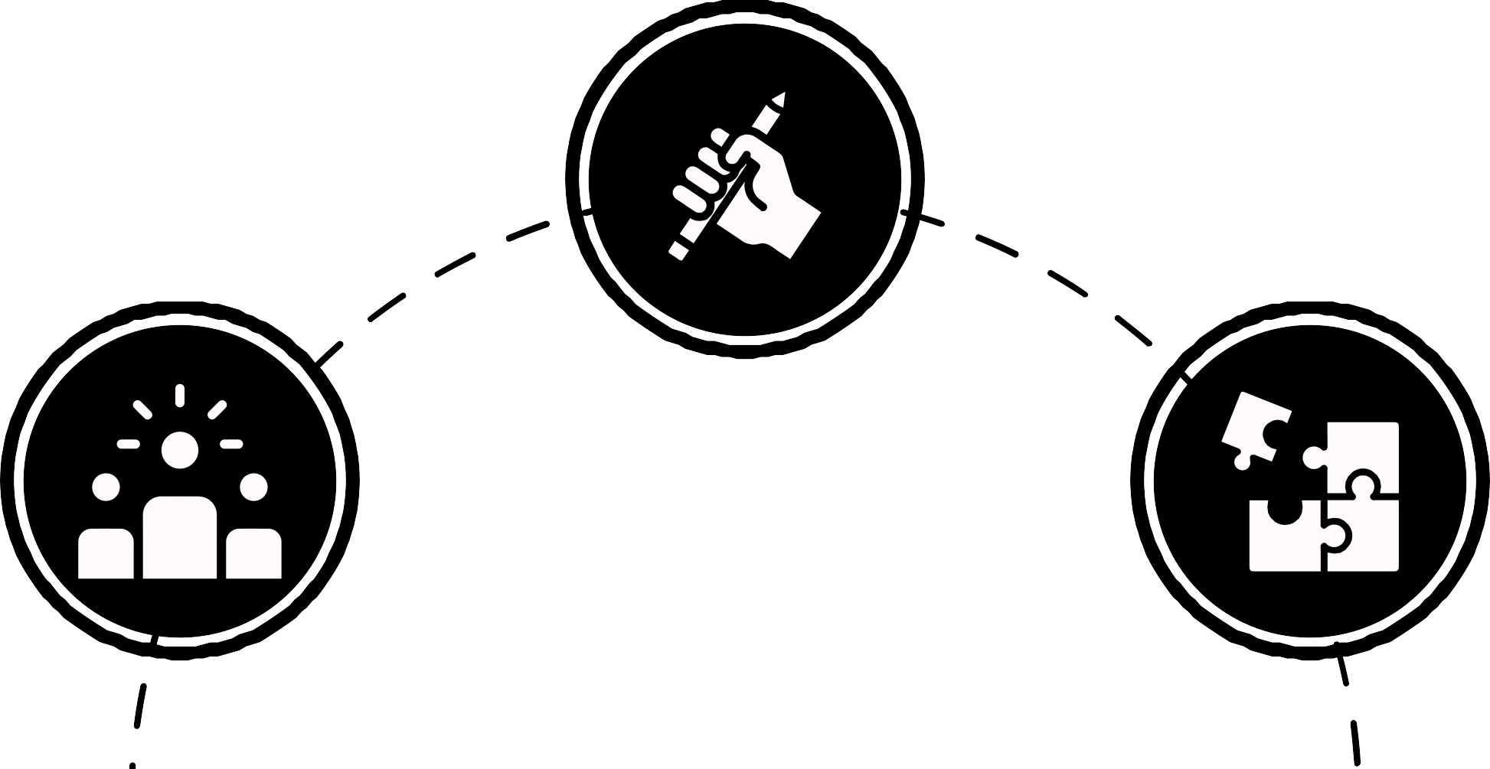

YOUR DYNAMIC TEAM WORKSPACE
A hub for team collaboration,
knowledge sharing, and project management
Dynamic pages allow for easy creation, capture, and collaboration on any project
or idea
Structured spaces organize related
content, ensuring a streamlined workflow
Notes:
"Confluence serves as a hub for team collaboration, knowledge sharing, and project management. Dynamic pages allow for easy creation, capture, and collaboration on any project or idea. Structured spaces organize related content, ensuring a streamlined workflow."

Slide 5




WHY CHOOSE CONFLUENCE?
problem
Lost ideas burie in emails or chat
Isolated pockets of knowledge hinder team collaboration
Lack of a single source of truth leads to Confusion And inefficiencies
solution
Confluence captures great ideas within l iving documents, ensuring nothing gets lost
Information f lows freely across the organization, breaking down silos
Confluence houses everything from project plans
to blogs to documentation, serving as a single source of truth
Notes:
"Many teams face problems such as lost ideas buried in emails or chat, isolated pockets of knowledge that hinder team collaboration, and a lack of a single source of truth leading to confusion and inefficiencies. Confluence addresses these issues by capturing great ideas within living documents, ensuring nothing gets lost. Information flows freely across the organization, breaking down silos. Confluence houses everything from project plans to blogs to documentation, serving as a single source of truth."

Slide 6


CONFLUENCE VS. COMPETITORS
Confluence: Standing Out in the Crowd
Facilitates seamless team collaboration with real-time editing and commenting
Intuitive and user-friendly interface
Ideal for organizing and managing project plans, documentatio n, and other structured content
COLLABORATION
EASE OF USE
STRUCTURED CONTENT
MANAGEMENT
Notes:
Confluence stands out in the crowd with its ease of use, featuring an intuitive and user-friendly interface. It's ideal for organizing and managing project plans, documentation, and other structured content. Confluence facilitates seamless team collaboration with real-time editing and commenting."

Slide 7


PRICING PLANS
Confluence offers several subscription plans to cater to different needs:
Free Plan: Ideal for small teams of up to 10 users.It provides essential features and 2 GB of file storage.
Standard Plan: Priced at $5.50 per user/month,it includes unlimited spaces, page versioning, and more.
Premium Plan: At $10.50 per user/month, you get advanced features like analytics, automation, and whiteboards.
Enterprise Plan: For larger organizations with specific requirements. Contact Atlassian for tailored solutions.
Notes:
"Confluence offers several pricing plans:
1. Free Plan: Ideal for small teams of up to 10 users, providing essential features and 2 GB of file storage.
2. Standard Plan: Priced at $5.50 per user/month, it includes unlimited spaces, page versioning, and more.
3. Premium Plan: At $10.50 per user/month, you get advanced features like analytics, automation, and whiteboards.
4. Enterprise Plan: For larger organizations with specific requirements. Contact Atlassian for tailored solutions."

Slide 8

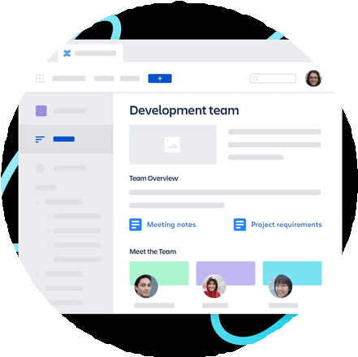


Stop wasting time searching for information...
Start collaborating seamlessly!
Get a free trial of Confluence today!
Try Confluence Free on https://www.atlassian.com/softw are/confluence
Want to see Confluence in action? Watch a Demo on our website https://confluence.atlassian.com
Notes:
"Stop wasting time searching for information and start collaborating seamlessly! Get a free trial of Confluence today by visiting www.atlassian.com/software/confluence. Want to see Confluence in action? Watch a demo on our website at https://confluence.atlassian.com."

Slide 9
THANK' S FOR WATCHING
LARANA, INC.
Notes:
"Thank you for watching! We appreciate your time and interest in Confluence. If you have any questions or need more information, please feel free to contact us."

