Slide 1
Introduction to
Java Programming
for High School
{
< Here is where your presentation begins >
}
...

Slide 2
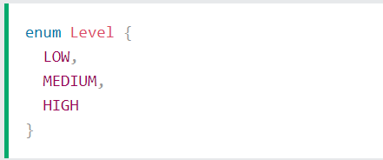

Enums
An Enum is a special "class" that represents a group of constants
(unchangeable variables, like final variables).
To create an Enum, use the Enum keyword (instead of class or interface), and separate the constants with a comma. Note that they should be in uppercase letters:
You can access enum constants with the dot syntax:
1/2

Slide 3
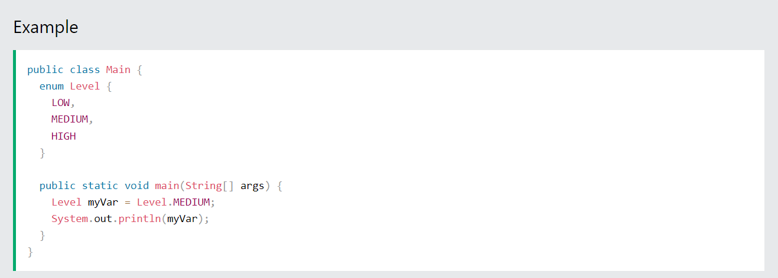
Enum inside a Class
You can also have an Enum inside a class:
1/2

Slide 4
Enum in a Switch Statement
Enums are often used in switch statements to check for corresponding values:
enum Level {
LOW,
MEDIUM,
HIGH
}
public class Main {
public static void main(String[] args) {
Level myVar = Level.MEDIUM;
switch(myVar) {
case LOW:
System.out.println("Low level");
break;
case MEDIUM:
System.out.println("Medium level");
break;
case HIGH:
System.out.println("High level");
break;
}
}
}
1/2

Slide 5
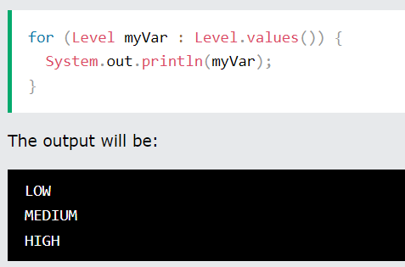
Loop Through an Enum
The enum type has a values() method, which returns an array of all enum constants.
This method is useful when you want to loop through the constants of an enum:
1/2

Slide 6
Difference between Enums and Classes
An Enum can, just like a class, have attributes and methods. The only difference is that Enum constants are public, static and final (unchangeable - cannot be overridden).
An Enum cannot be used to create objects, and it cannot extend other classes (but it can implement interfaces).
Why And When To Use Enums?
Use Enums when you have values that you know aren't going to change, like month days, days, colors, deck of cards, etc.
1/2

Slide 7
Java User Input
The Scanner class is used to get user input, and it is found in the java.util package.
To use the Scanner class, create an object of the class and use any of the available methods found in the Scanner class documentation. In our example, we will use the nextLine() method, which is used to read Strings:
1/2

Slide 8
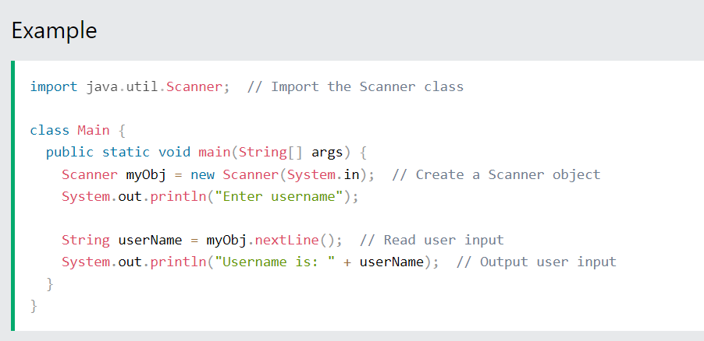
Java User Input
1/2

Slide 9
Java User Input
1/2

Slide 10
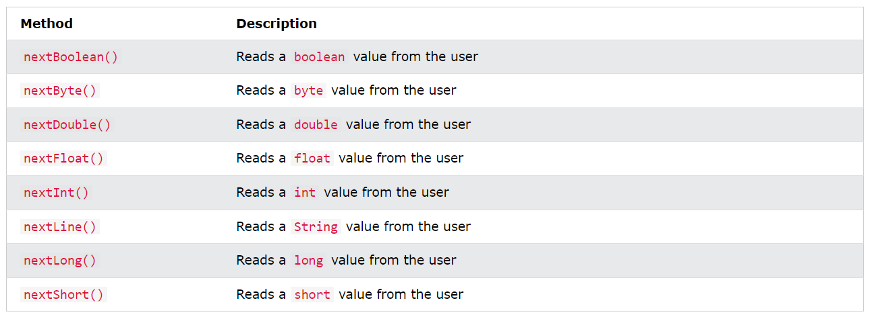
Input Types
1/2

Slide 11
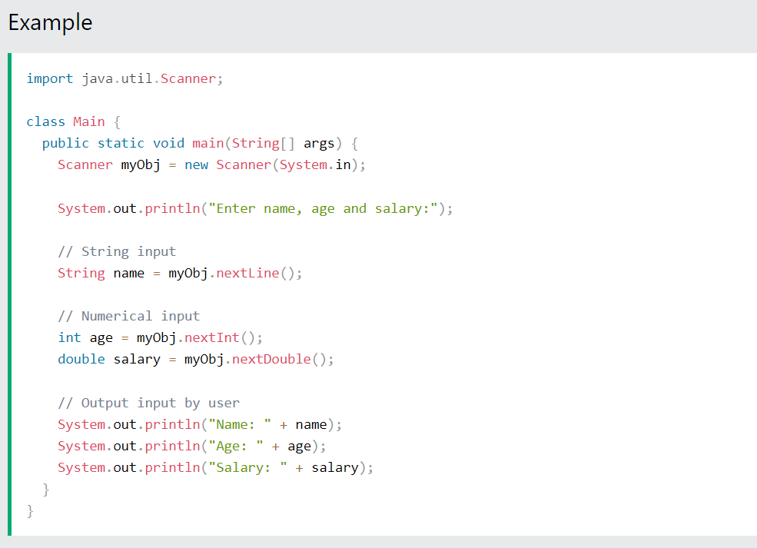
Input Types
1/2

Slide 12
Input Types
1/2

Slide 13
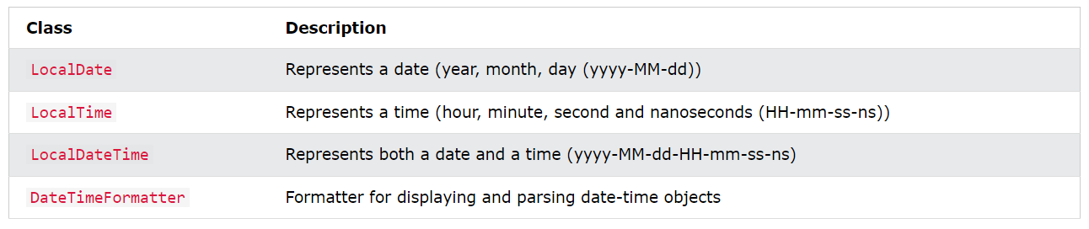
Java Date and Time
Java does not have a built-in Date class, but we can import the java.time package to work with the date and time API. The package includes many date and time classes. For example:
1/2

Slide 14
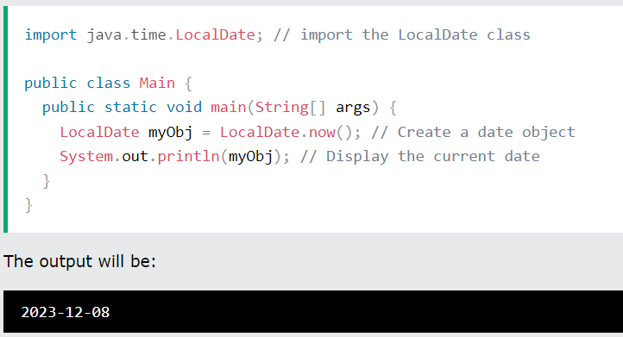
Display Current Date
To display the current date, import the java.time.LocalDate class, and use its now() method:
1/2

Slide 15
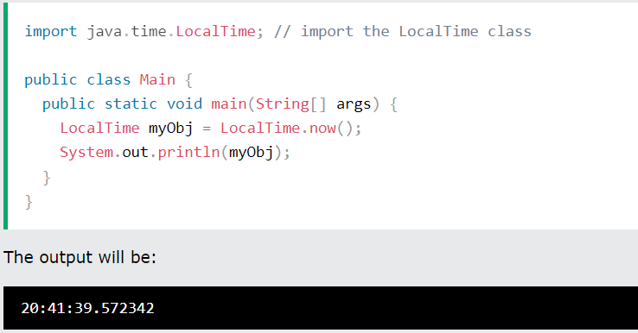
Display Current Time
To display the current time (hour, minute, second, and nanoseconds), import the java.time.LocalTime class, and use its now() method:
1/2

Slide 16
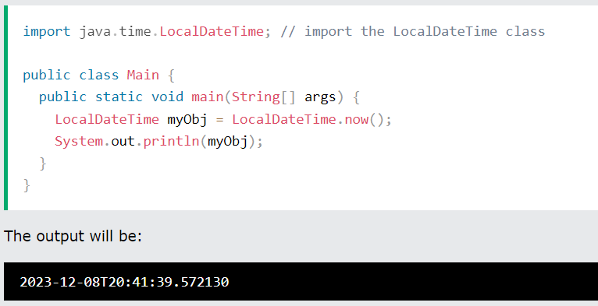
Display Current Date and Time
To display the current date and time, import the java.time.LocalDateTime class, and use its now() method:
1/2

Slide 17
Formatting Date and Time
The "T" in the example above is used to separate the date from the time. You can use the DateTimeFormatter class with the ofPattern()method in the same package to format or parse date-time objects. The following example will remove both the "T" and nanoseconds from the date-time:
1/2

Slide 18
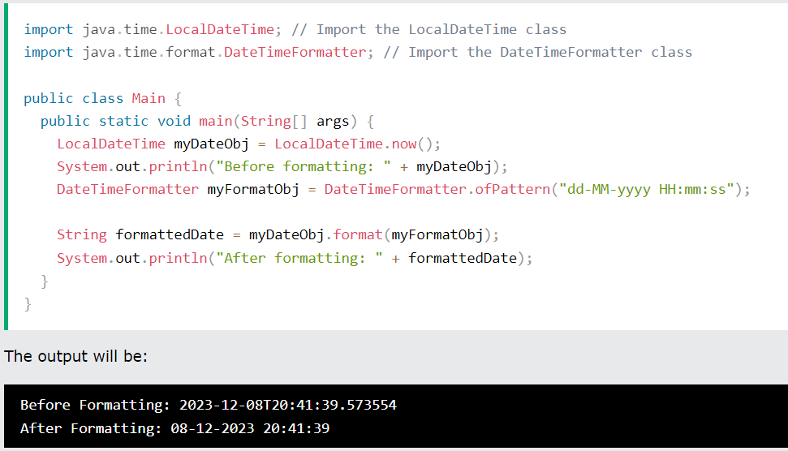
Formatting Date and Time
1/2

Slide 19
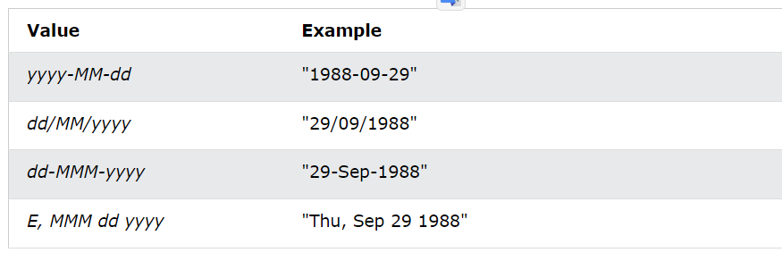
Formatting Date and Time
The ofPattern() method accepts all sorts of values, if you want to display the date and time in a different format. For example:
1/2

Slide 20
Exercises
Write a Java program to implement an Enum called "Direction" with constants representing the cardinal directions (North, South, East, West).
Write a Java program to create an Enum called "DaysOfWeek" representing the days of the week.

