Slide 1
INSTRUMENT
FLIGHT PROCEDURES

Slide 2
INSTRUMENT FLIGHT PROCEDURES
1. Introduction to IFP
2. Arcs & Radials
3. Fix to fix Nav
4. Holding
5. Instrument Approach Plates
6. Instrument Approaches
7. Over-run/Revision
8. Exam
2

Slide 3
INTRODUCTION
THE AIM OF IF IS TO FLY SAFELY USING THE A/C INSTURMENTS UNDER IMC CONDITIONS.
IMC:
VMC:
IFR:
VFR:
Instrument Meteorological Conditions.
Visual Meteorological Conditions.
Instrument Flight Rules.
Visual Flight Rules.
3

Slide 4
AIRSPACE CLASSIFICATION
CLASS A:
IFR FLIGTS ARE ONLY PPERMITED,AND SUBJECT TO AIR TRAFFIC CONTROL SERVICE AND ARE SEPRATED FROM EACH OTHER.
CLASS B: (NOT USED IN THE MUSCAT FIR)
IFR AND VFR FLIGHTS ARE PERMITED ALL FLIGTS ARE SUBJECT TO AIR TRAFFIC CONTROL SERVICE AND ARE SEPRATED FROM EACH OTHER.
4

Slide 5
AIRSPACE CLASSIFICATION
CLASS C:
IFR AND VFR FLIGHTS ARE PERMITED, ALL FLIGTS ARE SUBJECT TO AIR TRAFFIC CONTROL SERVICE AND IFR FLIGHTS ARE SEPARATED FROM OTHER IFR FLIGHTS AND FROM VFR FLIGTS.
VFR FLIGHTS ARE SEPRATED FROM IFR FLIGHTS AND RECEIVE TRAFFIC INFO ABOUT OTHER VFR TRAFFIC.
5

Slide 6
AIRSPACE CLASSIFICATION
CLASS D (NOT IN USE IN MUSCAT FIR)
SAME LIKE CLASS C BUT HERE VFR FLIGTS RECEIVES TRAFFIC INFO ABOUT ALL OTHER TRAFFIC.
CLASS E (NOT IN USE IN MUSCAT FIR)
IFR AND VFR FLIGHTS ARE PERMITED,IFR FLIGTS ARE SUBJECT TO AIR TRAFFIC CONTROL SERVICE AND ARE SEPARATED FROM OTHER IFR FLIGHTS. ALL FLIGTS RECEIVE TRAFFIC INFO AS FAR AS PRACTICABLE.
6

Slide 7
AIRSPACE CLASSIFICATION
CLASS F:
IFR AND VFR FLIGHTS ARE PERMITTED. ALL FLIGHTS RECEIVE AN AIR TRAFFIC ADVISORY SERVICE.
CLASS G: (NOT IN USE IN MUSCAT FIR)
IFR AND VFR FLIGHTS AND RECEIVE FLIGHT INFO SERVICE IF REQUESTED.
7

Slide 8
Class | Type of Flight | Separation Provided | Service Provided | VMC Visibility and Distance from Cloud Minima | Speed Limita- tion | Radio Com- munication Requirement | ATC Clear- ance
A | IFR only | All aircraft | Air traffic control service | Not applicable | Not applicable | Continuous two-way | Yes
B | IFR | All aircraft | Air traffic control service | Not applicable | Not applicable | Continuous two-way | Yes
 | VFR | All aircraft | Air traffic control service | 8 km at and above 3050m (10000 FT) AMSL 5 km below 3050m (10000 FT) AMSL Clear of clouds | Not applicable | Continuous two-way | Yes
8
Notes:
<number>

Slide 9
Class | Type of Flight | Separation Provided | Service Provided | VMC Visibility and Distance from Cloud Minima | Speed Limita- tion | Radio Com- munication Requirement | ATC Clear- ance
C | IFR | IFR from IFR IFR from VFR | Air traffic control service | Not applicable | 250 KT IAS below 3050m (10000 FT) AMSL, unless advised by ATC. | Continuous two-way | Yes
 | VFR | VFR from IFR | 1) Air traffic control service for separa- tion from IFR; 2) VFR /IFR traffic information (and traffic avoidance advice on request) | 8 km at and above 3050m (10000 FT) AMSL 5 km below 3050m (10000 FT) AMSL 1500m horizontal; 300m vertical dis- tance from cloud | 250 KT IAS below 3050m (10000 FT) AMSL | Continuous two-way | Yes
9
Notes:
<number>

Slide 10
Class | Type of Flight | Separation Provided | Service Provided | VMC Visibility and Distance from Cloud Minima | Speed Limita- tion | Radio Com- munication Requirement | ATC Clear- ance
D | IFR | IFR from IFR | Air traffic control service including traffic information about VFR flights (and traffic avoid- ance advice on request) | Not applicable | 250 KT IAS below 3050m (10000 FT) AMSL | Continuous two-way | Yes
 | VFR | Nil | Traffic information between VFR and IFR flights (and traf- fic avoidance advice on request) | 8 km at and above 3050m (10000 FT) AMSL 5 km below 3050m (10000 FT) AMSL 1500m horizontal; 300m vertical dis- tance from cloud | 250 KT IAS below 3050m (10000 FT) AMSL | Continuous two-way | Yes
10
Notes:
<number>

Slide 11
Class | Type of Flight | Separation Provided | Service Provided | VMC Visibility and Distance from Cloud Minima | Speed Limita- tion | Radio Com- munication Requirement | ATC Clear- ance
E | IFR | IFR from IFR | Air traffic control service and traffic information about VFR flights as far as practical | Not applicable | 250 KT IAS below 3050m (10000 FT) AMSL | Continuous two-way | Yes
 | VFR | Nil | Traffic information as far as practical | 8 km at and above 3050m (10000 FT) AMSL 5 km below 3050m (10000 FT) AMSL 1500m horizontal; 300m vertical dis- tance from cloud | 250 KT IAS below 3050m (10000 FT) AMSL | No | No
11
Notes:
<number>

Slide 12
Class | Type of Flight | Separation Provided | Service Provided | VMC Visibility and Distance from Cloud Minima | Speed Limita- tion | Radio Com- munication Requirement | ATC Clear-ance
F | IFR | IFR from IFR as far as practical | Air traffic advisory service; flight infor- mation service, radar advisory ser- vice. | Not applicable | 250 KT IAS below 3050m (10000 FT) AMSL | Continuous two-way | No
 | VFR | Nil | Flight information service, radar advi- sory service. | 8 km at and above 3050m (10000 FT) AMSL 5 km below 3050m (10000 FT) AMSL 1500m horizontal; 300m vertical distance from cloud At and below 900m AMSL or 300m above terrain which ever is higher . 5 km (2) , clear of cloud and in sight of ground or water | 250 KT IAS below 3050m (10000 FT) AMSL | No | No
12
Notes:
<number>

Slide 13
Class | Type of Flight | Separation Provided | Service Provided | VMC Visibility and Distance from Cloud Minima | Speed Limita- tion | Radio Com- munication Requirement | ATC Clear- ance
G | IFR | Nil | Flight information service | Not applicable | 250 KT IAS below 3050m (10000 FT) AMSL | Continuous two-way | No
 | VFR | Nil | Flight information service | 8 km at and above 3050m (10000 FT) AMSL 5 km below 3050m (10000 FT) AMSL 1500m horizontal; 300m vertical dis- tance from cloud At and below 900m AMSL or 300m above terrain which- ever is higher - 5 km, clear of cloud and in sight of ground or water | 250 KT IAS below 3050m (10000 FT) AMSL | No | No
13
Notes:
<number>

Slide 14
AIRSPACES USED IN OMAN
A
C
F
14

Slide 15
VMC VISIBILITY AND DISTANCE FROM CLOUD MINIMA .
8 km AT AND ABOVE 10000`.
5 km BELOW 10000`.
1500M HORIZONTAL
300 M VERTICAL DISTANCE FROM CLOUD.
15

Slide 16
ARCS & RADIALS
16

Slide 17
ARCS & RADIALS
Intercepting and Maintaining a Radial
Maintaining/Correcting an Arc
Arc Interception from a Radial
Radial Interception from an Arc
17

Slide 18
ARCS & RADIALS
THE AIMS
18

Slide 19
ARCS & RADIALS
INTERCEPTING & MAINTAINING
A RADIAL
a. Using VOR needle
b. Using beam bar on HSI
19

Slide 20
ARCS & RADIALS
Using a VOR needle
‘Pull the tail, push the head’ of the needle to the required radial
20

Slide 21
ARCS & RADIALS
‘Pulling the tail’
On 315R, fly to intercept 360R
Hdg 360
Hdg 360, 360R
Hdg 030
315 R
21
adjust hdg to offset drift!

Slide 22
ARCS & RADIALS
‘pushing the head’
On 315(125R!), fly to intercept 360 inbound (180R!)
Hdg 360
Hdg 360, 180R
315 R
Hdg
280
22
adjust hdg to offset drift!

Slide 23
ARCS & RADIALS
using an HSI
select required course (120) on HSI
Hdg 360
23
120

Slide 24
ARCS & RADIALS
turn onto intercept hdg (090)
establish on desired course
Hdg 090
Hdg & cse 120
120
24

Slide 25
ARCS & RADIALS
MAINTAINING AN ARC
To maintain an arc the aircraft must be kept at 90° to the beacon
25

Slide 26
ARCS & RADIALS
This is achieved by keeping the VOR needle at 90° to the aircraft heading on the compass
360R
045R
12.0
090R
26

Slide 27
ARCS & RADIALS
In practise,a heading is maintained until the needle ‘drops’ by 10° below the horizontal
085R
12.5
090R
27

Slide 28
ARCS & RADIALS
The aircraft is then turned toward the beacon until the needle ‘climbs’ 10° above the horizontal
085R
11.5
090R
28

Slide 29
ARCS & RADIALS
This heading is maintained as the needle passes through the horizontal & again ‘drops’ 10° below the horizontal.
The aircraft is then turned again towards the beacon until the needle has climbed 10° above the horizontal.
The process is repeated to maintain the arc!
29

Slide 30
ARCS & RADIALS
CORRECTING AN ARC
a. When too close to the beacon
turn aircraft away from beacon until correct distance achieved; turn aircraft back towards beacon until needle horizontal.
30
10.0

Slide 31
ARCS & RADIALS
b. When too far out from the beacon
turn aircraft towards beacon until correct distance achieved; turn aircraft away from beacon until needle horizontal.
14.0
31

Slide 32
ARCS & RADIALS
ARC INTERCEPTION FROM A RADIAL
Maintain radial until 0.5 mile from required arc
At 0.5 mile from arc, turn aircraft until VOR needle at 90° to aircraft’s heading
Check actual distance from beacon:
if correct, maintain arc
if too close/too far out correct to required distance an then maintain!
32

Slide 33
ARCS & RADIALS
RADIAL INTERCEPTION FROM AN ARC
maintain arc until 5° before reaching required radial
turn aircraft onto desired heading for intercepting and maintaining required radial
adjust aircraft heading as required to maintain radial!
33

Slide 34
ARCS & RADIALS
We have studied:
Homing Principles
Intercepting and Maintaining a Radial
Maintaining/Correcting an Arc
Arc Interception from a Radial
Radial Interception from an Arc
34

Slide 35
ARCS & RADIALS
ANY
QUESTIONS?
35

Slide 36
FIX TO FIX
AIM: TO FLY POINT TO POINT NAVIGATION USING VOR-DME
THER ARE TWO METHODES
1. KNEEPAD MAP
2. HSI
36
Notes:
<number>

Slide 37
KNEEPAD MAP
360
40
30
20
10
270
90
120
210
180
37
Notes:
<number>

Slide 38
180
210
DES
120
30
R T
P P
40
R H
088
360
38
Notes:
<number>

Slide 39

39

Slide 40
HSI
360
180
40
Notes:
<number>

Slide 41
HOLDING PROCEDURE
41
Notes:
<number>

Slide 42
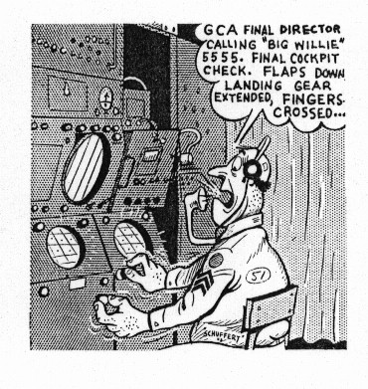
MJN 572 STOP TURNING TAKE HEADING 060 DEG. REPORT ESTABLISHED
42
Notes:
<number>

Slide 43
HOLDING PROCEDURE
43

Slide 44
objectives
TO RECOGNIZE THE 3 TYPES OF HOLDING PATTERN
TO UNDERSTAND THE PROCEDURES TO BE USED WHEN HOLDING
TO UNDERSTAND THE 3 TYPES OF ENTRY INTO A HOLDING PATTERN
TO BE ABLE TO CALCULATE A MINIMUM HOLDING LEVEL
TO KNOW YOUR AIRCRAFT’S HOLDING SPEED
44
Notes:
<number>

Slide 45
HOLDING
HOLDING PROCEDURE ORIENTATE THE A/C ON THE CORRECT HEADING TO FLY THE APPROACH PROCEDURE AND ALLOW ATC TO SEQUENCE SEVERAL A/C INTO THE APPROACH PATTERN.
45
Notes:
<number>

Slide 46

HOLDING PROCEDURES
OUTBOUND
INBOUND
HOLDING SIDE
NON-HOLDING SIDE
HOLDING FIX
46

Slide 47
HOLDING PROCEDURES
TYPES OF HOLDING PATTERN
HOLDING OVERHEAD A BEACON
VOR/DME - HOLDING TOWARDS THE BEACON.
VOR/DME - HOLDING AWAY FROM THE BEACON.
47

Slide 48
TYPES OF HOLDING PATTERN
1. HOLDING OVERHEAD A BEACON
ABEAM
OUTBOUND
INBOUND
HOLDING SIDE
NON-HOLDING SIDE
BEACON
HOLDING FIX
48
Notes:
<number>

Slide 49
TYPES OF HOLDING PATTERN
2. VOR/DME, HOLDING TOWARDS THE BEACON
LIMITING OUTBOUND
DISTANCE
OUTBOUND
INBOUND
HOLDING
DISTANCE
HOLDING
FIX
BEACON
49
Notes:
<number>

Slide 50
TYPES OF HOLDING PATTERN
3. VOR/DME, HOLDING AWAY FROM THE BEACON
LIMITING OUTBOUND DISTANCE
OUTBOUND
BEACON
INBOUND
HOLDING DISTANCE
HOLDING
FIX
50
Notes:
<number>

Slide 51
HOLDING PROCEDURES
ALL TURNS TO BE RATE 1 (3°/SECOND) OR 25° AOB.
ALL PROCEDURES DEPICT TRACKS, TRACKS SHOULD BE MAINTAINED BY MAKING ALLOWANCE FOR WIND BY APPLYING CORRECTIONS TO HEADINGS AND TIMINGS DURING ENTRY AND HOLDING PROCEDURES.
OUTBOUND TIMING STARTS ABEAM THE FIX (IF ABEAM POSITION CANNOT BE DETERMINED,START TIMING UPON COMPLETION OF OUTBOUND TURN).
IF THE OUTBOUND LEG LENGTH IS BASED ON A DME DISTANCE. THE OUTBOUND LEG ENDS AS SOON AS THE LIMITING DME DISTANCE IS ACHIEVED
51

Slide 52
ENTRY
There are 3 entry sectors:
sector 1 (parallel entry)
sector 2 (offset entry)
sector 3 (direct entry)
52

Slide 53
ENTRY
SECTOR 1, (PARALLEL ENTRY)
FROM OVERHEAD FIX, A/C TURNED ONTO OUTBOUND HEADING (1 MINUTE, WIND ADJUSTED).
A/C TURNED ONTO HOLDING SIDE TO INTERCEPT INBOUND TRACK OR TO RETURN TO FIX.
090
1
270
70°
53
Notes:
<number>

Slide 54
ENTRY
SECTOR 2, (OFFSET ENTRY)
FROM OVERHEAD THE FIX, A/C TURNED ONTO TRACK 30° OFFSET (1 MINUTE, WIND-ADJUSTED OR UNTIL LIMITING DME).
A/C TURNED TO INTERCEPT INBOUND TRACK.
090
30°
2
270
70°
54
Notes:
<number>

Slide 55
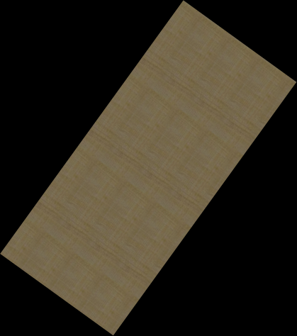
ENTRY
SECTOR 3, (DIRECT ENTRY)
HAVING REACHED THE FIX, A/C IS TURNED TO FOLLOW THE HOLDING PATTERN
3
70°
N
70°
55
Notes:
<number>

Slide 56
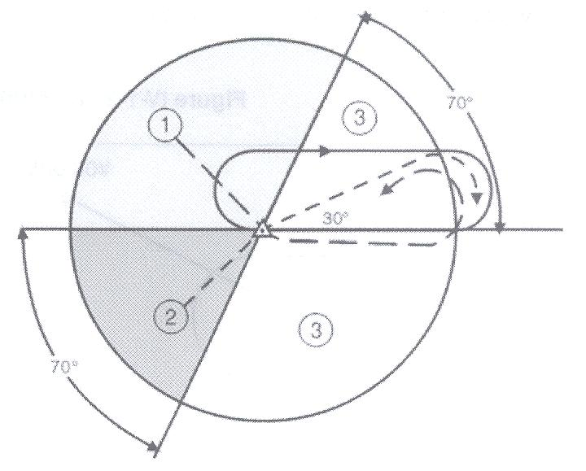
THE THREE HOLDING SECTORS
360
270
090
180
56
Notes:
<number>

Slide 57

ENTRY
The entry to be used into the holding pattern depends on the aircraft heading in relation to the 3 entry sectors
For entry, there is a zone of flexibility of 5° on either side of the sector boundaries
57

Slide 58
HOLDING PROCEDURES
Minimum Holding Level
The minimum holding level provides TERRAIN CLEARANCE in the holding area (the airspace required for the entry and holding patterns) and the buffer area (an area extending 5nm beyond the boundary of the holding area)
The minimum holding level provides
a clearance of 300m (984’) above obstacles in the holding area
a clearance above obstacles in the buffer area; the extent of the clearance reduces with the distance from the holding area
58
Notes:
<number>

Slide 59
AIRCRAFT HOLDING SPEEDS
AN AIRCRAFT’S HOLDING SPEED DEPENDS UPON WHETHER IT IS A JET OR TURBOPROP AIRCRAFT, AND THE HOLDING ALTITUDE.
ALT/LEVEL | TURBOPROP | JET
UP TO 14,000’ | 170KTS | 210 KTS
ABOVE 14,000’ | 175 KTS | 240 KTS
59
Notes:
<number>

Slide 60

HOLDING PROCEDURE
CONCLUTION
WE HAVE:
THE 3 TYPES OF HOLDING PATTERN
THE PROCEDURES TO BE USED WHEN HOLDING
THE 3 TYPES OF ENTRY INTO A HOLDING PATTERN
THE CALCULATION OF A MINIMUM HOLDING LEVEL
AIRCRAFT HOLDING SPEEDS
60
Notes:
<number>

Slide 61
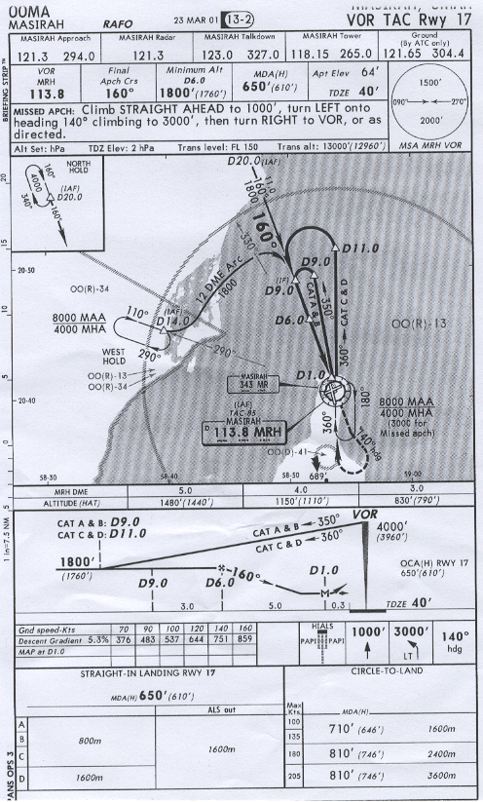
61
Notes:
<number>

Slide 62
HOLDING PROCEDURE
ANY
QUESTIONS?
62
Notes:
<number>

Slide 63
TERMINAL APPROACH PLATES (TAPs)
63
Notes:
<number>

Slide 64
TERMINAL APPROACH PLATES
(TAPs)
64
Notes:
<number>

Slide 65
TERMINAL APPROACH PLATES (TAPs)
AIMS:
TO UNDERSTAND THE ABBREVIATIONS USED ON TAPS
TO UNDERSTAND THE SYMBOLS USED ON TAPS
TO LEARN HOW TO INTERPRET A PRECISION & A NON-PRECISION APPROACH
65
Notes:
<number>

Slide 66
TERMINAL APPROACH PLATES (TAPs)
ABBREVIATIONS & SYMBOLS
TAP STUDY
MASIRAH VORTAC RWY 17
66
Notes:
<number>

Slide 67
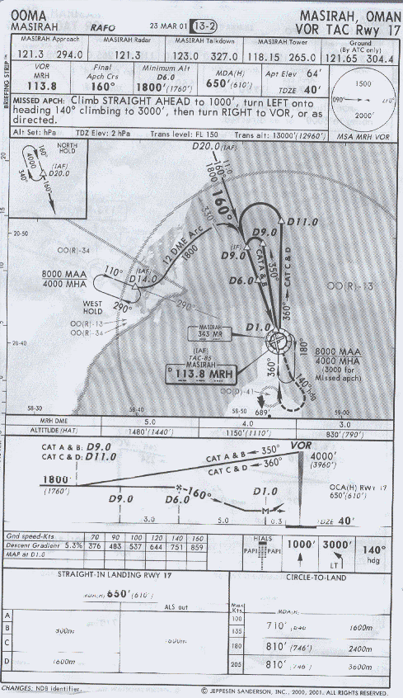
67
Notes:
<number>

Slide 68
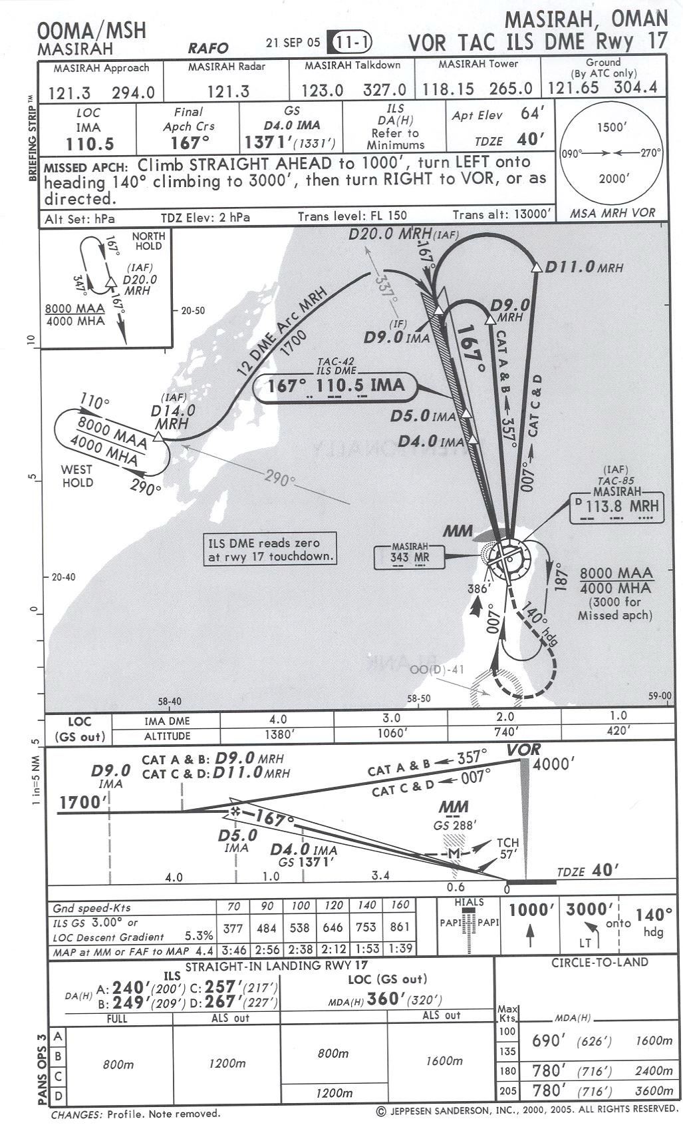
heading
Plan view
PROFILE
VIEW
LANDING
MINIMUMS
68

Slide 69
GEOGRAPHIC NAME
CHART DATE
GEOGRAPHICAL LOCATION
AIRPORT NAME
CART INDEX NUMBER
PROCEDURE IDENTIFICATION
DESIGNATED RUNWAY
69
Notes:
<number>

Slide 70
ALTIMETER SETTING
MSA Minimum Safe Altitude
T.L IS THE LOWEST LEVEL OF FLIGT USING STANDARD ALTIMETER SETTING ( OF 1013.25 MILLIBARS ).
T.A IS THE ALTITUDE AT AND BELOW WICH LOCAL PRESSURE SETTING MUST BE USE (QNH).
70
Notes:
<number>

Slide 71
APPROCH PLAN VIEW
71
Notes:
<number>

Slide 72
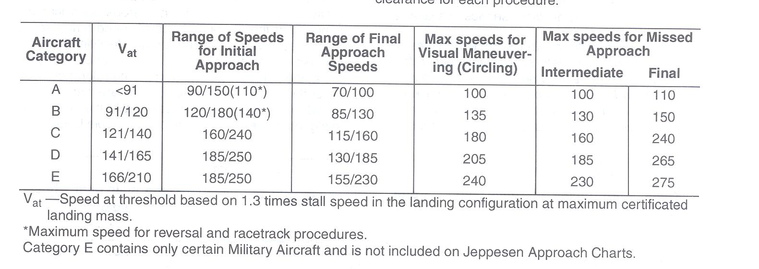
72
Notes:
<number>

Slide 73
PROCEDURE TURN
DME FIXES
FAF
MINIMUM ALTITUDE AND HIGHT ABOVE TDZE
NM DISTANCE BETWEEN FIXES
MAP
OBSTACLE CLEARANCE ALTITUDE
73
Notes:
<number>

Slide 74
74
Notes:
<number>

Slide 75
INSTRUMENT APPROACH PROCEDURES
OBJECTIVES:
To identify the 4 segments of an instrument approach.
To examine the differences between a precision and a non- precision approach.
To study the circling approach.
75

Slide 76
INSTRUMENT APPROACH PROCEDURES
Segments of an Instrument Approach
There are 4 separate segments to an instrument approach:
Initial
Intermediate
Final
Missed Approach
76

Slide 77
INSTRUMENT APPROACH PROCEDURES
Arrival Segment
Standard Instrument Arrival (STAR)
May be replaced by radar vectoring
77

Slide 78
INSTRUMENT APPROACH PROCEDURES
Initial Approach Segment
From Initial Approach Fix (IAF) to Intermediate Fix (IF).
Aircraft has departed the en-route structure and is maneuvered to enter the intermediate approach sector.
78

Slide 79
INSTRUMENT APPROACH PROCEDURES
Intermediate Approach Segment
From Intermediate Fix (IF) to Final Approach Fix (FAF).
Aircraft’s speed and configuration adjusted to prepare for the final approach.
79

Slide 80
INSTRUMENT APPROACH PROCEDURES
Final Approach Segment
From Final Approach Fix (FAF) to Missed Approach Point (MAP).
Aircraft aligned and descended for landing.
Final approach may be made to runway for straight-in landing or to an airfield for visual, circling, maneuvers to land.
80

Slide 81
INSTRUMENT APPROACH PROCEDURES
Missed Approach Procedure
From Missed Approach Point (MAP) to point where a new approach, a holding pattern, or as directed by radar, or entry into en-route flight may be initiated.
81

Slide 82
INSTRUMENT APPROACH PROCEDURES
The Precision Approach
A precision approach is one that uses electronic glide path information.
The Minima for a precision approach is a DA.
82

Slide 83
INSTRUMENT APPROACH PROCEDURES
The Non-Precision Approach
A non-precision approach is one that does not use electronic glide path information.
The Minima for a non-precision approach is an MDA.
83

Slide 84
INSTRUMENT APPROACH PROCEDURES
Missed Approach Point
The MAP in a procedure may be:
intersection of electronic glide path with applicable DA.
a beacon.
a fix.
a specified distance from the FAF.
84

Slide 85
INSTRUMENT APPROACH PROCEDURES
Circling Approach
The visual phase of flight, after completing an instrument approach from which a straight-in landing was not possible, during which the A/C is maneuvered into position for landing, the A/C must not be descended below DA/MDA until visual with airfield and the A/c position can be determined.
85

Slide 86
INSTRUMENT APPROACH PROCEDURES
Circling Approach
If visual reference lost while circling to land from an instrument approach, the missed approach for that approach procedure must be flown!
86

Slide 87
INSTRUMENT APPROACH PROCEDURES
objectives:
Identified the 4 segments of an instrument approach
Studied the procedures used in the initial approach sector
Examined the differences between a precision and a non- precision approach
Studied the circling approach
87

Slide 88
INSTRUMENT APPROACH PROCEDURES
ANY
QUESTIONS?
88

