Slide 1

E-COMMERCE PORTAL FOR FURNITURE SALES

Slide 2
Objective
E- commerce portal is created to meet the needs of furniture and , with 2 actors:
Admin: Add a new furniture, view all furniture, cancel/ delete an existing furniture and modify the price amount.
Customer: Make a order, view existing orders, cancel an existing orders.

Slide 3
Miceroservices
Login/Registration service (By admin/User)
Product-Management service
(Admin performs CURD operations of items)
Addto-cart service
(User can add item to cart or cancel item)
Payment-service
(User can make payment)

Slide 4
Technology Stack
1. Presentation Layer:
NodeJS 10.16.3 (Javascript Runtime Environment)
Angular 8 (framework to develop web apps)
VSCode 1.39 (to develop front end)
2. Business Layer:
Java 8 (base programming language)
Postman 7.9.0 (for running RESTful service)
Spring framework (for creating webservices)
Spring Boot 2.1.9 (auto configuring)
3. Persistence Layer:
Hibernate 2.1 (JPA implementation)
Spring Data 2.1.9 (performing repository ops)
MySQL 5.5.1 7(database storage)
4. Cross Cutting Concern:
Spring Security & JWT 2.1.9 (access restriction)
. Hardware and Software Requirements:
Windows 10, RAM 2GB, I.E 7+ or Google Chrome, Memory Space: 500MB.

Slide 5
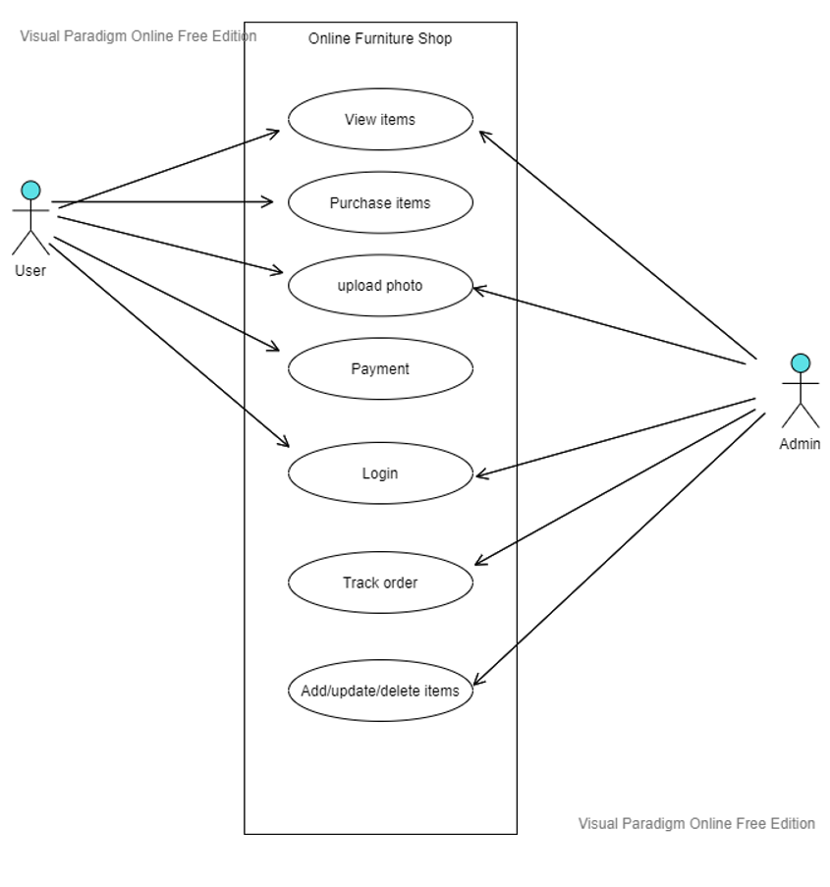
UseCase Diagram

Slide 6
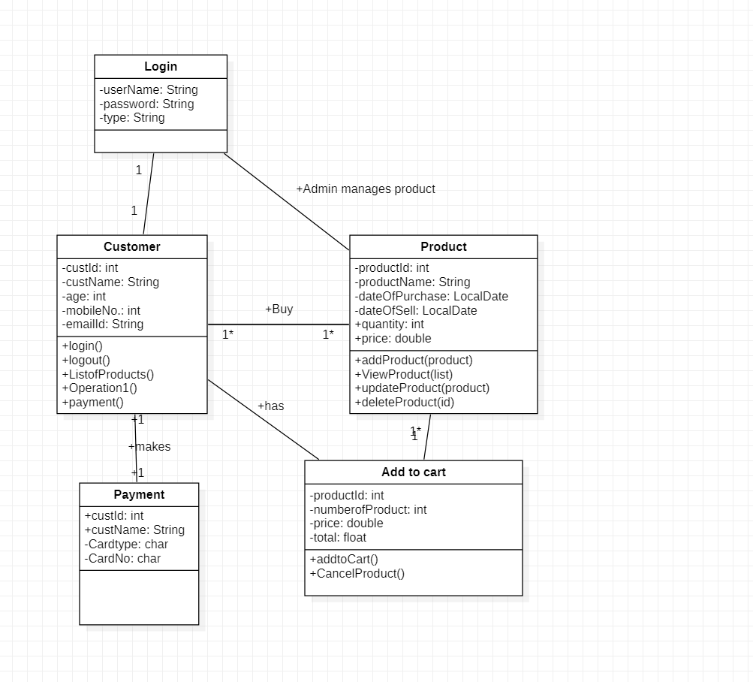
Class Diagram

Slide 7


