Slide 1


Slide 2
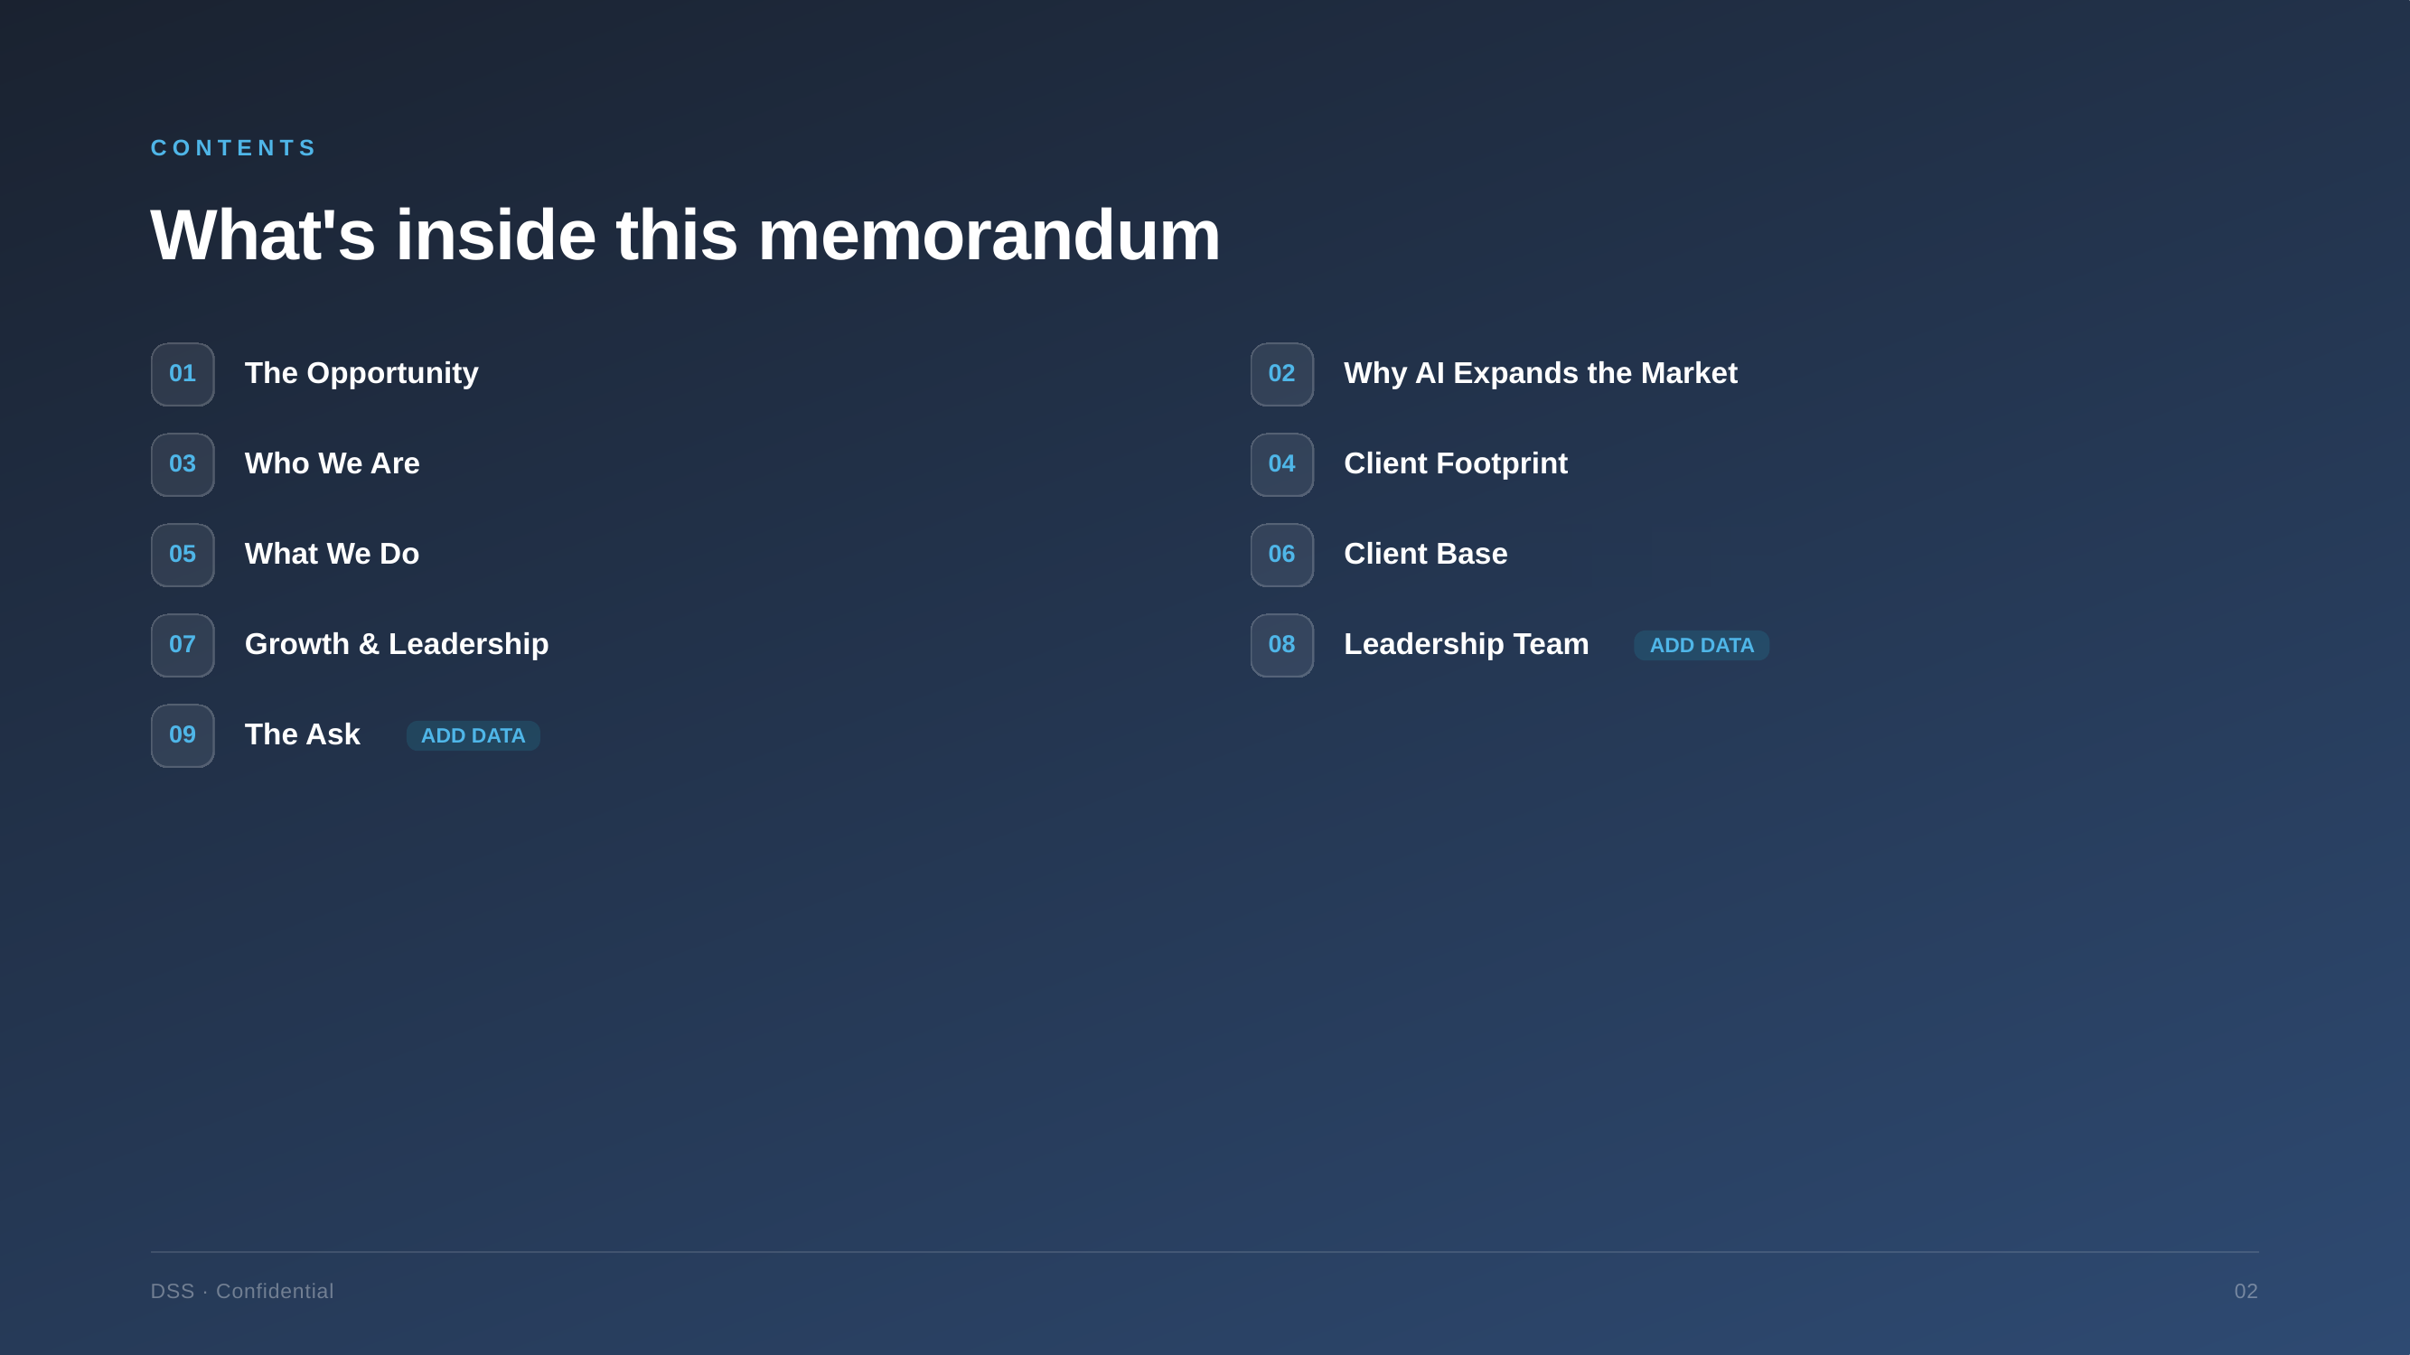

Slide 3
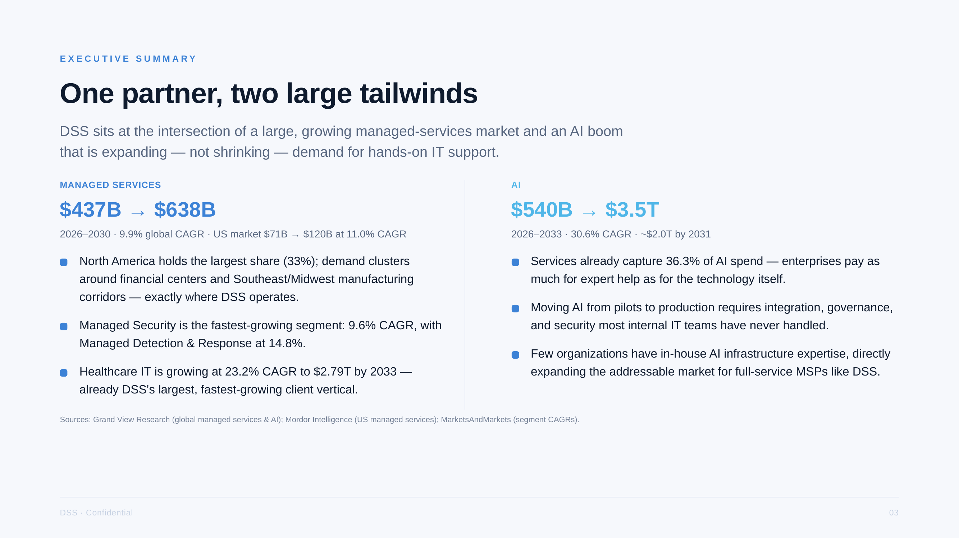

Slide 4
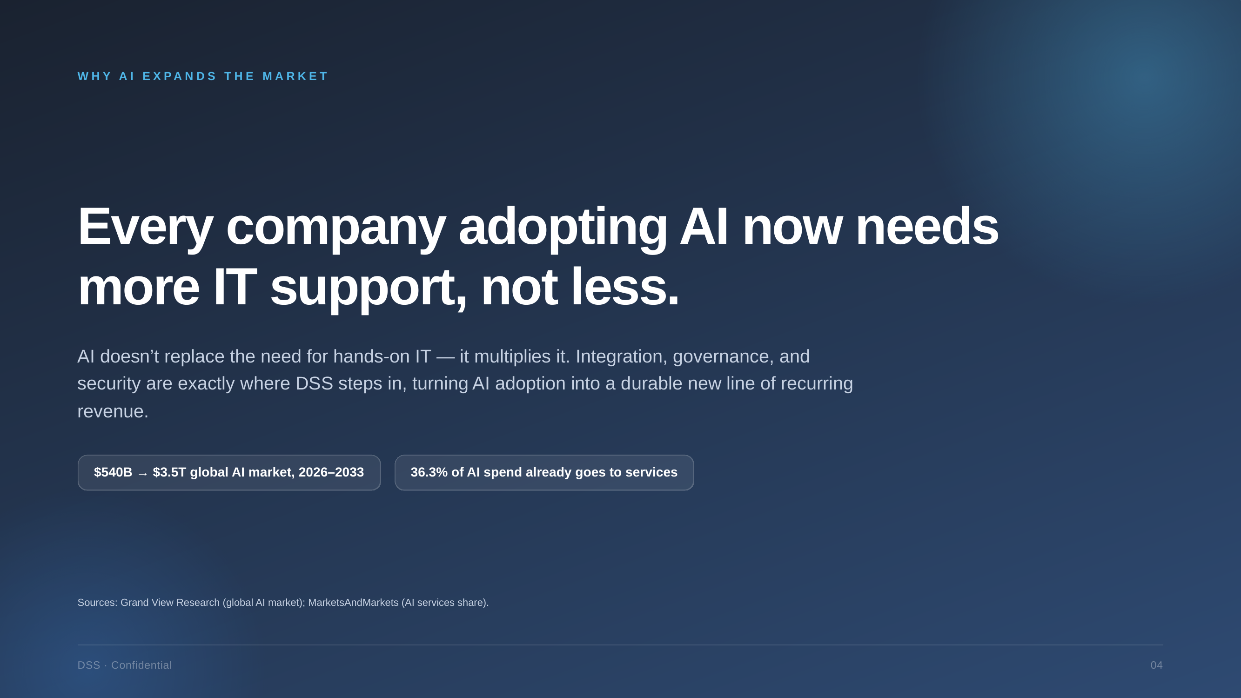

Slide 5
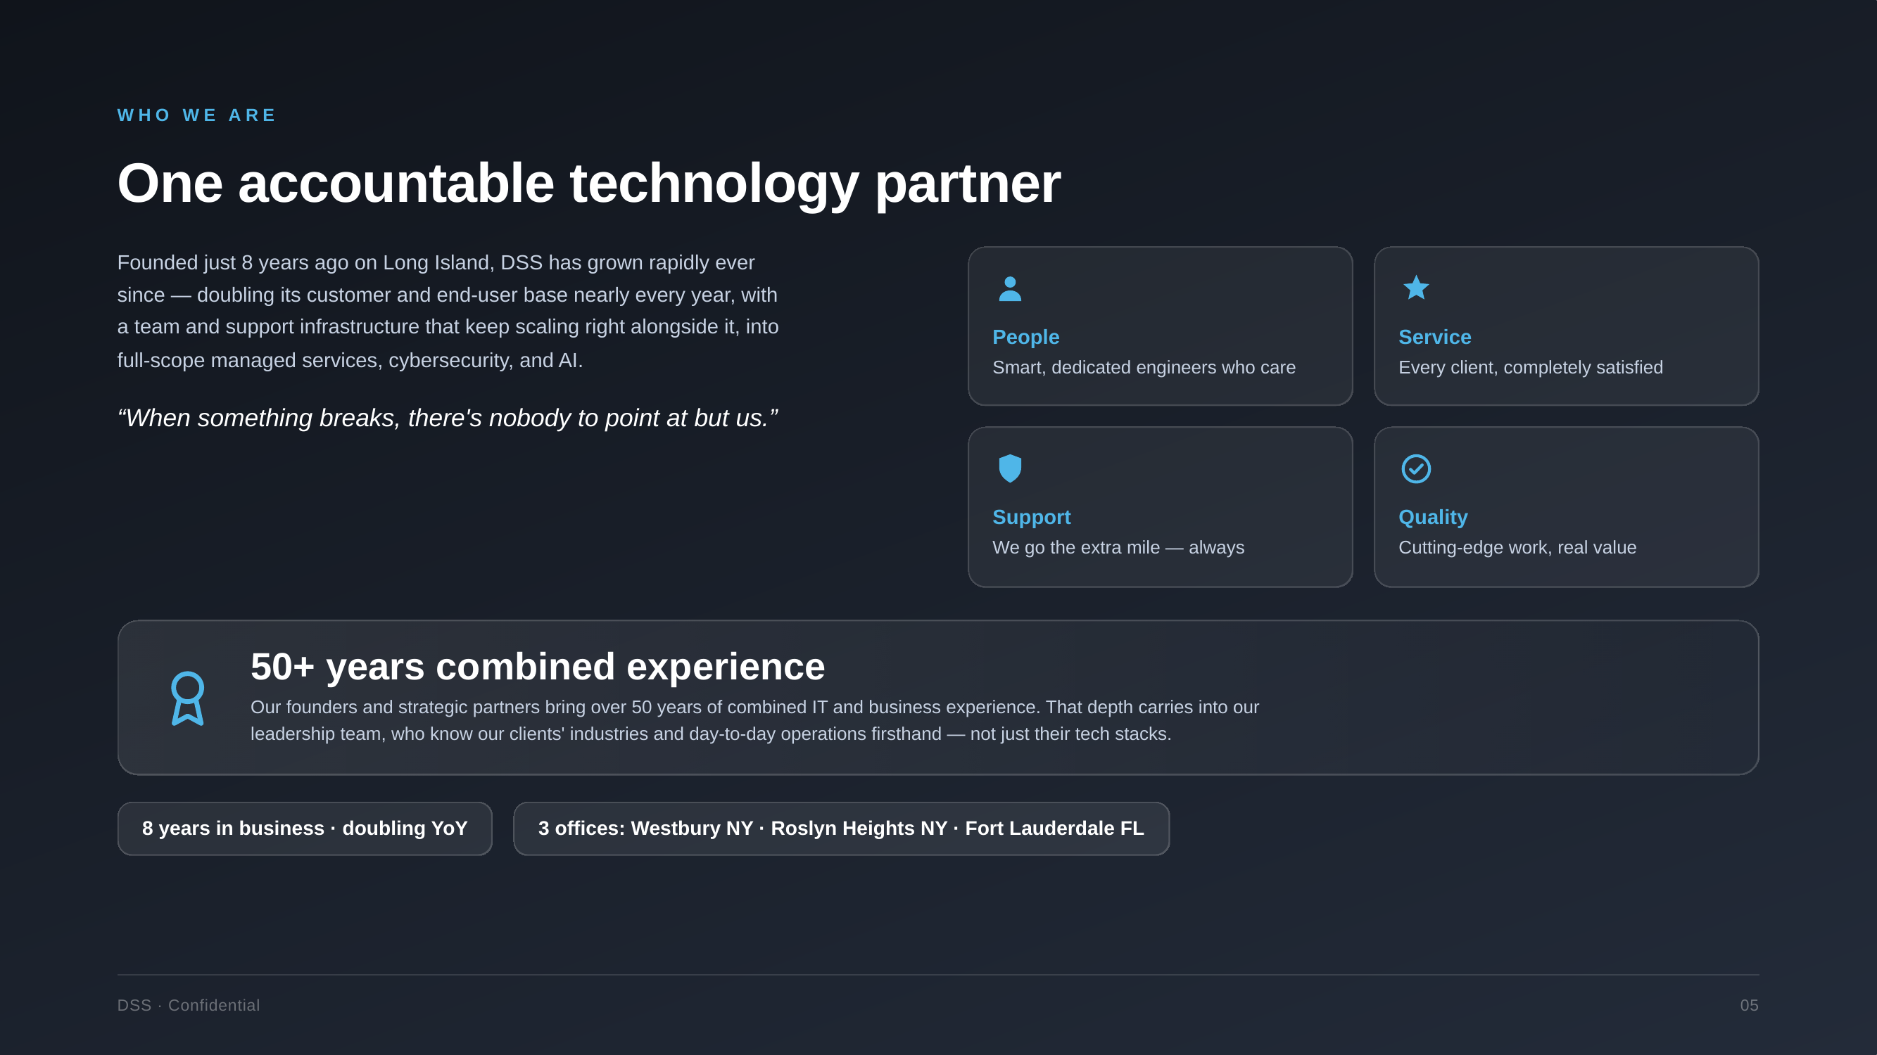

Slide 6
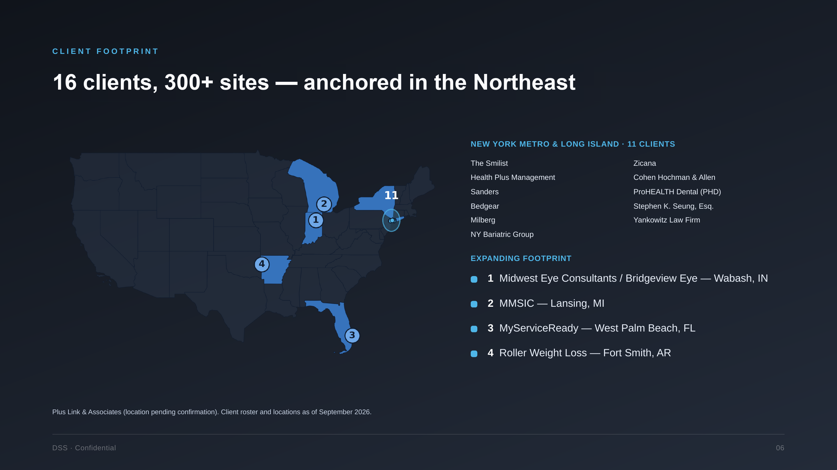

Slide 7
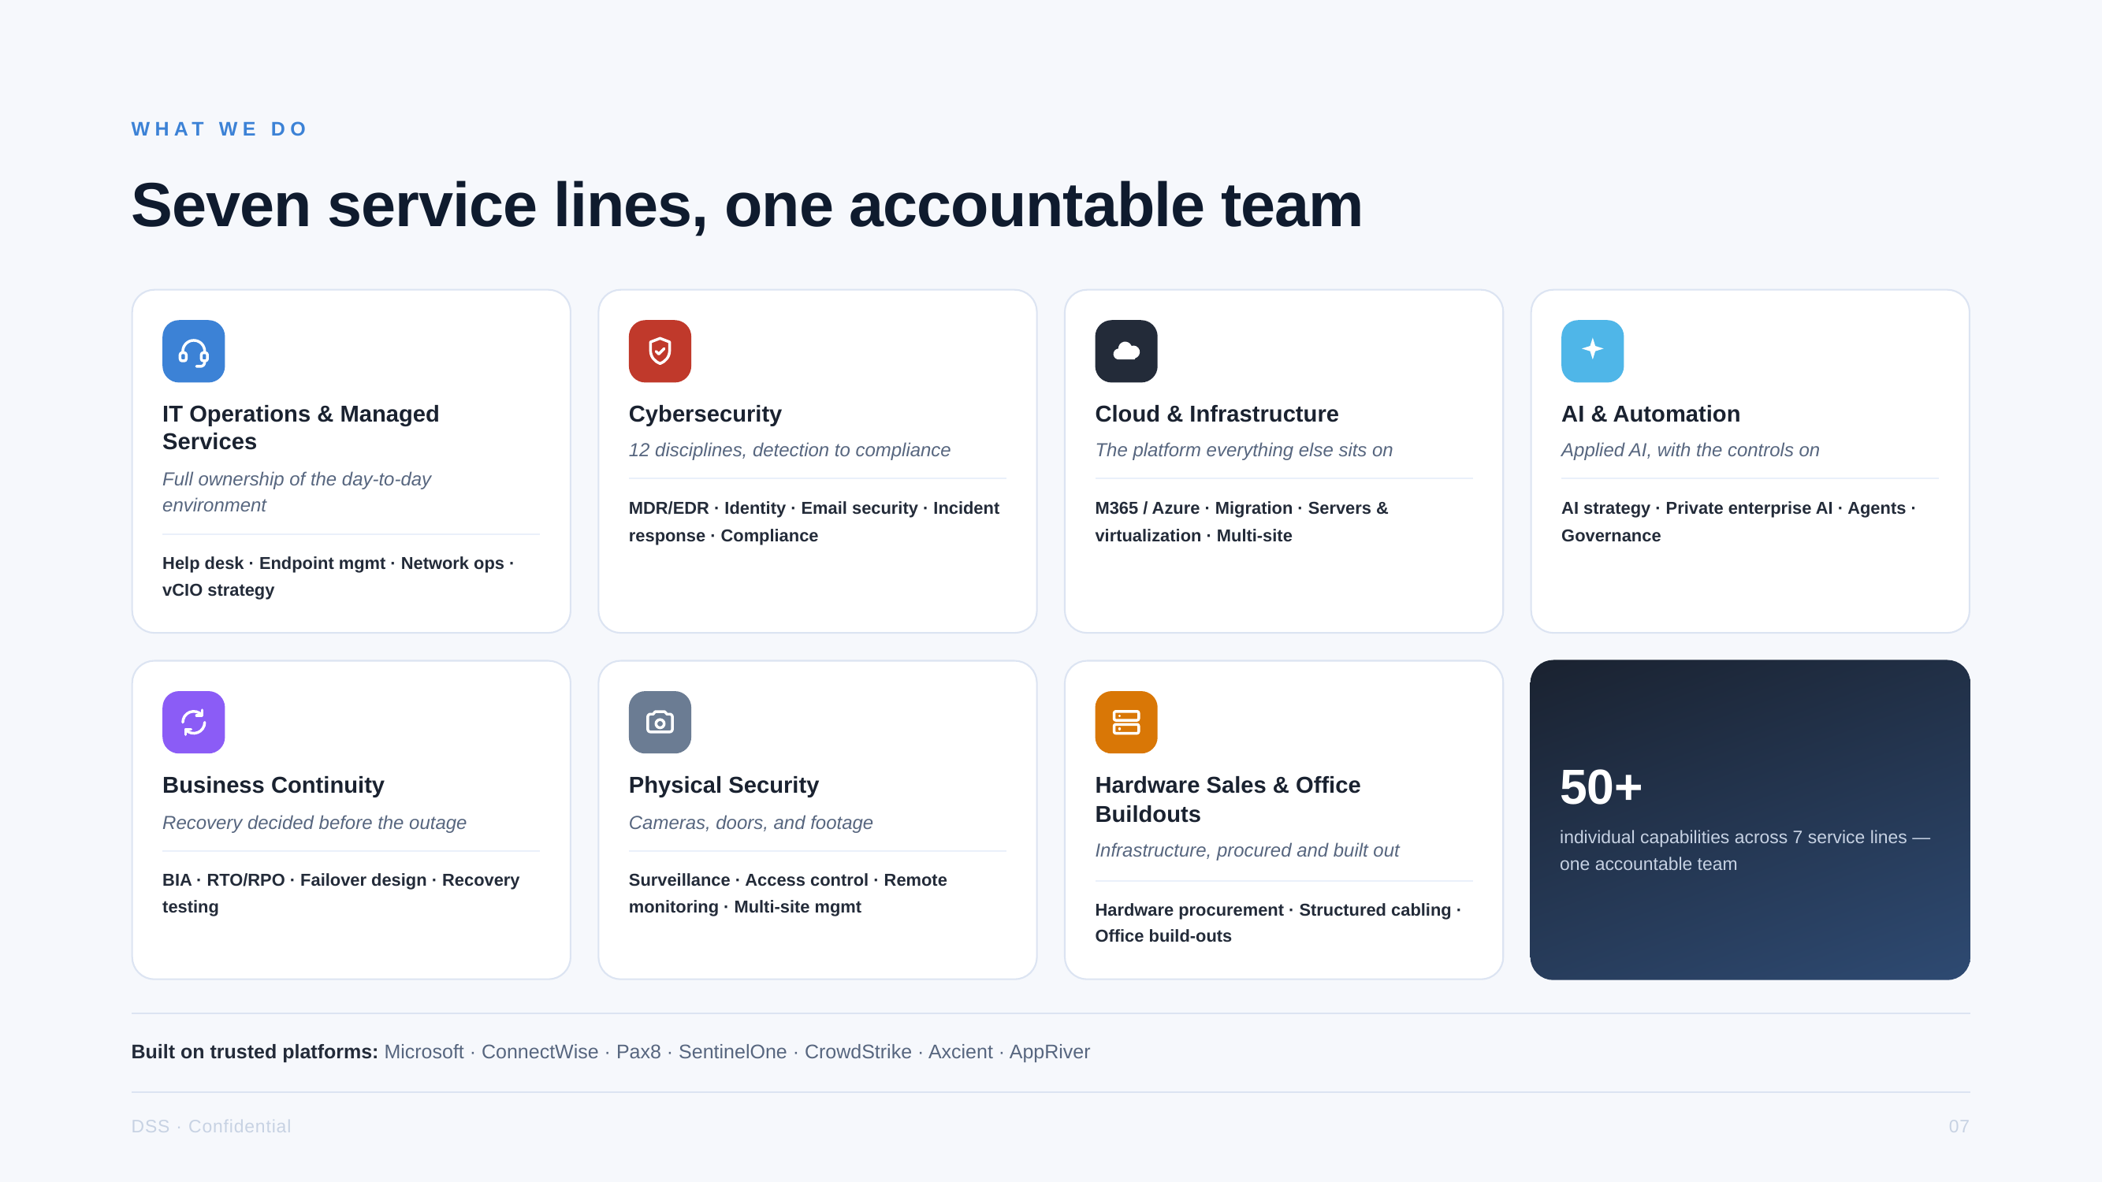

Slide 8
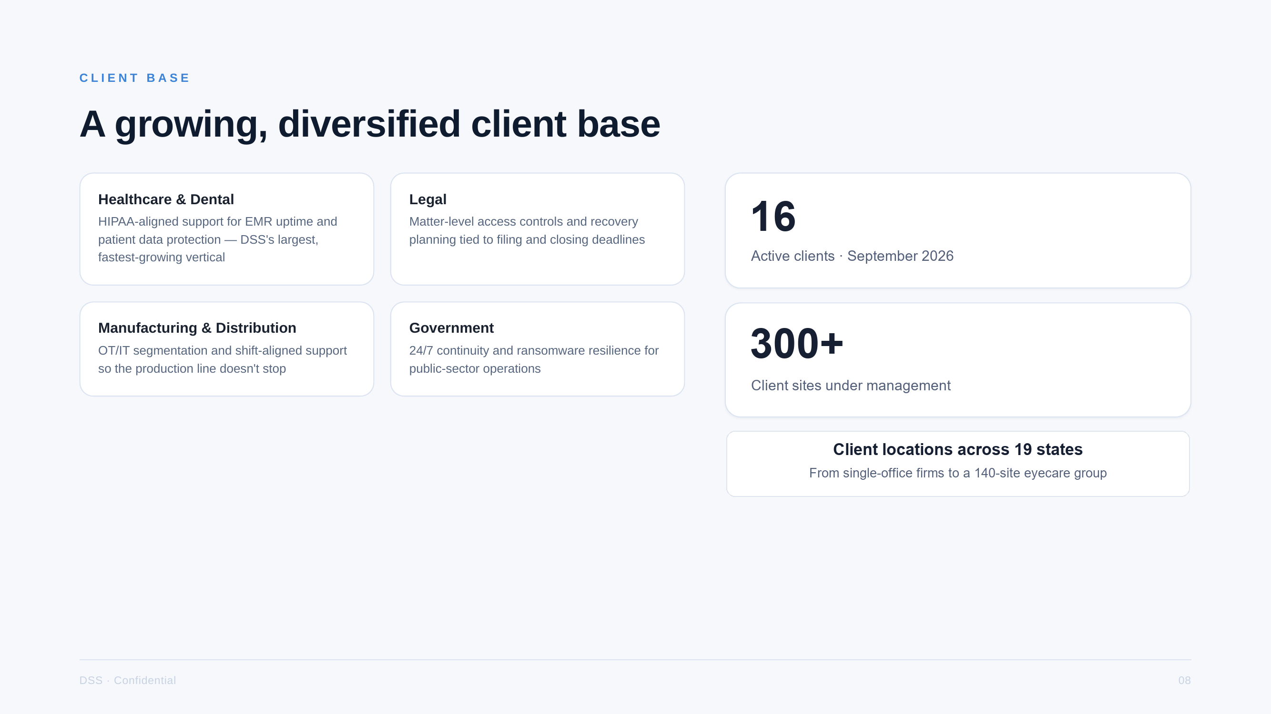

Slide 9
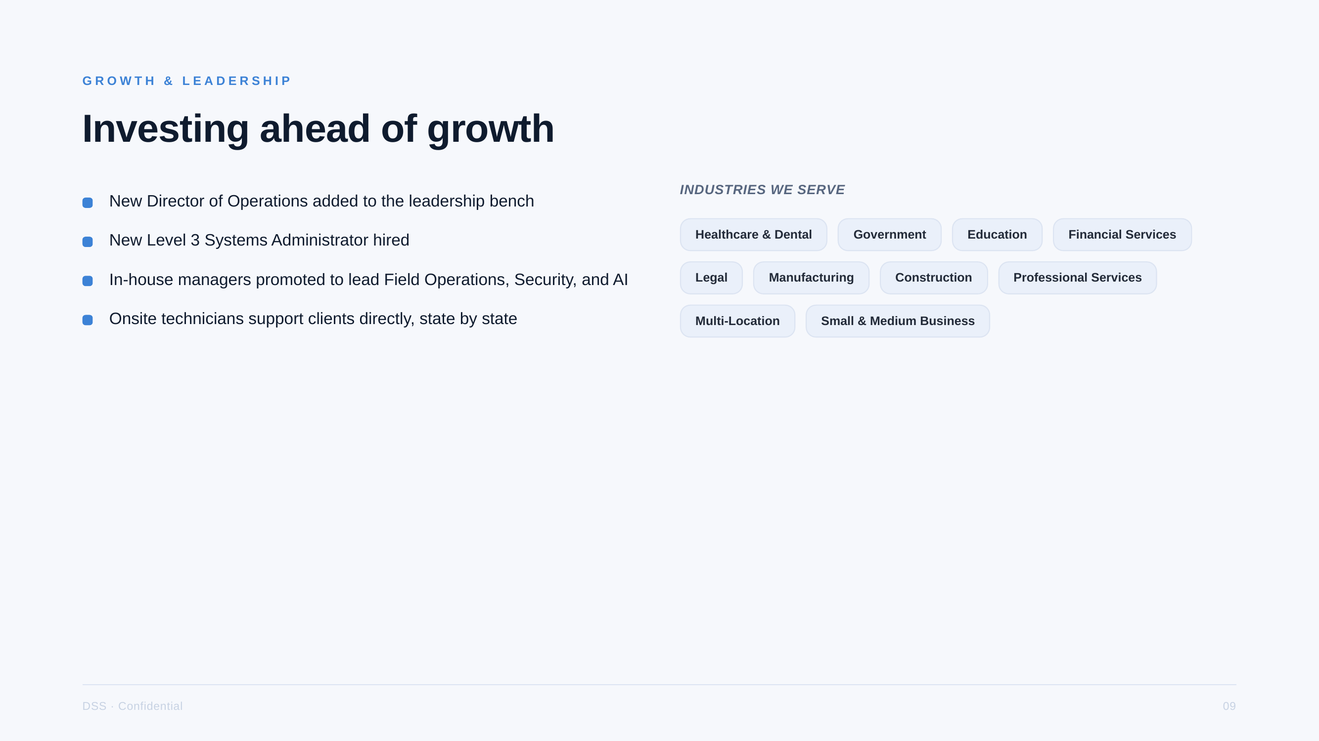

Slide 10



LEADERSHIP TEAM
Leadership Team
Dashmir Dalipi
Jose Ra
Sajid Kakana
Chief Executive Officer
Director of Operations
Level 3 Systems Administrator
DSS · Confidential
10
Notes:
Dashmir Dalipi, CEO: founded DSS - IT & Cyber Security Management in 2019. 20+ years in healthcare IT; previously Director of IT / Chief Information Security at ProHEALTH Care.
Jose Ra, Director of Operations.
Sajid Kakana, Level 3 Systems Administrator.
Headshots are initials placeholders: right-click a circle > Change Picture to drop in a photo; the circle crop and size are kept.

Slide 11
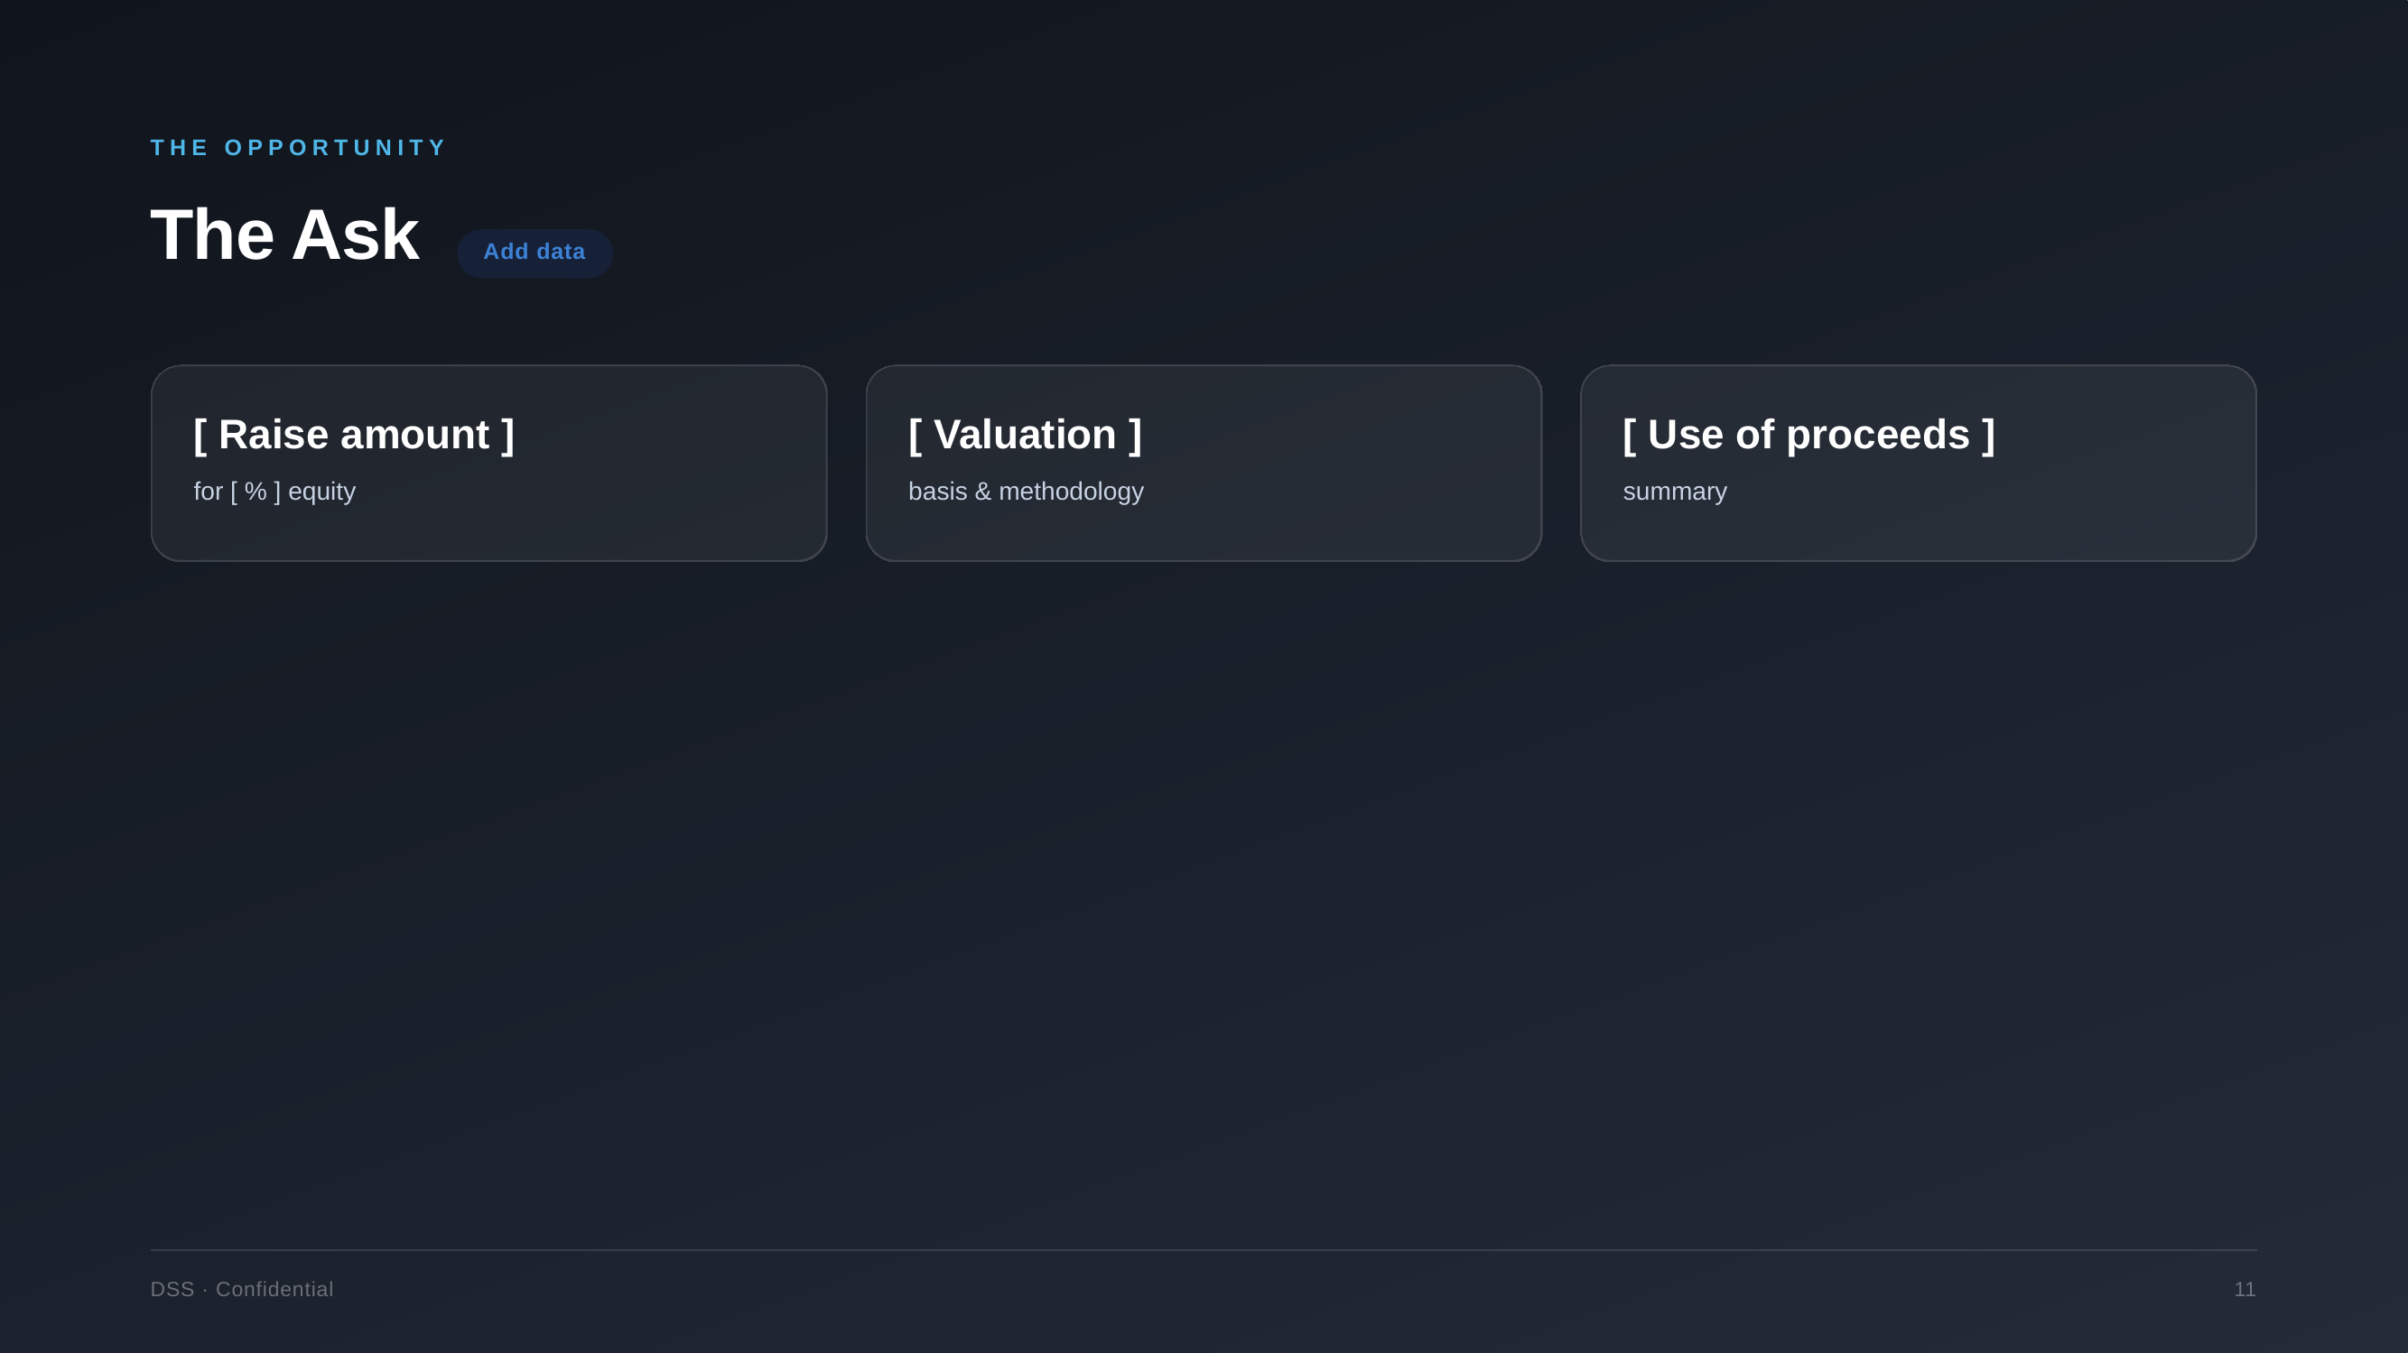

Slide 12


