Slide 1
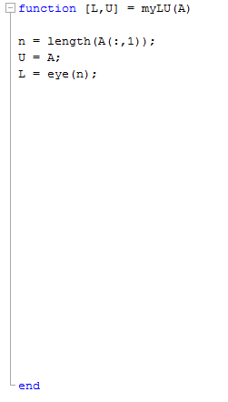
for i from 1 to n-1
for k from i+1 to n
L(k,i) = U(k,i) / U(i,i)
for j from i to n
U(k,j) = U(k,j) - L(k,i) * U(i,j)

