Slide 1
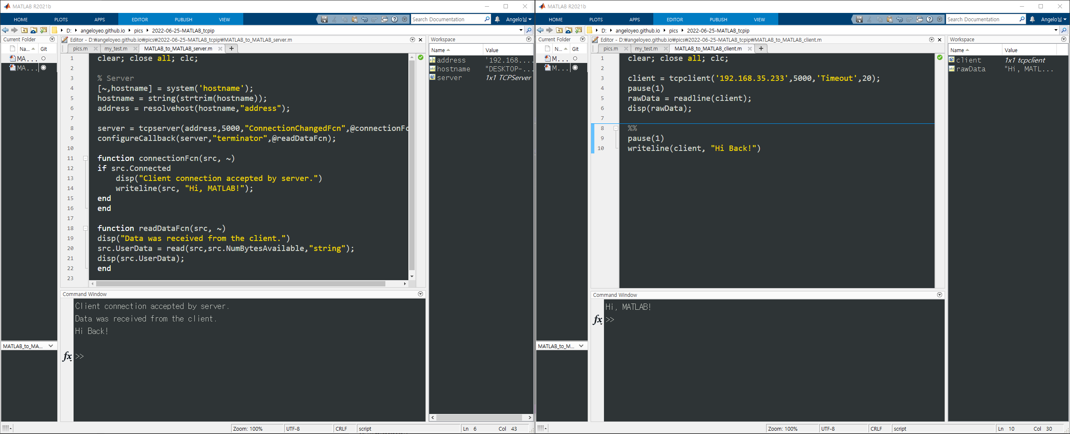
Hi, MATLAB!
Hi Back!
Server
Client

