Slide 1


Mateusz Lewandowski
08/19/2025

Slide 2

Outline
Executive Summary
Introduction
Methodology
Results
Conclusion
Appendix

Slide 3
Executive Summary
This project analyzes SpaceX launch data to identify factors affecting mission success. Using SQL for data extraction, data preprocessing, feature engineering, and data visualization, we uncover key patterns and build machine learning models.
The results highlight the most important drivers of launch outcomes and provide actionable insights for mission planning and risk management.

Slide 4
Introduction
SpaceX has revolutionized space exploration by developing reusable rockets and reducing launch costs. Understanding the factors that influence the success of launches is critical for mission planning, risk management, and continuous improvement of rocket technology. By analyzing historical launch data, we can identify patterns and insights that help improve future mission outcomes.
Problems We Want to Find Answers To:
Which factors most strongly influence the success or failure of a SpaceX launch?
Can we predict the outcome of a launch based on available data?
How can data-driven insights help optimize mission planning and reduce risk?
Are there trends or patterns in launch outcomes over time or by rocket type?

Slide 5

Section 1

Slide 6
Methodology
Executive Summary
Data collection methodology: Data was collected from CSV file available in IBM Cloud Platform
Perform data wrangling The data was cleaned, encoded, and scaled, with SQL used for extraction and visualization applied to identify patterns before modeling.
Perform exploratory data analysis (EDA) using visualization and SQL
Perform interactive visual analytics using Folium and Plotly Dash
Perform predictive analysis using classification models Build classification models by selecting features and algorithms, tune hyperparameters with cross-validation, and evaluate performance using accuracy.

Slide 7
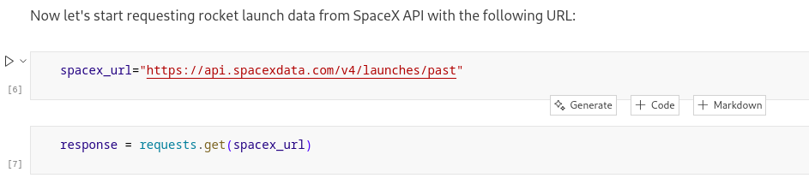
Data Collection
Data was downloaded from CSV file with pandas library. CSV file was available in IBM platform Cloud, initially provided by SpaceX company (shared publicly).

Slide 8
Data Collection – SpaceX API
Make GET request https://api.spacexdata.com/v4/launches/past
Receive JSON response with launch data
Parse JSON and store in DataFrame
Data Collection API - link to notebook

Slide 9
Data Collection - Scraping
Make GET request to Wikipedia https://en.wikipedia.org/w/index.php?title=List_of_Falcon_9_and_Falcon_Heavy_launches&oldid=1027686922
Parse table with BeautifulSoup library
Store parsed result into Pandas DataFrame
Data Collection WebScraping - link

Slide 10
Data Wrangling
Filter the dataframe include only Falcon 9 launches
Cleaning and preparing data strip strings, formatting numbers, dates
Dealing with Missing Values
Initial exploratory analysis
Determine training labels
Data wrangling - link

Slide 11
EDA with Data Visualization
Scatter plots show result of mission (success or fail) depending on:
flight number and payload mass
flight number and launch site
payload mass and launch site
flight number and orbit type
payload mass and orbit type
Line plot to visualize the launch success yearly trend
Bar plot with success rate by orbit type
EDA Data visualization - Link

Slide 12
EDA with SQL
names of the unique launch sites in the space mission
5 records where launch sites begin with the string 'CCA'
total payload mass carried by boosters launched by NASA (CRS)
average payload mass carried by booster version F9 v1.1
date when the first succesful landing outcome in ground pad was acheived
boosters with success in drone ship with payload mass 4000-6000 kg
total number of successful and failure mission outcomes
booster_versions that have carried the maximum payload mass
failure missions (month, booster version, launch site) in 2015
ranking of missions between 2010-06-04 and 2017-03-20 by landing outcome
EDA SQL - Link

Slide 13
Build an Interactive Map with Folium
On the Folium map, I added markers for individual launch sites and grouped them using marker clusters to improve readability when multiple points were close together. I also created a choropleth map to visualize launch success rates by region, providing a clear geographic overview.
These objects were included to highlight both the exact locations of launches and the broader spatial patterns, making the data more insightful and easier to interpret.
Interactive Map with Folium - link

Slide 14
Build a Dashboard with Plotly Dash
Dashboard Summary
Dropdown menu – allows selecting a specific launch site or all sites.
Pie chart – shows success counts per site (or success vs. failure for a chosen site).
Range slider – lets users filter launches by payload mass.
Scatter plot – visualizes the correlation between payload mass and launch success, colored by booster version.
These plots and interactions were added to make the dashboard interactive and insightful, helping users explore success rates, compare sites, and understand how payload and booster type influence mission outcomes.
Interactive dashboard - Link

Slide 15
Predictive Analysis (Classification)
Prepare data define target variable, stanardize data
Different estimators:
Logistic Regression
KNN
SVM
Decision Tree
Split data into train and test
Train data find optimal parameters using GridSearchCV
Calculate accuracy and score on test data Plot confusion matrix
Find method that performs best
Classification - Link

Slide 16
Results
EDA (visualization and SQL):
success rate increased from 0 to 80% from 2013 to 2017
most launches were to orbit GTO and ISS
first succesful landing outcome in ground pad was in 2015
99/101 missions had successful outcome
although a lot of landings failed
Interactive dashboards and classification:
most success were with launch site KSC LC-39A
no significant correlation between payload mass and success, except a lot of failures for payload mass between 500-750 kg
best achieved score on test data was 83.3%
all estimators achieved same score
100% accuracy for negative 80% accuracy for positive cases

Slide 17

Section 2

Slide 18
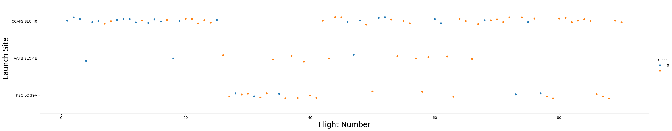
Flight Number vs. Launch Site
First flights were mostly failure, launched on CCAFS SLC 40
Recent flights were successful mostly launched on CCAFS and KSC
VAFB was launched rarely

Slide 19
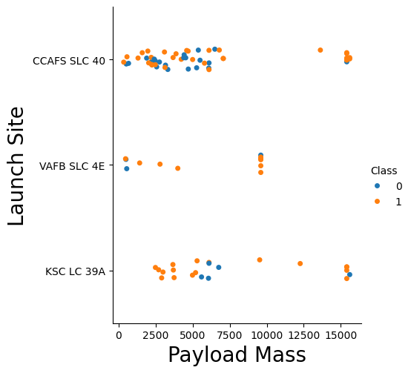
Payload vs. Launch Site
CCAFS was mostly launched with payload mass less than 7,5t and with maximum mass
VAFB was used for mass ~10t with success
KSC was used similarly to CCAFS

Slide 20
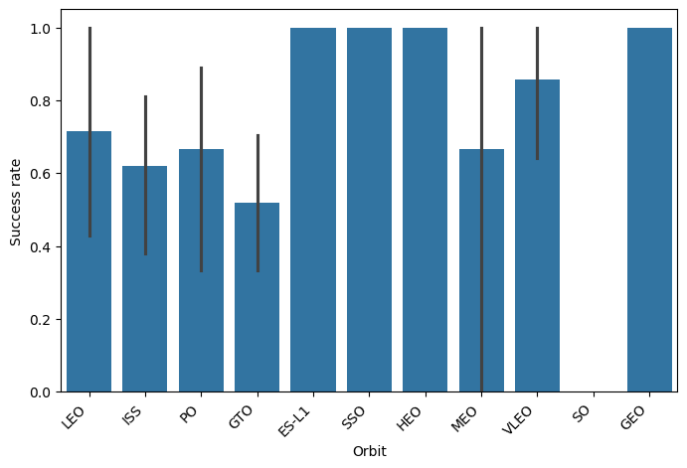
Success Rate vs. Orbit Type
100% success for orbits: ES-L1, SSO, HEO, GEO
Smallest success rate for GTO (~50%) probably because of a lot tries in early stage
Small confidence for results for MEO orbit

Slide 21
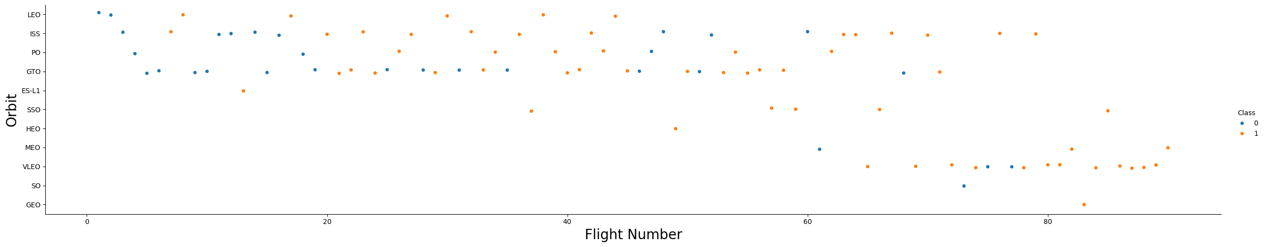
Flight Number vs. Orbit Type
Most recent success launches were to VLEO orbit
First launches were mostly done on orbits: LEO, ISS, GTO, PO
GEO orbit was launched only once with success probably due to high cost

Slide 22
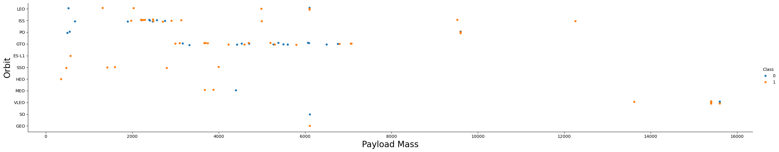
Payload vs. Orbit Type
Launches with high payload were only done with VLEO orbit
Small payloads were sent to ISS orbit mostly
Medium payloads were tested mostly on GTO orbit (with a lot of failures)

Slide 23
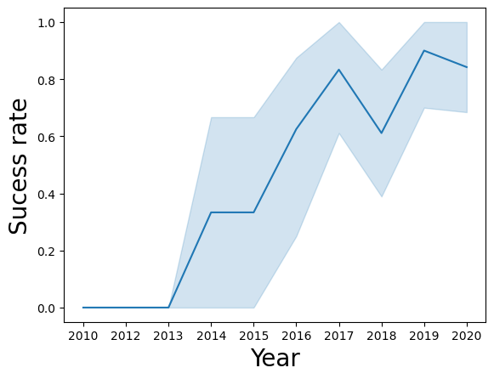
Launch Success Yearly Trend
First success was in 2013
Most increasing trend was between 2013 and 2017
Average success rate in recent years was around 80% (2017-2020)

Slide 24
All Launch Site Names
select distinct(launch_site) from spacextable
Zwraca unikalne nazwy miejsc startowych (launch_site).

Slide 25
Launch Site Names Begin with 'CCA'
Select * from spacextable where launch_site like 'CCA%' limit 5
Gets first 5 rows from table, where launch site begins with ‘CCA’

Slide 26
Total Payload Mass
select sum(payload_mass__kg_) from spacextable where customer = 'NASA (CRS)'
Calculates total payload mass launched for customer NASA (CRS)

Slide 27
Average Payload Mass by F9 v1.1
select avg(payload_mass__kg_) from spacextable where booster_version = 'F9 v1.1'
Calculates average payload mass for booster version F9 v1.1

Slide 28
First Successful Ground Landing Date
select min(date) from spacextable where landing_outcome = 'Success (ground pad)'
Finds minimum date for landing_outcome: ‘Success (ground pad’

Slide 29
Successful Drone Ship Landing with Payload between 4000 and 6000
Select * from spacextable where (PAYLOAD_MASS__KG_ between 4000 and 6000) and (Landing_Outcome = 'Success (drone ship)')
Selects every launch when payload mass was between 4000 and 6000 kg and landing outcome wass succesful on drone ship

Slide 30
Total Number of Successful and Failure Mission Outcomes
select mission_outcome, count(1) from spacextable group by mission_outcome
Groups launches by mission outcome, and counts frequency of groups. Display mission_outcome and counter for every group

Slide 31
Boosters Carried Maximum Payload
select distinct(booster_version) from spacextable where PAYLOAD_MASS__KG_ = (select max(PAYLOAD_MASS__KG_) from spacextable)
Firstly calculates maximum payload mass, then find unique booster versions that carried this mass

Slide 32
2015 Launch Records
select substr(date,6,2) month, landing_outcome, booster_version, launch_site from spacextable where substr(date,1,4) = '2015' and landing_outcome = 'Failure (drone ship)'
Selects data from year 2015 with landing outcome failure on drone ship. Then displays month, landing outcome, booster version and launch site for every launch

Slide 33
Rank Landing Outcomes Between 2010-06-04 and 2017-03-20
select landing_outcome, COUNT(1) AS outcome_count from spacextable where date BETWEEN '2010-06-04' and '2017-03-20' group by landing_outcome order by outcome_count DESC;
Ranks the count of landing outcomes (such as Failure (drone ship) or Success (ground pad)) between the date 2010-06-04 and 2017-03-20, in descending order

Slide 34

Section 3

Slide 35
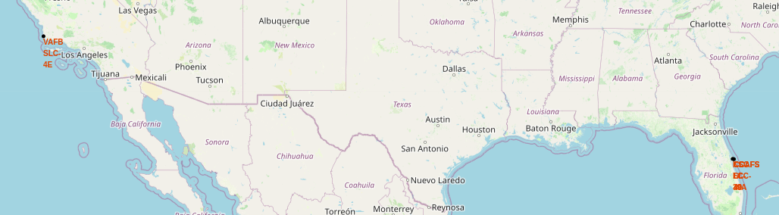
Launch Sites
Launch Sites are located near ocean and near coasts. Some of them are on south and some on west of USA

Slide 36
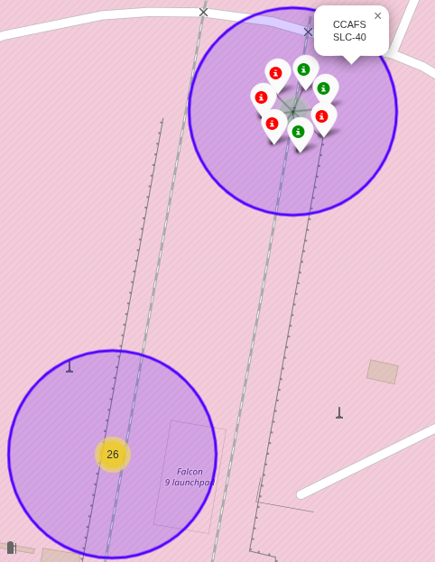
Success vs fail – Launch site: CCAFS SLC - 40
At CCAFS SLC-40 launch site, a little less than 50% launches were successful

Slide 37
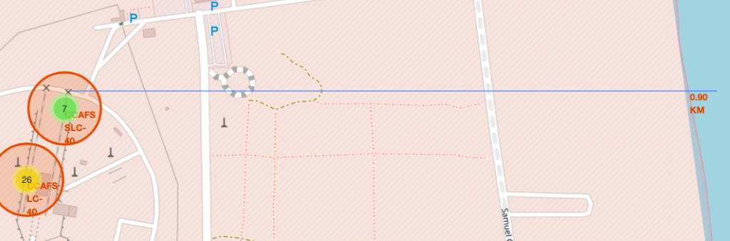
Proximity to coasts, railways, highways
The selected launch site is located near a highway, a railway, and the coastline, providing good access and transport options. Distances to each feature are clearly displayed on the map, showing that the railway is slightly farther than the highway but still nearby. This proximity to multiple transport routes could be important for launch logistics and safety planning.

Slide 38

Section 4

Slide 39
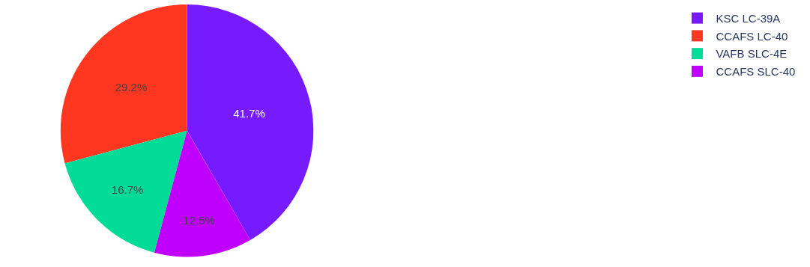
Success rate by launch site
Most success launches was from launch site KSC LC-39A 29,2% of successful launches was from CCAFS LC-40 Less successes occurred for VAFB SLC-4E and CCAFS SLC-40

Slide 40
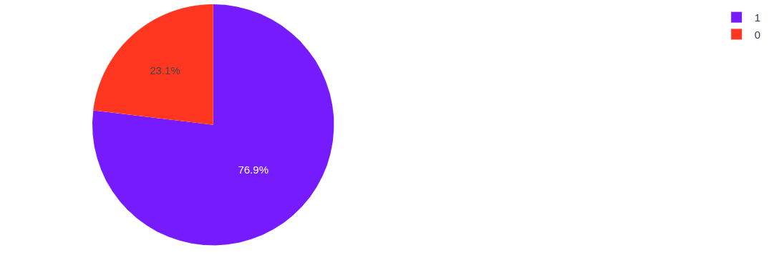
Total success launches for site KSC LC-39A
KSC LC-39A has success rate 76,9%. 23,1% of launches failed.

Slide 41
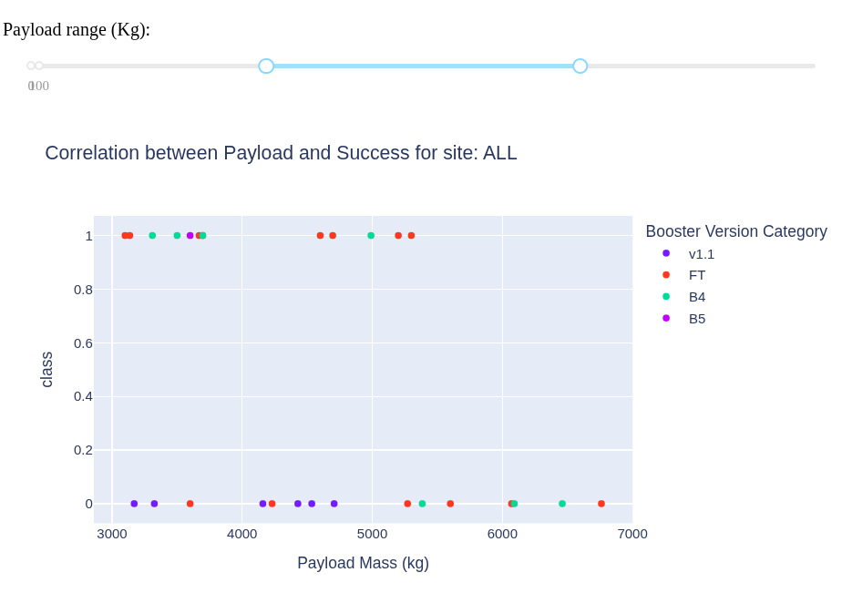
Correlation between Payload mass and success
For payload mass in range 3000-7000 kg a lot of success launches were for FT Booster Ver. Category. On the other hand a lot of fails occurred for B5

Slide 42

Section 5

Slide 43
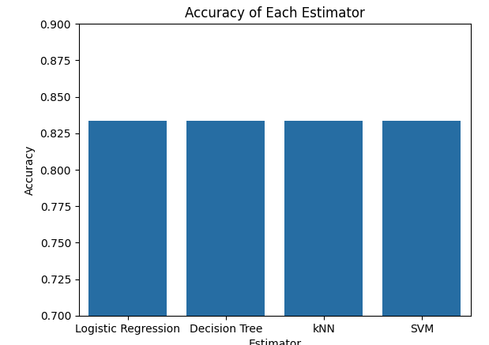
Classification Accuracy
All models achieved the same accuracy: 83,3%

Slide 44
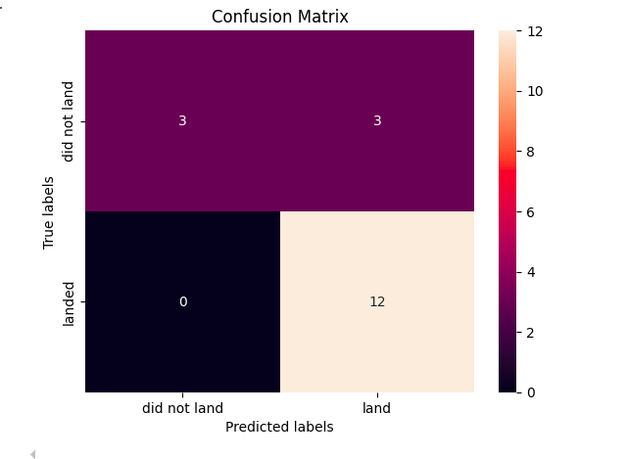
Confusion Matrix
15/18 predictions (83,3%) were correct. All successful landings were predicted correctly (recall is 100%) But there is problem with negative cases. Only 50% (3 out of 6 were predicted correctly)

Slide 45
Conclusions
Most SpaceX launches occurred at a few key sites, with some sites showing higher success rates than others.
Payload mass distributions vary significantly by booster version, affecting launch outcomes.
SQL analysis revealed that NASA (CRS) missions contributed the largest total payload mass.
Interactive dashboards showed correlations between payload mass and success, with sliders and dropdowns enabling site-specific exploration.
Folium maps highlighted spatial patterns: most launch sites are near highways and coastlines, while railways are slightly farther.
Predictive models using standardized features could reasonably classify launch success, confirming the importance of payload and booster type as key predictors.

Slide 46
Appendix
Link to repository on github:
- https://github.com/matlewan/coursera-learning/blob/main/10-capstone-project

Slide 47


