Slide 1
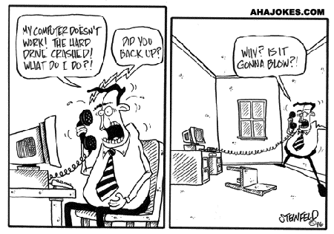
Check Backup Integrity with Clojure
Mathieu Gauthron
Command-line to compare nested directory structures

Slide 2


Example
content different
only on left
only on right
tree1
tree2
file-dif-2
file-only-in-1
file1
exampledir
file-dif-2
file1
exampledir
file4
file4
file-only-in-2

Slide 3
Command line
$ ./fileComp.sh
NAME
fileComp.sh -- A file and directory structure comparison tool written in Clojure. Can work locally or remotely over ssh.
SYNOPSIS
fileComp.sh [options] path1 path2

Slide 4
Local File Comparison
fileComp.sh treestructure/tree1 treestructure/tree2

Slide 5
SSH File Comparison
fileComp.sh
--identity id_rsa
ssh://user@hostname:/tmp/treestructure/tree2
treestructure/tree2

Slide 6

Demo

Slide 7

Future Developments
Support remote agents (nrepl?)
Distribute as a clojar lib
Multithreaded directory traversal
Skip md5sum on missing files
Do you want to contribute?

Slide 8

Questions?
Project available on:
https://github.com/matlux/File-and-Directory-Structure-Comparison

