Slide 1

In a world of Distributed Computing

Slide 2
Agenda
What is Spark?
Why Spark ?
Spark's Features
How does it compare to Grid Computing?

Slide 3
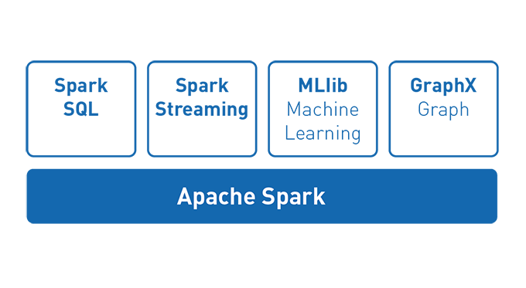
What is Spark?
General-purpose distributed data processing engine
A few libs...
Notes:
Spark is a general-purpose distributed data processing engine that is suitable for use in a wide range of circumstances.
On top of the Spark core data processing engine, there are libraries for
SQL,
machine learning,
graph computation,
and stream processing
which can be used together in an application.
Programming languages supported by Spark include: Java, Python, Scala, and R. Application developers and data scientists incorporate Spark into their applications to rapidly query, analyze, and transform data at scale.
Tasks most frequently associated with Spark include ETL and SQL batch jobs across large data sets.

Slide 4

Why Spark?

Slide 5
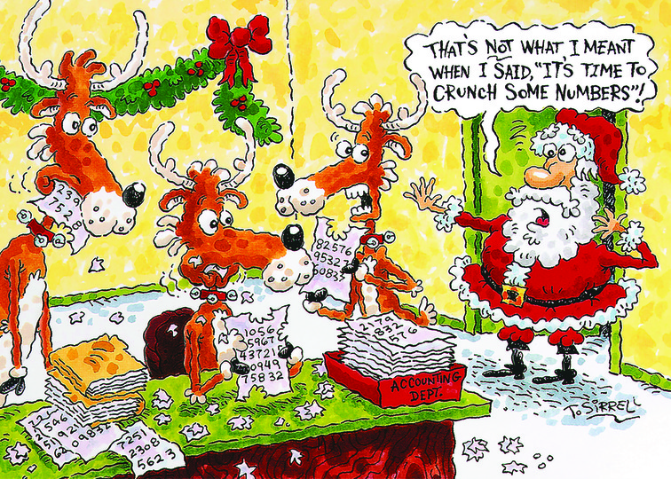
Why Spark?
Distribute data across a cluster
Process that data in parallel
Open source
Notes:
open source (No vendor lock-in), scalable, massively parallel, in-memory execution environment for running analytics applications
Similarly to DataSynapse it is really good at crunching numbers.

Slide 6

Origin of Spark

Slide 7
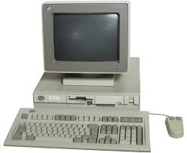
Earth was filled with Darkness

Slide 8
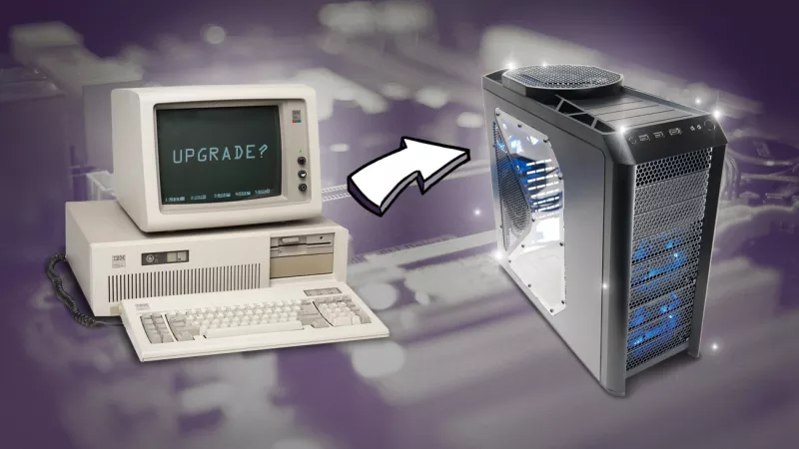
Vertical Scaling

Slide 9
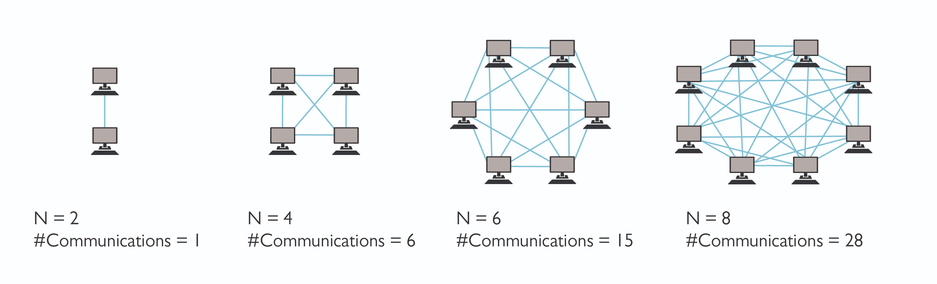
Horizontal Scaling

Slide 10
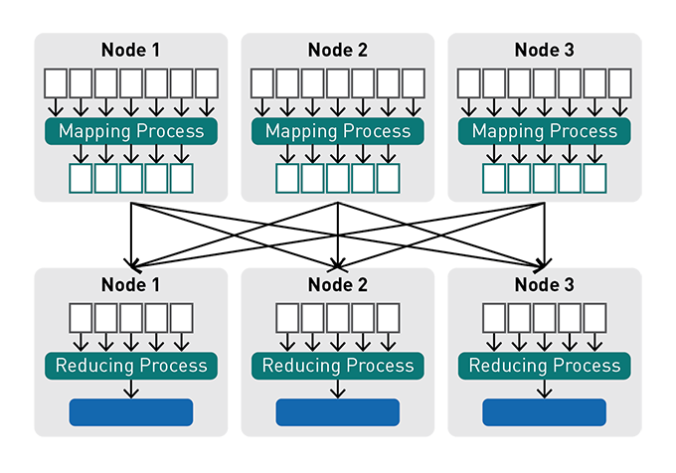
Let there be the light: MapReduce
Notes:
Before Spark, there was MapReduce, a resilient distributed processing framework, which enabled Google to index the exploding volume of content on the web, across large clusters of commodity servers.
3 core concepts to the Google strategy:
Distribute data: when a data file is uploaded into the cluster, it is split into chunks, called data blocks, and distributed amongst the data nodes and replicated across the cluster.
Distribute computation: users specify a map function that processes a key/value pair to generate a set of intermediate key/value pairs and a reduce function that merges all intermediate values associated with the same intermediate key. Programs written in this functional style are automatically parallelized and executed on a large cluster of commodity machines in the following way:
The mapping process runs on each assigned data node, working only on its block of data from a distributed file.
The results from the mapping processes are sent to the reducers in a process called "shuffle and sort": key/value pairs from the mappers are sorted by key, partitioned by the number of reducers, and then sent across the network and written to key sorted "sequence files" on the reducer nodes.
The reducer process executes on its assigned node and works only on its subset of the data (its sequence file). The output from the reducer process is written to an output file.
Tolerate faults: both data and computation can tolerate failures by failing over to another node for data or processing.

Slide 11
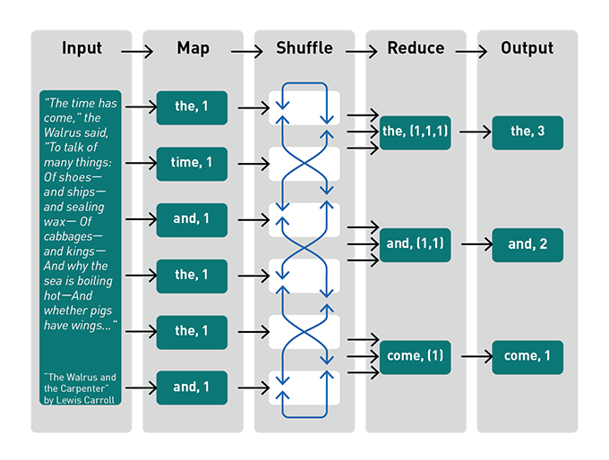
MapReduce word count

Slide 12
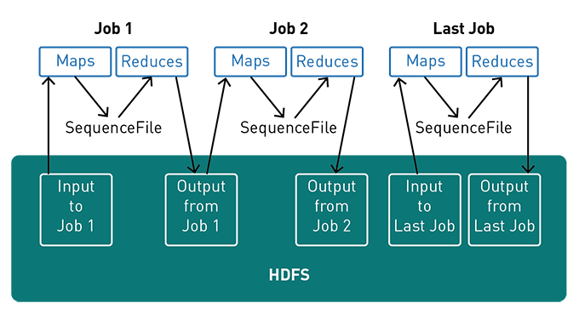
MapReduce word count

Slide 13
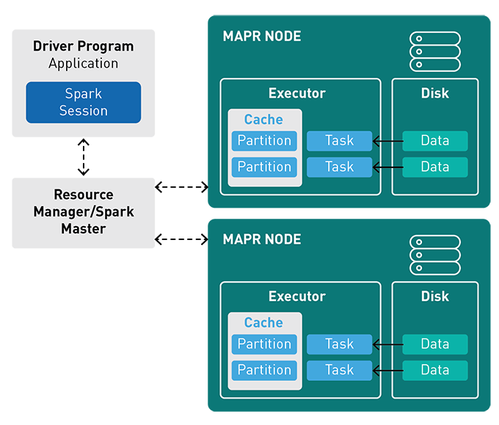
How it Runs on a Cluster

Slide 14
Spark supports the following resource/cluster managers
Spark Standalone
Apache Mesos
Apache Hadoop YARN
Kubernetes

Slide 15
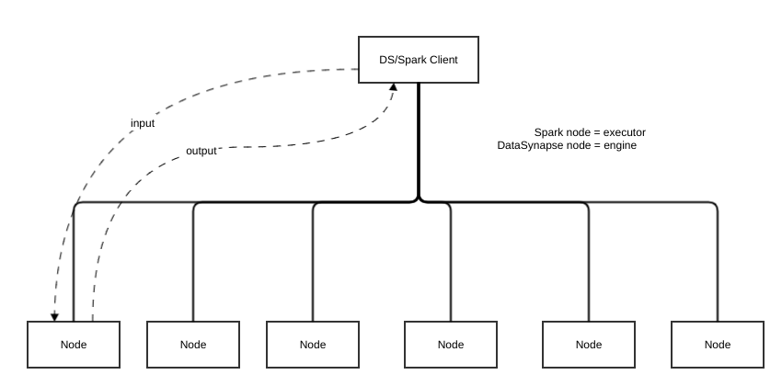
Spark vs DataSynapse

Slide 16
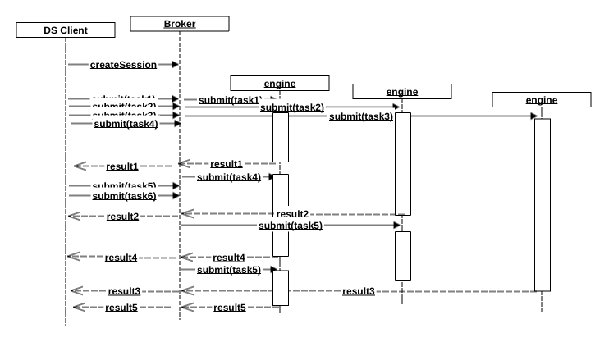
DataSynapse Task Lifecycle

Slide 17
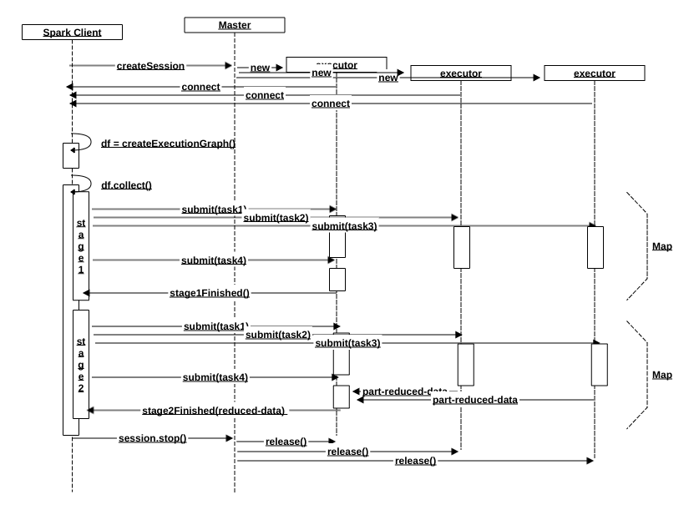
Spark Task Lifecycle

Slide 18

Any Questions?

