Slide 1
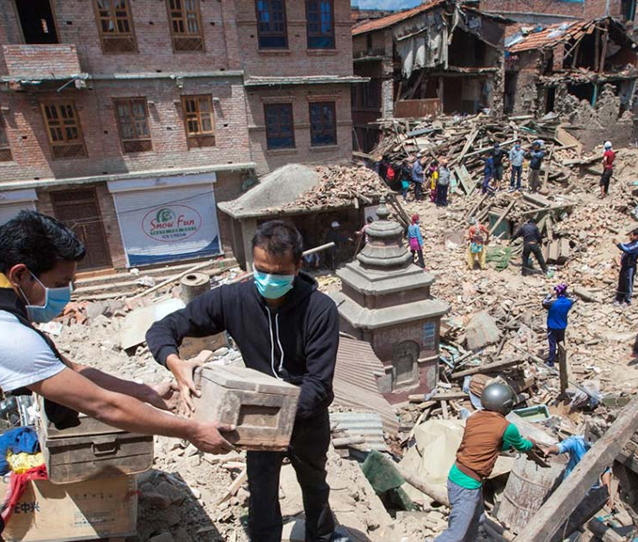
LANL Earthquake Prediction
Data Science Intensive Capstone
Matthew Miller

Slide 2
THE PROBLEM
Prevent Loss of Life
Machine Learning Model
Reduce Costs to Infrastructure
Notes:
20,000 annual deaths globally
$6.1 Billion cost to United States infrastructure
Target: Reliable Predictions
Prevent Loss of Life
Reduce infrastructure costs $200,000 - $5,000,000

Slide 3

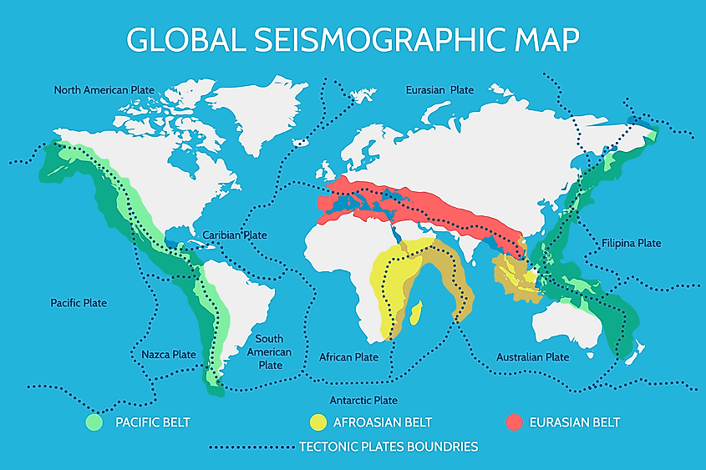

Who is Interested?
Notes:
(LANL) an institution dedicated to developing technologies addressing threats to national security
Released Kaggle competition and experimental data for teams to work on this problem

Slide 4
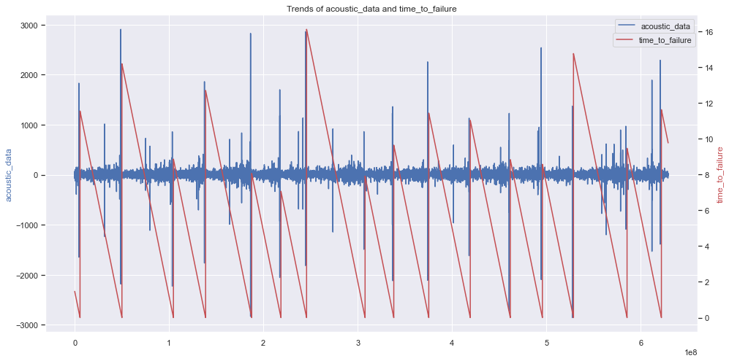
The Data
Notes:
Kaggle competition
The experiments are performed by applying a shear force to a sample equivalent of earth and rock, which contains a fault line.
Single sequence of acoustic and time to failure data
All features had to be extracted from the single signal
16 events, which could be improved
Can observe some impulsiveness especially right before the event

Slide 5
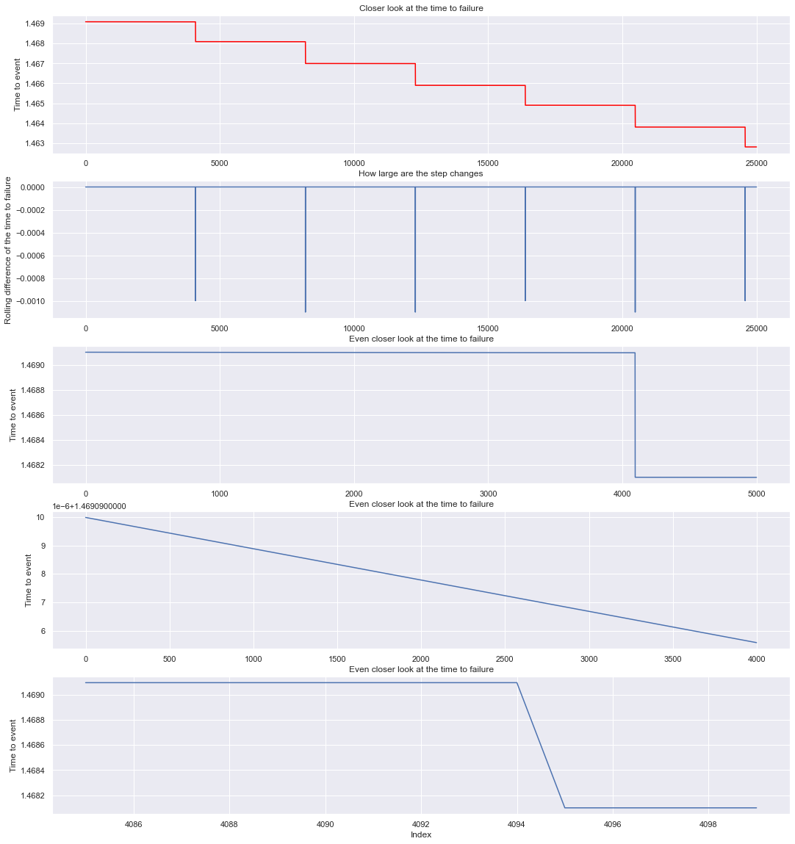
Exploring the Data – Time to Failure
Are the step changes equal in size?
Is the time between step changes constant?
How many samples between the step changes?

Slide 6
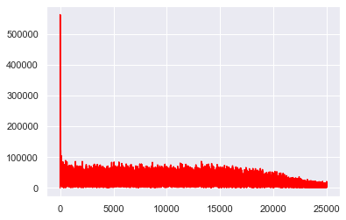
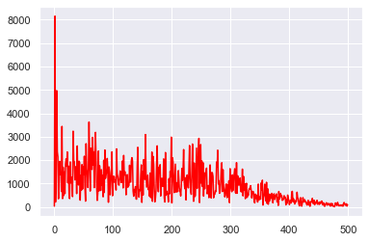
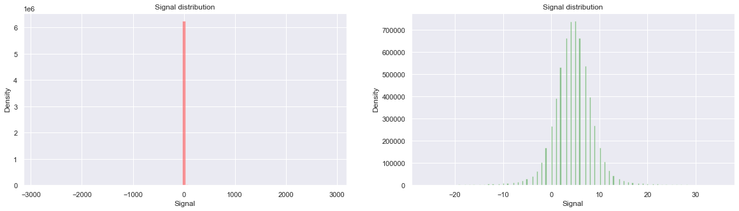
Exploring the Data – Acoustic
Are there any dominant frequencies?
What is the distribution of the data?

Slide 7
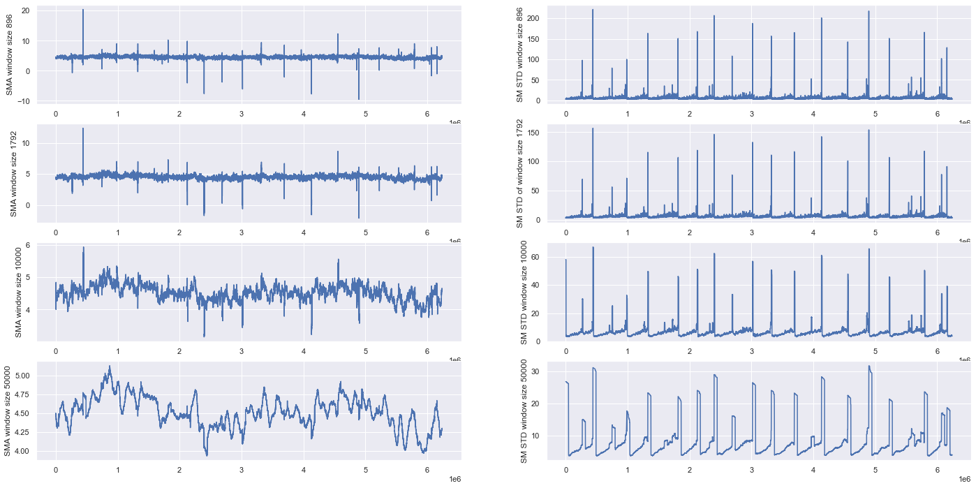
Feature Creation
Simple Moving averages and standard deviations
Impulsiveness
Kurtosis
Skew
STA/LTA Ratios

Slide 8
Machine Learning Models and Results

Slide 9
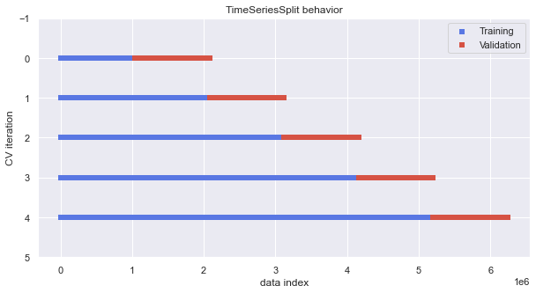
Time Series Train/Test Split

Slide 10
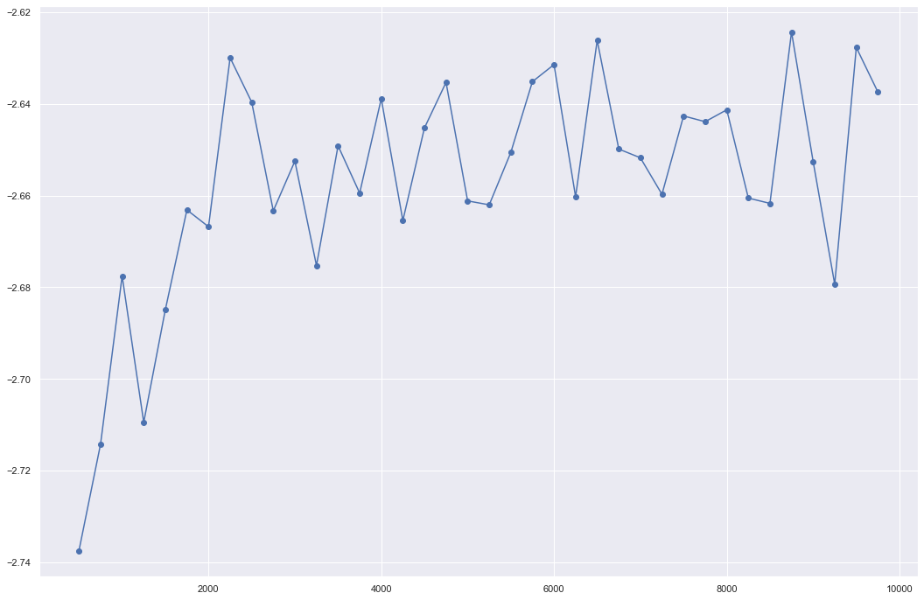
GridSearchCV
Hyperparameter tuning
min_sample_leafs = 2500
Reduce overfit

Slide 11
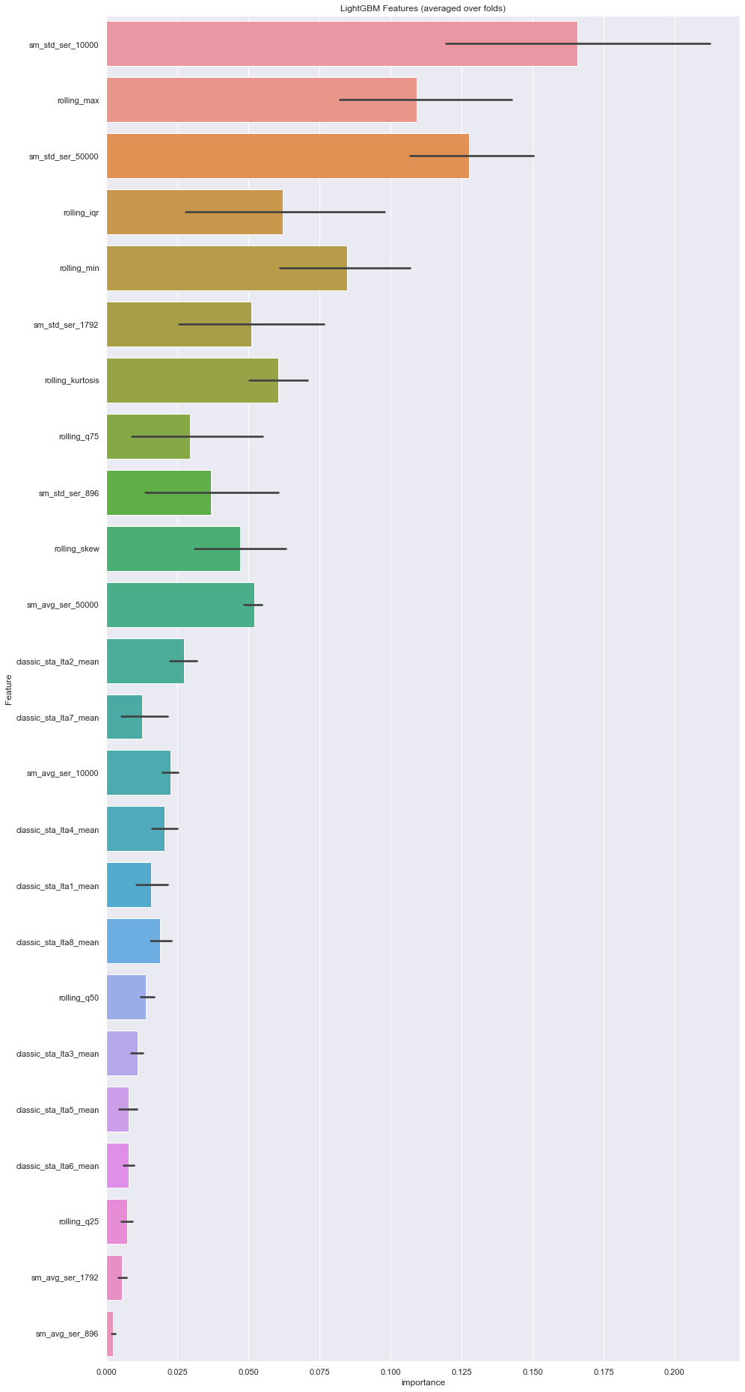
Feature Importance
Top Features:
Simple Moving STD (windows = 10k & 50k)
Rolling Max

Slide 12
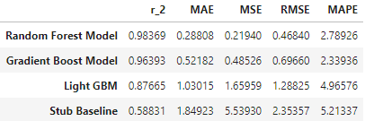
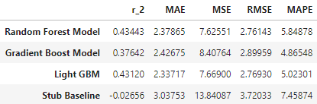
Results and Models Comparison
Train Results Models Comparison
Best Model: Random Forest Model
Most Efficient: LightGBM Model
Baseline: Stub Baseline Model
Test Results Models Comparison
Notes:
RMSE used for defining best model
As you can see we overfit significantly to the training data

Slide 13
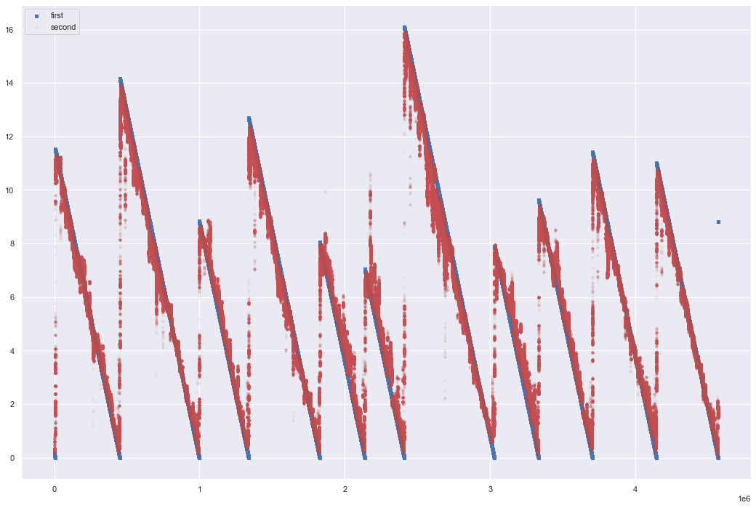
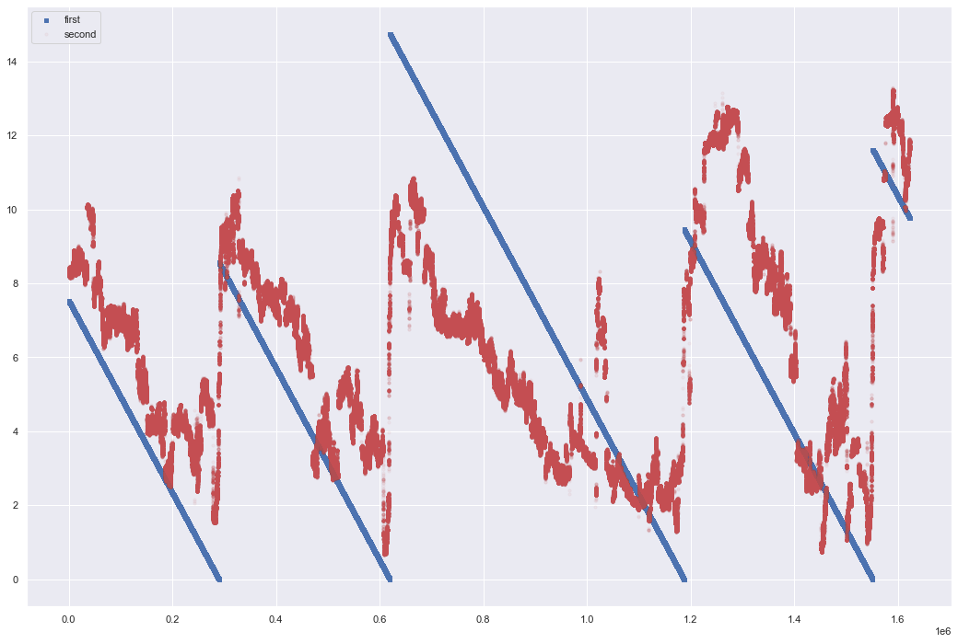
Best Model – Random Forest Regression Model
Used best params from gridsearch-cv
Overfit to the training data
Predictions from model in red
Actual ttf in blue
Train Predictions
Test Predictions

Slide 14
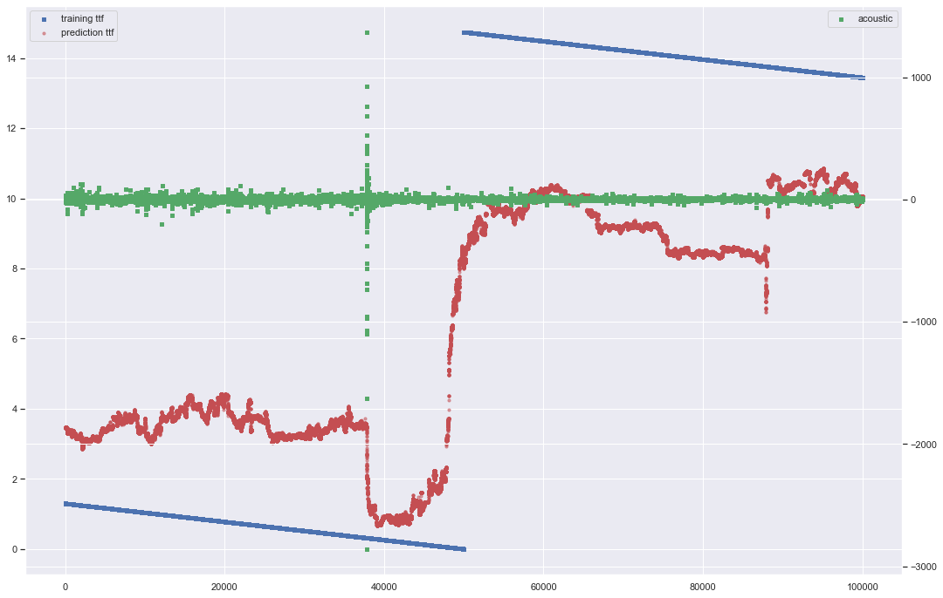
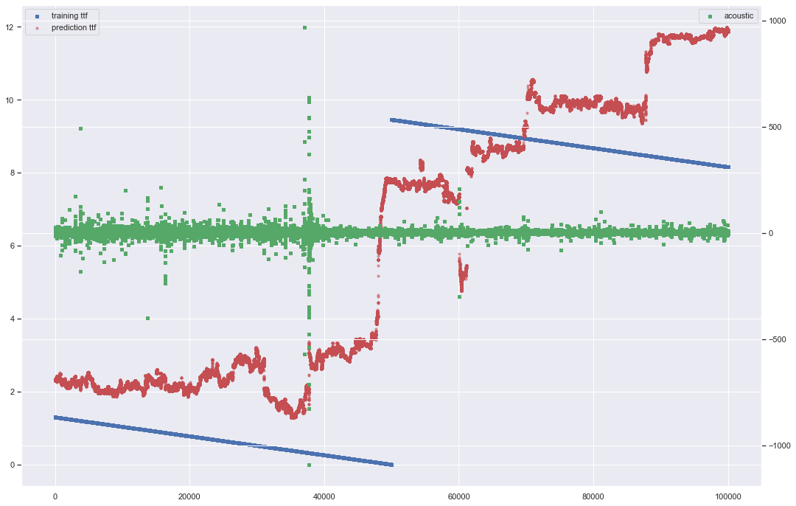
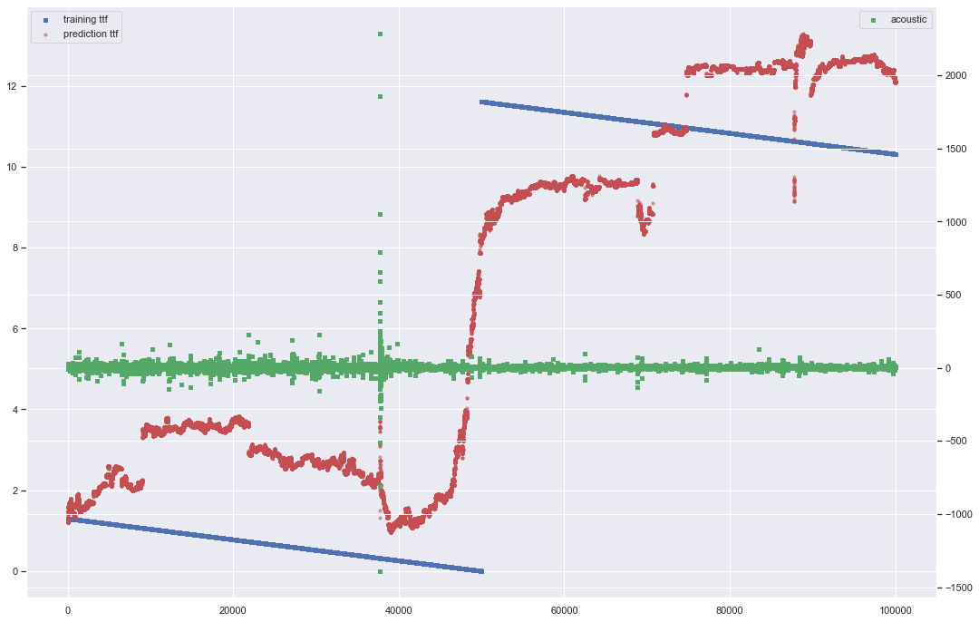
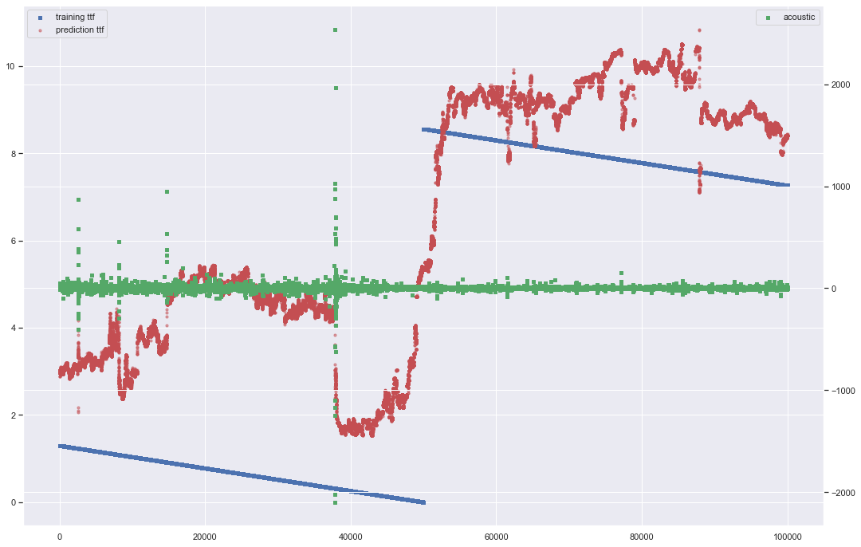
Closer Look at Test Results
Notes:
Observed the impact of the impulsiveness in the acoustic data (green) on the predictions
We see an immediate decrease in our predictions before they rise back up indicating an earthquake occurred

Slide 15
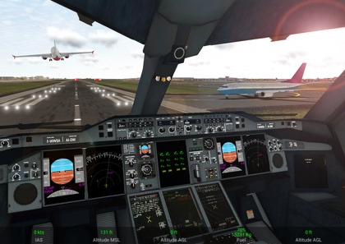
Impact
Similar to a flight simulator, the model must scale
Better than a human prediction
Inform Medical Services
Inform people in the area
Notes:
Similar to a flight simulator the model has to scale to the real world where the consequences are much greater
We know it is better than the stub baseline and will help identify the impending earthquake, however, more data is necessary to improve the model

Slide 16
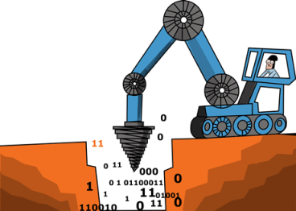
Further Explorations/Work
Research the scalability of the models, collecting acoustic data on real-world earthquakes
To further prevent loss of life and inflicted costs, we could research the location of where the earthquake will most likely strike
Notes:
Mine for more data on simulated earthquakes to build a more accurate model
16 may not be enough
Again, we go back to location search from the global seismographic map
Trends could be used to determine more specific locations of the event

Slide 17

Any Questions?
Thank you, Springboard Mentor:
Blake Arensdorf, On Deck

